Slide 1
The Protestant Reformation: The Good, The Bad, and The Ugly Session 11
Andy Woods, Th.M.., JD., PhD.
Sr. Pastor, Sugar Land Bible Church
President Chafer Theological Seminary

Slide 2
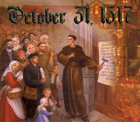
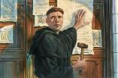
Introduction
Oct 31, 1517
500 years
Far reaching impact
Partial restoration
Restoration of a hermeneutic
Selectively applied
Subsequent generations applied consistently
Preview

Slide 3
Overview
The early church
The Alexandrian eclipse
The Dark Ages
The contribution of the Protestant Reformers
The Reformers’ incomplete revolution
Reformed Theology today
Dispensationalism & the completed revolution
Looking back 500 years later
Notes:
Outline

Slide 4
Overview
THE EARLY CHURCH
The Alexandrian eclipse
The Dark Ages
The contribution of the Protestant Reformers
The Reformers’ incomplete revolution
Reformed Theology today
Dispensationalism & the completed revolution
Looking back 500 years later
Notes:
Outline

Slide 5
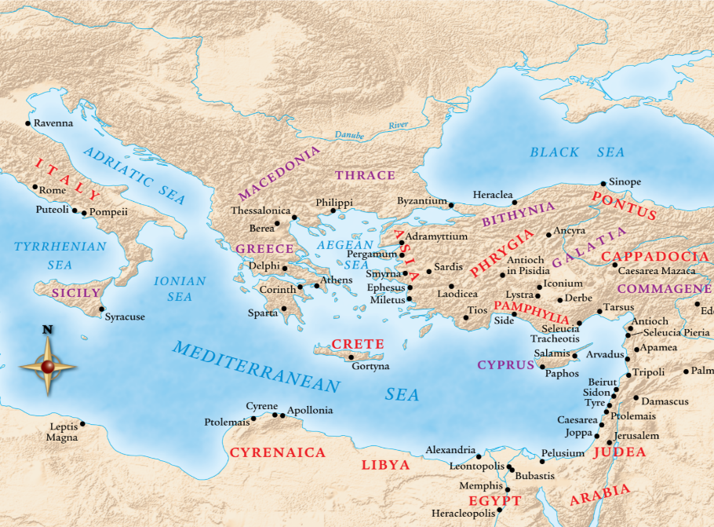

Slide 6
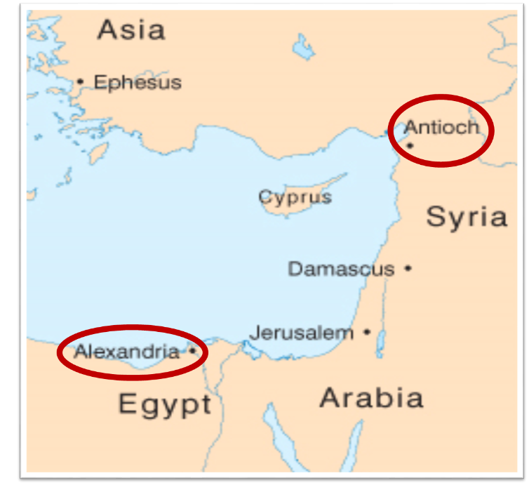

Slide 7
Overview
The early church
THE ALEXANDRIAN ECLIPSE
The Dark Ages
The contribution of the Protestant Reformers
The Reformers’ incomplete revolution
Reformed Theology today
Dispensationalism & the completed revolution
Looking back 500 years later
Notes:
Outline

Slide 10
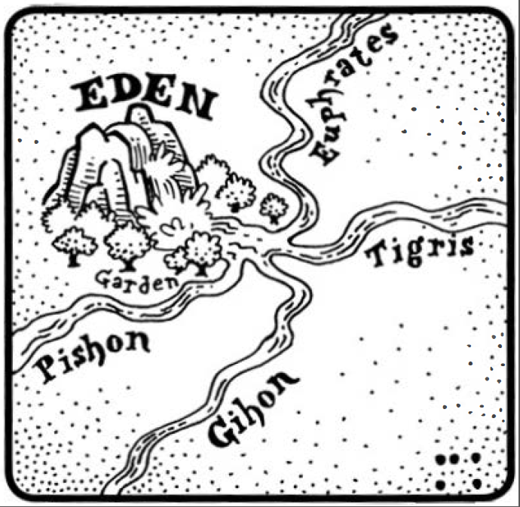
Dangers of Allegorization – Philo

Slide 11
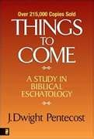
Dangers of Allegorization
Text is not being interpreted
Authority is transferred from text to interpreter
There is no way to test the interpreter
No mechanism for controlling the interpreter’s imagination
Pentecost, Things to Come, pps. 4-5

Slide 12
What Caused the Shift Into Allegorism?
Need for immediate relevance
Incorporation of human philosophy into interpretation
Gnostic dualism (Gen. 1:31; 1 John 2:22; 4:2-3; Acts 17:32; 1 Cor. 15:12)
Decline of the church's Jewish population
Constantine’s Edict of Milan (A.D. 313)
AD 70 and Hadrian’s (A.D. 117–138)“Palestine”
Notes:
Outline

Slide 13
Overview
The early church
The Alexandrian eclipse
THE DARK AGES
The contribution of the Protestant Reformers
The Reformers’ incomplete revolution
Reformed Theology today
Dispensationalism & the completed revolution
Looking back 500 years later
Notes:
Outline

Slide 14
III. The Dark Ages (or the Middle Ages)
Lasted from the 4th to the 16th centuries
Obsolescence of prophetic studies
Domination of Augustinian Amillennialism
Only one church: Roman Catholicism
The Bible is removed from the people
Allegorization
Illiteracy
Mass read in Latin
Sale of indulgences
Anti-Semitism
Church in need of rescue
Notes:
Outline

Slide 15
Overview
The early church
The Alexandrian eclipse
The Dark Ages
THE CONTRIBUTION OF THE PROTESTANT REFORMERS
The Reformers’ incomplete revolution
Reformed Theology today
Dispensationalism & the completed revolution
Looking back 500 years later
Notes:
Outline

Slide 16
IV. Contribution of the Protestant Reformers
Preparation of the Reformers
Emphasis on literal interpretation
Denunciation of allegorization
Rejection of church tradition as a guide
Priesthood of all believers
Bible translations
Literacy
Basis for the American system of governance
Five solas
Rejection of celibacy of the priesthood
The ultimate sacrifice
Rejoice
Notes:
Outline

Slide 17
Overview
The early church
The Alexandrian eclipse
The Dark Ages
The Contribution of the Protestant Reformers
THE REFORMERS’ INCOMPLETE REVOLUTION
Reformed Theology today
Dispensationalism & the completed revolution
Looking back 500 years later
Notes:
Outline

Slide 18
V. The Reformers’ Incomplete Revolution
Protology
Selective literalism
Did not deal with eschatology in depth
Retention of Augustinian Amillennialism
Antichrist & Babylon = Pope and Papacy
Dragged vestiges of Roman Catholicism with them
Initially desired to remain Catholics
Infant baptism
Consubstantiation
Church = the earthly kingdom
Anti-Semitism
Reasons for their inconsistency
Laid the groundwork for future generations
Notes:
Outline

Slide 19
V. The Reformers’ Incomplete Revolution
Protology
Selective literalism
Did not deal with eschatology in depth
Retention of Augustinian Amillennialism
Antichrist & Babylon = Pope and Papacy
Dragged vestiges of Roman Catholicism with them
Initially desired to remain Catholics
Infant baptism
Consubstantiation
Church = the earthly kingdom
Anti-Semitism
Reasons for their inconsistency
Laid the groundwork for future generations
Notes:
Outline

Slide 20
V. The Reformers’ Incomplete Revolution
Protology
Selective literalism
Did not deal with eschatology in depth
Retention of Augustinian Amillennialism
Antichrist & Babylon = Pope and Papacy
Dragged vestiges of Roman Catholicism with them
Initially desired to remain Catholics
Infant baptism
Consubstantiation
Church = the earthly kingdom
Anti-Semitism
Reasons for their inconsistency
Laid the groundwork for future generations
Notes:
Outline

Slide 21
V. The Reformers’ Incomplete Revolution
Protology
Selective literalism
Did not deal with eschatology in depth
Retention of Augustinian Amillennialism
Antichrist & Babylon = Pope and Papacy
Dragged vestiges of Roman Catholicism with them
Initially desired to remain Catholics
Infant baptism
Consubstantiation
Church = the earthly kingdom
Anti-Semitism
Reasons for their inconsistency
Laid the groundwork for future generations
Notes:
Outline

Slide 22
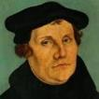
Martin Luther
Preface to the New Testament, 1522.
"I miss more than one thing in this book, and this makes me hold it to be neither apostolic nor prophetic…I think of it almost as I do of the Fourth Book of Esdras, and can in no way detect that the Holy Spirit produced it…It is just the same as if we did not have it, and there are many far better books for us to keep. Finally, let everyone think of it [Revelation] as his own spirit gives him to. My spirit cannot fit itself into this book. There is one sufficient reason for me not to think highly of it — Christ is not taught or known in it; but to teach Christ is the thing which an apostle is bound, above all else, to do, as He says in Acts 1, ‘Ye shall be my witnesses.’ Therefore I stick to the books which give me Christ, clearly and purely." In 1545, Luther printed the Book of Revelation with Hebrews, James and Jude as an appendix to the New Testament.
Notes:
Outline

Slide 23
V. The Reformers’ Incomplete Revolution
Protology
Selective literalism
Did not deal with eschatology in depth
Retention of Augustinian Amillennialism
Antichrist & Babylon = Pope and Papacy
Dragged vestiges of Roman Catholicism with them
Initially desired to remain Catholics
Infant baptism
Consubstantiation
Church = the earthly kingdom
Anti-Semitism
Reasons for their inconsistency
Laid the groundwork for future generations
Notes:
Outline

Slide 24
V. The Reformers’ Incomplete Revolution
Protology
Selective literalism
Did not deal with eschatology in depth
Retention of Augustinian Amillennialism
Antichrist & Babylon = Pope and Papacy
Dragged vestiges of Roman Catholicism with them
Initially desired to remain Catholics
Infant baptism
Consubstantiation
Church = the earthly kingdom
Anti-Semitism
Reasons for their inconsistency
Laid the groundwork for future generations
Notes:
Outline

Slide 25
V. The Reformers’ Incomplete Revolution
Protology
Selective literalism
Did not deal with eschatology in depth
Retention of Augustinian Amillennialism
Antichrist & Babylon = Pope and Papacy
Dragged vestiges of Roman Catholicism with them
Initially desired to remain Catholics
Infant baptism
Consubstantiation
Church = the earthly kingdom
Anti-Semitism
Reasons for their inconsistency
Laid the groundwork for future generations
Notes:
Outline

Slide 26
V. The Reformers’ Incomplete Revolution
Protology
Selective literalism
Did not deal with eschatology in depth
Retention of Augustinian Amillennialism
Antichrist & Babylon = Pope and Papacy
Dragged vestiges of Roman Catholicism with them
Initially desired to remain Catholics
Infant baptism
Consubstantiation
Church = the earthly kingdom
Anti-Semitism
Reasons for their inconsistency
Laid the groundwork for future generations
Notes:
Outline

Slide 27
V. The Reformers’ Incomplete Revolution
Protology
Selective literalism
Did not deal with eschatology in depth
Retention of Augustinian Amillennialism
Antichrist & Babylon = Pope and Papacy
Dragged vestiges of Roman Catholicism with them
Initially desired to remain Catholics
Infant baptism
Consubstantiation
Church = the earthly kingdom
Anti-Semitism
Reasons for their inconsistency
Laid the groundwork for future generations
Notes:
Outline

Slide 28
V. The Reformers’ Incomplete Revolution
Protology
Selective literalism
Did not deal with eschatology in depth
Retention of Augustinian Amillennialism
Antichrist & Babylon = Pope and Papacy
Dragged vestiges of Roman Catholicism with them
Initially desired to remain Catholics
Infant baptism
Consubstantiation
Church = the earthly kingdom
Anti-Semitism
Reasons for their inconsistency
Laid the groundwork for future generations
Notes:
Outline

Slide 29
V. The Reformers’ Incomplete Revolution
Protology
Selective literalism
Did not deal with eschatology in depth
Retention of Augustinian Amillennialism
Antichrist & Babylon = Pope and Papacy
Dragged vestiges of Roman Catholicism with them
Initially desired to remain Catholics
Infant baptism
Consubstantiation
Church = the earthly kingdom
Anti-Semitism
Reasons for their inconsistency
Laid the groundwork for future generations
Notes:
Outline

Slide 30
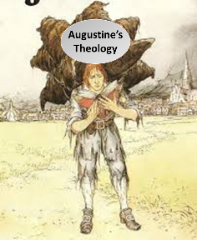
Augustine
The City of God, trans., Marcus Dods (NY: Random House, 1950), Book XX, chap. 9, p. 725-26.
Augustine wrote, “the saints reign with Christ during the same thousand years, understood in the same way, that is, of the time of His first coming” and “Therefore the Church even now is the kingdom of Christ, and the kingdom of heaven. Accordingly, even now His saints reign with Him.”

Slide 31
Augustine
Augustine, “Advice to Marcellinus on the Punishment of Donatists,” AD 412; Tr. J. G. Cunningham, Letters of Augustine, II, 169ff. In Stevenson, Creeds, Councils, and Controversies, 213.
In matters of church discipline Calvin imitated Augustine’s totalitarian style of government. Augustine, it will be remembered, advised Marcellinus, an African governor, to punish the Donatists (a Christian sect who objected to certain Church practices), “not by stretching them on the rack, nor by furrowing their flesh with iron claws, nor by scorching them with flames, but by beating them with rods.”

Slide 32
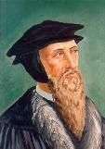
“Augustine is so wholly with me, that if I wished to write a confession of my faith, I could do so with all fullness and satisfaction to myself out of his writings.”
John Calvin
John Calvin, “A Treatise on the Eternal Predestination of God,” in John Calvin, Calvin’s Calvinism, trans. Henry Cole (Grandville, MI: Reformed Free Publishing Association, 1987), 38

Slide 33
John Calvin
Institutes of the Christian Religion, III, xxv, 5.
“But Satan has not only befuddled men’s senses to make them bury with the corpses the memory of resurrection; he has also attempted to corrupt this part of the doctrine with various falsifications…Now their fiction is too childish either to need or to be worth a refutation. And the Apocalypse, from which they undoubtedly drew a pretext for their error, does not support them. For the number ‘one thousand’ [Rev. 20:4] does not apply to the eternal blessedness of the church but only to the various disturbances that awaited the church, while still toiling on earth…Those who assign the children of God a thousand years in which to enjoy the inheritance of the life to come do not realize how much reproach they are casting upon Christ and his Kingdom.”

Slide 34
John Calvin
Encyclopedia Judaica (Jerusalem: Keter Publishing, 1971), 66.
Here, Calvin sought to reconstruct a society through the imposition of the Mosaic Law, “which he tried to imitate as much as possible in his new Christian republic in Geneva.”

Slide 35
John Calvin
James Edward McGoldrick, "Introducing John Calvin: The Reformer's Preparation," Reformation and Revival 10, no. 4 (2001): 21.
“A measure of legalism became apparent in Geneva, as the consistory put the lives of church members under continuous review and applied discipline to offenders. Church attendance was compulsory. Eating fish on Fridays was forbidden, as were attendance at theaters, dancing, cardplaying, and criticism of pastors. All heretical teaching was deemed subversive and subject to penalties under criminal law. Flagrant infractions could lead to banishment, imprisonment, and in extreme cases death. Judicial torture was common procedure.”

Slide 36
The Encyclopaedia Judaica refers to Calvin’s “despotic theocratic regime in Geneva.”
John Calvin
“Calvin, John,” in Encyclopaedia Judaica, Vol. 5, 67.

Slide 37
“The execution of Servetus is the greatest blot on Calvin’s life” and reveals “that vindictive streak which sometimes disgraced the character of the Reformer.”
John Calvin
Lewis Lupton, A History of the Geneva Bible, Vol. 2 (London: Olive Tree, 1969), 23–24.

Slide 38
V. The Reformers’ Incomplete Revolution
Protology
Selective literalism
Did not deal with eschatology in depth
Retention of Augustinian Amillennialism
Antichrist & Babylon = Pope and Papacy
Dragged vestiges of Roman Catholicism with them
Initially desired to remain Catholics
Infant baptism
Consubstantiation
Church = the earthly kingdom
Anti-Semitism
Reasons for their inconsistency
Laid the groundwork for future generations
Notes:
Outline

Slide 39
Luther and Antisemitism
95 Theses (1517)
Excommunication (1521)
“Jesus Was Born a Jew” (1523)
“Of the Jews and Their Lies” (1543)
“Of the Unknowable Name and the Generations of the Messiah” (1543)
Several sermons in Eisleben (1546)
Groundwork laid for Nazi Germany

Slide 40
Luther and Antisemitism
95 Theses (1517)
Excommunication (1521)
“Jesus Was Born a Jew” (1523)
“Of the Jews and Their Lies” (1543)
“Of the Unknowable Name and the Generations of the Messiah” (1543)
Several sermons in Eisleben (1546)
Groundwork laid for Nazi Germany

Slide 41
Luther and Antisemitism
95 Theses (1517)
Excommunication (1521)
“Jesus Was Born a Jew” (1523)
“Of the Jews and Their Lies” (1543)
“Of the Unknowable Name and the Generations of the Messiah” (1543)
Several sermons in Eisleben (1546)
Groundwork laid for Nazi Germany

Slide 42
Luther and Antisemitism
95 Theses (1517)
Excommunication (1521)
“Jesus Was Born a Jew” (1523)
“Of the Jews and Their Lies” (1543)
“Of the Unknowable Name and the Generations of the Messiah” (1543)
Several sermons in Eisleben (1546)
Groundwork laid for Nazi Germany

Slide 43
Martin Luther
Jesus Was Born a Jew (1523).
“If I had been a Jew and had seen such dolts and blockheads govern and teach the Christian faith, I would sooner have become a hog than a Christian. They have dealt with the Jews as if they were dogs rather than human beings; they have done little else than deride them and seize their property. When they baptize them they show them nothing of Christian doctrine or life, but only subject them to popishness and monkery…If the apostles, who also were Jews, had dealt with us Gentiles as we Gentiles deal with the Jews, there would never have been a Christian among the Gentiles…."
Notes:
Outline

Slide 44
Martin Luther
Jesus Was Born a Jew (1523).
“When we are inclined to boast of our position we should remember that we are but Gentiles, while the Jews are of the lineage of Christ. We are aliens and in-laws; they are blood relatives, cousins, and brothers of our Lord. Therefore, if one is to boast of flesh and blood, the Jews are actually nearer to Christ than we are…If we really want to help them, we must be guided in our dealings with them not by papal law but by the law of Christian love. We must receive them cordially, and permit them to trade and work with us, that they may have occasion and opportunity to associate with us, hear our Christian teaching, and witness our Christian life. If some of them should prove stiff-necked, what of it? After all, we ourselves are not all good Christians either."
Notes:
Outline

Slide 45
Luther and Antisemitism
95 Theses (1517)
Excommunication (1521)
“Jesus Was Born a Jew” (1523)
“Of the Jews and Their Lies” (1543)
“Of the Unknowable Name and the Generations of the Messiah” (1543)
Several sermons in Eisleben (1546)
Groundwork laid for Nazi Germany

Slide 46
Christian Anti-Semitism
“First, their synagogues should be set on fire…Secondly, their homes should likewise be broken down and destroyed… Thirdly, they should be deprived of their prayer books and Talmuds…”

Slide 47
Christian Anti-Semitism
“…Fourthly, their rabbis must be forbidden under threat of death to teach any more… Fifthly, passport and traveling privileges should be absolutely forbidden to the Jews… Sixthly, they ought to be stopped from usury (charging interest on loans…”

Slide 48
Christian Anti-Semitism
“Seventhly, let the young and strong Jews and Jewesses be given the flail, the ax, the hoe, the spade, the distaff, and spindle, and let the earn their bread by the sweat of their noses…We ought to drive the rascally lazy bones out of our system...”

Slide 49
Christian Anti-Semitism
“…Therefore away with them… To sum up, dear princes and nobles who have Jews in your domains, if this advice of mine does not suit you, then find a better one so that you and we may all be free of this insufferable devilish burden–the Jews.”
Martin Luther, Concerning the Jews and Their Lies, cited in Michael Brown’s Our Hands Are Stained with Blood, pp. 14-15.

Slide 50
Luther and Antisemitism
95 Theses (1517)
Excommunication (1521)
“Jesus Was Born a Jew” (1523)
“Of the Jews and Their Lies” (1543)
“Of the Unknowable Name and the Generations of the Messiah” (1543)
Several sermons in Eisleben (1546)
Groundwork laid for Nazi Germany

Slide 51
Luther and Antisemitism
95 Theses (1517)
Excommunication (1521)
“Jesus Was Born a Jew” (1523)
“Of the Jews and Their Lies” (1543)
“Of the Unknowable Name and the Generations of the Messiah” (1543)
Several sermons in Eisleben (1546)
Groundwork laid for Nazi Germany

Slide 52
Lutheran Statement https://www.ccjr.us/dialogika-resources/documents-and-statements/interreligious/759-lwfijcic1983
“We Lutherans take our name and much of our understanding of Christianity from Martin Luther. But we cannot accept or condone the violent verbal attacks that the Reformer made against the Jews…The sins of Luther’s anti-Jewish remarks, the violence of his attacks on the Jews, must be acknowledged with deep distress. And all occasions for similar sin in the present or the future must be removed from our churches…Lutherans of today refuse to be bound by all of Luther’s utterances on the Jews.”

Slide 53
Luther and Antisemitism
95 Theses (1517)
Excommunication (1521)
“Jesus Was Born a Jew” (1523)
“Of the Jews and Their Lies” (1543)
“Of the Unknowable Name and the Generations of the Messiah” (1543)
Several sermons in Eisleben (1546)
Groundwork laid for Nazi Germany

Slide 54
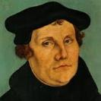
The Encyclopaedia Judaica says “Short of the Auschwitz oven and the extermination, the whole Nazi holocaust is pre-outlined here.”
Martin Luther
“Luther, Martin,” in Encyclopaedia Judaica, Vol. 8, 693.

Slide 55
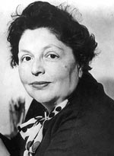
“…both Luther and Hitler were obsessed by the ‘demonologized universe’ inhabited by the Jews.”
Lucy Dawidowicz
“Luther, Martin,” in Encyclopaedia Judaica, Vol. 8, 693.

Slide 56
Olivier J. Melnick Oliver J. Melnick, End-Times Antisemitism: A New Chapter in the Longest Hatred (Tustin, CA: Hope For Today Publications, 2017), 89, 92.
“In 1543, when the Jewish community didn't meet his expectations, Luther published the book Of the Jews and Their Lies, where his description of the Jewish people is so venomous that Hitler was quoted saying that he was just finishing up what Luther started...As a matter of fact, many scholars and historians believe that Luther's view of the Jews had a profound effect on Germans for centuries to come and also had a serious influence on Hitler's ideology and implementing the final solution to the Jewish question. The connection between Luther and Hitler is not difficult to make.”

Slide 57
Thomas D. Ice Thomas D. Ice, “Yad Vashem and the Holocaust,” online: www.pre-trib.org, accessed 19 August 2017, 2.
“We learned at the conference that Hitler was not alone in his irrational desire to murder Jews it was embedded in the German, Austrian, and Eastern European nations. The original source for such anti-Semitism goes back to the common experience of all of Europe’s medieval Roman Catholic Jew-hatred. Most of the people throughout Europe did not have to be taught by Hitler or the Nazis to hate the Jews, it was endemic in their culture for hundreds of years. When the Nazis crystalized their anti-Semitism into murdering the Jews as a virtue, they already had a willing mass of people ready to join their crusade. After all, Hitler quoted the founder of the Reformation three times in Mein Kampf and called Martin Luther one of the greatest Christians in all of history. It is not surprising (for the most part) the German clergy were great Hitler enthusiasts since almost all of them were liberal and held to replacement theology.”

Slide 58
Matthew 16:13-23 (NASB)
¹⁶ Now when Jesus came into the district of Caesarea Philippi, He was asking His disciples, “Who do people say that the Son of Man is?”…¹⁶ Simon Peter answered, “You are the Christ, the Son of the living God.” ¹⁷ And Jesus said to him, “Blessed are you, Simon Barjona, because flesh and blood did not reveal this to you, but My Father who is in heaven. ¹⁸ I also say to you that you are Peter, and upon this rock I will build My church; and the gates of Hades will not overpower it. ¹⁹ I will give you the keys of the kingdom of heaven; and whatever you bind on earth shall have been bound in heaven, and whatever you loose on earth shall have been loosed in heaven.”

Slide 59
Matthew 16:13-23 (NASB)
²⁰ Then He warned the disciples that they should tell no one that He was the Christ.²¹ From that time Jesus began to show His disciples that He must go to Jerusalem, and suffer many things from the elders and chief priests and scribes, and be killed, and be raised up on the third day. ²² Peter took Him aside and began to rebuke Him, saying, “God forbid it, Lord! This shall never happen to You.” ²³ But He turned and said to Peter, “Get behind Me, Satan! You are a stumbling block to Me; for you are not setting your mind on God’s interests, but man’s.

Slide 60
John Calvin
Commentary on the Prophet Daniel (Vol 1, p. 185). Bellingham, WA: Logos Bible Software. Commentary on Daniel 2:44-45. (2010).
“But here he [the rabbi] not only betrays his ignorance, but his utter stupidity, since God so blinded the whole people that they were like restive dogs. I have had much conversation with many Jews: I have never seen either a drop of piety or a grain of truth or ingenuousness—nay, I have never found common sense in any Jew. But this fellow, who seems so sharp and ingenious, displays his own impudence to his great disgrace.”

Slide 61
Calvin repeatedly refers to the Jews as “profane unholy sacrilegious dogs,” describing them as “a barbarous nation” and “the people of Israel rejected by God.”
John Calvin
1. John Calvin, Ioannis Calvini opera quae supersunt Omnia, 50, 307; Sermon on Gal. 1:6–8; quoted in Selderhuis, Calvin Handbook, 145; 2. John Calvin, Supplementa Calviniana, V, 145, 10; Sermon on Mic. 40b–11; quoted in Selderhuis, Calvin Handbook, 145; 3. John Calvin, Ioannis Calvini opera quae supersunt Omnia, 27, 6; Sermon on Deut. 10:1–8; quoted in Selderhuis, Calvin Handbook, 145.

Slide 62
Notes:
62

Slide 63
Romans 11:13, 17-21 (NASB)
“But I am speaking to you who are Gentiles. Inasmuch then as I am an apostle of Gentiles, I magnify my ministry…But if some of the branches were broken off, and you, being a wild olive, were grafted in among them and became partaker with them of the rich root of the olive tree, ¹⁸ do not be arrogant toward the branches; but if you are arrogant, remember that it is not you who supports the root, but the root supports you. ¹⁹ You will say then, “Branches were broken off so that I might be grafted in.” ²⁰ Quite right, they were broken off for their unbelief, but you stand by your faith. Do not be conceited, but fear; ²¹ for if God did not spare the natural branches, He will not spare you, either.”

Slide 64
Romans 11:28-29
“From the standpoint of the gospel they are enemies for your sake, but from the standpoint of God’s choice they are beloved for the sake of the fathers; ²⁹ for the gifts and the calling of God are irrevocable.”

Slide 65
V. The Reformers’ Incomplete Revolution
Protology
Selective literalism
Did not deal with eschatology in depth
Retention of Augustinian Amillennialism
Antichrist & Babylon = Pope and Papacy
Dragged vestiges of Roman Catholicism with them
Initially desired to remain Catholics
Infant baptism
Consubstantiation
Church = the earthly kingdom
Anti-Semitism
Reasons for their inconsistency
Laid the groundwork for future generations
Notes:
Outline

Slide 66
G. Reasons for the Reformers’ Inconsistency
Focus
Fatigue
Sacrifice – Huss, Tyndale

Slide 67
V. The Reformers’ Incomplete Revolution
Protology
Selective literalism
Did not deal with eschatology in depth
Retention of Augustinian Amillennialism
Antichrist & Babylon = Pope and Papacy
Dragged vestiges of Roman Catholicism with them
Initially desired to remain Catholics
Infant baptism
Consubstantiation
Church = the earthly kingdom
Anti-Semitism
Reasons for their inconsistency
Laid the groundwork for future generations
Notes:
Outline

Slide 68
H. Laid the Groundwork for Future Generations
Thankful
Selective literal approach
An incomplete hermeneutical revolution
Provided the right method by which future generations could continue to reform the church through a consistent application of the Reformers’ interpretive approach

Slide 69
CONCLUSION

Slide 70
V. The Reformers’ Incomplete Revolution
Protology
Selective literalism
Did not deal with eschatology in depth
Retention of Augustinian Amillennialism
Antichrist & Babylon = Pope and Papacy
Dragged vestiges of Roman Catholicism with them
Initially desired to remain Catholics
Infant baptism
Consubstantiation
Church = the earthly kingdom
Anti-Semitism
Reasons for their inconsistency
Laid the groundwork for future generations
Notes:
Outline

Slide 71
NEXT WEEK
The early church
The Alexandrian eclipse
The Dark Ages
The Contribution of the Protestant Reformers
The Reformers’ Incomplete Revolution
REFORMED THEOLOGY TODAY
Dispensationalism & the completed revolution
Looking back 500 years later
Notes:
Outline

