Slide 1
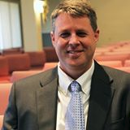
The Protestant Reformation: The Good, The Bad, and The Ugly Session 4
Andy Woods, Th.M.., JD., PhD.
Sr. Pastor, Sugar Land Bible Church
President Chafer Theological Seminary

Slide 2
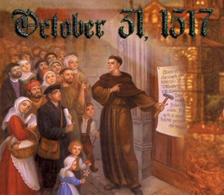
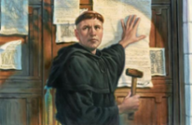
Introduction
Oct 31, 1517
500 years
Far reaching impact
Partial restoration
Restoration of a hermeneutic
Selectively applied
Subsequent generations applied consistently
Preview

Slide 3
Overview
The early church
The Alexandrian eclipse
The Dark Ages
The contribution of the Protestant Reformers
The Reformers’ incomplete revolution
Reformed Theology today
Dispensationalism & the completed revolution
Looking back 500 years later
Notes:
Outline

Slide 4
Overview
THE EARLY CHURCH
The Alexandrian eclipse
The Dark Ages
The contribution of the Protestant Reformers
The Reformers’ incomplete revolution
Reformed Theology today
Dispensationalism & the completed revolution
Looking back 500 years later
Notes:
Outline

Slide 5
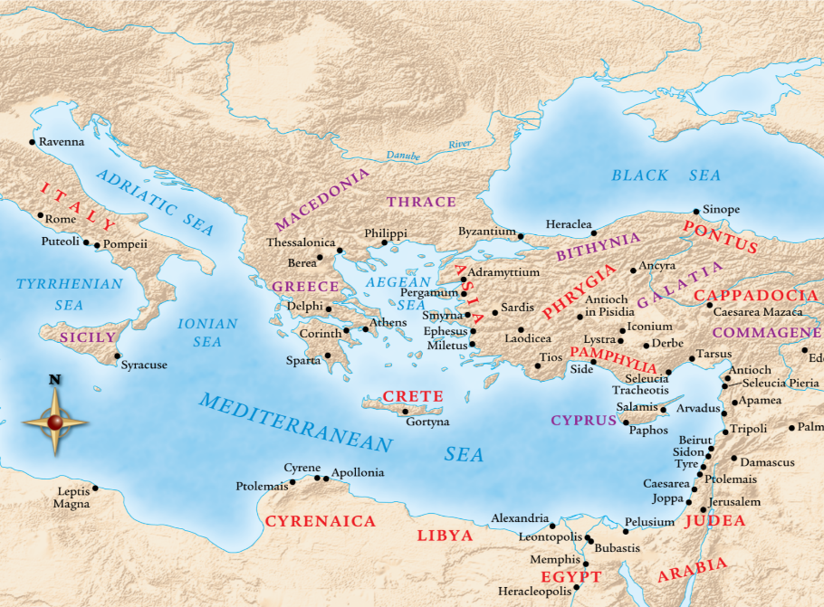

Slide 6
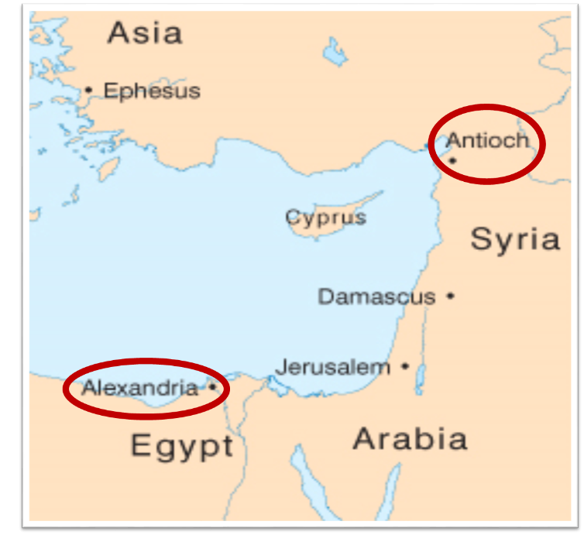

Slide 7
Overview
The early church
THE ALEXANDRIAN ECLIPSE
The Dark Ages
The contribution of the Protestant Reformers
The Reformers’ incomplete revolution
Reformed Theology today
Dispensationalism & the completed revolution
Looking back 500 years later
Notes:
Outline

Slide 10
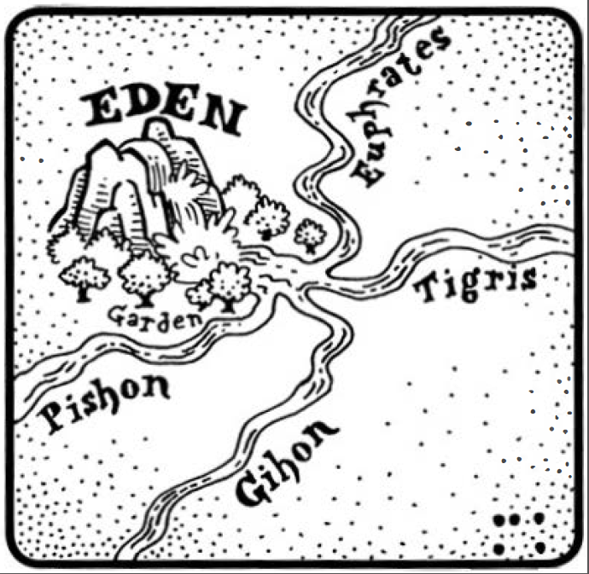
Dangers of Allegorization – Philo

Slide 11
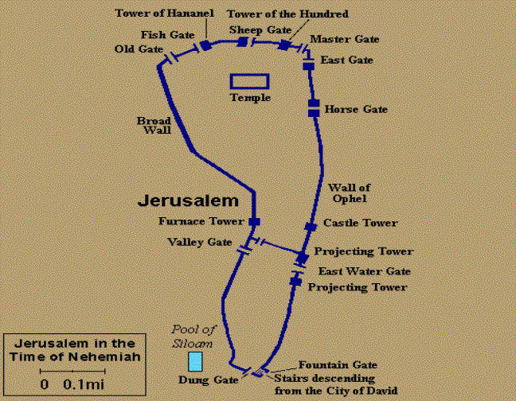
Dangers of Allegorization
Gates of Nehemiah

Slide 12
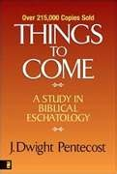
Dangers of Allegorization
Text is not being interpreted
Authority is transferred from text to interpreter
There is no way to test the interpreter
No mechanism for controlling the interpreter’s imagination
Pentecost, Things to Come, pps. 4-5

Slide 13
What Caused the Shift Into Allegorism?
Need for immediate relevance
Incorporation of human philosophy into interpretation
Gnostic dualism (Gen. 1:31; 1 John 2:22; 4:2-3; Acts 17:32; 1 Cor. 15:12)
Decline of the church's Jewish population
Constantine’s Edict of Milan (A.D. 313)
AD 70 and Hadrian’s (A.D. 117–138)“Palestine”
Notes:
Outline

Slide 14
Overview
The early church
The Alexandrian eclipse
THE DARK AGES
The contribution of the Protestant Reformers
The Reformers’ incomplete revolution
Reformed Theology today
Dispensationalism & the completed revolution
Looking back 500 years later
Notes:
Outline

Slide 15
III. The Dark Ages (or the Middle Ages)
Lasted from the 4th to the 16th centuries
Obsolescence of prophetic studies
Domination of Augustinian Amillennialism
Only one church: Roman Catholicism
The Bible is removed from the people
Allegorization
Illiteracy
Mass read in Latin
Sale of indulgences
Anti-Semitism
Church in need of rescue
Notes:
Outline

Slide 16
III. The Dark Ages (or the Middle Ages)
Lasted from the 4th to the 16th centuries
Obsolescence of prophetic studies
Domination of Augustinian Amillennialism
Only one church: Roman Catholicism
The Bible is removed from the people
Allegorization
Illiteracy
Mass read in Latin
Sale of indulgences
Anti-Semitism
Church in need of rescue
Notes:
Outline

Slide 17
III. The Dark Ages (or the Middle Ages)
Lasted from the 4th to the 16th centuries
Obsolescence of prophetic studies
Domination of Augustinian Amillennialism
Only one church: Roman Catholicism
The Bible is removed from the people
Allegorization
Illiteracy
Mass read in Latin
Sale of indulgences
Anti-Semitism
Church in need of rescue
Notes:
Outline

Slide 18
III. The Dark Ages (or the Middle Ages)
Lasted from the 4th to the 16th centuries
Obsolescence of prophetic studies
Domination of Augustinian Amillennialism
Only one church: Roman Catholicism
The Bible is removed from the people
Allegorization
Illiteracy
Mass read in Latin
Sale of indulgences
Anti-Semitism
Church in need of rescue
Notes:
Outline

Slide 19
Renald Showers
John Ankerberg and Renald Showers, The Most Asked Prophecy Questions (Chattanooga, TN: ATRI, 2000), 327-28.
“Augustine's allegorical amillennialism became the official doctrine of the church, and Premillennialism went underground. Some aspects of Premillennialism were even branded as heretical. The Roman Catholic Church strongly advocated and maintained Augustine's Amillennial view throughout the Middle Ages. During that span of time occasionally pre-millennial groups formed to challenge the doctrine and political power of the major part of organized Christendom, but they were not able to restore Premillennialism to its original position as the accepted, orthodox view of the Church.”

Slide 20
Matthew 16:18 (NASB)
“I also say to you that you are Peter, and upon this rock I will build My church; and the gates of Hades will not overpower it.”

Slide 21
Pseudo Ephraem (4th-6th century A.D.)
“Why therefore do we not reject every care of earthly actions and prepare ourselves for the meeting of the Lord Christ, so that he may draw us from the confusion, which overwhelms all the world…For all the saints and the elect of god are gathered, prior to the tribulation that is to come, and are taken to the Lord lest they see the confusion that is to overwhelm the world because of our sins.”

Slide 22
III. The Dark Ages (or the Middle Ages)
Lasted from the 4th to the 16th centuries
Obsolescence of prophetic studies
Domination of Augustinian Amillennialism
Only one church: Roman Catholicism
The Bible is removed from the people
Allegorization
Illiteracy
Mass read in Latin
Sale of indulgences
Anti-Semitism
Church in need of rescue
Notes:
Outline

Slide 23
III. The Dark Ages (or the Middle Ages)
Lasted from the 4th to the 16th centuries
Obsolescence of prophetic studies
Domination of Augustinian Amillennialism
Only one church: Roman Catholicism
The Bible is removed from the people
Allegorization
Illiteracy
Mass read in Latin
Sale of indulgences
Anti-Semitism
Church in need of rescue
Notes:
Outline

Slide 24
III. The Dark Ages (or the Middle Ages)
Lasted from the 4th to the 16th centuries
Obsolescence of prophetic studies
Domination of Augustinian Amillennialism
Only one church: Roman Catholicism
The Bible is removed from the people
Allegorization
Illiteracy
Mass read in Latin
Sale of indulgences
Anti-Semitism
Church in need of rescue
Notes:
Outline

Slide 25
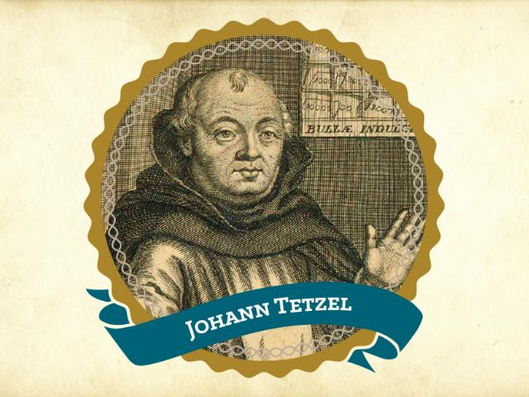
“As soon as the gold in the casket rings; the rescued soul to heaven springs.”

Slide 26
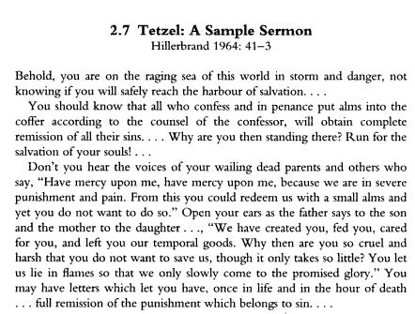

Slide 27
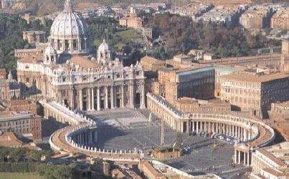

Slide 28
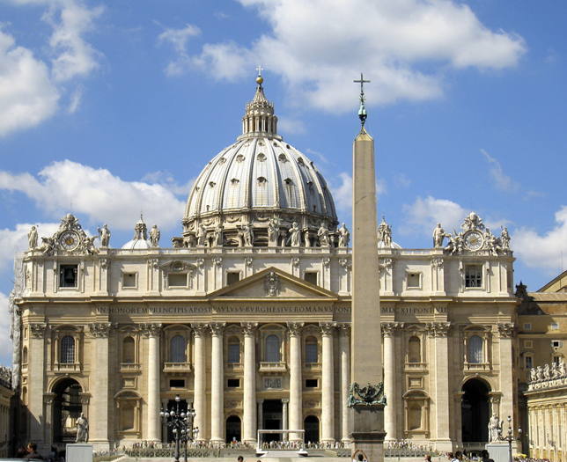

Slide 29
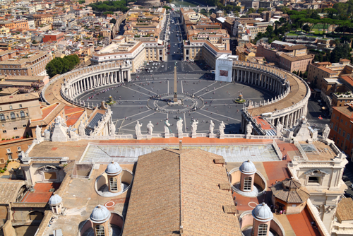

Slide 30
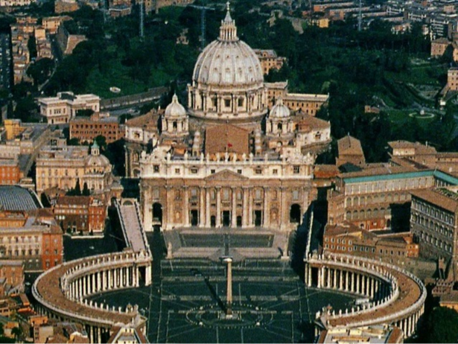

Slide 31
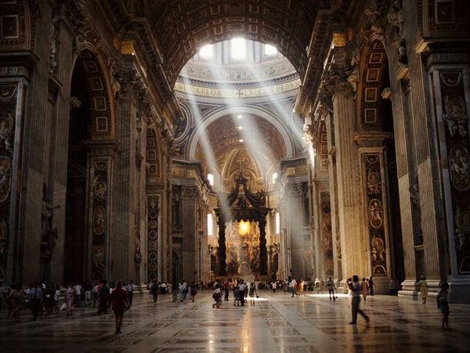

Slide 32
Acts 17:10-11 (NASB)
“The brethren immediately sent Paul and Silas away by night to Berea, and when they arrived, they went into the synagogue of the Jews. ¹¹ Now these were more noble-minded than those in Thessalonica, for they received the word with great eagerness, examining the Scriptures daily to see whether these things were so.”

Slide 33
1 Thessalonians 5:20-21 (NASB)
“do not despise prophetic utterances. But examine everything carefully; hold fast to that which is good.”

Slide 34
1 Corinthians 14:29 (NASB)
“Let two or three prophets speak, and let the others pass judgment.”

Slide 35
Revelation 2:2 (NASB)
“I know your deeds and your toil and perseverance, and that you cannot tolerate evil men, and you put to the test those who call themselves apostles, and they are not, and you found them to be false.”

Slide 36
III. The Dark Ages (or the Middle Ages)
Lasted from the 4th to the 16th centuries
Obsolescence of prophetic studies
Domination of Augustinian Amillennialism
Only one church: Roman Catholicism
The Bible is removed from the people
Allegorization
Illiteracy
Mass read in Latin
Sale of indulgences
Anti-Semitism
Church in need of rescue
Notes:
Outline

Slide 37
Acts 18:1-2 (NASB)
“After these things he left Athens and went to Corinth. And he found a Jew named Aquila, a native of Pontus, having recently come from Italy with his wife Priscilla, because Claudius had commanded all the Jews to leave Rome. He came to them.”

Slide 38
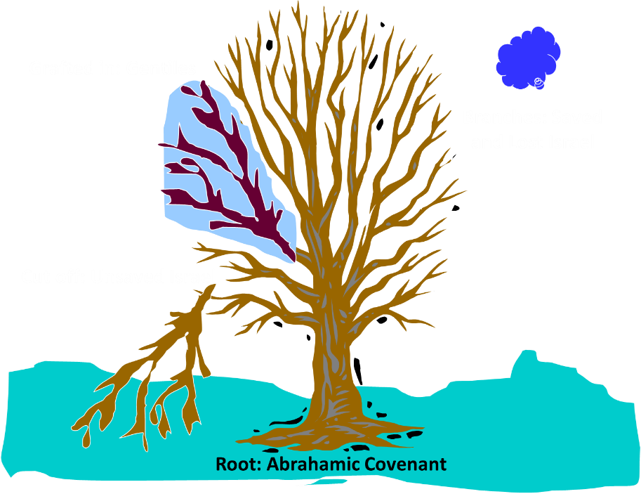
Notes:
38

Slide 39
Romans 11:13, 17-21 (NASB)
¹³ “But I am speaking to you who are Gentiles. Inasmuch then as I am an apostle of Gentiles, I magnify my ministry…¹⁷ But if some of the branches were broken off, and you, being a wild olive, were grafted in among them and became partaker with them of the rich root of the olive tree, ¹⁸ do not be arrogant toward the branches; but if you are arrogant, remember that it is not you who supports the root, but the root supports you. ¹⁹ You will say then, “Branches were broken off so that I might be grafted in.” ²⁰ Quite right, they were broken off for their unbelief, but you stand by your faith. Do not be conceited, but fear; ²¹ for if God did not spare the natural branches, He will not spare you, either.”

Slide 40
III. The Dark Ages (or the Middle Ages)
Lasted from the 4th to the 16th centuries
Obsolescence of prophetic studies
Domination of Augustinian Amillennialism
Only one church: Roman Catholicism
The Bible is removed from the people
Allegorization
Illiteracy
Mass read in Latin
Sale of indulgences
Anti-Semitism
Church in need of rescue
Notes:
Outline

Slide 41
Matthew 16:18 (NASB)
“I also say to you that you are Peter, and upon this rock I will build My church; and the gates of Hades will not overpower it.”

Slide 42
Emergent Preaching
“At Solomon’s porch, sermons are not primarily about my extracting truth from the Bible to apply to people’s lives…So our sermons are not lessons that precisely define belief so much as they are stories that welcome our hopes and ideas and participation” (Italics added).
Doug Pagitt, cited in Oakland, 41-42.

Slide 43
Emergent Preaching
“It isn’t about clever apologetics or careful exegetical or expository preaching…Emerging generations are hungering to experience God in worship” (Italics added).
Dan Kimball, The Emerging Church, 116

Slide 44
Emergent Preaching
“A spiritual Tsunami has hit postmodern culture. The wave will build without breaking for decades to come. The wave is this: People want to know God. They want less to know about God …they want new experiences, especially new experiences of the divine” (Italics added).
Leonard Sweet, Soul Tsunami, 420.

Slide 45
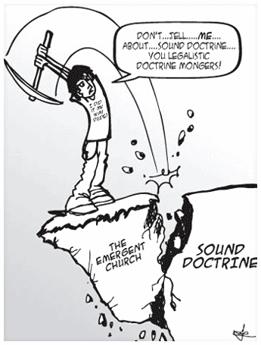
Emergent Doctrine
“…something beyond a belief system or doctrinal array or even a practice. I mean an attitude–an attitude toward God and our neighbor and our mission that is passionate.”
Brian McLaren, A Generous Orthodoxy, 117-18.

Slide 46
“Don’t give me doctrine, just give me Jesus.”
“What really matters is Christ not creed.”
“Devotion is important and not doctrine.”
“What counts is our behavior, and not our beliefs.”
Most of these slogans were originally accumulated in Henry Holloman, “Prolegomena, Bibliology, and Theology (Part 1)” (unpublished class notes in TTH511 Theology I, Talbot Theological Seminary, Spring 1998), 9.

Slide 47
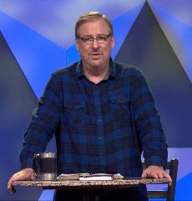
Rick Warren Purpose Driven Life 34, 124, 183
“God won’t ask you about your religious background or doctrinal views.”
“Jesus said our love for each other - not our doctrinal beliefs - is our greatest witness to the world.”
“Today many assume that spiritual maturity is measured by the amount of biblical information and doctrine you know.”

Slide 48
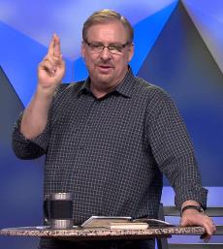
Rick Warren Purpose Driven Life 186, 231; Purpose Driven Church 300
“The Bible is far more than a doctrinal guidebook.”
“The last thing many believers need today is to go to another Bible study. They already know far more than they are putting into practice.”
“My pastor has been in Daniel’s seventy weeks longer than Daniel was!”

Slide 49
Biblical Preaching
Biblical priority of preaching-Acts 2:42; 2 Tim 3:15–4:2; Matt 4:4; Neh 8; 2 Kgs 22
New dark ages?

Slide 50
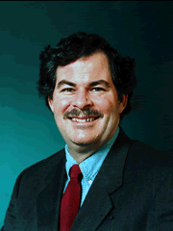
Emphasis of 2 Timothy
“By my count, there are twenty-seven explicit commands given in the body of this letter. In 27 words Paul tells pastors what to focus on. You have to be blind to miss the thrust of Paul's instructions here, because eighteen of those commands--fully two-thirds--have to do with the ministry of the Word..”
Daniel Wallace, “Crisis of the Word: A Message to Pastors or Would-be Pastors,” Conservative Theological Journal 1, no. 2 (August 1997): 108.

Slide 51
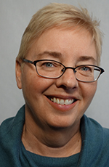
Emergent Worship
“Post-moderns prefer to encounter Christ by using all their senses. That’s part of the appeal of classical liturgical or contemplative worship: the incense and candles, making the sign of the cross, the taste and smell of the bread and wine, touching icons and being anointed with oil.”
Julie B. Sevig, The Lutheran, 9/2001.

Slide 52
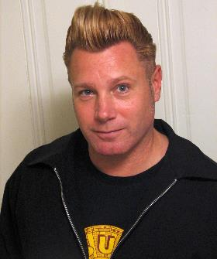
Emergent Worship
“multisensory and interactive …Through various experimental elements as well as through the space itself, we can actually preach. Art preaches. Scripture preaches. Music preaches. Even silence preaches.”
Dan Kimball, The Emerging Church, 186

Slide 53
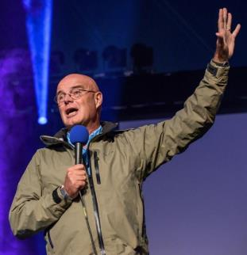
Emergent Worship
“If Charismatics gave me my high school diploma in the ways of the Spirit, it was from Catholic contemplatives that I entered an undergraduate degree in the liberal arts of the Spirit.”
Brian McLaren
A Generous Orthodoxy, 175.

Slide 54
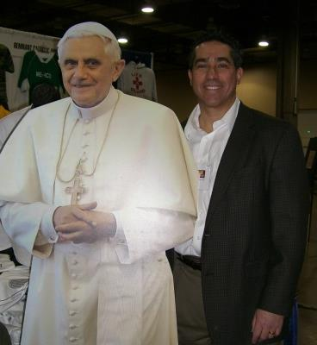
Francis Beckwith

Slide 55
Acts 20:29
“For I know this, that after my departure savage wolves will come in among you, not sparing the flock.” (Italics added).

Slide 56
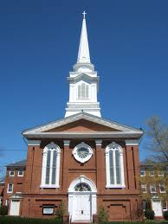
Emergent Worship
Why not go back to the very beginning?
Where in Scripture are we told that it is essential to embrace ancient liturgical and contemplative practices?
Matt 6:7

Slide 57
CONCLUSION

Slide 58
NEXT SESSION
The early church
The Alexandrian eclipse
The Dark Ages
THE CONTRIBUTION OF THE PROTESTANT REFORMERS
The Reformers’ incomplete revolution
Reformed Theology today
Dispensationalism & the completed revolution
Looking back 500 years later
Notes:
Outline

