Slide 1

THE BOOK OF DANIEL
Dr. Andy Woods

Slide 2

Message
Times of the Gentiles are revealed prophetically (2, 7, 8-12) and ethically (1, 3-6)

Slide 3

Synthetic Outline
Historical (1-7):
  Daniel interprets, 3rd person, gentile nations
  Intro “Hebrew” (1)
  Aramaic chiasm (2-7)

Slide 4
Synthetic Outline
Prophetic (8-12):
  Angel interprets, 1st person, Jewish nation, Hebrew
  Ram & Goat (8)
  70 weeks (9)
  Final vision (10-12)

Slide 5
Synthetic Outline
Historical (1-7):
  Daniel interprets, 3rd person, gentile nations
  Intro “Hebrew” (1)
  Aramaic chiasm (2-7)

Slide 6
Synthetic Outline
Historical (1-7):
  Daniel interprets, 3rd person, gentile nations
  Intro “Hebrew” (1)
  Aramaic chiasm (2-7)

Slide 7

Synthetic Outline
  Chiasm “Aramaic” ( 2-7)
1. Gentile History (2)
  2. Protection (3)
    3. Revelation to a gentile king (4)
    3. Revelation to a gentile king (5)
  2. Protection (6)
1. Gentile history (7)

Slide 8
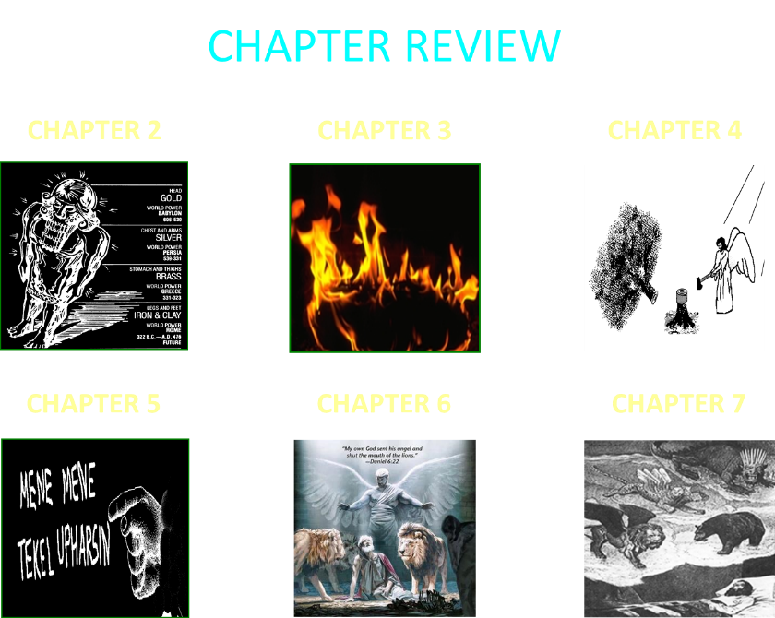

Slide 9
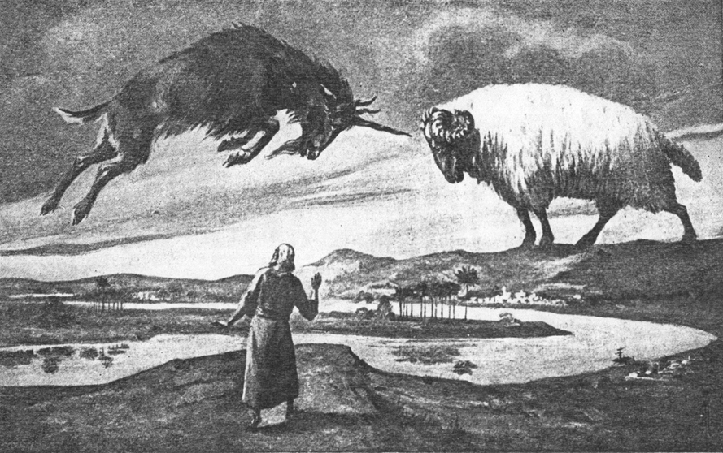
CHAPTER 8

Slide 10
Synthetic Outline
Prophetic (8-12):
  Angel interprets, 1st person, Jewish nation, Hebrew
  Ram & Goat (8)
  70 weeks (9)
  Final vision (10-12)

Slide 11
Synthetic Outline
Prophetic (8-12):
  Angel interprets, 1st person, Jewish nation, Hebrew
  Ram & Goat (8)
  70 weeks (9)
  Final vision (10-12)

Slide 12

Chapter 8 Outline
The Historical Setting (1)
The Vision (2-14)
The Vision’s Interpretation (15-26)
The Personal Impact on Daniel (27)

Slide 13
Chapter 8 Outline
The Historical Setting (1)
The Vision (2-14)
The Vision’s Interpretation (15-26)
The Personal Impact on Daniel (27)

Slide 14
CHAPTER AND VERSE IN DANIEL | CHRONOLOGICAL DATE | BIBLICAL DATE
1:1 | 605 | 3rd year of Jehoiakim
2:1 | 603 | 2nd year of Nebuchadnezzar
5 | Sat. night 10/12/539 (Hoehner)
7:1 | 553 | 1st year of Belshazzar
8:1 | 551 | 3rd year of Belshazzar
9:1 | 538 | 1st year of Darius
10:1 | 536 | 3rd year of Cyrus

Slide 15
Daniel’s Age
CHAPTER | EVENTS | AGE
1 | Taken to Babylonian captivity | 15
2 | Interpreting Nebuchadnezzar’s 1st dream (huge image) | 17
3 | Daniel’s 3 friends cast into the fiery furnace | 19 or 20
4 | Interpreting Nebuchadnezzar’s 2nd dream (huge tree) | 45-50
5 | Interpreting handwriting of the wall at Belshazzar’s feast | Early 80’s
6 | Delivered from the den of lions | c.83
7-8 | Daniel’s visions and dreams | Mid-60’s
9 | Daniel’s seventy “sevens” prophecy | Early-80’s
10-12 | Final dreams and visions | Mid-80’s

Slide 16
Succession of Gentile Rulers
1-4: Nebuchadnezzar of Babylon
5: Belshazzar of Babylon
6: Darius of Media – Persia
7-8: Belshazzar of Babylon
9: Darius of Media – Persia
10-12: Cyrus of Media – Persia

Slide 17

Matthew 24:15
“Therefore when you see the abomination of desolation which was spoken of through Daniel the prophet, standing in the holy place (let the reader understand).”

Slide 18
SETTING V. 1
Daniel has another vision
3rd year of Belshazzar
551 BC
2 years after the events in Chp. 7
12 years before the events in Chp. 5

Slide 19

Daniel 8:20-21 (NASB)
“The ram which you saw with the two horns represents the kings of Media and Persia. ²¹ The shaggy goat represents the kingdom of Greece, and the large horn that is between his eyes is the first king.”

Slide 20
6 Empires
Babylon (2:36-38; 7:4) 605-539 BC
Media-Persia (2:39a; 7:5) 539-331 BC
Greece (2:39b; 7:6) 331-63 BC
Rome I (2:40; 7:7a) 63 BC – 70 AD
Rome II (2:41-43; 7:7b-8) Tribulation
Kingdom (2:44-45; 7:9-14) After 2nd Coming

Slide 21
6 Empires
Babylon (2:36-38; 7:4) 605-539 BC
Media-Persia (2:39a; 7:5) 539-331 BC
Greece (2:39b; 7:6) 331-63 BC
Rome I (2:40; 7:7a) 63 BC – 70 AD
Rome II (2:41-43; 7:7b-8) Tribulation
Kingdom (2:44-45; 7:9-14) After 2nd Coming

Slide 22


Statue
&
Stone

Slide 23

CHART1

Slide 24

Description of 4 Beasts
2nd Beast (V.5)
  Bear
  Media-Persia
  Chest & Arms of Silver
  5:28; 8:20
  539-331 BC
  Raised on One Side
  Three Ribs
  Arise and Devour

Slide 25

Description of 4 Beasts
3rd Beast (V. 6)
  Leopard
  Greece
  Belly & Thighs of Bronze
  8:21
  331-63 BC
  Rapid Conquest (Wings & Leopard)
  Four Generals (Wings & Heads)

Slide 26
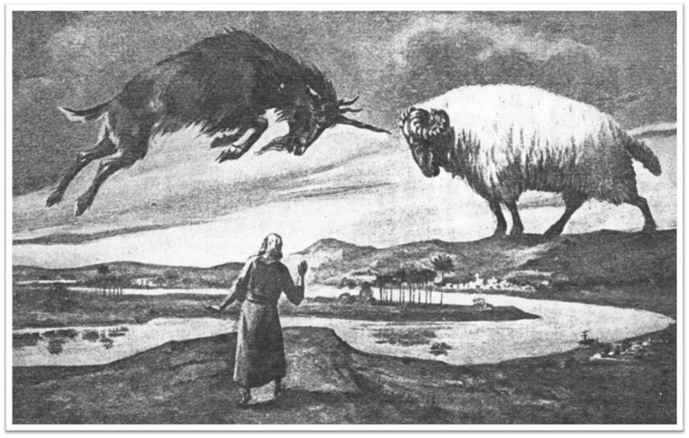

Slide 27
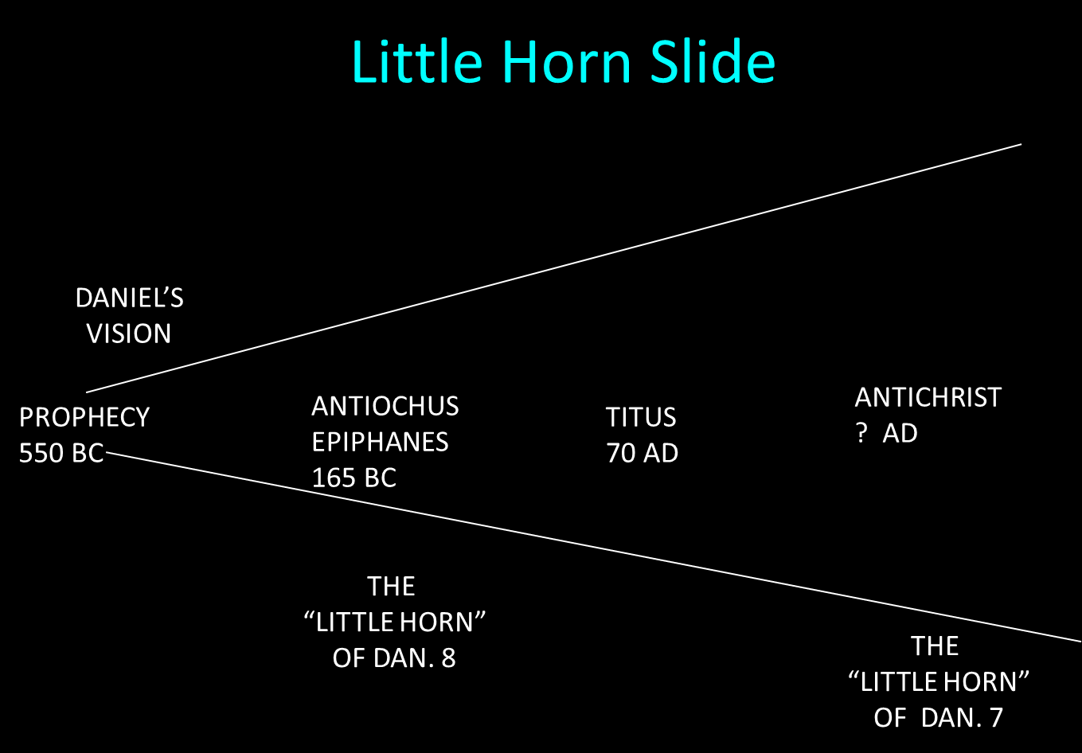

Slide 28
Chapter 8 Outline
The Historical Setting (1)
The Vision (2-14)
The Vision’s Interpretation (15-26)
The Personal Impact on Daniel (27)

Slide 29
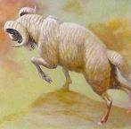
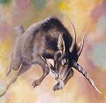

OUTLINE OF THE VISION
2 Horned Ram: Media-Persia (v.2-4)
1 Horned Goat: Greece (v.5-8)
The Boastful Little Horn: Antiochus Epiphanes (v.9-14)

Slide 30
OUTLINE OF THE VISION
2 Horned Ram: Media-Persia (v.2-4)
1 Horned Goat: Greece (v.5-8)
The Boastful Little Horn: Antiochus Epiphanes (v.9-14)

Slide 31

THE 2 HORNED RAM v. 2-4
Susa of Elam: evidence of an early date (v.2)
One horn longer than the other:
  Persians dominate the Medes (v.3)
Conquest of Media-Persia: Chp. 5 flashback (v.4)

Slide 32
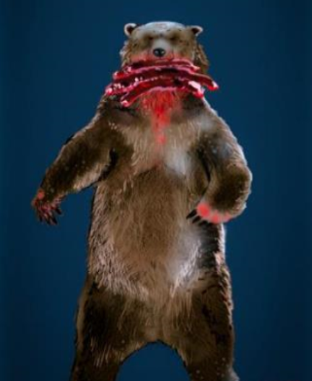

Slide 34
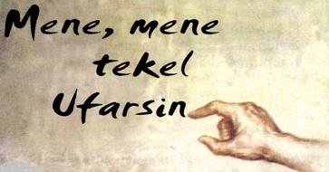
Daniel Interprets the Writing (5:24-28)

Slide 35
OUTLINE OF THE VISION
2 Horned Ram: Media-Persia (v.2-4)
1 Horned Goat: Greece (v.5-8)
The Boastful Little Horn: Antiochus Epiphanes (v.9-14)

Slide 37
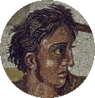
THE 1 HORNED GOAT V. 5-8
(v. 5)
  Alexander the Great
  The speed of the conquest
(v. 6-7)
  Greece conquers Media-Persia

Slide 38
CHAPTER AND VERSE IN DANIEL | CHRONOLOGICAL DATE | BIBLICAL DATE
1:1 | 605 | 3rd year of Jehoiakim
2:1 | 603 | 2nd year of Nebuchadnezzar
5 | Sat. night 10/12/539 (Hoehner)
7:1 | 553 | 1st year of Belshazzar
8:1 | 551 | 3rd year of Belshazzar
9:1 | 538 | 1st year of Darius
10:1 | 536 | 3rd year of Cyrus

Slide 39
THE 1 HORNED GOAT V. 5-8 (cont’d)
(v. 8)
  The goat’s changing horns
    He magnifies himself (v.8a)
    Alexander’s death (v.8b)
    Alexander’s empire is divided among his four generals (v.8c)

Slide 40
Four Generals
Daniel 7:6; 8:8,22
Cassander Macedonia | Ptolemy Egypt
Lysimachus Thrace & Asia Minor | Seleucus Syria (including Israel)

Slide 41
Description of 4 Beasts
3rd Beast (V. 6)
  Leopard
  Greece
  Belly & Thighs of Bronze
  8:21
  331-63 BC
  Rapid Conquest (Wings & Leopard)
  Four Generals (Wings & Heads)

Slide 42
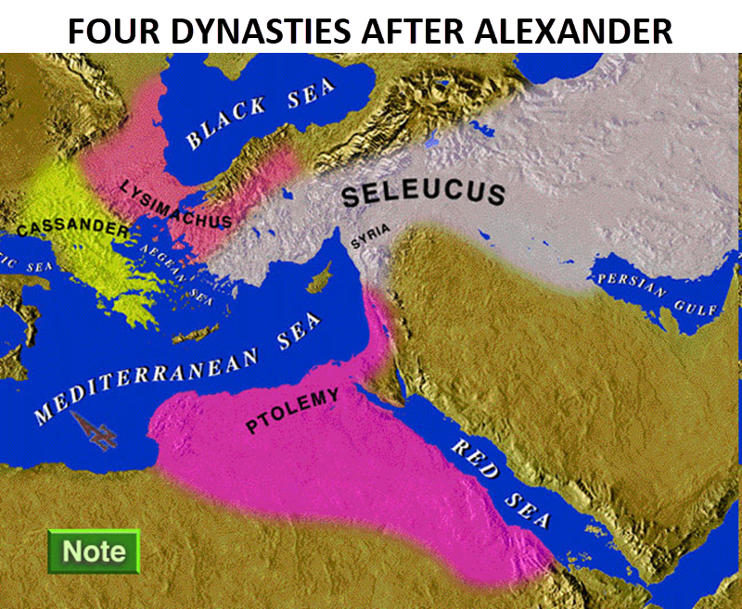

Slide 43
OUTLINE OF THE VISION
2 Horned Ram: Media-Persia (v.2-4)
1 Horned Goat: Greece (v.5-8)
The Boastful Little Horn: Antiochus Epiphanes (v.9-14)

Slide 44
THE RISE OF ANTIOCHUS
The Seleucid dynasty
The Seleucid dynasty rules over Syria and Israel
Antiochus becomes the ruler of the Seleucid dynasty
Antiochus is the subject of verses 9-14

Slide 45
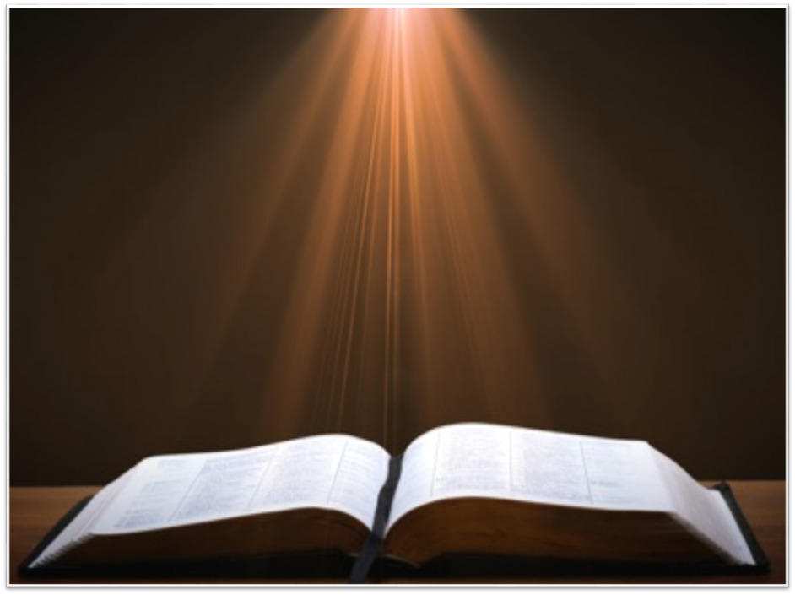
Ezekiel 5:5
“Thus says the Lord God, ‘This is Jerusalem; I have set her at the center of the nations, with lands around her.’”

Slide 46
Ezekiel 38:12
“to capture spoil and to seize plunder, to turn your hand against the waste places which are now inhabited, and against the people who are gathered from the nations, who have acquired cattle and goods, who live at the center of the world.”

Slide 47

THE BOASTFUL LITTLE HORN V. 9-14
V. 9
  The conquests of Antiochus
  Antiochus foreshadows the future Antichrist

Slide 49

THE BOASTFUL LITTLE HORN V. 9-14
V. 10
  Antiochus’ persecution of Israel
  Goal is Hellenization
  He viewed the Jews as an obstacle to his goal
  He outlawed the Hebrew scriptures and executed families who observed the Sabbath and circumcision

Slide 50
THE BOASTFUL LITTLE HORN V. 9-14
V. 11
  Made himself equal with God
  Stopped Jewish sacrifices
  Desecrated the temple (167 BC)
    Set up an image of Zeus
    Sacrificed a pig on the altar

Slide 51


Slide 52
THE BOASTFUL LITTLE HORN V. 9-14
V. 12
  Persecuted Israel
  Stopped the sacrifices
  Disregarded the truth
  Prospered

Slide 53
THE BOASTFUL LITTLE HORN V. 9-14
Persecuted the Jews
Desecrated the temple
Prospered

Slide 54
THE BOASTFUL LITTLE HORN V. 9-14
V. 13
  How long will temple desecration last?
V. 14
  2300 evenings and mornings

Slide 55

THE BOASTFUL LITTLE HORN V. 9-14
171 BC-Dec. 25th 165 BC
= 2300 mornings and evenings
Daniel predicted these events roughly 400 years in advance
Argument over the date of Daniel

Slide 56

HANUKKAH
The Maccabean revolt
December 25th 165 BC : the temple is liberated and rededicated
1 & 2 Maccabees
The miracle of the lamp oil
Hanukkah “Feast of Dedication” (festival of lights).
Christmas / Jewish Holiday
John 10:22-24

Slide 57
Levitical Feasts (Lev. 23)
Feast | Season | Purpose | Type
Passover | Spring | Redemption | 1 Cor. 5:7
Unleavened Bread | Spring | Separation | John 6:35
1st fruits | Spring | Praise | 1 Cor. 15:20
Pentecost | Spring | Praise | Acts 2:1-4
Trumpets | Fall | New Year | Matt. 24:31
Atonement | Fall | Lev 16 | Zech. 12:10
Booths | Fall | Wilderness provision | Zech. 14:16-18

Slide 58
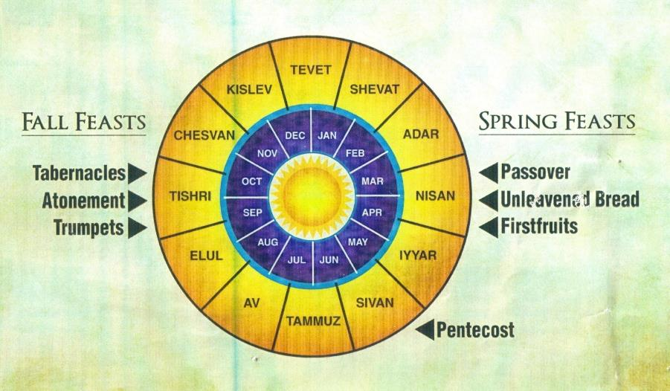

Slide 59


Slide 60
John 10:22-24 (NASB)
“At that time the Feast of the Dedication took place at Jerusalem; ²³ it was winter, and Jesus was walking in the temple in the portico of Solomon. ²⁴ The Jews then gathered around Him, and were saying to Him, “How long will You keep us in suspense? If You are the Christ, tell us plainly.”

Slide 61
Chapter 8 Outline
The Historical Setting (1)
The Vision (2-14)
The Vision’s Interpretation (15-26)
The Personal Impact on Daniel (27)

Slide 62
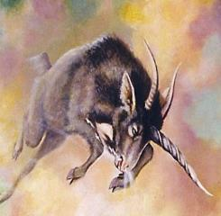

INTERPRETATION OF THE VISION
Daniel seeks an interpretation (v.15-19)
Interpretation of the vision (v.20-26)
Time frame of the vision (v.26)

Slide 63
INTERPRETATION OF THE VISION
Daniel seeks an interpretation (v.15-19)
Interpretation of the vision (v.20-26)
Time frame of the vision (v.26)

Slide 64
INTERPRETATION V.15-25
No guess work is needed
V. 15
  Daniel seeks an interpretation
V. 16
  A voice tells Gabriel to interpret the vision
V. 17
  “Time of the end” means the end of the third kingdom (Greece) not the end of the age
V. 18-19
  “Time of the end” is the end of Antiochus’ desecration

Slide 65
INTERPRETATION OF THE VISION
Daniel seeks an interpretation (v.15-19)
Interpretation of the vision (v.20-26)
Time frame of the vision (v.26)

Slide 66
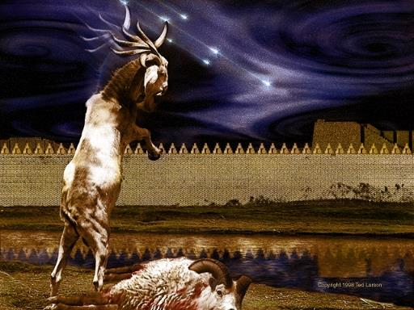
INTERPRETATION V.15-25
V. 20
Ram = Media-Persia

Slide 67
INTERPRETATION V.15-25
V. 21
  Goat = Greece
  Horn between eyes = Alexander the Great
V. 22
  “Broken horn” = the demise of Alexander the Great
  “Four Horns” = four generals
  The divided kingdom was not as strong as Alexander’s kingdom
V. 23-35
  The Activities of Antiochus Epiphanes
  Foreshadowing of the antichrist

Slide 70
INTERPRETATION OF THE VISION
Daniel seeks an interpretation (v.15-19)
Interpretation of the vision (v.20-26)
Time frame of the vision (v.26)

Slide 71
TIME FRAME V.26
V. 26
  True
  Daniel is told to keep it a secret
  The vision will not be fulfilled for 386 years
  Daniel 12:4, 9

Slide 72
Daniel 12:4, 9 (NASB)
“But as for you, Daniel, conceal these words and seal up the book until the end of time; many will go back and forth, and knowledge will increase...Go your way, Daniel, for these words are concealed and sealed up until the end time.”

Slide 73

Amos 8:12 (NASB)
“People will stagger from sea to sea And from the north even to the east; They will go to and fro to seek the word of the Lord, But they will not find it.”

Slide 74
Chapter 8 Outline
The Historical Setting (1)
The Vision (2-14)
The Vision’s Interpretation (15-26)
The Personal Impact on Daniel (27)

Slide 75
THE EFFECT ON DANIEL V. 27
Daniel is exhausted
Daniel is astounded
Daniel wants more understanding
  Daniel 12:8-9

Slide 76
Conclusion

Slide 77
Chapter 8 Outline
The Historical Setting (1)
The Vision (2-14)
The Vision’s Interpretation (15-26)
The Personal Impact on Daniel (27)

