Slide 1
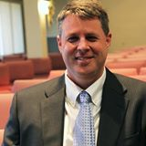
The Protestant Reformation: The Good, The Bad, and The Ugly Session 5
Andy Woods, Th.M.., JD., PhD.
Sr. Pastor, Sugar Land Bible Church
President Chafer Theological Seminary

Slide 2
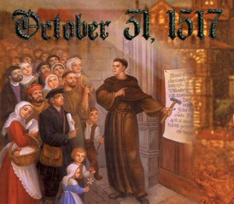
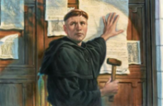
Introduction
Oct 31, 1517
500 years
Far reaching impact
Partial restoration
Restoration of a hermeneutic
Selectively applied
Subsequent generations applied consistently
Preview

Slide 3
Overview
The early church
The Alexandrian eclipse
The Dark Ages
The contribution of the Protestant Reformers
The Reformers’ incomplete revolution
Reformed Theology today
Dispensationalism & the completed revolution
Looking back 500 years later
Notes:
Outline

Slide 4
Overview
THE EARLY CHURCH
The Alexandrian eclipse
The Dark Ages
The contribution of the Protestant Reformers
The Reformers’ incomplete revolution
Reformed Theology today
Dispensationalism & the completed revolution
Looking back 500 years later
Notes:
Outline

Slide 5
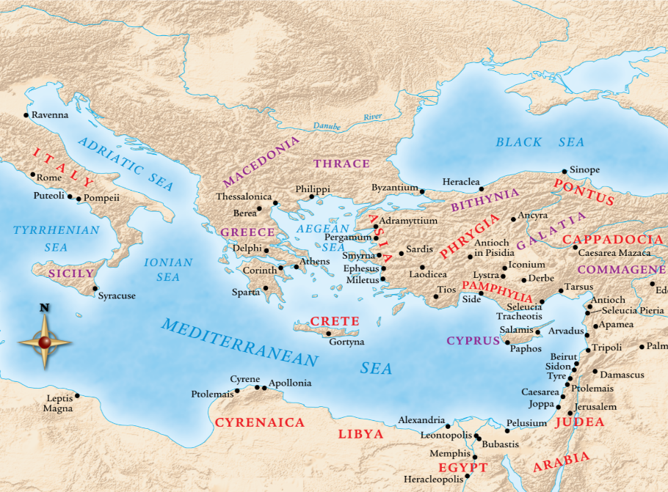

Slide 6
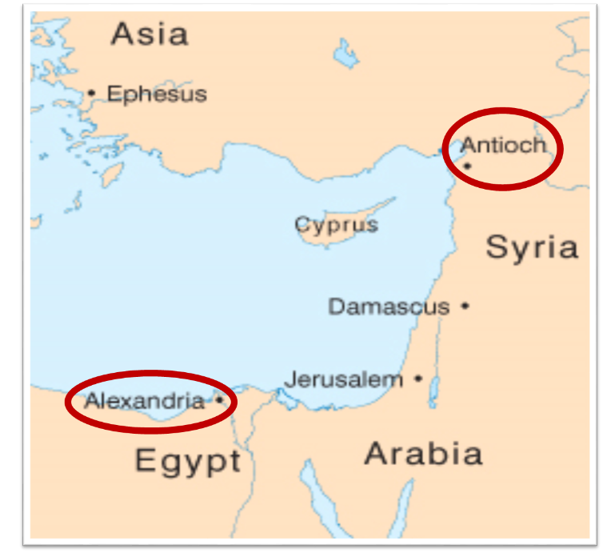

Slide 7
Overview
The early church
THE ALEXANDRIAN ECLIPSE
The Dark Ages
The contribution of the Protestant Reformers
The Reformers’ incomplete revolution
Reformed Theology today
Dispensationalism & the completed revolution
Looking back 500 years later
Notes:
Outline

Slide 10
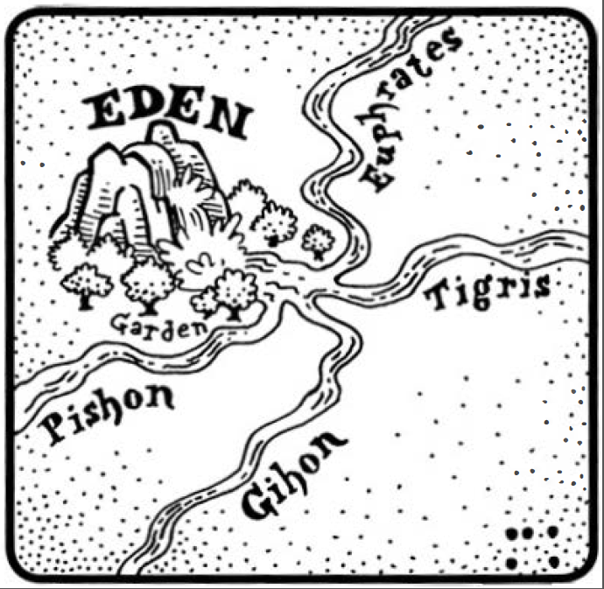
Dangers of Allegorization – Philo

Slide 11
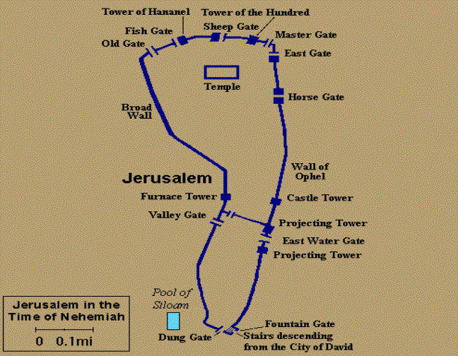
Dangers of Allegorization
Gates of Nehemiah

Slide 12
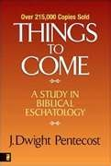
Dangers of Allegorization
Text is not being interpreted
Authority is transferred from text to interpreter
There is no way to test the interpreter
No mechanism for controlling the interpreter’s imagination
Pentecost, Things to Come, pps. 4-5

Slide 13
What Caused the Shift Into Allegorism?
Need for immediate relevance
Incorporation of human philosophy into interpretation
Gnostic dualism (Gen. 1:31; 1 John 2:22; 4:2-3; Acts 17:32; 1 Cor. 15:12)
Decline of the church's Jewish population
Constantine’s Edict of Milan (A.D. 313)
AD 70 and Hadrian’s (A.D. 117–138)“Palestine”
Notes:
Outline

Slide 14
Overview
The early church
The Alexandrian eclipse
THE DARK AGES
The contribution of the Protestant Reformers
The Reformers’ incomplete revolution
Reformed Theology today
Dispensationalism & the completed revolution
Looking back 500 years later
Notes:
Outline

Slide 15
III. The Dark Ages (or the Middle Ages)
Lasted from the 4th to the 16th centuries
Obsolescence of prophetic studies
Domination of Augustinian Amillennialism
Only one church: Roman Catholicism
The Bible is removed from the people
Allegorization
Illiteracy
Mass read in Latin
Sale of indulgences
Anti-Semitism
Church in need of rescue
Notes:
Outline

Slide 16
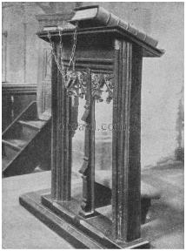
III. The Dark Ages (or the Middle Ages)
Lasted from the 4th to the 16th centuries
Obsolescence of prophetic studies
Domination of Augustinian Amillennialism
Only one church: Roman Catholicism
The Bible is removed from the people
Allegorization
Illiteracy
Mass read in Latin
Sale of indulgences
Anti-Semitism
Church in need of rescue
Notes:
Outline

Slide 17
III. The Dark Ages (or the Middle Ages)
Lasted from the 4th to the 16th centuries
Obsolescence of prophetic studies
Domination of Augustinian Amillennialism
Only one church: Roman Catholicism
The Bible is removed from the people
Allegorization
Illiteracy
Mass read in Latin
Sale of indulgences
Anti-Semitism
Church in need of rescue
Notes:
Outline

Slide 18
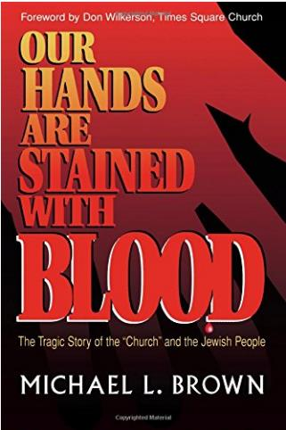
III. The Dark Ages (or the Middle Ages)
Anti-Semitism

Slide 19
III. The Dark Ages (or the Middle Ages)
Lasted from the 4th to the 16th centuries
Obsolescence of prophetic studies
Domination of Augustinian Amillennialism
Only one church: Roman Catholicism
The Bible is removed from the people
Allegorization
Illiteracy
Mass read in Latin
Sale of indulgences
Anti-Semitism
Church in need of rescue
Notes:
Outline

Slide 20
Matthew 16:18 (NASB)
“I also say to you that you are Peter, and upon this rock I will build My church; and the gates of Hades will not overpower it.”

Slide 21
Emergent Preaching
“At Solomon’s porch, sermons are not primarily about my extracting truth from the Bible to apply to people’s lives…So our sermons are not lessons that precisely define belief so much as they are stories that welcome our hopes and ideas and participation” (Italics added).
Doug Pagitt, cited in Oakland, 41-42.

Slide 22
Emergent Preaching
“It isn’t about clever apologetics or careful exegetical or expository preaching…Emerging generations are hungering to experience God in worship” (Italics added).
Dan Kimball, The Emerging Church, 116

Slide 23
Emergent Preaching
“A spiritual Tsunami has hit postmodern culture. The wave will build without breaking for decades to come. The wave is this: People want to know God. They want less to know about God …they want new experiences, especially new experiences of the divine” (Italics added).
Leonard Sweet, Soul Tsunami, 420.

Slide 24
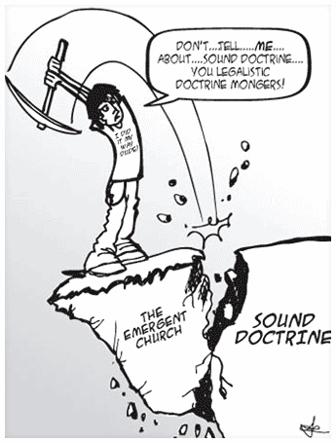
Emergent Doctrine
“…something beyond a belief system or doctrinal array or even a practice. I mean an attitude–an attitude toward God and our neighbor and our mission that is passionate.”
Brian McLaren, A Generous Orthodoxy, 117-18.

Slide 25
“Don’t give me doctrine, just give me Jesus.”
“What really matters is Christ not creed.”
“Devotion is important and not doctrine.”
“What counts is our behavior, and not our beliefs.”
Most of these slogans were originally accumulated in Henry Holloman, “Prolegomena, Bibliology, and Theology (Part 1)” (unpublished class notes in TTH511 Theology I, Talbot Theological Seminary, Spring 1998), 9.

Slide 26
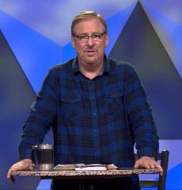
Rick Warren Purpose Driven Life 34, 124, 183
“God won’t ask you about your religious background or doctrinal views.”
“Jesus said our love for each other - not our doctrinal beliefs - is our greatest witness to the world.”
“Today many assume that spiritual maturity is measured by the amount of biblical information and doctrine you know.”

Slide 27
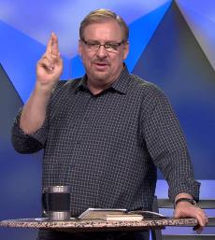
Rick Warren Purpose Driven Life 186, 231; Purpose Driven Church 300
“The Bible is far more than a doctrinal guidebook.”
“The last thing many believers need today is to go to another Bible study. They already know far more than they are putting into practice.”
“My pastor has been in Daniel’s seventy weeks longer than Daniel was!”

Slide 28
Biblical Preaching
Biblical priority of preaching-Acts 2:42; 2 Tim 3:15–4:2; Matt 4:4; Neh 8; 2 Kgs 22
New dark ages?

Slide 29
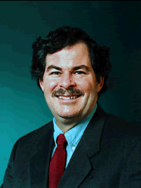
Emphasis of 2 Timothy
“By my count, there are twenty-seven explicit commands given in the body of this letter. In 27 words Paul tells pastors what to focus on. You have to be blind to miss the thrust of Paul's instructions here, because eighteen of those commands--fully two-thirds--have to do with the ministry of the Word..”
Daniel Wallace, “Crisis of the Word: A Message to Pastors or Would-be Pastors,” Conservative Theological Journal 1, no. 2 (August 1997): 108.

Slide 30
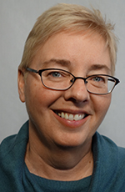
Emergent Worship
“Post-moderns prefer to encounter Christ by using all their senses. That’s part of the appeal of classical liturgical or contemplative worship: the incense and candles, making the sign of the cross, the taste and smell of the bread and wine, touching icons and being anointed with oil.”
Julie B. Sevig, The Lutheran, 9/2001.

Slide 31
Emergent Worship
“multisensory and interactive …Through various experimental elements as well as through the space itself, we can actually preach. Art preaches. Scripture preaches. Music preaches. Even silence preaches.”
Dan Kimball, The Emerging Church, 186

Slide 32
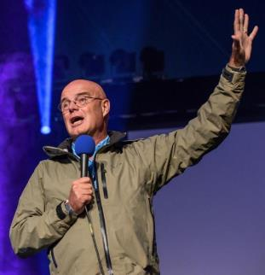
Emergent Worship
“If Charismatics gave me my high school diploma in the ways of the Spirit, it was from Catholic contemplatives that I entered an undergraduate degree in the liberal arts of the Spirit.”
Brian McLaren
A Generous Orthodoxy, 175.

Slide 33
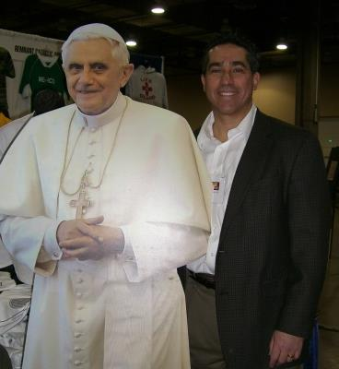
Francis Beckwith

Slide 34
Acts 20:29
“For I know this, that after my departure savage wolves will come in among you, not sparing the flock.” (Italics added).

Slide 35
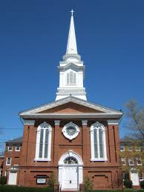
Emergent Worship
Why not go back to the very beginning?
Where in Scripture are we told that it is essential to embrace ancient liturgical and contemplative practices?
Matt 6:7

Slide 36
Overview
The early church
The Alexandrian eclipse
The Dark Ages
THE CONTRIBUTION OF THE PROTESTANT REFORMERS
The Reformers’ incomplete revolution
Reformed Theology today
Dispensationalism & the completed revolution
Looking back 500 years later
Notes:
Outline

Slide 37
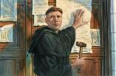
IV. Contribution of the Protestant Reformers
Preparation of the Reformers
Emphasis on literal interpretation
Denunciation of allegorization
Rejection of church tradition as a guide
Priesthood of all believers
Bible translations
Literacy
Basis for the American system of governance
Five solas
Rejection of celibacy of the priesthood
The ultimate sacrifice
Rejoice
Notes:
Outline

Slide 38
IV. Contribution of the Protestant Reformers
Preparation of the Reformers
Emphasis on literal interpretation
Denunciation of allegorization
Rejection of church tradition as a guide
Priesthood of all believers
Bible translations
Literacy
Basis for the American system of governance
Five solas
Rejection of celibacy of the priesthood
The ultimate sacrifice
Rejoice
Notes:
Outline

Slide 39
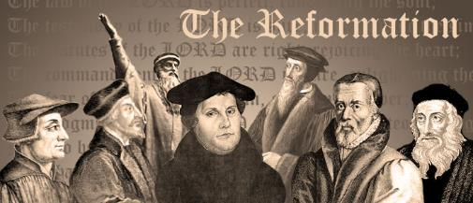
A. Preparation of the Reformers
Morning stars of the Reformation
God prepares His instruments
Legal background
Luther
Consecration
Monasticism
Conversion
Reformation
Notes:
Outline

Slide 40
A. Preparation of the Reformers
Morning stars of the Reformation
God prepares His instruments
Legal background
Luther
Consecration
Monasticism
Conversion
Reformation
Notes:
Outline

Slide 41
A. Preparation of the Reformers
Morning stars of the Reformation
God prepares His instruments
Legal background
Luther
Consecration
Monasticism
Conversion
Reformation
Notes:
Outline

Slide 42
THREE PHASES OF MOSES’ 120 YEAR LIFE
LIFE PHASE | SCRIPTURE | YEARS | AGE | ACTIVITY
Natural Training | Acts 7:23 | 1526–1486 B.C. | 1-40 | Egyptian Education
Spiritual Training | Exod. 7:7 | 1486–1446 B.C. | 40-80 | Midian Shepherding
Ministry | Deut. 31:2; 34:7; Acts 7:36 | 1446–1406 B.C. | 80-120 | Exodus, Law, Wilderness Preservation, Pentateuch Authorship

Slide 43
A. Preparation of the Reformers
Morning stars of the Reformation
God prepares His instruments
Legal background
Luther
Consecration
Monasticism
Conversion
Reformation
Notes:
Outline

Slide 44
A. Preparation of the Reformers
Morning stars of the Reformation
God prepares His instruments
Legal background
Luther
Consecration
Monasticism
Conversion
Reformation
Notes:
Outline

Slide 45
A. Preparation of the Reformers
Morning stars of the Reformation
God prepares His instruments
Legal background
Luther
Consecration
Monasticism
Conversion
Reformation
Notes:
Outline

Slide 46
A. Preparation of the Reformers
Morning stars of the Reformation
God prepares His instruments
Legal background
Luther
Consecration
Monasticism
Conversion
Reformation
Notes:
Outline

Slide 47
Colossians 2:20-23 (NASB)
²⁰“If you have died with Christ to the elementary principles of the world, why, as if you were living in the world, do you submit yourself to decrees, such as, ²¹ “Do not handle, do not taste, do not touch!” ²² (which all refer to things destined to perish with use)—in accordance with the commandments and teachings of men? ²³ These are matters which have, to be sure, the appearance of wisdom in self-made religion and self-abasement and severe treatment of the body, but are of no value against fleshly indulgence.”

Slide 48
A. Preparation of the Reformers
Morning stars of the Reformation
God prepares His instruments
Legal background
Luther
Consecration
Monasticism
Conversion
Reformation
Notes:
Outline

Slide 49
Galatians 2:16 (NASB)
“nevertheless knowing that a man is not justified by the works of the Law but through faith in Christ Jesus, even we have believed in Christ Jesus, so that we may be justified by faith in Christ and not by the works of the Law; since by the works of the Law no flesh will be justified.”

Slide 50
Galatians 2:20 (NASB)
“I have been crucified with Christ; and it is no longer I who live, but Christ lives in me; and the life which I now live in the flesh I live by faith in the Son of God, who loved me and gave Himself up for me.”

Slide 51
Galatians 3:3 (NASB)
“Are you so foolish? Having begun by the Spirit, are you now being perfected by the flesh?”

Slide 52
Galatians 5:16 (NASB)
“But I say, walk by the Spirit, and you will not carry out the desire of the flesh.”

Slide 53
A. Preparation of the Reformers
Morning stars of the Reformation
God prepares His instruments
Legal background
Luther
Consecration
Monasticism
Conversion
Reformation
Notes:
Outline

Slide 54
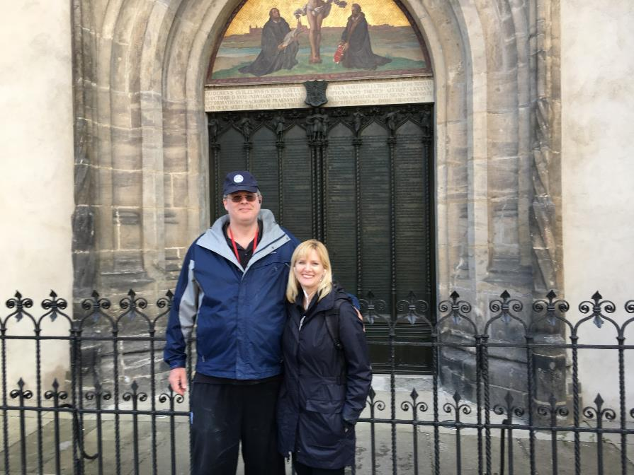

Slide 55
CONCLUSION

Slide 56
NEXT WEEK
The early church
The Alexandrian eclipse
The Dark Ages
THE CONTRIBUTION OF THE PROTESTANT REFORMERS
The Reformers’ incomplete revolution
Reformed Theology today
Dispensationalism & the completed revolution
Looking back 500 years later
Notes:
Outline

