Slide 1
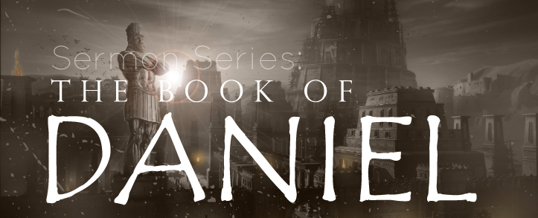
THE BOOK OF DANIEL
Dr. Andy Woods

Slide 2

Message
Times of the Gentiles are revealed prophetically (2, 7, 8-12) and ethically (1, 3-6)

Slide 3

Synthetic Outline
Historical (1-7):
  Daniel interprets, 3rd person, gentile nations
  Intro “Hebrew” (1)
  Aramaic chiasm (2-7)

Slide 4
Synthetic Outline
Historical (1-7):
  Daniel interprets, 3rd person, gentile nations
  Intro “Hebrew” (1)
  Aramaic chiasm (2-7)

Slide 5

Synthetic Outline
  Chiasm “Aramaic” ( 2-7)
1. Gentile History (2)
  2. Protection (3)
    3. Revelation to a gentile king (4)
    3. Revelation to a gentile king (5)
  2. Protection (6)
1. Gentile history (7)

Slide 6
Synthetic Outline
Prophetic (8-12):
  Angel interprets, 1st person, Jewish nation, Hebrew
  Ram & Goat (8)
  70 weeks (9)
  Final vision (10-12)

Slide 7
Synthetic Outline
Prophetic (8-12):
  Angel interprets, 1st person, Jewish nation, Hebrew
  Ram & Goat (8)
  70 weeks (9)
  Final vision (10-12)

Slide 8

Chapter 8 Outline
The Historical Setting (1)
The Vision (2-14)
The Vision’s Interpretation (15-26)
The Personal Impact on Daniel (27)

Slide 9
Chapter 8 Outline
The Historical Setting (1)
The Vision (2-14)
The Vision’s Interpretation (15-26)
The Personal Impact on Daniel (27)

Slide 10
CHAPTER AND VERSE IN DANIEL | CHRONOLOGICAL DATE | BIBLICAL DATE
1:1 | 605 | 3rd year of Jehoiakim
2:1 | 603 | 2nd year of Nebuchadnezzar
5 | Sat. night 10/12/539 (Hoehner)
7:1 | 553 | 1st year of Belshazzar
8:1 | 551 | 3rd year of Belshazzar
9:1 | 538 | 1st year of Darius
10:1 | 536 | 3rd year of Cyrus

Slide 11
Daniel’s Age
CHAPTER | EVENTS | AGE
1 | Taken to Babylonian captivity | 15
2 | Interpreting Nebuchadnezzar’s 1st dream (huge image) | 17
3 | Daniel’s 3 friends cast into the fiery furnace | 19 or 20
4 | Interpreting Nebuchadnezzar’s 2nd dream (huge tree) | 45-50
5 | Interpreting handwriting of the wall at Belshazzar’s feast | Early 80’s
6 | Delivered from the den of lions | c.83
7-8 | Daniel’s visions and dreams | Mid-60’s
9 | Daniel’s seventy “sevens” prophecy | Early-80’s
10-12 | Final dreams and visions | Mid-80’s

Slide 12
Succession of Gentile Rulers
1-4: Nebuchadnezzar of Babylon
5: Belshazzar of Babylon
6: Darius of Media – Persia
7-8: Belshazzar of Babylon
9: Darius of Media – Persia
10-12: Cyrus of Media – Persia

Slide 13

Daniel 8:20-21 (NASB)
“The ram which you saw with the two horns represents the kings of Media and Persia. ²¹ The shaggy goat represents the kingdom of Greece, and the large horn that is between his eyes is the first king.”

Slide 14
6 Empires
Babylon (2:36-38; 7:4) 605-539 BC
Media-Persia (2:39a; 7:5) 539-331 BC
Greece (2:39b; 7:6) 331-63 BC
Rome I (2:40; 7:7a) 63 BC – 70 AD
Rome II (2:41-43; 7:7b-8) Tribulation
Kingdom (2:44-45; 7:9-14) After 2nd Coming

Slide 15
6 Empires
Babylon (2:36-38; 7:4) 605-539 BC
Media-Persia (2:39a; 7:5) 539-331 BC
Greece (2:39b; 7:6) 331-63 BC
Rome I (2:40; 7:7a) 63 BC – 70 AD
Rome II (2:41-43; 7:7b-8) Tribulation
Kingdom (2:44-45; 7:9-14) After 2nd Coming

Slide 16


Statue
&
Stone

Slide 17

CHART1

Slide 18
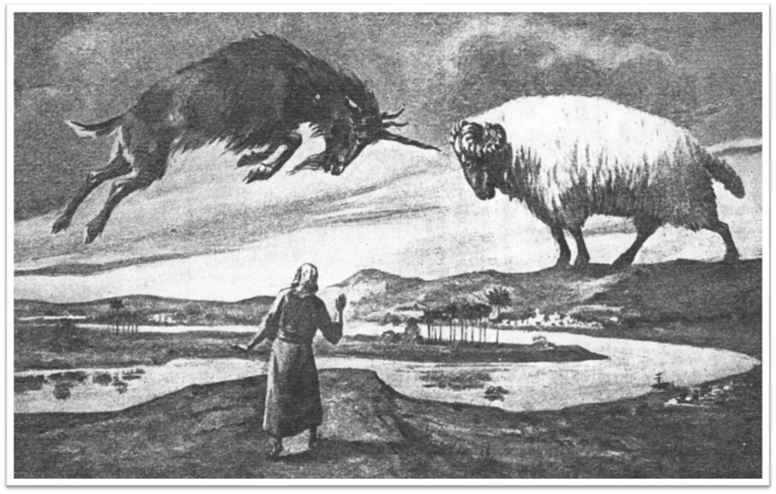

Slide 19
Chapter 8 Outline
The Historical Setting (1)
The Vision (2-14)
The Vision’s Interpretation (15-26)
The Personal Impact on Daniel (27)

Slide 20
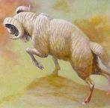
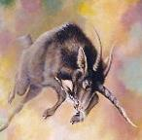

OUTLINE OF THE VISION
2 Horned Ram: Media-Persia (v.2-4)
1 Horned Goat: Greece (v.5-8)
The Boastful Little Horn: Antiochus Epiphanes (v.9-14)

Slide 21
OUTLINE OF THE VISION
2 Horned Ram: Media-Persia (v.2-4)
1 Horned Goat: Greece (v.5-8)
The Boastful Little Horn: Antiochus Epiphanes (v.9-14)

Slide 22
OUTLINE OF THE VISION
2 Horned Ram: Media-Persia (v.2-4)
1 Horned Goat: Greece (v.5-8)
The Boastful Little Horn: Antiochus Epiphanes (v.9-14)

Slide 24
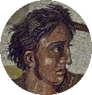
THE 1 HORNED GOAT V. 5-8 (cont’d)
(v. 8)
  The goat’s changing horns
    He magnifies himself (v.8a)
    Alexander’s death (v.8b)
    Alexander’s empire is divided among his four generals (v.8c)

Slide 25
Four Generals
Daniel 7:6; 8:8,22
Cassander Macedonia | Ptolemy Egypt
Lysimachus Thrace & Asia Minor | Seleucus Syria (including Israel)

Slide 26
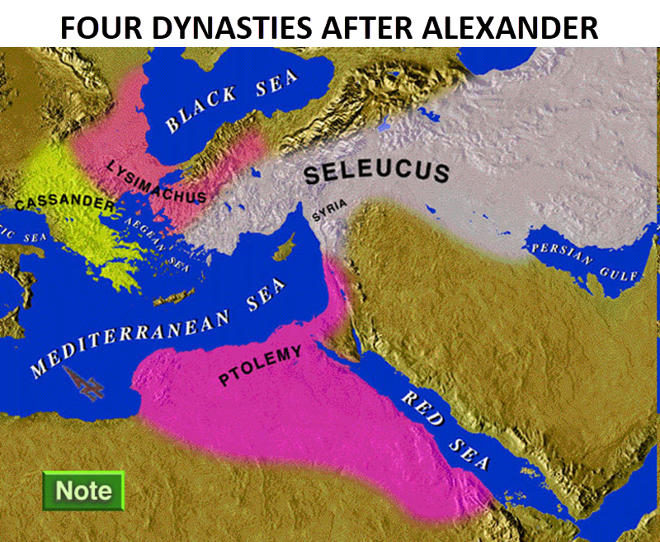

Slide 27
OUTLINE OF THE VISION
2 Horned Ram: Media-Persia (v.2-4)
1 Horned Goat: Greece (v.5-8)
The Boastful Little Horn: Antiochus Epiphanes (v.9-14)

Slide 28


Slide 29

THE BOASTFUL LITTLE HORN V. 9-14
V. 10
  Antiochus’ persecution of Israel
  Goal is Hellenization
  He viewed the Jews as an obstacle to his goal
  He outlawed the Hebrew scriptures and executed families who observed the Sabbath and circumcision

Slide 30
THE BOASTFUL LITTLE HORN V. 9-14
V. 11
  Made himself equal with God
  Stopped Jewish sacrifices
  Desecrated the temple (167 BC)
    Set up an image of Zeus
    Sacrificed a pig on the altar

Slide 31
THE BOASTFUL LITTLE HORN V. 9-14
V. 12
  Persecuted Israel
  Stopped the sacrifices
  Disregarded the truth
  Prospered

Slide 32

THE BOASTFUL LITTLE HORN V. 9-14
V. 13
  How long will temple desecration last?
V. 14
  2300 evenings and mornings

Slide 33

THE BOASTFUL LITTLE HORN V. 9-14
171 BC-Dec. 25th 165 BC
= 2300 mornings and evenings
Daniel predicted these events roughly 400 years in advance
Argument over the date of Daniel

Slide 34

HANUKKAH
The Maccabean revolt
December 25th 165 BC : the temple is liberated and rededicated
1 & 2 Maccabees
The miracle of the lamp oil
Hanukkah “Feast of Dedication” (festival of lights).
Christmas / Jewish Holiday
John 10:22-24

Slide 35


Slide 36
Chapter 8 Outline
The Historical Setting (1)
The Vision (2-14)
The Vision’s Interpretation (15-26)
The Personal Impact on Daniel (27)

Slide 37
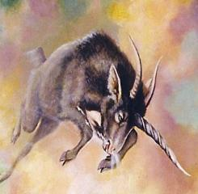

INTERPRETATION OF THE VISION
Daniel seeks an interpretation (v.15-19)
Interpretation of the vision (v.20-25)
Time frame of the vision (v.26)

Slide 38
INTERPRETATION OF THE VISION
Daniel seeks an interpretation (v.15-19)
Interpretation of the vision (v.20-25)
Time frame of the vision (v.26)

Slide 39
INTERPRETATION V.15-25
No guess work is needed
V. 15
  Daniel seeks an interpretation
V. 16
  A voice tells Gabriel to interpret the vision
V. 17
  “Time of the end” means the end of the third kingdom (Greece) not the end of the age
V. 18-19
  “Time of the end” is the end of Antiochus’ desecration

Slide 40
INTERPRETATION V.15-25
No guess work is needed
V. 15
  Daniel seeks an interpretation
V. 16
  A voice tells Gabriel to interpret the vision
V. 17
  “Time of the end” means the end of the third kingdom (Greece) not the end of the age
V. 18-19
  “Time of the end” is the end of Antiochus’ desecration

Slide 41

Matthew 24:15
“Therefore when you see the abomination of desolation which was spoken of through Daniel the prophet, standing in the holy place (let the reader understand).”

Slide 42
INTERPRETATION V.15-25
No guess work is needed
V. 15
  Daniel seeks an interpretation
V. 16
  A voice tells Gabriel to interpret the vision
V. 17
  “Time of the end” means the end of the third kingdom (Greece) not the end of the age
V. 18-19
  “Time of the end” is the end of Antiochus’ desecration

Slide 43
INTERPRETATION V.15-25
No guess work is needed
V. 15
  Daniel seeks an interpretation
V. 16
  A voice tells Gabriel to interpret the vision
V. 17
  “Time of the end” means the end of the third kingdom (Greece) not the end of the age
V. 18-19
  “Time of the end” is the end of Antiochus’ desecration

Slide 44
INTERPRETATION V.15-25
No guess work is needed
V. 15
  Daniel seeks an interpretation
V. 16
  A voice tells Gabriel to interpret the vision
V. 17
  “Time of the end” means the end of the third kingdom (Greece) not the end of the age
V. 18-19
  “Time of the end” is the end of Antiochus’ desecration

Slide 45
INTERPRETATION OF THE VISION
Daniel seeks an interpretation (v.15-19)
Interpretation of the vision (v.20-25)
Time frame of the vision (v.26)

Slide 46
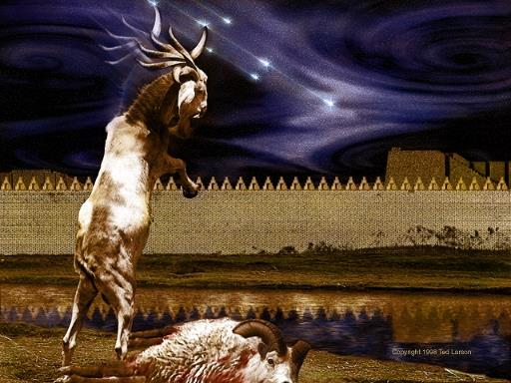
INTERPRETATION V.15-25
V. 20
Ram = Media-Persia

Slide 47
Daniel 8:20-21 (NASB)
“The ram which you saw with the two horns represents the kings of Media and Persia. ²¹ The shaggy goat represents the kingdom of Greece, and the large horn that is between his eyes is the first king.”

Slide 48
INTERPRETATION V.15-25
V. 21
  Goat = Greece
  Horn between eyes = Alexander the Great
V. 22
  “Broken horn” = the demise of Alexander the Great
  “Four Horns” = four generals
  The divided kingdom was not as strong as Alexander’s kingdom
V. 23-35
  The Activities of Antiochus Epiphanes
  Foreshadowing of the antichrist

Slide 49
INTERPRETATION V.15-25
V. 21
  Goat = Greece
  Horn between eyes = Alexander the Great
V. 22
  “Broken horn” = the demise of Alexander the Great
  “Four Horns” = four generals
  The divided kingdom was not as strong as Alexander’s kingdom
V. 23-35
  The Activities of Antiochus Epiphanes
  Foreshadowing of the antichrist

Slide 51
INTERPRETATION V.15-25
V. 21
  Goat = Greece
  Horn between eyes = Alexander the Great
V. 22
  “Broken horn” = the demise of Alexander the Great
  “Four Horns” = four generals
  The divided kingdom was not as strong as Alexander’s kingdom
V. 23-35
  The Activities of Antiochus Epiphanes
  Foreshadowing of the antichrist

Slide 52
Four Generals
Daniel 7:6; 8:8,22
Cassander Macedonia | Ptolemy Egypt
Lysimachus Thrace & Asia Minor | Seleucus Syria (including Israel)

Slide 54
INTERPRETATION V.15-25
V. 21
  Goat = Greece
  Horn between eyes = Alexander the Great
V. 22
  “Broken horn” = the demise of Alexander the Great
  “Four Horns” = four generals
  The divided kingdom was not as strong as Alexander’s kingdom
V. 23-35
  The Activities of Antiochus Epiphanes
  Foreshadowing of the antichrist

Slide 56


Slide 57
Antichrist’s Satanic Miracles 2 Thessalonians 2:9
Miracle | Greek | Christ’s Ministry
Signs | Dynamis | Matt. 11:20
Powers | Semēion | John 20:30
Wonders | Teras | Acts 2:22

Slide 58
INTERPRETATION OF THE VISION
Daniel seeks an interpretation (v.15-19)
Interpretation of the vision (v.20-25)
Time frame of the vision (v.26)

Slide 59
TIME FRAME V.26
V. 26
  True
  Daniel is told to keep it a secret
  The vision will not be fulfilled for 386 years
  Daniel 12:4, 9

Slide 60
Daniel 12:4, 9 (NASB)
⁴“But as for you, Daniel, conceal these words and seal up the book until the end of time; many will go back and forth, and knowledge will increase...⁹ Go your way, Daniel, for these words are concealed and sealed up until the end time.”

Slide 61

Amos 8:12 (NASB)
“People will stagger from sea to sea And from the north even to the east; They will go to and fro to seek the word of the Lord, But they will not find it.”

Slide 62
Chapter 8 Outline
The Historical Setting (1)
The Vision (2-14)
The Vision’s Interpretation (15-26)
The Personal Impact on Daniel (27)

Slide 63
THE EFFECT ON DANIEL V. 27
Daniel is exhausted
Daniel is astounded
Daniel wants more understanding
  Daniel 12:8-9

Slide 64
Conclusion

Slide 65
Chapter 8 Outline
The Historical Setting (1)
The Vision (2-14)
The Vision’s Interpretation (15-26)
The Personal Impact on Daniel (27)

