Slide 1
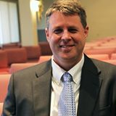
The Protestant Reformation: The Good, The Bad, and The Ugly Session 7
Andy Woods, Th.M.., JD., PhD.
Sr. Pastor, Sugar Land Bible Church
President Chafer Theological Seminary

Slide 2
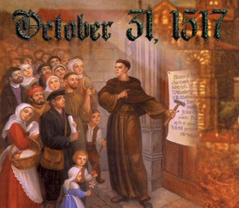
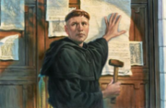
Introduction
Oct 31, 1517
500 years
Far reaching impact
Partial restoration
Restoration of a hermeneutic
Selectively applied
Subsequent generations applied consistently
Preview

Slide 3
Overview
The early church
The Alexandrian eclipse
The Dark Ages
The contribution of the Protestant Reformers
The Reformers’ incomplete revolution
Reformed Theology today
Dispensationalism & the completed revolution
Looking back 500 years later
Notes:
Outline

Slide 4
Overview
THE EARLY CHURCH
The Alexandrian eclipse
The Dark Ages
The contribution of the Protestant Reformers
The Reformers’ incomplete revolution
Reformed Theology today
Dispensationalism & the completed revolution
Looking back 500 years later
Notes:
Outline

Slide 5
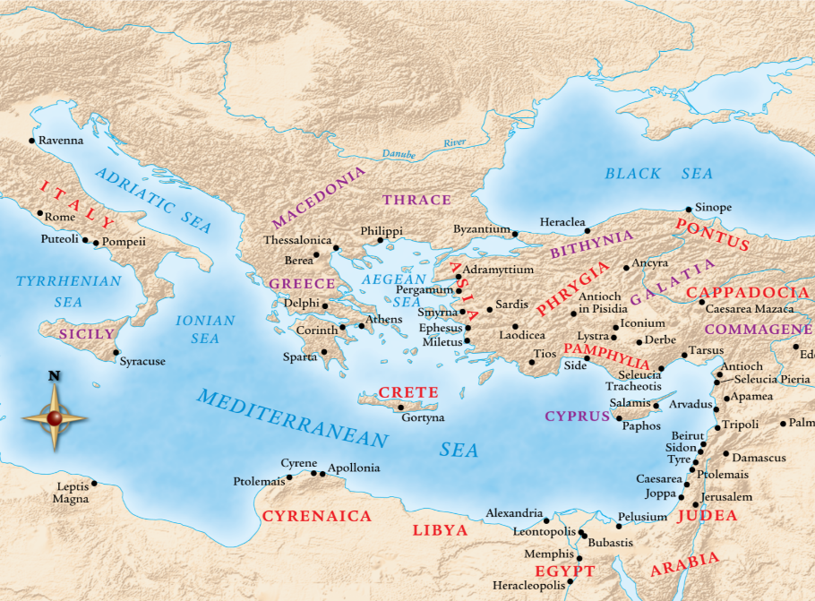

Slide 6
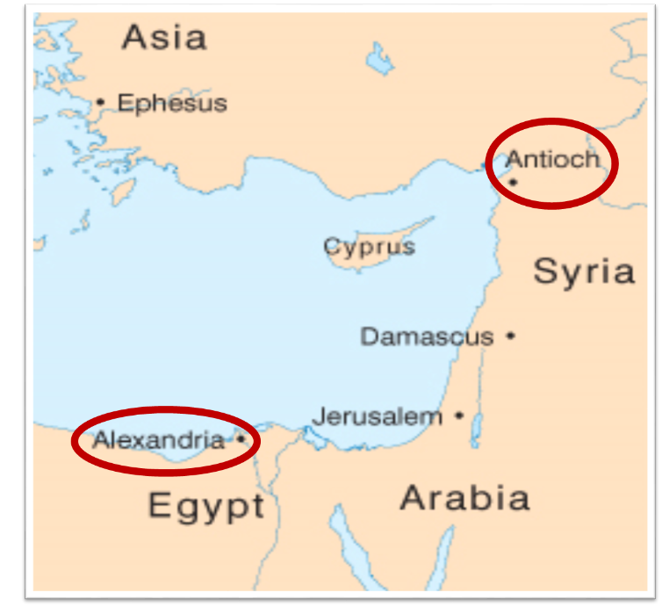

Slide 7
Overview
The early church
THE ALEXANDRIAN ECLIPSE
The Dark Ages
The contribution of the Protestant Reformers
The Reformers’ incomplete revolution
Reformed Theology today
Dispensationalism & the completed revolution
Looking back 500 years later
Notes:
Outline

Slide 10
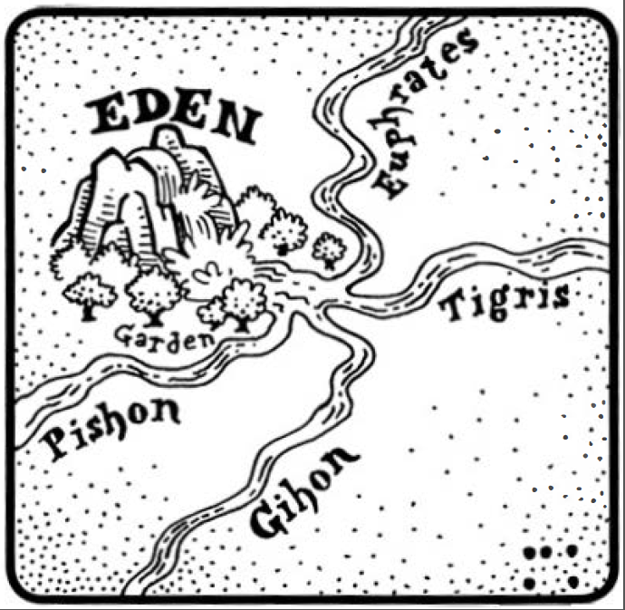
Dangers of Allegorization – Philo

Slide 11
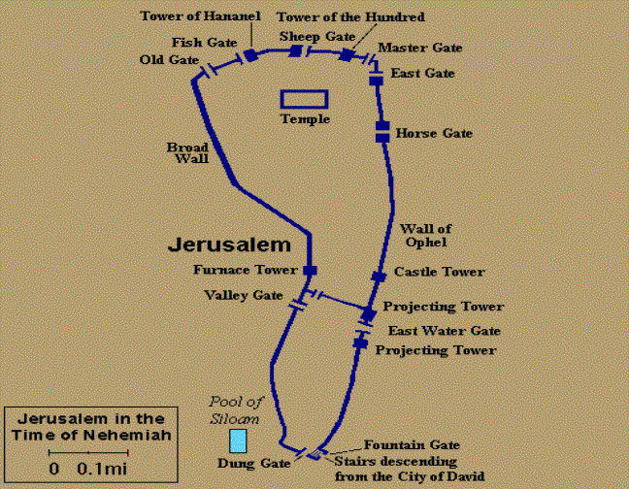
Dangers of Allegorization
Gates of Nehemiah 3

Slide 12
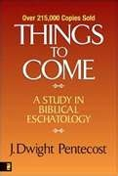
Dangers of Allegorization
Text is not being interpreted
Authority is transferred from text to interpreter
There is no way to test the interpreter
No mechanism for controlling the interpreter’s imagination
Pentecost, Things to Come, pps. 4-5

Slide 13
What Caused the Shift Into Allegorism?
Need for immediate relevance
Incorporation of human philosophy into interpretation
Gnostic dualism (Gen. 1:31; 1 John 2:22; 4:2-3; Acts 17:32; 1 Cor. 15:12)
Decline of the church's Jewish population
Constantine’s Edict of Milan (A.D. 313)
AD 70 and Hadrian’s (A.D. 117–138)“Palestine”
Notes:
Outline

Slide 14
Overview
The early church
The Alexandrian eclipse
THE DARK AGES
The contribution of the Protestant Reformers
The Reformers’ incomplete revolution
Reformed Theology today
Dispensationalism & the completed revolution
Looking back 500 years later
Notes:
Outline

Slide 15
III. The Dark Ages (or the Middle Ages)
Lasted from the 4th to the 16th centuries
Obsolescence of prophetic studies
Domination of Augustinian Amillennialism
Only one church: Roman Catholicism
The Bible is removed from the people
Allegorization
Illiteracy
Mass read in Latin
Sale of indulgences
Anti-Semitism
Church in need of rescue
Notes:
Outline

Slide 16
Overview
The early church
The Alexandrian eclipse
The Dark Ages
THE CONTRIBUTION OF THE PROTESTANT REFORMERS
The Reformers’ incomplete revolution
Reformed Theology today
Dispensationalism & the completed revolution
Looking back 500 years later
Notes:
Outline

Slide 17
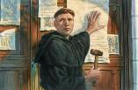
IV. Contribution of the Protestant Reformers
Preparation of the Reformers
Emphasis on literal interpretation
Denunciation of allegorization
Rejection of church tradition as a guide
Priesthood of all believers
Bible translations
Literacy
Basis for the American system of governance
Five solas
Rejection of celibacy of the priesthood
The ultimate sacrifice
Rejoice
Notes:
Outline

Slide 18
IV. Contribution of the Protestant Reformers
Preparation of the Reformers
Emphasis on literal interpretation
Denunciation of allegorization
Rejection of church tradition as a guide
Priesthood of all believers
Bible translations
Literacy
Basis for the American system of governance
Five solas
Rejection of celibacy of the priesthood
The ultimate sacrifice
Rejoice
Notes:
Outline

Slide 19
IV. Contribution of the Protestant Reformers
Preparation of the Reformers
Emphasis on literal interpretation
Denunciation of allegorization
Rejection of church tradition as a guide
Priesthood of all believers
Bible translations
Literacy
Basis for the American system of governance
Five solas
Rejection of celibacy of the priesthood
The ultimate sacrifice
Rejoice
Notes:
Outline

Slide 20
IV. Contribution of the Protestant Reformers
Preparation of the Reformers
Emphasis on literal interpretation
Denunciation of allegorization
Rejection of church tradition as a guide
Priesthood of all believers
Bible translations
Literacy
Basis for the American system of governance
Five solas
Rejection of celibacy of the priesthood
The ultimate sacrifice
Rejoice
Notes:
Outline

Slide 23
IV. Contribution of the Protestant Reformers
Preparation of the Reformers
Emphasis on literal interpretation
Denunciation of allegorization
Rejection of church tradition as a guide
Priesthood of all believers
Bible translations
Literacy
Basis for the American system of governance
Five solas
Rejection of celibacy of the priesthood
The ultimate sacrifice
Rejoice
Notes:
Outline

Slide 24
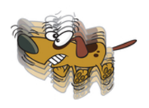
Mark 7:13 (NASB)
“thus invalidating the word of God by your tradition which you have handed down; and you do many things such as that.”

Slide 25
IV. Contribution of the Protestant Reformers
Preparation of the Reformers
Emphasis on literal interpretation
Denunciation of allegorization
Rejection of church tradition as a guide
Priesthood of all believers
Bible translations
Literacy
Basis for the American system of governance
Five solas
Rejection of celibacy of the priesthood
The ultimate sacrifice
Rejoice
Notes:
Outline

Slide 26
IV. Contribution of the Protestant Reformers
Preparation of the Reformers
Emphasis on literal interpretation
Denunciation of allegorization
Rejection of church tradition as a guide
Priesthood of all believers
Bible translations
Literacy
Basis for the American system of governance
Five solas
Rejection of celibacy of the priesthood
The ultimate sacrifice
Rejoice
Notes:
Outline

Slide 27
IV. Contribution of the Protestant Reformers
Preparation of the Reformers
Emphasis on literal interpretation
Denunciation of allegorization
Rejection of church tradition as a guide
Priesthood of all believers
Bible translations
Literacy
Basis for the American system of governance
Five solas
Rejection of celibacy of the priesthood
The ultimate sacrifice
Rejoice
Notes:
Outline

Slide 28
IV. Contribution of the Protestant Reformers
Preparation of the Reformers
Emphasis on literal interpretation
Denunciation of allegorization
Rejection of church tradition as a guide
Priesthood of all believers
Bible translations
Literacy
Basis for the American system of governance
Five solas
Rejection of celibacy of the priesthood
The ultimate sacrifice
Rejoice
Notes:
Outline

Slide 29
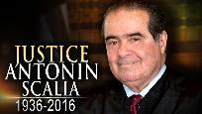
“Every tin horn dictator in the world today, every president for life, has a Bill of Rights,”...“That’s not what makes us free; if it did, you would rather live in Zimbabwe. But you wouldn’t want to live in most countries in the world that have a Bill of Rights. What has made us free is our Constitution. Think of the word ‘constitution;’ it means structure.” “That’s why America’s framers debated not the Bill of Rights during the Constitutional Convention of 1787 in Philadelphia,” he said, “but rather the structure of the federal government.” “The genius of the American constitutional system is the dispersal of power,” he said. “Once power is centralized in one person, or one part [of government], a Bill of Rights is just words on paper.”...“A constitution is about setting structure; it is not about writing the preferences of special interest groups,” he said.”
Kevin Mooney, “Supreme Court Justice Scalia: Constitution, Not Bill of Rights, Makes Us Free,” online: http://dailysignal.com/2015/05/11/supreme-court-justice-scalia-constitution-not-bill-of-rights-makes-us-free/, May 11 2015, accessed 20 January 2016.

Slide 31
Martin Luther
The Bondage of the Will

Slide 32
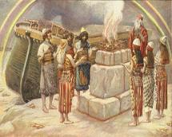
Genesis 8:21
The Lord smelled the soothing aroma; and the Lord said to Himself, “I will never again curse the ground on account of man, for the intent of man’s heart is evil from his youth; and I will never again destroy every living thing, as I have done.[emphasis mine].

Slide 33
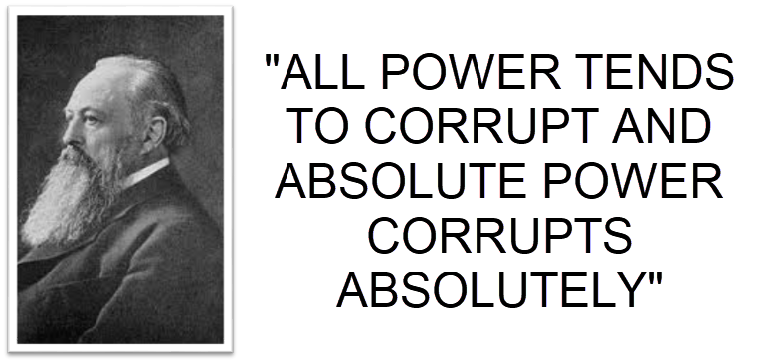
Lord Acton

Slide 34
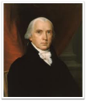
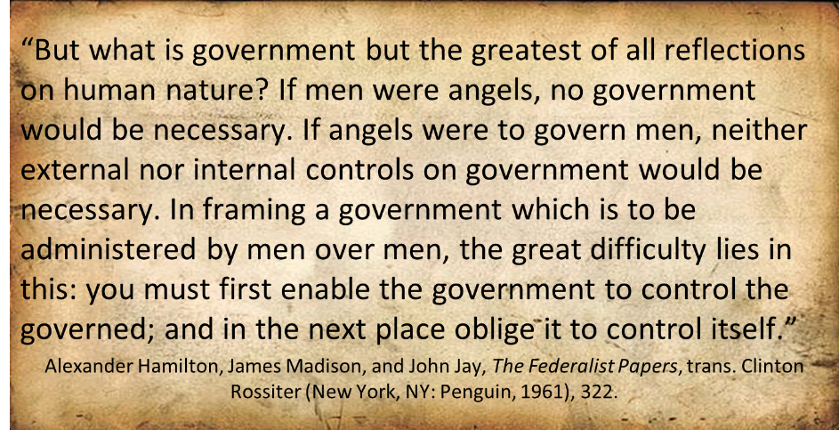
Federalist # 51

Slide 35
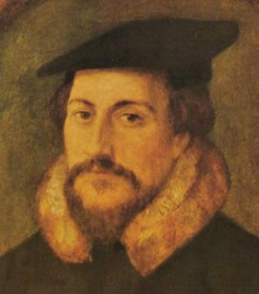
John Calvin

Slide 36
IV. Contribution of the Protestant Reformers
Preparation of the Reformers
Emphasis on literal interpretation
Denunciation of allegorization
Rejection of church tradition as a guide
Priesthood of all believers
Bible translations
Literacy
Basis for the American system of governance
Five solas
Rejection of celibacy of the priesthood
The ultimate sacrifice
Rejoice
Notes:
Outline

Slide 37
Number | Latin | Meaning
1. | Sola Scriptura | Scripture Alone
2. | Solus Christus | Christ Alone
3. | Sola Fide | Faith Alone
4. | Sola Graetia | Grace Alone
5. | Soli Deo Gloria | To the Glory of God Alone

Slide 38
Number | Latin | Meaning
1. | Sola Scriptura | Scripture Alone
2. | Solus Christus | Christ Alone
3. | Sola Fide | Faith Alone
4. | Sola Graetia | Grace Alone
5. | Soli Deo Gloria | To the Glory of God Alone

Slide 39
Emergent Church & Biblical Authority
“Anglicans have demonstrated this both/and beautifully in relation to Scripture. Scripture is always a factor in Anglican thinking. In Anglicans’ best moments, it is their primary factor, but it is never…the only factor. Rather Scripture is always in dialogue with tradition, reason, and experience. None of them sola can be the ultimate source of authority…” (Italics added).
Brian McLaren, A Generous Orthodoxy, 210.

Slide 40
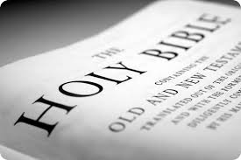
Biblical Authority
Tradition? (Mark 7:13; Col 2:8)
Reason? (Prov 3:5; 14:12; Isa 55:8-9)
Experience? (2 Thess 2:9)

Slide 41
Biblical Authority
Tradition? (Mark 7:13; Col 2:8)
Reason? (Prov 3:5; 14:12; Isa 55:8-9)
Experience? (2 Thess 2:9)

Slide 42
2 Thessalonians 2:15 (NASB)
“So then, brethren, stand firm and hold to the traditions which you were taught, whether by word of mouth or by letter from us..”

Slide 43
Mark 7:13 (NASB)
“thus invalidating the word of God by your tradition which you have handed down; and you do many things such as that.”

Slide 44
Colossians 2:8 (NASB)
“See to it that no one takes you captive through philosophy and empty deception, according to the tradition of men, according to the elementary principles of the world, rather than according to Christ.”

Slide 45
Biblical Authority
Tradition? (Mark 7:13; Col 2:8)
Reason? (Prov 3:5; 14:12; Isa 55:8-9)
Experience? (2 Thess 2:9)

Slide 46
Biblical Authority
Tradition? (Mark 7:13; Col 2:8)
Reason? (Prov 3:5; 14:12; Isa 55:8-9)
Experience? (2 Thess 2:9)

Slide 47
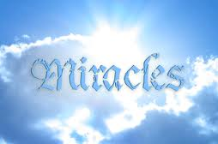
Satanic / Demonic Miracles
Exod 7–8
Deut 13:1-3
Matt 7:21-23; 24:24
Acts 8:9; 16:16
Gal 1:6-9
2 Thess 2:9
Rev 13:3, 13; 16:13-14

Slide 48
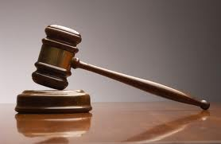
Biblical Authority
Where in Scripture are we told to dialogue with all four?
Magisterial vs. ministerial

Slide 49
Number | Latin | Meaning
1. | Sola Scriptura | Scripture Alone
2. | Solus Christus | Christ Alone
3. | Sola Fide | Faith Alone
4. | Sola Graetia | Grace Alone
5. | Soli Deo Gloria | To the Glory of God Alone

Slide 50
John 14:6 (NASB)
“Jesus said to him, “I am the way, and the truth, and the life; no one comes to the Father but through Me.”

Slide 51
Acts 4:12 (NASB)
“And there is salvation in no one else; for there is no other name under heaven that has been given among men by which we must be saved.”

Slide 52
1 Timothy 2:5 (NASB)
“For there is one God, and one mediator also between God and men, the man Christ Jesus.”

Slide 53
Matthew 13:55 (NASB)
“Is not this the carpenter’s son? Is not His mother called Mary, and His brothers, James and Joseph and Simon and Judas?”

Slide 54
Luke 1:46-47 (NASB)
“And Mary said: ‘My soul exalts the Lord, And my spirit has rejoiced in God my Savior.’”

Slide 55
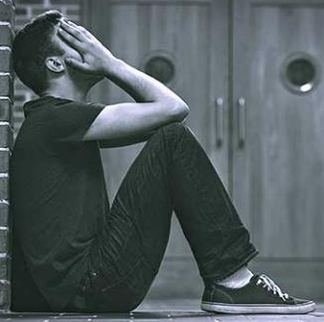
Romans 3:23 (NASB)
“ for all have sinned and fall short of the glory of God.”

Slide 56
Number | Latin | Meaning
1. | Sola Scriptura | Scripture Alone
2. | Solus Christus | Christ Alone
3. | Sola Fide | Faith Alone
4. | Sola Graetia | Grace Alone
5. | Soli Deo Gloria | To the Glory of God Alone

Slide 57
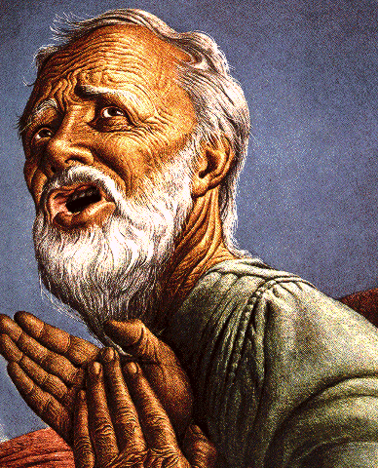
Belief – God’s One Condition for Justification
Gen 15:6
Then he believed in the LORD; and He reckoned it to him as righteousness.
John 3:16
For God so loved the world, that He gave His only begotten Son, that whoever believes in Him shall not perish, but have eternal life.
Acts 16:30-31
"Sirs, what must I do to be saved?" They said, "Believe in the Lord Jesus, and you will be saved..."

Slide 58
Ephesians 2:8-9 (NASB)
“For by grace you have been saved through faith; and that not of yourselves, it is the gift of God; ⁹ not as a result of works, so that no one may boast.”

Slide 59
Hebrews 11:6 (NASB)
“And without faith it is impossible to please Him, for he who comes to God must believe that He is and that He is a rewarder of those who seek Him.”

Slide 60
Number | Latin | Meaning
1. | Sola Scriptura | Scripture Alone
2. | Solus Christus | Christ Alone
3. | Sola Fide | Faith Alone
4. | Sola Graetia | Grace Alone
5. | Soli Deo Gloria | To the Glory of God Alone

Slide 61
Ephesians 2:8-9 (NASB)
“For by grace you have been saved through faith; and hat not of yourselves, it is the gift of God; ⁹ not as a result of works, so that no one may boast.”

Slide 62
Number | Latin | Meaning
1. | Sola Scriptura | Scripture Alone
2. | Solus Christus | Christ Alone
3. | Sola Fide | Faith Alone
4. | Sola Graetia | Grace Alone
5. | Soli Deo Gloria | To the Glory of God Alone

Slide 63
Ephesians 2:8-9 (NASB)
“For by grace you have been saved through faith; and that not of yourselves, it is the gift of God; ⁹ not as a result of works, so that no one may boast.”

Slide 64
Romans 3:27-28 (NASB)
“Where then is boasting? It is excluded. By what kind of law? Of works? No, but by a law of faith. ²⁸ For we maintain that a man is justified by faith apart from works of the Law.”

Slide 65
IV. Contribution of the Protestant Reformers
Preparation of the Reformers
Emphasis on literal interpretation
Denunciation of allegorization
Rejection of church tradition as a guide
Priesthood of all believers
Bible translations
Literacy
Basis for the American system of governance
Five solas
Rejection of celibacy of the priesthood
The ultimate sacrifice
Rejoice
Notes:
Outline

Slide 66
Matthew 16:18 (NASB)
“I also say to you that you are Peter, and upon this rock I will build My church; and the gates of Hades will not overpower it.”

Slide 67
Matthew 8:14 (NASB)
“When Jesus came into Peter’s home, He saw his mother-in-law lying sick in bed with a fever.”

Slide 68
1 Corinthians 9:5 (NASB)
“Do we not have a right to take along a believing wife, even as the rest of the apostles and the brothers of the Lord and Cephas?”

Slide 69
IV. Contribution of the Protestant Reformers
Preparation of the Reformers
Emphasis on literal interpretation
Denunciation of allegorization
Rejection of church tradition as a guide
Priesthood of all believers
Bible translations
Literacy
Basis for the American system of governance
Five solas
Rejection of celibacy of the priesthood
The ultimate sacrifice
Rejoice
Notes:
Outline

Slide 70
IV. Contribution of the Protestant Reformers
Preparation of the Reformers
Emphasis on literal interpretation
Denunciation of allegorization
Rejection of church tradition as a guide
Priesthood of all believers
Bible translations
Literacy
Basis for the American system of governance
Five solas
Rejection of celibacy of the priesthood
The ultimate sacrifice
Rejoice
Notes:
Outline

Slide 71
CONCLUSION

Slide 72
IV. Contribution of the Protestant Reformers
Preparation of the Reformers
Emphasis on literal interpretation
Denunciation of allegorization
Rejection of church tradition as a guide
Priesthood of all believers
Bible translations
Literacy
Basis for the American system of governance
Five solas
Rejection of celibacy of the priesthood
The ultimate sacrifice
Rejoice
Notes:
Outline

Slide 73
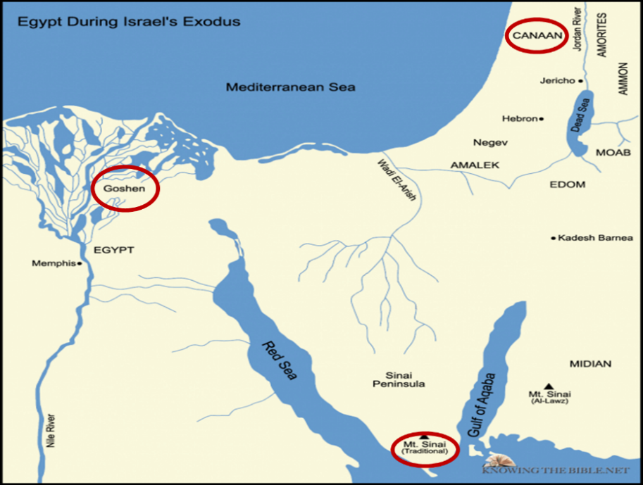

Slide 74
Numbers 21:9 (NASB)
“And Moses made a bronze serpent and set it on the standard; and it came about, that if a serpent bit any man, when he looked to the bronze serpent, he lived.”

Slide 75
John 3:14-15 (NASB)
“As Moses lifted up the serpent in the wilderness, even so must the Son of Man be lifted up; ¹⁵ so that whoever believes will in Him have eternal life.”

Slide 76
2 Kings 18:4 (NASB)
“He removed the high places and broke down the sacred pillars and cut down the Asherah. He also broke in pieces the bronze serpent that Moses had made, for until those days the sons of Israel burned incense to it; and it was called Nehushtan.”

Slide 77
Joshua 1:2 (NASB)
“Moses My servant is dead; now therefore arise, cross this Jordan, you and all this people, to the land which I am giving to them, to the sons of Israel.”

Slide 78
Matthew 16:13-23 (NASB)
¹⁶ Now when Jesus came into the district of Caesarea Philippi, He was asking His disciples, “Who do people say that the Son of Man is?”…¹⁶ Simon Peter answered, “You are the Christ, the Son of the living God.” ¹⁷ And Jesus said to him, “Blessed are you, Simon Barjona, because flesh and blood did not reveal this to you, but My Father who is in heaven. ¹⁸ I also say to you that you are Peter, and upon this rock I will build My church; and the gates of Hades will not overpower it. ¹⁹ I will give you the keys of the kingdom of heaven; and whatever you bind on earth shall have been bound in heaven, and whatever you loose on earth shall have been loosed in heaven.”

Slide 79
Matthew 16:13-23 (NASB)
²⁰ Then He warned the disciples that they should tell no one that He was the Christ.²¹ From that time Jesus began to show His disciples that He must go to Jerusalem, and suffer many things from the elders and chief priests and scribes, and be killed, and be raised up on the third day. ²² Peter took Him aside and began to rebuke Him, saying, “God forbid it, Lord! This shall never happen to You.” ²³ But He turned and said to Peter, “Get behind Me, Satan! You are a stumbling block to Me; for you are not setting your mind on God’s interests, but man’s.

Slide 80
NEXT WEEK
The early church
The Alexandrian eclipse
The Dark Ages
The Contribution of the Protestant Reformers
THE REFORMERS INCOMPLETE REVOLUTION
Reformed Theology today
Dispensationalism & the completed revolution
Looking back 500 years later
Notes:
Outline

