Slide 1
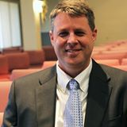
The Protestant Reformation: The Good, The Bad, and The Ugly Session 8
Andy Woods, Th.M.., JD., PhD.
Sr. Pastor, Sugar Land Bible Church
President Chafer Theological Seminary

Slide 2
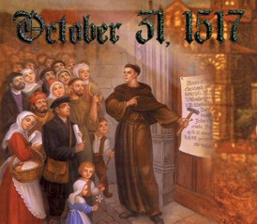
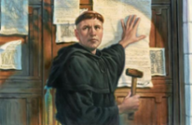
Introduction
Oct 31, 1517
500 years
Far reaching impact
Partial restoration
Restoration of a hermeneutic
Selectively applied
Subsequent generations applied consistently
Preview

Slide 3
Overview
The early church
The Alexandrian eclipse
The Dark Ages
The contribution of the Protestant Reformers
The Reformers’ incomplete revolution
Reformed Theology today
Dispensationalism & the completed revolution
Looking back 500 years later
Notes:
Outline

Slide 4
Overview
THE EARLY CHURCH
The Alexandrian eclipse
The Dark Ages
The contribution of the Protestant Reformers
The Reformers’ incomplete revolution
Reformed Theology today
Dispensationalism & the completed revolution
Looking back 500 years later
Notes:
Outline

Slide 5
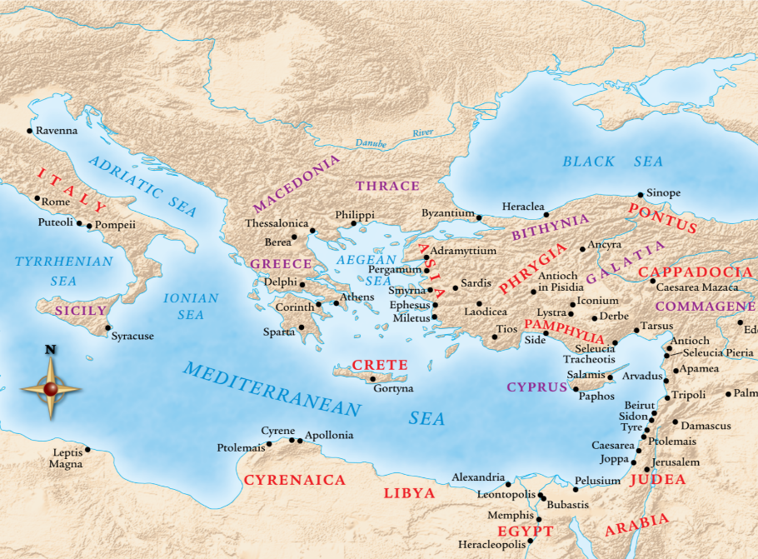

Slide 6
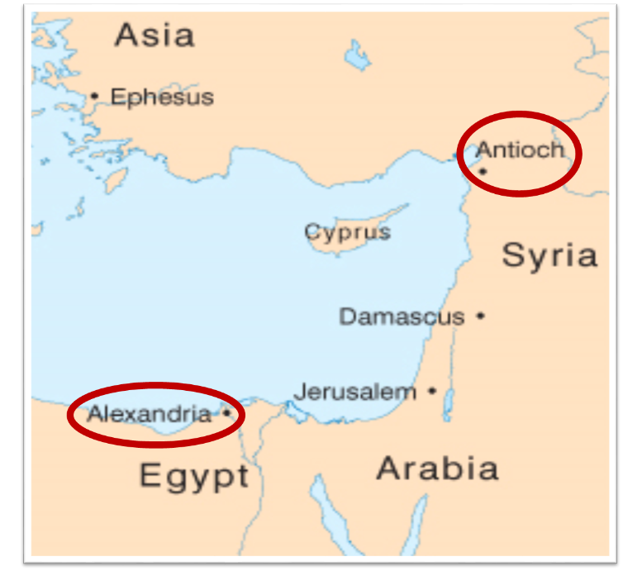

Slide 7
Overview
The early church
THE ALEXANDRIAN ECLIPSE
The Dark Ages
The contribution of the Protestant Reformers
The Reformers’ incomplete revolution
Reformed Theology today
Dispensationalism & the completed revolution
Looking back 500 years later
Notes:
Outline

Slide 10
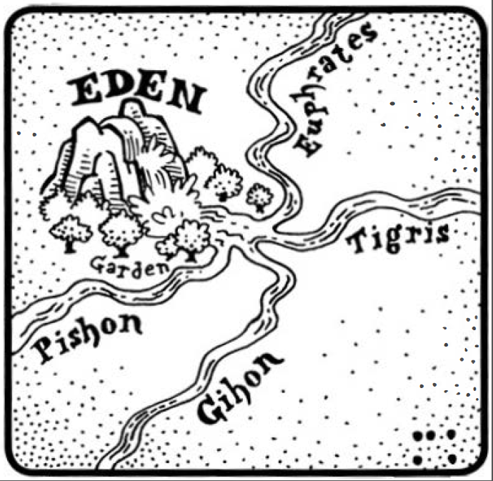
Dangers of Allegorization – Philo

Slide 11
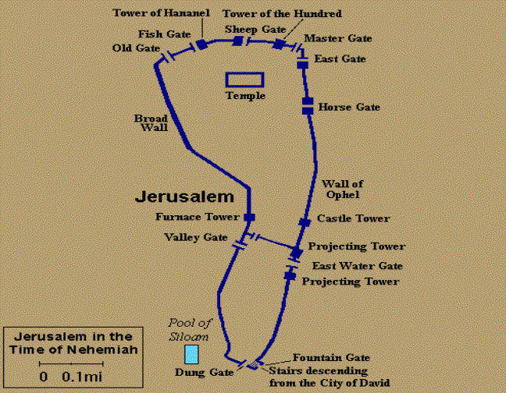
Dangers of Allegorization
Gates of Nehemiah 3

Slide 12
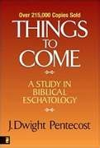
Dangers of Allegorization
Text is not being interpreted
Authority is transferred from text to interpreter
There is no way to test the interpreter
No mechanism for controlling the interpreter’s imagination
Pentecost, Things to Come, pps. 4-5

Slide 13
What Caused the Shift Into Allegorism?
Need for immediate relevance
Incorporation of human philosophy into interpretation
Gnostic dualism (Gen. 1:31; 1 John 2:22; 4:2-3; Acts 17:32; 1 Cor. 15:12)
Decline of the church's Jewish population
Constantine’s Edict of Milan (A.D. 313)
AD 70 and Hadrian’s (A.D. 117–138)“Palestine”
Notes:
Outline

Slide 14
Overview
The early church
The Alexandrian eclipse
THE DARK AGES
The contribution of the Protestant Reformers
The Reformers’ incomplete revolution
Reformed Theology today
Dispensationalism & the completed revolution
Looking back 500 years later
Notes:
Outline

Slide 15
III. The Dark Ages (or the Middle Ages)
Lasted from the 4th to the 16th centuries
Obsolescence of prophetic studies
Domination of Augustinian Amillennialism
Only one church: Roman Catholicism
The Bible is removed from the people
Allegorization
Illiteracy
Mass read in Latin
Sale of indulgences
Anti-Semitism
Church in need of rescue
Notes:
Outline

Slide 16
Overview
The early church
The Alexandrian eclipse
The Dark Ages
THE CONTRIBUTION OF THE PROTESTANT REFORMERS
The Reformers’ incomplete revolution
Reformed Theology today
Dispensationalism & the completed revolution
Looking back 500 years later
Notes:
Outline

Slide 17
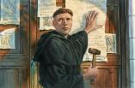
IV. Contribution of the Protestant Reformers
Preparation of the Reformers
Emphasis on literal interpretation
Denunciation of allegorization
Rejection of church tradition as a guide
Priesthood of all believers
Bible translations
Literacy
Basis for the American system of governance
Five solas
Rejection of celibacy of the priesthood
The ultimate sacrifice
Rejoice
Notes:
Outline

Slide 18
IV. Contribution of the Protestant Reformers
Preparation of the Reformers
Emphasis on literal interpretation
Denunciation of allegorization
Rejection of church tradition as a guide
Priesthood of all believers
Bible translations
Literacy
Basis for the American system of governance
Five solas
Rejection of celibacy of the priesthood
The ultimate sacrifice
Rejoice
Notes:
Outline

Slide 19
IV. Contribution of the Protestant Reformers
Preparation of the Reformers
Emphasis on literal interpretation
Denunciation of allegorization
Rejection of church tradition as a guide
Priesthood of all believers
Bible translations
Literacy
Basis for the American system of governance
Five solas
Rejection of celibacy of the priesthood
The ultimate sacrifice
Rejoice
Notes:
Outline

Slide 20
IV. Contribution of the Protestant Reformers
Preparation of the Reformers
Emphasis on literal interpretation
Denunciation of allegorization
Rejection of church tradition as a guide
Priesthood of all believers
Bible translations
Literacy
Basis for the American system of governance
Five solas
Rejection of celibacy of the priesthood
The ultimate sacrifice
Rejoice
Notes:
Outline

Slide 21
IV. Contribution of the Protestant Reformers
Preparation of the Reformers
Emphasis on literal interpretation
Denunciation of allegorization
Rejection of church tradition as a guide
Priesthood of all believers
Bible translations
Literacy
Basis for the American system of governance
Five solas
Rejection of celibacy of the priesthood
The ultimate sacrifice
Rejoice
Notes:
Outline

Slide 22
IV. Contribution of the Protestant Reformers
Preparation of the Reformers
Emphasis on literal interpretation
Denunciation of allegorization
Rejection of church tradition as a guide
Priesthood of all believers
Bible translations
Literacy
Basis for the American system of governance
Five solas
Rejection of celibacy of the priesthood
The ultimate sacrifice
Rejoice
Notes:
Outline

Slide 23
IV. Contribution of the Protestant Reformers
Preparation of the Reformers
Emphasis on literal interpretation
Denunciation of allegorization
Rejection of church tradition as a guide
Priesthood of all believers
Bible translations
Literacy
Basis for the American system of governance
Five solas
Rejection of celibacy of the priesthood
The ultimate sacrifice
Rejoice
Notes:
Outline

Slide 24
IV. Contribution of the Protestant Reformers
Preparation of the Reformers
Emphasis on literal interpretation
Denunciation of allegorization
Rejection of church tradition as a guide
Priesthood of all believers
Bible translations
Literacy
Basis for the American system of governance
Five solas
Rejection of celibacy of the priesthood
The ultimate sacrifice
Rejoice
Notes:
Outline

Slide 25
IV. Contribution of the Protestant Reformers
Preparation of the Reformers
Emphasis on literal interpretation
Denunciation of allegorization
Rejection of church tradition as a guide
Priesthood of all believers
Bible translations
Literacy
Basis for the American system of governance
Five solas
Rejection of celibacy of the priesthood
The ultimate sacrifice
Rejoice
Notes:
Outline

Slide 26
IV. Contribution of the Protestant Reformers
Preparation of the Reformers
Emphasis on literal interpretation
Denunciation of allegorization
Rejection of church tradition as a guide
Priesthood of all believers
Bible translations
Literacy
Basis for the American system of governance
Five solas
Rejection of celibacy of the priesthood
The ultimate sacrifice
Rejoice
Notes:
Outline

Slide 27
Number | Latin | Meaning
1. | Sola Scriptura | Scripture Alone
2. | Solus Christus | Christ Alone
3. | Sola Fide | Faith Alone
4. | Sola Graetia | Grace Alone
5. | Soli Deo Gloria | To the Glory of God Alone

Slide 28
Number | Latin | Meaning
1. | Sola Scriptura | Scripture Alone
2. | Solus Christus | Christ Alone
3. | Sola Fide | Faith Alone
4. | Sola Graetia | Grace Alone
5. | Soli Deo Gloria | To the Glory of God Alone

Slide 29
Number | Latin | Meaning
1. | Sola Scriptura | Scripture Alone
2. | Solus Christus | Christ Alone
3. | Sola Fide | Faith Alone
4. | Sola Graetia | Grace Alone
5. | Soli Deo Gloria | To the Glory of God Alone

Slide 30
Number | Latin | Meaning
1. | Sola Scriptura | Scripture Alone
2. | Solus Christus | Christ Alone
3. | Sola Fide | Faith Alone
4. | Sola Graetia | Grace Alone
5. | Soli Deo Gloria | To the Glory of God Alone

Slide 31
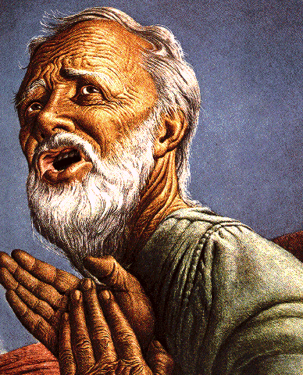
Belief – God’s One Condition for Justification
Gen 15:6
Then he believed in the LORD; and He reckoned it to him as righteousness.
John 3:16
For God so loved the world, that He gave His only begotten Son, that whoever believes in Him shall not perish, but have eternal life.
Acts 16:30-31
"Sirs, what must I do to be saved?" They said, "Believe in the Lord Jesus, and you will be saved..."

Slide 32
Ephesians 2:8-9 (NASB)
“For by grace you have been saved through faith; and that not of yourselves, it is the gift of God; ⁹ not as a result of works, so that no one may boast.”

Slide 33
Hebrews 11:6 (NASB)
“And without faith it is impossible to please Him, for he who comes to God must believe that He is and that He is a rewarder of those who seek Him.”

Slide 34
Number | Latin | Meaning
1. | Sola Scriptura | Scripture Alone
2. | Solus Christus | Christ Alone
3. | Sola Fide | Faith Alone
4. | Sola Graetia | Grace Alone
5. | Soli Deo Gloria | To the Glory of God Alone

Slide 35
Ephesians 2:8-9 (NASB)
“For by grace you have been saved through faith; and hat not of yourselves, it is the gift of God; ⁹ not as a result of works, so that no one may boast.”

Slide 36
Number | Latin | Meaning
1. | Sola Scriptura | Scripture Alone
2. | Solus Christus | Christ Alone
3. | Sola Fide | Faith Alone
4. | Sola Graetia | Grace Alone
5. | Soli Deo Gloria | To the Glory of God Alone

Slide 37
Ephesians 2:8-9 (NASB)
“For by grace you have been saved through faith; and that not of yourselves, it is the gift of God; ⁹ not as a result of works, so that no one may boast.”

Slide 38
Romans 3:27-28 (NASB)
“Where then is boasting? It is excluded. By what kind of law? Of works? No, but by a law of faith. ²⁸ For we maintain that a man is justified by faith apart from works of the Law.”

Slide 39
IV. Contribution of the Protestant Reformers
Preparation of the Reformers
Emphasis on literal interpretation
Denunciation of allegorization
Rejection of church tradition as a guide
Priesthood of all believers
Bible translations
Literacy
Basis for the American system of governance
Five solas
Rejection of celibacy of the priesthood
The ultimate sacrifice
Rejoice
Notes:
Outline

Slide 40
Matthew 16:18 (NASB)
“I also say to you that you are Peter, and upon this rock I will build My church; and the gates of Hades will not overpower it.”

Slide 41
Matthew 16:18 (NASB)
“I also say to you that you are Peter (petros, masculine, little stone), and upon this rock (petra, feminine, large stone) I will build My church; and the gates of Hades will not overpower it.”

Slide 42
Matthew 8:14 (NASB)
“When Jesus came into Peter’s home, He saw his mother-in-law lying sick in bed with a fever.”

Slide 43
1 Corinthians 9:5 (NASB)
“Do we not have a right to take along a believing wife, even as the rest of the apostles and the brothers of the Lord and Cephas?”

Slide 44
IV. Contribution of the Protestant Reformers
Preparation of the Reformers
Emphasis on literal interpretation
Denunciation of allegorization
Rejection of church tradition as a guide
Priesthood of all believers
Bible translations
Literacy
Basis for the American system of governance
Five solas
Rejection of celibacy of the priesthood
The ultimate sacrifice
Rejoice
Notes:
Outline

Slide 45
William Tyndale
(A.D. 1494‒1536)
“In 1535, Tyndale was arrested and jailed in the castle of Vilvoord (Filford) outside Brussels for over a year. In 1536, he was convicted of heresy and executed by strangulation, after which his body was burnt at the stake. His dying prayer was that the King of England's eyes would be opened; this seemed to find its fulfilment just two years later with Henry's authorisation of the Great Bible for the Church of England, which was largely Tyndale's own work. Hence, the Tyndale Bible, as it was known, continued to play a key role in spreading Reformation ideas across the English-speaking world and, eventually, to the British Empire.”
https://en.wikipedia.org/wiki/William_Tyndale
Notes:
Outline

Slide 46
IV. Contribution of the Protestant Reformers
Preparation of the Reformers
Emphasis on literal interpretation
Denunciation of allegorization
Rejection of church tradition as a guide
Priesthood of all believers
Bible translations
Literacy
Basis for the American system of governance
Five solas
Rejection of celibacy of the priesthood
The ultimate sacrifice
Rejoice
Notes:
Outline

Slide 47
CONCLUSION

Slide 48
IV. Contribution of the Protestant Reformers
Preparation of the Reformers
Emphasis on literal interpretation
Denunciation of allegorization
Rejection of church tradition as a guide
Priesthood of all believers
Bible translations
Literacy
Basis for the American system of governance
Five solas
Rejection of celibacy of the priesthood
The ultimate sacrifice
Rejoice
Notes:
Outline

Slide 49
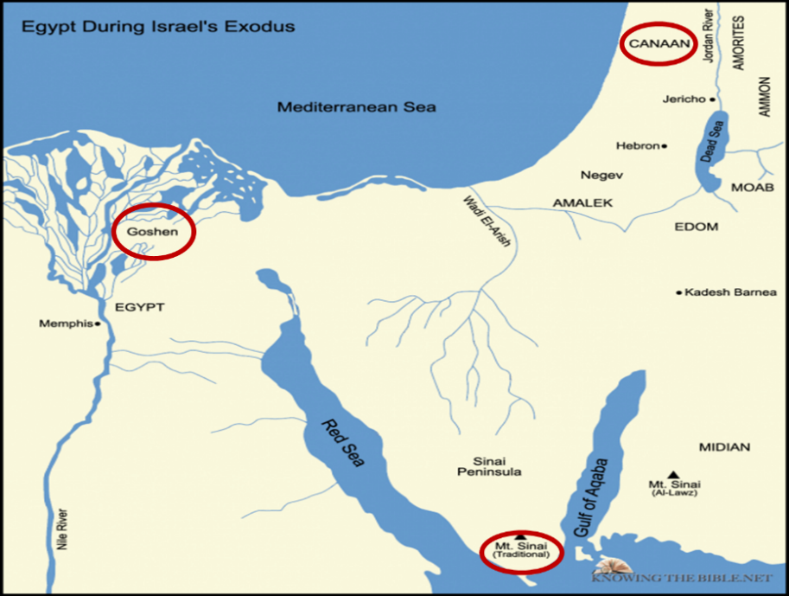

Slide 50
Numbers 21:9 (NASB)
“And Moses made a bronze serpent and set it on the standard; and it came about, that if a serpent bit any man, when he looked to the bronze serpent, he lived.”

Slide 51
John 3:14-15 (NASB)
“As Moses lifted up the serpent in the wilderness, even so must the Son of Man be lifted up; ¹⁵ so that whoever believes will in Him have eternal life.”

Slide 52
2 Kings 18:4 (NASB)
“He removed the high places and broke down the sacred pillars and cut down the Asherah. He also broke in pieces the bronze serpent that Moses had made, for until those days the sons of Israel burned incense to it; and it was called Nehushtan.”

Slide 53
Joshua 1:2 (NASB)
“Moses My servant is dead; now therefore arise, cross this Jordan, you and all this people, to the land which I am giving to them, to the sons of Israel.”

Slide 54
Matthew 16:13-23 (NASB)
¹⁶ Now when Jesus came into the district of Caesarea Philippi, He was asking His disciples, “Who do people say that the Son of Man is?”…¹⁶ Simon Peter answered, “You are the Christ, the Son of the living God.” ¹⁷ And Jesus said to him, “Blessed are you, Simon Barjona, because flesh and blood did not reveal this to you, but My Father who is in heaven. ¹⁸ I also say to you that you are Peter, and upon this rock I will build My church; and the gates of Hades will not overpower it. ¹⁹ I will give you the keys of the kingdom of heaven; and whatever you bind on earth shall have been bound in heaven, and whatever you loose on earth shall have been loosed in heaven.”

Slide 55
Matthew 16:13-23 (NASB)
²⁰ Then He warned the disciples that they should tell no one that He was the Christ.²¹ From that time Jesus began to show His disciples that He must go to Jerusalem, and suffer many things from the elders and chief priests and scribes, and be killed, and be raised up on the third day. ²² Peter took Him aside and began to rebuke Him, saying, “God forbid it, Lord! This shall never happen to You.” ²³ But He turned and said to Peter, “Get behind Me, Satan! You are a stumbling block to Me; for you are not setting your mind on God’s interests, but man’s.

Slide 56
NEXT WEEK
The early church
The Alexandrian eclipse
The Dark Ages
The Contribution of the Protestant Reformers
THE REFORMERS INCOMPLETE REVOLUTION
Reformed Theology today
Dispensationalism & the completed revolution
Looking back 500 years later
Notes:
Outline

