Slide 1
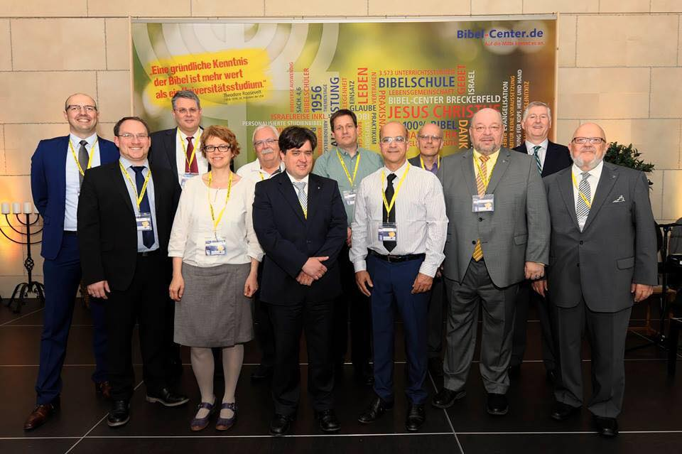
PROPHETICON 2017 GERMANY

Slide 2
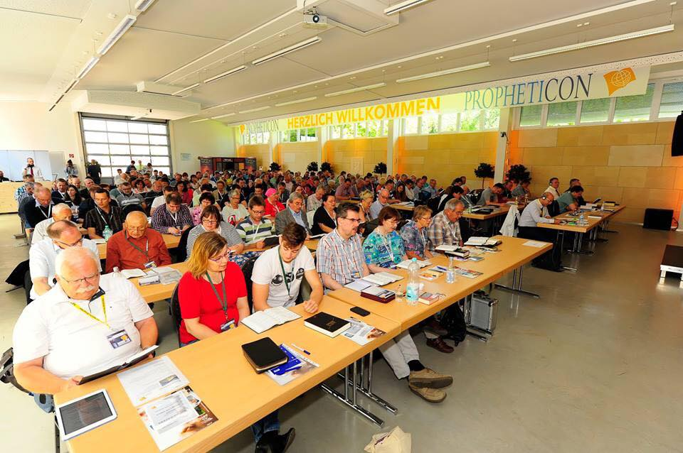
PROPHETICON 2017 GERMANY

Slide 3
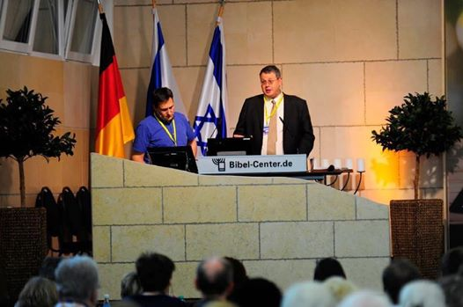
PROPHETICON 2017 GERMANY

Slide 4

THE BOOK OF DANIEL
Dr. Andy Woods

Slide 5

Message
Times of the Gentiles are revealed prophetically (2, 7, 8-12) and ethically (1, 3-6)

Slide 6

Synthetic Outline
Historical (1-7):
  Daniel interprets, 3rd person, gentile nations
  Intro “Hebrew” (1)
  Aramaic chiasm (2-7)

Slide 7
Synthetic Outline
Prophetic (8-12):
  Angel interprets, 1st person, Jewish nation, Hebrew
  Ram & Goat (8)
  70 weeks (9)
  Final vision (10-12)

Slide 8
Synthetic Outline
Historical (1-7):
  Daniel interprets, 3rd person, gentile nations
  Intro “Hebrew” (1)
  Aramaic chiasm (2-7)

Slide 9
Synthetic Outline
Historical (1-7):
  Daniel interprets, 3rd person, gentile nations
  Intro “Hebrew” (1)
  Aramaic chiasm (2-7)

Slide 10

Synthetic Outline
  Chiasm “Aramaic” ( 2-7)
1. Gentile History (2)
  2. Protection (3)
    3. Revelation to a gentile king (4)
    3. Revelation to a gentile king (5)
  2. Protection (6)
1. Gentile history (7)

Slide 11
Synthetic Outline
  Chiasm “Aramaic” ( 2-7)
1. Gentile History (2)
  2. Protection (3)
    3. Revelation to a gentile king (4)
    3. Revelation to a gentile king (5)
  2. Protection (6)
1. Gentile history (7)

Slide 12
Synthetic Outline
  Chiasm “Aramaic” ( 2-7)
1. Gentile History (2)
  2. Protection (3)
    3. Revelation to a gentile king (4)
    3. Revelation to a gentile king (5)
  2. Protection (6)
1. Gentile history (7)

Slide 13
Synthetic Outline
  Chiasm “Aramaic” ( 2-7)
1. Gentile History (2)
  2. Protection (3)
    3. Revelation to a gentile king (4)
    3. Revelation to a gentile king (5)
  2. Protection (6)
1. Gentile history (7)

Slide 14
Synthetic Outline
  Chiasm “Aramaic” ( 2-7)
1. Gentile History (2)
  2. Protection (3)
    3. Revelation to a gentile king (4)
    3. Revelation to a gentile king (5)
  2. Protection (6)
1. Gentile history (7)

Slide 15
Synthetic Outline
  Chiasm “Aramaic” ( 2-7)
1. Gentile History (2)
  2. Protection (3)
    3. Revelation to a gentile king (4)
    3. Revelation to a gentile king (5)
  2. Protection (6)
1. Gentile history (7)

Slide 16
Synthetic Outline
  Chiasm “Aramaic” ( 2-7)
1. Gentile History (2)
  2. Protection (3)
    3. Revelation to a gentile king (4)
    3. Revelation to a gentile king (5)
  2. Protection (6)
1. Gentile history (7)

Slide 17

Chapter 7 Outline
The Historical Setting (1)
The Vision (2-14)
The Vision’s Interpretation (15-27)
The Personal Impact on Daniel (28)

Slide 18
Chapter 7 Outline
The Historical Setting (1)
The Vision (2-14)
The Vision’s Interpretation (15-27)
The Personal Impact on Daniel (28)

Slide 19
CHAPTER AND VERSE IN DANIEL | CHRONOLOGICAL DATE | BIBLICAL DATE
1:1 | 605 | 3rd year of Jehoiakim
2:1 | 603 | 2nd year of Nebuchadnezzar
5 | Sat. night 10/12/539 (Hoehner)
7:1 | 553 | 1st year of Belshazzar
8:1 | 551 | 3rd year of Belshazzar
9:1 | 538 | 1st year of Darius
10:1 | 536 | 3rd year of Cyrus

Slide 20
Daniel’s Age
CHAPTER | EVENTS | AGE
1 | Taken to Babylonian captivity | 15
2 | Interpreting Nebuchadnezzar’s 1st dream (huge image) | 17
3 | Daniel’s 3 friends cast into the fiery furnace | 19 or 20
4 | Interpreting Nebuchadnezzar’s 2nd dream (huge tree) | 45-50
5 | Interpreting handwriting of the wall at Belshazzar’s feast | Early 80’s
6 | Delivered from the den of lions | c.83
7-8 | Daniel’s visions and dreams | Mid-60’s
9 | Daniel’s seventy “sevens” prophecy | Early-80’s
10-12 | Final dreams and visions | Mid-80’s

Slide 21
Succession of Gentile Rulers
1-4: Nebuchadnezzar of Babylon
5: Belshazzar of Babylon
6: Darius of Media – Persia
7-8: Belshazzar of Babylon
9: Darius of Media – Persia
10-12: Cyrus of Media – Persia

Slide 22
Synthetic Outline
  Chiasm “Aramaic” ( 2-7)
1. Gentile History (2)
  2. Protection (3)
    3. Revelation to a gentile king (4)
    3. Revelation to a gentile king (5)
  2. Protection (6)
1. Gentile history (7)

Slide 23


Statue
&
Stone

Slide 24

CHART1

Slide 25
Comparing Daniel 2 & 7: A Matter of Perspective
 | Daniel 2 | Daniel 7
Receiver | Nebuchadnezzar | Daniel
Position | Oppressor | Oppressee
Nationality | Babylonian | Hebrew
Perspective | Gentile | Jewish
Viewpoint | Antropocentric | Theocentric
Description | Statue | Beasts
Appearance | Beautiful | Grotesque

Slide 26
Chapter 7 Outline
The Historical Setting (1)
The Vision (2-14)
The Vision’s Interpretation (15-27)
The Personal Impact on Daniel (28)

Slide 27
DANIEL 7:2-14
Outline
4 Beasts Coming out of the Sea V.2-3
A Description of the 4 Beasts V.4-8
The Ancient of Days V. 9-12
The Son of Man V.13-14

Slide 28

Description of 4 Beasts
1st Beast (V.4)
  Lion
  Babylon
  Head of Gold
  2:38
  605-539 BC
  Eagle’s Wings
  Nebuchadnezzar’s Experience

Slide 29

Description of 4 Beasts
2nd Beast (V.5)
  Bear
  Media-Persia
  Chest & Arms of Silver
  5:28; 8:20
  539-331 BC
  Raised on One Side
  Three Ribs
  Arise and Devour

Slide 30

Description of 4 Beasts
3rd Beast (V. 6)
  Leopard
  Greece
  Belly & Thighs of Bronze
  8:21
  331-63 BC
  Rapid Conquest (Wings & Leopard)
  Four Generals (Wings & Heads)

Slide 31
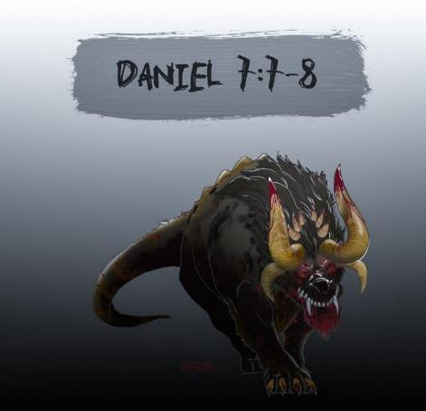
Description of 4 Beasts
4th Beast (V.7-8)
  Description
  Rome
  Legs of Iron
  Secular History
  63 Bc-70 AD
  10 Horns & Little Horn
  Revelation 13:2

Slide 32
DANIEL 7:2-14
Outline
4 Beasts Coming out of the Sea V.2-3
A Description of the 4 Beasts V.4-8
The Ancient of Days V. 9-12
The Son of Man V.13-14

Slide 33
Chapter 7 Outline
The Historical Setting (1)
The Vision (2-14)
The Vision’s Interpretation (15-27)
The Personal Impact on Daniel (28)

Slide 34
DANIEL 7:15-27
OUTLINE
The Vision Troubles Daniel V.15
Daniel Requests An Interpretation V.16
An Interpretation Is Given V. 17-18
Daniel Requests Further Explanation V. 19-22
Angelic Interpretation V. 23-27

Slide 35
DANIEL 7:15-27
OUTLINE
The Vision Troubles Daniel V.15
Daniel Requests An Interpretation V.16
An Interpretation Is Given V. 17-18
Daniel Requests Further Explanation V. 19-22
Angelic Interpretation V. 23-27

Slide 36
DANIEL 7:15-27
OUTLINE
The Vision Troubles Daniel V.15
Daniel Requests An Interpretation V.16
An Interpretation Is Given V. 17-18
Daniel Requests Further Explanation V. 19-22
Angelic Interpretation V. 23-27

Slide 37
DANIEL 7:15-27
OUTLINE
The Vision Troubles Daniel V.15
Daniel Requests An Interpretation V.16
An Interpretation Is Given V. 17-18
Daniel Requests Further Explanation V. 19-22
Angelic Interpretation V. 23-27

Slide 38
DANIEL 7:15-27
OUTLINE
The Vision Troubles Daniel V.15
Daniel Requests An Interpretation V.16
An Interpretation Is Given V. 17-18
Daniel Requests Further Explanation V. 19-22
Angelic Interpretation V. 23-27

Slide 39
DANIEL 7:15-27
OUTLINE
The Vision Troubles Daniel V.15
Daniel Requests An Interpretation V.16
An Interpretation Is Given V. 17-18
Daniel Requests Further Explanation V. 19-22
Angelic Interpretation V. 23-27

Slide 40
Angelic Interpretation
V. 23
  Daniel 2:40, 41-43
  World-wide empire

Slide 41
Statue
&
Stone

Slide 42

David Rockefeller cited in Memoirs, page 405.
“For more than a century ideological extremists…have seized upon well-publicized incidents…to attack the Rockefeller family for the inordinate influence they claim we wield over American political and economic institutions. Some even believe we are part of a secret cabal working against the best interests of the United States, characterizing my family and me as 'internationalists' and of conspiring with others around the world to build a more integrated global political and economic structure--one world, if you will. If that's the charge, I stand guilty, and I am proud of it.”

Slide 43

Zbigniew Brzezinski
Between Two Ages: America's Role in the Technetronic Era (New York: Viking Press, 1970).
“Brezinski does make a number of statements about the decline of the nation-state: “the nation-state is gradually yielding its sovereignty” (p.56); “the fiction of sovereignty” (p.274); and “developing limitations on national sovereignty” (p.296).”

Slide 44
Humanist Manifesto II (1973)
Page 21
“We deplore the division of humankind on nationalistic grounds. We have reached a turning point in human history where the best option is to transcend the limits of national sovereignty and to move toward the building of a world community… a system of world law and world order based upon transnational federal government.”

Slide 45
Genesis 11:6
The Lord said, “Behold, they are one people, and they all have the same language. And this is what they began to do, and now nothing which they purpose to do will be impossible for them.”

Slide 46
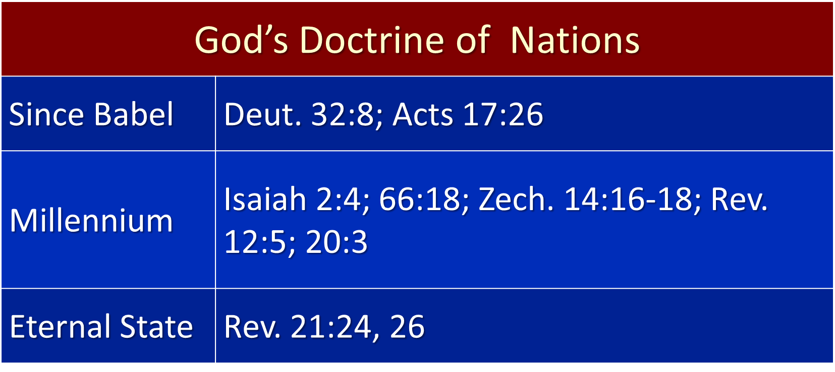

Slide 47

Zbigniew Brzezinski cited in Zbigniew Brzezinski, Between Two Ages: America's Role in the Technetronic Era (New York: Viking Press, 1970), 252-53.
“Another threat, less overt but no less basic, confronts liberal democracy. More directly linked to the impact of technology, it involves the gradual appearance of a more controlled and directed society. Such a society would be dominated by an elite whose claim to political power would rest on allegedly superior scientific knowhow. Unhindered by the restraints of traditional liberal values, this elite would not hesitate to achieve its political ends by using the latest modern techniques for influencing public behavior and keeping society under close surveillance and control.”

Slide 48
Zbigniew Brzezinski cited in Zbigniew Brzezinski, “America in the Technetronic Age”, Encounter (January 1968), p. 21.
“At the same time, the capacity to assert social and political control over the individual will vastly increase. As I have already noted, it will soon be possible to assert almost continuous surveillance over every citizen and to maintain up-to-date, complete files, containing even most personal information about the health or personal behavior of the citizen, in addition to more customary data. These files will be subject to instantaneous retrieval by the authorities.”

Slide 49

Revelation 13:16-18 (NASB)
“And he causes all, the small and the great, and the rich and the poor, and the free men and the slaves, to be given a mark on their right hand or on their forehead, ¹⁷ and he provides that no one will be able to buy or to sell, except the one who has the mark, either the name of the beast or the number of his name. ¹⁸ Here is wisdom. Let him who has understanding calculate the number of the beast, for the number is that of a man; and his number is six hundred and sixty-six.”

Slide 50
Angelic Interpretation
  V. 24
  A Ten King Confederacy
  A Revived Roman Empire
  EEC or ECM / European Common Market?
  The Antichrist Will Subdue 3 Kings

Slide 51

Daniel 2:37-38 (NASB)
You, O king, are the king of kings, to whom the God of heaven has given the kingdom, the power, the strength and the glory; ³⁸ and wherever the sons of men dwell, or the beasts of the field, or the birds of the sky, He has given them into your hand and has caused you to rule over them all. You are the head of gold.

Slide 52
Angelic Interpretation
  V. 25
  His Boasting Mouth (Dan. 7:8,11,20; Rev 13:5-6)
  Persecution Of The Saints (Rev. 6:9-11; 13:7, 17:6; Matt. 24:9)
  The Creation of a New System
  Three And A Half Years (Dan. 9:27, 12:7; Rev. 12:6, 14; 13:5)

Slide 53
Angelic Interpretation
  V. 25
  His Boasting Mouth (Dan. 7:8,11,20; Rev 13:5-6)
  Persecution Of The Saints (Rev. 6:9-11; 13:7, 17:6; Matt. 24:9)
  The Creation of a New System
  Three And A Half Years (Dan. 9:27, 12:7; Rev. 12:6, 14; 13:5)

Slide 54
Angelic Interpretation
  V. 25
  His Boasting Mouth (Dan. 7:8,11,20; Rev 13:5-6)
  Persecution Of The Saints (Rev. 6:9-11; 13:7, 17:6; Matt. 24:9)
  The Creation of a New System
  Three And A Half Years (Dan. 9:27, 12:7; Rev. 12:6, 14; 13:5)

Slide 55
When Will the Rapture Take Place Relative to the Tribulation Period?
Pre-tribulation rapture theory
Mid-tribulation rapture theory
Post-tribulation rapture theory
Pre-wrath rapture theory

Slide 56


Slide 57

“I personally do not believe that by the year 2020, any credible person will be teaching the secret pre-trib. rapture doctrine. I think the events that are coming in the next five years will utterly destroy the doctrine.”
--Rick Wiles
http://www.wnd.com/2015/08/is-everything-you-know-about-second-coming-wrong/

Slide 58
When is the Rapture? Seven Arguments Favoring the Pre-Tribulation View
Tribulation's purpose concerns Israel (Jer 30:7; Dan 9:24)
No biblical reference to the church on earth during the Tribulation period (Rev 4-22)
Church is promised an exemption from divine wrath (1 Thess 1:10; 5:9; Rom 5:9; Rev 3:10; 6:17)
Rapture is imminent (1 Cor 15:51; 1 Thess 4:15)
Rapture is a comfort (1 Thess 4:18)
Antichrist cannot come to power until the restrainer is removed (2 Thess 2:6-7)
Symbolic parallels (2 Peter 2:5-9)

Slide 59
When is the Rapture? Seven Arguments Favoring the Pre-Tribulation View
Tribulation's purpose concerns Israel (Jer 30:7; Dan 9:24)
No biblical reference to the church on earth during the Tribulation period (Rev 4-22)
Church is promised an exemption from divine wrath (1 Thess 1:10; 5:9; Rom 5:9; Rev 3:10; 6:17)
Rapture is imminent (1 Cor 15:51; 1 Thess 4:15)
Rapture is a comfort (1 Thess 4:18)
Antichrist cannot come to power until the restrainer is removed (2 Thess 2:6-7)
Symbolic parallels (2 Peter 2:5-9)

Slide 60
Pretribulationism is not Escapism
Trials (John 16:33)
Man’s wrath (2 Tim 3:12)
Satan’s wrath (Ephesians 6:11-12)
World’s wrath (John 15:18-19)

Slide 61
When is the Rapture? Seven Arguments Favoring the Pre-Tribulation View
Tribulation's purpose concerns Israel (Jer 30:7; Dan 9:24)
No biblical reference to the church on earth during the Tribulation period (Rev 4-22)
Church is promised an exemption from divine wrath (1 Thess 1:10; 5:9; Rom 5:9; Rev 3:10; 6:17)
Rapture is imminent (1 Cor 15:51; 1 Thess 4:15)
Rapture is a comfort (1 Thess 4:18)
Antichrist cannot come to power until the restrainer is removed (2 Thess 2:6-7)
Symbolic parallels (2 Peter 2:5-9)

Slide 62
Ephesians 3:3-6 (NASB)
“that by revelation there was made known to me the mystery, as I wrote before in brief. ⁴ By referring to this, when you read you can understand my insight into the mystery of Christ, ⁵ which in other generations was not made known to the sons of men, as it has now been revealed to His holy apostles and prophets in the Spirit; ⁶ to be specific, that the Gentiles are fellow heirs and fellow members of the body, and fellow partakers of the promise in Christ Jesus through the gospel”.

Slide 63
Ephesians 3:9 (NASB)
“and to bring to light what is the administration of the mystery which for ages has been hidden in God who created all things.”

Slide 64
“Mystery” Defined
“In the N.T, it [mystērion] denotes, not the mysterious (as with the Eng. word), but that which, being outside the range of unassisted natural apprehension, can be made known only by Divine revelation, and is made known in a manner and at a time appointed by God, and to those who are illumined by His Spirit.”
W. E. Vine, Merrill F. Unger, and William White, Vine's Complete Expository Dictionary of the Old and New Testament Words (Nashville: Nelson, 1996), 424.

Slide 65
Distinctions Between 144,000 & Multitude
REVELATION 7:1-8 | REVELATION 7:9-17
Numbered | Innumerable
Jews | All nations
Sealed | Slain
Sealed before the Tribulation | Converted out of the Tribulation
Hitchcock and Ice, The Truth Behind Left Behind, 77

Slide 66
Angelic Interpretation
  V. 25
  His Boasting Mouth (Dan. 7:8,11,20; Rev 13:5-6)
  Persecution Of The Saints (Rev. 6:9-11; 13:7, 17:6; Matt. 24:9)
  The Creation of a New System
  Three And A Half Years (Dan. 9:27, 12:7; Rev. 12:6, 14; 13:5)

Slide 67
Angelic Interpretation
  V. 25
  His Boasting Mouth (Dan. 7:8,11,20; Rev 13:5-6)
  Persecution Of The Saints (Rev. 6:9-11; 13:7, 17:6; Matt. 24:9)
  The Creation of a New System
  Three And A Half Years (Dan. 9:27, 12:7; Rev. 12:6, 14; 13:5)

Slide 68
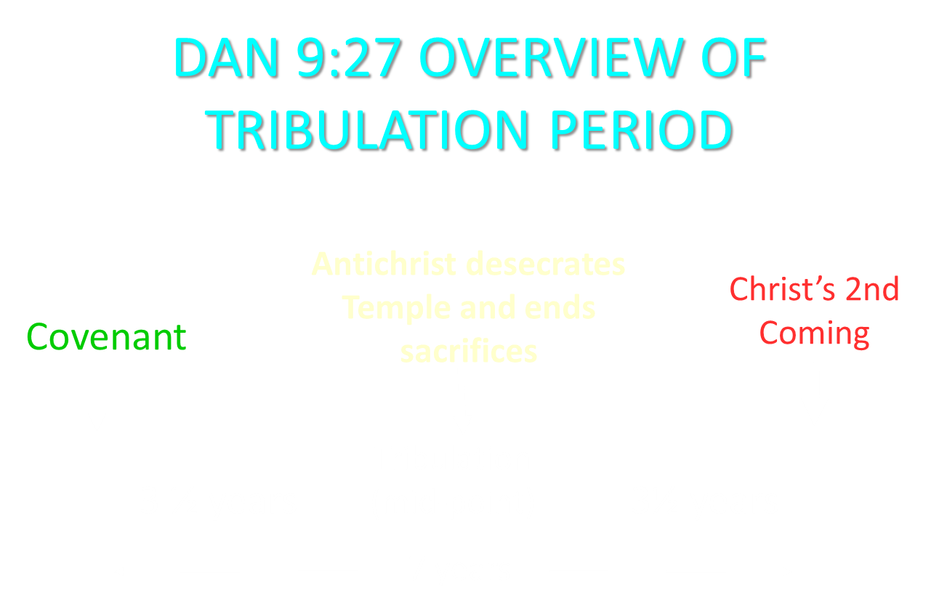

Slide 69
Angelic Interpretation
  V. 26
  The Ancient of Days Destroys the Little Horn
  The Ancient of Days is God the Father
  Dan. 9:27; 2 Thess. 2:8; Rev. 19:20
  Antichrist’s Rise and Fall

Slide 70
Angelic Interpretation
  V. 27
  The Millennium
    Rev. 11:15; Dan. 2:44-45
    Six Kingdoms?
  The saints receive the kingdom
    Judah’s Focus
    Our Hope
  An eternal kingdom
  Universal service and submission

Slide 71
Angelic Interpretation
  V. 27
  The Millennium
    Rev. 11:15; Dan. 2:44-45
    Six Kingdoms?
  The saints receive the kingdom
    Judah’s Focus
    Our Hope
  An eternal kingdom
  Universal service and submission

Slide 72
6 Empires
Babylon (2:36-38) 605-539 BC
Media-Persia (2:39a) 539-331 BC
Greece (2:39b) 331-63 BC
Rome I (2:40) 63 BC – 70 AD
Rome II (2:41-43) Tribulation
Kingdom (2:44-45) After 2nd Coming

Slide 73


Slide 74
Statue
&
Stone

Slide 75
Angelic Interpretation
  V. 27
  The Millennium
    Rev. 11:15; Dan. 2:44-45
    Six Kingdoms?
  The saints receive the kingdom
    Judah’s Focus
    Our Hope
  An eternal kingdom
  Universal service and submission

Slide 76
Angelic Interpretation
  V. 27
  The Millennium
    Rev. 11:15; Dan. 2:44-45
    Six Kingdoms?
  The saints receive the kingdom
    Judah’s Focus
    Our Hope
  An eternal kingdom
  Universal service and submission

Slide 77
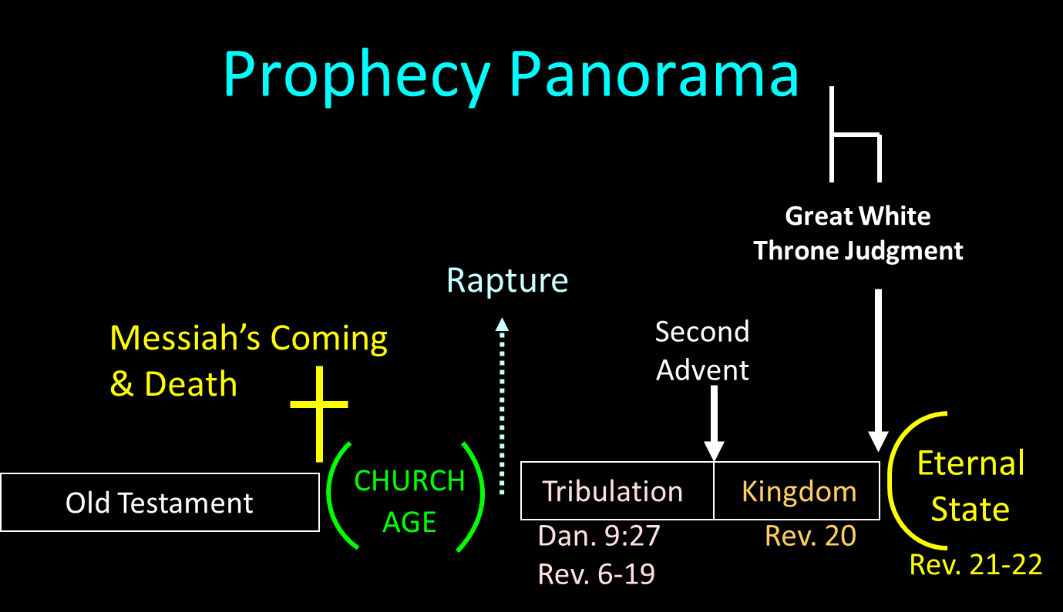

Slide 78
Angelic Interpretation
  V. 27
  The Millennium
    Rev. 11:15; Dan. 2:44-45
    Six Kingdoms?
  The saints receive the kingdom
    Judah’s Focus
    Our Hope
  An eternal kingdom
  Universal service and submission

Slide 79
Zechariah 14:16-18 (NASB)
“Then it will come about that any who are left of all the nations that went against Jerusalem will go up from year to year to worship the King, the Lord of hosts, and to celebrate the Feast of Booths. ¹⁷ And it will be that whichever of the families of the earth does not go up to Jerusalem to worship the King, the Lord of hosts, there will be no rain on them. ¹⁸ If the family of Egypt does not go up or enter, then no rain will fall on them; it will be the plague with which the Lord smites the nations who do not go up to celebrate the Feast of Booths.”

Slide 80
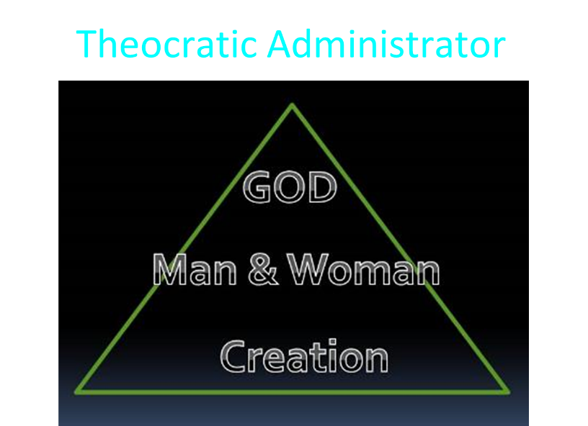

Slide 81
Chapter 7 Outline
The Historical Setting (1)
The Vision (2-14)
The Vision’s Interpretation (15-27)
The Personal Impact on Daniel (28)

Slide 82
THE EFFECT ON DANIEL
V. 28
Daniel is Traumatized
7:15, 19, 21, 25
Daniel’s Heart for His People
8:27

Slide 83
Conclusion

Slide 84
Chapter 7 Outline
The Historical Setting (1)
The Vision (2-14)
The Vision’s Interpretation (15-27)
The Personal Impact on Daniel (28)

