Slide 1
The Protestant Reformation: The Good, The Bad, and The Ugly
Andy Woods, Th.M.., JD., PhD.
Sr. Pastor, Sugar Land Bible Church

Slide 2
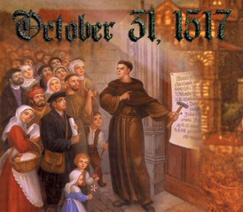
Introduction
Oct 31, 1517
500 years
Far reaching impact
Partial restoration
Restoration of a hermeneutic
Selectively applied
Subsequent generations applied consistently
Preview

Slide 3
Overview
The early church
The Alexandrian eclipse
The Dark Ages
The contribution of the Protestant Reformers
The Reformers’ incomplete revolution
Reformed Theology today
Dispensationalism & the completed revolution
Looking back 500 years later
Notes:
Outline

Slide 4
Overview
THE EARLY CHURCH
The Alexandrian eclipse
The Dark Ages
The contribution of the Protestant Reformers
The Reformers’ incomplete revolution
Reformed Theology today
Dispensationalism & the completed revolution
Looking back 500 years later
Notes:
Outline

Slide 5
Matthew 19:28 (NASB)
And Jesus said to them, “Truly I say to you, that you who have followed Me, in the regeneration when the Son of Man will sit on His glorious throne, you also shall sit upon twelve thrones, judging the twelve tribes of Israel.”

Slide 6
Romans 11:25-27 (NASB)
“For I do not want you, brethren, to be uninformed of this mystery—so that you will not be wise in your own estimation—that a partial hardening has happened to Israel until the fullness of the Gentiles has come in; and so all Israel will be saved; just as it is written, ‘The Deliverer will come from Zion, He will remove ungodliness from Jacob. This is My covenant with them, When I take away their sins.’”

Slide 7
Revelation 5:10 (NASB)
“You have made them to be a kingdom and priests to our God; and they will reign upon the earth.”

Slide 8
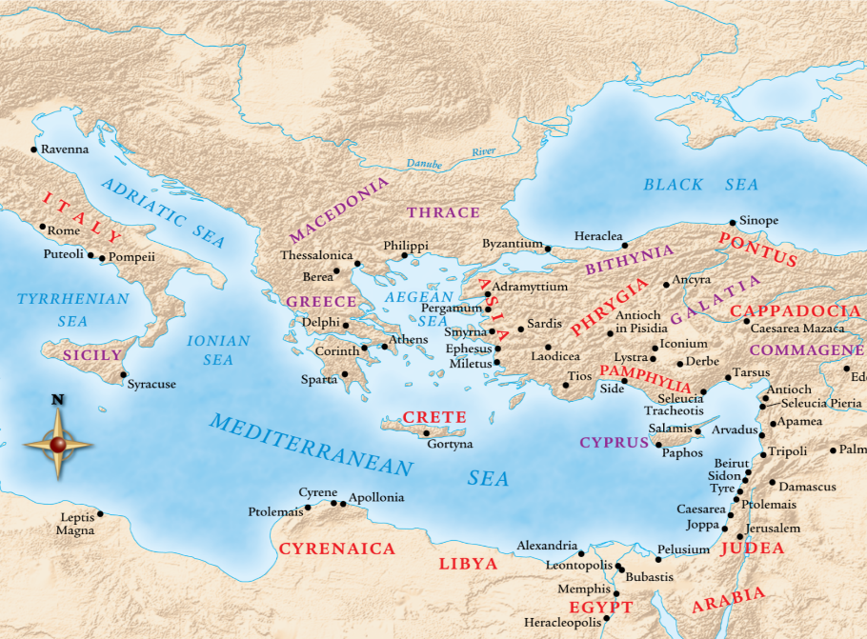

Slide 9
Justin Martyr
Dialogue with Trypho, 80.
“But I and every other completely orthodox Christian feel certain that there will be a resurrection of the flesh, followed by a thousand years in the rebuilt, embellished, and enlarged city of Jerusalem as was announced by the prophets Ezekiel, Isaiah, and the others.”

Slide 10
Schaff
History of the Christian Church, vol. 2 , p. 614.
“The most striking point in the eschatology of the ante-Nicene age (A.D. 100–325) is the prominent chiliasm, or millenarianism, that is the belief of a visible reign of Christ in glory on earth with the risen saints for a thousand years, before the general resurrection and judgment. It was indeed not the doctrine of the church embodied in any creed or form of devotion, but a widely current opinion of distinguished teachers, such as Barnabas, Papias, Justin Martyr, Irenaeus, Tertullian, Methodius, and Lactantius.”

Slide 11
Edward Gibbon
History of Christianity (NY: Eckler, 1916), 141-44.
“The ancient and popular doctrine of the Millennium was intimately connected with the second coming of Christ. As the works of the creation had been finished in six days, their duration in their present state, according to a tradition which was attributed to the prophet Elijah, was fixed to six thousand years. By the same analogy it was inferred, that this long period of labor and contention, which was now almost elapsed, would be succeeded by a joyful Sabbath of a thousand years; and that Christ, with the triumphant band of the saints and the elect who had escaped death, or who had been miraculously revived, would reign upon earth till the time appointed for the last and general resurrection…The assurance of such a Millennium was carefully inculcated by a succession of fathers from Justin Martyr, and Irenaeus, who conversed with the immediate disciples of the apostles, down to Lactantius, who was preceptor to the son of Constantine. Though it might not be universally received, it appears to have been the reigning sentiment of the orthodox believers; and it seems so well adapted to the desires and apprehensions of mankind, that it must have contributed in a very considerable degree to the progress of the Christian faith.”

Slide 12
Jesse Forest Silver
The Lord’s Return: Seen in History and in Scripture as Premillennial and Imminent (NY: Revell, 1914), 62-64.
Silver says of the apostolic fathers that "they expected the return of the Lord in their day…They believed the time was imminent because the Lord had taught them to live in a watchful attitude." Concerning the ante Nicene fathers, he says: "by tradition they knew the faith of the apostles. They taught the doctrine of the imminent and pre-millennial return of the Lord.”

Slide 13
Overview
The early church
THE ALEXANDRIAN ECLIPSE
The Dark Ages
The contribution of the Protestant Reformers
The Reformers’ incomplete revolution
Reformed Theology today
Dispensationalism & the completed revolution
Looking back 500 years later
Notes:
Outline

Slide 14
Acts 20:29-30 (NASB)
“I know that after my departure savage wolves will come in among you, not sparing the flock; and from among your own selves men will arise, speaking perverse things, to draw away the disciples after them.”

Slide 16
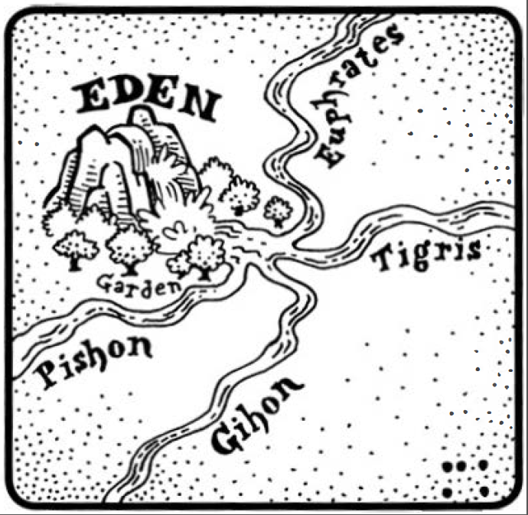

Slide 17
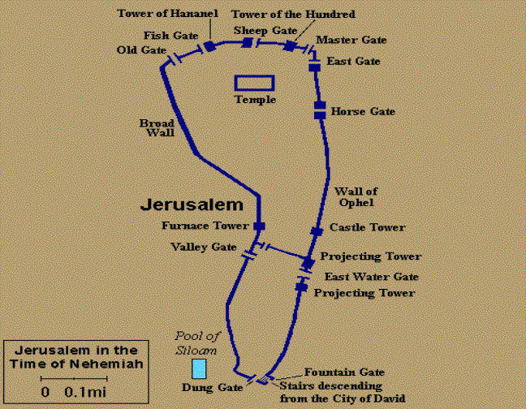

Slide 18
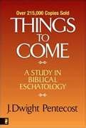
Dangers of Allegorization
Text is not being interpreted
Authority is transferred from text to interpreter
There is no way to test the interpreter
No mechanism for controlling the interpreter’s imagination
Pentecost, Things to Come, pps. 4-5

Slide 19
Dangers of Allegorization
Text is not being interpreted
Authority is transferred from text to interpreter
There is no way to test the interpreter
No mechanism for controlling the interpreter’s imagination
Pentecost, Things to Come, pps. 4-5

Slide 20
“…it will be noticed at once that its habit is to disregard the common signification of words and give wing to all manner of fanciful speculation. It does not draw out the legitimate meaning of an author’s language, but foists into it whatever the whim or fancy of an interpreter may desire.”
Milton S. Terry
Biblical Hermeneutics (NY: Philips and Hunt, 1883), 224.

Slide 21
“He (or she) who spiritualizes tells spiritual lies.”

Slide 22
Dangers of Allegorization
Text is not being interpreted
Authority is transferred from text to interpreter
There is no way to test the interpreter
No mechanism for controlling the interpreter’s imagination
Pentecost, Things to Come, pps. 4-5

Slide 23
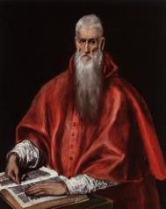
“…once we start with the rule that whole passages and books of scripture say one thing when they mean another, the reader is delivered bound hand and foot to the caprice of the interpreter.”
Jerome
Quoted by F.W. Farrar, History of interpretation (NY: E.P. Dutton and Company, 1886), 238-39.

Slide 24
Dangers of Allegorization
Text is not being interpreted
Authority is transferred from text to interpreter
There is no way to test the interpreter
No mechanism for controlling the interpreter’s imagination
Pentecost, Things to Come, pps. 4-5

Slide 25
Dangers of Allegorization
Text is not being interpreted
Authority is transferred from text to interpreter
There is no way to test the interpreter
No mechanism for controlling the interpreter’s imagination
Pentecost, Things to Come, pps. 4-5

Slide 26
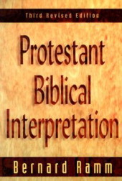
“…to state that the principal meaning of the Bible is a second-sense meaning, and that the principle method of interpretation is ‘spiritualizing,’ is to open the door to almost uncontrolled speculation and imagination. For this reason we have insisted that the control in interpretation is the literal method.”
Bernard Ramm
Protestant Biblical Interpretation, 3d ed. (Boston: W.A. Wilde, 1956; reprint, Grand Rapids: Baker, 1979), 65.

Slide 27
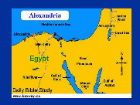
What Caused the Shift Into Allegorism?
Need for immediate relevance
Incorporation of human philosophy into interpretation
Gnostic dualism (Gen. 1:31; 1 John 2:22; 4:2-3; Acts 17:32; 1 Cor. 15:12)
Decline of the church's Jewish population
Constantine’s Edict of Milan (A.D. 313)
Notes:
Outline

Slide 28
What Caused the Shift Into Allegorism?
Need for immediate relevance
Incorporation of human philosophy into interpretation
Gnostic dualism (Gen. 1:31; 1 John 2:22; 4:2-3; Acts 17:32; 1 Cor. 15:12)
Decline of the church's Jewish population
Constantine’s Edict of Milan (A.D. 313)
Notes:
Outline

Slide 29
Bernard Ramm
Protestant Biblical Interpretation, 3rd rev. ed. (Grand Rapids: Baker, 1970), 30.
“But citing verses in the Old Testament, in themselves frequently very obscure, as if superior to verses in the New, revealed no understanding of the significance of historical and progressive revelation for hermeneutics…They considered the Old (especially) and the New Testaments filled with parables, enigmas, and riddles. The allegorical method alone sufficed to bring out the meaning of these parables, enigmas, and riddles.”

Slide 30
What Caused the Shift Into Allegorism?
Need for immediate relevance
Incorporation of human philosophy into interpretation
Gnostic dualism (Gen. 1:31; 1 John 2:22; 4:2-3; Acts 17:32; 1 Cor. 15:12)
Decline of the church's Jewish population
Constantine’s Edict of Milan (A.D. 313)
Notes:
Outline

Slide 31
Bernard Ramm
Protestant Biblical Interpretation, 3rd rev. ed. (Grand Rapids: Baker, 1970), 27.
“The outstanding Jewish allegorist was Philo…He was a thoroughly convinced Jew. To him the Scriptures (primarily in the Septuagint version) were superior to Plato and Greek philosophy…Yet, he had a great fondness for Greek philosophy, especially Plato and Pythagoras. By a most elaborate system of allegorizing he was able to reconcile for himself his loyalty to his Hebrew faith and his love for Greek philosophy.”

Slide 32
Ronald E. Diprose
Israel in the Development of Christian Thought (Rome: IBEI, 2000), 157-58.
“Clement of Alexandria (c. 155‒c. 220) was unashamedly a Christian Platonist and as such he quoted from Plato, and indeed from other philosophers, with the same ease the He quoted from the Hebrew Scriptures and the New Testament. Moreover, he interpreted the Bible in light of Platonic concepts…His dependence upon Plato is further evident in a speculative passage in which the Jews feature as ‘helpers’ while the Christians are considered ‘fit to rule.’ Origen continued the Alexandrian tradition of interpreting the Bible in a way which harmonized with Greek philosophy.”

Slide 33
What Caused the Shift Into Allegorism?
Need for immediate relevance
Incorporation of human philosophy into interpretation
Gnostic dualism (Gen. 1:31; 1 John 2:22; 4:2-3; Acts 17:32; 1 Cor. 15:12)
Decline of the church's Jewish population
Constantine’s Edict of Milan (A.D. 313)
Notes:
Outline

Slide 35
Genesis 1:31 (NASB)
“God saw all that He had made, and behold, it was very good. And there was evening and there was morning, the sixth day.”

Slide 36
1 John 2:22 (NASB)
“Who is the liar but the one who denies that Jesus is the Christ? This is the antichrist, the one who denies the Father and the Son.”

Slide 37
1 John 4:2-3 (NASB)
“By this you know the Spirit of God: every spirit that confesses that Jesus Christ has come in the flesh is from God; ³ and every spirit that does not confess Jesus is not from God; this is the spirit of the antichrist, of which you have heard that it is coming, and now it is already in the world.”

Slide 38
Acts 17:32 (NASB)
“Now when they heard of the resurrection of the dead, some began to sneer, but others said, “We shall hear you again concerning this.”

Slide 39
1 Corinthians 15:12 (NASB)
“Now if Christ is preached, that He has been raised from the dead, how do some among you say that there is no resurrection of the dead?”

Slide 40
Matthew 8:11 (NASB)
“I say to you that many will come from east and west, and recline at the table with Abraham, Isaac and Jacob in the kingdom of heaven.”

Slide 41
Matthew 26:29 (NASB)
“But I say to you, I will not drink of this fruit of the vine from now on until that day when I drink it new with you in My Father’s kingdom.”

Slide 42
Luke 13:29 (NASB)
“And they will come from east and west and from north and south, and will recline at the table in the kingdom of God.”

Slide 43
Renald Showers
John Ankerberg and Renald Showers, The Most Asked Prophecy Questions (Chattanooga, TN: ATRI, 2000), 326.
“The…factor in his change of view was the influence of Greek philosophy upon his thinking. Before his conversion Augustine was deeply immersed in the study of this philosophy, much of which asserted the inherent evil of the physical or material and the inherent goodness of the totally spiritual. This philosophy continued to leave it's mark up on him even after his conversion. It prompted him to reject as carnal the pre-millennial idea of an earthly, political Kingdom of God with great material blessings. He believed that, in order for the Kingdom of God to be good, it must be spiritual in nature.”

Slide 44
Augustine
The City of God, trans., Marcus Dods (NY: Random House, 1950), Book XX, chap. 7, p. 719.
“And this opinion would not be objectionable, if it were believed that the joys of the saints in that Sabbath shall be spiritual, and consequent on the presence of God; for I myself, too, once held this opinion. But, as they assert that those who then rise again shall enjoy the leisure of immoderate carnal banquets, furnished with an amount of meat and drink such as not only to shock the feeling of the temperate, but even to surpass the measure of credulity itself, such assertions can be believed only by the carnal. They who do believe them are called by the spiritual Chiliasts, which we may literally reproduce by the name Millenarians.”

Slide 45
What Caused the Shift Into Allegorism?
Need for immediate relevance
Incorporation of human philosophy into interpretation
Gnostic dualism (Gen. 1:31; 1 John 2:22; 4:2-3; Acts 17:32; 1 Cor. 15:12)
Decline of the church's Jewish population
Constantine’s Edict of Milan (A.D. 313)
Notes:
Outline

Slide 46
Romans 11:13, 17-21 (NASB)
“But I am speaking to you who are Gentiles. Inasmuch then as I am an apostle of Gentiles, I magnify my ministry…But if some of the branches were broken off, and you, being a wild olive, were grafted in among them and became partaker with them of the rich root of the olive tree, ¹⁸ do not be arrogant toward the branches; but if you are arrogant, remember that it is not you who supports the root, but the root supports you. ¹⁹ You will say then, “Branches were broken off so that I might be grafted in.” ²⁰ Quite right, they were broken off for their unbelief, but you stand by your faith. Do not be conceited, but fear; ²¹ for if God did not spare the natural branches, He will not spare you, either.”

Slide 47
Notes:
47

Slide 48
What Caused the Shift Into Allegorism?
Need for immediate relevance
Incorporation of human philosophy into interpretation
Gnostic dualism (Gen. 1:31; 1 John 2:22; 4:2-3; Acts 17:32; 1 Cor. 15:12)
Decline of the church's Jewish population
Constantine’s Edict of Milan (A.D. 313)
Notes:
Outline

Slide 49
Renald Showers
John Ankerberg and Renald Showers, The Most Asked Prophecy Questions (Chattanooga, TN: ATRI, 2000), 325.
“That new view became known as Amillennialism. Several things prompted this change in Augustine. First, the political situation of the Church in the Roman empire had changed radically around the period of his life. By his time the Roman persecution of the Church had stopped, and the state had made itself the servant of the Church. As the Roman empire crumbled, the Church stood fast, ready to rule in the place of the empire. It looked as if Gentile world dominion was being crushed and that the Church was becoming victorious over it. Under these circumstances Augustine concluded that Premillennialism was obsolete, and that it did not fit the current situation. In the place of it he developed the idea that the Church is the Kingdom of the Messiah foretold in such Scriptures as Daniel 2 and 7 and Revelation 20. In his book, The City of God, he became the first person to teach the idea that the organized Catholic (Universal) Church is the promised Messianic Kingdom and that the Millennium began with the first coming of Christ.”

Slide 50
Ronald Diprose
Israel in the Development of Christian Thought (Rome: IBEI, 2000), 86-87.
“Origen was also influenced by the example of Philo, a first-century Alexandrian Jew who had interpreted the Old Testament Scriptures allegorically in order to make them harmonize with his Platonism. Allegorism played an important part in Origen's theory of interpretation and, as he was the first biblical scholar to work out ‘a complete hermeneutical theory’, his work was destined to exert great influence on the Christian approach to the Hebrew Scriptures, for centuries to come…Origen is remembered for his philosophical speculation as the allegorist par excellence among Biblical interpreters.”

Slide 51
Augustine
The City of God, trans., Marcus Dods (NY: Random House, 1950), Book XX, chap. 9, p. 725-26.
Augustine wrote, “the saints reign with Christ during the same thousand years, understood in the same way, that is, of the time of His first coming” and “Therefore the Church even now is the kingdom of Christ, and the kingdom of heaven. Accordingly, even now His saints reign with Him.”

Slide 52
Eusebius
Ecclesiastical History, 3.39.12-13
“Papias . . . says that there will be a millennium after the resurrections of the dead, when the kingdom of Christ will be set up in material form on this earth. I suppose that he got these notions by a perverse reading of the apostolic accounts, not realizing that they had spoken mystically and symbolically. For he was a man of very little intelligence, as is clear from his books. But he is responsible for the fact that so many Christian writers after him held the same opinion, relying on his antiquity, for instance Irenaeus and whoever else appears to have held the same views.”

Slide 53
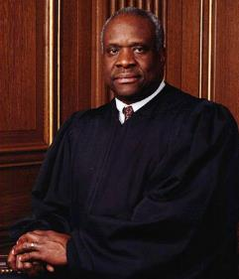
“He is the dumbest Justice to ever sit on the bench...He waits to see how Scalia votes, and he votes the same. He rarely issues comments or engages in questions during any Supreme Court hearing...He rarely grants media interviews (because he knows he will look stupid). He rarely writes opinions. He believes in a narrow interpretation of the Constitution. He is an idiot.”
http://juneauempire.com/opinion/2011-09-22/outside-editorial-law-and-clarence-thomas#.Tn5rqNSo1_p

Slide 54
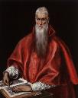
“How must we understand what the Saviour says in Matthew: ‘But I say to you, I will not drink again of this fruit of the vine until that day when I drink it new with you in the Kingdom of my Father’? (Matth. 26. 29). This passage is the origin of a certain fable of a thousand years, in which they say that Christ will reign in the flesh and will drink that wine which He has not drunk since that time until the end of the world…For the kingdom of God isn’t food and drink, but justice, joy and peace in the Holy Spirit (Rom. 14. 17).”
Jerome
http://www.tertullian.org/fathers/jerome_letter_120.htm

Slide 55
CONCLUSION

Slide 56
Review
The early church
THE ALEXANDRIAN ECLIPSE
The Dark Ages
The contribution of the Protestant Reformers
The Reformers’ incomplete revolution
Reformed Theology today
Dispensationalism & the completed revolution
Looking back 500 years later
Notes:
Outline

Slide 57
NEXT SESSION
The early church
The Alexandrian eclipse
THE DARK AGES
The contribution of the Protestant Reformers
The Reformers’ incomplete revolution
Reformed Theology today
Dispensationalism & the completed revolution
Looking back 500 years later
Notes:
Outline

