Slide 1

THE BOOK OF DANIEL
Dr. Andy Woods

Slide 2

Message
Times of the Gentiles are revealed prophetically (2, 7, 8-12) and ethically (1, 3-6)

Slide 3

Synthetic Outline
Historical (1-7):
  Daniel interprets, 3rd person, gentile nations
  Intro “Hebrew” (1)
  Aramaic chiasm (2-7)

Slide 4
Synthetic Outline
Prophetic (8-12):
  Angel interprets, 1st person, Jewish nation, Hebrew
  Ram & Goat (8)
  70 weeks (9)
  Final vision (10-12)

Slide 5
Synthetic Outline
Historical (1-7):
  Daniel interprets, 3rd person, gentile nations
  Intro “Hebrew” (1)
  Aramaic chiasm (2-7)

Slide 6
Synthetic Outline
Historical (1-7):
  Daniel interprets, 3rd person, gentile nations
  Intro “Hebrew” (1)
  Aramaic chiasm (2-7)

Slide 7

Synthetic Outline
  Chiasm “Aramaic” ( 2-7)
1. Gentile History (2)
  2. Protection (3)
    3. Revelation to a gentile king (4)
    3. Revelation to a gentile king (5)
  2. Protection (6)
1. Gentile history (7)

Slide 8
Synthetic Outline
  Chiasm “Aramaic” ( 2-7)
1. Gentile History (2)
  2. Protection (3)
    3. Revelation to a gentile king (4)
    3. Revelation to a gentile king (5)
  2. Protection (6)
1. Gentile history (7)

Slide 9
Synthetic Outline
  Chiasm “Aramaic” ( 2-7)
1. Gentile History (2)
  2. Protection (3)
    3. Revelation to a gentile king (4)
    3. Revelation to a gentile king (5)
  2. Protection (6)
1. Gentile history (7)

Slide 10
Synthetic Outline
  Chiasm “Aramaic” ( 2-7)
1. Gentile History (2)
  2. Protection (3)
    3. Revelation to a gentile king (4)
    3. Revelation to a gentile king (5)
  2. Protection (6)
1. Gentile history (7)

Slide 11
Synthetic Outline
  Chiasm “Aramaic” ( 2-7)
1. Gentile History (2)
  2. Protection (3)
    3. Revelation to a gentile king (4)
    3. Revelation to a gentile king (5)
  2. Protection (6)
1. Gentile history (7)

Slide 12
Synthetic Outline
  Chiasm “Aramaic” ( 2-7)
1. Gentile History (2)
  2. Protection (3)
    3. Revelation to a gentile king (4)
    3. Revelation to a gentile king (5)
  2. Protection (6)
1. Gentile history (7)

Slide 13
Synthetic Outline
  Chiasm “Aramaic” ( 2-7)
1. Gentile History (2)
  2. Protection (3)
    3. Revelation to a gentile king (4)
    3. Revelation to a gentile king (5)
  2. Protection (6)
1. Gentile history (7)

Slide 14

Chapter 7 Outline
The Historical Setting (1)
The Vision (2-14)
The Vision’s Interpretation (15-27)
The Personal Impact on Daniel (28)

Slide 15
Chapter 7 Outline
The Historical Setting (1)
The Vision (2-14)
The Vision’s Interpretation (15-27)
The Personal Impact on Daniel (28)

Slide 16
CHAPTER AND VERSE IN DANIEL | CHRONOLOGICAL DATE | BIBLICAL DATE
1:1 | 605 | 3rd year of Jehoiakim
2:1 | 603 | 2nd year of Nebuchadnezzar
5 | Sat. night 10/12/539 (Hoehner)
7:1 | 553 | 1st year of Belshazzar
8:1 | 551 | 3rd year of Belshazzar
9:1 | 538 | 1st year of Darius
10:1 | 536 | 3rd year of Cyrus

Slide 17
Daniel’s Age
CHAPTER | EVENTS | AGE
1 | Taken to Babylonian captivity | 15
2 | Interpreting Nebuchadnezzar’s 1st dream (huge image) | 17
3 | Daniel’s 3 friends cast into the fiery furnace | 19 or 20
4 | Interpreting Nebuchadnezzar’s 2nd dream (huge tree) | 45-50
5 | Interpreting handwriting of the wall at Belshazzar’s feast | Early 80’s
6 | Delivered from the den of lions | c.83
7-8 | Daniel’s visions and dreams | Mid-60’s
9 | Daniel’s seventy “sevens” prophecy | Early-80’s
10-12 | Final dreams and visions | Mid-80’s

Slide 18
Succession of Gentile Rulers
1-4: Nebuchadnezzar of Babylon
5: Belshazzar of Babylon
6: Darius of Media – Persia
7-8: Belshazzar of Babylon
9: Darius of Media – Persia
10-12: Cyrus of Media – Persia

Slide 19
Synthetic Outline
  Chiasm “Aramaic” ( 2-7)
1. Gentile History (2)
  2. Protection (3)
    3. Revelation to a gentile king (4)
    3. Revelation to a gentile king (5)
  2. Protection (6)
1. Gentile history (7)

Slide 20


Statue
&
Stone

Slide 21

CHART1

Slide 22
Comparing Daniel 2 & 7: A Matter of Perspective
 | Daniel 2 | Daniel 7
Receiver | Nebuchadnezzar | Daniel
Position | Oppressor | Oppressee
Nationality | Babylonian | Hebrew
Perspective | Gentile | Jewish
Viewpoint | Antropocentric | Theocentric
Description | Statue | Beasts
Appearance | Beautiful | Grotesque

Slide 23
Chapter 7 Outline
The Historical Setting (1)
The Vision (2-14)
The Vision’s Interpretation (15-27)
The Personal Impact on Daniel (28)

Slide 24
DANIEL 7:2-14
Outline
4 Beasts Coming out of the Sea V.2-3
A Description of the 4 Beasts V.4-8
The Ancient of Days V. 9-12
The Son of Man V.13-14

Slide 25

Description of 4 Beasts
1st Beast (V.4)
  Lion
  Babylon
  Head of Gold
  2:38
  605-539 BC
  Eagle’s Wings
  Nebuchadnezzar’s Experience

Slide 26

Description of 4 Beasts
2nd Beast (V.5)
  Bear
  Media-Persia
  Chest & Arms of Silver
  5:28; 8:20
  539-331 BC
  Raised on One Side
  Three Ribs
  Arise and Devour

Slide 27

Description of 4 Beasts
3rd Beast (V. 6)
  Leopard
  Greece
  Belly & Thighs of Bronze
  8:21
  331-63 BC
  Rapid Conquest (Wings & Leopard)
  Four Generals (Wings & Heads)

Slide 28
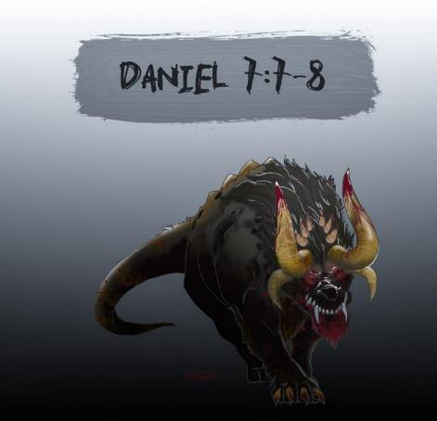
Description of 4 Beasts
4th Beast (V.7-8)
  Description
  Rome
  Legs of Iron
  Secular History
  63 Bc-70 AD
  10 Horns & Little Horn
  Revelation 13:2

Slide 29
DANIEL 7:2-14
Outline
4 Beasts Coming out of the Sea V.2-3
A Description of the 4 Beasts V.4-8
The Ancient of Days V. 9-12
The Son of Man V.13-14

Slide 30
Chapter 7 Outline
The Historical Setting (1)
The Vision (2-14)
The Vision’s Interpretation (15-27)
The Personal Impact on Daniel (28)

Slide 31
DANIEL 7:15-27
OUTLINE
The Vision Troubles Daniel V.15
Daniel Requests An Interpretation V.16
An Interpretation Is Given V. 17-18
Daniel Requests Further Explanation V. 19-22
Angelic Interpretation V. 23-27

Slide 32
DANIEL 7:15-27
OUTLINE
The Vision Troubles Daniel V.15
Daniel Requests An Interpretation V.16
An Interpretation Is Given V. 17-18
Daniel Requests Further Explanation V. 19-22
Angelic Interpretation V. 23-27

Slide 33
DANIEL 7:15-27
OUTLINE
The Vision Troubles Daniel V.15
Daniel Requests An Interpretation V.16
An Interpretation Is Given V. 17-18
Daniel Requests Further Explanation V. 19-22
Angelic Interpretation V. 23-27

Slide 34
DANIEL 7:15-27
OUTLINE
The Vision Troubles Daniel V.15
Daniel Requests An Interpretation V.16
An Interpretation Is Given V. 17-18
Daniel Requests Further Explanation V. 19-22
Angelic Interpretation V. 23-27

Slide 35
DANIEL 7:15-27
OUTLINE
The Vision Troubles Daniel V.15
Daniel Requests An Interpretation V.16
An Interpretation Is Given V. 17-18
Daniel Requests Further Explanation V. 19-22
Angelic Interpretation V. 23-27

Slide 36
DANIEL 7:15-27
OUTLINE
The Vision Troubles Daniel V.15
Daniel Requests An Interpretation V.16
An Interpretation Is Given V. 17-18
Daniel Requests Further Explanation V. 19-22
Angelic Interpretation V. 23-27

Slide 37
Angelic Interpretation
V. 23
  Daniel 2:40, 41-43
  World-wide empire

Slide 38
Angelic Interpretation
  V. 24
  A Ten King Confederacy
  A Revived Roman Empire
  EEC or ECM / European Common Market?
  The Antichrist Will Subdue 3 Kings

Slide 39
Angelic Interpretation
  V. 25
  His Boasting Mouth (Dan. 7:8,11,20; Rev 13:5-6)
  Persecution Of The Saints (Rev. 6:9-11; 13:7, 17:6; Matt. 24:9)
  The Creation of a New System
  Three And A Half Years (Dan. 9:27, 12:7; Rev. 12:6, 14; 13:5)

Slide 40
Angelic Interpretation
  V. 26
  The Ancient of Days Destroys the Little Horn
  The Ancient of Days is God the Father
  Dan. 9:27; 2 Thess. 2:8; Rev. 19:20
  Antichrist’s Rise and Fall

Slide 41
Angelic Interpretation
  V. 27
  The Millennium
    Rev. 11:15; Dan. 2:44-45
    Six Kingdoms?
  The saints receive the kingdom
    Judah’s Focus
    Our Hope
  An eternal kingdom
  Universal service and submission

Slide 42
Angelic Interpretation
  V. 27
  The Millennium
    Rev. 11:15; Dan. 2:44-45
    Six Kingdoms?
  The saints receive the kingdom
    Judah’s Focus
    Our Hope
  An eternal kingdom
  Universal service and submission

Slide 43
6 Empires
Babylon (7:4) 605-539 BC
Media-Persia (7:5) 539-331 BC
Greece (7:6) 331-63 BC
Rome I (7:7a) 63 BC – 70 AD
Rome II (7:7b-8) Tribulation
Kingdom (7:9-14) After 2nd Coming

Slide 44


Slide 45
Statue
&
Stone

Slide 46
Angelic Interpretation
  V. 27
  The Millennium
    Rev. 11:15; Dan. 2:44-45
    Six Kingdoms?
  The saints receive the kingdom
    Judah’s Focus
    Our Hope
  An eternal kingdom
  Universal service and submission

Slide 47
Angelic Interpretation
  V. 27
  The Millennium
    Rev. 11:15; Dan. 2:44-45
    Six Kingdoms?
  The saints receive the kingdom
    Judah’s Focus
    Our Hope
  An eternal kingdom
  Universal service and submission

Slide 48
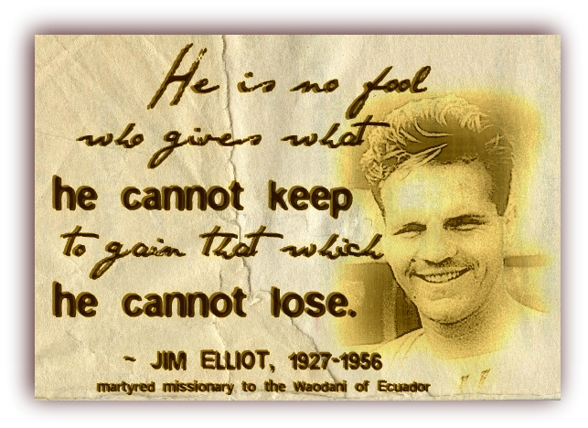

Slide 49
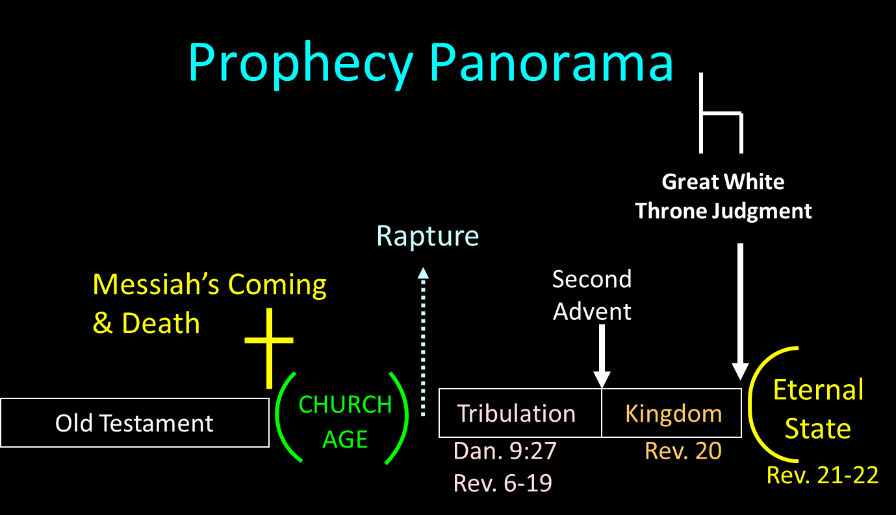

Slide 50
Angelic Interpretation
  V. 27
  The Millennium
    Rev. 11:15; Dan. 2:44-45
    Six Kingdoms?
  The saints receive the kingdom
    Judah’s Focus
    Our Hope
  An eternal kingdom
  Universal service and submission

Slide 51

Zechariah 14:16-18 (NASB)
“Then it will come about that any who are left of all the nations that went against Jerusalem will go up from year to year to worship the King, the Lord of hosts, and to celebrate the Feast of Booths. ¹⁷ And it will be that whichever of the families of the earth does not go up to Jerusalem to worship the King, the Lord of hosts, there will be no rain on them. ¹⁸ If the family of Egypt does not go up or enter, then no rain will fall on them; it will be the plague with which the Lord smites the nations who do not go up to celebrate the Feast of Booths.”

Slide 52
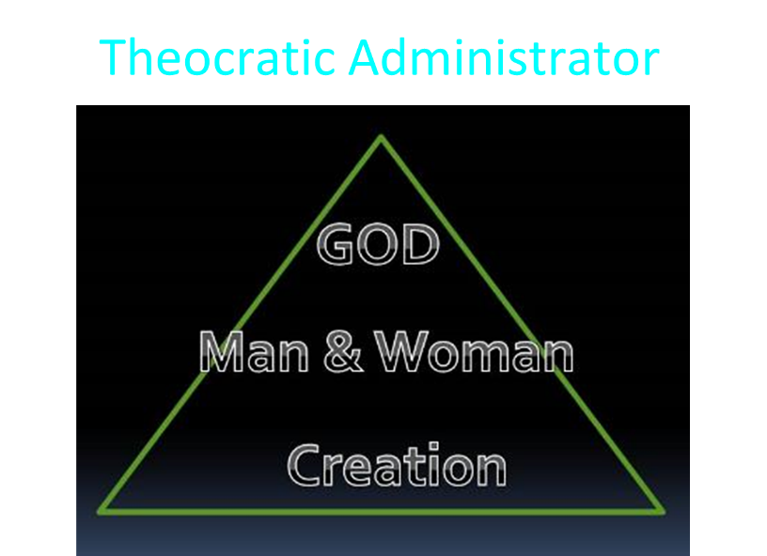

Slide 53
Chapter 7 Outline
The Historical Setting (1)
The Vision (2-14)
The Vision’s Interpretation (15-27)
The Personal Impact on Daniel (28)

Slide 54
THE EFFECT ON DANIEL
V. 28
Daniel is Traumatized
Dan. 7:15, 19, 21, 25
Daniel’s Heart for His People
Dan. 8:27

Slide 55
Conclusion

Slide 56
Chapter 7 Outline
The Historical Setting (1)
The Vision (2-14)
The Vision’s Interpretation (15-27)
The Personal Impact on Daniel (28)

