Slide 1
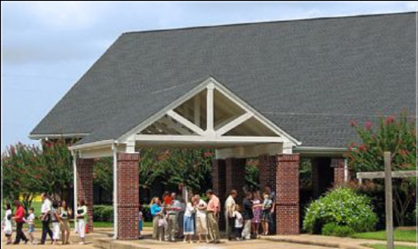
Beholding the Lord through His Word – Part 3
Jim McGowan, Th.D. Sugar Land Bible Church 06-25-2017.
This presentation was compiled using resources obtained from Dr. Vern Peterman, Holly Hills Bible Church – Used with permission.

Slide 2
Beholding the Lord through His word
Seeing the Living Word of God
in the written word of God

Slide 3
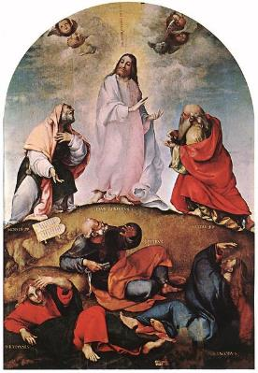
Beholding the Lord through His word
2 Corinthians 3:18
“But we all… beholding… the glory of the Lord”
John 1:14
“we saw His glory…full of grace and truth” (see 1:1-18)
Seeing the Living Word of God
in the written word of God

Slide 4
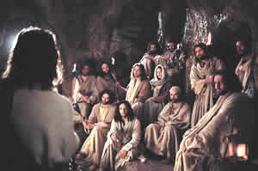
Beholding the Lord through His word
1 John 1:3
“we have seen with our eyes…the Word of Life” (see 1:1-4)
Hebrews 12:2
“fixing our eyes on Jesus” (see 12:1-2)
Seeing the Living Word of God
in the written word of God

Slide 5
1 John 1:1–4 (NASB95)
¹ What was from the beginning, what we have heard, what we have seen with our eyes, what we have looked at and touched with our hands, concerning the Word of Life— ² and the life was manifested, and we have seen and testify and proclaim to you the eternal life, which was with the Father and was manifested to us— ³ what we have seen and heard we proclaim to you also, so that you too may have fellowship with us; and indeed our fellowship is with the Father, and with His Son Jesus Christ. ⁴ These things we write, so that our joy may be made complete.

Slide 6
Outline
Preliminary Observations
Exegesis / Exposition of Verse 1
Exegesis / Exposition Verse 2
Exegesis / Exposition Verse 3-4

Slide 7
Outline
PRELIMINARY OBSERVATIONS
Exegesis / Exposition of Verse 1
Exegesis / Exposition Verse 2
Exegesis / Exposition Verse 3-4

Slide 8
PRELIMINARY OBSERVATIONS
Use of ‘we’ with reference to physical senses
Action based upon the response to physical senses.
The Apostle’s reason for writing.
The Apostle’s consistency in stating his purpose in his writings.

Slide 9
1 John 1:1–4 (NASB95)
¹ What was from the beginning, what we have heard, what we have seen with our eyes, what we have looked at and touched with our hands, concerning the Word of Life— ² and the life was manifested, and we have seen and testify and proclaim to you the eternal life, which was with the Father and was manifested to us— ³ what we have seen and heard we proclaim to you also, so that you too may have fellowship with us; and indeed our fellowship is with the Father, and with His Son Jesus Christ. ⁴ These things we write, so that our joy may be made complete.
Notes:
What ‘we’ have observed in 1 John 1:1-4

Slide 10
PRELIMINARY OBSERVATIONS
Use of ‘we’ with reference to physical senses
Actions based upon the response to physical senses.
The Apostle’s reason for writing.
The Apostle’s consistency in stating his purpose in his writings.

Slide 11
1 John 1:1–4 (NASB95)
¹ What was from the beginning, what we have heard, what we have seen with our eyes, what we have looked at and touched with our hands, concerning the Word of Life— ² and the life was manifested, and we have seen and testify and proclaim to you the eternal life, which was with the Father and was manifested to us— ³ what we have seen and heard we proclaim to you also, so that you too may have fellowship with us; and indeed our fellowship is with the Father, and with His Son Jesus Christ. ⁴ These things we write, so that our joy may be made complete.
Notes:
What ‘we’ did in response in 1 John 1:1-4

Slide 12
PRELIMINARY OBSERVATIONS
Use of ‘we’ with reference to physical senses
Action based upon the response to physical senses.
The Apostle’s reason for writing.
The Apostle’s consistency in stating his purpose in his writings.

Slide 13
1 John 1:1–4 (NASB95)
¹ What was from the beginning, what we have heard, what we have seen with our eyes, what we have looked at and touched with our hands, concerning the Word of Life— ² and the life was manifested, and we have seen and testify and proclaim to you the eternal life, which was with the Father and was manifested to us— ³ what we have seen and heard we proclaim to you also, so that you too may have fellowship with us; and indeed our fellowship is with the Father, and with His Son Jesus Christ. ⁴ These things we write, so that our joy may be made complete.
Notes:
Why ‘we’ proclaimed & wrote in 1 John 1:1-4

Slide 14
PRELIMINARY OBSERVATIONS
Use of ‘we’ with reference to physical senses
Action based upon the response to physical senses.
The Apostle’s reason for writing.
The Apostle’s consistency in stating his purpose in his writings.

Slide 15
John 20:30-31 (NASB95)
³⁰ Therefore many other signs Jesus also performed in the presence of the disciples, which are not written in this book; ³¹ but these have been written so that you may believe that Jesus is the Christ, the Son of God; and that believing you may have life in His name.
Notes:
Why ‘we’ proclaimed & wrote in 1 John 1:1-4

Slide 16
1 John 1:1–4 (NASB95)
¹ What was from the beginning, what we have heard, what we have seen with our eyes, what we have looked at and touched with our hands, concerning the Word of Life— ² and the life was manifested, and we have seen and testify and proclaim to you the eternal life, which was with the Father and was manifested to us— ³ what we have seen and heard we proclaim to you also, so that you too may have fellowship with us; and indeed our fellowship is with the Father, and with His Son Jesus Christ. ⁴ These things we write, so that our joy may be made complete.
Notes:
Why ‘we’ proclaimed & wrote in 1 John 1:1-4

Slide 17
Outline
Preliminary Observations
EXEGESIS / EXPOSITION OF VERSE 1
Exegesis / Exposition Verse 2
Exegesis / Exposition Verse 3-4

Slide 18
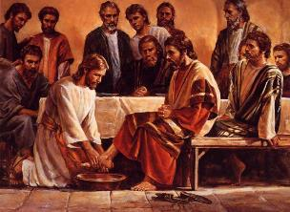
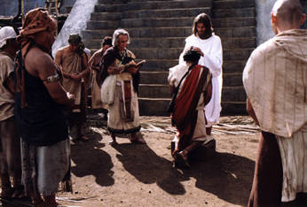
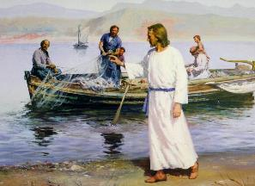
1 John 1:1 (NASB95)
¹ What was from the beginning, what we have heard, what we have seen with our eyes, what we have looked at and touched with our hands, concerning the Word of Life—

Slide 19
Genesis 1:1
In the beginning God created the heavens and the earth.
John 1:1
In the beginning was the Word, and the Word was with God, and the Word was God.

Slide 20
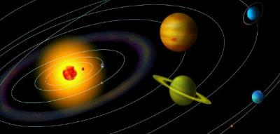
1 John 1:1 (NASB95)
¹ What was from the beginning, what we have heard, what we have seen with our eyes, what we have looked at and touched with our hands, concerning the Word of Life—
Notes:
In Genesis 1:1 & John 1:1, “In the beginning”, was the time God spoke the present creation into existence. But here it points to the beginning of the introduction of the gospel (confirmed by John’s use of the same phrase in 1 John 2:7, 13, 14, 24 & 3:11). John is writing these things to believers (1 John 5:13)

Slide 21
1 John 2:7 (NASB95)
Beloved, I am not writing a new commandment to you, but an old commandment which you have had from the beginning; the old commandment is the word which you have heard.

Slide 22
1 John 2:13-14a (NASB95)
¹³ I am writing to you, fathers, because you know Him who has been from the beginning. I am writing to you, young men, because you have overcome the evil one. I have written to you, children, because you know the Father. ¹⁴ I have written to you, fathers, because you know Him who has been from the beginning…

Slide 23
1 John 2:24 (NASB95)
As for you, let that abide in you which you heard from the beginning. If what you heard from the beginning abides in you, you also will abide in the Son and in the Father.

Slide 24
1 John 3:11 (NASB95)
For this is the message which you have heard from the beginning, that we should love one another;

Slide 25
1 John 5:13 (NASB95)
These things I have written to you who believe in the name of the Son of God, so that you may know that you have eternal life. (cf. John 20:30-31)
Notes:
What's interesting is John will often put his purpose and his target statements towards the end of the books that he writes. This is exactly what he does in 1 John 5:13.

Slide 26
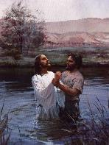
Revealing the poetic form of 1 John 1:1
¹ What was from the beginning,
what we have heard,
what we have seen with our eyes,
what we have looked at and
touched with our hands,
concerning the Word of Life—
Notes:
Who are the “WE”?

Slide 27
Revealing the poetic form of 1 John 1:1
¹ What was from the beginning,
what we have heard,
what we have seen with our eyes,
what we have looked at and
touched with our hands,
concerning the Word of Life—
Notes:
The ones John called ‘we’ were the ones who had heard, seen, looked at & touched the things concerning the Word of Life. These were the apostles, the ones who walked with the Lord day by day.

Slide 28
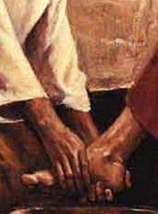
Revealing the poetic form of 1 John 1:1
¹ What was from the beginning,
what we have heard,
what we have seen with our eyes,
what we have looked at and
touched with our hands,
concerning the Word of Life—
Notes:
The Greek words translated ‘heard’ & ‘seen’ are in the perfect tense, so having heard & having seen were completed, but the results are ongoing.
John was saying that what Jesus had said was still ringing in the apostles’ ears & what they had seen was in their minds’ eye

Slide 29
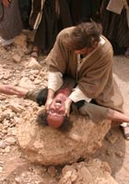
Revealing the poetic form of 1 John 1:1
¹ What was from the beginning,
what we have heard,
what we have seen with our eyes,
what we have looked at and
touched with our hands,
concerning the Word of Life—
Notes:
John refers to three senses (hearing, seeing & touching), twice being very physically specific: “with our eyes”, “with our hands”. ‘Seen’ means to actively view to gain insight, & ‘looked at’ means to actively behold, looking closely, understanding the significance).

Slide 30
John 1:14 (NASB95)
And the Word became flesh, and dwelt among us, and we saw His glory, glory as of the only begotten from the Father, full of grace and truth.
1 John 1:1 (NASB95)
¹ What was from the beginning, what we have heard, what we have seen with our eyes, what we have looked at and touched with our hands, concerning the Word of Life—
Notes:
Remember John 1:14?
The word in John 1:14 translated “we saw” (KJV: beheld) is the same one translated “looked at” in 1 John 1:1. θεάομαι theáomai - To behold, view attentively, contemplate, indicating the sense of a wondering consideration involving a careful and deliberate vision which interprets its object. Zodhiates, S. (2000). The complete word study dictionary: New Testament (electronic ed.). Chattanooga, TN: AMG Publishers.

Slide 31
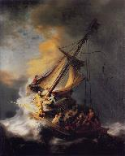
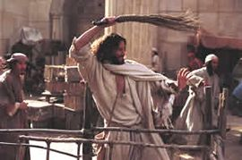
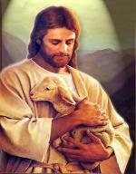
1 John 1:1 (NASB95)
¹ What was from the beginning, what we have heard, what we have seen with our eyes, what we have looked at and touched with our hands, concerning the Word of Life—
Notes:
John repeatedly called Christ ‘the Word’, varying the words that went alongside.

Slide 32
John 1:1
In the beginning was the Word, and the Word was with God, and the Word was God.
John 1:14
And the Word became flesh, and dwelt among us, and we saw His glory, glory as of the only begotten from the Father, full of grace and truth.
Revelation 19:13b
…and His name is called, The Word of God.

Slide 33
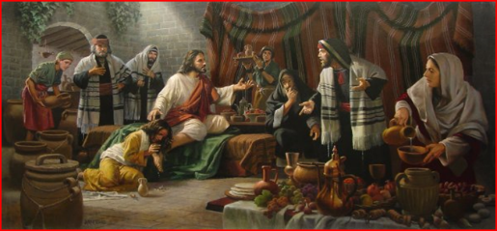
1 John 1:1
What was from the beginning, what we have heard, what we have seen with our eyes, what we have looked at and touched with our hands, concerning the Word of Life—
Notes:
John is very clear about the character of the Word of Life – Jesus Christ: as John & the others in close company with Christ lived right alongside Him, even witnessing Christ’s death & resurrection & ascension into the heavenlies first hand, John was emphatic that He was very real!

Slide 34
John 20:24–27 (NASB95)
²⁴ But Thomas,…said to them, “Unless I see in His hands the imprint of the nails, and put my finger into the place of the nails, and put my hand into His side, I will not believe.”…Jesus came,…said to Thomas, “Reach here with your finger, and see My hands; and reach here your hand and put it into My side; and do not be unbelieving, but believing.”

Slide 35
1 John 1:1
What was from the beginning, what we have heard, what we have seen with our eyes, what we have looked at and touched with our hands, concerning the Word of Life—
Ὃ ἦν ἀπ̓ ἀρχῆς, ὃ ἀκηκόαμεν, ὃ ἑωράκαμεν τοῖς ὀφθαλμοῖς ἡμῶν, ὃ ἐθεασάμεθα καὶ αἱ χεῖρες ἡμῶν ἐψηλάφησαν περὶ τοῦ λόγου τῆς ζωῆς-
Notes:
The Greek of the end of verse 1 literally says, “the Word of the Life”. What does that tell us?
John understood Jesus Christ - the one with whom he & the other apostles walked & lived & talked & ate - as the singular expression of God Himself, who was also the one source of spiritual life, that is, true life.

Slide 36
1 John 1:1
What was from the beginning, what we have heard, what we have seen with our eyes, what we have looked at and touched with our hands, concerning the Word of Life—
Notes:
The Greek of the end of verse 1 literally says, “the Word of the Life”. What does that tell us?
John understood Jesus Christ - the one with whom he & the other apostles walked & lived & talked & ate - as the singular expression of God Himself, who was also the one source of spiritual life, that is, true life.

Slide 37
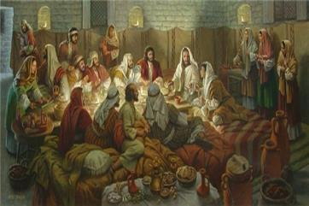
1 John 1:1
What was from the beginning, what we have heard, what we have seen with our eyes, what we have looked at and touched with our hands, concerning the Word of Life—
Notes:
What was John talking about when he wrote that they ‘touched’ the Word of Life?

Slide 38
John 20:19-20 (NASB95)
¹⁹ So when it was evening on that day, the first day of the week, and when the doors were shut where the disciples were, for fear of the Jews, Jesus came and stood in their midst and said to them, “Peace be with you.” ²⁰ And when He had said this, He showed them both His hands and His side. The disciples then rejoiced when they saw the Lord.
Notes:
Christ, after He was resurrected, appeared as told in John 20:24-25

Slide 39
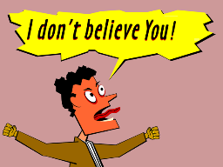
John 20:24–25 (NASB95)
²⁴ But Thomas, one of the twelve, called Didymus, was not with them when Jesus came. ²⁵ So the other disciples were saying to him, “We have seen the Lord!” But he said to them, “Unless I see in His hands the imprint of the nails, and put my finger into the place of the nails, and put my hand into His side, I will not believe.”
Notes:
Christ, after He was resurrected, appeared as told in John 20:24-25

Slide 40
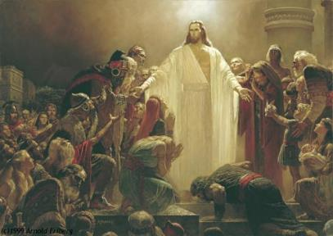
John 20:26 (NASB95)
²⁶ After eight days His disciples were again inside, and Thomas with them. Jesus came, the doors having been shut, and stood in their midst and said, “Peace be with you.”

Slide 41
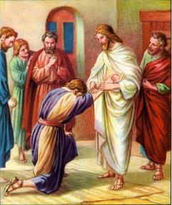
John 20:27 (NASB95)
²⁷ Then He said to Thomas, “Reach here with your finger, and see My hands; and reach here your hand and put it into My side; and do not be unbelieving, but believing.”

Slide 42
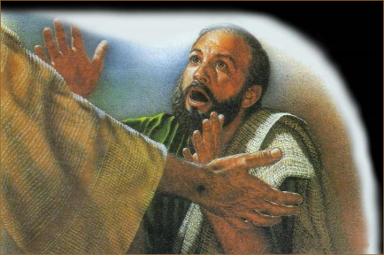
John 20:28–29 (NASB95)
²⁸ Thomas answered and said to Him, “My Lord and my God!” ²⁹ Jesus said to him, “Because you have seen Me, have you believed? Blessed are they who did not see, and yet believed.” (cf. Luke 24:36-43)

Slide 43
Outline
Preliminary Observations
Exegesis / Exposition of Verse 1
EXEGESIS / EXPOSITION VERSE 2
Exegesis / Exposition Verse 3-4

Slide 44
1 John 1:2 (NASB95)
² and the life was manifested, and we have seen and testify and proclaim to you the eternal life, which was with the Father and was manifested to us—

Slide 45
Revealing the poetic form of 1 John 1:2
and the life was manifested [to us],
and we have seen
and [we] testify
and [we] proclaim to you
the eternal life,
which was with the Father
and [the life] was manifested to us--

Slide 46
1 John 1:2 (NASB95)
² and the life was manifested, and we have seen and testify and proclaim to you the eternal life, which was with the Father and was manifested to us—
John 21:1 (NASB95)
¹ After these things Jesus manifested Himself again to the disciples at the Sea of Tiberias, and He manifested Himself in this way.

Slide 47
1 John 1:2 (NASB95)
² and the life was manifested, and we have seen and testify and proclaim to you the eternal life, which was with the Father and was manifested to us—
Notes:
Why both testify & proclaim?
Both are verbal or written expressions, but ‘to testify’ is to tell the truth about something, & to proclaim is to make the message quite public.

Slide 48
Acts 9:20 (NASB95)
and immediately [Saul] began to proclaim Jesus in the synagogues, saying, “He is the Son of God.”
1 John 4:14 (NASB95)
We have seen and testify that the Father has sent the Son to be the Savior of the world.
Notes:
These are exactly the things the apostles did (Acts 9:20; 1 John 4:14).

Slide 49
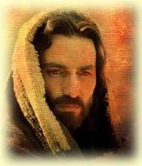
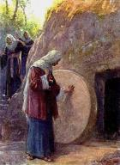
1 John 1:2 (NASB95)
² and the life was manifested, and we have seen and testify and proclaim to you the eternal life, which was with the Father and was manifested to us—
Notes:
The Greek text at the end of the 2nd line literally says “the life, the eternal”, having the idea “the life, [that is], the eternal one’.
Why? John wrote about “life” over a dozen times in this letter.
He recognized the unfathomable value of Real Life!
But when John says that Christ is eternal, his meaning goes beyond just ‘infinite in time’ to convey that Christ is Real Life: enduring, changeless, a certain hope.
Christ, who is ‘the Life’ of us, in Colossians 3:3-4

Slide 50
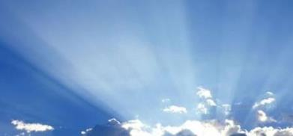
Colossians 3:3–4 (NASB95)
³ For you have died and your life [the life of you] is hidden with Christ in God. ⁴ When Christ, who is our life, [the life of us] is revealed, then you also will be revealed with Him in glory.
Notes:
the Life of you
the Life of us

Slide 51
If these things are true, (and they are), why would you worry?

Slide 52
John 14:1-6 (NASB95)
¹Do not let your heart be troubled; believe in God, believe also in Me. ²"In My Father's house are many dwelling places; if it were not so, I would have told you; for I go to prepare a place for you. ³"If I go and prepare a place for you, I will come again and receive you to Myself, that where I am, there you may be also. ⁴"And you know the way where I am going." ⁵Thomas said to Him, "Lord, we do not know where You are going, how do we know the way?" ⁶Jesus said to him, "I am the way, and the truth, and the life; no one comes to the Father but through Me.
Notes:
Christ, the Life, in John 14:1-6
‘I go and prepare a place for you’ are the words the Groom would say to his Bride!

Slide 53
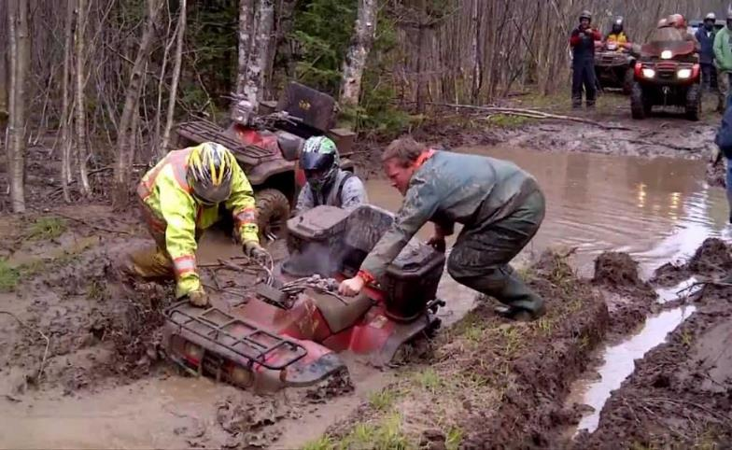
Have you ever wished that somebody had posted a warning sign?
Notes:
Ever wished somebody had posted a warning sign?

Slide 55
JOHN IS ALSO ISSUING A CRITICAL WARNING
Saying that Christ is not actual and real is a spiritual dead end. (Docetism)
Saying that Christ is only spiritually or mystically true is also a spiritual dead end. (Gnosticism)

Slide 56
John 19:26–27 (NASB95)
²⁶ When Jesus then saw His mother, and the disciple whom He loved standing nearby, He said to His mother, “Woman, behold, your son!” ²⁷ Then He said to the disciple, “Behold, your mother!” From that hour the disciple took her into his own household.

Slide 57
JOHN IS ALSO ISSUING A CRITICAL WARNING
Saying that Christ didn’t actually die and resurrect physically in a real body is a spiritual dead end.
Saying that we can find life in anyone or anything else is a also spiritual dead end.

Slide 58
Outline
Preliminary Observations
Exegesis / Exposition Of Verse 1
Exegesis / Exposition Verse 2
Exegesis / Exposition Verse 3-4

Slide 59
1 John 1:3–4 (NASB95)
³ what we have seen and heard we proclaim to you also, so that you too may have fellowship with us; and indeed our fellowship is with the Father, and with His Son Jesus Christ. ⁴ These things we write, so that our joy may be made complete.

Slide 60
Revealing the poetic form of 1 John 1:3-4
what we have seen and heard
we proclaim to you also,
so that you too may have fellowship with us; and indeed our fellowship is with the Father, and with His Son Jesus Christ.
These things
we write,
so that our joy may be made complete.

Slide 61
1 John 1:3–4 (NASB95)
³ what we have seen and heard we proclaim to you also, so that you too may have fellowship with us; and indeed our fellowship is with the Father, and with His Son Jesus Christ. ⁴ These things we write, so that our joy may be made complete.
Notes:
These words summarize the first two verses in order to tell us the ‘Why are we doing this’? questions addressed in the rest of verse 3 & in verse 4.

Slide 62
1 John 1:3–4 (NASB95)
³ what we have seen and heard we proclaim to you also, so that you too may have fellowship with us; and indeed our fellowship is with the Father, and with His Son Jesus Christ. ⁴ These things we write, so that our joy may be made complete.
Notes:
The ‘really big becauses’ given in 1 John 1:3-4

Slide 63
Revealing the poetic form of 1 John 1:3-4
what we have seen and heard
we proclaim to you also,
so that you too may have fellowship with us; and indeed our fellowship is with the Father, and with His Son Jesus Christ.
These things
we write,
so that our joy may be made complete.
Notes:
John has invited us to join in the very same fellowship that the apostles themselves had with each other because of knowing Christ

Slide 64
Revealing the poetic form of 1 John 1:3-4
what we have seen and heard
we proclaim to you also,
so that you too may have fellowship with us; and indeed our fellowship is with the Father, and with His Son Jesus Christ.
These things
we write,
so that our joy may be made complete.
Notes:
The fellowship that John invited us to join is not only among humans, but with the Father & with Jesus Christ, His Son – in whom we are

Slide 65
Revealing the poetic form of 1 John 1:3-4
what we have seen and heard
we proclaim to you also,
so that you too may have fellowship with us; and indeed our fellowship is with the Father, and with His Son Jesus Christ.
These things
we write,
so that our joy may be made complete.
Notes:
This joy to which John has invited us is not simply a modest improvement. It is total & full & complete - & not from earthly circumstances!

Slide 66
1 John 1:4 (NASB95)
⁴ These things we write, so that our joy may be made complete.
John 17:13 (NASB95)
“But now I come to You; and these things I speak in the world so that they may have My joy made full in themselves.
Notes:
The ‘really big becauses’ given in 1 John 1:3-4

Slide 67
Revealing the poetic form of 1 John 1:3-4
what we have seen and heard
we proclaim to you also,
so that you too may have fellowship with us; and indeed our fellowship is with the Father, and with His Son Jesus Christ.
These things
we write,
so that our joy may be made complete.
Notes:
This joy to which John has invited us is not simply a modest improvement. It is total & full & complete - & not from earthly circumstances!

Slide 69
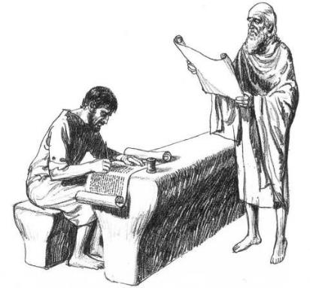
WHAT’S THE POINT OF ALL THIS?
Paul wrote that as we behold the Lord through His written word, we are changed from glory to glory (2 Corinthians 3:18)
God’s written word is His glory growth tool in our lives!

Slide 70
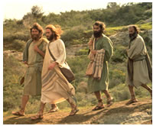
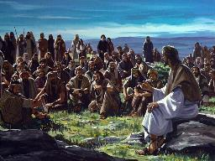
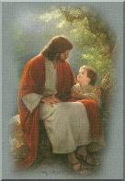
WHAT’S THE POINT OF ALL THIS?
John wrote that when Christ walked this earth, he and the apostles did behold His glory (John 1:14)
We are therefore changed from glory to glory as we read and hear of John beholding Christ

Slide 71
CONCLUSION

Slide 72
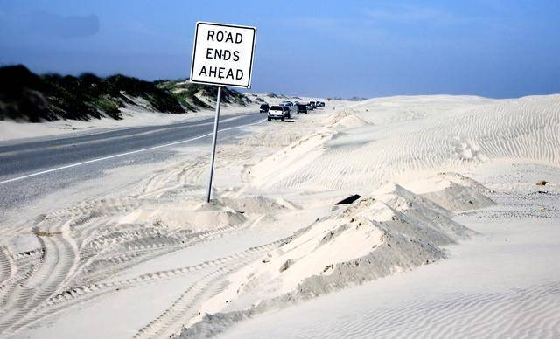
WHERE DOES THIS ALL END… OR DOES IT?

Slide 73
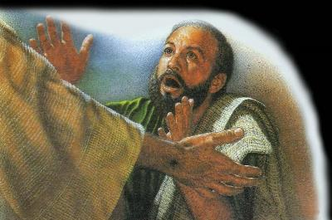
WHERE DOES THIS ALL END… OR DOES IT?
Here in today’s passage (1 John 1:1-4), we find that John’s beholding, touching and hearing Christ - the Life, the eternal One - is a continuously open invitation for us to join in a fellowship…

Slide 74
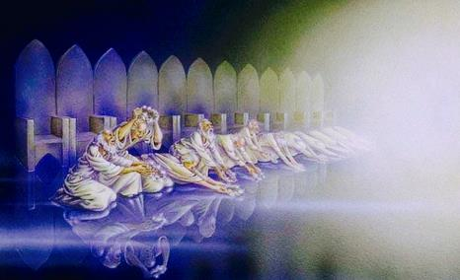
WHERE DOES THIS ALL END… OR DOES IT?
It is a fellowship the apostles shared with one another, and with the Father of glory and with Jesus Christ, His glorious Son
That is not a joy that disappoints, but is full, complete, total, and eternal – the Life!

