Slide 1
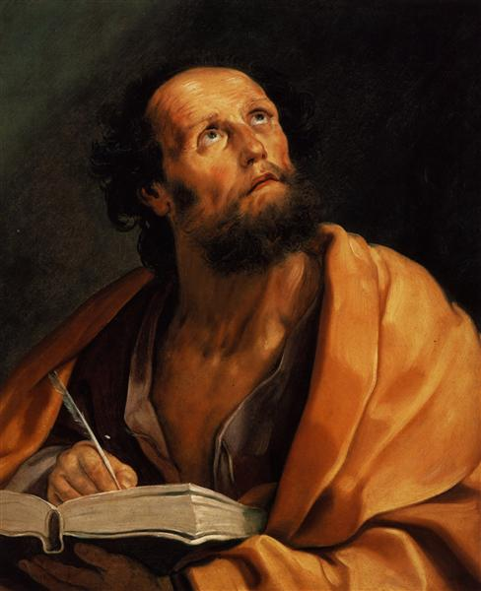
Lessons in Luke
The life and works of Luke

Slide 2
Luke
The Book of Luke is unique

Slide 3
Luke
The Book of Luke is unique
Synoptics

Slide 4
Luke
The Book of Luke is unique
Synoptics
Unique Qualities

Slide 5
Luke
The Book of Luke is unique
Synoptics
Unique Qualities
Longest book of NT

Slide 6
Luke
The Book of Luke is unique
Synoptics
Unique Qualities
Longest book of NT
Most Literary

Slide 7
Luke
The Book of Luke is unique
Synoptics
Unique Qualities
Longest book of NT
Most Literary
Exclusive material/events/quotes

Slide 8
Luke
2. The Author

Slide 9
Luke
2. The Author
External Evidence

Slide 10
Luke
2. The Author
External Evidence
Internal Evidence

Slide 11
Luke
2. The Author
External Evidence
Internal Evidence
Characteristics of Luke

Slide 12
Luke
2. The Author
External Evidence
Internal Evidence
Characteristics of Luke
Gentile believer

Slide 13
Luke
2. The Author
External Evidence
Internal Evidence
Characteristics of Luke
Gentile believer
Humble

Slide 14
Humility
“…humility is considered the proper attitude of human beings toward their Creator. Humility is a grateful and spontaneous awareness that life is a gift, and it is manifested as an ungrudging and unhypocritical acknowledgment of absolute dependence upon God”
Walter A. Elwell and Philip Wesley Comfort, Tyndale Bible Dictionary, Tyndale Reference Library (Wheaton, IL: Tyndale House Publishers, 2001), 618.

Slide 15
Philippians 2:5-8
“Have this attitude in yourselves which was also in Christ Jesus, who, although He existed in the form of God, did not regard equality with God a thing to be grasped, but emptied Himself, taking the form of a bond-servant, and being made in the likeness of men. Being found in appearance as a man, He humbled Himself by becoming obedient to the point of death, even death on a cross.”

Slide 16
Humility
“…humility is considered the proper attitude of human beings toward their Creator. Humility is a grateful and spontaneous awareness that life is a gift, and it is manifested as an ungrudging and unhypocritical acknowledgment of absolute dependence upon God”
Walter A. Elwell and Philip Wesley Comfort, Tyndale Bible Dictionary, Tyndale Reference Library (Wheaton, IL: Tyndale House Publishers, 2001), 618.

Slide 17
Luke
2. The Author
External Evidence
Internal Evidence
Characteristics of Luke
Gentile believer
Humble
Faithful

Slide 18
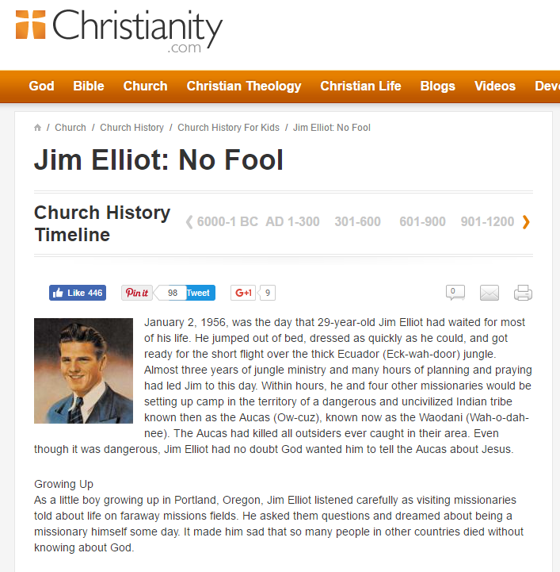
Source: http://www.christianity.com/church/church-history/church-history-for-kids/jim-elliot-no-fool-11634862.html

Slide 19
Luke
2. The Author
External Evidence
Internal Evidence
Characteristics of Luke
Gentile believer
Humble
Faithful
Beloved Physician

Slide 20
http://info.fortbendchristian.org/blog/fbca-alumni-emily-parker-christian-service?utm_content=55928467&utm_medium=social&utm_source=facebook

Slide 21
Luke was also…
2. The Author
C. Characteristics of Luke (Cont.)
Not an eye witness
Theologian
Historian
Faithful Preacher
D. Purpose of the Book

Slide 22
Conclusion

Slide 23
Lessons in Luke
The life and works of Luke

