Slide 1
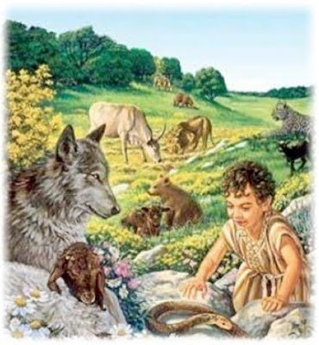
A Review of The Millennial Kingdom Part 1
Jim McGowan, Th.D. Sugar Land Bible Church 05-03-2017
This presentation was compiled using the following resources: Charting the End Times; Major Bible Themes, Not By Bread Alone: An Outlined Guide to Bible Doctrine, The Footsteps of the Messiah: A Study of the Sequence of Prophetic Events, The Prophecy Knowledge Handbook, and materials provided by Dr. Andy Woods and Dr. Vern Peterman.

Slide 2
Outline
Overview of the Millennial Kingdom
Millennial Views of the Kingdom
Nature of Millennium

Slide 3
Outline
Overview of the Millennial Kingdom
Millennial Views of the Kingdom
Nature of Millennium

Slide 4
Overview of the Millennial Kingdom
From the 2nd Coming to the Millennial Kingdom
A Panoramic View of the Millennial Kingdom

Slide 5
From the 2nd Coming to the Millennial Kingdom

Slide 6
Overview of the Millennial Kingdom
From the 2nd Coming to the Millennial Kingdom
A Panoramic View of the Millennial Kingdom

Slide 7
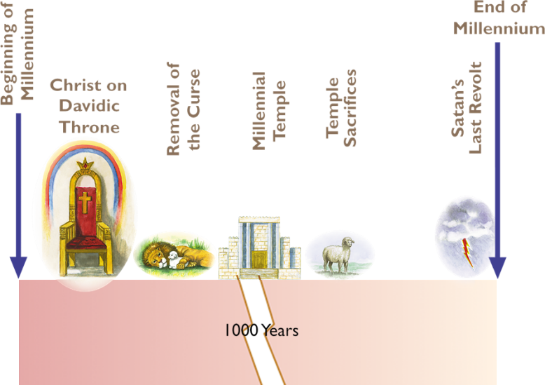
A Panoramic View of the Millennial Kingdom

Slide 8
Outline
Overview of the Millennial Kingdom
Millennial Views of the Kingdom
Nature of Millennium

Slide 9
Millennial Views of the Kingdom
Amillennial
Post-Millennial
Pre-Millennial

Slide 10
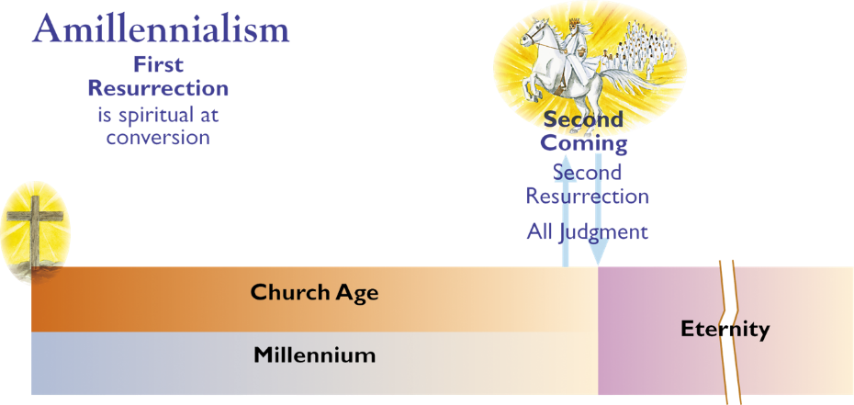
Millennial Views of the Kingdom

Slide 11
Millennial Views of the Kingdom
Amillennial interpretations
Augustinian - there will be no literal future thousand-year reign of Christ on earth. The Millennium refers to the present age or possibly the last thousand years of the present age.
Modified Amillennial interpretations
The Millennium is fulfilled in the time between the death and resurrection of a Christian.
The Millennium will be fulfilled in the new heaven and the new earth described in Revelation 21–22.

Slide 12
Millennial Views of the Kingdom
Modified Amillennial interpretations (cont’d)
Millennial passages are conditional and will not be fulfilled due to the departure of Israel from the faith. Still others suggest that the kingdom on earth was fulfilled in the reign of Solomon who controlled the land promised to Abraham (Gen. 15:18).
The neoorthodox view considers the kingdom being fulfilled now in the experience of individual Christians.

Slide 13
Millennial Views of the Kingdom
Amillennial
Post-Millennial
Pre-Millennial

Slide 14
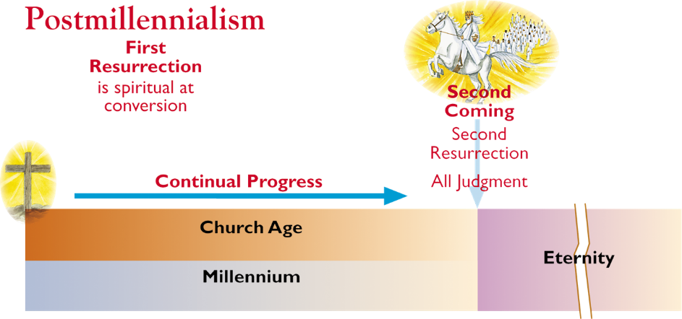
Millennial Views of the Kingdom

Slide 15
Millennial Views of the Kingdom
Post-Millennial interpretations
18th Century - the Gospel will triumph to such an extent in the world that the whole world will be Christianized, bringing in a golden age which will correspond to the millennial kingdom. The Millennium will be the last 1,000 years of the present age.
20th Century - influenced by evolution, has become less biblical and adopted the concept of spiritual progress over a long period of time as in a general way bringing in a golden age. It is not considered orthodox.

Slide 16
Millennial Views of the Kingdom
Amillennial
Post-Millennial
Pre-Millennial

Slide 17
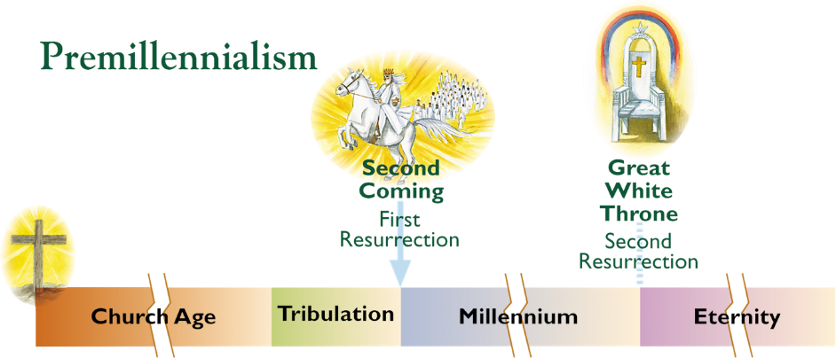
Millennial Views of the Kingdom

Slide 18
Millennial Views of the Kingdom
Pre-Millennial
This was the predominant view of the early church as witnessed by the early church fathers. It wasn’t until the 3rd century, under the influence of the Alexandria school of theology, that allegorical interpretation of Scripture, succeeded in displacing the premillennial view.
The premillennial interpretation has no liberal adherents because it takes the view all scripture including prophecies, are to be interpreted in their normal literal sense, using a consistent hermeneutic.

Slide 19
Outline
Overview of the Millennial Kingdom
Millennial Views of the Kingdom
Nature of Millennium

Slide 20
Nature of Millennium
Duration of the Kingdom
General Conditions
Political Conditions
Governors, Governed In Millennium
Spiritual Conditions

Slide 21
Nature of Millennium
Duration of the Kingdom
General Conditions
Political Conditions
Governors, Governed In Millennium

Slide 22
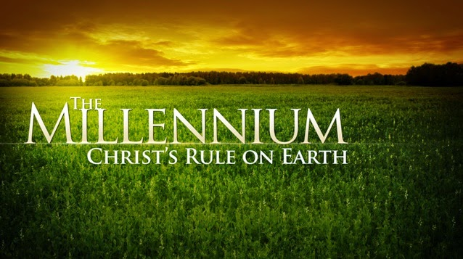
Duration of the Kingdom
1000 years
Eternal

Slide 23
Duration of the Kingdom
1000 years
The term Millennium comes from a Latin phrase meaning “one-thousand years.” There are six references to 1,000 years within Rev. 20:1-7.

Slide 24
Duration of the Kingdom
Eternal
Most Scriptures also speak of an eternal aspect to Messiah’s Kingdom on earth (cf. 2 Sam. 7:13, 28-29; 1 Chron. 17:12, 14, 23; Psa. 72:5, 17; 89:3-4, 34-37; Isa. 9:6-7; 55:3; 56:5; 60:19-21; 61:8; Jer. 32:40; 33:14-17, 20-21; Ezek. 16:60; 43:7-9; Dan. 9:24; Hosea 2:19; Amos 9:15; and Luke 1:30-33).

Slide 25
Duration of the Kingdom
While most of the time we think in terms of the 1,000 years time frame for the Theocratic Kingdom, we must understand that Christ’s rule over the earth will continue eternally. So in one sense the Millennial Kingdom does come to an end, but in a fuller sense, it is actually eternal. Perhaps a better way of looking at it is that at the end of 1,000 years, there will be a new and different phase of the Theocratic Kingdom.
The reason the Kingdom can be viewed as both ending after 1,000 years and yet continuing eternally is that 1,000 years marks the earth’s transformation into sinless resubmission to God and a total merger into the rest of God’s universal Kingdom. At the end of the first 1,000 years the earthly Kingdom merges with the eternal Kingdom (1 Cor. 15:24-28).

Slide 26
Nature of Millennium
Duration of the Kingdom
General Conditions
Political Conditions
Governors, Governed In Millennium
Spiritual Conditions

Slide 27
General Conditions
Better Health Conditions
Increased Fertility
Labor and Productivity
Partial Removal of Curse
Glory
Joy
Wealth

Slide 28
General Conditions
Better Health Conditions
The effects of sin’s curse will be greatly diminished, but surviving “Tribulation believers” entering the millennial Kingdom in an unglorified state, will still be subject to physical sickness and even death. They will still have a sin nature.
Isaiah teaches that death at age 100 will be considered premature in the coming Kingdom (Isa. 65:20).
Some theologians believe that sickness will only come as a result of willful sin (cf. Jer. 31:30).
Isa. 29:18; 33:24, 35:5-6; 65:20; Jer. 30:17; Ezek. 34:16; Mal. 4:2

Slide 29
General Conditions
Increased Fertility
There will be both glorified and non-glorified people in the Kingdom. Initially, glorified saints (O.T. saints, Church saints, and martyred tribulation saints) will most likely greatly outnumber the surviving tribulation saints who still possess “normal” bodies.
Given the better health conditions women will likely be fruitful for centuries with no danger of death in childbirth so eventually “glorified saints” will be kept very busy administering a huge population.
Deut. 30:9; Jer. 30:19b-20a; 31:27; Isa. 65:20a; Ezek. 36:10-11

Slide 30
General Conditions
Labor and Productivity
There will be increased rainfall in areas that are now agriculturally unproductive and it is possible that the sun will be modified to increase crop yield. (Isa. 30:23-26; 35: 6b-7; Ezek. 34:26; Joel 2:23)
The human race will forget famine and hunger. (Isa. 32:15; 35:1-2a; Jer. 31:12; Ezek. 34:27; 36:8-11, 29-30; Joel 2:21-27; 3:18; Amos 9:13-14a; Zech. 8:11-12; 9:17)
Many verses give a picture of normal human work in the Kingdom such as planting and building (Deut 30:9; Isa. 62:8-9; 65:21-23; Jer. 31:5, 23-25).

Slide 31
General Conditions
Labor and Productivity (cont’d)
The Word of God emphasizes the fair distribution of wealth where only those who refuse to worship Christ will suffer.
Micah 4:4; Isa. 62:8-9; Isa. 65:22; cf. Zech. 14:16-19

Slide 32
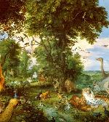
General Conditions
Partial Removal of Curse
Increase in lifespans, fertility, productivity, the reduction of sickness, and especially changes in animal behavior all indicate a lessening of sin’s harmful affects.
The millennial Kingdom will not be a total eradication of sin or a total removal of its curse, but the Millennium will bring in a great reduction in sorrow caused by sin.

Slide 33
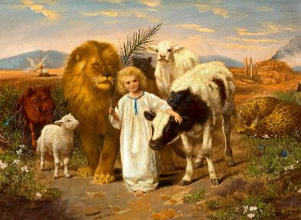
General Conditions
Partial Removal of Curse
Millennial conditions for animals will revert to the pre-fall status when they did not consume meat and were tame and friendly to man.
Isa. 11:6-9; 35:9; 65:25; Ezek. 34:25; Hosea 2:18

Slide 34
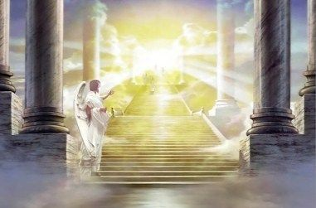
General Conditions
Glory
Christ will return in a glorious manner and bring glory to the world. The Millennium will be a time of unimaginable splendor with visible displays of God’s power, majesty, and wealth.
Isa. 4:5; Isa. 24:23; 35:2b; 40:5; 60:1-3; 66:18

Slide 35
General Conditions
Joy
The Kingdom period will be a time of happiness and joy. Physical and emotional pain will be replaced by joy that comes from the personal presence of Christ the King.
Isa. 14:7; 25:8-9; 30:29 ; 42:10-12; 60:15; 61:7; 65:18-19; 66:10-14; Jer. 30:18-19; 31:13-14; Zeph. 3:14-17

Slide 36
General Conditions
Wealth
The wealth of the world will pour into Jerusalem and be given to Christ to whom it belongs.
This wealth will come from existing nations in the Millennium.
Isa. 19:21-23; 60:3-17; Zech. 14:14, 18; Haggai 2:7; Rev. 21:24; 22:2

Slide 37
CONCLUSION - PART 1
An Review of The Millennial Kingdom

Slide 38
Outline
Overview of the Millennial Kingdom
Millennial Views of the Kingdom
Nature of Millennium

Slide 39
Overview of the Millennial Kingdom
From the 2nd Coming to the Millennial Kingdom
A Panoramic View of the Millennial Kingdom

Slide 41
Outline
Overview of the Millennial Kingdom
Millennial Views of the Kingdom
Nature of Millennium

Slide 42
Millennial Views of the Kingdom
Amillennial
Post-Millennial
Pre-Millennial

Slide 44
Outline
Overview of the Millennial Kingdom
Millennial Views of the Kingdom
Nature of Millennium

Slide 45
Nature of Millennium
Duration of the Kingdom
General Conditions
Political Conditions
Governors, Governed In Millennium
Spiritual Conditions

Slide 46
Duration of the Kingdom
1000 years
Eternal

Slide 47
Nature of Millennium
Duration of the Kingdom
General Conditions
Political Conditions
Governors, Governed In Millennium
Spiritual Conditions

Slide 48
General Conditions
Better Health Conditions
Increased Fertility
Labor and Productivity
Partial Removal of Curse
Glory
Joy
Wealth

Slide 49
Nature of Millennium
Duration of the Kingdom
General Conditions
Political Conditions
Governors, Governed In Millennium
Spiritual Conditions

