Slide 1
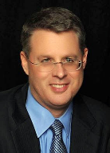
Soteriology Session 57
Dr. Andy Woods
Senior Pastor – Sugar Land Bible Church
President – Chafer Theological Seminary

Slide 2
Soteriology Overview
Definition
Election
Atonement
Salvation words
God’s one condition of salvation
Results of salvation
Eternal security
Faulty views of salvation

Slide 3
FINAL EXAM!

Slide 4
Results of Salvation
Sonship/adoption (Gal 4:5-7; Rom 8:14-17)
Eternal life (John 3:16)
Regeneration (John 3:5; Titus 3:5)
Justification (Rom 8:33-34)
Forgiveness of all pre-cross sins (Acts 17:30; Rom 3:25)
Good works (Eph 2:8-10)
Sanctification (John 17:17)
Glorification (Rom 8:30)
End of the Law (Rom 10:4)
Miscellaneous privileges (Philip 3:20; 1 Pet 2:5, 9; Rev 19:7; 1 Pet 1:4; Rom 5:1)

Slide 5
Capacity for Good Works
Good works – Ephes. 2:8-10; Jas 2:18, 26
Overcoming habitual sins that characterize unbelievers – Gal. 5:19-21; 1 Cor. 6:9-10; Eph. 5:5; Rev. 21:8; 22:15
Desirable but not automatic
Good works – John 15:8
Habitual Sin – 2 Pet 2:7; 1 Cor. 3:15; 6:19

Slide 6
James 2:14–26
(NASB95)
¹⁴ What use is it, my brethren, if someone says he has faith but he has no works? Can that faith save him? ¹⁵ If a brother or sister is without clothing and in need of daily food, ¹⁶ and one of you says to them, “Go in peace, be warmed and be filled,” and yet you do not give them what is necessary for their body, what use is that? ¹⁷ Even so faith, if it has no works, is dead, being by itself. ¹⁸ But someone may well say, “You have faith and I have works; show me your faith without the works, and I will show you my faith by my works.” ¹⁹ You believe that God is one. You do well; the demons also believe, and shudder. ²⁰ But are you willing to recognize, you foolish fellow, that faith without works is useless? ²¹ Was not Abraham our father justified by works when he offered up Isaac his son on the altar? ²² You see that faith was working with his works, and as a result of the works, faith was perfected; ²³ and the Scripture was fulfilled which says, “And Abraham believed God, and it was reckoned to him as righteousness,” and he was called the friend of God. ²⁴ You see that a man is justified by works and not by faith alone. ²⁵ In the same way, was not Rahab the harlot also justified by works when she received the messengers and sent them out by another way? ²⁶ For just as the body without the spirit is dead, so also faith without works is dead.

Slide 7
Harmony Between Paul and James
 | PAUL | JAMES
Issue | Self righteous Judaism | Dead orthodoxy
Justification | Declaration of innocence before God | Evidence of the believer's useful faith before man
Genesis | Gen 15:6 | Gen 22
Faith | Justification – “Abram” | Sanctification – “Abraham”
Works | Favor with God | Believer's moral deeds

Slide 8
JUSTIFICATION – SALVATION | DISCIPLESHIP
FREE GIFT | COSTLY
RECEIVED THROUGH FAITH | ENTERED INTO THROUGH COMMITMENT AND OBEDIENCE THROUGH THE SPIRIT’S ENABLEMENT
NOT BY WORKS | INVOLVES OUR COOPERATION
INSTANT | LIFE-LONG PROCESS
JUSTIFICATION | SANCTIFICATION
JESUS PAID THE PRICE | BELIEVER PAYS THE PRICE
TRUSTING JESUS AS SAVIOR | FOLLOWING JESUS AS LORD
BELIEVE THE GOSPEL | OBEY THE COMMANDS
ONE CONDITION | MULTIPLE CONDITIONS
EXPERIENCED BY ALL CHRISTIANS | EXPERIENCED BY SOME CHRISTIANS
RESULTS IN ETERNAL LIFE | RESULTS IN REWARDS & AUTHORITY
Adapted from http://www.gracelife.org/resources/gracenotes.asp?id=23

Slide 9
Believe and Be Baptized? Problem Passages
Mark 16:15-16
John 3:5
Acts 2:38
Rom. 6:3-4 & Col. 2:11-12
1 Pet. 3:20-21

Slide 10
Acts 2:38 (NASB)
“Peter said to them, “Repent, and each of you be baptized in the name of Jesus Christ for (eis) the forgiveness of your sins; and you will receive the gift of the Holy Spirit.”

Slide 11
Matthew 12:41 (NASB)
“The men of Nineveh will stand up with this generation at the judgment, and will condemn it because they repented at [in the face of/because of] (eis) the preaching of Jonah; and behold, something greater than Jonah is here.”

Slide 12
Acts 2:38 (NASB)
“Peter said to them, “Repent, and each of you be baptized in the name of Jesus Christ because of (eis) the forgiveness of your sins; and you will receive the gift of the Holy Spirit.”

Slide 13
Evidence for Eternal Security
Because self-righteousness did not save us it is not a basis upon which salvation can be lost
Salvation is not given or maintained by works
If a believer can lose eternal life, then how can this life be eternal (John 3:16)?
The Bible’s promises guarantee security (John 10:28)
The assurance of salvation (1 John 5:14)
The believer is predestined for glory (Rom 8:29-30)
The Spirit’s seal cannot be broken (Eph 4:30)

Slide 14
Evidence for Eternal Security
God keeps us from falling (1 Pet 1:4-5)
Christ’s role as intercessor and advocate (John 17:11-12, 20)
Christ’s death perfectly dealt with all sins (Titus 2:14)
A believer cannot be removed from Christ’s body (1 Cor. 12:13)
The Bible does not specify which sins remove salvation
Believers with unfruitful lives still have salvation although lose rewards at the Bema Seat (1 Cor 3:15)

Slide 15
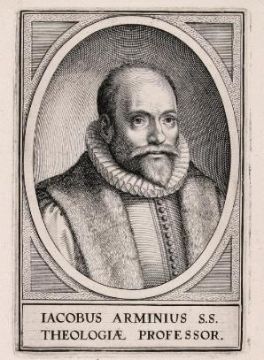
2. Passages From Matthew
Matt. 6:14-15
Matt. 7:21-23
Matt. 8:11-12; 25:30
Matt. 10:32-33
Matt. 12:31-32
Matt. 24:13
Matt. 25:41

Slide 16
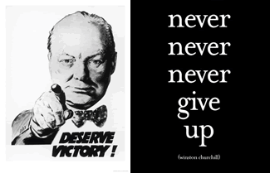
Matt. 24:13 (NASB)
“But the one who endures to the end, he will be saved.”

Slide 17
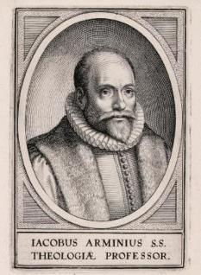
5. Passages From Paul
Gal. 5:4
Gal. 5:19-21
Rom. 8:13
1 Cor. 8:11
1 Cor. 9:24-27
1 Cor. 11:28-30, 32
1 Cor. 15:2
2 Cor. 13:5
Gal. 5:19-21
Philip. 2:12
Col. 1:23
1 Tim. 5:15
2 Tim. 2:12
2 Tim. 4:10

Slide 18
Galatians 5:4 (NASB)
“You have been severed from Christ, you who are seeking to be justified by law; you have fallen from grace.”

Slide 19
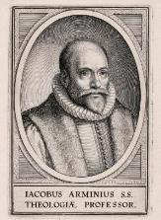
a. Galatians 5:4
The Galatians were believers (4:6; 5:16)
Three types of Pharisees
Galatians is a spiritual life book (3:3)
The Galatians were missing God’s grace in the middle tense of their salvation (not the first tense)
Reverting to a performance based relationship in daily living is quite a fall from grace
Galatians 5:4 does not teach a loss of salvation

Slide 20
5. Passages From Paul
Gal. 5:4
Gal. 5:19-21
Rom. 8:13
1 Cor. 8:11
1 Cor. 9:24-27
1 Cor. 11:28-30, 32
1 Cor. 15:2
2 Cor. 13:5
Philip. 2:12
Col. 1:23
1 Tim. 5:15
2 Tim. 2:12
2 Tim. 4:10

Slide 21
Philippians 2:12 (NASB)
“So then, my beloved, just as you have always obeyed, not as in my presence only, but now much more in my absence, work out your salvation with fear and trembling.”

Slide 22
Three Tenses of Salvation
Phase | Justification | Sanctification | Glorification
Tense | Past | Present | Future
Saved from sin’s: | Penalty | Power | Presence
Scripture | Eph 2:8-9; Titus 3:5 | Philip 2:12 | Rom 5:10

Slide 23
Three Tenses of Salvation
Phase | Justification | Sanctification | Glorification
Tense | Past | Present | Future
Saved from sin’s: | Penalty | Power | Presence
Scripture | Eph 2:8-9; Titus 3:5 | Philip 2:12 | Rom 5:10

Slide 24
Three Tenses of Salvation
Phase | Justification | Sanctification | Glorification
Tense | Past | Present | Future
Saved from sin’s: | Penalty | Power | Presence
Scripture | Eph 2:8-9; Titus 3:5 | Philip 2:12 | Rom 5:10

Slide 25
Philippians 2:12
Middle tense of salvation
Immediate context – Philippians 2:14-16
Overall context – Philippians 4:2-3

Slide 26
Passages from the General Letters & Revelation
Jas. 5:19-20
Heb. 3:6, 14
Heb. 5:9-10
Heb. 6:4-6
Heb. 10:26-30
Heb. 12:14
2 Pet. 1:10-11, 20-22
Jude 11
1 John 2:3
1 John 3:9
1 John 3:15
1 John 5:16
Rev. 3:5
Rev. 22:18-19

Slide 27
1 John 5:16-17
“If anyone sees his brother committing a sin not leading to death, he shall ask and God will for him give life to those who commit sin not leading to death. There is a sin leading to death; I do not say that he should make request for this. ¹⁷ All unrighteousness is sin, and there is a sin not leading to death.” (NASB)

Slide 28
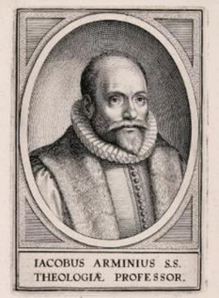
1 John 5:16-17
Sin brings death
Rom. 6:23
Jas. 1:14-16
Maximum divine discipline
Acts 5:1-11
1 Cor. 11:30
1 John 5:16-17
Rev. 2:22-23

Slide 29
Passages from the General Letters & Revelation
Jas. 5:19-20
Heb. 3:6, 14
Heb. 5:9-10
Heb. 6:4-6
Heb. 10:26-30
Heb. 12:14
2 Pet. 1:10-11
2 Pet. 2:20-22
1 John 2:3
1 John 3:9
1 John 3:15
1 John 5:16
Rev. 3:5
Rev. 22:18-19

Slide 30
2 Peter 1:10-11
“Therefore, brethren, be all the more diligent to make certain about His calling and choosing you; for as long as you practice these things, you will never stumble; ¹¹ for in this way the entrance into the eternal kingdom of our Lord and Savior Jesus Christ will be abundantly supplied to you.” (NASB)

Slide 31
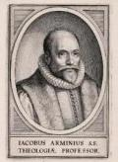
2 Peter 1:10-11
Diligence in the Christian life does not make the believer more secure
However, it can deepen inward assurance
“Abundant entrance into the kingdom”-some believers will be saved but have little reward (1 Cor. 3:15; 2 John 8; Rev. 3:11)
Our ultimate assurance comes from Christ’s promises (John 5:24; 6:47)

Slide 32
Lordship Salvation 7 Problems
Changes the gospel
Places an impossible burden upon the unsaved
Confuses justification with sanctification
Confuses the result of with requirement for salvation
Fails to make basic dispensational distinctions
Ignores the reality of a carnal Christian
Destroys the assurance of salvation

Slide 33
Notes:
Ray Steadman – “1st Californians”
Unbelievers vs Categories of Believers
Unbelievers – ψυχικός psuchikós; Natural, pertaining to the natural as distinguished from the spiritual
Spiritual Believers – πνευματικός pneumatikós; of persons who are spiritual, enlightened by the Holy Spirit
Infant Believers – σάρκινος sárkinos; with propensities of the flesh unto sin; νήπιος nḗpios; an infant, child, baby without any definite limitation of age. (This relates to immaturity and lack of instruction)
Carnal Believers – σαρκικός sarkikós; tendency to satisfy the flesh, implying sinfulness, sinful propensity, carnal (This relates to disobedience and open rebellion)

Slide 34
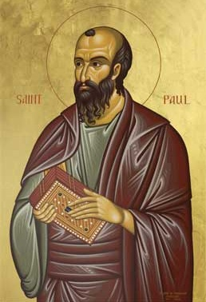
4 KINDS OF PEOPLE 1 Corinthians 3:1-3
¹ And I, brethren, could not speak to you as to spiritual people but as to carnal, as to babes in Christ. ² I fed you with milk and not with solid food; for until now you were not able to receive it, and even now you are still not able; ³ for you are still carnal. For where there are envy, strife, and divisions among you, are you not carnal and behaving like mere men? (NKJV)

Slide 35
Carnal Christianity “an unfortunate possibility”
Exod. 19:1ff Acts 10:14 Gal. 2:11-14 Acts 19:18-19 1 Cor. 1:2, 7 | 1 Cor. 3:15 1 Cor. 6:19 1 Cor. 9:24-27 Philip. 4:2-3 Lot-Gen. 13:12; 19:4-8, 14, 30-38 vs. Gen 19:22; 2 Pet. 2:7-8

Slide 36
CONCLUSION

Slide 37
Soteriology Overview
Definition
Election
Atonement
Salvation words
God’s one condition of salvation
Results of salvation
Eternal security
Faulty views of salvation

