Slide 1

THE BOOK OF DANIEL
Dr. Andy Woods

Slide 2

Message
Times of the Gentiles are revealed prophetically (2, 7, 8-12) and ethically (1, 3-6)

Slide 3

Synthetic Outline
Historical (1-7):
  Daniel interprets, 3rd person, gentile nations
  Intro “Hebrew” (1)
  Aramaic chiasm (2-7)

Slide 4
Synthetic Outline
Prophetic (8-12):
  Angel interprets, 1st person, Jewish nation, Hebrew
  Ram & Goat (8)
  70 weeks (9)
  Final vision (10-12)

Slide 5
Synthetic Outline
Historical (1-7):
  Daniel interprets, 3rd person, gentile nations
  Intro “Hebrew” (1)
  Aramaic chiasm (2-7)

Slide 6
Synthetic Outline
Historical (1-7):
  Daniel interprets, 3rd person, gentile nations
  Intro “Hebrew” (1)
  Aramaic chiasm (2-7)

Slide 7

Synthetic Outline
  Chiasm “Aramaic” ( 2-7)
1. Gentile History (2)
  2. Protection (3)
    3. Revelation to a gentile king (4)
    3. Revelation to a gentile king (5)
  2. Protection (6)
1. Gentile history (7)

Slide 8
Synthetic Outline
  Chiasm “Aramaic” ( 2-7)
1. Gentile History (2)
  2. Protection (3)
    3. Revelation to a gentile king (4)
    3. Revelation to a gentile king (5)
  2. Protection (6)
1. Gentile history (7)

Slide 9
Synthetic Outline
  Chiasm “Aramaic” ( 2-7)
1. Gentile History (2)
  2. Protection (3)
    3. Revelation to a gentile king (4)
    3. Revelation to a gentile king (5)
  2. Protection (6)
1. Gentile history (7)

Slide 10
Synthetic Outline
  Chiasm “Aramaic” ( 2-7)
1. Gentile History (2)
  2. Protection (3)
    3. Revelation to a gentile king (4)
    3. Revelation to a gentile king (5)
  2. Protection (6)
1. Gentile history (7)

Slide 11
Synthetic Outline
  Chiasm “Aramaic” ( 2-7)
1. Gentile History (2)
  2. Protection (3)
    3. Revelation to a gentile king (4)
    3. Revelation to a gentile king (5)
  2. Protection (6)
1. Gentile history (7)

Slide 12
Synthetic Outline
  Chiasm “Aramaic” ( 2-7)
1. Gentile History (2)
  2. Protection (3)
    3. Revelation to a gentile king (4)
    3. Revelation to a gentile king (5)
  2. Protection (6)
1. Gentile history (7)

Slide 13
Synthetic Outline
  Chiasm “Aramaic” ( 2-7)
1. Gentile History (2)
  2. Protection (3)
    3. Revelation to a gentile king (4)
    3. Revelation to a gentile king (5)
  2. Protection (6)
1. Gentile history (7)

Slide 14

Chapter 7 Outline
The Historical Setting (1)
The Vision (2-14)
The Vision’s Interpretation (15-27)
The Personal Impact on Daniel (28)

Slide 15
CHAPTER AND VERSE IN DANIEL | CHRONOLOGICAL DATE | BIBLICAL DATE
1:1 | 605 | 3rd year of Jehoiakim
2:1 | 603 | 2nd year of Nebuchadnezzar
5 | Sat. night 10/12/539 (Hoehner)
7:1 | 553 | 1st year of Belshazzar
8:1 | 551 | 3rd year of Belshazzar
9:1 | 538 | 1st year of Darius
10:1 | 536 | 3rd year of Cyrus

Slide 16
Daniel’s Age
CHAPTER | EVENTS | AGE
1 | Taken to Babylonian captivity | 15
2 | Interpreting Nebuchadnezzar’s 1st dream (huge image) | 17
3 | Daniel’s 3 friends cast into the fiery furnace | 19 or 20
4 | Interpreting Nebuchadnezzar’s 2nd dream (huge tree) | 45-50
5 | Interpreting handwriting of the wall at Belshazzar’s feast | Early 80’s
6 | Delivered from the den of lions | c.83
7-8 | Daniel’s visions and dreams | Mid-60’s
9 | Daniel’s seventy “sevens” prophecy | Early-80’s
10-12 | Final dreams and visions | Mid-80’s

Slide 17
Succession of Gentile Rulers
1-4: Nebuchadnezzar of Babylon
5: Belshazzar of Babylon
6: Darius of Media – Persia
7-8: Belshazzar of Babylon
9: Darius of Media – Persia
10-12: Cyrus of Media – Persia

Slide 18
Synthetic Outline
  Chiasm “Aramaic” ( 2-7)
1. Gentile History (2)
  2. Protection (3)
    3. Revelation to a gentile king (4)
    3. Revelation to a gentile king (5)
  2. Protection (6)
1. Gentile history (7)

Slide 19


Statue
&
Stone

Slide 20

CHART1

Slide 21
Comparing Daniel 2 & 7: A Matter of Perspective
 | Daniel 2 | Daniel 7
Receiver | Nebuchadnezzar | Daniel
Position | Oppressor | Oppressee
Nationality | Babylonian | Hebrew
Perspective | Gentile | Jewish
Viewpoint | Antropocentric | Theocentric
Description | Statue | Beasts
Appearance | Beautiful | Grotesque

Slide 22
Chapter 7 Outline
The Historical Setting (1)
The Vision (2-14)
The Vision’s Interpretation (15-27)
The Personal Impact on Daniel (28)

Slide 23
DANIEL 7:2-14
Outline
4 Beasts Coming out of the Sea V.2-3
A Description of the 4 Beasts V.4-8
The Ancient of Days V. 9-12
The Son of Man V.13-14

Slide 24

Description of 4 Beasts
1st Beast (V.4)
  Lion
  Babylon
  Head of Gold
  2:38
  605-539 BC
  Eagle’s Wings
  Nebuchadnezzar’s Experience

Slide 25

Description of 4 Beasts
2nd Beast (V.5)
  Bear
  Media-Persia
  Chest & Arms of Silver
  5:28; 8:20
  539-331 BC
  Raised on One Side
  Three Ribs
  Arise and Devour

Slide 26

Description of 4 Beasts
3rd Beast (V. 6)
  Leopard
  Greece
  Belly & Thighs of Bronze
  8:21
  331-63 BC
  Rapid Conquest (Wings & Leopard)
  Four Generals (Wings & Heads)

Slide 27
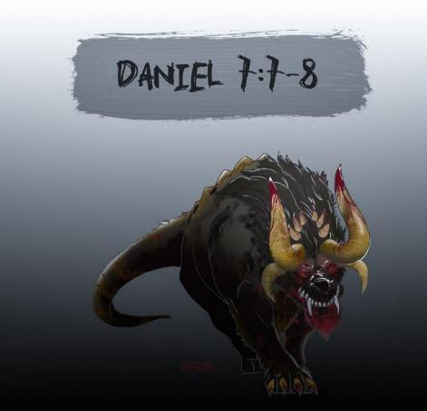
Description of 4 Beasts
4th Beast (V.7-8)
  Description
  Rome
  Legs of Iron
  Secular History
  63 Bc-70 AD
  10 Horns & Little Horn
  Revelation 13:2

Slide 28
DANIEL 7:2-14
Outline
4 Beasts Coming out of the Sea V.2-3
A Description of the 4 Beasts V.4-8
The Ancient of Days V. 9-12
The Son of Man V.13-14

Slide 29
Chapter 7 Outline
The Historical Setting (1)
The Vision (2-14)
The Vision’s Interpretation (15-27)
The Personal Impact on Daniel (28)

Slide 30
DANIEL 7:15-27
OUTLINE
The Vision Troubles Daniel V.15
Daniel Requests An Interpretation V.16
An Interpretation Is Given V. 17-18
Daniel Requests Further Explanation V. 19-22
Angelic Interpretation V. 23-27

Slide 31
DANIEL 7:15-27
OUTLINE
The Vision Troubles Daniel V.15
Daniel Requests An Interpretation V.16
An Interpretation Is Given V. 17-18
Daniel Requests Further Explanation V. 19-22
Angelic Interpretation V. 23-27

Slide 32
DANIEL 7:15-27
OUTLINE
The Vision Troubles Daniel V.15
Daniel Requests An Interpretation V.16
An Interpretation Is Given V. 17-18
Daniel Requests Further Explanation V. 19-22
Angelic Interpretation V. 23-27

Slide 33
Daniel Seeks An Interpretation
V.16
Daniel asks an Angel for an interpretation V. 16
  No Guesswork Needed
  Gabriel ?

Slide 34
DANIEL 7:15-27
OUTLINE
The Vision Troubles Daniel V.15
Daniel Requests An Interpretation V.16
An Interpretation Is Given V. 17-18
Daniel Requests Further Explanation V. 19-22
Angelic Interpretation V. 23-27

Slide 35
DANIEL 7:15-27
OUTLINE
The Vision Troubles Daniel V.15
Daniel Requests An Interpretation V.16
An Interpretation Is Given V. 17-18
Daniel Requests Further Explanation V. 19-22
Angelic Interpretation V. 23-27

Slide 36
When Will the Rapture Take Place Relative to the Tribulation Period?
Pre-tribulation rapture theory
Mid-tribulation rapture theory
Post-tribulation rapture theory
Pre-wrath rapture theory

Slide 37


Slide 38
When is the Rapture? Seven Arguments Favoring the Pre-Tribulation View
Tribulation's purpose concerns Israel (Jer 30:7; Dan 9:24)
No biblical reference to the church on earth during the Tribulation period (Rev 4-22)
Church is promised an exemption from divine wrath (1 Thess 1:10; 5:9; Rom 5:9; Rev 3:10; 6:17)
Rapture is imminent (1 Cor 15:51; 1 Thess 4:15)
Rapture is a comfort (1 Thess 4:18)
Antichrist cannot come to power until the restrainer is removed (2 Thess 2:6-7)
Symbolic parallels (2 Peter 2:5-9)

Slide 39
Pretribulationism is not Escapism
Trials (John 16:33)
Man’s wrath (2 Tim 3:12)
Satan’s wrath (Eph 6:11-12)
World’s wrath (John 15:18-19)

Slide 40
When is the Rapture? Seven Arguments Favoring the Pre-Tribulation View
Tribulation's purpose concerns Israel (Jer 30:7; Dan 9:24)
No biblical reference to the church on earth during the Tribulation period (Rev 4-22)
Church is promised an exemption from divine wrath (1 Thess 1:10; 5:9; Rom 5:9; Rev 3:10; 6:17)
Rapture is imminent (1 Cor 15:51; 1 Thess 4:15)
Rapture is a comfort (1 Thess 4:18)
Antichrist cannot come to power until the restrainer is removed (2 Thess 2:6-7)
Symbolic parallels (2 Peter 2:5-9)

Slide 41

Ephesians 3:3-6 (NASB)
“that by revelation there was made known to me the mystery, as I wrote before in brief. ⁴ By referring to this, when you read you can understand my insight into the mystery of Christ, ⁵ which in other generations was not made known to the sons of men, as it has now been revealed to His holy apostles and prophets in the Spirit; ⁶ to be specific, that the Gentiles are fellow heirs and fellow members of the body, and fellow partakers of the promise in Christ Jesus through the gospel”.

Slide 42
Ephesians 3:9 (NASB)
“and to bring to light what is the administration of the mystery which for ages has been hidden in God who created all things.”

Slide 43
“Mystery” Defined
“In the N.T, it [mystērion] denotes, not the mysterious (as with the Eng. word), but that which, being outside the range of unassisted natural apprehension, can be made known only by Divine revelation, and is made known in a manner and at a time appointed by God, and to those who are illumined by His Spirit.”
W. E. Vine, Merrill F. Unger, and William White, Vine's Complete Expository Dictionary of the Old and New Testament Words (Nashville: Nelson, 1996), 424.

Slide 44
Distinctions Between 144,000 & Multitude
REVELATION 7:1-8 | REVELATION 7:9-17
Numbered | Innumerable
Jews | All nations
Sealed | Slain
Sealed before the Tribulation | Converted out of the Tribulation
Hitchcock and Ice, The Truth Behind Left Behind, 77

Slide 45
DANIEL 7:15-27
OUTLINE
The Vision Troubles Daniel V.15
Daniel Requests An Interpretation V.16
An Interpretation Is Given V. 17-18
Daniel Requests Further Explanation V. 19-22
Angelic Interpretation V. 23-27

Slide 46
Angelic Interpretation
V. 23
  Daniel 2:40, 41-43
  World-wide empire

Slide 47
Statue
&
Stone

Slide 48

David Rockefeller cited in Memoirs, page 405.
“For more than a century ideological extremists…have seized upon well-publicized incidents…to attack the Rockefeller family for the inordinate influence they claim we wield over American political and economic institutions. Some even believe we are part of a secret cabal working against the best interests of the United States, characterizing my family and me as 'internationalists' and of conspiring with others around the world to build a more integrated global political and economic structure--one world, if you will. If that's the charge, I stand guilty, and I am proud of it.”

Slide 49
Angelic Interpretation
  V. 24
  A Ten King Confederacy
  A Revived Roman Empire
  EEC or ECM / European Common Market?
  The Antichrist Will Subdue 3 Kings

Slide 50
Angelic Interpretation
  V. 25
  His Boasting Mouth (Dan. 7:8,11,20; Rev 13:5-6)
  Persecution Of The Saints (Rev. 6:9-11; 13:7, 17:6; Matt. 24:9)
  The Creation Of A New System
  Three And A Half Years (Dan. 9:27, 12:7; Rev. 12:6, 14,13:5)

Slide 51
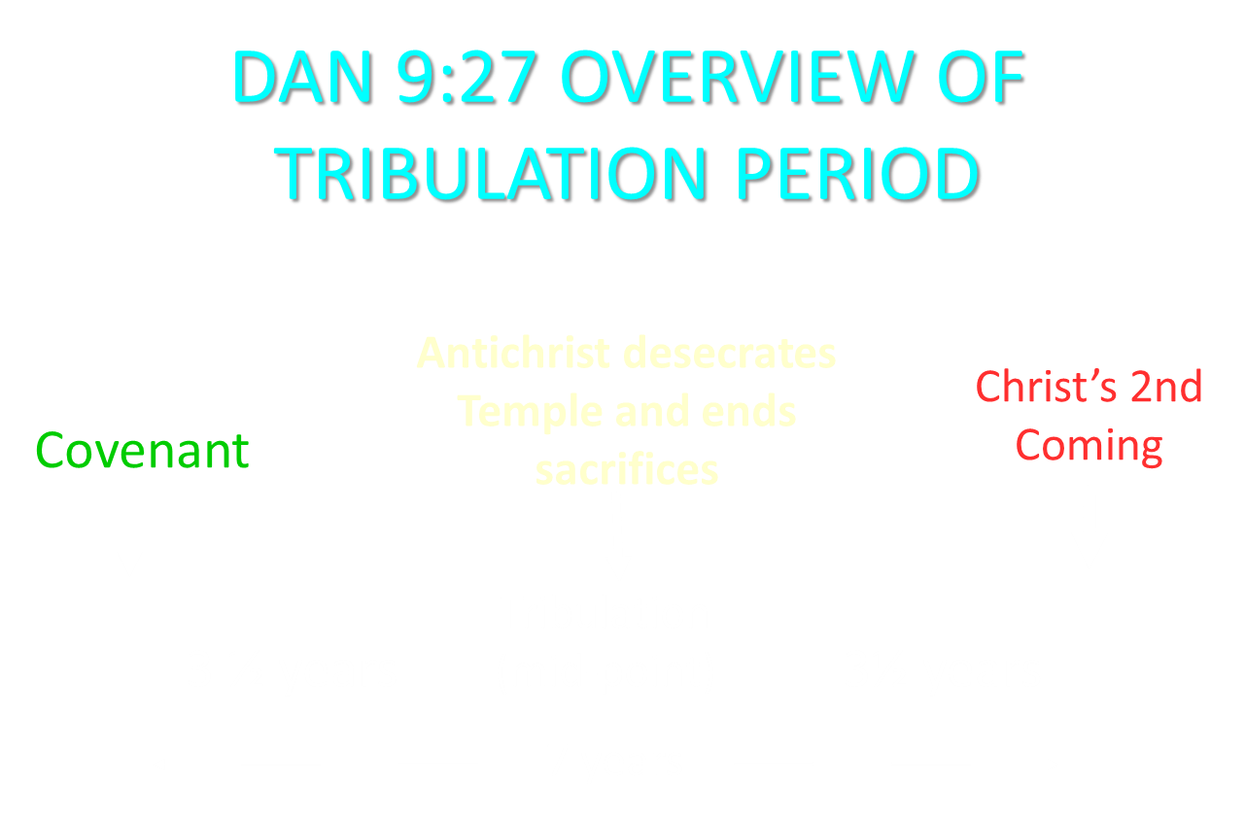

Slide 52
Angelic Interpretation
  V. 26
  The Ancient of Days Destroys the Little Horn
  The Ancient of Days is God the Father
  Dan. 9:27; 2 Thess. 2:8; Rev. 19:20
  Antichrist’s Rise and Fall

Slide 53
Angelic Interpretation
  V. 27
  Rev. 11:15
  The Millennium
  Dan. 2:44-45
  Six Kingdoms?
  Our Focus Vs. Judah’s Focus
  Our Hope

Slide 54
6 Empires
Babylon (2:36-38) 605-539 BC
Media-Persia (2:39a) 539-331 BC
Greece (2:39b) 331-63 BC
Rome I (2:40) 63 BC – 70 AD
Rome II (2:41-43) Tribulation
Kingdom (2:44-45) After 2nd Coming

Slide 55
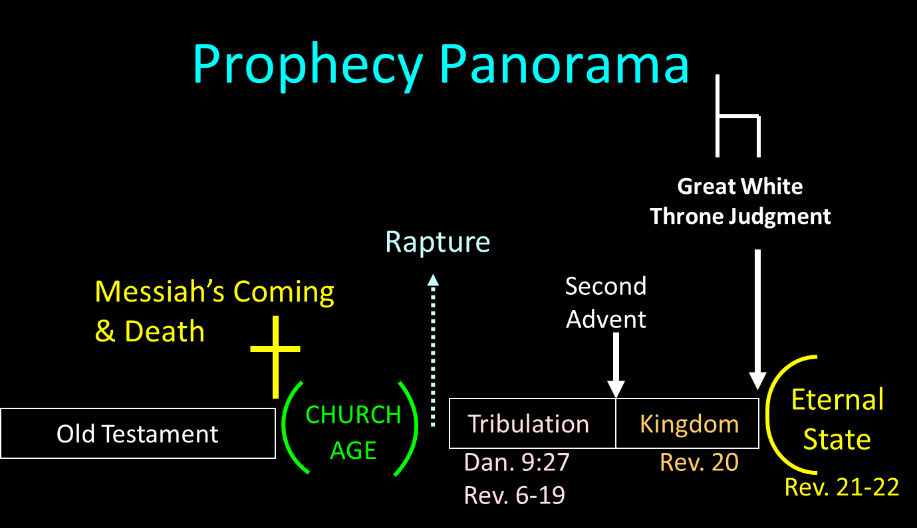

Slide 56
Zechariah 14:16-18 (NASB)
“Then it will come about that any who are left of all the nations that went against Jerusalem will go up from year to year to worship the King, the Lord of hosts, and to celebrate the Feast of Booths. ¹⁷ And it will be that whichever of the families of the earth does not go up to Jerusalem to worship the King, the Lord of hosts, there will be no rain on them. ¹⁸ If the family of Egypt does not go up or enter, then no rain will fall on them; it will be the plague with which the Lord smites the nations who do not go up to celebrate the Feast of Booths.”

Slide 57
Chapter 7 Outline
The Historical Setting (1)
The Vision (2-14)
The Vision’s Interpretation (15-27)
The Personal Impact on Daniel (28)

Slide 58
THE EFFECT ON DANIEL
V. 28
Daniel is Traumatized
7:19
Daniel’s Heart for His People
8:27

Slide 59
Conclusion

Slide 60
Chapter 7 Outline
The Historical Setting (1)
The Vision (2-14)
The Vision’s Interpretation (15-27)
The Personal Impact on Daniel (28)

