Slide 1

THE BOOK OF DANIEL
Dr. Andy Woods

Slide 2

Message
Times of the Gentiles are revealed prophetically (2, 7, 8-12) and ethically (1, 3-6)

Slide 3
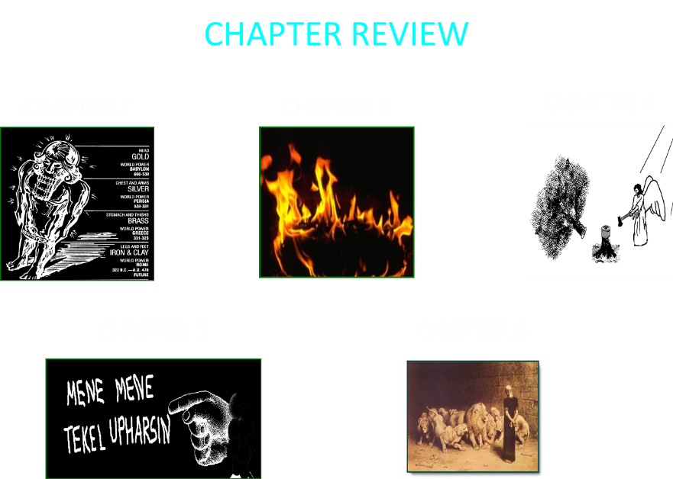

Slide 4

Synthetic Outline
Historical (1-7):
  Daniel interprets, 3rd person, gentile nations
  Intro “Hebrew” (1)
  Aramaic chiasm (2-7)

Slide 5
Synthetic Outline
Prophetic (8-12):
  Angel interprets, 1st person, Jewish nation, Hebrew
  Ram & Goat (8)
  70 weeks (9)
  Final vision (10-12)

Slide 6
Synthetic Outline
Historical (1-7):
  Daniel interprets, 3rd person, gentile nations
  Intro “Hebrew” (1)
  Aramaic chiasm (2-7)

Slide 7
Synthetic Outline
Historical (1-7):
  Daniel interprets, 3rd person, gentile nations
  Intro “Hebrew” (1)
  Aramaic chiasm (2-7)

Slide 8

Synthetic Outline
  Chiasm “Aramaic” ( 2-7)
1. Gentile History (2)
  2. Protection (3)
    3. Revelation to a gentile king (4)
    3. Revelation to a gentile king (5)
  2. Protection (6)
1. Gentile history (7)

Slide 9
Synthetic Outline
  Chiasm “Aramaic” ( 2-7)
1. Gentile History (2)
  2. Protection (3)
    3. Revelation to a gentile king (4)
    3. Revelation to a gentile king (5)
  2. Protection (6)
1. Gentile history (7)

Slide 10

Statue
&
Stone

Slide 11
Synthetic Outline
  Chiasm “Aramaic” ( 2-7)
1. Gentile History (2)
  2. Protection (3)
    3. Revelation to a gentile king (4)
    3. Revelation to a gentile king (5)
  2. Protection (6)
1. Gentile history (7)

Slide 12
Synthetic Outline
  Chiasm “Aramaic” ( 2-7)
1. Gentile History (2)
  2. Protection (3)
    3. Revelation to a gentile king (4)
    3. Revelation to a gentile king (5)
  2. Protection (6)
1. Gentile history (7)

Slide 13
Synthetic Outline
  Chiasm “Aramaic” ( 2-7)
1. Gentile History (2)
  2. Protection (3)
    3. Revelation to a gentile king (4)
    3. Revelation to a gentile king (5)
  2. Protection (6)
1. Gentile history (7)

Slide 14
Synthetic Outline
  Chiasm “Aramaic” ( 2-7)
1. Gentile History (2)
  2. Protection (3)
    3. Revelation to a gentile king (4)
    3. Revelation to a gentile king (5)
  2. Protection (6)
1. Gentile history (7)

Slide 15

THE EVENTS OF CHAPTER 5
THE
FALL OF
BABYLON
DARIUS
REPLACES
BELSHAZZAR

Slide 16
Succession of Gentile Rulers
1-4: Nebuchadnezzar of Babylon
5: Belshazzar of Babylon
6: Darius of Media – Persia
7-8: Belshazzar of Babylon
9: Darius of Media – Persia
10-12: Cyrus of Media – Persia

Slide 17
Succession of Gentile Rulers
1-4: Nebuchadnezzar of Babylon
5: Belshazzar of Babylon
6: Darius of Media – Persia
7-8: Belshazzar of Babylon
9: Darius of Media – Persia
10-12: Cyrus of Media – Persia

Slide 18
CHAPTER & VERSE IN DANIEL | CHRONOLOGICAL DATE | BIBLICAL DATE
1:1 | 605 | 3rd year of Jehoiakim
2:1 | 603 | 2nd year of Nebuchadnezzar
5 | Sat. night 10/12/539 (Hoehner)
7:1 | 553 | 1st year of Belshazzar
8:1 | 551 | 3rd year of Belshazzar
9:1 | 538 | 1st year of Darius
10:1 | 536 | 3rd year of Cyrus

Slide 19
Daniel’s Age
CHAPTER | EVENTS | AGE
1 | Taken to Babylonian captivity | 15
2 | Interpreting Nebuchadnezzar’s 1st dream (huge image) | 17
3 | Daniel’s 3 friends cast into the fiery furnace | 19 or 20
4 | Interpreting Nebuchadnezzar’s 2nd dream (huge tree) | 45-50
5 | Interpreting handwriting of the wall at Belshazzar’s feast | Early 80’s
6 | Delivered from the den of lions | c.83
7-8 | Daniel’s visions and dreams | Mid-60’s
9 | Daniel’s seventy “sevens” prophecy | Early-80’s
10-12 | Final dreams and visions | Mid-80’s

Slide 20

Chapter 6 Outline
The Position of Daniel (1-3)
The Plot Against Daniel (4-9)
The Prayer of Daniel (10-11)
The Prosecution of Daniel (12-15)
The Presentation of Daniel into the Lion’s Den (16-17)
The Protection of Daniel (18-23)
The Product of Daniel’s Ordeal (24-28)

Slide 21
Chapter 6 Outline
The Position of Daniel (1-3)
The Plot Against Daniel (4-9)
The Prayer of Daniel (10-11)
The Prosecution of Daniel (12-15)
The Presentation of Daniel into the Lion’s Den (16-17)
The Protection of Daniel (18-23)
The Product of Daniel’s Ordeal (24-28)

Slide 22
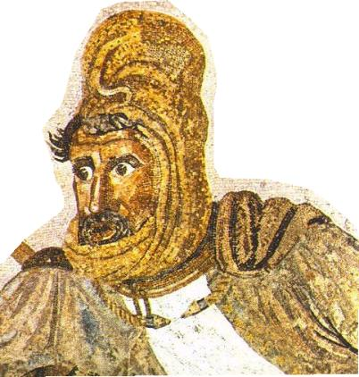
THE POSITION OF DANIEL V.1
Darius reorganizes conquered Babylon
120 satraps

Slide 23
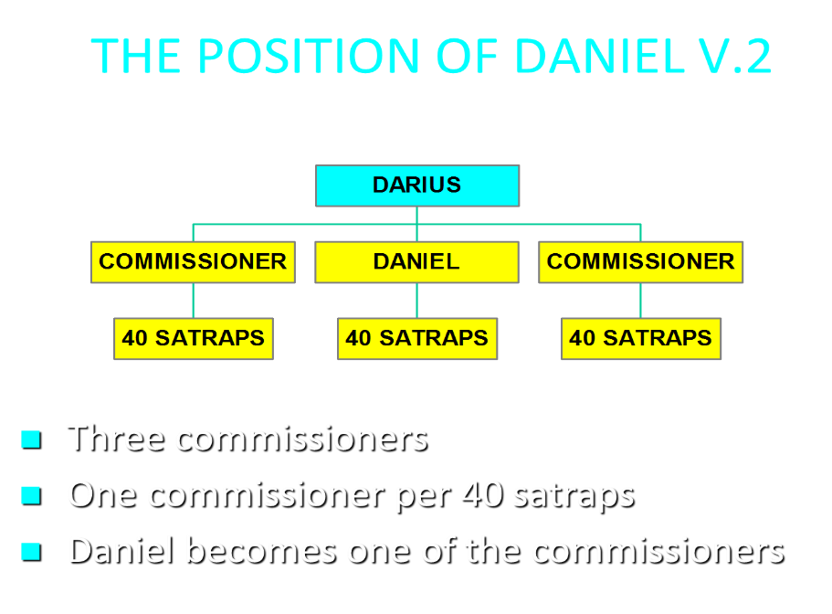

Slide 24
THE POSITION OF DANIEL V.3
Daniel distinguishes himself
    1 John 4:4
    Genesis 39:2-4

Slide 25
Succession of Gentile Rulers
1-4: Nebuchadnezzar of Babylon
5: Belshazzar of Babylon
6: Darius of Media – Persia
7-8: Belshazzar of Babylon
9: Darius of Media – Persia
10-12: Cyrus of Media – Persia

Slide 26
Succession of Gentile Rulers
1-4: Nebuchadnezzar of Babylon
5: Belshazzar of Babylon
6: Darius of Media – Persia
7-8: Belshazzar of Babylon
9: Darius of Media – Persia
10-12: Cyrus of Media – Persia

Slide 27
Daniel’s Age
CHAPTER | EVENTS | AGE
1 | Taken to Babylonian captivity | 15
2 | Interpreting Nebuchadnezzar’s 1st dream (huge image) | 17
3 | Daniel’s 3 friends cast into the fiery furnace | 19 or 20
4 | Interpreting Nebuchadnezzar’s 2nd dream (huge tree) | 45-50
5 | Interpreting handwriting of the wall at Belshazzar’s feast | Early 80’s
6 | Delivered from the den of lions | c.83
7-8 | Daniel’s visions and dreams | Mid-60’s
9 | Daniel’s seventy “sevens” prophecy | Early-80’s
10-12 | Final dreams and visions | Mid-80’s

Slide 28
Daniel’s Age
CHAPTER | EVENTS | AGE
1 | Taken to Babylonian captivity | 15
2 | Interpreting Nebuchadnezzar’s 1st dream (huge image) | 17
3 | Daniel’s 3 friends cast into the fiery furnace | 19 or 20
4 | Interpreting Nebuchadnezzar’s 2nd dream (huge tree) | 45-50
5 | Interpreting handwriting of the wall at Belshazzar’s feast | Early 80’s
6 | Delivered from the den of lions | c.83
7-8 | Daniel’s visions and dreams | Mid-60’s
9 | Daniel’s seventy “sevens” prophecy | Early-80’s
10-12 | Final dreams and visions | Mid-80’s

Slide 29
Chapter 6 Outline
The Position of Daniel (1-3)
The Plot Against Daniel (4-9)
The Prayer of Daniel (10-11)
The Prosecution of Daniel (12-15)
The Presentation of Daniel into the Lion’s Den (16-17)
The Protection of Daniel (18-23)
The Product of Daniel’s Ordeal (24-28)

Slide 30
THE PLOT AGAINST DANIEL V. 4-9
The problem v.4
  Commissioners and satraps devise a plot
  The motivation is jealousy
  Seeking to find a “skeleton in the closet”
  No corruption or negligence
  Protestant work ethic Col. 3:23

Slide 31
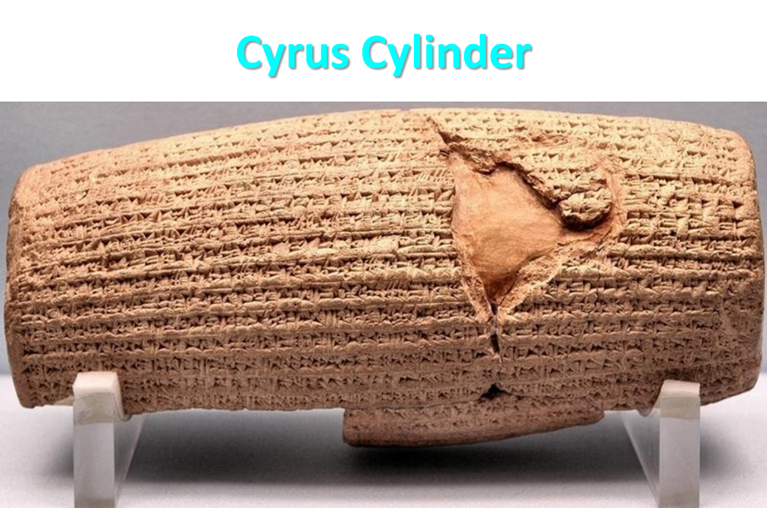

Slide 32

Herodotus
Histories, 1:191 (450 B.C.)
“…he conducted the river by a channel into the lake…and so he made the former course of the river passable by the sinking of the stream. When this had been done, the Persians who had been posted for this very purpose entered by the bed of the river Euphrates into Babylon, the stream having sunk so far that it reached about to the middle of a man’s thigh…those Babylonians who dwelt in the middle did not know that they had been captured…”

Slide 33
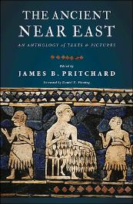
James Pritchard
The Ancient Near East Texts Relating to the Old Testament, 315-16.
Without any battle. . . sparing Babylon . . . any calamity.... I am Cyrus...king of Babylon....When I entered Babylon...under jubilation and rejoicing...troops walked around Babylon...in peace, I did not allow anybody to terrorize (any place) of the [country of Sumer] and Akkad. I strove for peace in Babylon...and in all his (other) sacred cities....I returned to (these) sacred cities on the other side of the Tigris, the sanctuaries of which have been in ruins for a long time, the images which (used) to live therein and established for them permanent sanctuaries.

Slide 34
James Pritchard
The Ancient Near East Texts Relating to the Old Testament, 315-16.
I (also) gathered all their (former) inhabitants and returned (to them) their habitations. Furthermore, I resettled... unharmed, in their (former) chapels, the places which make them happy. May all the gods whom I have resettled in their sacred cities ask daily Bel and Nebo for a long life for me...all of them I resettled in a peaceful place... ducks and doves,...I endeavoured to fortify/repair their dwelling places . . .

Slide 35
THE PLOT AGAINST DANIEL V. 4-9
What a complement! v. 5
The request v.6-9
  A set-up
  Esther 1:19; 8:8

Slide 36
THE PLOT AGAINST DANIEL V. 4-9
What a complement! v. 5
The request v.6-9
  A set-up
  Esther 1:19; 8:8

Slide 37
THE PLOT AGAINST DANIEL V. 4-9
What a complement! v. 5
The request v.6-9
  A set-up
  Esther 1:19; 8:8

Slide 38
THE PRAYER OF DANIEL V.10-11
Civil disobedience
  Genesis 6:11; 9:6;
  Rom. 13:1-7; 1 Tim. 2:1-4; 1 Pet. 2:13-15
  Acts 5:29; Daniel 3:4-6

Slide 39
Baker Faces Prison for Refusing to Bake Same-Sex Wedding Cake
“Jack Phillips is a baker who declined to bake a wedding cake for a same-sex couple because his Christian belief is that marriage exists only between a man and woman. Now a Colorado judge has ordered him to bake cakes for same-sex marriages, and if Phillips refuses, he could go to jail.”
Ken Klukowski, “Baker Faces Prison for Refusing to Bake Same-Sex Wedding Cake,” online: http://www.breitbart.com/Big-Government/2013/12/12/Christian-Baker-Willing-to-Go-to-Jail-for-Declining-Gay-Wedding-Cake, 12 December 2013, accessed 16 May 2014.

Slide 40
Oregon Declares War on Aaron & Melissa Klein
“In yet another example of gay activist overreach, an Oregon official has not only burdened a Christian couple with a ridiculous fine, he has imposed a gag order on them…In one of the most egregious anti-Christian acts committed by a state official in recent memory, Oregon Labor Commissioner Brad Avakian not only upheld the ridiculous $135,000 fine levied against Aaron and Melissa Klein for declining to bake a cake for a lesbian commitment ceremony, but he ordered the Kleins to ‘cease and desist’ from making any public comments about their religious convictions relative to this case.”
http://www.onenewsnow.com/perspectives/michael-brown/2015/07/06/oregon-declares-war-on-christian-faith

Slide 41
Principles of Civil Disobedience
Clear conflict between the laws of man and God
Exhaustion of all creative legal remedies
A willingness to pay the consequences
Maintaining of respect for civil authorities

Slide 42
Chapter 6 Outline
The Position of Daniel (1-3)
The Plot Against Daniel (4-9)
The Prayer of Daniel (10-11)
The Prosecution of Daniel (12-15)
The Presentation of Daniel into the Lion’s Den (16-17)
The Protection of Daniel (18-23)
The Product of Daniel’s Ordeal (24-28)

Slide 43
THE PRAYER OF DANIEL V.10-11
Ingredients of a healthy prayer life
  Priority
  Obedience & faith: 1 Kgs. 8:44, 48-49
  Consistency: Matt. 14:23
  Humility: kneeling
  Thanksgiving
  Petitioning God
  Supplication: Phil. 4:6

Slide 44
Chapter 6 Outline
The Position of Daniel (1-3)
The Plot Against Daniel (4-9)
The Prayer of Daniel (10-11)
The Prosecution of Daniel (12-15)
The Presentation of Daniel into the Lion’s Den (16-17)
The Protection of Daniel (18-23)
The Product of Daniel’s Ordeal (24-28)

Slide 45
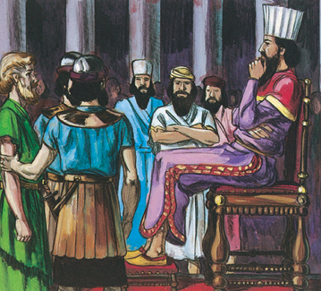
PROSECUTION OF DANIEL V.12-15
The enemies’ question v.12a
The king’s affirmation v. 12b

Slide 46
PROSECUTION OF DANIEL V.12-15
The enemies’ question v.12a
The king’s affirmation v. 12b

Slide 47
PROSECUTION OF DANIEL V.12-15
The enemies’ question v.12a
The king’s affirmation v. 12b

Slide 48
PROSECUTION OF DANIEL V.12-15
The enemies’ complaint v. 13
  Anti-Semitic motivation (3:12)
Darius’ distress v. 14
The enemies’ technicality v.15

Slide 49
PROSECUTION OF DANIEL V.12-15
The enemies’ complaint v. 13
  Anti-Semitic motivation (3:12)
Darius’ distress v. 14
The enemies’ technicality v.15

Slide 50
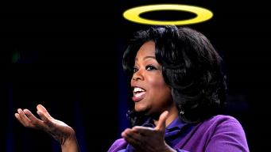
“…one of the mistakes that human beings make is believing that there is only one way…We don’t accept that there are diverse ways of being in the world; that there are millions of ways to be a human being. And many ways…many paths to what you call God. That her path might be something else and when she gets there she might call it the light. But her loving, and her kindness, and her generosity brings her to the…same point that it brings you…
www.youtube.com/watch?v=Lb2RUpMDk34

Slide 51

…It doesn’t matter whether she called it ‘God’ along the way or not…There couldn’t possibly be just one way!…There couldn’t possibly be only one way with millions of people in the world!...You think…if you are somewhere on the planet and you never hear the name of Jesus but yet you live with a loving heart. You lived as Jesus would have had you to live. You lived for the same purpose as Jesus came to the planet to teach us all, but you are in some remote part of the earth and you never heard the name of Jesus. You cannot get to Heaven…?”
www.youtube.com/watch?v=Lb2RUpMDk34

Slide 52
PROSECUTION OF DANIEL V.12-15
The enemies’ complaint v. 13
  Anti-Semitic motivation (3:12)
Darius’ distress v. 14
The enemies’ technicality v.15

Slide 54
Herodotus
Histories, 1:191 (450 B.C.)
“…he conducted the river by a channel into the lake…and so he made the former course of the river passable by the sinking of the stream. When this had been done, the Persians who had been posted for this very purpose entered by the bed of the river Euphrates into Babylon, the stream having sunk so far that it reached about to the middle of a man’s thigh…those Babylonians who dwelt in the middle did not know that they had been captured…”

Slide 55
James Pritchard
The Ancient Near East Texts Relating to the Old Testament, 315-16.
Without any battle. . . sparing Babylon . . . any calamity.... I am Cyrus...king of Babylon....When I entered Babylon...under jubilation and rejoicing...troops walked around Babylon...in peace, I did not allow anybody to terrorize (any place) of the [country of Sumer] and Akkad. I strove for peace in Babylon...and in all his (other) sacred cities....I returned to (these) sacred cities on the other side of the Tigris, the sanctuaries of which have been in ruins for a long time, the images which (used) to live therein and established for them permanent sanctuaries.

Slide 56
James Pritchard
The Ancient Near East Texts Relating to the Old Testament, 315-16.
I (also) gathered all their (former) inhabitants and returned (to them) their habitations. Furthermore, I resettled... unharmed, in their (former) chapels, the places which make them happy. May all the gods whom I have resettled in their sacred cities ask daily Bel and Nebo for a long life for me...all of them I resettled in a peaceful place... ducks and doves,...I endeavoured to fortify/repair their dwelling places . . .

Slide 57
Three Returns
 | Date | Duration | Persian king | Jewish leader | Scripture | Purpose | Number of returnees
1st return | 538–515 B.C. | 23 years | Cyrus (Isa 44:28‒45:1) | Zerubbabel | Ezra 1–6; Isaiah 44:28 | Rebuilding the temple | 50,000
2nd return | 458–457 B.C. | 2 years | Artaxerxes | Ezra | Ezra 7–10 | Adorning of the temple and reforming the people | 2,000
3rd return | 444–432 B.C. | 8 years | Artaxerxes | Nehemiah | Nehemiah | Rebuilding the wall

Slide 58
PROSECUTION OF DANIEL V.12-15
The enemies’ complaint v. 13
  Anti-Semitic motivation (3:12)
Darius’ distress v. 14
The enemies’ technicality v.15

Slide 59
Chapter 6 Outline
The Position of Daniel (1-3)
The Plot Against Daniel (4-9)
The Prayer of Daniel (10-11)
The Prosecution of Daniel (12-15)
The Presentation of Daniel into the Lion’s Den (16-17)
The Protection of Daniel (18-23)
The Product of Daniel’s Ordeal (24-28)

Slide 60
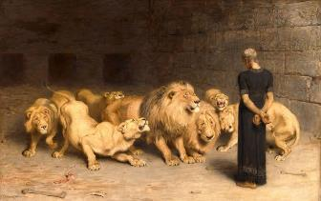
JUDGMENT OF DANIEL V.16-17
The king’s order v. 16a
The king’s judgment v.16b
The king’s authorization v. 17
  Matthew 27:66

Slide 61
JUDGMENT OF DANIEL V.16-17
The king’s order v. 16a
The king’s judgment v.16b
The king’s authorization v. 17
  Matthew 27:66

Slide 62
JUDGMENT OF DANIEL V.16-17
The king’s order v. 16a
The king’s judgment v.16b
The king’s authorization v. 17
  Matthew 27:66

Slide 63
JUDGMENT OF DANIEL V.16-17
The king’s order v. 16a
The king’s judgment v.16b
The king’s authorization v. 17
  Matthew 27:66

Slide 64
Chapter 6 Outline
The Position of Daniel (1-3)
The Plot Against Daniel (4-9)
The Prayer of Daniel (10-11)
The Prosecution of Daniel (12-15)
The Presentation of Daniel into the Lion’s Den (16-17)
The Protection of Daniel (18-23)
The Product of Daniel’s Ordeal (24-28)

Slide 65
THE PROTECTION OF DANIEL V. 18-23
The king’s agony v. 18
The king’s inquiry v. 19-20

Slide 66
THE PROTECTION OF DANIEL V. 18-23
The king’s agony v. 18
The king’s inquiry v. 19-20

Slide 67
THE PROTECTION OF DANIEL V. 18-23
The king’s agony v. 18
The king’s inquiry v. 19-20

Slide 68
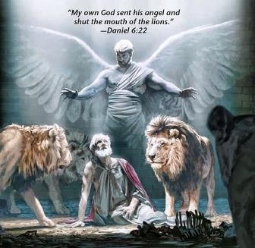
THE PROTECTION OF DANIEL V. 18-23
Daniel’s response v. 21-22
  Daniel 3:25
The king’s command v.23
  Daniel 3:27

Slide 69
THE PROTECTION OF DANIEL V. 18-23
Daniel’s response v. 21-22
  Daniel 3:25
The king’s command v.23
  Daniel 3:27

Slide 70
Synthetic Outline
  Chiasm “Aramaic” ( 2-7)
1. Gentile History (2)
  2. Protection (3)
    3. Revelation to a gentile king (4)
    3. Revelation to a gentile king (5)
  2. Protection (6)
1. Gentile history (7)

Slide 71
Synthetic Outline
  Chiasm “Aramaic” ( 2-7)
1. Gentile History (2)
  2. Protection (3)
    3. Revelation to a gentile king (4)
    3. Revelation to a gentile king (5)
  2. Protection (6)
1. Gentile history (7)

Slide 72
THE PROTECTION OF DANIEL V. 18-23
Daniel’s response v. 21-22
  Daniel 3:25
The king’s command v.23
  Daniel 3:27

Slide 73
Chapter 6 Outline
The Position of Daniel (1-3)
The Plot Against Daniel (4-9)
The Prayer of Daniel (10-11)
The Prosecution of Daniel (12-15)
The Presentation of Daniel into the Lion’s Den (16-17)
The Protection of Daniel (18-23)
The Product of Daniel’s Ordeal (24-28)

Slide 74
THE RESULTS OF DANIEL’S ORDEAL V. 24-28
Judgment on Daniel’s enemies v. 24
  Rom. 12:19; Esther 7:9-10
Glorification of Daniel’s God v. 25-27
  Darius describes God’s attributes
  Daniel 3:28
  God’s revelation to Darius
The success of Daniel’s leadership V.28
  Daniel 1:21

Slide 75
THE RESULTS OF DANIEL’S ORDEAL V. 24-28
Judgment on Daniel’s enemies v. 24
  Rom. 12:19; Esther 7:9-10
Glorification of Daniel’s God v. 25-27
  Darius describes God’s attributes
  Daniel 3:28
  God’s revelation to Darius
The success of Daniel’s leadership V.28
  Daniel 1:21

Slide 76
THE RESULTS OF DANIEL’S ORDEAL V. 24-28
Judgment on Daniel’s enemies v. 24
  Rom. 12:19; Esther 7:9-10
Glorification of Daniel’s God v. 25-27
  Darius describes God’s attributes
  Daniel 3:28
  God’s revelation to Darius
The success of Daniel’s leadership V.28
  Daniel 1:21

Slide 77
THE RESULTS OF DANIEL’S ORDEAL V. 24-28
Judgment on Daniel’s enemies v. 24
  Rom. 12:19; Esther 7:9-10
Glorification of Daniel’s God v. 25-27
  Darius describes God’s attributes
  Daniel 3:28
  God’s revelation to Darius
The success of Daniel’s leadership V.28
  Daniel 1:21

Slide 78
The 4 Jewish Youths Rise to Favor (1:17-21)
The length of their service (1:21)
  Nebuchadnezzar’s initial siege (605)
  Decree of Cyrus (536)
  Daniel served for 69 years
  Daniel served through 2 gentile empires and 4 successive gentile administrations

Slide 79
Basic Chronology
Babylon (605‒539)
  Nebuchadnezzar
  Belshazzar
Media-Persia (538‒536)
  Darius
  Cyrus

Slide 80
Conclusion

Slide 81
Chapter 6 Outline
The Position of Daniel (1-3)
The Plot Against Daniel (4-9)
The Prayer of Daniel (10-11)
The Prosecution of Daniel (12-15)
The Presentation of Daniel into the Lion’s Den (16-17)
The Protection of Daniel (18-23)
The Product of Daniel’s Ordeal (24-28)

