Slide 1
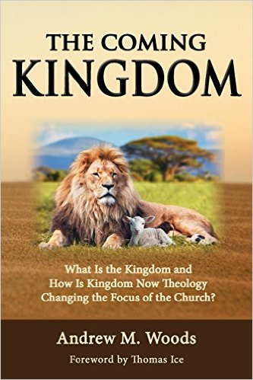

Slide 2

The Coming Kingdom
Chapter 9
Dr. Andy Woods
Senior Pastor – Sugar Land Bible Church
Adjunct Professor of Bible & Theology – College of Biblical Studies

Slide 3

Kingdom Study Outline
What does the Bible Say About the Kingdom?
The Main Problem with Kingdom Now NT interpretations
Why do some believe that we are in the kingdom now?
Why does it matter?

Slide 4
Kingdom Study Outline
What does the Bible Say About the Kingdom?
The Main Problem with Kingdom Now NT interpretations
Why do some believe that we are in the kingdom now?
Why does it matter?

Slide 5
1. Kingdom Throughout the Bible
Eden Abrahamic Covenant Mosaic Covenant Divided Kingdom Times of the Gentiles | Old Testament Prophets Post exile Offer of the King / Kingdom Rejection of the Offer Interim Age

Slide 6
1. Kingdom Throughout the Bible
Eden Abrahamic Covenant Mosaic Covenant Divided Kingdom Times of the Gentiles | Old Testament Prophets Post exile Offer of the King / Kingdom Rejection of the Offer Interim Age

Slide 7
1. Kingdom Throughout the Bible
Eden Abrahamic Covenant Mosaic Covenant Divided Kingdom Times of the Gentiles | Old Testament Prophets Post exile Offer of the King / Kingdom Rejection of the Offer Interim Age

Slide 8
1. Kingdom Throughout the Bible
Eden Abrahamic Covenant Mosaic Covenant Divided Kingdom Times of the Gentiles | Old Testament Prophets Post exile Offer of the King / Kingdom Rejection of the Offer Interim Age

Slide 9
1. Kingdom Throughout the Bible
Eden Abrahamic Covenant Mosaic Covenant Divided Kingdom Times of the Gentiles | Old Testament Prophets Post exile Offer of the King / Kingdom Rejection of the Offer Interim Age

Slide 10
1. Kingdom Throughout the Bible
Eden Abrahamic Covenant Mosaic Covenant Divided Kingdom Times of the Gentiles | Old Testament Prophets Post exile Offer of the King / Kingdom Rejection of the Offer Interim Age

Slide 11
1. Kingdom Throughout the Bible
Eden Abrahamic Covenant Mosaic Covenant Divided Kingdom Times of the Gentiles | Old Testament Prophets Post exile Offer of the King / Kingdom Rejection of the Offer Interim Age

Slide 12
1. Kingdom Throughout the Bible
Eden Abrahamic Covenant Mosaic Covenant Divided Kingdom Times of the Gentiles | Old Testament Prophets Post exile Offer of the King / Kingdom Rejection of the Offer Interim Age

Slide 13
1. Kingdom Throughout the Bible
Eden Abrahamic Covenant Mosaic Covenant Divided Kingdom Times of the Gentiles | Old Testament Prophets Post exile Offer of the King / Kingdom Rejection of the Offer Interim Age

Slide 14
1. Kingdom Throughout the Bible
Eden Abrahamic Covenant Mosaic Covenant Divided Kingdom Times of the Gentiles | Old Testament Prophets Post exile Offer of the King / Kingdom Rejection of the Offer Interim Age

Slide 15
1. Kingdom Throughout the Bible
Eden Abrahamic Covenant Mosaic Covenant Divided Kingdom Times of the Gentiles | Old Testament Prophets Post exile Offer of the King / Kingdom Rejection of the Offer Interim Age

Slide 16

THE INTERIM AGE
The Inter-advent Age (Matt. 13)
The Church Age (Matt. 16:18)

Slide 17
Five Preliminary Observations
An Authentic Age
An Age Caused by Israel’s Unbelief
A Mystery Age
A Priestly Age
An Important Age

Slide 18
Five Preliminary Observations
An Authentic Age
An Age Caused by Israel’s Unbelief
A Mystery Age
A Priestly Age
An Important Age

Slide 19

Luke 19:11 (NASB)
“While they were listening to these things, Jesus went on to tell a parable, because He was near Jerusalem, and they supposed that the kingdom of God was going to appear immediately.”

Slide 20
Luke 19:15 (NASB)
“When he returned, after receiving the kingdom, he ordered that these slaves, to whom he had given the money, be called to him so that he might know what business they had done.”

Slide 21
The Prophetic Parables of
Matthew Thirteen - A. W. Pink
“Because Israel rejected their King, He temporarily rejected them, and therefore the setting up of His Messianic kingdom on this earth was postponed. The King would depart from this world and be absent for a lengthy season, before He returned again and set up His kingdom—see Luke 19:12, 15.”
A. W. Pink (2005). The Prophetic Parables of Matthew Thirteen. Bellingham, WA: Logos Bible Software.

Slide 22
Five Preliminary Observations
An Authentic Age
An Age Caused by Israel’s Unbelief
A Mystery Age
A Priestly Age
An Important Age

Slide 23
Daniel 9:26 (NASB)
“So you are to know and discern that from the issuing of a decree to restore and rebuild Jerusalem until Messiah the Prince there will be seven weeks and sixty-two weeks; it will be built again, with plaza and moat, even in times of distress. ²⁶ Then after the sixty-two weeks the Messiah will be cut off and have nothing, and the people of the prince who is to come will destroy the city and the sanctuary. And its end will come with a flood; even to the end there will be war; desolations are determined.’”

Slide 24

Lewis Sperry Chafer, vol. 5, Systematic Theology (Grand Rapids, MI: Kregel Publications, 1993), 347-48.
God not only knows beforehand the choice His creatures will make, but is Himself able to work in them both to will and to do of His own good pleasure. The Scriptures present many incidents which disclose the fact that the will of God is executed by men even when they have no conscious intention to do the will of God. . . . Was the death of Christ in danger of being abortive and all the types and prophecies respecting His death of being proved untrue until Pilate made his decision regarding that death?

Slide 25
Five Preliminary Observations
An Authentic Age
An Age Caused by Israel’s Unbelief
A Mystery Age
A Priestly Age
An Important Age

Slide 26
Matthew 13:11 (NASB)
Jesus answered them, “To you it has been granted to know the mysteries of the kingdom of heaven, but to them it has not been granted.”

Slide 27
Ephesians 3:9 (NASB)
“and to bring to light what is the administration of the mystery which for ages has been hidden in God who created all things.”

Slide 28
“Mystery” Defined
In the N.T, it [mystērion] denotes, not the mysterious (as with the Eng. word), but that which, being outside the range of unassisted natural apprehension, can be made known only by Divine revelation, and is made known in a manner and at a time appointed by God, and to those who are illumined by His Spirit.
W. E. Vine, Merrill F. Unger, and William White, Vine's Complete Expository Dictionary of the Old and New Testament Words (Nashville: Nelson, 1996), 424.

Slide 29
Ephesians 3:9 (NASB)
“and to bring to light what is the administration of the mystery which for ages has been hidden in God who created all things.”

Slide 30
Ephesians 2:15-16 (NASB)
“by abolishing in His flesh the enmity, which is the Law of commandments contained in ordinances, so that in Himself He might make the two into one new man, thus establishing peace, ¹⁶ and might reconcile them both in one body to God through the cross, by it having put to death the enmity.”

Slide 31
Ephesians 3:3-6 (NASB)
“that by revelation there was made known to me the mystery, as I wrote before in brief. ⁴ By referring to this, when you read you can understand my insight into the mystery of Christ, ⁵ which in other generations was not made known to the sons of men, as it has now been revealed to His holy apostles and prophets in the Spirit; ⁶ to be specific, that the Gentiles are fellow heirs and fellow members of the body, and fellow partakers of the promise in Christ Jesus through the gospel”.

Slide 32
1 Corinthians 12:12-13 (NASB)
“For even as the body is one and yet has many members, and all the members of the body, though they are many, are one body, so also is Christ. ¹³ For by one Spirit we were all baptized into one body, whether Jews or Greeks, whether slaves or free, and we were all made to drink of one Spirit”

Slide 33
Ruth 1:16 (NASB)
“But Ruth said, “Do not urge me to leave you or turn back from following you; for where you go, I will go, and where you lodge, I will lodge. Your people shall be my people, and your God, my God.”

Slide 34

Acts 7:38 (NASB)
“This is the one who was in the congregation (church or ekklēsia) in the wilderness together with the angel who was speaking to him on Mount Sinai, and who was with our fathers; and he received living oracles to pass on to you.”

Slide 35
The “Mystery” in Progressive Dispensationalism
“The evidence from the Old Testament prophecies and in some cases their later Jewish interpretation shows a relationship between what was promised and what is now revealed. Specifically, the promises concerning the salvation of the Gentiles along with Israel, a certain solidarity between the promises concerning the Messiah and his people, and, perhaps most important, the prediction of the indwelling Spirit of God, make it difficult to deny some connection between this Old Testament hope and the mystery of the union of Gentiles and Israel in Christ found in Ephesians 3.”
Robert L. Saucy, “The Church as the Mystery of God,” in Dispensationalism, Israel and the Church: The Search for a Definition, ed. Craig A. Blaising and Darrell L. Bock (Grand Rapids: Zondervan, 1992), 149.

Slide 36
Isaiah 49:6 (NASB)
He says, “It is too small a thing that You should be My Servant To raise up the tribes of Jacob and to restore the preserved ones of Israel; I will also make You a light of the nations So that My salvation may reach to the end of the earth.”

Slide 37
Ezekiel 36:26-27 (NASB)
²⁶ “Moreover, I will give you a new heart and put a new spirit within you; and I will remove the heart of stone from your flesh and give you a heart of flesh. ²⁷ I will put My Spirit within you and cause you to walk in My statutes, and you will be careful to observe My ordinances.”

Slide 38

Statue
&
Stone

Slide 39

Daniel 2:18-19, 27-30 (NASB)
“¹⁸ so that they might request compassion from the God of heaven concerning this mystery, so that Daniel and his friends would not be destroyed with the rest of the wise men of Babylon. ¹⁹ Then the mystery was revealed to Daniel in a night vision. Then Daniel blessed the God of heaven; ²⁷ Daniel answered before the king and said, “As for the mystery about which the king has inquired, neither wise men, conjurers, magicians nor diviners are able to declare it to the king. ²⁸ However, there is a God in heaven who reveals mysteries, and He has made known to King Nebuchadnezzar what will take place in the latter days. This was your dream and the visions in your mind while on your bed. ²⁹ As for you, O king, while on your bed your thoughts turned to what would take place in the future; and He who reveals mysteries has made known to you what will take place. ³⁰ But as for me, this mystery has not been revealed to me for any wisdom residing in me more than in any other living man, but for the purpose of making the interpretation known to the king, and that you may understand the thoughts of your mind.”

Slide 40
Two Battleground Passages
Ephesians 3:5
Romans 16:25-26

Slide 41
Two Battleground Passages
Ephesians 3:5
Romans 16:25-26

Slide 42
Ephesians 3:5 (NASB)
“which in other generations was not made known to the sons of men, as [hos] it has now been revealed to His holy apostles and prophets in the Spirit.”

Slide 43
Acts 2:15 (NASB)
“or these men are not drunk, as [hos] you suppose, for it is only the third hour of the day.”

Slide 44
Ephesians 3:9 (NASB)
“and to bring to light what is the administration of the mystery which for ages has been hidden in God who created all things.”

Slide 45
Ephesians 3:5 (NASB)
“which in other generations was not made known to the sons of men, as it has now been revealed [apokaluptō] to His holy apostles and prophets in the Spirit.”

Slide 46
Ephesians 3:5 (NASB)
“which in other generations was not made known to the sons of men, as it has now [nyn] been revealed to His holy apostles and prophets in the Spirit.”

Slide 47
Ephesians 3:10 (NASB)
“so that the manifold wisdom of God might now now [nyn] be made known through the church to the rulers and the authorities in the heavenly places.”

Slide 48
Ephesians 3:5 (NASB)
“which in other generations was not made known [gnōrizō] to the sons of men, as it has now been revealed to His holy apostles and prophets in the Spirit.”

Slide 49
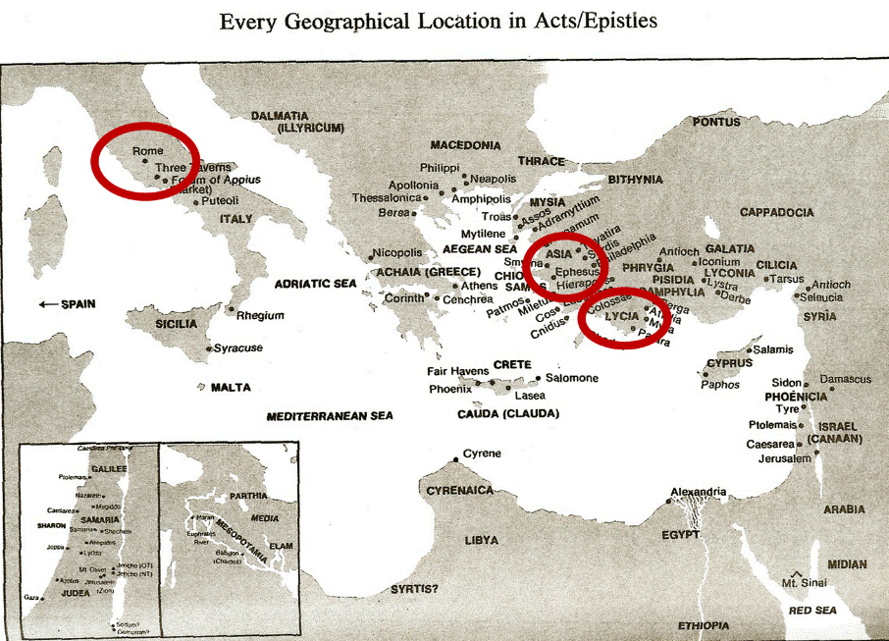

Slide 50
Colossians 1:26 (NASB)
“that is, the mystery which has been hidden from the past ages and generations, but has now been manifested to His.”

Slide 51
Ephesians 3:5 (NASB)
“which in other generations was not made known to the sons of men, as [hos] it has now been revealed to His holy apostles and prophets in the Spirit.”

Slide 52
Two Battleground Passages
Ephesians 3:5
Romans 16:25-26

Slide 53
Romans 16:25-26 (NASB)
²⁵ “Now to Him who is able to establish you according to my gospel and the preaching of Jesus Christ, according to the revelation of the mystery which has been kept secret for long ages past, ²⁶ but now is manifested, and by the Scriptures of the prophets, according to the commandment of the eternal God, has been made known to all the nations, leading to obedience of faith.”

Slide 54
The “Mystery” in Progressive Dispensationalism
“A normal, contextual, and historical reading of the phrase, shows, then, that the most natural reading of this benediction is to see a reference to the prophetic Hebrew Scriptures here. . . . If this is so, then mystery, at least in this Romans context must refer not to totally new truth, but to truth that was already somewhat revealed in those Scriptures.”
Darrell Bock, “Hermeneutics of Progressive Dispensationalism,” in Three Central Issues in Contemporary Dispensationalism: A Comparison of Traditional and Progressive Views, ed. Herbert W. Bateman (Grand Rapids: Kregel, 1999), 117 n. 28.

Slide 55
Romans 16:25-26 (NASB)
²⁵ “Now to Him who is able to establish you according to my gospel and the preaching of Jesus Christ, according to the revelation of the mystery which has been kept secret for long ages past, ²⁶ but now is manifested, and by the Scriptures of the prophets, according to the commandment of the eternal God, has been made known to all the nations, leading to obedience of faith.”

Slide 56
Ephesians 2:20 (NASB)
“having been built on the foundation of the apostles and prophets, Christ Jesus Himself being the corner stone.”

Slide 57
Ephesians 3:5 (NASB)
“which in other generations was not made known to the sons of men, as it has now been revealed to His holy apostles and prophets in the Spirit.”

Slide 58
Order of Paul’s Letters
Galatians (A.D. 49)
1‒2 Thessalonians (A.D. 51)
1‒2 Corinthians (A.D. 56)
Romans (A.D. 57)
Ephesians, Colossians, Philemon, Philippians (A.D. 60‒62)
1 Timothy, Titus (A.D. 62‒66)
2 Timothy (A.D. 67)

Slide 59
Order of Paul’s Letters
Galatians (A.D. 49)
1‒2 Thessalonians (A.D. 51)
1‒2 Corinthians (A.D. 56)
Romans (A.D. 57)
Ephesians, Colossians, Philemon, Philippians (A.D. 60‒62)
1 Timothy, Titus (A.D. 62‒66)
2 Timothy (A.D. 67)

Slide 60
Romans 16:25-26 (NASB)
“Now to Him who is able to establish you according to my gospel and the preaching of Jesus Christ, according to the revelation of the mystery which has been kept secret for long ages past, 26 but now is manifested, and by the Scriptures of the prophets, according to the commandment of the eternal God, has been made known to all the nations, leading to obedience of faith.”

Slide 61
Romans 1:2-3 (NASB)
“² which He promised beforehand through His prophets in the holy Scriptures, ³ concerning His Son, who was born of a descendant of David according to the flesh.”

Slide 62
Romans 16:25-26 (NASB)
²⁵ “Now to Him who is able to establish you according to my gospel and the preaching of Jesus Christ, according to the revelation of the mystery which has been kept secret for long ages past, ²⁶ but now is manifested, and by the Scriptures of the prophets, according to the commandment of the eternal God, has been made known to all the nations, leading to obedience of faith.”

Slide 63
 | ROMANS 1:2-3 | ROMANS 16:25-26
Location | Beginning | End
Function | Introduction | Doxology
Mystery | No | Yes
Davidic lineage | Yes | No
“Holy” modifying “Scriptures” | Yes | No
Definite article before “Scriptures” | Yes | No
“Prophets” | Noun | Adjective
“Prophets” | Old Testament | New Testament
Scripture | Old Testament | NT “mysteries” (Rom. 11:25b)

Slide 64
Romans 11:25 (NASB)
“For I do not want you, brethren, to be uninformed of this mystery—so that you will not be wise in your own estimation—that a partial hardening has happened to Israel until the fullness of the Gentiles has come in”.

Slide 65
Romans 16:25-26 (NASB)
²⁵ “Now to Him who is able to establish you according to my gospel and the preaching of Jesus Christ, according to the revelation of the mystery which has been kept secret for long ages past, ²⁶ but now is manifested, and by the Scriptures of the prophets, according to the commandment of the eternal God, has been made known to all the nations, leading to obedience of faith.”

Slide 66
Five Preliminary Observations
An Authentic Age
An Age Caused by Israel’s Unbelief
A Mystery Age
A Priestly Age
An Important Age

Slide 67
Daniel 9:26 (NASB)
“So you are to know and discern that from the issuing of a decree to restore and rebuild Jerusalem until Messiah the Prince there will be seven weeks and sixty-two weeks; it will be built again, with plaza and moat, even in times of distress. ²⁶ Then after the sixty-two weeks the Messiah will be cut off and have nothing, and the people of the prince who is to come will destroy the city and the sanctuary. And its end will come with a flood; even to the end there will be war; desolations are determined.’”

Slide 68
Revelation 3:21 (NASB)
“He who overcomes, I will grant to him to sit down with Me on My throne, as I also overcame and sat down with My Father on His throne.”

Slide 69
Revelation 12:5 (NASB)
“And she gave birth to a son, a male child, who is to rule all the nations with a rod of iron; and her child was caught up to God and to His throne.”

Slide 70
John 17:5 (NASB)
“Now, Father, glorify Me together with Yourself, with the glory which I had with You before the world was.”

Slide 71
Revelation 3:7 (NASB)
“And to the angel of the church in Philadelphia write: He who is holy, who is true, who has the key of David, who opens and no one will shut, and who shuts and no one opens, says this:…”

Slide 72
Revelation 5:5 (NASB)
and one of the elders said to me, “Stop weeping; behold, the Lion that is from the tribe of Judah, the Root of David, has overcome so as to open the book and its seven seals.”

Slide 73
Hebrews 7:3 (NASB)
Without father, without mother, without genealogy, having neither beginning of days nor end of life, but made like the Son of God, he remains a priest perpetually.”

Slide 74
Lewis Sperry Chafer, vol. 5, Systematic Theology (Grand Rapids, MI: Kregel Publications, 1993), 315.
Similarly, the earthly kingdom that according to the Scriptures had its origin in the covenant made to David, which is mundane and literal in its original form and equally as mundane and literal in uncounted references to it in all subsequent Scriptures which trace it on to its consummation, is by theological legerdemain metamorphosed into a spiritual monstrosity in which an absent King seated on His Father’s throne in heaven is accepted in lieu of the theocratic monarch of David’s line seated on David’s throne in Jerusalem.

Slide 75
Five Preliminary Observations
An Authentic Age
An Age Caused by Israel’s Unbelief
A Mystery Age
A Priestly Age
An Important Age

Slide 76
Ephesians 3:11 (NASB)
“This was in accordance with the eternal purpose which He carried out in Christ Jesus our Lord.”

Slide 77
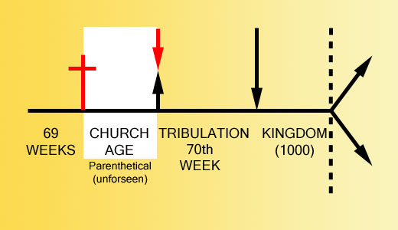

Slide 78
The Church is not “Plan B”
“In almost 35 years since I have become a dispensationalist, I have never heard nor read of a dispensationalist teaching a plan B scenario. Yet opponents often present this straw man in their statement of what we supposedly believe. We believe that God’s single plan has always included the Church, but He did not reveal the church age part of the plan in the Old Testament. . . . Paul states specifically that the church age “was in accordance with the eternal purpose which He carried out in Christ Jesus our Lord” (verse 11). This is why dispensationalists have never taught the so-called plan A and plan B theory that critics suppose we hold. Dispensationalists have always taught that there is a single plan carried out in stages.”
Thomas Ice, “The Uniqueness of the Church,” Pre-Trib Perspectives 8, no. 6 (September 2003): 4.

Slide 79
Conclusion

Slide 80
Five Preliminary Observations
An Authentic Age
An Age Caused by Israel’s Unbelief
A Mystery Age
A Priestly Age
An Important Age

Slide 81
1. Kingdom Throughout the Bible
Kingdom Mysteries Church Re-offer of the King/Kingdom Transfer of Kingdom Authority | Kingdom Establishment Eternal State Testimony of Early Church History

Slide 82
1. Kingdom Throughout the Bible
Kingdom Mysteries Church Re-offer of the King/Kingdom Transfer of Kingdom Authority | Kingdom Establishment Eternal State Testimony of Early Church History

