Slide 1

THE BOOK OF DANIEL
Dr. Andy Woods

Slide 2

Message
Times of the Gentiles are revealed prophetically (2, 7, 8-12) and ethically (1, 3-6)

Slide 3
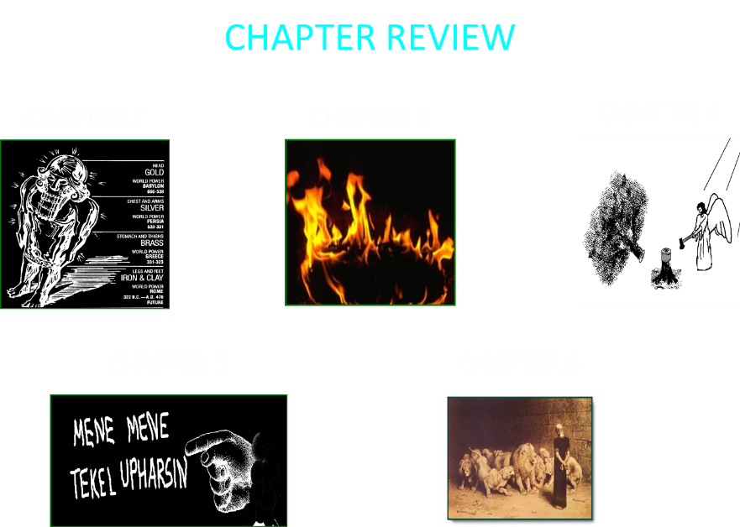

Slide 4

Synthetic Outline
Historical (1-7):
  Daniel interprets, 3rd person, gentile nations
  Intro “Hebrew” (1)
  Aramaic chiasm (2-7)

Slide 5
Synthetic Outline
Prophetic (8-12):
  Angel interprets, 1st person, Jewish nation, Hebrew
  Ram & Goat (8)
  70 weeks (9)
  Final vision (10-12)

Slide 6
Synthetic Outline
Historical (1-7):
  Daniel interprets, 3rd person, gentile nations
  Intro “Hebrew” (1)
  Aramaic chiasm (2-7)

Slide 7
Synthetic Outline
Historical (1-7):
  Daniel interprets, 3rd person, gentile nations
  Intro “Hebrew” (1)
  Aramaic chiasm (2-7)

Slide 8

Synthetic Outline
  Chiasm “Aramaic” ( 2-7)
1. Gentile History (2)
  2. Protection (3)
    3. Revelation to a gentile king (4)
    3. Revelation to a gentile king (5)
  2. Protection (6)
1. Gentile history (7)

Slide 9
Synthetic Outline
  Chiasm “Aramaic” ( 2-7)
1. Gentile History (2)
  2. Protection (3)
    3. Revelation to a gentile king (4)
    3. Revelation to a gentile king (5)
  2. Protection (6)
1. Gentile history (7)

Slide 10

Statue
&
Stone

Slide 11
Synthetic Outline
  Chiasm “Aramaic” ( 2-7)
1. Gentile History (2)
  2. Protection (3)
    3. Revelation to a gentile king (4)
    3. Revelation to a gentile king (5)
  2. Protection (6)
1. Gentile history (7)

Slide 12
Synthetic Outline
  Chiasm “Aramaic” ( 2-7)
1. Gentile History (2)
  2. Protection (3)
    3. Revelation to a gentile king (4)
    3. Revelation to a gentile king (5)
  2. Protection (6)
1. Gentile history (7)

Slide 13
Synthetic Outline
  Chiasm “Aramaic” ( 2-7)
1. Gentile History (2)
  2. Protection (3)
    3. Revelation to a gentile king (4)
    3. Revelation to a gentile king (5)
  2. Protection (6)
1. Gentile history (7)

Slide 14
Synthetic Outline
  Chiasm “Aramaic” ( 2-7)
1. Gentile History (2)
  2. Protection (3)
    3. Revelation to a gentile king (4)
    3. Revelation to a gentile king (5)
  2. Protection (6)
1. Gentile history (7)

Slide 15

THE EVENTS OF CHAPTER 5
THE
FALL OF
BABYLON
DARIUS
REPLACES
BELSHAZZAR

Slide 16
Succession of Gentile Rulers
1-4: Nebuchadnezzar of Babylon
5: Belshazzar of Babylon
6: Darius of Media – Persia
7-8: Belshazzar of Babylon
9: Darius of Media – Persia
10-12: Cyrus of Media – Persia

Slide 17
Succession of Gentile Rulers
1-4: Nebuchadnezzar of Babylon
5: Belshazzar of Babylon
6: Darius of Media – Persia
7-8: Belshazzar of Babylon
9: Darius of Media – Persia
10-12: Cyrus of Media – Persia

Slide 18
CHAPTER & VERSE IN DANIEL | CHRONOLOGICAL DATE | BIBLICAL DATE
1:1 | 605 | 3rd year of Jehoiakim
2:1 | 603 | 2nd year of Nebuchadnezzar
5 | Sat. night 10/12/539 (Hoehner)
7:1 | 553 | 1st year of Belshazzar
8:1 | 551 | 3rd year of Belshazzar
9:1 | 538 | 1st year of Darius
10:1 | 536 | 3rd year of Cyrus

Slide 19
Daniel’s Age
CHAPTER | EVENTS | AGE
1 | Taken to Babylonian captivity | 15
2 | Interpreting Nebuchadnezzar’s 1st dream (huge image) | 17
3 | Daniel’s 3 friends cast into the fiery furnace | 19 or 20
4 | Interpreting Nebuchadnezzar’s 2nd dream (huge tree) | 45-50
5 | Interpreting handwriting of the wall at Belshazzar’s feast | Early 80’s
6 | Delivered from the den of lions | c.83
7-8 | Daniel’s visions and dreams | Mid-60’s
9 | Daniel’s seventy “sevens” prophecy | Early-80’s
10-12 | Final dreams and visions | Mid-80’s

Slide 20

Chapter 6 Outline
The Position of Daniel (1-3)
The Plot Against Daniel (4-9)
The Prayer of Daniel (10-11)
The Prosecution of Daniel (12-15)
The Presentation of Daniel into the Lion’s Den (16-17)
The Protection of Daniel (18-23)
The Product of Daniel’s Ordeal (24-28)

Slide 21
Chapter 6 Outline
The Position of Daniel (1-3)
The Plot Against Daniel (4-9)
The Prayer of Daniel (10-11)
The Prosecution of Daniel (12-15)
The Presentation of Daniel into the Lion’s Den (16-17)
The Protection of Daniel (18-23)
The Product of Daniel’s Ordeal (24-28)

Slide 22
Chapter 6 Outline
The Position of Daniel (1-3)
The Plot Against Daniel (4-9)
The Prayer of Daniel (10-11)
The Prosecution of Daniel (12-15)
The Presentation of Daniel into the Lion’s Den (16-17)
The Protection of Daniel (18-23)
The Product of Daniel’s Ordeal (24-28)

Slide 23
Chapter 6 Outline
The Position of Daniel (1-3)
The Plot Against Daniel (4-9)
The Prayer of Daniel (10-11)
The Prosecution of Daniel (12-15)
The Presentation of Daniel into the Lion’s Den (16-17)
The Protection of Daniel (18-23)
The Product of Daniel’s Ordeal (24-28)

Slide 24
Chapter 6 Outline
The Position of Daniel (1-3)
The Plot Against Daniel (4-9)
The Prayer of Daniel (10-11)
The Prosecution of Daniel (12-15)
The Presentation of Daniel into the Lion’s Den (16-17)
The Protection of Daniel (18-23)
The Product of Daniel’s Ordeal (24-28)

Slide 25
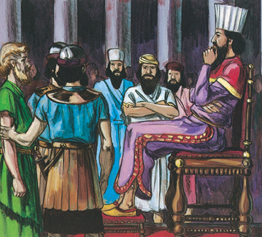
PROSECUTION OF DANIEL V.12-15
The enemies’ question v.12a
The king’s affirmation v. 12b

Slide 26
PROSECUTION OF DANIEL V.12-15
The enemies’ question v.12a
The king’s affirmation v. 12b

Slide 27
PROSECUTION OF DANIEL V.12-15
The enemies’ question v.12a
The king’s affirmation v. 12b

Slide 28
PROSECUTION OF DANIEL V.12-15
The enemies’ complaint v. 13
  Anti-Semitic motivation (3:12)
Darius’ distress v. 14
The enemies’ technicality v.15

Slide 29
PROSECUTION OF DANIEL V.12-15
The enemies’ complaint v. 13
  Anti-Semitic motivation (3:12)
Darius’ distress v. 14
The enemies’ technicality v.15

Slide 30
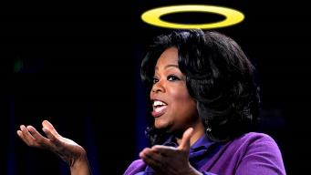
“…one of the mistakes that human beings make is believing that there is only one way…We don’t accept that there are diverse ways of being in the world; that there are millions of ways to be a human being. And many ways…many paths to what you call God. That her path might be something else and when she gets there she might call it the light. But her loving, and her kindness, and her generosity brings her to the…same point that it brings you…
www.youtube.com/watch?v=Lb2RUpMDk34

Slide 31

…It doesn’t matter whether she called it ‘God’ along the way or not…There couldn’t possibly be just one way!…There couldn’t possibly be only one way with millions of people in the world!...You think…if you are somewhere on the planet and you never hear the name of Jesus but yet you live with a loving heart. You lived as Jesus would have had you to live. You lived for the same purpose as Jesus came to the planet to teach us all, but you are in some remote part of the earth and you never heard the name of Jesus. You cannot get to Heaven…?”
www.youtube.com/watch?v=Lb2RUpMDk34

Slide 32
PROSECUTION OF DANIEL V.12-15
The enemies’ complaint v. 13
  Anti-Semitic motivation (3:12)
Darius’ distress v. 14
The enemies’ technicality v.15

Slide 33
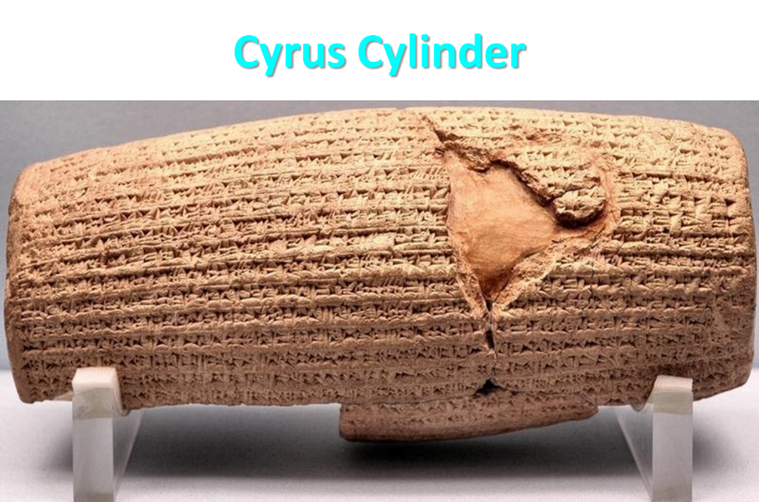

Slide 34

Herodotus
Histories, 1:191 (450 B.C.)
“…he conducted the river by a channel into the lake…and so he made the former course of the river passable by the sinking of the stream. When this had been done, the Persians who had been posted for this very purpose entered by the bed of the river Euphrates into Babylon, the stream having sunk so far that it reached about to the middle of a man’s thigh…those Babylonians who dwelt in the middle did not know that they had been captured…”

Slide 35
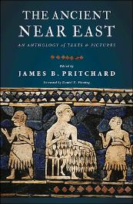
James Pritchard
The Ancient Near East Texts Relating to the Old Testament, 315-16.
Without any battle. . . sparing Babylon . . . any calamity.... I am Cyrus...king of Babylon....When I entered Babylon...under jubilation and rejoicing...troops walked around Babylon...in peace, I did not allow anybody to terrorize (any place) of the [country of Sumer] and Akkad. I strove for peace in Babylon...and in all his (other) sacred cities....I returned to (these) sacred cities on the other side of the Tigris, the sanctuaries of which have been in ruins for a long time, the images which (used) to live therein and established for them permanent sanctuaries.

Slide 36
James Pritchard
The Ancient Near East Texts Relating to the Old Testament, 315-16.
I (also) gathered all their (former) inhabitants and returned (to them) their habitations. Furthermore, I resettled... unharmed, in their (former) chapels, the places which make them happy. May all the gods whom I have resettled in their sacred cities ask daily Bel and Nebo for a long life for me...all of them I resettled in a peaceful place... ducks and doves,...I endeavoured to fortify/repair their dwelling places . . .

Slide 37
Three Returns
 | Date | Duration | Persian king | Jewish leader | Scripture | Purpose | Number of returnees
1st return | 538–515 B.C. | 23 years | Cyrus (Isa 44:28‒45:1) | Zerubbabel | Ezra 1–6; Isaiah 44:28 | Rebuilding the temple | 50,000
2nd return | 458–457 B.C. | 2 years | Artaxerxes | Ezra | Ezra 7–10 | Adorning of the temple and reforming the people | 2,000
3rd return | 444–432 B.C. | 8 years | Artaxerxes | Nehemiah | Nehemiah | Rebuilding the wall

Slide 38
PROSECUTION OF DANIEL V.12-15
The enemies’ complaint v. 13
  Anti-Semitic motivation (3:12)
Darius’ distress v. 14
The enemies’ technicality v.15

Slide 39
Chapter 6 Outline
The Position of Daniel (1-3)
The Plot Against Daniel (4-9)
The Prayer of Daniel (10-11)
The Prosecution of Daniel (12-15)
The Presentation of Daniel into the Lion’s Den (16-17)
The Protection of Daniel (18-23)
The Product of Daniel’s Ordeal (24-28)

Slide 40
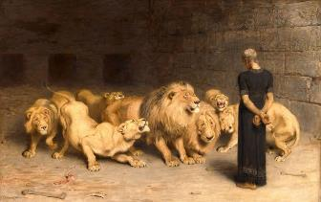
JUDGMENT OF DANIEL V.16-17
The king’s order v. 16a
The king’s judgment v.16b
The king’s authorization v. 17
  Matthew 27:66

Slide 41
JUDGMENT OF DANIEL V.16-17
The king’s order v. 16a
The king’s judgment v.16b
The king’s authorization v. 17
  Matthew 27:66

Slide 42
JUDGMENT OF DANIEL V.16-17
The king’s order v. 16a
The king’s judgment v.16b
The king’s authorization v. 17
  Matthew 27:66

Slide 43
JUDGMENT OF DANIEL V.16-17
The king’s order v. 16a
The king’s judgment v.16b
The king’s authorization v. 17
  Matthew 27:66

Slide 44
Chapter 6 Outline
The Position of Daniel (1-3)
The Plot Against Daniel (4-9)
The Prayer of Daniel (10-11)
The Prosecution of Daniel (12-15)
The Presentation of Daniel into the Lion’s Den (16-17)
The Protection of Daniel (18-23)
The Product of Daniel’s Ordeal (24-28)

Slide 45
THE PROTECTION OF DANIEL V. 18-23
The king’s agony v. 18
The king’s inquiry v. 19-20

Slide 46
THE PROTECTION OF DANIEL V. 18-23
The king’s agony v. 18
The king’s inquiry v. 19-20

Slide 47
THE PROTECTION OF DANIEL V. 18-23
The king’s agony v. 18
The king’s inquiry v. 19-20

Slide 48
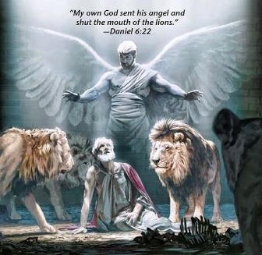
THE PROTECTION OF DANIEL V. 18-23
Daniel’s response v. 21-22
  Daniel 3:25
The king’s command v.23
  Daniel 3:27

Slide 49
THE PROTECTION OF DANIEL V. 18-23
Daniel’s response v. 21-22
  Daniel 3:25
The king’s command v.23
  Daniel 3:27

Slide 50
Synthetic Outline
  Chiasm “Aramaic” ( 2-7)
1. Gentile History (2)
  2. Protection (3)
    3. Revelation to a gentile king (4)
    3. Revelation to a gentile king (5)
  2. Protection (6)
1. Gentile history (7)

Slide 51
Synthetic Outline
  Chiasm “Aramaic” ( 2-7)
1. Gentile History (2)
  2. Protection (3)
    3. Revelation to a gentile king (4)
    3. Revelation to a gentile king (5)
  2. Protection (6)
1. Gentile history (7)

Slide 52
THE PROTECTION OF DANIEL V. 18-23
Daniel’s response v. 21-22
  Daniel 3:25
The king’s command v.23
  Daniel 3:27

Slide 53
Chapter 6 Outline
The Position of Daniel (1-3)
The Plot Against Daniel (4-9)
The Prayer of Daniel (10-11)
The Prosecution of Daniel (12-15)
The Presentation of Daniel into the Lion’s Den (16-17)
The Protection of Daniel (18-23)
The Product of Daniel’s Ordeal (24-28)

Slide 54
THE RESULTS OF DANIEL’S ORDEAL V. 24-28
Judgment on Daniel’s enemies v. 24
  Rom. 12:19; Esther 7:9-10
Glorification of Daniel’s God v. 25-27
  Darius describes God’s attributes
  Daniel 3:28
  God’s revelation to Darius
The success of Daniel’s leadership V.28
  Daniel 1:21

Slide 55
THE RESULTS OF DANIEL’S ORDEAL V. 24-28
Judgment on Daniel’s enemies v. 24
  Rom. 12:19; Esther 7:9-10
Glorification of Daniel’s God v. 25-27
  Darius describes God’s attributes
  Daniel 3:28
  God’s revelation to Darius
The success of Daniel’s leadership V.28
  Daniel 1:21

Slide 56
THE RESULTS OF DANIEL’S ORDEAL V. 24-28
Judgment on Daniel’s enemies v. 24
  Rom. 12:19; Esther 7:9-10
Glorification of Daniel’s God v. 25-27
  Darius describes God’s attributes
  Daniel 3:28
  God’s revelation to Darius
The success of Daniel’s leadership V.28
  Daniel 1:21

Slide 57
THE RESULTS OF DANIEL’S ORDEAL V. 24-28
Judgment on Daniel’s enemies v. 24
  Rom. 12:19; Esther 7:9-10
Glorification of Daniel’s God v. 25-27
  Darius describes God’s attributes
  Daniel 3:28
  God’s revelation to Darius
The success of Daniel’s leadership V.28
  Daniel 1:21

Slide 58
The 4 Jewish Youths Rise to Favor (1:17-21)
The length of their service (1:21)
  Nebuchadnezzar’s initial siege (605)
  Decree of Cyrus (536)
  Daniel served for 69 years
  Daniel served through 2 gentile empires and 4 successive gentile administrations

Slide 59
Basic Chronology
Babylon (605‒539)
  Nebuchadnezzar
  Belshazzar
Media-Persia (538‒536)
  Darius
  Cyrus

Slide 60
Conclusion

Slide 61
Chapter 6 Outline
The Position of Daniel (1-3)
The Plot Against Daniel (4-9)
The Prayer of Daniel (10-11)
The Prosecution of Daniel (12-15)
The Presentation of Daniel into the Lion’s Den (16-17)
The Protection of Daniel (18-23)
The Product of Daniel’s Ordeal (24-28)

