Slide 1
Law & Grace Jim McGowan, Th.D. Sugar Land Bible Church 04-23-2017.
Special thanks to Dr. Vern Peterman for access to his insights and resources.
Notes:
Law vs. Grace

Slide 2
Outline
Our Purpose, Aim, and Objective
Review
Contrast and Comparison of Law & Grace – Exodus 12:1-13
Conclusion

Slide 3
Outline
Our Purpose, Aim, and Objective
Review
Contrast and Comparison of Law & Grace – Exodus 12:1-13
Conclusion

Slide 4
OUR PURPOSE, AIM AND OBJECTIVE
Law & Grace
…is to Compare and Contrast Law and Grace so as to properly understand these two important themes and how they are related to the life of the New Testament Believer.

Slide 5
Outline
Our Purpose, Aim, and Objective
Review
Contrast and Comparison of Law & Grace – Exodus 12:1-13
Conclusion

Slide 8
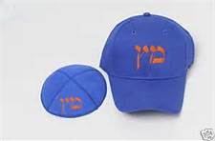
THE BIG RULE BOOK of
from the BIG INNING

Slide 9
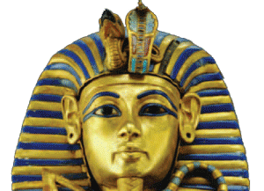
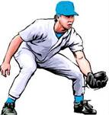
The
Israelites
vs
The
Egyptians

Slide 10
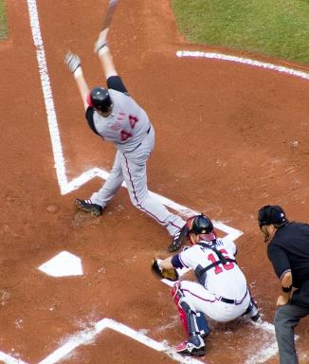
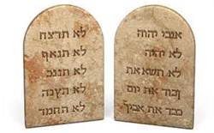
TEN
STRIKES
AND YOU’RE OUT!

Slide 11
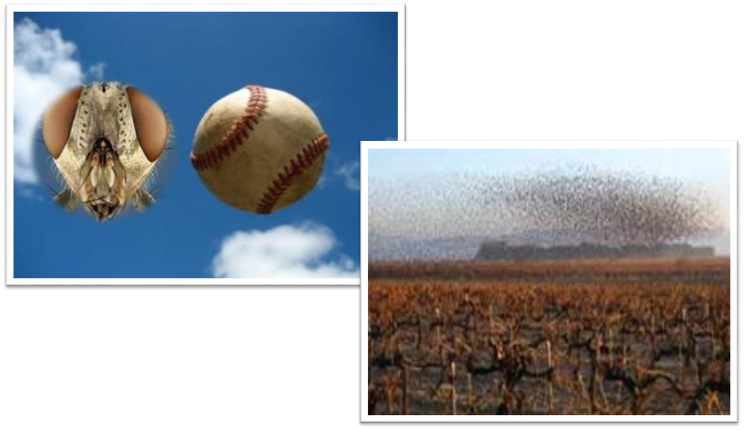
Fly Ball?
In Jewish baseball, ‘flies’ mean something completely different.

Slide 12
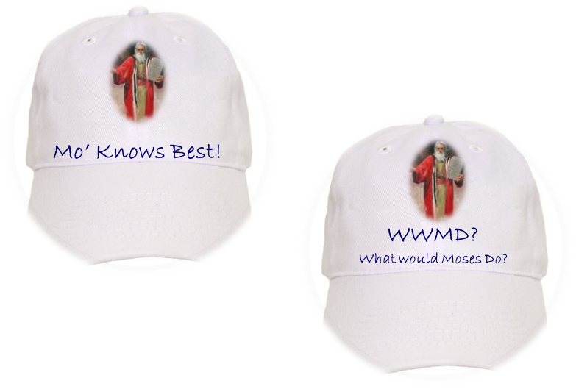

Slide 14
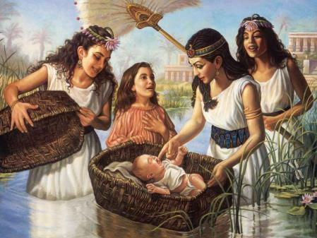
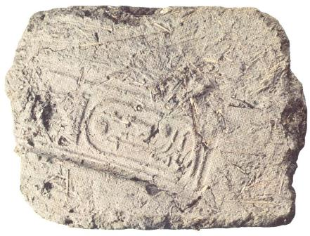
Moses found by Pharaoh's daughter.
Brick made of straw and mud with Pharaoh's stamp.
Notes:
Brick made of straw and mud.
Moses found by Pharaoh's daughter.

Slide 15
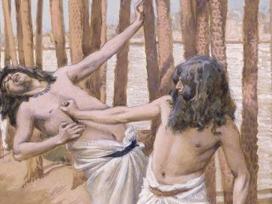
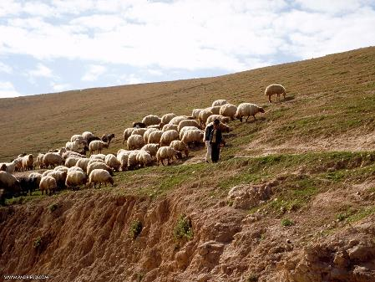
Moses kill an Egyptian.
Moses flees Egypt and becomes a shepherd.
Notes:
Moses kill an Egyptian.
Moses becomes a shepherd.

Slide 16
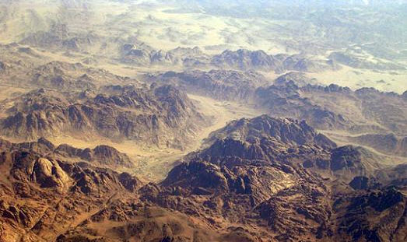
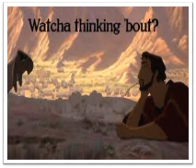
The Sinai (Horeb) Wilderness

Slide 18
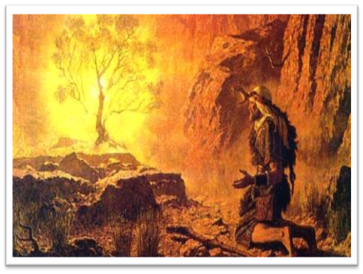
Exodus 3

Slide 19
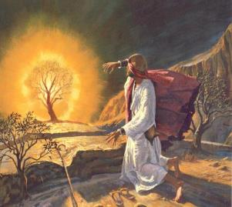
Exodus 3:7-10
⁷ The LORD said, "I have surely seen the affliction of My people who are in Egypt, and have given heed to their cry because of their taskmasters, for I am aware of their sufferings… ¹⁰ Therefore, come now, and I will send you to Pharaoh, so that you may bring My people, the sons of Israel, out of Egypt."

Slide 20
Exodus 3:11
But Moses said to God, “Who am I, that I should go to Pharaoh, and that I should bring the sons of Israel out of Egypt?”

Slide 21
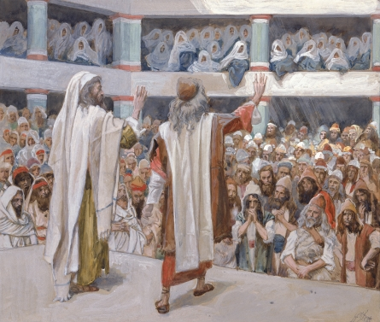
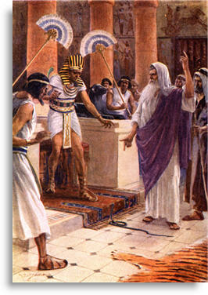
Moses & his brother Aaron would appear before their own people, & before Pharaoh’s court…
Notes:
Rod into a serpent…

Slide 22
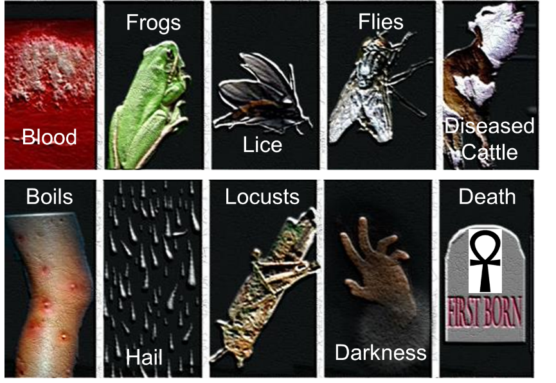

Slide 23
Over 1,500 Deities in Ancient Egypt…The Plagues were an Assault on the Gods of Egypt!
Exodus 3:20 “So I will stretch out My hand and strike Egypt with all My miracles which I shall do in the midst of it; and after that [Pharaoh] will let you go.
Exodus 12:12 …against all the gods of Egypt I will execute judgments—I am the LORD.
Numbers 33:4 …The LORD had also executed judgments on their gods.

Slide 24
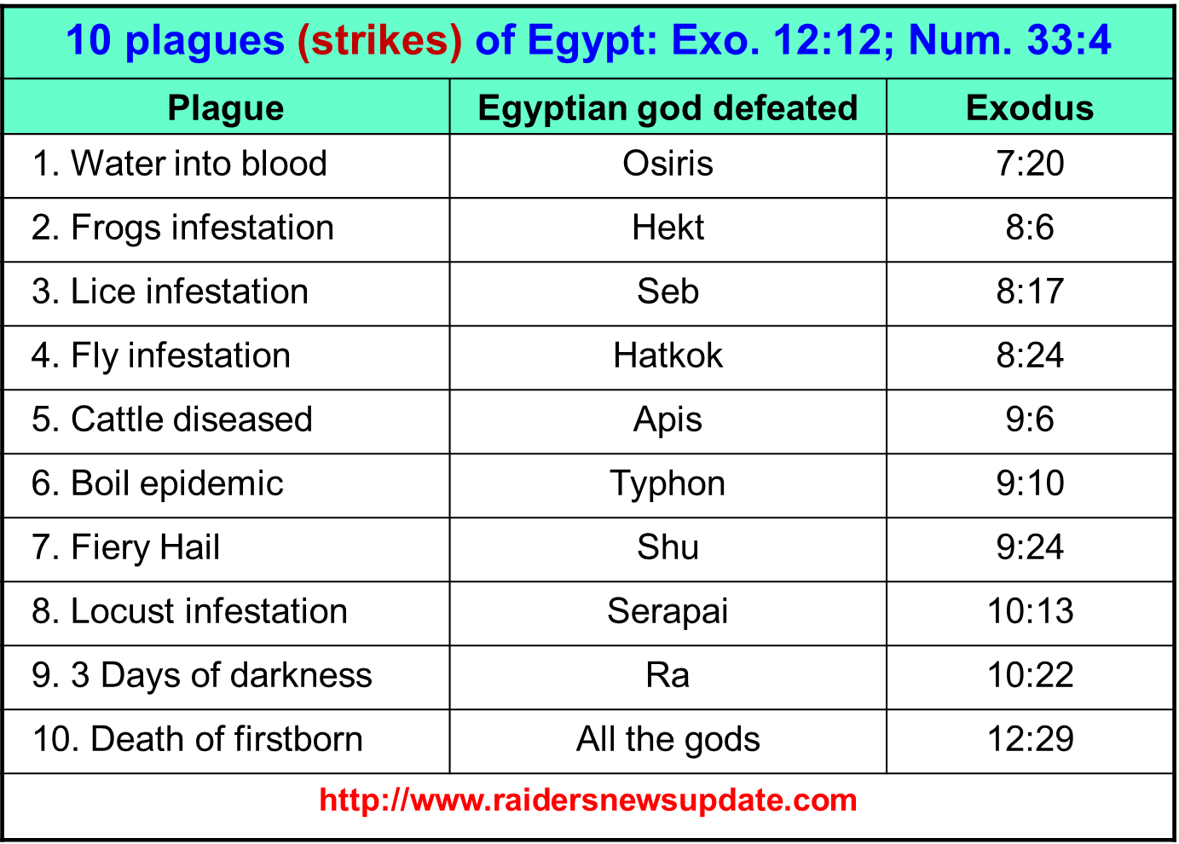

Slide 26
Outline
Our Purpose, Aim, and Objective
Review
Contrast and Comparison of Law & Grace – Exodus 12:1-13
Conclusion

Slide 27
Law & Grace: Session 3 – 10 Strikes and YOU”RE OUT – Part 2
10 Strikes and YOU”RE OUT – Part 2
THE BIG RULE BOOK of
from the BIG INNING

Slide 28
Law & Grace: Session 3 – 10 Strikes and YOU”RE OUT – Part 2
INSIGHTS INTO THE TEN PLAGUES ON EGYPT
Scripture (Exodus) | Plague | Pharaoh Warned | Response |  |  | Not in Goshen
 |  |  | magician’s | people’s | pharaoh’s
7:14-25 | Water to Blood | Yes, by the Nile River | Did the same | - | Didn’t care | -
8:1-15 | Frogs | Yes | Did the same | - | Called Moses to intercede, then changed his mind | -
8:16-19 | Lice, gnats, mosquitos, or ticks | - | Couldn’t do the same | - | - | -
8:20-23 | Flies | Warned of separation of Israel | - | - | Called Moses to intercede, then changed his mind | 1st time that a plague is specifically not to be in Goshen
9:1-7 | Livestock Dies | Yes | - | - | Sent someone to check on Goshen | Israel’s livestock is all healthy

Slide 29
Law & Grace: Session 3 – 10 Strikes and YOU”RE OUT – Part 2
INSIGHTS INTO THE TEN PLAGUES ON EGYPT
Scripture (Exodus) | Plague | Pharaoh Warned | Response |  |  | Not in Goshen
 |  |  | magician’s | people’s | pharaoh’s
9:8-12 | Boils | Yes, threw soot at him | Also struck with boils | - | Didn’t listen to Moses | Assumed: no boils in Israel
9:13-35 | Hail, Fire & Thunder | Yes | - | Some took warning & hid | - | No plague found in Goshen
10:1-20 | Locusts | Yes | - | Servants pled to let Israel go | Called Moses, then changed his mind | Assumed: no locusts in Israel
10:21-29 | Darkness for 3 days | - | - | - | They can go but no livestock – banished Moses | Darkness everywhere but light in Goshen
11:1-10 | Death of firstborn | Yes | - | Gave gifts to Israel | Called Moses & said, “Get out” | No death among Israelites, Goshen

Slide 30
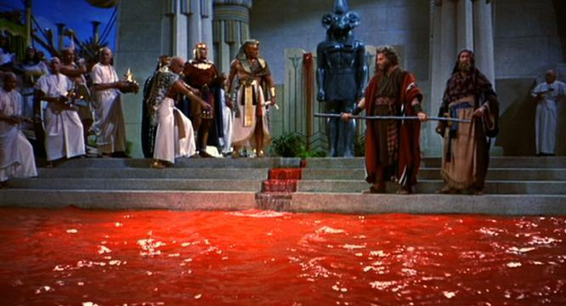
Law & Grace: Session 3 – 10 Strikes and YOU”RE OUT – Part 2
INSIGHTS INTO THE TEN PLAGUES ON EGYPT
Scripture (Exodus) | Plague | Pharaoh Warned | Response |  |  | Not in Goshen
 |  |  | magician’s | people’s | pharaoh’s
7:14-25 | Water to Blood | Yes, by the Nile River | Did the same | - | Didn’t care | -

Slide 31
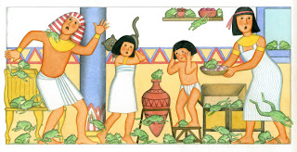
Law & Grace: Session 3 – 10 Strikes and YOU”RE OUT – Part 2
INSIGHTS INTO THE TEN PLAGUES ON EGYPT
Scripture (Exodus) | Plague | Pharaoh Warned | Response |  |  | Not in Goshen
 |  |  | magician’s | people’s | pharaoh’s
8:1-15 | Frogs | Yes | Did the same | - | Called Moses to intercede, then changed his mind | -

Slide 32
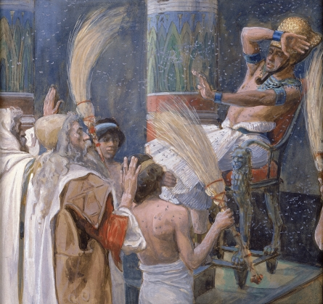
Law & Grace: Session 3 – 10 Strikes and YOU”RE OUT – Part 2
INSIGHTS INTO THE TEN PLAGUES ON EGYPT
Scripture (Exodus) | Plague | Pharaoh Warned | Response |  |  | Not in Goshen
 |  |  | magician’s | people’s | pharaoh’s
8:16-19 | Lice, gnats, mosquitos, or ticks | - | Couldn’t do the same | - | - | -

Slide 33
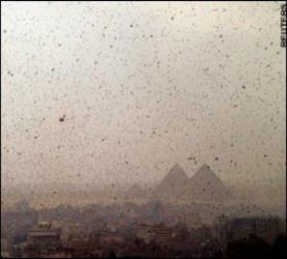
Law & Grace: Session 3 – 10 Strikes and YOU”RE OUT – Part 2
INSIGHTS INTO THE TEN PLAGUES ON EGYPT
Scripture (Exodus) | Plague | Pharaoh Warned | Response |  |  | Not in Goshen
 |  |  | magician’s | people’s | pharaoh’s
8:20-23 | Flies | Warned of separation of Israel | - | - | Called Moses to intercede, then changed his mind | 1st time that a plague is specifically not to be in Goshen
Exodus 8:22-23
²² “But on that day I will set apart the land of Goshen, where My people are living, so that no swarms of flies will be there, in order that you may know that I, the Lord, am in the midst of the land. ²³ “I will put a division between My people and your people.”
Notes:
God Separates Israel from Egypt

Slide 34
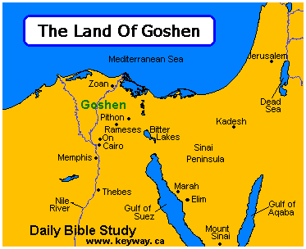
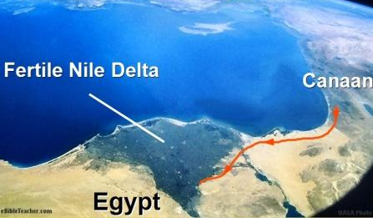
Law & Grace: Session 3 – 10 Strikes and YOU”RE OUT – Part 2
Notes:
God Separates Israel from Egypt

Slide 35
Set Apart & Separated in Exo. 8:20-23
Law & Grace: Session 3 – 10 Strikes and YOU”RE OUT – Part 2
Israel | Church
God made Israel to be set apart & separate physically, in the land, so that Israel did not share in the plagues upon Egypt, even though they were in Egypt. | God made us who are in the Church to be set apart & separate spiritually, in the heavenlies, so that we do not share in the wrath of God upon the world.
our being set apart in christ separates us from the old man, the sin nature, the law and the world.

Slide 36
“My People”, The People of God
Law & Grace: Session 3 – 10 Strikes and YOU”RE OUT – Part 2
Israel | Believing Jewish Remnant
In Exodus 8:20-23 God calls Israel, “My people”, twice. In Judges 20:2 Israel is also called, “the people of God.” | In 1 Peter 2:9-10 Peter, the apostle, writes that the “believing Jewish remnant” of his day, are likewise called, “the people of God”.

Slide 37
Law & Grace: Session 3 – 10 Strikes and YOU”RE OUT – Part 2
The Peoples of God
During the future Eternal Reign of Christ, the saved Gentiles, Israel and the Church are referred to as the peoples of God (Rev. 21:3).
Revelation 21:3
And I heard a loud voice from the throne, saying, “Behold, the tabernacle of God is among men, and He will dwell among them, and they shall be His people*, and God Himself will be among them,
*Literally – His peoples (αὐτοὶ λαοὶ αὐτοῦ)

Slide 38
Law & Grace: Session 3 – 10 Strikes and YOU”RE OUT – Part 2
The Peoples of God
“The conclusion is that the church is never called a ‘spiritual Israel’ or a ‘new Israel.’ The term Israel is either used of the nation or the people as a whole, or of the believing remnant within. It is never used of the church in general or of Gentile believers in particular. In fact, even after the Cross there remains a threefold distinction. First, there is a distinction between Israel and the Gentiles as in 1 Corinthians 10:32 and Ephesians 2:11–12. Second, there is a distinction between Israel and the church in 1 Corinthians 10:32. Third, there is a distinction between Jewish believers (the Israel of God) and Gentile believers in Romans 9:6 and Galatians 6:16.”
Fruchtenbaum, Arnold G. “Israel and the Church.” In Issues in Dispensationalism, pp. 113–30. Edited by Wesley R. Willis and John R. Master. Chicago: Moody Press, 1994.

Slide 39
Interesting Contrast!
Law & Grace: Session 3 – 10 Strikes and YOU”RE OUT – Part 2
Moses | Christ
Speaking for God, and for the benefit of Israel, Moses told Pharaoh, “Let my people go…” Exo. 5:1 | In the Epistles, the Apostles, under the direction of the Lord Jesus told the Church, “Let my people know….”

Slide 40
“Let my people know….”
Law & Grace: Session 3 – 10 Strikes and YOU”RE OUT – Part 2
Growth toward spiritual maturity can be summed up as “having faith (aka trust) in biblically revealed facts” and can only take place when we learn, know, and understand:
who we are in Christ
who He is in us and,
when we place our faith in Him accordingly.
As our learning, knowing, and understanding of what God has done, is doing and will do, increases, so does our growth toward spiritual maturity.

Slide 41
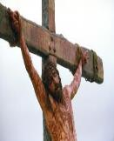
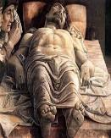
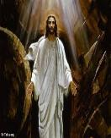
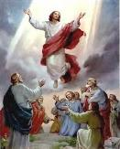
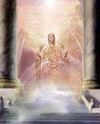
“Let my people know….”
Law & Grace: Session 3 – 10 Strikes and YOU”RE OUT – Part 2
It is imperative the we understand that the focal point of all of the teachings of the New Testament epistles is that God graciously causes all of us who believe, to share Christ’s history, in these five events and locations:
Death
Burial
Resurrection
Ascension
Heavenly
Seating
Christ’s history is now OUR HISTORY!

Slide 42
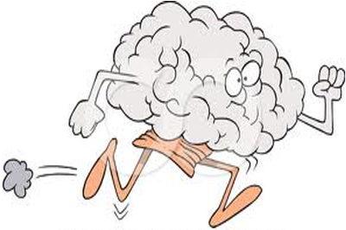
“Let my people know….”
Law & Grace: Session 3 – 10 Strikes and YOU”RE OUT – Part 2
In the context of who you now are in Christ, your mind has some ‘catching up’ to do.

Slide 43
Interesting Contrast!
Law & Grace: Session 3 – 10 Strikes and YOU”RE OUT – Part 2
Moses | Christ
Speaking for God, and for the benefit of Israel, Moses told Pharoah, “Let my people go…” Exo. 5:1 | In the Epistles, the Apostles, under the direction of the Lord Jesus told the Church, “Let my people know….”

Slide 44
Law & Grace: Session 3 – 10 Strikes and YOU”RE OUT – Part 2
INSIGHTS INTO THE TEN PLAGUES ON EGYPT
Scripture (Exodus) | Plague | Pharaoh Warned | Response |  |  | Not in Goshen
 |  |  | magician’s | people’s | pharaoh’s
8:20-32 | Flies | Warned of separation of Israel | - | - | Called Moses to intercede, then changed his mind | 1st time that a plague is specifically not to be in Goshen
Exodus 8:22-23
²² “But on that day I will set apart the land of Goshen, where My people are living, so that no swarms of flies will be there, in order that you may know that I, the Lord, am in the midst of the land. ²³ “I will put a division between My people and your people.”
Notes:
God Separates Israel from Egypt

Slide 45
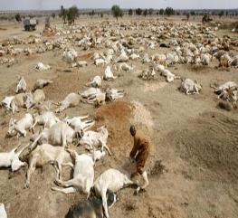
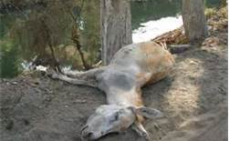
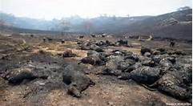
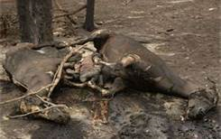
Law & Grace: Session 3 – 10 Strikes and YOU”RE OUT – Part 2
INSIGHTS INTO THE TEN PLAGUES ON EGYPT
Scripture (Exodus) | Plague | Pharaoh Warned | Response |  |  | Not in Goshen
 |  |  | magician’s | people’s | pharaoh’s
9:1-7 | Livestock Dies | Yes | - | - | Sent someone to check on Goshen | Israel’s livestock is all healthy

Slide 46
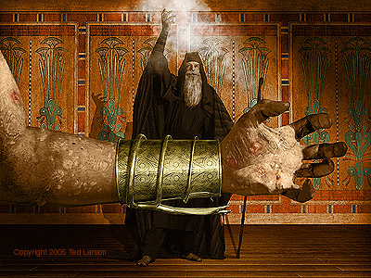
Law & Grace: Session 3 – 10 Strikes and YOU”RE OUT – Part 2
INSIGHTS INTO THE TEN PLAGUES ON EGYPT
Scripture (Exodus) | Plague | Pharaoh Warned | Response |  |  | Not in Goshen
 |  |  | magician’s | people’s | pharaoh’s
9:8-12 | Boils | Yes, threw soot at him | Also struck with boils | - | Didn’t listen to Moses | Assumed: no boils in Israel

Slide 47
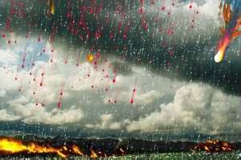
Law & Grace: Session 3 – 10 Strikes and YOU”RE OUT – Part 2
INSIGHTS INTO THE TEN PLAGUES ON EGYPT
Scripture (Exodus) | Plague | Pharaoh Warned | Response |  |  | Not in Goshen
 |  |  | magician’s | people’s | pharaoh’s
9:13-35 | Hail, Fire & Thunder | Yes | - | Some took warning & hid | - | No plague found in Goshen

Slide 48
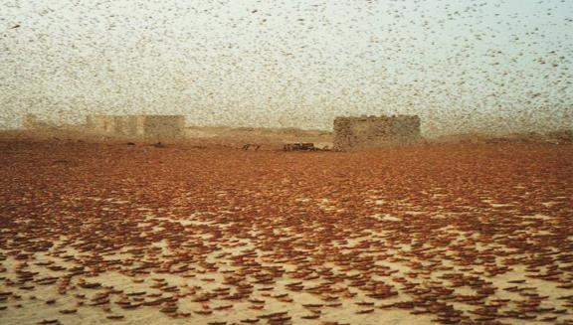
Law & Grace: Session 3 – 10 Strikes and YOU”RE OUT – Part 2
INSIGHTS INTO THE TEN PLAGUES ON EGYPT
Scripture (Exodus) | Plague | Pharaoh Warned | Response |  |  | Not in Goshen
 |  |  | magician’s | people’s | pharaoh’s
10:1-20 | Locusts | Yes | - | Servants pled to let Israel go | Called Moses, then changed his mind | Assumed: no locusts in Israel

Slide 49
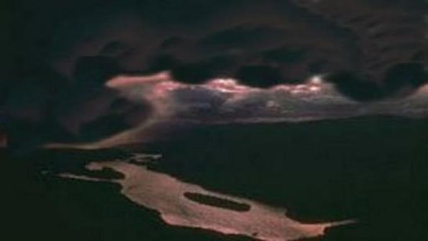
Law & Grace: Session 3 – 10 Strikes and YOU”RE OUT – Part 2
INSIGHTS INTO THE TEN PLAGUES ON EGYPT
Scripture (Exodus) | Plague | Pharaoh Warned | Response |  |  | Not in Goshen
 |  |  | magician’s | people’s | pharaoh’s
10:21-29 | Darkness for 3 days | - | - | - | They can go but no livestock – banished Moses | Darkness everywhere but light in Goshen

Slide 50
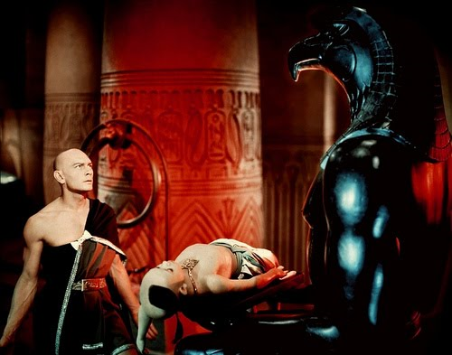
Law & Grace: Session 3 – 10 Strikes and YOU”RE OUT – Part 2
INSIGHTS INTO THE TEN PLAGUES ON EGYPT
Scripture (Exodus) | Plague | Pharaoh Warned | Response |  |  | Not in Goshen
 |  |  | magician’s | people’s | pharaoh’s
11:1-10 | Death of firstborn | Yes | - | Gave gifts to Israel | Called Moses & said, “Get out” | No death among Israelites, Goshen

Slide 51
Law & Grace: Session 3 – 10 Strikes and YOU”RE OUT – Part 1
Over 1,500 Deities in Ancient Egypt…The Plagues were an Assault on the Gods of Egypt!
Exodus 3:20
“So I will stretch out My hand and strike Egypt with all My miracles which I shall do in the midst of it; and after that [Pharaoh] will let you go.
Exodus 12:12 …against all the gods of Egypt I will execute judgments—I am the LORD. | Numbers 33:4 …The LORD had also executed judgments on their gods.

Slide 52
Law & Grace: Session 3 – 10 Strikes and YOU”RE OUT – Part 2
INSIGHTS INTO THE TEN PLAGUES ON EGYPT
Scripture (Exodus) | Plague | Pharaoh Warned | Response |  |  | Not in Goshen
 |  |  | magician’s | people’s | pharaoh’s
11:1-10 | Death of firstborn | Yes | - | Gave gifts to Israel | Called Moses & said, “Get out” | No death among Israelites, Goshen

Slide 53
Exodus 12:1–13 (NASB95)
¹ Now the Lord said to Moses and Aaron in the land of Egypt, ² “This month shall be the beginning of months for you; it is to be the first month of the year to you. ³ “Speak to all the congregation of Israel, saying, ‘On the tenth of this month they are each one to take a lamb for themselves, according to their fathers’ households, a lamb for each household. ⁴ ‘Now if the household is too small for a lamb, then he and his neighbor nearest to his house are to take one according to the number of persons in them; according to what each man should eat, you are to divide the lamb. ⁵ ‘Your lamb shall be an unblemished male a year old; you may take it from the…

Slide 54
Exodus 12:1–13 (NASB95)
…sheep or from the goats. ⁶ ‘You shall keep it until the fourteenth day of the same month, then the whole assembly of the congregation of Israel is to kill it at twilight. ⁷ ‘Moreover, they shall take some of the blood and put it on the two doorposts and on the lintel of the houses in which they eat it. ⁸ ‘They shall eat the flesh that same night, roasted with fire, and they shall eat it with unleavened bread and bitter herbs. ⁹ ‘Do not eat any of it raw or boiled at all with water, but rather roasted with fire, both its head and its legs along with its entrails. ¹⁰ ‘And you shall not leave any of it over until morning, but whatever is left of it until morning, you shall…

Slide 55
Exodus 12:1–13 (NASB95)
…burn with fire. ¹¹ ‘Now you shall eat it in this manner: with your loins girded, your sandals on your feet, and your staff in your hand; and you shall eat it in haste—it is the Lord’s Passover. ¹² ‘For I will go through the land of Egypt on that night, and will strike down all the firstborn in the land of Egypt, both man and beast; and against all the gods of Egypt I will execute judgments—I am the Lord. ¹³ ‘The blood shall be a sign for you on the houses where you live; and when I see the blood I will pass over you, and no plague will befall you to destroy you when I strike the land of Egypt.

Slide 56
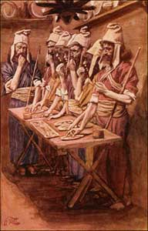
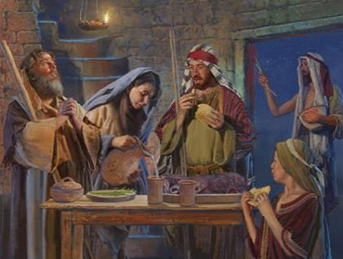
Passover
Law & Grace: Session 3 – 10 Strikes and YOU”RE OUT – Part 2
Exodus 12:11
‘Now you shall eat it in this manner: with your loins girded, your sandals on your feet, and your staff in your hand; and you shall eat it in haste—it is the LORD’S Passover.
Notes:
Exodus 12:11 ‘Now you shall eat it in this manner: with your loins girded, your sandals on your feet, and your staff in your hand; and you shall eat it in haste—it is the LORD’S Passover.

Slide 57
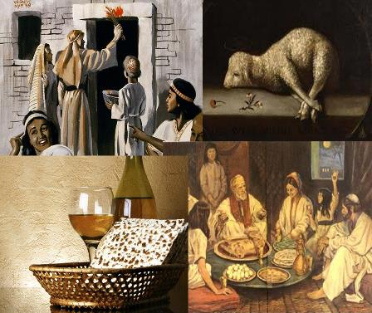
Passover
Law & Grace: Session 3 – 10 Strikes and YOU”RE OUT – Part 2
Israel
In Exodus 12:1-51 we see the first commands for Israel to establish the Passover, then & every year after that, in which the Passover lamb is sacrificed by men.
Notes:
Major Spring event…

Slide 58
Law & Grace: Session 3 – 10 Strikes and YOU”RE OUT – Part 2
Israel’s Holidays
March April | Passover (Pesach) – Nisan 14 Unleavend Bread (Chag Hamotzi) – Nisan 15-22 First Fruits (Yom habikkurim) – Nisan 16
Late May Early June | Pentecost (Shavu”ot) – Sivan 6
September October | Trumpets (Yom Teru”ah) – Tishri 1 Atonement (Yom Kippur) - Tishri 10 Tabernacles (Sukkot) – Tishri 15
Notes:
March - April
Passover (Pesach) – Nisan 14
Unleavend Bread (Chag Hamotzi) – Nisan 15-22
First Fruits (Yom habikkurim) – Nisan 16
Late May or Early June
Pentecost (Shavu”ot) – Sivan 6
September - October
Trumpets (Yom Teru”ah) – Tishri 1
Atonement (Yom Kippur) - Tishri 10
Tabernacles (Sukkot) – Tishri 15
Added Feasts
February - March
Purim - Book of Esther - Adar 14
Late November to late December
Hanukkah (Festival of Lights and Feast of Dedication) – Kislev 25; John 10:22

Slide 59
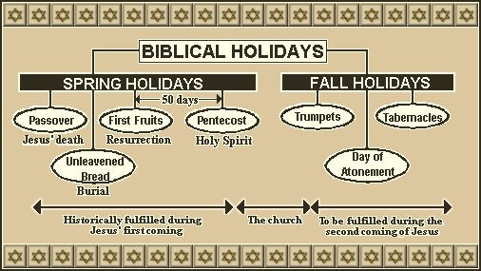
Israel’s Holidays
Law & Grace: Session 3 – 10 Strikes and YOU”RE OUT – Part 2

Slide 60
Passover
Law & Grace: Session 3 – 10 Strikes and YOU”RE OUT – Part 2
Exodus 12:11
‘Now you shall eat it in this manner: with your loins girded, your sandals on your feet, and your staff in your hand; and you shall eat it in haste—it is the LORD’S Passover.
Notes:
Exodus 12:11 ‘Now you shall eat it in this manner: with your loins girded, your sandals on your feet, and your staff in your hand; and you shall eat it in haste—it is the LORD’S Passover.

Slide 61
Passover
Law & Grace: Session 3 – 10 Strikes and YOU”RE OUT – Part 2
John 1:29
The next day he saw Jesus coming to him and said, “Behold, the Lamb of God who takes away the sin of the world!
John 1:35–36
³⁵…John was standing…, ³⁶ and he looked at Jesus as He walked, and said, “Behold, the Lamb of God!”

Slide 62
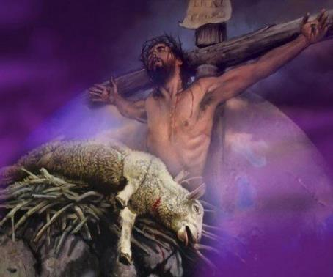
Passover
Law & Grace: Session 3 – 10 Strikes and YOU”RE OUT – Part 2
1 Corinthians 5:7b For Christ our Passover also has been sacrificed.
Notes:
Major Spring event…

Slide 63
Exodus: from position to condition
Law & Grace: Session 3 – 10 Strikes and YOU”RE OUT – Part 2
In Exodus 12:1-51 we also see the Exodus of Israel from the land and control of Egypt.
So the physical Exodus fulfilled in their condition their being separate and set apart in their position.
we in the church have been separated and set apart in our spiritual position, and our calling to live by the very life of christ, fulfills in condition who we are by our position.

Slide 64
With Whom are YOU Identified?
Law & Grace: Session 3 – 10 Strikes and YOU”RE OUT – Part 2
1 Corinthians 10:1–2 (NASB95)
¹ For I do not want you to be unaware, brethren, that our fathers were all under the cloud and all passed through the sea; ² and all were baptized into Moses in the cloud and in the sea;
Israel - Baptized into Moses
1 Cor. 10:2 says that the people of Israel were all baptized into Moses under the cloud & through the sea, a physical presence. This baptism placed them all under the principle of Law.

Slide 65
With Whom are YOU Identified?
Law & Grace: Session 3 – 10 Strikes and YOU”RE OUT – Part 2
Romans 6:3 (NASB95)
Or do you not know that all of us who have been baptized into Christ Jesus have been baptized into His death?
Galatians 3:27 (NASB95)
For all of you who were baptized into Christ have clothed yourselves with Christ.
Church - Baptized into Christ
And Rom. 6:3 & also Gal. 3:27 say that we in the Church were all baptized into Christ Jesus, which is a spiritual presence. This baptism places all of us under the principle of Grace.

Slide 66
Outline
Our Purpose, Aim, and Objective
Review
Contrast and Comparison of Law & Grace – Exodus 12:1-13
Conclusion

Slide 67
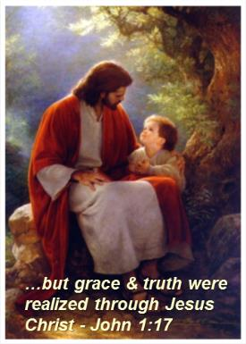
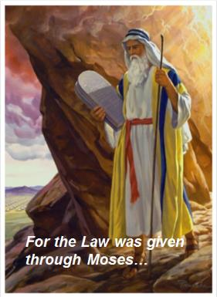
Law & Grace: Session 3 – 10 Strikes and YOU”RE OUT – Part 2
CONCLUSION

Slide 68
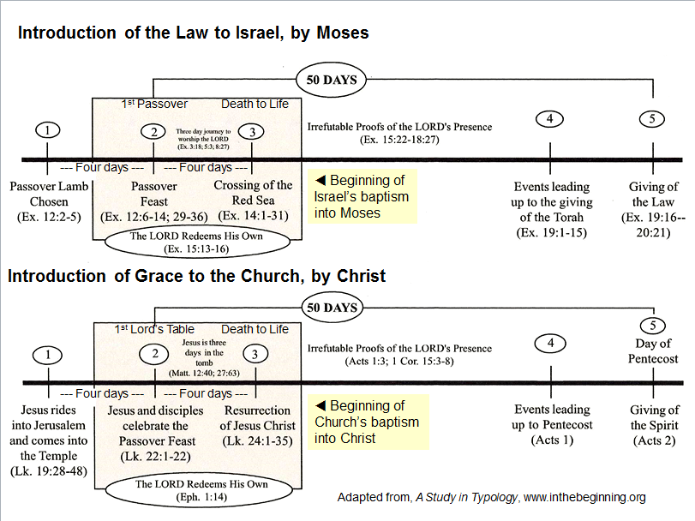

Slide 69
What Should I Take Away From This?
Law & Grace: Session 3 – 10 Strikes and YOU”RE OUT – Part 2
For the Believer:
We in the church have been separated and set apart in our spiritual position.
Our calling to live by the very life of Christ, fulfills in condition who we are by our position.
Israel was baptized into Moses and that baptism placed them all under the principle of Law.
Believers are baptized into Christ and that baptism places all of us under the principle of Grace.
Notes:
Conclusion
For the Believer:
We in the church have been separated and set apart in our spiritual position.
Our calling to live by the very life of Christ, fulfills in condition who we are by our position.
Israel was baptized into Moses and that baptism placed them all under the principle of Law.
Believers are baptized into Christ and that baptism places all of us under the principle of Grace.
NEXT SLIDE

Slide 70
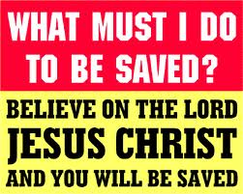
What Should I Take Away From This?
Law & Grace: Session 3 – 10 Strikes and YOU”RE OUT – Part 2
For the Non-Believer:
The admonition to those present who are unbelievers is: Today is the Day of Salvation.
Place your faith in Christ’s promises right now.
Notes:
Conclusion
The admonition to those present who are unbelievers is: Today is the Day of Salvation.
You can place your faith in Christ’s promises right now.
God is Holy and cannot tolerate sin.
All have sinned – Rom. 3:23
All sin offends God’s Holiness and demands retribution. – Rom. 6:23
God loves you and made provision for your sin – Rom. 5:8
God loves you and offers you eternal life through His Son, Jesus - John 3:16
There is no other way to God – John 14:6
The one condition of salvation is simple faith, (which is trust in or confidence in or reliance upon), Christ’s promise to give New Life to all those who come to Him for salvation.
If this is something you have done or are doing right now, God’s Word authoritatively declares that you are a Child of God and you have access to all of God’s Divine Riches of Grace. God now wants you to grow and mature spiritually, and I can of no better place to do so than here at SLBC.
If you would like more information, the Elders, Deacons, Pastoral staff, and members would be happy to talk with your immediately after the service.
PRAYER - Father, thank you for the convicting power of the Holy Spirit. May we all be sensitive to heed His voice as He draws us to the Lord Jesus Christ for salvation, restoration of fellowship, or spiritual growth. Amen!

