Slide 1
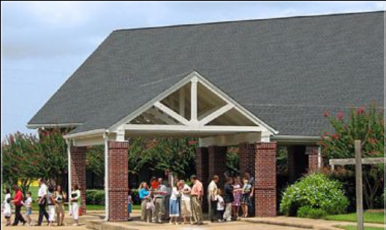
Beholding the Lord through His Word - Part 1
Jim McGowan, Th.D. Sugar Land Bible Church 04-23-2017.
This presentation was compiled using resources obtained from Dr. Vern Peterman, Holly Hills Bible Church – Used with permission.

Slide 2
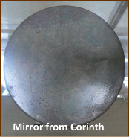
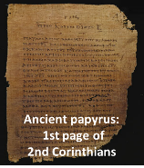
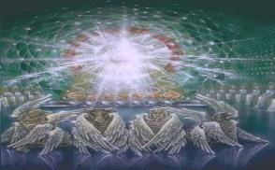
2 Corinthians 3:18
But we all, with unveiled face, beholding as in a mirror the glory of the Lord, are being transformed into the same image from glory to glory, just as from the Lord, the Spirit.

Slide 3
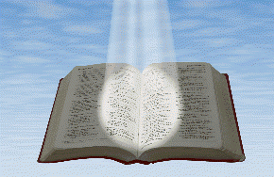
Beholding the Lord through His word
Seeing the Living Word of God
in the written word of God

Slide 4
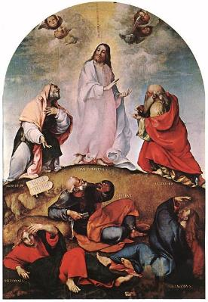
Beholding the Lord through His word
2 Corinthians 3:18
“But we all… beholding… the glory of the Lord”
John 1:14
“we saw His glory…full of grace and truth” (see 1:1-18)
Seeing the Living Word of God
in the written word of God

Slide 5
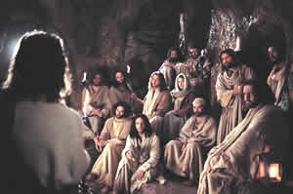
Beholding the Lord through His word
1 John 1:3
“we have seen with our eyes…the Word of Life” (see 1:1-4)
Hebrews 12:2
“fixing our eyes on Jesus” (see 12:1-2)
Seeing the Living Word of God
in the written word of God

Slide 6
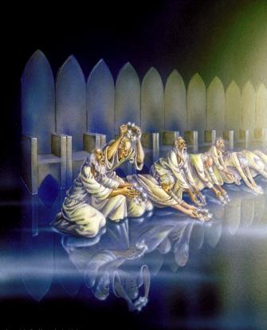
Why would we do such a thing?!
2 Corinthians 3:18
“being transformed into the same image from glory to glory”
John 1:16
“of His fullness we have all received, and grace upon grace” (cf. 1:1-18)

Slide 7
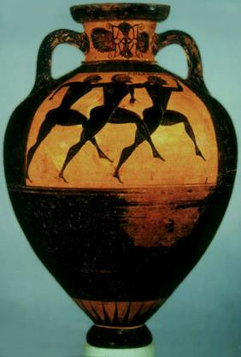
Why would we do such a thing?!
1 John 1:3
“our fellowship is with the Father, and with His Son Jesus Christ” (cf. 1:1-4)
Hebrews 12:1
“run with endurance the race that is set before us” (cf. 1:1-4)

Slide 8
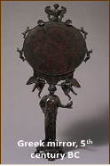
2 Corinthians 3:18
But we all, with unveiled face, beholding as in a mirror the glory of the Lord, are being transformed into the same image from glory to glory, just as from the Lord, the Spirit.

Slide 13
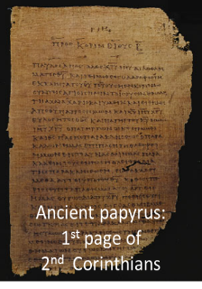
We believe that all the authors of the entire Old and New Testaments wrote by the guidance of the Holy Spirit (i.e., verbal inspiration). Those books are completely inerrant and infallible in the original writings. They are the final authority for faith and practice, and the means through which believers behold Christ.

Slide 14
The Life and Walk of Believers - We believe that every believer possesses the life of Christ and grows in the grace and knowledge of Christ through the Holy Spirit, who fills the believer with the things of Christ. This occurs as the believer beholds Christ in the word of God, as he walks by faith, moment by moment abiding in Christ. The believer is to walk and rest in the eternally established identity that he possesses by virtue of his faith in the crucified, buried, resurrected, ascended and seated person of Christ (his position) and his identification with Him in these things. Christ’s life is then lived in the believer, which is evident to those who do not know Christ and to those who share Christ’s life.

Slide 15
2 Corinthians 3:18
But we all, with unveiled face, beholding as in a mirror the glory of the Lord, are being transformed into the same image from glory to glory, just as from the Lord, the Spirit.

Slide 16
2 Corinthians 3:18
But we all, with unveiled face, beholding as in a mirror the glory of the Lord, are being transformed into the same image from glory to glory, just as from the Lord, the Spirit.

Slide 17
2 Corinthians 3:18
But we all, with unveiled face, beholding as in a mirror the glory of the Lord, are being transformed into the same image from glory to glory, just as from the Lord, the Spirit.

Slide 18
2 Corinthians 3:13–16
¹³ and [we] are not like Moses, who used to put a veil over his face so that the sons of Israel would not look intently at the end of what was fading away. ¹⁴ But their minds were hardened; for until this very day at the reading of the old covenant the same veil remains unlifted, because it is removed in Christ. ¹⁵ But to this day whenever Moses is read, a veil lies over their heart; ¹⁶ but whenever a person turns to the Lord, the veil is taken away.

Slide 19
2 Corinthians 3:18
But we all, with unveiled face, beholding as in a mirror the glory of the Lord, are being transformed into the same image from glory to glory, just as from the Lord, the Spirit.

Slide 20
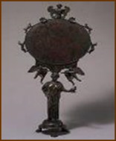
2 Corinthians 3:18
But we all, with unveiled face, beholding as in a mirror the glory of the Lord, are being transformed into the same image from glory to glory, just as from the Lord, the Spirit.

Slide 21
1 Corinthians 13:12
For now we see in a mirror dimly, but then face to face; now I know in part, but then I will know fully just as I also have been fully known.

Slide 22
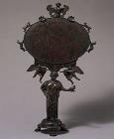
James 1:22–24
²² But prove yourselves doers of the word, and not merely hearers who delude themselves. ²³ For if anyone is a hearer of the word and not a doer, he is like a man who looks at his natural face in a mirror; ²⁴ for once he has looked at himself and gone away, he has immediately forgotten what kind of person he was.

Slide 23
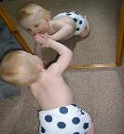
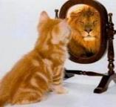
2 Corinthians 3:18
But we all, with unveiled face, beholding as in a mirror the glory of the Lord, are being transformed into the same image from glory to glory, just as from the Lord, the Spirit.
Notes:
In all three passages, (1 Cor. 318, 13:12 and James 1:22–24) the mirror represents God’s word.

Slide 24
2 Corinthians 3:18
But we all, with unveiled face, beholding as in a mirror the glory of the Lord, are being transformed into the same image from glory to glory, just as from the Lord, the Spirit.

Slide 25
Revelation 21:23; 22:5
²³ And the city has no need of the sun or of the moon to shine on it, for the glory of God has illumined it, and its lamp is the Lamb… ^{22:5} And there will no longer be any night; and they will not have need of the light of a lamp nor the light of the sun, because the Lord God will illumine them; and they will reign forever and ever.

Slide 26
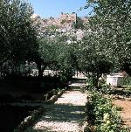
John 17:24
"Father, I desire that they also, whom You have given Me, be with Me where I am, so that they may see My glory which You have given Me, for You loved Me before the foundation of the world."
Notes:
Our Lord even prayed in the final hours of His earthly life that we would see His glory, which will be ultimately fulfilled when we see Him face to face.

Slide 27
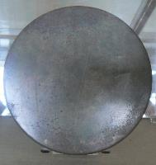
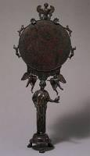
2 Corinthians 3:18
But we all, with unveiled face, beholding as in a mirror the glory of the Lord, are being transformed into the same image from glory to glory, just as from the Lord, the Spirit.
Notes:
The Greek word translated “beholding as in a mirror” is a present tense verb, conveying ongoing action on our part.
The Greek word translated “are being transformed” is (μεταμορφόω [metamorphóō]); a present passive indicative verb, conveying a real ongoing action which is the Holy Spirit’s work upon each of us.

Slide 28
2 Corinthians 3:18
But we all, with unveiled face, beholding as in a mirror the glory of the Lord, are being transformed into the same image from glory to glory, just as from the Lord, the Spirit.
Notes:
The words “into the same image” refers to the image of the Lord Jesus Christ, similar to what we read of in Romans 8:29.

Slide 29
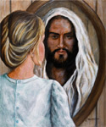
Romans 8:28-29
²⁸ And we know that God causes all things to work together for good to those who love God, to those who are called according to His purpose. ²⁹ For those whom He foreknew, He also predestined to become conformed to the image of His Son, so that He would be the firstborn among many brethren;

Slide 30
2 Corinthians 3:18
But we all, with unveiled face, beholding as in a mirror the glory of the Lord, are being transformed into the same image from glory to glory, just as from the Lord, the Spirit.
Notes:
So what does “same image” mean? Does it mean that we will all end up looking like 30 year old first century Jewish carpenters from Nazareth?
In New Testament times the Greek word eikon, which is translated as ‘image’, referred to a representation of something or someone in some respect, but not to an exact likeness.

Slide 31
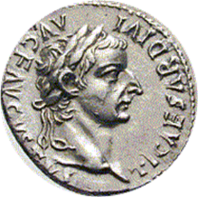
Luke 20:23–24
²³ But He detected their trickery and said to them, ²⁴ “Show Me a denarius. Whose likeness [image] and inscription does it have?” They said, “Caesar’s.”

Slide 32
2 Corinthians 3:18
But we all, with unveiled face, beholding as in a mirror the glory of the Lord, are being transformed into the same image from glory to glory, just as from the Lord, the Spirit.
Romans 8:29
“For those whom He foreknew, He also predestined to become conformed to the image of His Son…”
Notes:
The word ‘image’ (Greek: εἰκών eikṓn) in the context of 2 Corinthians 3:18 & Romans 8:29 refers to being changed into Christ’s spiritual character in every respect but His deity.
1 John – face to face

Slide 33
1 Corinthians 13:12
¹² For now we see in a mirror dimly, but then face to face; now I know in part, but then I will know fully just as I also have been fully known.

Slide 34
1 John 3:2
Beloved, now we are children of God, and it has not appeared as yet what we will be. We know that when He appears, we will be like Him, because we will see Him just as He is.

Slide 35
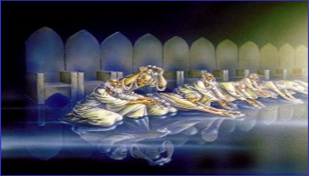
2 Corinthians 3:18
But we all, with unveiled face, beholding as in a mirror the glory of the Lord, are being transformed into the same image from glory to glory, just as from the Lord, the Spirit.
Notes:
‘from glory to glory” is Paul’s expression of increasing, from one level to another:
Just a chapter earlier, Paul wrote in 2 Corinthians 2:15-16:

Slide 36
2 Corinthians 2:15–16
¹⁵ For we are a fragrance of Christ to God among those who are being saved and among those who are perishing; ¹⁶ to the one an aroma from death to death, to the other an aroma from life to life….

Slide 37
2 Corinthians 3:18
But we all, with unveiled face, beholding as in a mirror the glory of the Lord, are being transformed into the same image from glory to glory, just as from the Lord, the Spirit.
Notes:
The growing glory – from glory to glory – is not the result of our trying really hard to be glorious or to be worthy of Christ’s glory.
It is a process whereby the Holy Spirit brings the Word of God to us, and brings us to the word of God. This process brings about the transformation in each of us.

Slide 38
2 Corinthians 3:18
Expanded & Explained
But all of us who are in Christ, with a face that is not veiled by the Law, having died in relationship to the Law and living by God’s amazing grace, are right now continuing to behold as we read and hear the written word of God, seeing as one who looks into a mirror, the glory – the radiant essence of who Christ is – the glory that comes from Christ Himself, and we are in fact in the very the process of being changed and transformed into the same spiritual character, growing from one level of Christ’s glory to the next, and every part of this beholding and transformation is from the God-given ministries of the Holy Spirit.

Slide 40
Beholding the Lord is an essential aspect of our fellowship with Christ
Condition | Position
In John 15 we read of Christ’s call to “abide in Me”. | Rom. 6:11 & Gal. 2:19-20 both refer to ‘being alive to God’ or to ‘live to God’.
Abiding in Christ is an aspect of fellowship with Him, that conveys our continual dependence & intimacy with Christ. | Being alive to God or living to God is about our ongoing fellowship with God, based on position.

Slide 41
Colossians 3:1-4
¹ Therefore if you have been raised up with Christ, keep seeking the things above, where Christ is, seated at the right hand of God. ² Set your mind on the things above, not on the things that are on earth. ³ For you have died and your life is hidden with Christ in God. ⁴ When Christ, who is our life, is revealed, then you also will be revealed with Him in glory.
Notes:
Setting our minds on things above is not just about location – it is about fellowship with Christ!
1st class condition - It introduces a assumed to be true to reality for the sake of his argument.

Slide 42
Colossians 3:1-4
Expanded & Explained
¹ Therefore since you have been raised up with Christ, you must keep on seeking the things above, where Christ is, seated at the right hand of God. ² You must keep on setting your mind on the things above, not on the things that are on earth. ³ For you have died and your life is hidden with Christ in the God. ⁴ When Christ, who is our life, is revealed, at His second coming (Luke 17:30), then you also will be revealed with Him in glory.
Notes:
Setting our minds on things above is not just about location – it is about fellowship with Christ!

Slide 43
Colossians 3:16-17
¹⁶ Let the word of Christ richly dwell within you, with all wisdom teaching and admonishing one another with psalms and hymns and spiritual songs, singing with thankfulness in your hearts to God. ¹⁷ Whatever you do in word or deed, do all in the name of the Lord Jesus, giving thanks through Him to God the Father.
Notes:
The “word of Christ,” used only here in the New Testament, is Christ’s teachings, not only during His earthly ministry but also in all of Scripture.

Slide 44
Colossians 3:16-17
Expanded & Explained
¹⁶ The personal communication of Christ must richly dwell and make a home within you with all wisdom teaching and admonishing one another with psalms and hymns and spiritual songs singing with thankfulness in your heart to God. ¹⁷ Whatever you do in word or deed you must do all in the name of the Lord Jesus (meaning His person in character in all of his accomplishments in you and on your behalf) giving thanks through Christ to God the Father (as both Romans 8 and Ephesians 2 indicate, by means of, and as a ministry of, the Holy Spirit).
Notes:
and as both Romans 8 and Ephesians 2 indicate, by means of and as a ministry of the Holy Spirit.

Slide 45
Conclusion
Beholding the Lord through His word

Slide 46
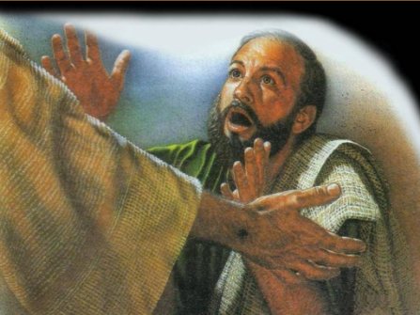
Our beholding the Living Word of God through the Written Word of God is an essential aspect of our fellowship with Him.
We don't get closer by bypassing our beholding of the Living Word of God through the Written Word of God. It's not incidental it's essential.

