Slide 1


Slide 2

The Coming Kingdom
Chapter 7, (cont’d)
Dr. Andy Woods
Senior Pastor – Sugar Land Bible Church
Adjunct Professor of Bible & Theology – College of Biblical Studies

Slide 3

Kingdom Study Outline
What does the Bible Say About the Kingdom?
The Main Problem with Kingdom Now NT interpretations
Why do some believe that we are in the kingdom now?
Why does it matter?

Slide 4
Kingdom Study Outline
What does the Bible Say About the Kingdom?
The Main Problem with Kingdom Now NT interpretations
Why do some believe that we are in the kingdom now?
Why does it matter?

Slide 5
1. Kingdom Throughout the Bible
Eden Abrahamic Covenant Mosaic Covenant Divided Kingdom Times of the Gentiles | Old Testament Prophets Post exile Offer of the King / Kingdom Rejection of the Offer Interim Age

Slide 6
1. Kingdom Throughout the Bible
Eden Abrahamic Covenant Mosaic Covenant Divided Kingdom Times of the Gentiles | Old Testament Prophets Post exile Offer of the King / Kingdom Rejection of the Offer Interim Age

Slide 7
1. Kingdom Throughout the Bible
Eden Abrahamic Covenant Mosaic Covenant Divided Kingdom Times of the Gentiles | Old Testament Prophets Post exile Offer of the King / Kingdom Rejection of the Offer Interim Age

Slide 8
1. Kingdom Throughout the Bible
Eden Abrahamic Covenant Mosaic Covenant Divided Kingdom Times of the Gentiles | Old Testament Prophets Post exile Offer of the King / Kingdom Rejection of the Offer Interim Age

Slide 9
1. Kingdom Throughout the Bible
Eden Abrahamic Covenant Mosaic Covenant Divided Kingdom Times of the Gentiles | Old Testament Prophets Post exile Offer of the King / Kingdom Rejection of the Offer Interim Age

Slide 10
1. Kingdom Throughout the Bible
Eden Abrahamic Covenant Mosaic Covenant Divided Kingdom Times of the Gentiles | Old Testament Prophets Post exile Offer of the King / Kingdom Rejection of the Offer Interim Age

Slide 11
1. Kingdom Throughout the Bible
Eden Abrahamic Covenant Mosaic Covenant Divided Kingdom Times of the Gentiles | Old Testament Prophets Post exile Offer of the King / Kingdom Rejection of the Offer Interim Age

Slide 12
1. Kingdom Throughout the Bible
Eden Abrahamic Covenant Mosaic Covenant Divided Kingdom Times of the Gentiles | Old Testament Prophets Post exile Offer of the King / Kingdom Rejection of the Offer Interim Age

Slide 13

Matthew 3:1-2 (NASB)
“Now in those days John the Baptist came, preaching in the wilderness of Judea, saying, ‘Repent, for the kingdom of heaven is at hand.’”

Slide 14

QUESTIONS CONCERNING THE
OFFER OF THE KINGDOM
Kingdom?
Kingdom of Heaven?
At hand?
To whom was the kingdom offered?
Misinterpretation of the kingdom offer?

Slide 15
Matthew 10:5-7 (NASB)
“These twelve Jesus sent out after instructing them: “Do not go in the way of the Gentiles, and do not enter any city of the Samaritans; ⁶ but rather go to the lost sheep of the house of Israel. ⁷ And as you go, preach, saying, ‘The kingdom of heaven is at hand.’”

Slide 16
QUESTIONS CONCERNING THE
OFFER OF THE KINGDOM
Kingdom?
Kingdom of Heaven?
At hand?
To whom was the kingdom offered?
Misinterpretation of the kingdom offer?

Slide 17
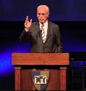
John F. MacArthur
“Listen, the Jews were looking for a political kingdom but Jesus never offered one...There’s no politics in the Sermon on the Mount. None. There is not one reference to the social, political aspect of the kingdom made here, not one. The Jews were so concerned about the politics and the social life. Jesus makes no reference to that at all...The stress is on being. It’s not on ruling or possessing, it is on being...So the political aspect of this message was devastating. It was absolutely everything was the opposite of what they expected a Messiah to say.”
https://www.gty.org/library/print/study-guide-chapter/2197

Slide 18
John F. MacArthur,
John F. MacArthur, The Gospel According to Jesus: What Does Jesus Mean When He Says, “Follow Me”? (Grand Rapids: Zondervan, 1988), 89.
“We must not forget that Jesus came to seek and to save the lost, not merely to announce the earthly kingdom. When Jesus proclaimed His kingdom, He was preaching salvation.”

Slide 19
Matthew 28:18-20 (NASB)
“And Jesus came up and spoke to them, saying, ‘All authority has been given to Me in heaven and on earth. ¹⁹ Go therefore and make disciples of all the nations, baptizing them in the name of the Father and the Son and the Holy Spirit, ²⁰ teaching them to observe all that I commanded you; and lo, I am with you always, even to the end of the age.’”

Slide 20
Matthew 10:5-7 (NASB)
“These twelve Jesus sent out after instructing them: “Do not go in the way of the Gentiles, and do not enter any city of the Samaritans; ⁶ but rather go to the lost sheep of the house of Israel. ⁷ And as you go, preach, saying, ‘The kingdom of heaven is at hand.’”

Slide 21
Acts 16:30-31 (NASB)
“and after he brought them out, he said, ‘Sirs, what must I do to be saved?’ ³¹ They said, ‘Believe in the Lord Jesus, and you will be saved, you and your household.’”

Slide 22
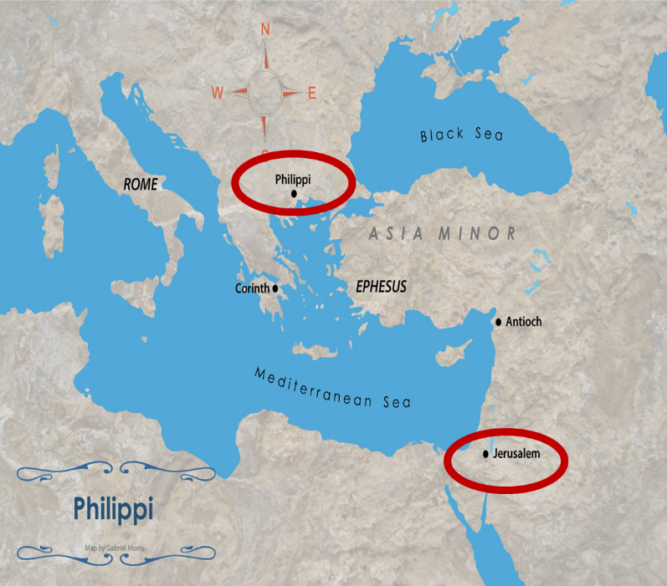

Slide 23
Matthew 10:5-7 (NASB)
“These twelve Jesus sent out after instructing them: “Do not go in the way of the Gentiles, and do not enter any city of the Samaritans; ⁶ but rather go to the lost sheep of the house of Israel. ⁷ And as you go, preach, saying, ‘The kingdom of heaven is at hand.’”

Slide 24
Kingdom Gospel vs. Personal Gospel
 | Kingdom Gospel | Personal Gospel
Biblical example | Matt. 3:2; 4:17; 10:5-7 | Acts 16:30-31
Target audience | National Israel (Matt. 10:5-7) | All nations (Matt. 28:18-20)
Type of salvation offered | National | Personal and individual
Portrayal of Christ | National savior and king | Personal savior
Kingdom expectancy | Imminent | Absent

Slide 25
Kingdom Gospel vs. Personal Gospel
 | Kingdom Gospel | Personal Gospel
Contribution to God’s program | Appearing of the kingdom | Building of the church (Matt. 16:18; Rom. 11:25b)
Scriptural foundation | Mosaic Covenant (Exod. 19:5-6; Deut. 28:15-68) | Gen. 3:15; 15:6; John 3:16; Gal 3:16
When preached? | Early Gospels and Tribulation (Matt. 3:2; 24:14) | Church Age
Preached today? | No | Yes
Perpetual availability? | No | Yes

Slide 26
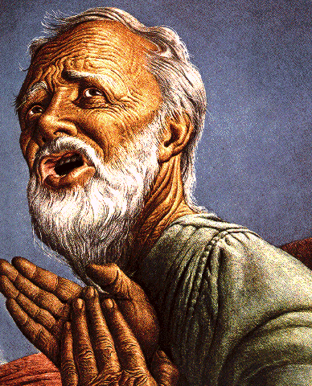
Belief – God’s One Condition for Justification
Gen 15:6
Then he believed in the LORD; and He reckoned it to him as righteousness.
John 3:16
For God so loved the world, that He gave His only begotten Son, that whoever believes in Him shall not perish, but have eternal life.
Acts 16:30-31
"Sirs, what must I do to be saved?" They said, "Believe in the Lord Jesus, and you will be saved..."

Slide 27

Lewis Sperry Chafer, Salvation: God’s Marvelous Work of Grace (Grand Rapids: Kregel, 1991), 49–50; idem, Grace: The Glorious Theme (Grand Rapids: Zondervan, 1972), 132.
Lewis Sperry Chafer
“Such insistence is too often based on Scripture which is addressed to the covenant people, Israel. They . . . being covenant people, are privileged to return to God on the grounds of their covenant by repentance. There is much Scripture both in the Old Testament and in the New that calls this one nation to its long-predicted repentance. . . . The preaching of John the Baptist, of Jesus and the early message of the disciples, was, ‘repent for the kingdom of heaven is at hand’; but it was addressed only to Israel (Matt. 10:5, 6).” The gospel of the kingdom was for the nation of Israel only “and should in no wise be confused with the gospel of saving grace.”

Slide 28

Charles Ryrie
So Great A Salvation, Pages 36-37
“Even the New Testament uses the word gospel to mean various types of good news, so one has to describe what good news is in view. . . . In the Gospel of Matthew, all but one time the word gospel is used concerning the good news of the gospel of the kingdom. This is the message of John the Baptist (Matthew 3:1–2), of our Lord (Matthew 4:17), and of the twelve disciples when they were first sent out by the Lord (Matthew 10:5–7). What was the good news about the kingdom? The correct answer lies in the concept and hope of the kingdom that the Jewish people had at the time of the first coming of Christ. In fact, their hope was for the establishment of the promised rule of the Messiah in His kingdom on this earth, and in the kingdom that would exalt the Jewish people and free them from the rule of Rome under which they lived. But the rule of heaven did not arrive during Jesus’ lifetime because the people refused to repent and meet the spiritual conditions for the kingdom. Most only wanted a political deliverance without having to meet any personal requirements for change of life. So the kingdom did not arrive because the people would not prepare properly for it.”

Slide 29

George Zeller
“MacArthur also runs counter to traditional Dispensationalism in his understanding of ‘the gospel of the kingdom’. . . . He sees this phrase as simply meaning that Jesus was ‘preaching salvation’. . . . Dispensationalists understand this as a reference to that preaching which takes place when the Messianic kingdom is ‘at hand’ which was true in the days of John the Baptist and Christ, and will also be true during the closing years of this age (Matthew 24:14). Nowhere in the New Testament does it say that the gospel of the kingdom is being preached during this church age.”
George Zeller, “John MacArthur and Dispensationalism: And Our Response,” 14, accessed April 5, 2016, http://www.middletownbiblechurch.org/dispen/jmacdis.htm.

Slide 30

John MacArthur
The Gospel According to Jesus, page 25.
“There is a tendency, however, for dispensationalists to get carried away with compartmentalizing truth to the point that they make unbiblical differentiations. An almost obsessive desire to categorize and contrast related truths has carried various dispensationalist interpreters (Chafer, Ryrie, Hodges, etc.) far beyond the legitimate distinctions between Israel and the Church. Many would also draw hard lines between salvation and discipleship (justification and sanctification), the church and the kingdom, Christ's preaching and the apostolic message, faith and repentance, and the age of law and the age of grace." (bold & emphasis mine)

Slide 31
John MacArthur
“I was raised in a dispensational environment; there’s no question… But, as I got into seminary, I began to test some of those things. I have been perhaps aptly designated as a leaky dispensationalist…. Here’s my dispensationalism – I’ll give it to you in one sentence: there’s a difference between the church and Israel – period!... At the same time in seminary, I began to be exposed to reading among more Reformed theologians… And over the years of exegeting the scripture, it has again yielded to me a Reformed theology…. I was convinced of it (Reformed theology) when I started and I’m more convinced of it now as I’ve gone through the text. I was convinced of it when I started because I read so many noble men who have held that view (Reformed Theology). It was more at that point hero worship, and now it’s become my own.”
Transcribed from tape, #GC 70-15, entitled “Bible Questions and Answers” (italics added). A copy of the tape can be obtained by writing, Word of Grace, P.O. Box 4000, Panorama City, CA 91412. Copyright 1994 by John MacArthur Jr., All Rights Reserved.

Slide 32
QUESTIONS CONCERNING THE
OFFER OF THE KINGDOM
Kingdom?
Kingdom of Heaven?
At hand?
To whom was the kingdom offered?
Misinterpretation of the kingdom offer?

Slide 33
The Coming Kingdom
Chapter 8
Dr. Andy Woods
Senior Pastor – Sugar Land Bible Church
Adjunct Professor of Bible & Theology – College of Biblical Studies

Slide 34
Kingdom Study Outline
What does the Bible Say About the Kingdom?
The Main Problem with Kingdom Now NT interpretations
Why do some believe that we are in the kingdom now?
Why does it matter?

Slide 35
Kingdom Study Outline
What does the Bible Say About the Kingdom?
The Main Problem with Kingdom Now NT interpretations
Why do some believe that we are in the kingdom now?
Why does it matter?

Slide 36
1. Kingdom Throughout the Bible
Eden Abrahamic Covenant Mosaic Covenant Divided Kingdom Times of the Gentiles | Old Testament Prophets Post exile Offer of the King / Kingdom Rejection of the Offer Interim Age

Slide 37
1. Kingdom Throughout the Bible
Eden Abrahamic Covenant Mosaic Covenant Divided Kingdom Times of the Gentiles | Old Testament Prophets Post exile Offer of the King / Kingdom Rejection of the Offer Interim Age

Slide 38
1. Kingdom Throughout the Bible
Eden Abrahamic Covenant Mosaic Covenant Divided Kingdom Times of the Gentiles | Old Testament Prophets Post exile Offer of the King / Kingdom Rejection of the Offer Interim Age

Slide 39
1. Kingdom Throughout the Bible
Eden Abrahamic Covenant Mosaic Covenant Divided Kingdom Times of the Gentiles | Old Testament Prophets Post exile Offer of the King / Kingdom Rejection of the Offer Interim Age

Slide 40
1. Kingdom Throughout the Bible
Eden Abrahamic Covenant Mosaic Covenant Divided Kingdom Times of the Gentiles | Old Testament Prophets Post exile Offer of the King / Kingdom Rejection of the Offer Interim Age

Slide 41
1. Kingdom Throughout the Bible
Eden Abrahamic Covenant Mosaic Covenant Divided Kingdom Times of the Gentiles | Old Testament Prophets Post exile Offer of the King / Kingdom Rejection of the Offer Interim Age

Slide 42
1. Kingdom Throughout the Bible
Eden Abrahamic Covenant Mosaic Covenant Divided Kingdom Times of the Gentiles | Old Testament Prophets Post exile Offer of the King / Kingdom Rejection of the Offer Interim Age

Slide 43
1. Kingdom Throughout the Bible
Eden Abrahamic Covenant Mosaic Covenant Divided Kingdom Times of the Gentiles | Old Testament Prophets Post exile Offer of the King / Kingdom Rejection of the Offer Interim Age

Slide 44
1. Kingdom Throughout the Bible
Eden Abrahamic Covenant Mosaic Covenant Divided Kingdom Times of the Gentiles | Old Testament Prophets Post exile Offer of the King / Kingdom Rejection of the Offer Interim Age

Slide 45

REJECTION OF THE
OFFER OF THE KINGDOM
Why did Israel reject the offer of the kingdom?
What was the turning point?
Was the kingdom re-offered in Acts?

Slide 46
REJECTION OF THE
OFFER OF THE KINGDOM
Why did Israel reject the offer of the kingdom?
What was the turning point?
Was the kingdom re-offered in Acts?

Slide 47
Why did Israel reject the offer of the kingdom?
Christ’s kingdom was not just political but also moral and ethical in tone
Israel pursued righteousness by self righteousness rather than by transferred righteousness available though faith alone

Slide 48
Why did Israel reject the offer of the kingdom?
Christ’s kingdom was not just political but also moral and ethical in tone
Israel pursued righteousness by self righteousness rather than by transferred righteousness available though faith alone

Slide 49
Ezekiel 37:23-24 (NASB)
“They will no longer defile themselves with their idols, or with their detestable things, or with any of their transgressions; but I will deliver them from all their dwelling places in which they have sinned, and will cleanse them. And they will be My people, and I will be their God. “My servant David will be king over them, and they will all have one shepherd; and they will walk in My ordinances and keep My statutes and observe them.”

Slide 50
Matthew 3:1-2 (NASB)
“Now in those days John the Baptist came, preaching in the wilderness of Judea, saying, ‘Repent, for the kingdom of heaven is at hand.’”

Slide 51
Messengers of the Kingdom In Matthew
John the Baptist – 3:2
Jesus Christ – 4:17
12 Apostles – 10:5-7
Seventy – Luke 10:1, 9
Toussaint, Behold the King, 18-20

Slide 52
Matthew 4:17 (NASB)
“From that time Jesus began to preach and say, ‘Repent, for the kingdom of heaven is at hand.’”

Slide 53
Matthew 10:5-7 (NASB)
“These twelve Jesus sent out after instructing them: “Do not go in the way of the Gentiles, and do not enter any city of the Samaritans; ⁶ but rather go to the lost sheep of the house of Israel. ⁷ And as you go, preach, saying, ‘The kingdom of heaven is at hand.’”

Slide 54
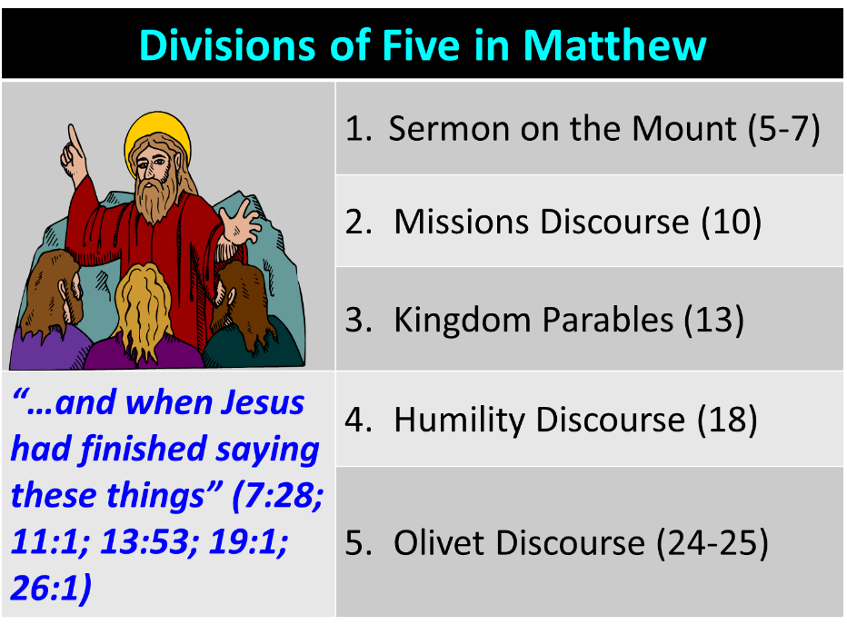

Slide 55
Sermon on the Mount (5–7)
Setting (5:1-2)
Beatitudes (5:3-12)
Influence of the kingdom’s citizens upon fallen culture (5:13-16)
Relationship of the kingdom to the Mosaic Law (5:17-48)
Public vs. private righteousness (6:1-18)
Wealth (6:19-34)
Judging (7:1-6)
Righteousness (7:7-12)
Christ’s teaching vs. the Pharisees (7:13-27)
Conclusion (7:28-29)

Slide 56

Sermon on the Mount: Inclusions & Omissions
Inclusions
  Animal sacrifice & the temple (Matt. 5:27)
  Unlimited giving (Matt. 5:40)
Omissions
  Christ’s sacrifice for sins (John 3)
  Salvation by faith alone
  Prayer in Christ’s name (John 14:13-14)
  Holy Spirit (John 14:26)
  The Church (Matt. 16:18)

Slide 57
Why did Israel reject the offer of the kingdom?
Christ’s kingdom was not just political but also moral and ethical in tone
Israel pursued righteousness by self righteousness rather than by transferred righteousness available though faith alone

Slide 58
Romans 9:30-32 (NASB)
“What shall we say then? That Gentiles, who did not pursue righteousness, attained righteousness, even the righteousness which is by faith; ³¹ but Israel, pursuing a law of righteousness, did not arrive at that law. ³² Why? Because they did not pursue it by faith, but as though it were by works. They stumbled over the stumbling stone.”

Slide 59
REJECTION OF THE
OFFER OF THE KINGDOM
Why did Israel reject the offer of the kingdom?
What was the turning point?
Was the kingdom re-offered in Acts?

Slide 60
Matthew 12:24 (NASB)
“But when the Pharisees heard this, they said, “This man casts out demons only by Beelzebul the ruler of the demons.”

Slide 61
Matthew 24:14 (NASB)
“This gospel of the kingdom shall be preached in the whole world as a testimony to all the nations, and then the end will come.”

Slide 62
Transition from Public to Private Ministry
 | Public | Personal Gospel
Scripture | Matt. 1–12 | Matt. 13–28
Focus | Nation | Remnant
Miracles | Proof to nation | Training for remnant
Offer | Prominent | Disappears
Teaching | Discourse | Parabolic
Interim program | Not mentioned | Prominent

Slide 63
Matthew Outline
Pedigree of the king (1–2)
  Preparation of the king (3–4)
    Pedagogy of the king (5–7)
      Power of the king (8–9)
        Program of the king (10)
          Progressive rejection of the king (11–12)
        Preparation of the king’s disciples (13–20)
      Presentation & rejection of the king (21–23)
    Prophecies of the king (24–25)
  Passion of the king (26–27)
Proof of the king (28)

Slide 64
Matthew Outline
Pedigree of the king (1–2)
  Preparation of the king (3–4)
    Pedagogy of the king (5–7)
      Power of the king (8–9)
        Program of the king (10)
          Progressive rejection of the king (11–12)
        Preparation of the king’s disciples (13–20)
      Presentation & rejection of the king (21–23)
    Prophecies of the king (24–25)
  Passion of the king (26–27)
Proof of the king (28)

Slide 65
Six Parts of a Suzerain-Vassal Treaty in Deuteronomy
Preamble (1:1-5)
Prologue (1:6–4:40)
Covenant obligations (5–26)
Storage and reading instructions (27:2-3; 31:9, 24, 26)
Witnesses (32:1)
Blessings and curses (28)

Slide 66
Six Parts of a Suzerain-Vassal Treaty in Deuteronomy
Preamble (1:1-5)
Prologue (1:6–4:40)
Covenant obligations (5–26)
Storage and reading instructions (27:2-3; 31:9, 24, 26)
Witnesses (32:1)
Blessings and curses (28)

Slide 67
Israel's Judgments
Division of the kingdom in 931 B.C. (1 Kgs. 12)
Assyrian judgment in 722 B.C. (2 Kgs. 17)
Babylonian captivity in 586 B.C. (2 Kgs. 25)
Roman judgment in A.D. 70 (Luke 19:41-44)

Slide 68
Israel's Judgments
Division of the kingdom in 931 B.C. (1 Kgs. 12)
Assyrian judgment in 722 B.C. (2 Kgs. 17)
Babylonian captivity in 586 B.C. (2 Kgs. 25)
Roman judgment in A.D. 70 (Luke 19:41-44)

Slide 69
REJECTION OF THE
OFFER OF THE KINGDOM
Why did Israel reject the offer of the kingdom?
What was the turning point?
Was the kingdom re-offered in Acts?

Slide 70
Acts 3:19-21 (NASB)
“Therefore repent and return, so that your sins may be wiped away, in order that times of refreshing may come from the presence of the Lord; ²⁰ and that He may send Jesus, the Christ appointed for you, ²¹ whom heaven must receive until the period of restoration of all things about which God spoke by the mouth of His holy prophets from ancient time.”

Slide 71
Acts 3:19-21 (NASB)
“Therefore repent and return, so that your sins may be wiped away, in order that times of refreshing may come from the presence of the Lord; ²⁰ and that He may send Jesus, the Christ appointed for you, ²¹ whom heaven must receive until the period of restoration of all things about which God spoke by the mouth of His holy prophets from ancient time.”

Slide 72

3. Was the kingdom re-offered in Acts? No!
The king was absent (Acts 1:9-11)
Irreversible language found in the Gospels (Matt. 12:31-32; 21:42; 22:7)
A new age in the kingdom’s absence has already been disclosed (Luke 19:11-27; Matt. 13; 24‒25)
“Kingdom” is mentioned 45x in Luke’s Gospel but only 8x in Acts
Expression “repent for the kingdom of heaven is at hand” is absent from Acts

Slide 73
3. Was the kingdom re-offered in Acts? No!
Co-mingling of kingdom truth with Church Age truth
The timing of the kingdom has already been fixed by the Father’s authority (Acts 1:6-7)
Acts 3:19-21 is laying out the condition by which the kingdom will ultimately come to the earth (Acts 3:19-21)
The miracles in Acts authenticate the new age of the Church (Heb. 2:2-3) and not the ongoing offer of the kingdom

Slide 74
3. Was the kingdom re-offered in Acts? No!
The king was absent (Acts 1:9-11)
Irreversible language found in the Gospels (Matt. 12:31-32; 21:42; 22:7)
A new age in the kingdom’s absence has already been disclosed (Luke 19:11-27; Matt. 13; 24‒25)
“Kingdom” is mentioned 45x in Luke’s Gospel but only 8x in Acts
Expression “repent for the kingdom of heaven is at hand” is absent from Acts

Slide 75

Isaiah 9:6-7 (NASB)
⁶ For a child will be born to us, a son will be given to us; And the government will rest on His shoulders; And His name will be called Wonderful Counselor, Mighty God, Eternal Father, Prince of Peace.⁷ There will be no end to the increase of His government or of peace, On the throne of David and over his kingdom, To establish it and to uphold it with justice and righteousness From then on and forevermore. The zeal of the Lord of hosts will accomplish this.

Slide 76
Luke 1:32-33 (NASB)
Most High; and the Lord God will give Him the throne of His father David; and He will reign over the house of Jacob forever, and His kingdom will have no end.

Slide 77


Deuteronomy 17:15
“you shall surely set a king over you whom the Lord your God chooses, one from among your countrymen you shall set as king over yourselves; you may not put a foreigner over yourselves who is not your countryman.”

Slide 78
Acts 3:19-21 (NASB)
“Therefore repent and return, so that your sins may be wiped away, in order that times of refreshing may come from the presence of the Lord; ²⁰ and that He may send Jesus, the Christ appointed for you, ²¹ whom heaven must receive until the period of restoration of all things about which God spoke by the mouth of His holy prophets from ancient time.”

Slide 79
3. Was the kingdom re-offered in Acts? No!
The king was absent (Acts 1:9-11)
Irreversible language found in the Gospels (Matt. 12:31-32; 21:42; 22:7)
A new age in the kingdom’s absence has already been disclosed (Luke 19:11-27; Matt. 13; 24‒25)
“Kingdom” is mentioned 45x in Luke’s Gospel but only 8x in Acts
Expression “repent for the kingdom of heaven is at hand” is absent from Acts

Slide 80
3. Was the kingdom re-offered in Acts? No!
The king was absent (Acts 1:9-11)
Irreversible language found in the Gospels (Matt. 12:31-32; 21:42; 22:7)
A new age in the kingdom’s absence has already been disclosed (Luke 19:11-27; Matt. 13; 24‒25)
“Kingdom” is mentioned 45x in Luke’s Gospel but only 8x in Acts
Expression “repent for the kingdom of heaven is at hand” is absent from Acts

Slide 81
3. Was the kingdom re-offered in Acts? No!
The king was absent (Acts 1:9-11)
Irreversible language found in the Gospels (Matt. 12:31-32; 21:42; 22:7)
A new age in the kingdom’s absence has already been disclosed (Luke 19:11-27; Matt. 13; 24‒25)
“Kingdom” is mentioned 45x in Luke’s Gospel but only 8x in Acts
Expression “repent for the kingdom of heaven is at hand” is absent from Acts

Slide 82
3. Was the kingdom re-offered in Acts? No!
The king was absent (Acts 1:9-11)
Irreversible language found in the Gospels (Matt. 12:31-32; 21:42; 22:7)
A new age in the kingdom’s absence has already been disclosed (Luke 19:11-27; Matt. 13; 24‒25)
“Kingdom” is mentioned 45x in Luke’s Gospel but only 8x in Acts
Expression “repent for the kingdom of heaven is at hand” is absent from Acts

Slide 83
Messengers of the Kingdom In Matthew
John the Baptist – 3:2
Jesus Christ – 4:17
12 Apostles – 10:5-7
Seventy – Luke 10:1, 9
Toussaint, Behold the King, 18-20

Slide 84
Matthew 3:1-2 (NASB)
“Now in those days John the Baptist came, preaching in the wilderness of Judea, saying, ‘Repent, for the kingdom of heaven is at hand.’”

Slide 85
Matthew 4:17 (NASB)
“From that time Jesus began to preach and say, ‘Repent, for the kingdom of heaven is at hand.’”

Slide 86
Matthew 10:5-7 (NASB)
“These twelve Jesus sent out after instructing them: “Do not go in the way of the Gentiles, and do not enter any city of the Samaritans; ⁶ but rather go to the lost sheep of the house of Israel. ⁷ And as you go, preach, saying, ‘The kingdom of heaven is at hand.’”

Slide 87
Luke 10:1, 9 (NASB)
“Now after this the Lord appointed seventy others, and sent them in pairs ahead of Him to every city and place where He Himself was going to come…and heal those in it who are sick, and say to them, ‘The kingdom of God has come near to you.’”

Slide 88
3. Was the kingdom re-offered in Acts? No!
Co-mingling of kingdom truth with Church Age truth
The timing of the kingdom has already been fixed by the Father’s authority (Acts 1:6-7)
Acts 3:19-21 is laying out the condition by which the kingdom will ultimately come to the earth (Acts 3:19-21)
The miracles in Acts authenticate the new age of the Church (Heb. 2:2-3) and not the ongoing offer of the kingdom

Slide 89
Origin of the Universal Church
Matt 16:18 – future tense
Eph 2:14-15; 3:9; Rom 16:25-26; Col 1:26-27 – mystery
Eph 1:20-22 – Christ’s headship over church after Ascension
Eph 4:7-11 – spiritual gifts after Ascension
1 Cor. 12:13 – Spirit’s baptizing ministry
  Acts 1:5 – above to begin after Ascension
  Acts 11:15-16 – above began in the past
  Acts 2 – only place for beginning of Spirit’s baptizing ministry

Slide 90
3. Was the kingdom re-offered in Acts? No!
Co-mingling of kingdom truth with Church Age truth
The timing of the kingdom has already been fixed by the Father’s authority (Acts 1:6-7)
Acts 3:19-21 is laying out the condition by which the kingdom will ultimately come to the earth (Acts 3:19-21)
The miracles in Acts authenticate the new age of the Church (Heb. 2:2-3) and not the ongoing offer of the kingdom

Slide 91
3. Was the kingdom re-offered in Acts? No!
Co-mingling of kingdom truth with Church Age truth
The timing of the kingdom has already been fixed by the Father’s authority (Acts 1:6-7)
Acts 3:19-21 is laying out the condition by which the kingdom will ultimately come to the earth (Acts 3:19-21)
The miracles in Acts authenticate the new age of the Church (Heb. 2:2-3) and not the ongoing offer of the kingdom

Slide 92
Acts 3:19-21 (NASB)
“Therefore repent and return, so that your sins may be wiped away, in order that times of refreshing may come from the presence of the Lord; ²⁰ and that He may send Jesus, the Christ appointed for you, ²¹ whom heaven must receive until the period of restoration of all things about which God spoke by the mouth of His holy prophets from ancient time.”

Slide 93
Matthew 23:37-39 (NASB)
“Jerusalem, Jerusalem, who kills the prophets and stones those who are sent to her! How often I wanted to gather your children together, the way a hen gathers her chicks under her wings, and you were unwilling. ³⁸ Behold, your house is being left to you desolate! ³⁹ For I say to you, from now on you will not see Me until you say, ‘Blessed is He who comes in the name of the Lord!”

Slide 94
3. Was the kingdom re-offered in Acts? No!
Co-mingling of kingdom truth with Church Age truth
The timing of the kingdom has already been fixed by the Father’s authority (Acts 1:6-7)
Acts 3:19-21 is laying out the condition by which the kingdom will ultimately come to the earth (Acts 3:19-21)
The miracles in Acts authenticate the new age of the Church (Heb. 2:2-3) and not the ongoing offer of the kingdom

Slide 95
Eras of Miracles in Scripture
Cluster | Confirmation
Moses | Law
Elijah & Elisha | Prophets
Christ | Offer of the kingdom
Apostles | Church
Antichrist | Satan’s kingdom

Slide 96
Conclusion

Slide 97
REJECTION OF THE
OFFER OF THE KINGDOM
Why did Israel reject the offer of the kingdom?
What was the turning point?
Was the kingdom re-offered in Acts?

Slide 98
1. Kingdom Throughout the Bible
Eden Abrahamic Covenant Mosaic Covenant Divided Kingdom Times of the Gentiles | Old Testament Prophets Post exile Offer of the King / Kingdom Rejection of the Offer Interim Age

