Slide 1
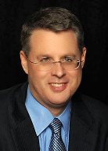
Soteriology Session 50
Dr. Andy Woods
Senior Pastor – Sugar Land Bible Church
Professor of Bible & Theology – College of Biblical Studies

Slide 2
Soteriology Overview
Definition
Election
Atonement
Salvation words
God’s one condition of salvation
Results of salvation
Eternal security
Faulty views of salvation

Slide 3
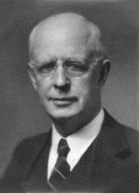
Soteriology Overview
This Session
VII. Eternal Security

Slide 4
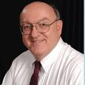
Definition of Eternal Security
“Eternal Security means that those who have been genuinely saved by God’s grace through faith alone in Christ alone shall never be in danger of God’s condemnation or loss of salvation but God’s grace and power keep them forever saved and secure.”
Dennis Rokser, Shall Never Perish Forever, p. 11

Slide 5
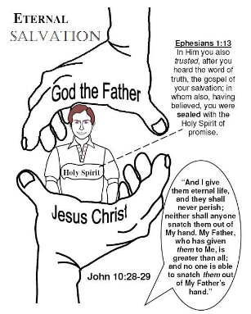
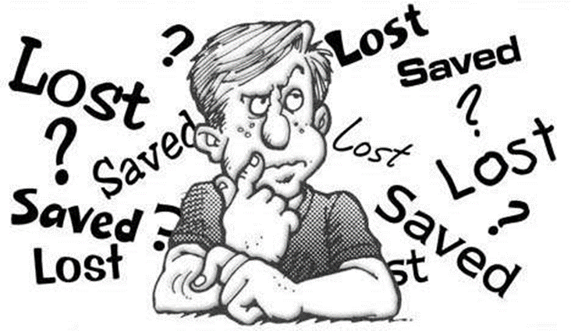
Eternal Security Outline
Eternal security arguments
Response to problem passages

Slide 6
Eternal Security Outline
Eternal security arguments
Response to problem passages

Slide 7
Eternal Security Outline
Eternal security arguments
Response to problem passages

Slide 8
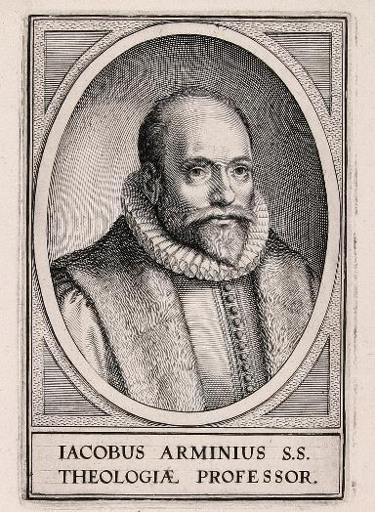
Response to Problem Passages
OT Passages
Passages from Matthew
Passages from John
Passages from Acts
Passages from Paul

Slide 9
Response to Problem Passages
Passages from James
Passages from Hebrews
Passages from 2 Peter
Passages from 1 John
Passages from Revelation
Miscellaneous argument

Slide 10
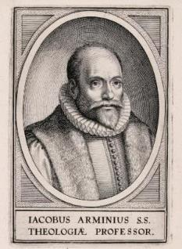
Passages from the General Letters & Revelation
Jas. 5:19-20
Heb. 3:6, 14
Heb. 5:9-10
Heb. 6:4-6
Heb. 10:26-30
Heb. 12:14
2 Pet. 1:10-11, 20-22
Jude 11
1 John 2:3
1 John 3:9
1 John 3:15
1 John 5:16
Rev. 3:5
Rev. 22:18-19

Slide 11
Passages from the General Letters & Revelation
Jas. 5:19-20
Heb. 3:6, 14
Heb. 5:9-10
Heb. 6:4-6
Heb. 10:26-30
Heb. 12:14
2 Pet. 1:10-11, 20-22
Jude 11
1 John 2:3
1 John 3:9
1 John 3:15
1 John 5:16
Rev. 3:5
Rev. 22:18-19

Slide 12
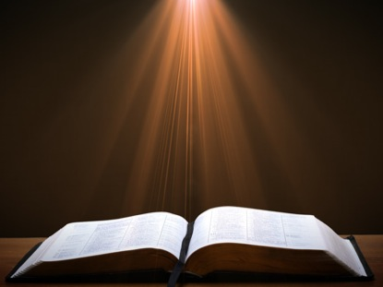
1 John 3:15
“Everyone who hates his brother is a murderer; and you know that no murderer has eternal life abiding in him.” (NASB)

Slide 13
1 John 3:15
“Everyone who hates his brother is a murderer; and you know that no murderer has eternal life abiding in him.” (NASB)

Slide 14
1 John 3:15
“Everyone who hates his brother is a murderer; and you know that no murderer has eternal life abiding in him.” (NASB)

Slide 15
John 15:4-5
“Abide in Me, and I in you. As the branch cannot bear fruit of itself unless it abides in the vine, so neither can you unless you abide in Me. ⁵ I am the vine, you are the branches; he who abides in Me and I in him, he bears much fruit, for apart from Me you can do nothing..” (NASB)

Slide 16
1 John 1:3-4
“what we have seen and heard we proclaim to you also, so that you too may have fellowship with us; and indeed our fellowship is with the Father, and with His Son Jesus Christ. ⁴ These things we write, so that our joy may be made complete.” (NASB)

Slide 17
1 John 3:6
“No one who abides in Him sins; no one who sins has seen Him or knows Him.” (NASB)

Slide 18
Passages from the General Letters & Revelation
Jas. 5:19-20
Heb. 3:6, 14
Heb. 5:9-10
Heb. 6:4-6
Heb. 10:26-30
Heb. 12:14
2 Pet. 1:10-11, 20-22
Jude 11
1 John 2:3
1 John 3:9
1 John 3:15
1 John 5:16
Rev. 3:5
Rev. 22:18-19

Slide 19
1 John 5:16-17
“If anyone sees his brother committing a sin not leading to death, he shall ask and God will for him give life to those who commit sin not leading to death. There is a sin leading to death; I do not say that he should make request for this. ¹⁷ All unrighteousness is sin, and there is a sin not leading to death.” (NASB)

Slide 20
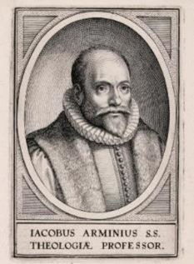
1 John 5:16-17
Sin brings death
Rom. 6:23
Jas. 1:14-16
Maximum divine discipline
Acts 5:1-11
1 Cor. 11:30
1 John 5:16-17
Rev. 2:22-23

Slide 21
Passages from the General Letters & Revelation
Jas. 5:19-20
Heb. 3:6, 14
Heb. 5:9-10
Heb. 6:4-6
Heb. 10:26-30
Heb. 12:14
2 Pet. 1:10-11, 20-22
Jude 11
1 John 2:3
1 John 3:9
1 John 3:15
1 John 5:16
Rev. 3:5
Rev. 22:18-19

Slide 22
Revelation 3:5
“He who overcomes [nikaō] will thus be clothed in white garments; and I will not erase his name from the book of life, and I will confess his name before My Father and before His angels.” (NASB)

Slide 23
Romans 8:37
“ But in all these things we overwhelmingly conquer [hypernikaō] through Him who loved us.” (NASB)

Slide 24
John 16:33
“These things I have spoken to you, so that in Me you may have peace. In the world you have tribulation, but take courage; I have overcome [nikaō] the world.” (NASB)

Slide 25
1 John 5:4-5
“For whatever is born of God overcomes [nikaō] the world; and this is the victory that has overcome [nikaō] the world—our faith.⁵ Who is the one who overcomes [nikaō] the world, but he who believes that Jesus is the Son of God?” (NASB)

Slide 26
Revelation 3:5
“He who overcomes [all believers; nikaō] will thus be clothed in white garments; and I will not [ou mē] erase his name from the book of life, and I will confess his name before My Father and before His angels.” (NASB)

Slide 27
Exodus 32:32
“But now, if You will, forgive their sin—and if not, please blot me out from Your book which You have written!” (NASB)

Slide 28
Psalm 69:28
“May they be blotted out of the book of life And may they not be recorded with the righteous.”

Slide 29
Passages from the General Letters & Revelation
Jas. 5:19-20
Heb. 3:6, 14
Heb. 5:9-10
Heb. 6:4-6
Heb. 10:26-30
Heb. 12:14
2 Pet. 1:10-11, 20-22
Jude 11
1 John 2:3
1 John 3:9
1 John 3:15
1 John 5:16
Rev. 3:5
Rev. 22:18-19

Slide 30
Revelation 22:18-19
“I testify to everyone who hears the words of the prophecy of this book: if anyone adds to them, God will add to him the plagues which are written in this book; ¹⁹ and if anyone takes away from the words of the book of this prophecy, God will take away his part from the tree of life and from the holy city, which are written in this book.” (NASB)

Slide 31
Revelation 22:17
“The Spirit and the bride say, “Come.” And let the one who hears say, “Come.” And let the one who is thirsty come; let the one who wishes take the water of life without cost.” (NASB)

Slide 32
Revelation 22:18-19
“I testify to everyone who hears the words of the prophecy of this book: if anyone adds to them, God will add to him the plagues which are written in this book; ¹⁹ and if anyone takes away from the words of the book of this prophecy, God will take away his part from the tree of life and from the holy city, which are written in this book.” (NASB)

Slide 33
2 Peter 3:16-17
“as also in all his letters, speaking in them of these things, in which are some things hard to understand, which the untaught and unstable distort, as they do also the rest of the Scriptures, to their own destruction. ¹⁷ You therefore, beloved, knowing this beforehand, be on your guard so that you are not carried away by the error of unprincipled men and fall from your own steadfastness.” (NASB)

Slide 34
Revelation 22:18-19
“I testify to everyone who hears the words of the prophecy of this book: if anyone adds to them, God will add to him the plagues which are written in this book; ¹⁹ and if anyone takes away from the words of the book of this prophecy, God will take away his part from the tree of life and ^{[i]}from the holy city, which are written in this book.” (NASB)

Slide 35
Revelation 22:18-19
“I testify to everyone who hears the words of the prophecy of this book: if anyone adds to them, God will add to him the plagues which are written in this book; ¹⁹ and if anyone takes away from the words of the book of this prophecy, God will take away his part from the tree of life and from the holy city, which are written in this book.” (NASB)

Slide 36
Passages from the General Letters & Revelation
Jas. 5:19-20
Heb. 3:6, 14
Heb. 5:9-10
Heb. 6:4-6
Heb. 10:26-30
Heb. 12:14
2 Pet. 1:10-11, 20-22
Jude 11
1 John 2:3
1 John 3:9
1 John 3:15
1 John 5:16
Rev. 3:5
Rev. 22:18-19

Slide 37
Response to Problem Passages
Passages from James
Passages from Hebrews
Passages from 2 Peter
Passages from 1 John
Passages from Revelation
Miscellaneous argument

Slide 38
Miscellaneous Argument
Allows people to live in sin without fear of losing salvation?
Ryrie A Survey of Bible Doctrine 133. “Actually one need not fear losing his salvation as long as he could be saved again by believing again. So even a doctrine of ‘insecurity’ could breed a license in living.”
Proper motivation for holy living

Slide 39
CONCLUSION

Slide 40
Response to Problem Passages
OT Passages
Passages from Matthew
Passages from John
Passages from Acts
Passages from Paul

Slide 41
Response to Problem Passages
Passages from James
Passages from Hebrews
Passages from 2 Peter
Passages from 1 John
Passages from Revelation
Miscellaneous argument

