Slide 1
THE BOOK OF DANIEL
Dr. Andy Woods

Slide 2
Message
Times of the Gentiles are revealed prophetically (2, 7, 8-12) and ethically (1, 3-6)

Slide 3
Synthetic Outline
Historical (1-7):
Daniel interprets, 3rd person, gentile nations
Intro “Hebrew” (1)
Aramaic chiasm (2-7)

Slide 4
Synthetic Outline
Prophetic (8-12):
Angel interprets, 1st person, Jewish nation, Hebrew
Ram & Goat (8)
70 weeks (9)
Final vision (10-12)

Slide 5
Synthetic Outline
Historical (1-7):
Daniel interprets, 3rd person, gentile nations
Intro “Hebrew” (1)
Aramaic chiasm (2-7)

Slide 6
Synthetic Outline
Historical (1-7):
Daniel interprets, 3rd person, gentile nations
Intro “Hebrew” (1)
Aramaic chiasm (2-7)

Slide 7
Synthetic Outline
Chiasm “Aramaic” ( 2-7)
1. Gentile History (2)
2. Protection (3)
3. Revelation to a gentile king (4)
3. Revelation to a gentile king (5)
2. Protection (6)
1. Gentile history (7)

Slide 8
Synthetic Outline
Chiasm “Aramaic” ( 2-7)
1. Gentile History (2)
2. Protection (3)
3. Revelation to a gentile king (4)
3. Revelation to a gentile king (5)
2. Protection (6)
1. Gentile history (7)

Slide 9
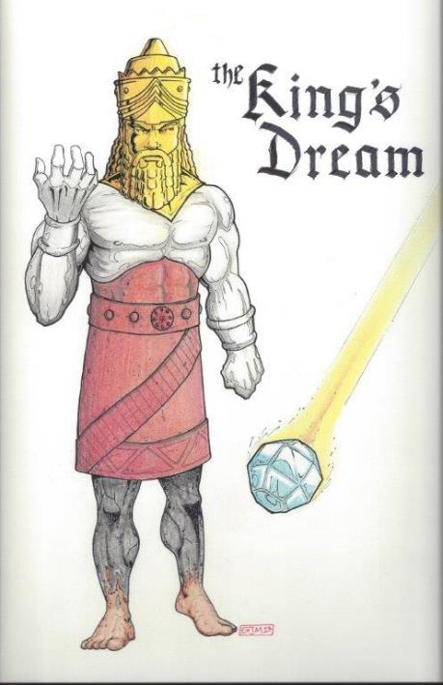
Statue
&
Stone

Slide 10
Synthetic Outline
Chiasm “Aramaic” ( 2-7)
1. Gentile History (2)
2. Protection (3)
3. Revelation to a gentile king (4)
3. Revelation to a gentile king (5)
2. Protection (6)
1. Gentile history (7)

Slide 11
Synthetic Outline
Chiasm “Aramaic” ( 2-7)
1. Gentile History (2)
2. Protection (3)
3. Revelation to a gentile king (4)
3. Revelation to a gentile king (5)
2. Protection (6)
1. Gentile history (7)

Slide 12
Succession of Gentile Rulers
1-4: Nebuchadnezzar of Babylon
5: Belshazzar of Babylon
6: Darius of Media – Persia
7-8: Belshazzar of Babylon
9: Darius of Media – Persia
10-12: Cyrus of Media – Persia

Slide 13
Succession of Gentile Rulers
1-4: Nebuchadnezzar of Babylon
5: Belshazzar of Babylon
6: Darius of Media – Persia
7-8: Belshazzar of Babylon
9: Darius of Media – Persia
10-12: Cyrus of Media – Persia

Slide 14
Daniel’s Age
CHAPTER | EVENTS | AGE
1 | Taken to Babylonian captivity | 15
2 | Interpreting Nebuchadnezzar’s 1st dream (huge image) | 17
3 | Daniel’s 3 friends cast into the fiery furnace | 19 or 20
4 | Interpreting Nebuchadnezzar’s 2nd dream (huge tree) | 45-50
5 | Interpreting handwriting of the wall at Belshazzar’s feast | Early 80’s
6 | Delivered from the den of lions | c.83
7-8 | Daniel’s visions and dreams | Mid-60’s
9 | Daniel’s seventy “sevens” prophecy | Early-80’s
10-12 | Final dreams and visions | Mid-80’s

Slide 15
Daniel’s Age
CHAPTER | EVENTS | AGE
1 | Taken to Babylonian captivity | 15
2 | Interpreting Nebuchadnezzar’s 1st dream (huge image) | 17
3 | Daniel’s 3 friends cast into the fiery furnace | 19 or 20
4 | Interpreting Nebuchadnezzar’s 2nd dream (huge tree) | 45-50
5 | Interpreting handwriting of the wall at Belshazzar’s feast | Early 80’s
6 | Delivered from the den of lions | c.83
7-8 | Daniel’s visions and dreams | Mid-60’s
9 | Daniel’s seventy “sevens” prophecy | Early-80’s
10-12 | Final dreams and visions | Mid-80’s

Slide 16
Chapter 4 Outline
Introduction (1-3)
Dream Described by Nebuchadnezzar (4-18)
Dream Interpreted by Daniel (19-27)
Dream Fulfilled by God (28-37)

Slide 17
Chapter 4 Outline
Introduction (1-3)
Dream Described by Nebuchadnezzar (4-18)
Dream Interpreted by Daniel (19-27)
Dream Fulfilled by God (28-37)

Slide 18
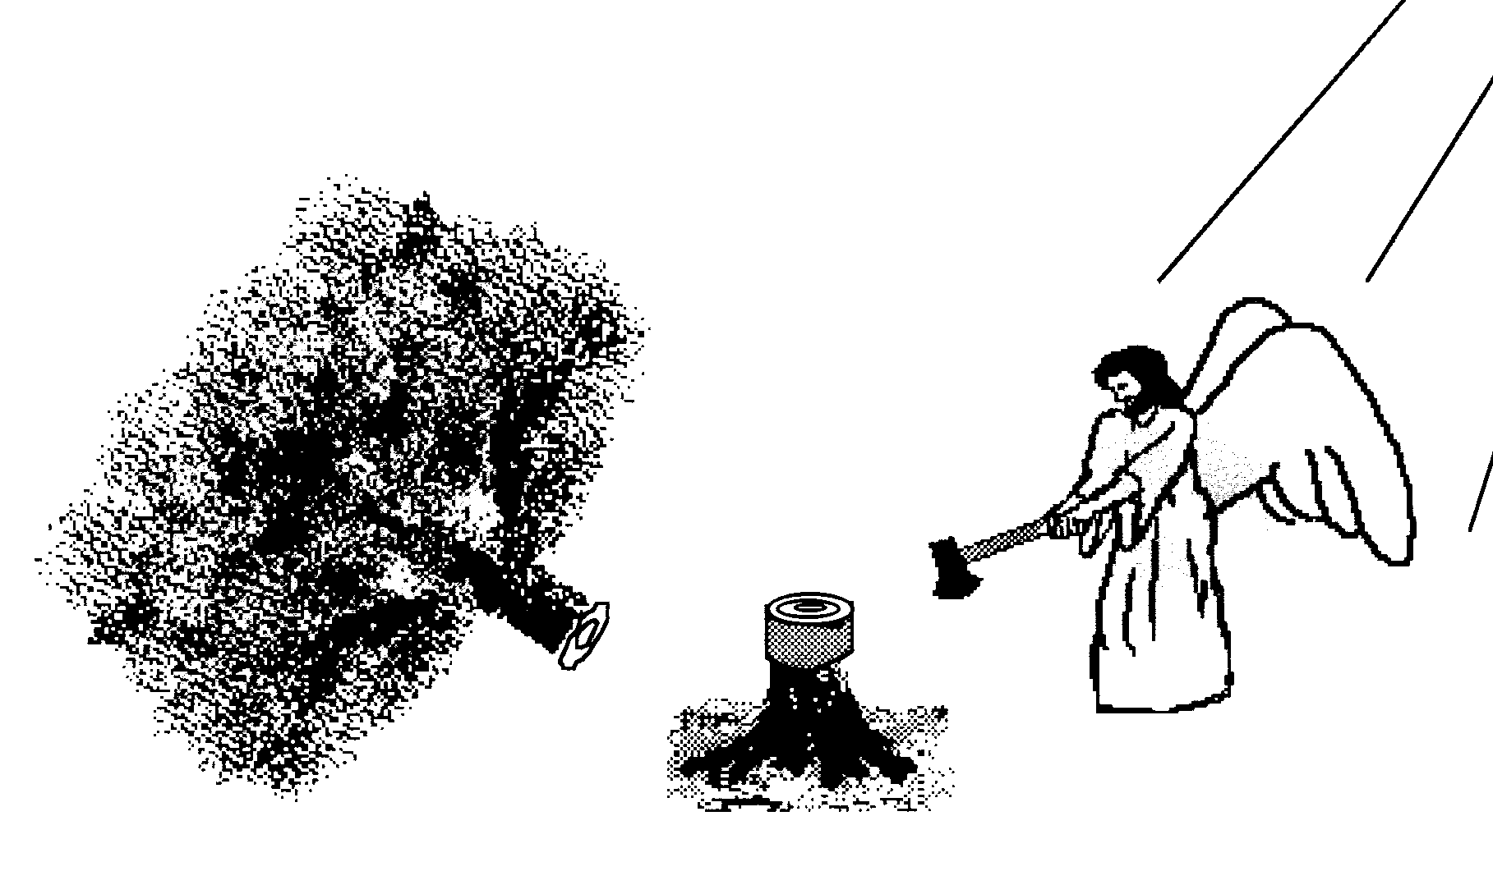
IV. Dream Fulfilled By God Daniel 4:28-37
Nebuchadnezzar’s insanity v. 28-33
Nebuchadnezzar’s humility v. 34-37

Slide 19
IV. Dream Fulfilled By God Daniel 4:28-37
Nebuchadnezzar’s insanity v. 28-33
Nebuchadnezzar’s humility v. 34-37

Slide 20
IV. Dream Fulfilled By God Daniel 4:28-37
Nebuchadnezzar’s insanity v. 28-33
Nebuchadnezzar’s humility v. 34-37

Slide 21
B. Nebuchadnezzar’s Humility (34-37)
Nebuchadnezzar’s Humiliation v. 34-35
Nebuchadnezzar’s Restoration v. 36-37

Slide 22
B. Nebuchadnezzar’s Humility (34-37)
Nebuchadnezzar’s Humiliation v. 34-35
Nebuchadnezzar’s Restoration v. 36-37

Slide 23
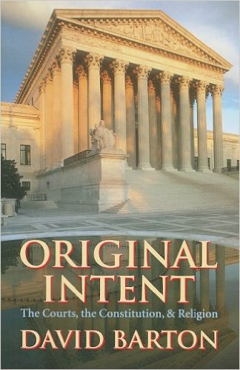
David Barton, Original Intent, p. 245

Slide 24
Daniel 2:37-38 (NASB)
You, O king, are the king of kings, to whom the God of heaven has given the kingdom, the power, the strength and the glory; ³⁸ and wherever the sons of men dwell, or the beasts of the field, or the birds of the sky, He has given them into your hand and has caused you to rule over them all. You are the head of gold.

Slide 25
Daniel 4:30 (NASB)
“The king reflected and said, ‘Is this not Babylon the great, which I myself have built as a royal residence by the might of my power and for the glory of my majesty?’”

Slide 26
B. Nebuchadnezzar’s Humility (34-37)
Nebuchadnezzar’s Humiliation v. 34-35
Nebuchadnezzar’s Restoration v. 36-37

Slide 27
Succession of Gentile Rulers
1-4: Nebuchadnezzar of Babylon
5: Belshazzar of Babylon
6: Darius of Media – Persia
7-8: Belshazzar of Babylon
9: Darius of Media – Persia
10-12: Cyrus of Media – Persia

Slide 28
Isaiah 9:6-7 (NASB)
⁶ For a child will be born to us, a son will be given to us; And the government will rest on His shoulders; And His name will be called Wonderful Counselor, Mighty God, Eternal Father, Prince of Peace.⁷ There will be no end to the increase of His government or of peace, On the throne of David and over his kingdom, To establish it and to uphold it with justice and righteousness From then on and forevermore. The zeal of the Lord of hosts will accomplish this.

Slide 29
Scripture and Pride
Prov 16:18
Isa 14:12-15; Ezek 28:12-17
1 Tim 3:6
Acts 12:21-23
2 Cor 12:7
1 Pet 5:5

Slide 30
Hall of the Humbled (Prov. 16:18; 1 Peter 5:5)
Satan (Isa. 14:12-15; Ezek. 28:12-17; 1 Tim. 3:6)
Uzziah (2 Chron 26:16)
Herod (Acts 12:20-23)
Paul (2 Cor 12:1-10)

Slide 31
Statue
&
Stone

Slide 32
DAN 9:27 OVERVIEW OF TRIBULATION PERIOD
Antichrist desecrates Temple and ends sacrifices
Christ’s 2nd Coming
Covenant
Tribulation
(mid-point)
3 ½ years
3½ years
7 years

Slide 33
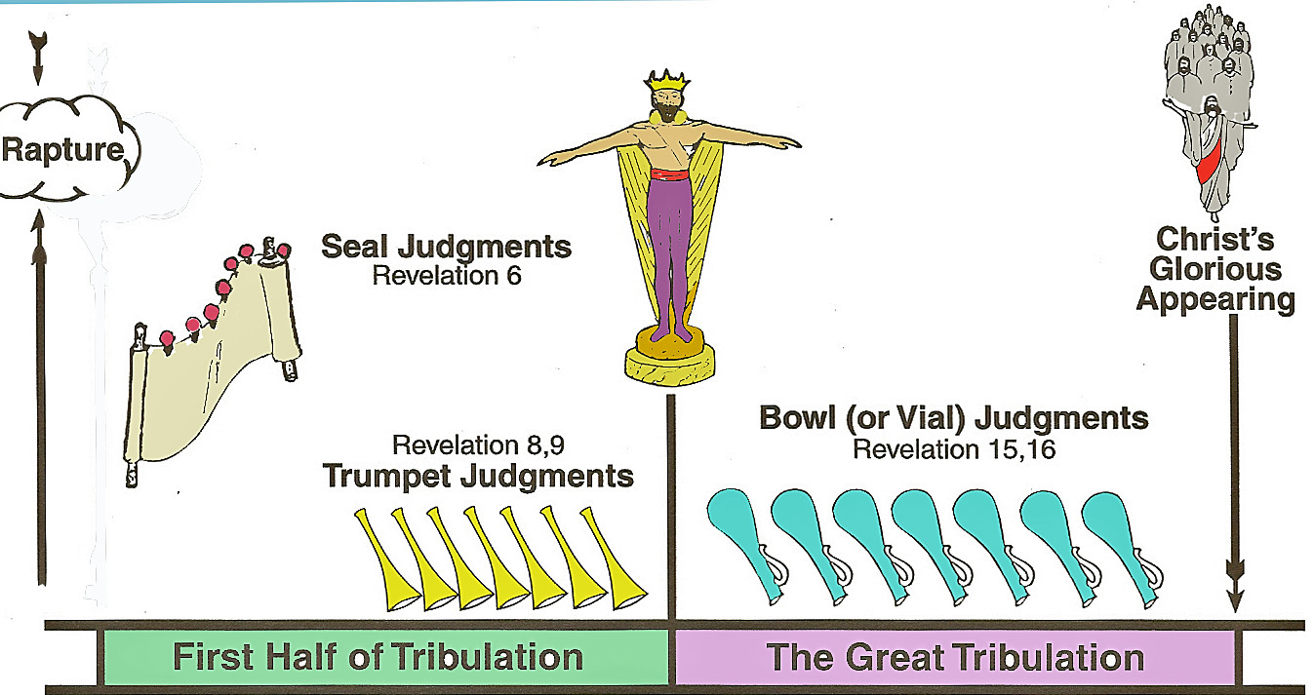
Tribulation Judgments

Slide 34
Conclusion

Slide 35
B. Nebuchadnezzar’s Humility (34-37)
Nebuchadnezzar’s Humiliation v. 34-35
Nebuchadnezzar’s Restoration v. 36-37

