Slide 1
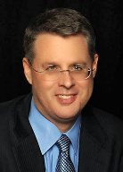
Soteriology Session 51
Dr. Andy Woods
Senior Pastor – Sugar Land Bible Church
Professor of Bible & Theology – College of Biblical Studies

Slide 2
Soteriology Overview
Definition
Election
Atonement
Salvation words
God’s one condition of salvation
Results of salvation
Eternal security
Faulty views of salvation

Slide 3
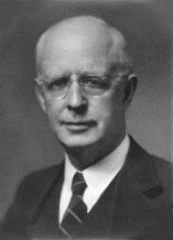
Soteriology Overview
This Session
VII. Eternal Security

Slide 4
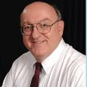
Definition of Eternal Security
“Eternal Security means that those who have been genuinely saved by God’s grace through faith alone in Christ alone shall never be in danger of God’s condemnation or loss of salvation but God’s grace and power keep them forever saved and secure.”
Dennis Rokser, Shall Never Perish Forever, p. 11

Slide 5
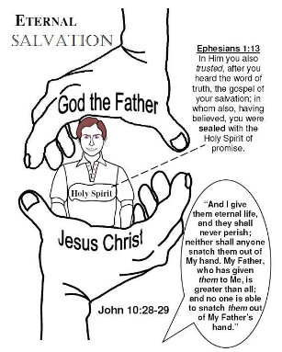
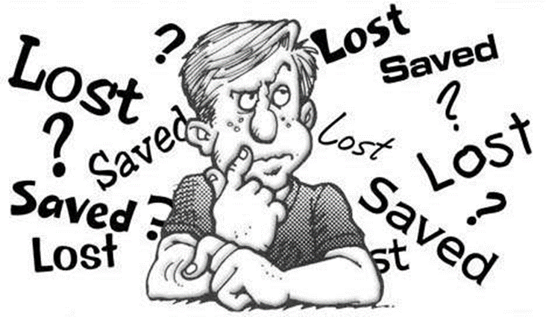
Eternal Security Outline
Eternal security arguments
Response to problem passages

Slide 6
Eternal Security Outline
Eternal security arguments
Response to problem passages

Slide 7
Eternal Security Outline
Eternal security arguments
Response to problem passages

Slide 8
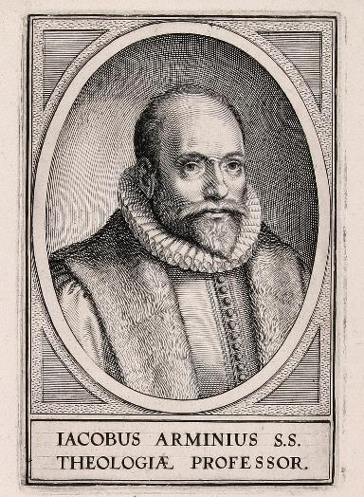
Response to Problem Passages
OT Passages
Passages from Matthew
Passages from John
Passages from Acts
Passages from Paul

Slide 9
Response to Problem Passages
Passages from James
Passages from Hebrews
Passages from 2 Peter
Passages from 1 John
Passages from Revelation
Miscellaneous argument

Slide 10
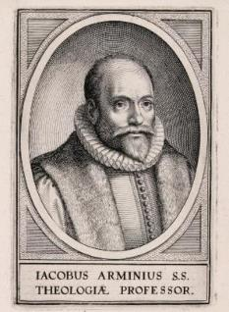
Passages from the General Letters & Revelation
Jas. 5:19-20
Heb. 3:6, 14
Heb. 5:9-10
Heb. 6:4-6
Heb. 10:26-30
Heb. 12:14
2 Pet. 1:10-11, 20-22
Jude 11
1 John 2:3
1 John 3:9
1 John 3:15
1 John 5:16
Rev. 3:5
Rev. 22:18-19

Slide 11
Passages from the General Letters & Revelation
Jas. 5:19-20
Heb. 3:6, 14
Heb. 5:9-10
Heb. 6:4-6
Heb. 10:26-30
Heb. 12:14
2 Pet. 1:10-11, 20-22
Jude 11
1 John 2:3
1 John 3:9
1 John 3:15
1 John 5:16
Rev. 3:5
Rev. 22:18-19

Slide 12
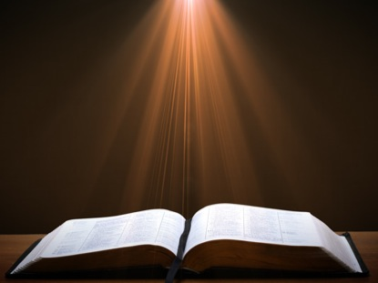
Revelation 22:18-19
“I testify to everyone who hears the words of the prophecy of this book: if anyone adds to them, God will add to him the plagues which are written in this book; ¹⁹ and if anyone takes away from the words of the book of this prophecy, God will take away his part from the tree of life and from the holy city, which are written in this book.” (NASB)

Slide 13
Revelation 22:17
“The Spirit and the bride say, ‘Come.’ And let the one who hears say, ‘Come.’ And let the one who is thirsty come; let the one who wishes take the water of life without cost.” (NASB)

Slide 14
Revelation 22:18-19
“I testify to everyone who hears the words of the prophecy of this book: if anyone adds to them, God will add to him the plagues which are written in this book; ¹⁹ and if anyone takes away from the words of the book of this prophecy, God will take away his part from the tree of life and from the holy city, which are written in this book.” (NASB)

Slide 15
2 Peter 3:16-17
“as also in all his letters, speaking in them of these things, in which are some things hard to understand, which the untaught and unstable distort, as they do also the rest of the Scriptures, to their own destruction. ¹⁷ You therefore, beloved, knowing this beforehand, be on your guard so that you are not carried away by the error of unprincipled men and fall from your own steadfastness.” (NASB)

Slide 16
Revelation 22:18-19
“I testify to everyone who hears the words of the prophecy of this book: if anyone adds to them, God will add to him the plagues which are written in this book; ¹⁹ and if anyone takes away from the words of the book of this prophecy, God will take away his part from the tree of life and ^{[i]}from the holy city, which are written in this book.” (NASB)

Slide 17
Revelation 22:18-19
“I testify to everyone who hears the words of the prophecy of this book: if anyone adds to them, God will add to him the plagues which are written in this book; ¹⁹ and if anyone takes away from the words of the book of this prophecy, God will take away his part [meros] from the tree of life and from the holy city, which are written in this book.” (NASB)

Slide 18
Revelation 20:6
“Blessed and holy is the one who has a part [meros] in the first resurrection; over these the second death has no power, but they will be priests of God and of Christ and will reign with Him for a thousand years.” (NASB)

Slide 19
Revelation 21:8
“But for the cowardly and ]unbelieving and abominable and murderers and immoral persons and sorcerers and idolaters and all liars, their part [meros] will be in the lake that burns with fire and brimstone, which is the second death.” (NASB)

Slide 20
Revelation 22:20-21
“He who testifies to these things says, ‘Yes, I am coming quickly.’ Amen. Come, Lord Jesus. The grace of the Lord Jesus be with all. Amen.” (NASB)

Slide 21
Response to Problem Passages
Passages from James
Passages from Hebrews
Passages from 2 Peter
Passages from 1 John
Passages from Revelation
Miscellaneous argument

Slide 22
Miscellaneous Argument
Allows people to live in sin without fear of losing salvation?
Ryrie A Survey of Bible Doctrine 133. “Actually one need not fear losing his salvation as long as he could be saved again by believing again. So even a doctrine of ‘insecurity’ could breed a license in living.”
Proper motivation for holy living (Rom. 12:1)

Slide 23
Romans Outline
Salutation (1:1-17)
Sin (1:18–3:20)
Salvation (3:21–5:21)
Sanctification (6–8)
Sovereignty (9–11)
Service (12:1–15:13)
Summation (15:14–16:27)

Slide 24
Romans Outline
Salutation (1:1-17)
Sin (1:18–3:20)
Salvation (3:21–5:21)
Sanctification (6–8)
Sovereignty (9–11)
Service (12:1–15:13)
Summation (15:14–16:27)

Slide 25
Sovereignty (Rom 9–11)
Israel in the past: elected (Rom 9)
Israel in the present: rejected (Rom 10)
Israel in the future: accepted (Rom 11)

Slide 26
Romans Outline
Salutation (1:1-17)
Sin (1:18–3:20)
Salvation (3:21–5:21)
Sanctification (6–8)
Sovereignty (9–11)
Service (12:1–15:13)
Summation (15:14–16:27)

Slide 27
CONCLUSION

Slide 28
Response to Problem Passages
OT Passages
Passages from Matthew
Passages from John
Passages from Acts
Passages from Paul

Slide 29
Response to Problem Passages
Passages from James
Passages from Hebrews
Passages from 2 Peter
Passages from 1 John
Passages from Revelation
Miscellaneous argument

Slide 30
Soteriology Overview
Definition
Election
Atonement
Salvation words
God’s one condition of salvation
Results of salvation
Eternal security
Faulty views of salvation

Slide 31
Unbiblical Views of Salvation
Universalism
Inclusivism

Slide 32
Unbiblical Views of Salvation
Universalism
Inclusivism

Slide 33
Unbiblical Views of Salvation
Universalism
Definition – everyone will eventually be saved
Scriptural support – John 12:32; Philip 2:11; 1 Tim 2:4; 2 Pet 3:9
Scriptural refutation – Matt 7:13-14; 13:49-50; 25:32, 34, 46; Rev 20:11-15

Slide 34
Unbiblical Views of Salvation
Universalism
Inclusivism

Slide 35
Unbiblical Views of Salvation
Inclusivism
Definition – all sincere seekers will be saved regardless of whether they know the name of Jesus Christ
Scriptural support – Acts 10:2
Scriptural refutation – Acts 11:14; John 14:6; Acts 4:12; 1 Tim 2:5; Gal 2:21

Slide 36
Unbiblical Views of Salvation
Inclusivism
Definition – all sincere seekers will be saved regardless of whether they know the name of Jesus Christ
Scriptural support – Acts 10:2
Scriptural refutation – Acts 11:14; John 14:6; Acts 4:12; 1 Tim 2:5; Gal 2:21

Slide 37
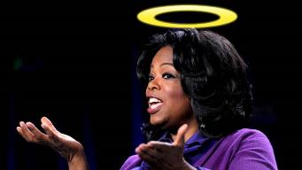
“…one of the mistakes that human beings make is believing that there is only one way…We don’t accept that there are diverse ways of being in the world; that there are millions of ways to be a human being. And many ways…many paths to what you call God. That her path might be something else and when she gets there she might call it the light. But her loving, and her kindness, and her generosity brings her to the…same point that it brings you…
www.youtube.com/watch?v=Lb2RUpMDk34

Slide 38
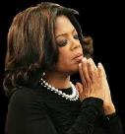
…It doesn’t matter whether she called it ‘God’ along the way or not…There couldn’t possibly be just one way!…There couldn’t possibly be only one way with millions of people in the world!...You think…if you are somewhere on the planet and you never hear the name of Jesus but yet you live with a loving heart. You lived as Jesus would have had you to live. You lived for the same purpose as Jesus came to the planet to teach us all, but you are in some remote part of the earth and you never heard the name of Jesus. You cannot get to Heaven…?”
www.youtube.com/watch?v=Lb2RUpMDk34

Slide 39
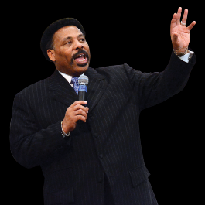
“In a class I once taught at Dallas Seminary, I inadvertently asked an exam question on material I had not covered in class. One of the students brought this discrepancy to my attention. To be fair, I had to rescore all of the test papers because I could not hold the
students liable for information they had never been given…So the premise is that God will not hold people accountable for a decision they cannot make, based on information they have not received…And people in faraway lands who have never heard the gospel still have their own sins to answer for. This means we need to talk about the provision God has made for those who cannot believe.
Tony Evans, Totally Saved: Understanding, Experiencing and Enjoying the
Greatness of Your Salvation (Chicago: Moody, 2002), 355, 359.

Slide 40
Here's the spiritual principle at work: When people respond to what they do know of God, He takes personal responsibility for giving them more information about Himself...In the case of a person who never hears the gospel and never knows the name of Jesus, but who responds to the light he has, God, treats that person like an Old Testament saint, if you will. That is, if the
person trusts in what God has revealed, God deals with that person based on the knowledge he has, not the information he never received. I call this transdispensationalism...By this I mean if a person is sincerely seeking God and desiring to know Him, and is responding to the truth he knows, if there is no missionary or direct manifestation of God, then God judges that person based on his faith in the light he has received. And as in the case of Abraham, God will retroactively count this person as righteous by applying the death of Christ from the dispensation of grace.”
Tony Evans, Totally Saved: Understanding, Experiencing and Enjoying the
Greatness of Your Salvation (Chicago: Moody, 2002), 359-361.

Slide 41
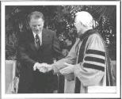
Dr. Schuller: "Tell me, what is the future of Christianity?"
Dr. Graham: "Well, Christianity and being a true believer, you know, I think there's the body of Christ which comes from all the Christian groups around the world, or outside the Christian groups. I think that everybody that loves Christ or knows Christ, whether they're conscious of it or not, they're members of the body of Christ. And I don't think that we're going to see a great sweeping revival that will turn the whole world to Christ at any time…and that’s what God is doing today. He is calling people out of the world for His name. Whether they come from the Muslim world, or the Buddhist world, or the Christian world, or the non-believing world, they are members of the body of Christ because they've been called by God. They may not even know the name of Jesus, but they know in their hearts they need something that they don't have and they turn to the only light that they have and I think they're saved and they're going to be with us in heaven.”
Dr. Schuller: "This is fantastic. I'm so thrilled to hear you say that. There's a wideness in God's mercy.”
Dr. Graham: “There is."
Hl9Aps://www.youtube.com/watch?v=hrf60-zHl9A

Slide 42
Unbiblical Views of Salvation
Inclusivism
Definition – all sincere seekers will be saved regardless of whether they know the name of Jesus Christ
Scriptural support – Acts 10:2
Scriptural refutation – Acts 11:14; John 14:6; Acts 4:12; 1 Tim 2:5; Gal 2:21

Slide 43
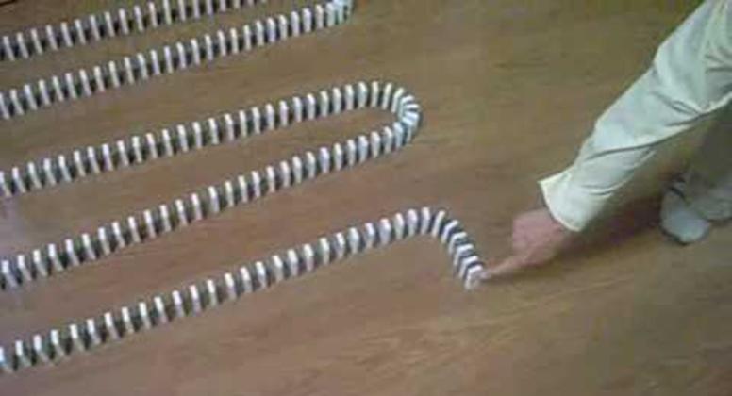
Dominoes in a Row

Slide 44
Soteriology Overview
Definition
Election
Atonement
Salvation words
God’s one condition of salvation
Results of salvation
Eternal security
Faulty views of salvation

