Slide 1
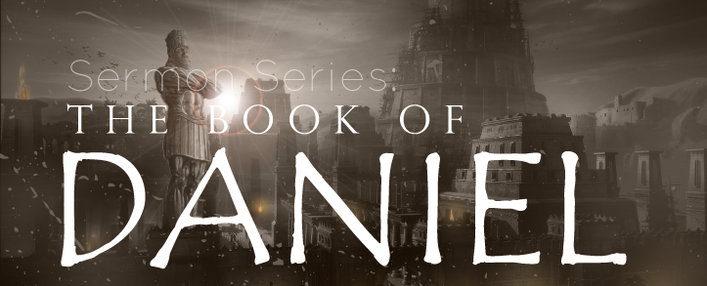
THE BOOK OF DANIEL
Dr. Andy Woods

Slide 2
Message
Times of the Gentiles are revealed prophetically (2, 7, 8-12) and ethically (1, 3-6)

Slide 3
Synthetic Outline
Historical (1-7):
Daniel interprets, 3rd person, gentile nations
Intro “Hebrew” (1)
Aramaic chiasm (2-7)

Slide 4
Synthetic Outline
Prophetic (8-12):
Angel interprets, 1st person, Jewish nation, Hebrew
Ram & Goat (8)
70 weeks (9)
Final vision (10-12)

Slide 5
Synthetic Outline
Historical (1-7):
Daniel interprets, 3rd person, gentile nations
Intro “Hebrew” (1)
Aramaic chiasm (2-7)

Slide 6
Synthetic Outline
Historical (1-7):
Daniel interprets, 3rd person, gentile nations
Intro “Hebrew” (1)
Aramaic chiasm (2-7)

Slide 7
Synthetic Outline
Chiasm “Aramaic” ( 2-7)
1. Gentile History (2)
2. Protection (3)
3. Revelation to a gentile king (4)
3. Revelation to a gentile king (5)
2. Protection (6)
1. Gentile history (7)

Slide 8
Synthetic Outline
Chiasm “Aramaic” ( 2-7)
1. Gentile History (2)
2. Protection (3)
3. Revelation to a gentile king (4)
3. Revelation to a gentile king (5)
2. Protection (6)
1. Gentile history (7)

Slide 9
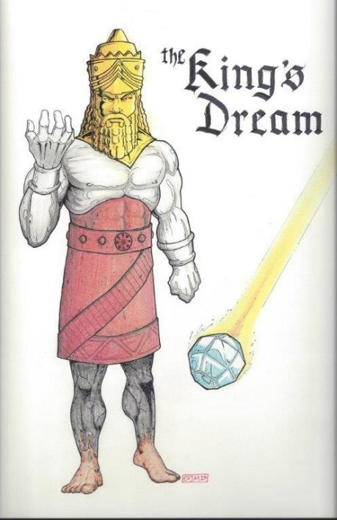
Statue
&
Stone

Slide 10
Synthetic Outline
Chiasm “Aramaic” ( 2-7)
1. Gentile History (2)
2. Protection (3)
3. Revelation to a gentile king (4)
3. Revelation to a gentile king (5)
2. Protection (6)
1. Gentile history (7)

Slide 11
Synthetic Outline
Chiasm “Aramaic” ( 2-7)
1. Gentile History (2)
2. Protection (3)
3. Revelation to a gentile king (4)
3. Revelation to a gentile king (5)
2. Protection (6)
1. Gentile history (7)

Slide 12
Synthetic Outline
Chiasm “Aramaic” ( 2-7)
1. Gentile History (2)
2. Protection (3)
3. Revelation to a gentile king (4)
3. Revelation to a gentile king (5)
2. Protection (6)
1. Gentile history (7)

Slide 13
Chapter 5 Outline
Belshazzar's contribution to the feast: unrestrained sensuality (1-4)
God’s contribution to the feast: the handwriting on the wall (5-6)
Daniel’s contribution to the feast: an announcement of doom (7-29)
Darius's contribution to the feast: the conquest of Babylon (30-31)
Ryrie Study Bible, pp. 1047-49

Slide 14
Chapter 5 Outline
Belshazzar's contribution to the feast: unrestrained sensuality (1-4)
God’s contribution to the feast: the handwriting on the wall (5-6)
Daniel’s contribution to the feast: an announcement of doom (7-29)
Darius's contribution to the feast: the conquest of Babylon (30-31)
Ryrie Study Bible, pp. 1047-49

Slide 15
Changing of the names (Dan. 1:6)
Jewish names (Deut. 6:6-7; Prov. 22:6)
Daniel – God is my judge
Hananiah – Yahweh is gracious
Mishael – Who is what God is?
Azariah – Yahweh has helped

Slide 16
Changing of the names (Dan. 1:7)
Babylonian names (Gen 2:19; Rom 12:2)
Beltshazzar – Lady protect the king
Shadrach – I am fearful of God
Meshach – I am of little account
Abed-nego – Servant of Nebo

Slide 17
Succession of Leadership
Nebuchadnezzar dies 562
His son Evil-Merodach assassinated after reigning 2 years
Neriglisar reigns for 4 years and dies
His son Laborosoarchod rules reigned 9 months before being beaten to death
Co-conspirators appoint Nabonidus
Nobonidus appoints his son Belshazzaar as co-regent

Slide 18
KINGS OF NEO-BABYLONIA
KING | DATES BC | SCRIPTURE | COMMENT
Nebuchadnezzer | 605-562 | 2 Kings 24-25; Daniel | Dies after ruling 43 years
Amel-Marduk (Evil-Merodach) [Nebuchadnezzer’s son] | 562-560 | 2 Kings 25:27-30; Jer. 52:31-34 | Murdered by Neriglissar
Neriglissar | 560-556 | Jer. 39:3, 13 | Dies
Labahi-Marduk [Neriglisser’s son] | 556 |  | Rules 2 months and is assassinated by Nabonidus
Nabonidus (Nabunaid) | 556-539
Belshazzar Nabonidus’ son (appointed as co-regent) | ?-539 BC

Slide 19
Succession of Gentile Rulers
1-4: Nebuchadnezzar of Babylon
5: Belshazzar of Babylon
6: Darius of Media – Persia
7-8: Belshazzar of Babylon
9: Darius of Media – Persia
10-12: Cyrus of Media – Persia

Slide 20
Succession of Gentile Rulers
1-4: Nebuchadnezzar of Babylon
5: Belshazzar of Babylon
6: Darius of Media – Persia
7-8: Belshazzar of Babylon
9: Darius of Media – Persia
10-12: Cyrus of Media – Persia

Slide 21
Succession of Gentile Rulers
1-4: Nebuchadnezzar of Babylon
5: Belshazzar of Babylon
6: Darius of Media – Persia
7-8: Belshazzar of Babylon
9: Darius of Media – Persia
10-12: Cyrus of Media – Persia

Slide 22
CHAPTER & VERSE IN DANIEL | CHRONOLOGICAL DATE | BIBLICAL DATE
1:1 | 605 | 3rd year of Jehoiakim
2:1 | 603 | 2nd year of Nebuchadnezzar
5 | Sat. night 10/12/539 (Hoehner)
7:1 | 553 | 1st year of Belshazzar
8:1 | 551 | 3rd year of Belshazzar
9:1 | 538 | 1st year of Darius
10:1 | 536 | 3rd year of Cyrus

Slide 23
CHAPTER & VERSE IN DANIEL | CHRONOLOGICAL DATE | BIBLICAL DATE
1:1 | 605 | 3rd year of Jehoiakim
2:1 | 603 | 2nd year of Nebuchadnezzar
5 | Sat. night 10/12/539 (Hoehner)
7:1 | 553 | 1st year of Belshazzar
8:1 | 551 | 3rd year of Belshazzar
9:1 | 538 | 1st year of Darius
10:1 | 536 | 3rd year of Cyrus

Slide 24
Daniel’s Age
CHAPTER | EVENTS | AGE
1 | Taken to Babylonian captivity | 15
2 | Interpreting Nebuchadnezzar’s 1st dream (huge image) | 17
3 | Daniel’s 3 friends cast into the fiery furnace | 19 or 20
4 | Interpreting Nebuchadnezzar’s 2nd dream (huge tree) | 45-50
5 | Interpreting handwriting of the wall at Belshazzar’s feast | Early 80’s
6 | Delivered from the den of lions | c.83
7-8 | Daniel’s visions and dreams | Mid-60’s
9 | Daniel’s seventy “sevens” prophecy | Early-80’s
10-12 | Final dreams and visions | Mid-80’s

Slide 25
Daniel’s Age
CHAPTER | EVENTS | AGE
1 | Taken to Babylonian captivity | 15
2 | Interpreting Nebuchadnezzar’s 1st dream (huge image) | 17
3 | Daniel’s 3 friends cast into the fiery furnace | 19 or 20
4 | Interpreting Nebuchadnezzar’s 2nd dream (huge tree) | 45-50
5 | Interpreting handwriting of the wall at Belshazzar’s feast | Early 80’s
6 | Delivered from the den of lions | c.83
7-8 | Daniel’s visions and dreams | Mid-60’s
9 | Daniel’s seventy “sevens” prophecy | Early-80’s
10-12 | Final dreams and visions | Mid-80’s

Slide 27
Succession of Leadership
Nebuchadnezzar dies 562
His son Evil-Merodach assassinated after reigning 2 years
Neriglisar reigns for 4 years and dies
His son Laborosoarchod rules reigned 9 months before being beaten to death
Co-conspirators appoint Nabonidus
Nobonidus appoints his son Belshazzaar as co-regent

Slide 28
KINGS OF NEO-BABYLONIA
KING | DATES BC | SCRIPTURE | COMMENT
Nebuchadnezzer | 605-562 | 2 Kings 24-25; Daniel | Dies after ruling 43 years
Amel-Marduk (Evil-Merodach) [Nebuchadnezzer’s son] | 562-560 | 2 Kings 25:27-30; Jer. 52:31-34 | Murdered by Neriglissar
Neriglissar | 560-556 | Jer. 39:3, 13 | Dies
Labahi-Marduk [Neriglisser’s son] | 556 |  | Rules 2 months and is assassinated by Nabonidus
Nabonidus (Nabunaid) | 556-539
Belshazzar Nabonidus’ son (appointed as co-regent) | ?-539 BC

Slide 30
Chapter 5 Outline
Belshazzar's contribution to the feast: unrestrained sensuality (1-4)
God’s contribution to the feast: the handwriting on the wall (5-6)
Daniel’s contribution to the feast: an announcement of doom (7-29)
Darius's contribution to the feast: the conquest of Babylon (30-31)
Ryrie Study Bible, pp. 1047-49

Slide 31
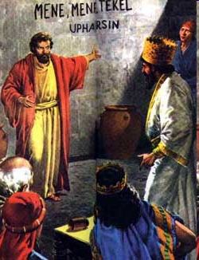
II. God’s Contribution to the Feast: The Handwriting on the Wall (5-6)
The writing v. 5
The reaction v. 6

Slide 32
II. God’s Contribution to the Feast: The Handwriting on the Wall (5-6)
The writing v. 5
The reaction v. 6

Slide 33
II. God’s Contribution to the Feast: The Handwriting on the Wall (5-6)
The writing v. 5
The reaction v. 6

Slide 34
Chapter 5 Outline
Belshazzar's contribution to the feast: unrestrained sensuality (1-4)
God’s contribution to the feast: the handwriting on the wall (5-6)
Daniel’s contribution to the feast: an announcement of doom (7-29)
Darius's contribution to the feast: the conquest of Babylon (30-31)
Ryrie Study Bible, pp. 1047-49

Slide 35
III. Daniel’s Contribution to the Feast: An Announcement of Doom (7-29)
Inability of the Chaldeans to interpret v. 7-9
Daniel’s summons v. 10-16
Daniel’s rebuke v. 17-23
Daniel interprets the writing v. 24-28
Belshazzar rewards Daniel v. 29

Slide 36
III. Daniel’s Contribution to the Feast: An Announcement of Doom (7-29)
Inability of the Chaldeans to interpret v. 7-9
Daniel’s summons v. 10-16
Daniel’s rebuke v. 17-23
Daniel interprets the writing v. 24-28
Belshazzar rewards Daniel v. 29

Slide 37
Nebuchadnezzar Demands the Revelation & Interpretation (2:2-13)
Nebuchadnezzar’s command (2:2-3)
Chaldean’s 1st response (2:4)
Nebuchadnezzar reaffirms his command (2:5-6)
Chaldean’s 2nd response (2:7)
Nebuchadnezzar reaffirms his command (2:8-9)
Chaldean’s 3rd response (2:10-11)
Nebuchadnezzar’s order for destruction (2:12-13)

Slide 38
“MYSTERY” IN HARLOT’S TITLE? REV. 17:5
And on her forehead a name was written: MYSTERY, BABYLON THE GREAT, THE MOTHER OF HARLOTS AND OF THE ABOMINATIONS OF THE EARTH. (KJV, NIV)
… and upon her forehead a name was written, a mystery, “BABYLON THE GREAT, THE MOTHER OF HARLOTS AND OF THE ABOMINATIONS OF THE EARTH.” (NASB)

Slide 39
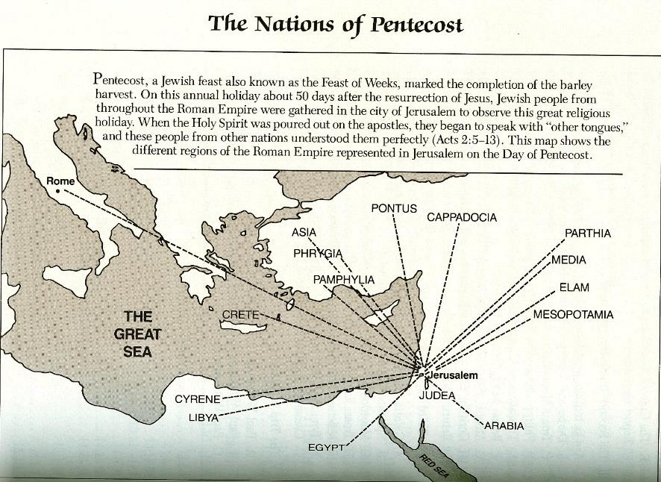

Slide 40
OT Descriptions of Babylon in Rev 17–18
 | Revelation 17–18 | Old Testament
Waters | 17:1 | Psalm 137:1
Babylon the Great | 17:5 | Daniel 4:30
Mother harlots | 17:5 | Genesis 11:1-9
Fallen, fallen is Babylon | 18:2 | Isaiah 21:9
Will not see widowhood | 18:7 | Isaiah 47:7-9
Colorful attire | 17:4; 18:16 | Daniel 5:7, 16, 29
Sorcery | 18:23 | 1saiah 47:9-13

Slide 41
OT Descriptions of Babylon in Rev 17–18
 | Revelation 17–18 | Old Testament
Waters | 17:1 | Psalm 137:1
Babylon the Great | 17:5 | Daniel 4:30
Mother harlots | 17:5 | Genesis 11:1-9
Fallen, fallen is Babylon | 18:2 | Isaiah 21:9
Will not see widowhood | 18:7 | Isaiah 47:7-9
Colorful attire | 17:4; 18:16 | Daniel 5:7, 16, 29
Sorcery | 18:23 | 1saiah 47:9-13

Slide 43
III. Daniel’s Contribution to the Feast: An Announcement of Doom (7-29)
Inability of the Chaldeans to interpret v. 7-9
Daniel’s summons v. 10-16
Daniel’s rebuke v. 17-23
Daniel interprets the writing v. 24-28
Belshazzar rewards Daniel v. 29

Slide 44
B. Daniel’s Summons (10-16)
The Queen’s advice v. 10-12
The King’s request v. 13-16

Slide 45
B. Daniel’s Summons (10-16)
The Queen’s advice v. 10-12
The King’s request v. 13-16

Slide 46
B. Daniel’s Summons (10-16)
The Queen’s advice v. 10-12
The King’s request v. 13-16

Slide 47
III. Daniel’s Contribution to the Feast: An Announcement of Doom (7-29)
Inability of the Chaldeans to interpret v. 7-9
Daniel’s summons v. 10-16
Daniel’s rebuke v. 17-23
Daniel interprets the writing v. 24-28
Belshazzar rewards Daniel v. 29

Slide 48
C. Daniel’s Rebuke (17-23)
Rejection of the King’s gifts v. 17
Reminder of Nebuchadnezzar’s judgment v. 18-21
Rehearsal of Nebuchadnezzar's sins (22-23)

Slide 49
C. Daniel’s Rebuke (17-23)
Rejection of the King’s gifts v. 17
Reminder of Nebuchadnezzar’s judgment v. 18-21
Rehearsal of Nebuchadnezzar's sins (22-23)

Slide 50
C. Daniel’s Rebuke (17-23)
Rejection of the King’s gifts v. 17
Reminder of Nebuchadnezzar’s judgment v. 18-21
Rehearsal of Nebuchadnezzar's sins (22-23)

Slide 51
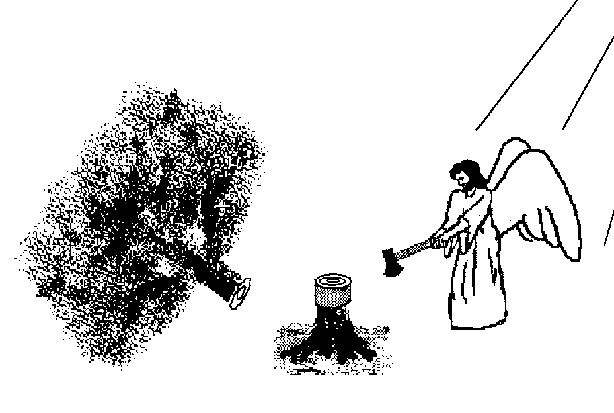

Slide 52
C. Daniel’s Rebuke (17-23)
Rejection of the King’s gifts v. 17
Reminder of Nebuchadnezzar’s judgment v. 18-21
Rehearsal of Nebuchadnezzar's sins (22-23)

Slide 53
III. Daniel’s Contribution to the Feast: An Announcement of Doom (7-29)
Inability of the Chaldeans to interpret v. 7-9
Daniel’s summons v. 10-16
Daniel’s rebuke v. 17-23
Daniel interprets the writing v. 24-28
Belshazzar rewards Daniel v. 29

Slide 54
D. Daniel Interprets the Writing (24-28)
The message v. 24-25
The meaning v. 26-28

Slide 55
D. Daniel Interprets the Writing (24-28)
The message v. 24-25
The meaning v. 26-28

Slide 56
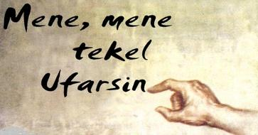
D. Daniel Interprets the Writing (24-28)

Slide 57
D. Daniel Interprets the Writing (24-28)
The message v. 24-25
The meaning v. 26-28

Slide 58
Belshazzar’s kingdom was to be taken away from him because he had been weighed in the balance of God’s justice and found wanting.

Slide 59
Statue
&
Stone

Slide 60
6 Empires
Babylon (2:36-38) 605-539 BC
Media-Persia (2:39a) 539-331 BC
Greece (2:39b) 331-63 BC
Rome I (2:40) 63 BC – 70 AD
Rome II (2:41-43) Tribulation
Kingdom (2:44-45) After 2nd Coming

Slide 61
4 Empires
Babylon (2:36-38) 605-539 BC
Media (2:39a) 539-331 BC
Persia (2:39a) 539-331 BC
Greece (2:39b) 331-63 BC

Slide 62
III. Daniel’s Contribution to the Feast: An Announcement of Doom (7-29)
Inability of the Chaldeans to interpret v. 7-9
Daniel’s summons v. 10-16
Daniel’s rebuke v. 17-23
Daniel interprets the writing v. 24-28
Belshazzar rewards Daniel v. 29

Slide 63
Chapter 5 Outline
Belshazzar's contribution to the feast: unrestrained sensuality (1-4)
God’s contribution to the feast: the handwriting on the wall (5-6)
Daniel’s contribution to the feast: an announcement of doom (7-29)
Darius's contribution to the feast: the conquest of Babylon (30-31)
Ryrie Study Bible, pp. 1047-49

Slide 64
IV. Darius’s Contribution to the Feast: The Conquest of Babylon (30-31)
Belshazzar’s death v. 30
Babylon’s fall v. 31

Slide 65
IV. Darius’s Contribution to the Feast: The Conquest of Babylon (30-31)
Belshazzar’s death v. 30
Babylon’s fall v. 31

Slide 66
IV. Darius’s Contribution to the Feast: The Conquest of Babylon (30-31)
Belshazzar’s death v. 30
Babylon’s fall v. 31

Slide 67
Statue
&
Stone

Slide 68
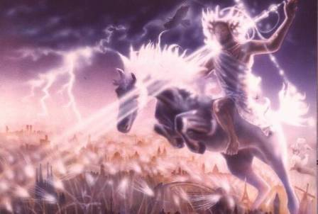
Isaiah 13-14
Day of the Lord (13:6-9)
Cosmic disturbances (13:10-13)
Global judgment (13:11-12)
Sodom and Gomorrah (13:19)
Complete and final desolation (13:20-22)
Universal peace and rest (14:5-8)
Israel’s regeneration (14:1-4)
Morris, Revelation Record, 348.

Slide 69
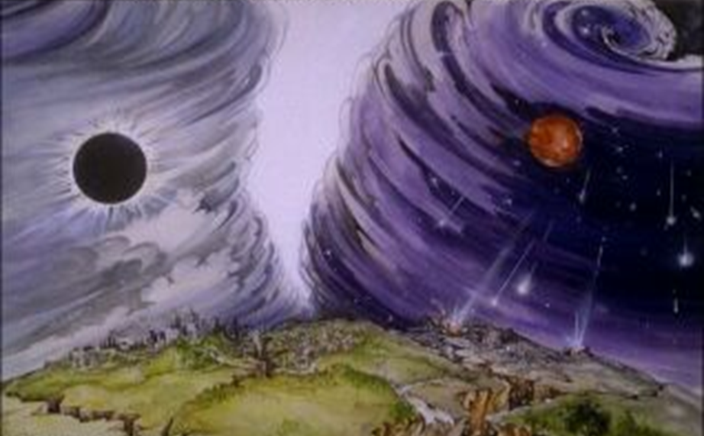
Isaiah 13/Matthew 24 Connection
Isaiah 13:10; Matthew 24:29
Isaiah 13:12; Matthew 24:21-22

Slide 70
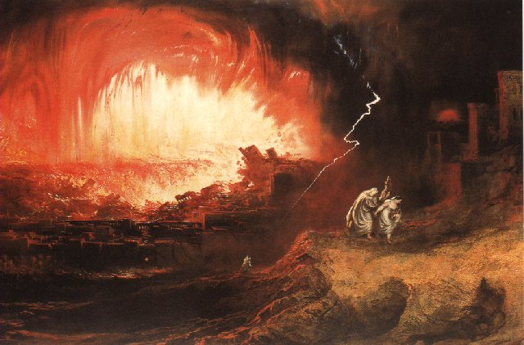
Jeremiah 50-51
Sudden destruction (51:8)
Complete destruction (50:3, 13, 26, 39-40; 51:29, 43, 62)
No reuse of building materials (51:26)
Believers flee (50:8; 51:6, 45)
Israel’s regeneration (50:2, 4-5, 20; 51:50)
Dyer, "The Identity of Babylon in Revelation 17–18 (Part 2)," 443-49.

Slide 71
Herodotus, Histories, 1:191 (450 B.C.)
“…he conducted the river by a channel into the lake…and so he made the former course of the river passable by the sinking of the stream. When this had been done, the Persians who had been posted for this very purpose entered by the bed of the river Euphrates into Babylon, the stream having sunk so far that it reached about to the middle of a man’s thigh…those Babylonians who dwelt in the middle did not know that they had been captured…”

Slide 73
Pritchard, The Ancient Near East Texts Relating to the Old Testament, 315-16.
Without any battle. . . sparing Babylon . . . any calamity. . . . I am Cyrus . . . king of Babylon. . . . When I entered Babylon . . . under jubilation and rejoicing. . . troops walked around Babylon . . . in peace, I did not allow anybody to terrorize (any place) of the [country of Sumer] and Akkad. I strove for peace in Babylon . . . and in all his (other) sacred cities. . . . I returned to (these) sacred cities on the other side of the Tigris, the sanctuaries of which have been in ruins for a long time, the images which (used) to live therein and established for them permanent sanctuaries.

Slide 74
Pritchard, The Ancient Near East Texts Relating to the Old Testament, 315-16.
I (also) gathered all their (former) inhabitants and returned (to them) their habitations. Furthermore, I resettled . . . unharmed, in their (former) chapels, the places which make them happy. May all the gods whom I have resettled in their sacred cities ask daily Bel and Nebo for a long life for me. . . all of them I resettled in a peaceful place . . . ducks and doves, . . . I endeavoured to fortify/repair their dwelling places . . .

Slide 75
Isaiah 13-14
Day of the Lord (13:6-9)
Cosmic disturbances (13:10-13)
Global judgment (13:11-12)
Sodom and Gomorrah (13:19)
Complete and final desolation (13:20-22)
Universal peace and rest (14:5-8)
Israel’s regeneration (14:1-4)
Morris, Revelation Record, 348.

Slide 76
Jeremiah 50-51
Sudden destruction (51:8)
Complete destruction (50:3, 13, 26, 39-40; 51:29, 43, 62)
No reuse of building materials (51:26)
Believers flee (50:8; 51:6, 45)
Israel’s regeneration (50:2, 4-5, 20; 51:50)
Dyer, "The Identity of Babylon in Revelation 17–18 (Part 2)," 443-49.

Slide 77
Babylon’s History After 539 B.C.
Herodotus gives Babylon’s measurements (450 B.C.)
Alexander the Great visits and dies in Babylon (323 B.C.)
Seleucus seizes Babylon (312 B.C.)
Strabo pronounces Babylon’s hanging gardens as one of “seven wonders of the world” (25 B.C)
Babylonians present on Pentecost (Acts 2:9)
Talmud promulgated from Babylon (A.D. 500)
Haukal mentions Babylonian village (A.D. 917)
Babylon known as “Two Mosques” and “Hilah” (A.D. 1100)
Hitchcock and Ice, The Truth Behind Left Behind, 109

Slide 78
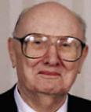
Dr. John Walvoord The Nations in Prophecy, 63-64
“As far as the historic fulfillment is concerned, it is obvious from both Scripture and history that these verses have not been literally fulfilled. The city of Babylon continued to flourish after the Medes conquered it, and though its glory dwindled, especially after the control of the Medes and the Persians ended in 323 B.C., the city continued in some form or substance until A.D. 1000 and did not experience a sudden termination such as anticipated in this prophecy.”

Slide 79
Parallels Between Jeremiah 50-51 & Revelation 17-18
 | Jeremiah | Revelation
Associated with a Golden cup | 51:7a | 17:3-4; 18:6
Dwelling on many waters | 51:13 | 17:1
Intoxicating the nations | 51:7b | 17:2
Same name | 50:1 | 17:5
Stone sinking into Euphrates | 51:63-64 | 18:21
Sudden destruction | 51:8 | 18:8
Destroyed by fire | 51:30 | 17:16
Final, uninhabitable | 50:39 | 18:21
Deserved | 50:29 | 18:6
God’s people flee | 51:6, 45 | 18:4
Heaven rejoices | 51:48 | 18:20
Dyer, "The Identity of Babylon in Revelation 17–18 (Part 2)," 441-43.

Slide 80
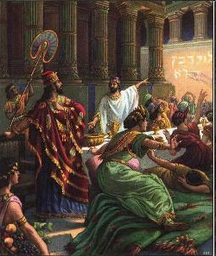
Isaiah’s Oracles Against the Nations (Isa 13–23)
Babylon (13:1-14:23)
Assyria (14:24-27)
Philistia (14:28-32)
Moab (15-16)
Damascus and Samaria (17)
Ethiopia (18)
Egypt (19-20)
Babylon (21:1-10)
Edom (21:11-12)
Arabia (21:13-17)
Jerusalem (22)
Tyre (23)

Slide 81
Isaiah’s Oracles Against the Nations (Isa 13–23)
Babylon (13:1-14:23)
Assyria (14:24-27)
Philistia (14:28-32)
Moab (15-16)
Damascus and Samaria (17)
Ethiopia (18)
Egypt (19-20)
Babylon (21:1-10)
Edom (21:11-12)
Arabia (21:13-17)
Jerusalem (22)
Tyre (23)

Slide 82
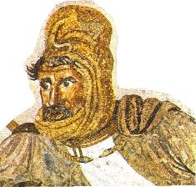
Darius the Mede?
Darius the Mede – in the Bible, a king of the Medes who succeeded to the throne of Babylonia after Belshazzar. Otherwise unknown outside biblical tradition, it is likely that this Darius has been confused with Cyrus the Persian, who succeeded Belshazzar and decreed (539 B.C.) the return of exiled Jews. He is also mentioned by Herodotus and Josephus.

Slide 83
Conclusion

Slide 84
Chapter 5 Outline
Belshazzar's contribution to the feast: unrestrained sensuality (1-4)
God’s contribution to the feast: the handwriting on the wall (5-6)
Daniel’s contribution to the feast: an announcement of doom (7-29)
Darius's contribution to the feast: the conquest of Babylon (30-31)
Ryrie Study Bible, pp. 1047-49

