Slide 1

Soteriology
Session 52
Dr. Andy Woods
Senior Pastor – Sugar Land Bible Church
Professor of Bible & Theology – College of Biblical Studies

Slide 2
Soteriology Overview
Definition
Election
Atonement
Salvation words
God’s one condition of salvation
Results of salvation
Eternal security
Faulty views of salvation

Slide 3
Soteriology Overview
Definition
Election
Atonement
Salvation words
God’s one condition of salvation
Results of salvation
Eternal security
Faulty views of salvation

Slide 4
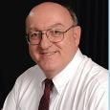
Definition of Eternal Security
“Eternal Security means that those who have been genuinely saved by God’s grace through faith alone in Christ alone shall never be in danger of God’s condemnation or loss of salvation but God’s grace and power keep them forever saved and secure.”
Dennis Rokser, Shall Never Perish Forever, p. 11

Slide 5
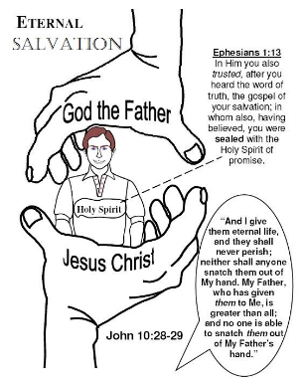
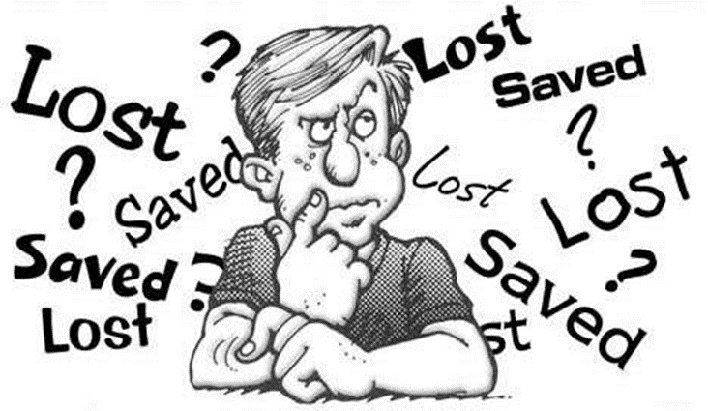
Eternal Security Outline
Eternal security arguments
Response to problem passages

Slide 6
Eternal Security Outline
Eternal security arguments
Response to problem passages

Slide 7
Eternal Security Outline
Eternal security arguments
Response to problem passages

Slide 8
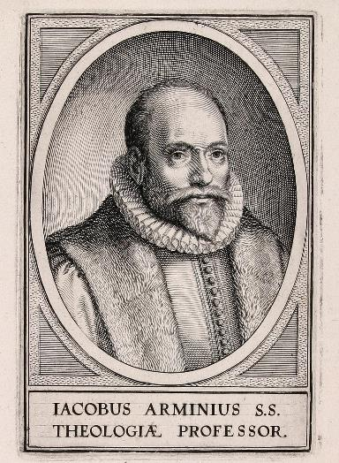
Response to Problem Passages
OT Passages
Passages from Matthew
Passages from John
Passages from Acts
Passages from Paul

Slide 9
Response to Problem Passages
Passages from James
Passages from Hebrews
Passages from 2 Peter
Passages from 1 John
Passages from Revelation
Miscellaneous argument

Slide 10
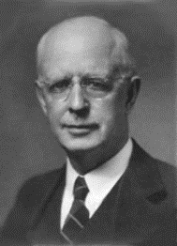
Soteriology Overview
This Session
VIII. Faulty Views of Salvation

Slide 11
Soteriology Overview
Definition
Election
Atonement
Salvation words
God’s one condition of salvation
Results of salvation
Eternal security
Faulty views of salvation

Slide 12
Unbiblical Views of Salvation
Universalism
Inclusivism

Slide 13
Unbiblical Views of Salvation
Universalism
Inclusivism

Slide 14
Unbiblical Views of Salvation
Universalism
  Definition – everyone will eventually be saved
  Scriptural support – John 12:32; Philip 2:11; 1 Tim 2:4; 2 Pet 3:9
  Scriptural refutation – Matt 7:13-14; 13:49-50; 25:32, 34, 46; Rev 20:11-15

Slide 15
Unbiblical Views of Salvation
Universalism
Inclusivism

Slide 16
Unbiblical Views of Salvation
Inclusivism
  Definition – all sincere seekers will be saved regardless of whether they know the name of Jesus Christ
  Scriptural support – Acts 10:2
  Scriptural refutation – Acts 11:14; John 14:6; Acts 4:12; 1 Tim 2:5; Gal 2:21
  Two incorrect premises – God has not revealed Himself and mankind is searching for God

Slide 17
Unbiblical Views of Salvation
Inclusivism
  Definition – all sincere seekers will be saved regardless of whether they know the name of Jesus Christ
  Scriptural support – Acts 10:2
  Scriptural refutation – Acts 11:14; John 14:6; Acts 4:12; 1 Tim 2:5; Gal 2:21
  Two incorrect premises – God has not revealed Himself and mankind is searching for God

Slide 18
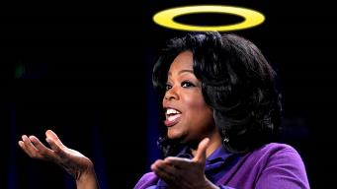
“…one of the mistakes that human beings make is believing that there is only one way…We don’t accept that there are diverse ways of being in the world; that there are millions of ways to be a human being. And many ways…many paths to what you call God. That her path might be something else and when she gets there she might call it the light. But her loving, and her kindness, and her generosity brings her to the…same point that it brings you…
www.youtube.com/watch?v=Lb2RUpMDk34

Slide 19
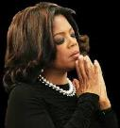
…It doesn’t matter whether she called it ‘God’ along the way or not…There couldn’t possibly be just one way!…There couldn’t possibly be only one way with millions of people in the world!...You think…if you are somewhere on the planet and you never hear the name of Jesus but yet you live with a loving heart. You lived as Jesus would have had you to live. You lived for the same purpose as Jesus came to the planet to teach us all, but you are in some remote part of the earth and you never heard the name of Jesus. You cannot get to Heaven…?”
www.youtube.com/watch?v=Lb2RUpMDk34

Slide 20
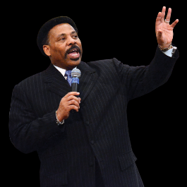
“In a class I once taught at Dallas Seminary, I inadvertently asked an exam question on material I had not covered in class. One of the students brought this discrepancy to my attention. To be fair, I had to rescore all of the test papers because I could not hold the
students liable for information they had never been given…So the premise is that God will not hold people accountable for a decision they cannot make, based on information they have not received…And people in faraway lands who have never heard the gospel still have their own sins to answer for. This means we need to talk about the provision God has made for those who cannot believe.
Tony Evans, Totally Saved: Understanding, Experiencing and Enjoying the
Greatness of Your Salvation (Chicago: Moody, 2002), 355, 359.

Slide 21

Here's the spiritual principle at work: When people respond to what they do know of God, He takes personal responsibility for giving them more information about Himself...In the case of a person who never hears the gospel and never knows the name of Jesus, but who responds to the light he has, God, treats that person like an Old Testament saint, if you will. That is, if the
person trusts in what God has revealed, God deals with that person based on the knowledge he has, not the information he never received. I call this transdispensationalism...By this I mean if a person is sincerely seeking God and desiring to know Him, and is responding to the truth he knows, if there is no missionary or direct manifestation of God, then God judges that person based on his faith in the light he has received. And as in the case of Abraham, God will retroactively count this person as righteous by applying the death of Christ from the dispensation of grace.”
Tony Evans, Totally Saved: Understanding, Experiencing and Enjoying the
Greatness of Your Salvation (Chicago: Moody, 2002), 359-361.

Slide 22
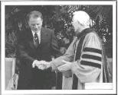
Dr. Schuller: "Tell me, what is the future of Christianity?"
Dr. Graham: "Well, Christianity and being a true believer, you know, I think there's the body of Christ which comes from all the Christian groups around the world, or outside the Christian groups. I think that everybody that loves Christ or knows Christ, whether they're conscious of it or not, they're members of the body of Christ. And I don't think that we're going to see a great sweeping revival that will turn the whole world to Christ at any time…and that’s what God is doing today. He is calling people out of the world for His name. Whether they come from the Muslim world, or the Buddhist world, or the Christian world, or the non-believing world, they are members of the body of Christ because they've been called by God. They may not even know the name of Jesus, but they know in their hearts they need something that they don't have and they turn to the only light that they have and I think they're saved and they're going to be with us in heaven.”
Dr. Schuller: "This is fantastic. I'm so thrilled to hear you say that. There's a wideness in God's mercy.”
Dr. Graham: “There is."
Hl9Aps://www.youtube.com/watch?v=hrf60-zHl9A

Slide 23
Unbiblical Views of Salvation
Inclusivism
  Definition – all sincere seekers will be saved regardless of whether they know the name of Jesus Christ
  Scriptural support – Acts 10:2
  Scriptural refutation – Acts 11:14; John 14:6; Acts 4:12; 1 Tim 2:5; Gal 2:21
  Two incorrect premises – God has not revealed Himself and mankind is searching for God

Slide 24

Acts 10:2
“Now there was a man at Caesarea named Cornelius, a centurion of what was called the Italian cohort, ² a devout man and one who feared God with all his household, and gave many alms to the Jewish people and prayed to God continually.” (NASB)

Slide 25
Unbiblical Views of Salvation
Inclusivism
  Definition – all sincere seekers will be saved regardless of whether they know the name of Jesus Christ
  Scriptural support – Acts 10:2
  Scriptural refutation – Acts 11:14; John 14:6; Acts 4:12; 1 Tim 2:5; Gal 2:21
  Two incorrect premises – God has not revealed Himself and mankind is searching for God

Slide 26
Acts 11:14
“and he will speak words to you by which you will be saved, you and all your household.” (NASB)

Slide 27
John 14:6
“Jesus said to him, ‘I am the way, and the truth, and the life; no one comes to the Father but through Me.’” (NASB)

Slide 28
Acts 4:12
“And there is salvation in no one else; for there is no other name under heaven that has been given among men by which we must [dei] be saved.” (NASB)

Slide 29
Luke 4:43
“But He said to them, “I must [dei] preach the kingdom of God to the other cities also, for I was sent for this purpose.” (NASB)

Slide 30
Luke 24:44
“Now He said to them, “These are My words which I spoke to you while I was still with you, that all things which are written about Me in the Law of Moses and the Prophets and the Psalms must [dei] be fulfilled.” (NASB)

Slide 31
1 Timothy 2:5
“For there is one God, and one mediator also between God and men, the man Christ Jesus.” (NASB)

Slide 32
Galatians 2:21
“I do not nullify the grace of God, for if righteousness comes through the Law, then Christ died needlessly.” (NASB)

Slide 33
Mathew 7:13-14
“Enter through the narrow gate; for the gate is wide and the way is broad that leads to destruction, and there are many who enter through it. ¹⁴ For the gate is small and the way is narrow that leads to life, and there are few who find it.” (NASB)

Slide 34
Unbiblical Views of Salvation
Inclusivism
  Definition – all sincere seekers will be saved regardless of whether they know the name of Jesus Christ
  Scriptural support – Acts 10:2
  Scriptural refutation – Acts 11:14; John 14:6; Acts 4:12; 1 Tim 2:5; Gal 2:21
  Two incorrect premises – God has not revealed Himself and mankind is searching for God

Slide 35
GENERAL VS. SPECIAL REVELATION
 | GENERAL | SPECIAL
EXAMPLES | Nature, conscience (Rom 1–2) | Incarnation, Scripture, miracles
AVAILABILITY | All | Some
ACCOMPLISHMENT | Accountability (Rom 1) | Salvation (Acts 4:12; 2 Tim 3:15)
FORM | Non-written | Written
QUALITY | Natural | Supernatural, miraculous
EXPECTATION | Search | Acts 8; 10

Slide 36
Romans 2:14-15
“For when Gentiles who do not have the Law do instinctively the things of the Law, these, not having the Law, are a law to themselves, ¹⁵ in that they show the work of the Law written in their hearts, their conscience bearing witness and their thoughts alternately accusing or else defending them.” (NASB)

Slide 37
Romans 1:18-20
“For the wrath of God is revealed from heaven against all ungodliness and unrighteousness of men who suppress the truth in unrighteousness, ¹⁹ because that which is known about God is evident within them; for God made it evident to them. ²⁰ For since the creation of the world His invisible attributes, His eternal power and divine nature, have been clearly seen, being understood through what has been made, so that they are without excuse.” (NASB)

Slide 38
Psalm 19:1-4
“The heavens are telling of the glory of God; And their expanse is declaring the work of His hands.² Day to day pours forth speech, And night to night reveals knowledge.³ There is no speech, nor are there words; Their voice is not heard. ⁴ Their line has gone out through all the earth, And their utterances to the end of the world. In them He has placed a tent for the sun.” (NASB)

Slide 39
Romans 1:18-20
“For the wrath of God is revealed from heaven against all ungodliness and unrighteousness of men who suppress the truth in unrighteousness, 19 because that which is known about God is evident within them; for God made it evident to them. 20 For since the creation of the world His invisible attributes, His eternal power and divine nature, have been clearly seen, being understood through what has been made, so that they are without excuse.” (NASB)

Slide 40
Romans 1:21-23
“²¹ For even though they knew God, they did not honor Him as God or give thanks, but they became futile in their speculations, and their foolish heart was darkened. ²² Professing to be wise, they became fools, ²³ and exchanged the glory of the incorruptible God for an image in the form of corruptible man and of birds and four-footed animals and crawling creatures.” (NASB)

Slide 41
Romans 3:11
“There is none who understands, There is none who seeks for God.” (NASB)

Slide 42
Genesis 3:8-10
“They heard the sound of the Lord God walking in the garden in the cool of the day, and the man and his wife hid themselves from the presence of the Lord God among the trees of the garden. ⁹ Then the Lord God called to the man, and said to him, “Where are you?” ¹⁰ He said, “I heard the sound of You in the garden, and I was afraid because I was naked; so I hid myself.” (NASB)

Slide 43
John 3:19-21
“This is the judgment, that the Light has come into the world, and men loved the darkness rather than the Light, for their deeds were evil. ²⁰ For everyone who does evil hates the Light, and does not come to the Light for fear that his deeds will be exposed. ²¹ But he who practices the truth comes to the Light, so that his deeds may be manifested as having been wrought in God.” (NASB)

Slide 44
Acts 4:12
“And there is salvation in no one else; for there is no other name under heaven that has been given among men by which we must be saved.” (NASB)

Slide 45
2 Timothy 3:15
“and that from childhood you have known the sacred writings which are able to give you the wisdom that leads to salvation through faith which is in Christ Jesus.” (NASB)

Slide 46
Romans 10:17
“So faith comes from hearing, and hearing by the word of Christ.” (NASB)

Slide 47
Luke 16:28-31
“for I have five brothers—in order that he may warn them, so that they will not also come to this place of torment.’ ²⁹ But Abraham said, ‘They have Moses and the Prophets; let them hear them.’ ³⁰ But he said, ‘No, father Abraham, but if someone goes to them from the dead, they will repent!’ ³¹ But he said to him, ‘If they do not listen to Moses and the Prophets, they will not be persuaded even if someone rises from the dead.” (NASB)

Slide 48

Dominoes in a Row

Slide 49
CONCLUSION

Slide 50
Unbiblical Views of Salvation
Inclusivism
  Definition – all sincere seekers will be saved regardless of whether they know the name of Jesus Christ
  Scriptural support – Acts 10:2
  Scriptural refutation – Acts 11:14; John 14:6; Acts 4:12; 1 Tim 2:5; Gal 2:21
  Two incorrect premises – God has not revealed Himself and mankind is searching for God

Slide 51
Soteriology Overview
Definition
Election
Atonement
Salvation words
God’s one condition of salvation
Results of salvation
Eternal security
Faulty views of salvation

Slide 52
FINAL EXAM!

