Slide 1

Soteriology
Session 53
Dr. Andy Woods
Senior Pastor – Sugar Land Bible Church
Professor of Bible & Theology – College of Biblical Studies

Slide 2
Soteriology Overview
Definition
Election
Atonement
Salvation words
God’s one condition of salvation
Results of salvation
Eternal security
Faulty views of salvation

Slide 3
FINAL EXAM!

Slide 4
Three Tenses of Salvation
Phase | Justification | Sanctification | Glorification
Tense | Past | Present | Future
Saved from sin’s: | Penalty | Power | Presence
Scripture | Eph 2:8-9; Titus 3:5 | Philip 2:12 | Rom 5:10

Slide 5
Definition & Uses
Definition – Action of God in choosing those who will be saved as members of the body of Christ
Many biblical uses
  Israel – Deut 4:37; 7:7
  Cyrus – Isa 45:1-4
  Christ – Isa 42:1
  Tribulation saints – Matt 24:22
  Believers in Christ today – Col 3:12; Titus 1:1

Slide 6
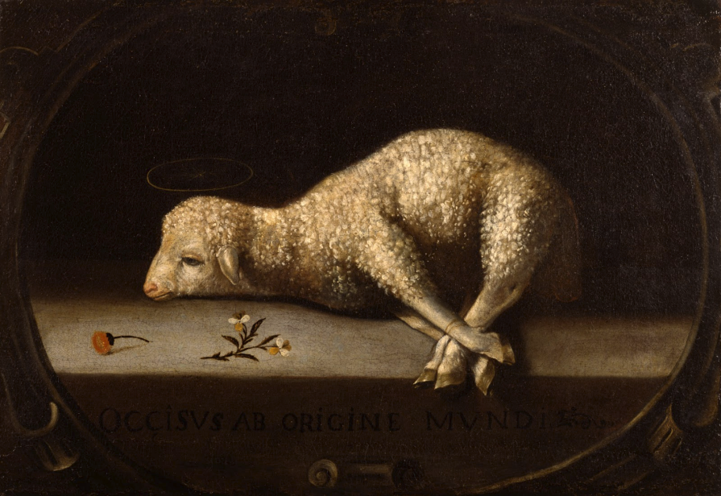
Christ’s Atoning Death
Substitution – Isa 53:3-6
Illustrations
  Secret serviceman
  Bee sting

Slide 7


Lordship Salvation Defined
“Lordship Salvation refers to the belief which says the sinner who wants to be saved must not only trust Christ as his substitute for sin, but must also surrender every area of his life to the complete control of Christ.”
Lightner, Sin, the Savior, and Salvation, 202

Slide 8
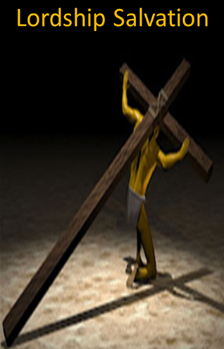
Lordship Salvation
Changes the gospel
Places an impossible burden upon the unsaved
Confuses justification with sanctification
Confuses the result of with requirement for salvation
Fails to make basic dispensational distinctions
Ignores the reality of a carnal Christian
Destroys the assurance of salvation

Slide 9

Regeneration
Definition – impartation of divine life
Needed because of spiritual death – Gen. 2:16-17; Eph. 2:1
New birth – John 3:5
If your are born once you will die twice; if you are born twice you will die once

Slide 10
Regeneration
Greek-palingenesia
Titus 3:5; Matt. 19:28
Accomplished through exposure to God’s Word – Jas.1:18; 1 Pet. 1:23; Rom. 10:17; 2 Tim. 3:15
Does regeneration precede faith? No! Result of salvation rather than its cause – John 1:12-13; 3:16; 5:24; 6:40, 47; 20:30-31

Slide 11

3 Transfers / Imputations
Adam’s Sin to All Humanity | Humanity’s Sin to Jesus Christ | Christ’s Righteousness to Believers
Hamartiology Rom. 5:12 | Christology 2 Cor. 5:21 | Soteriology Phil. 3:9

Slide 12
Unbiblical Views of Salvation
Universalism
  Definition – everyone will eventually be saved
  Scriptural support – John 12:32; Philip 2:11; 1 Tim 2:4; 2 Pet 3:9
  Scriptural refutation – Matt 7:13-14; 13:49-50; 25:32, 34, 46; Rev 20:11-15

Slide 13
Unbiblical Views of Salvation
Inclusivism
  Definition – all sincere seekers will be saved regardless of whether they know the name of Jesus Christ
  Scriptural support – Acts 10:2
  Scriptural refutation – Acts 11:14; John 14:6; Acts 4:12; 1 Tim 2:5; Gal 2:21
  Two incorrect premises – God has not revealed Himself and mankind is searching for God

Slide 14
Repentance
What repentance means
  Metanoeō / metanoia
  Meta = change (exs: metabolism, metamorphosis, metastasize
  Noeō = notion = mind
  “Change of mind”
  Change mind about whatever is preventing someone from trusting in Christ alone
  Synonym for faith (Acts 2:38; 3:19; 17:30; 2 Pet 3:9)
What repentance does NOT mean
  Feeling sorry or guilty (Heb 12:17; metamelomai)
  Turning from sin (John 4:10, 17-19)

Slide 15
Extent of the Atonement
  Limited
  Five point Calvinism – TULIP
  Biblical support
    Matt 20:28
    John 10:15
    Acts 20:28
    Eph 5:25

Slide 16
Extent of the Atonement
  Unlimited
  Biblical support
    John 1:29; 3:16-17; 4:42; 6:51; 12:32, 47; Acts 17:30; 2 Cor 5:19; 1 Tim 2:4, 6; 4:10; Titus 2:11; Heb 2:9; 1 John 2:2; 2 Pet 2:1
  Contradiction?
    John 12:19
    Only?
    Non exclusive
  Savable vs. saved
  Christ died for you!

Slide 17
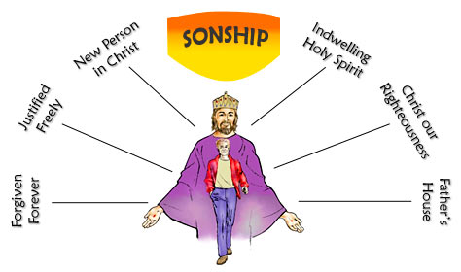
Sonship
Formerly strangers and aliens – Eph. 2:19a
New family
  Matt. 12:48-50; Eph. 2:19b
  Jesus as our “brother” – Rom. 8:29; Heb. 2:11-12
  Children of God – John 1:12-13; 1 John 3:2
  Sonship – Gal. 3:26; 4:5-7; Rom. 8:14-17; Eph. 1:5
New privileges
  Heirship-Gal. 4:7

Slide 18
Regeneration
Definition – impartation of divine life
Needed because of spiritual death – Gen. 2:16-17; Eph. 2:1
New birth – John 3:5
If your are born once you will die twice; if you are born twice you will die once

Slide 19
Regeneration
Greek-palingenesia
Titus 3:5; Matt. 19:28
Accomplished through exposure to God’s Word – Jas.1:18; 1 Pet. 1:23; Rom. 10:17; 2 Tim. 3:15
Does regeneration precede faith? No! Result of salvation rather than its cause – John 1:12-13; 3:16; 5:24; 6:40, 47; 20:30-31

Slide 20
3 Transfers / Imputations
Adam’s Sin to All Humanity | Humanity’s Sin to Jesus Christ | Christ’s Righteousness to Believers
Hamartiology Rom. 5:12 | Christology 2 Cor. 5:21 | Soteriology Phil. 3:9

Slide 21
Lordship Salvation 7 Problems
Changes the gospel
Places an impossible burden upon the unsaved
Confuses justification with sanctification
Confuses the result of with requirement for salvation
Fails to make basic dispensational distinctions
Ignores the reality of a carnal Christian
Destroys the assurance of salvation

Slide 22
Assurance of Salvation in Lordship Salvation?
TULIP
How much & how fast?
Bondage
Weather report
John 5:24; 6;47; 1 John 5:13
Bridge example

Slide 23
Divine Sovereignty
  Divine sovereignty
  Pre-temporal choice
  Unconditional
  John 6:44, 65, 69-70; 15:16; Matt 16:15-17; Acts 13:48; 16:14; Rom 8:28-30; 9:6-24; Rev 13:8; 17:8
  Those included
    Individual – Jer 1:4-5; Gal 1:15-16; Rom 16:13; 2 John 1, 13
    Group – 1 Pet 1:1-2
  Those not included – John 13:18; Rom 9:22; 1 Pet 2:8
  Product of election = good works – Jer. 1:4-5; Acts 9:15-16; Gal 1:15-16; Eph 2:10

Slide 24
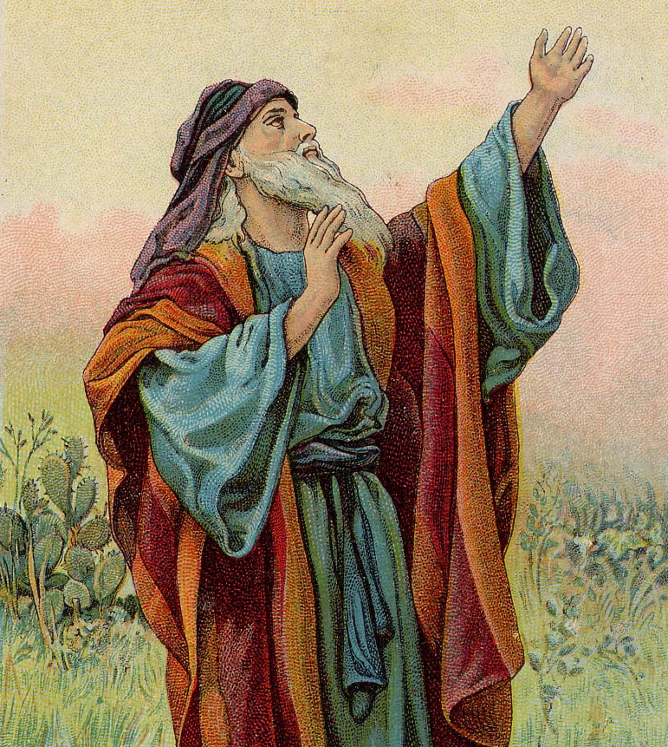
Isaiah 53:3–6
³ He was despised and forsaken of men, A man of sorrows and acquainted with grief; And like one from whom men hide their face He was despised, and we did not esteem Him. ⁴ Surely our griefs He Himself bore, And our sorrows He carried; Yet we ourselves esteemed Him stricken, Smitten of God, and afflicted. ⁵ But He was pierced through for our transgressions, He was crushed for our iniquities; The chastening for our well-being fell upon Him, And by His scourging we are healed. ⁶ All of us like sheep have gone astray, Each of us has turned to his own way; But the Lord has caused the iniquity of us all To fall on Him.

Slide 25
IV. Salvation Words
Redemption – payment of a purchase price in order to release from bondage (apolútrōsis, Rom. 3:24)
Reconciliation – change of relationship from one of hostility to one of peace (katallássō, Rom. 5:10)
Expiation – removal of sin’s eternal penalty (Ps. 103:11-12)
Propitiation – satisfaction of divine wrath (hilasmós, 1 John 2:2)
Imputation – Christ’s righteousness is transferred to us at the point of faith (Philip. 3:9)

Slide 26
God’s One Condition of Salvation
Misconceptions – multiple steps, poor word choices
Around 200 passages teach that justification is conditioned on faith alone
Why God has conditioned salvation on faith alone
What saving faith is – trust
What saving faith is not – Jas 2:19
Content of saving faith – John 8:24; 20:30-31; 1 Cor 15:1-4
An evangelistic model
Response to problem passages

Slide 27
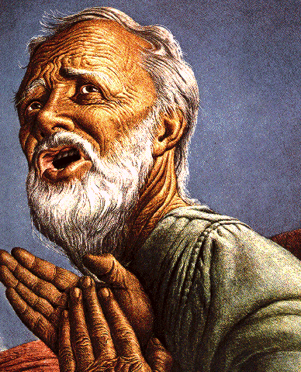
What Saving Faith is Not
Not merely intellectual assent (Jas. 2:19)
Illustrations
  Charles Blondin
  George Washington
  Airplane boarding

Slide 28
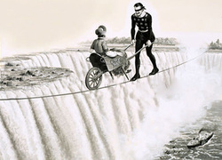

Slide 29
Lordship Salvation 7 Problems
Changes the gospel
Places an impossible burden upon the unsaved
Confuses justification with sanctification
Confuses the result of with requirement for salvation
Fails to make basic dispensational distinctions
Ignores the reality of a carnal Christian
Destroys the assurance of salvation

Slide 30
4 Kinds of People from 1 Corinthians 3:1-3
Spiritual Believers
Infant
Believers
Unbelievers
Carnal
Believers
Notes:
Ray Steadman – “1st Californians”
Unbelievers vs Categories of Believers
Unbelievers – ψυχικός psuchikós; Natural, pertaining to the natural as distinguished from the spiritual
Spiritual Believers – πνευματικός pneumatikós; of persons who are spiritual, enlightened by the Holy Spirit
Infant Believers – σάρκινος sárkinos; with propensities of the flesh unto sin; νήπιος nḗpios; an infant, child, baby without any definite limitation of age. (This relates to immaturity and lack of instruction)
Carnal Believers – σαρκικός sarkikós; tendency to satisfy the flesh, implying sinfulness, sinful propensity, carnal (This relates to disobedience and open rebellion)

Slide 31
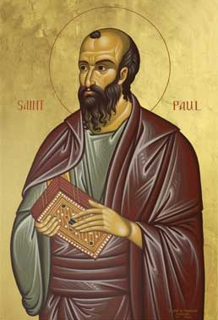
4 KINDS OF PEOPLE
1 Corinthians 3:1-3
¹ And I, brethren, could not speak to you as to spiritual people but as to carnal, as to babes in Christ. ² I fed you with milk and not with solid food; for until now you were not able to receive it, and even now you are still not able; ³ for you are still carnal. For where there are envy, strife, and divisions among you, are you not carnal and behaving like mere men? (NKJV)

Slide 32

Carnal Christianity
“an unfortunate possibility”
Exod. 19:1ff Acts 10:14 Gal. 2:11-14 Acts 19:18-19 1 Cor. 1:2, 7 | 1 Cor. 3:15 1 Cor. 6:19 1 Cor. 9:24-27 Philip. 4:2-3 Lot-Gen. 13:12; 19:4-8, 14, 30-38 vs. Gen 19:22; 2 Pet. 2:7-8

Slide 33
Evidence for Eternal Security
Because self-righteousness did not save us it is not a basis upon which salvation can be lost
Salvation is not given or maintained by works
If a believer can lose eternal life, then how can this life be eternal (John 3:16)?
The Bible’s promises guarantee security (John 10:28)
The assurance of salvation is impossible (1 John 5:14)
The believer is predestined for glory (Rom 8:29-30)
The Spirit’s seal cannot be broken (Eph 4:30)

Slide 34
Passage Conditioning Salvation on Faith Alone (Sola Fide)
Genesis 15:6
John 3:16; 5:24; 6:28-29, 47; 16:8-9; 20:30-31
Acts 16:30-31
Romans 1:16; Ephesians 2:8-9
Hebrews 11:6

Slide 35
IV. Salvation Words
Redemption – payment of a purchase price in order to release from bondage (apolútrōsis, Rom. 3:24)
Reconciliation – change of relationship from one of hostility to one of peace (katallássō, Rom. 5:10)
Expiation – removal of sin’s eternal penalty (Ps. 103:11-12)
Propitiation – satisfaction of divine wrath (hilasmós, 1 John 2:2)
Imputation – Christ’s righteousness is transferred to us at the point of faith (Philip. 3:9)

Slide 36
IV. Salvation Words
Redemption – payment of a purchase price in order to release from bondage (apolútrōsis, Rom. 3:24)
Reconciliation – change of relationship from one of hostility to one of peace (katallássō, Rom. 5:10)
Expiation – removal of sin’s eternal penalty (Ps. 103:11-12)
Propitiation – satisfaction of divine wrath (hilasmós, 1 John 2:2)
Imputation – Christ’s righteousness is transferred to us at the point of faith (Philip. 3:9)

Slide 37
Christ’s Atoning Death
Substitution – Isa 53:3-6
Illustrations
  Secret serviceman
  Bee sting

Slide 38
Isaiah 53:3–6
³ He was despised and forsaken of men, A man of sorrows and acquainted with grief; And like one from whom men hide their face He was despised, and we did not esteem Him. ⁴ Surely our griefs He Himself bore, And our sorrows He carried; Yet we ourselves esteemed Him stricken, Smitten of God, and afflicted. ⁵ But He was pierced through for our transgressions, He was crushed for our iniquities; The chastening for our well-being fell upon Him, And by His scourging we are healed. ⁶ All of us like sheep have gone astray, Each of us has turned to his own way; But the Lord has caused the iniquity of us all To fall on Him.

Slide 39
Christ’s Atoning Death
False views of the atonement
  Ransom to Satan – Christ’s death is a ransom to Satan and not the Father (A.D. 185‒54)
  Moral influence – Christ’s death is an expression of God’s love (A.D. 1079‒1142)
  Moral example – Christ’s death inspires us to be sacrificial (A.D. 1539‒1604)
  Governmental – Christ’s death promotes respect for God’s Law (A.D. 1583‒1645)
  Accidental – Fate accidently ended Christ’s life

Slide 40
God’s One Condition of Salvation
Misconceptions – multiple steps, poor word choices
Around 200 passages teach that justification is conditioned on faith alone
Why God has conditioned salvation on faith alone
What saving faith is – trust
What saving faith is not – Jas 2:19
Content of saving faith – John 8:24; 20:30-31; 1 Cor 15:1-4
An evangelistic model
Response to problem passages

Slide 41
God’s One Condition of Salvation
Misconceptions – multiple steps, poor word choices
Around 200 passages teach that justification is conditioned on faith alone
Why God has conditioned salvation on faith alone
What saving faith is – trust
What saving faith is not – Jas 2:19
Content of saving faith – John 8:24; 20:30-31; 1 Cor 15:1-4
An evangelistic model
Response to problem passages

Slide 42
Response to Problem Passages
Repent (Acts 2:38; 3:19; 17:30; 2 Pet 3:9)? Change of mind
Lordship (Matt 16:24-25)? Discipleship vs. justification
Receive/Accept Christ? – Synonym of faith (John 1:12)
Believe and work (Eph 2:8-10; Jas 2:14-26)? Sanctification
Believe and be baptized (Mark 16:15-16; John 3:5; Acts 2:38; Col 2:11-12; 1 Pet 3:21)? Context

Slide 43
Response to Problem Passages
Confession of Christ before man (Rom 10:9-10; Matt 10:32-33)? Context
Ask Jesus into your heart (Rev 3:20)? Context
Confess your sins (Matt 6:12; 1 John 1:9)? Context
Forgive others (Matt 6:14-15)? Father (6:9) vs. judge
Sell your possessions (Matt 19:21-22)? Unique situation
Prayer and saving faith? Faith expressed by the prayer saves and not merely the prayer

Slide 44
God’s One Condition of Salvation
Misconceptions – multiple steps, poor word choices
Around 200 passages teach that justification is conditioned on faith alone
Why God has conditioned salvation on faith alone
What saving faith is – trust
What saving faith is not – Jas 2:19
Content of saving faith – John 8:24; 20:30-31; 1 Cor 15:1-4
An evangelistic model
Response to problem passages

Slide 45
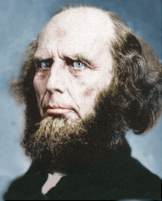
Poor Word Choices
ABC method – Admit, Believe, Confess
Miscellaneous poor word choices – confess, deny, yield, surrender, sorrow, make, ask, forsake, receive, accept, invite
Negative influence of Charles Finney

Slide 46
God’s One Condition of Salvation
Misconceptions – multiple steps, poor word choices
Around 200 passages teach that justification is conditioned on faith alone
Why God has conditioned salvation on faith alone
What saving faith is – trust
What saving faith is not – Jas 2:19
Content of saving faith – John 8:24; 20:30-31; 1 Cor 15:1-4
An evangelistic model
Response to problem passages

Slide 47
Poor Word Choices
ABC method – Admit, Believe, Confess
Miscellaneous poor word choices – confess, deny, yield, surrender, sorrow, make, ask, forsake, receive, accept, invite
Negative influence of Charles Finney

Slide 48
God’s One Condition of Salvation
Misconceptions – multiple steps, poor word choices
Around 200 passages teach that justification is conditioned on faith alone
Why God has conditioned salvation on faith alone
What saving faith is – trust
What saving faith is not – Jas 2:19
Content of saving faith – John 8:24; 20:30-31; 1 Cor 15:1-4
An evangelistic model
Response to problem passages

Slide 49
“Believe” Defined
pisteuō…“to believe,” also “to be persuaded of,” and hence, “to place confidence in, to trust,” signifies, in this sense of the word, reliance upon, not mere credence. It is most frequent in the writings of the apostle John, especially the Gospel. He does not use the noun…Of the writers of the Gospels…uses of the verb…John ninety-nine.
W. E. Vine, Merrill F. Unger, and William White, Vine's Complete Expository Dictionary of the Old and New Testament Words (Nashville: Nelson, 1996), 61.

Slide 50
Why Has God Designed
Justification by Faith Alone?
Faith in non-meritorious (Isa. 64:6; Rom. 4:4-5)
Faith is by grace and not works (Rom. 11:6)
Faith maintains God’s glory (Isa. 42:8)
Faith eliminates boasting (Rom. 3:27; Eph. 2:8-9)
Faith maintains the Gospel’s offense (Gal. 5:11)

Slide 51
Repentance
What repentance means
  Metanoeō / metanoia
  Meta = change (exs: metabolism, metamorphosis, metastasize
  Noeō = notion = mind
  “Change of mind”
  Change mind about whatever is preventing someone from trusting in Christ alone
  Synonym for faith (Acts 2:38; 3:19; 17:30; 2 Pet 3:9)
What repentance does NOT mean
  Feeling sorry or guilty (Heb 12:17; metamelomai)
  Turning from sin (John 4:10, 17-19)

Slide 52
Response to Problem Passages
Repent (Acts 2:38; 3:19; 17:30; 2 Pet 3:9)? Change of mind
Lordship (Matt 16:24-25)? Discipleship vs. justification
Receive/Accept Christ? – Synonym of faith (John 1:12)
Believe and work (Eph 2:8-10; Jas 2:14-26)? Sanctification
Believe and be baptized (Mark 16:15-16; John 3:5; Acts 2:38; Col 2:11-12; 1 Pet 3:21)? Context

Slide 53
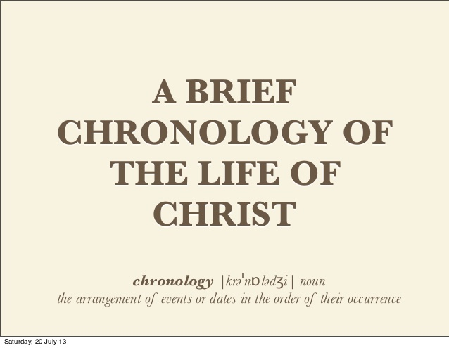
Notes:
See the Chronology of Christ's Life regarding Peter's conversion.

Slide 54
Lordship Sanctification
Believers
disciples

Slide 55
JUSTIFICATION – SALVATION | DISCIPLESHIP
FREE GIFT | COSTLY
RECEIVED THROUGH FAITH | ENTERED INTO THROUGH COMMITMENT AND OBEDIENCE THROUGH THE SPIRIT’S ENABLEMENT
NOT BY WORKS | INVOLVES OUR COOPERATION
INSTANT | LIFE-LONG PROCESS
JUSTIFICATION | SANCTIFICATION
JESUS PAID THE PRICE | BELIEVER PAYS THE PRICE
TRUSTING JESUS AS SAVIOR | FOLLOWING JESUS AS LORD
BELIEVE THE GOSPEL | OBEY THE COMMANDS
ONE CONDITION | MULTIPLE CONDITIONS
EXPERIENCED BY ALL CHRISTIANS | EXPERIENCED BY SOME CHRISTIANS
RESULTS IN ETERNAL LIFE | RESULTS IN REWARDS & AUTHORITY
Adapted from http://www.gracelife.org/resources/gracenotes.asp?id=23

Slide 56
Response to Problem Passages
Repent (Acts 2:38; 3:19; 17:30; 2 Pet 3:9)? Change of mind
Lordship (Matt 16:24-25)? Discipleship vs. justification
Receive/Accept Christ? – Synonym of faith (John 1:12)
Believe and work (Eph 2:8-10; Jas 2:14-26)? Sanctification
Believe and be baptized (Mark 16:15-16; John 3:5; Acts 2:38; Col 2:11-12; 1 Pet 3:21)? Context

Slide 57

John 1:12 (NASB)
“But as many as received Him, to them He gave the right to become children of God, even to those who believe in His name.”

Slide 58
Results of Salvation
Sonship/adoption (Gal 4:5-7; Rom 8:14-17)
Eternal life (John 3:16)
Regeneration (John 3:5; Titus 3:5)
Justification (Rom 8:33-34)
Forgiveness of all pre-cross sins (Acts 17:30; Rom 3:25)
Good works (Eph 2:8-10)
Sanctification (John 17:17)
Glorification (Rom 8:30)
End of the Law (Rom 10:4)
Miscellaneous privileges (Philip 3:20; 1 Pet 2:5, 9; Rev 19:7; 1 Pet 1:4; Rom 5:1)

Slide 59
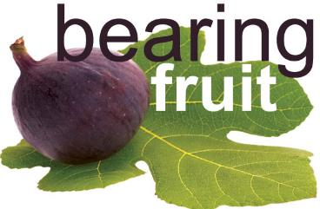
Capacity for Good Works
Good works – Ephes. 2:8-10; Jas 2:18, 26
Overcoming habitual sins that characterize unbelievers – Gal. 5:19-21; 1 Cor. 6:9-10; Eph. 5:5; Rev. 21:8; 22:15
Desirable but not automatic
  Good works – John 15:8
  Habitual Sin – 2 Pet 2:7; 1 Cor. 3:15; 6:19

Slide 60

James 2:14–26
(NASB95)
¹⁴ What use is it, my brethren, if someone says he has faith but he has no works? Can that faith save him? ¹⁵ If a brother or sister is without clothing and in need of daily food, ¹⁶ and one of you says to them, “Go in peace, be warmed and be filled,” and yet you do not give them what is necessary for their body, what use is that? ¹⁷ Even so faith, if it has no works, is dead, being by itself. ¹⁸ But someone may well say, “You have faith and I have works; show me your faith without the works, and I will show you my faith by my works.” ¹⁹ You believe that God is one. You do well; the demons also believe, and shudder. ²⁰ But are you willing to recognize, you foolish fellow, that faith without works is useless? ²¹ Was not Abraham our father justified by works when he offered up Isaac his son on the altar? ²² You see that faith was working with his works, and as a result of the works, faith was perfected; ²³ and the Scripture was fulfilled which says, “And Abraham believed God, and it was reckoned to him as righteousness,” and he was called the friend of God. ²⁴ You see that a man is justified by works and not by faith alone. ²⁵ In the same way, was not Rahab the harlot also justified by works when she received the messengers and sent them out by another way? ²⁶ For just as the body without the spirit is dead, so also faith without works is dead.

Slide 61
Harmony Between Paul and James
 | PAUL | JAMES
Issue | Self righteous Judaism | Dead orthodoxy
Justification | Declaration of innocence before God | Evidence of the believer's useful faith before man
Genesis | Gen 15:6 | Gen 22
Faith | Justification – “Abram” | Sanctification – “Abraham”
Works | Favor with God | Believer's moral deeds

Slide 62
JUSTIFICATION – SALVATION | DISCIPLESHIP
FREE GIFT | COSTLY
RECEIVED THROUGH FAITH | ENTERED INTO THROUGH COMMITMENT AND OBEDIENCE THROUGH THE SPIRIT’S ENABLEMENT
NOT BY WORKS | INVOLVES OUR COOPERATION
INSTANT | LIFE-LONG PROCESS
JUSTIFICATION | SANCTIFICATION
JESUS PAID THE PRICE | BELIEVER PAYS THE PRICE
TRUSTING JESUS AS SAVIOR | FOLLOWING JESUS AS LORD
BELIEVE THE GOSPEL | OBEY THE COMMANDS
ONE CONDITION | MULTIPLE CONDITIONS
EXPERIENCED BY ALL CHRISTIANS | EXPERIENCED BY SOME CHRISTIANS
RESULTS IN ETERNAL LIFE | RESULTS IN REWARDS & AUTHORITY
Adapted from http://www.gracelife.org/resources/gracenotes.asp?id=23

Slide 63

Believe and Be Baptized?
Problem Passages
Mark 16:15-16
John 3:5
Acts 2:38
Rom. 6:3-4 & Col. 2:11-12
1 Pet. 3:20-21

Slide 64
Evidence for Eternal Security
Because self-righteousness did not save us it is not a basis upon which salvation can be lost
Salvation is not given or maintained by works
If a believer can lose eternal life, then how can this life be eternal (John 3:16)?
The Bible’s promises guarantee security (John 10:28)
The assurance of salvation (1 John 5:14)
The believer is predestined for glory (Rom 8:29-30)
The Spirit’s seal cannot be broken (Eph 4:30)

Slide 65
Evidence for Eternal Security
God keeps us from falling (1 Pet 1:4-5)
Christ’s role as intercessor and advocate (John 17:11-12, 20)
Christ’s death perfectly dealt with all sins (Titus 2:14)
A believer cannot be removed from Christ’s body (1 Cor. 12:13)
The Bible does not specify which sins remove salvation
Believers with unfruitful lives still have salvation although lose rewards at the Bema Seat (1 Cor 3:15)

Slide 66
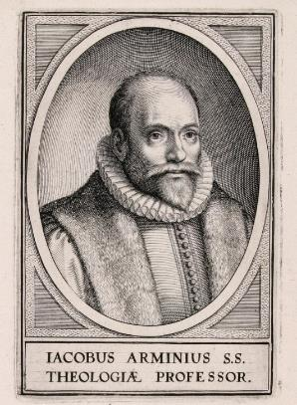
2. Passages From Matthew
Matt. 6:14-15
Matt. 7:21-23
Matt. 8:11-12; 25:30
Matt. 10:32-33
Matt. 12:31-32
Matt. 24:13
Matt. 25:41

Slide 67
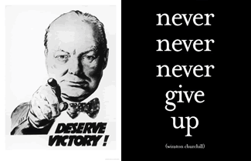
Matt. 24:13 (NASB)
“But the one who endures to the end, he will be saved.”

Slide 68
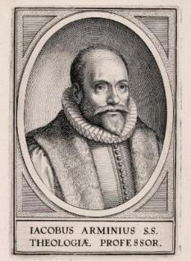
5. Passages From Paul
Gal. 5:4
Gal. 5:19-21
Rom. 8:13
1 Cor. 8:11
1 Cor. 9:24-27
1 Cor. 11:28-30, 32
1 Cor. 15:2
2 Cor. 13:5
Gal. 5:19-21
Philip. 2:12
Col. 1:23
1 Tim. 5:15
2 Tim. 2:12
2 Tim. 4:10

Slide 69
Galatians 5:4 (NASB)
“You have been severed from Christ, you who are seeking to be justified by law; you have fallen from grace.”

Slide 70
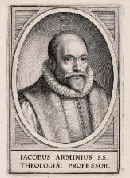
a. Galatians 5:4
The Galatians were believers (4:6; 5:16)
Three types of Pharisees
Galatians is a spiritual life book (3:3)
The Galatians were missing God’s grace in the middle tense of their salvation (not the first tense)
Reverting to a performance based relationship in daily living is quite a fall from grace
Galatians 5:4 does not teach a loss of salvation

Slide 71
5. Passages From Paul
Gal. 5:4
Gal. 5:19-21
Rom. 8:13
1 Cor. 8:11
1 Cor. 9:24-27
1 Cor. 11:28-30, 32
1 Cor. 15:2
2 Cor. 13:5
Philip. 2:12
Col. 1:23
1 Tim. 5:15
2 Tim. 2:12
2 Tim. 4:10

Slide 72
Philippians 2:12 (NASB)
“So then, my beloved, just as you have always obeyed, not as in my presence only, but now much more in my absence, work out your salvation with fear and trembling.”

Slide 73
Three Tenses of Salvation
Phase | Justification | Sanctification | Glorification
Tense | Past | Present | Future
Saved from sin’s: | Penalty | Power | Presence
Scripture | Eph 2:8-9; Titus 3:5 | Philip 2:12 | Rom 5:10

Slide 74
Three Tenses of Salvation
Phase | Justification | Sanctification | Glorification
Tense | Past | Present | Future
Saved from sin’s: | Penalty | Power | Presence
Scripture | Eph 2:8-9; Titus 3:5 | Philip 2:12 | Rom 5:10

Slide 75
Three Tenses of Salvation
Phase | Justification | Sanctification | Glorification
Tense | Past | Present | Future
Saved from sin’s: | Penalty | Power | Presence
Scripture | Eph 2:8-9; Titus 3:5 | Philip 2:12 | Rom 5:10

Slide 76
Philippians 2:12
Middle tense of salvation
Immediate context – Philippians 2:14-16
Overall context – Philippians 4:2-3

Slide 77
Passages from the General Letters & Revelation
Jas. 5:19-20
Heb. 3:6, 14
Heb. 5:9-10
Heb. 6:4-6
Heb. 10:26-30
Heb. 12:14
2 Pet. 1:10-11, 20-22
Jude 11
1 John 2:3
1 John 3:9
1 John 3:15
1 John 5:16
Rev. 3:5
Rev. 22:18-19

Slide 78
1 John 5:16-17
“If anyone sees his brother committing a sin not leading to death, he shall ask and God will for him give life to those who commit sin not leading to death. There is a sin leading to death; I do not say that he should make request for this. ¹⁷ All unrighteousness is sin, and there is a sin not leading to death.” (NASB)

Slide 79
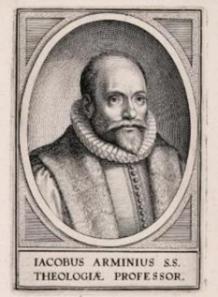
1 John 5:16-17
Sin brings death
  Rom. 6:23
  Jas. 1:14-16
Maximum divine discipline
  Acts 5:1-11
  1 Cor. 11:30
  1 John 5:16-17
  Rev. 2:22-23

Slide 80
Passages from the General Letters & Revelation
Jas. 5:19-20
Heb. 3:6, 14
Heb. 5:9-10
Heb. 6:4-6
Heb. 10:26-30
Heb. 12:14
2 Pet. 1:10-11
2 Pet. 2:20-22
1 John 2:3
1 John 3:9
1 John 3:15
1 John 5:16
Rev. 3:5
Rev. 22:18-19

Slide 81
2 Peter 1:10-11
“Therefore, brethren, be all the more diligent to make certain about His calling and choosing you; for as long as you practice these things, you will never stumble; ¹¹ for in this way the entrance into the eternal kingdom of our Lord and Savior Jesus Christ will be abundantly supplied to you.” (NASB)

Slide 82
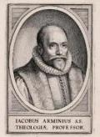
2 Peter 1:10-11
Diligence in the Christian life does not make the believer more secure
However, it can deepen inward assurance
“Abundant entrance into the kingdom”-some believers will be saved but have little reward (1 Cor. 3:15; 2 John 8; Rev. 3:11)
Our ultimate assurance comes from Christ’s promises (John 5:24; 6:47)

Slide 83
Lordship Salvation 7 Problems
Changes the gospel
Places an impossible burden upon the unsaved
Confuses justification with sanctification
Confuses the result of with requirement for salvation
Fails to make basic dispensational distinctions
Ignores the reality of a carnal Christian
Destroys the assurance of salvation

Slide 84
4 Kinds of People from 1 Corinthians 3:1-3
Spiritual Believers
Infant
Believers
Unbelievers
Carnal
Believers
Notes:
Ray Steadman – “1st Californians”
Unbelievers vs Categories of Believers
Unbelievers – ψυχικός psuchikós; Natural, pertaining to the natural as distinguished from the spiritual
Spiritual Believers – πνευματικός pneumatikós; of persons who are spiritual, enlightened by the Holy Spirit
Infant Believers – σάρκινος sárkinos; with propensities of the flesh unto sin; νήπιος nḗpios; an infant, child, baby without any definite limitation of age. (This relates to immaturity and lack of instruction)
Carnal Believers – σαρκικός sarkikós; tendency to satisfy the flesh, implying sinfulness, sinful propensity, carnal (This relates to disobedience and open rebellion)

Slide 85
4 KINDS OF PEOPLE
1 Corinthians 3:1-3
¹ And I, brethren, could not speak to you as to spiritual people but as to carnal, as to babes in Christ. ² I fed you with milk and not with solid food; for until now you were not able to receive it, and even now you are still not able; ³ for you are still carnal. For where there are envy, strife, and divisions among you, are you not carnal and behaving like mere men? (NKJV)

Slide 86
Carnal Christianity
“an unfortunate possibility”
Exod. 19:1ff Acts 10:14 Gal. 2:11-14 Acts 19:18-19 1 Cor. 1:2, 7 | 1 Cor. 3:15 1 Cor. 6:19 1 Cor. 9:24-27 Philip. 4:2-3 Lot-Gen. 13:12; 19:4-8, 14, 30-38 vs. Gen 19:22; 2 Pet. 2:7-8

Slide 87
CONCLUSION

Slide 88
Soteriology Overview
Definition
Election
Atonement
Salvation words
God’s one condition of salvation
Results of salvation
Eternal security
Faulty views of salvation

