Slide 1
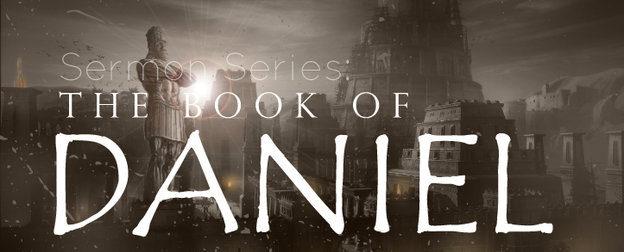
THE BOOK OF DANIEL
Dr. Andy Woods

Slide 2
Message
Times of the Gentiles are revealed prophetically (2, 7, 8-12) and ethically (1, 3-6)

Slide 3
Synthetic Outline
Historical (1-7):
Daniel interprets, 3rd person, gentile nations
Intro “Hebrew” (1)
Aramaic chiasm (2-7)

Slide 4
Synthetic Outline
Prophetic (8-12):
Angel interprets, 1st person, Jewish nation, Hebrew
Ram & Goat (8)
70 weeks (9)
Final vision (10-12)

Slide 5
Synthetic Outline
Historical (1-7):
Daniel interprets, 3rd person, gentile nations
Intro “Hebrew” (1)
Aramaic chiasm (2-7)

Slide 6
Synthetic Outline
Historical (1-7):
Daniel interprets, 3rd person, gentile nations
Intro “Hebrew” (1)
Aramaic chiasm (2-7)

Slide 7
Synthetic Outline
Chiasm “Aramaic” ( 2-7)
1. Gentile History (2)
2. Protection (3)
3. Revelation to a gentile king (4)
3. Revelation to a gentile king (5)
2. Protection (6)
1. Gentile history (7)

Slide 8
Synthetic Outline
Chiasm “Aramaic” ( 2-7)
1. Gentile History (2)
2. Protection (3)
3. Revelation to a gentile king (4)
3. Revelation to a gentile king (5)
2. Protection (6)
1. Gentile history (7)

Slide 9
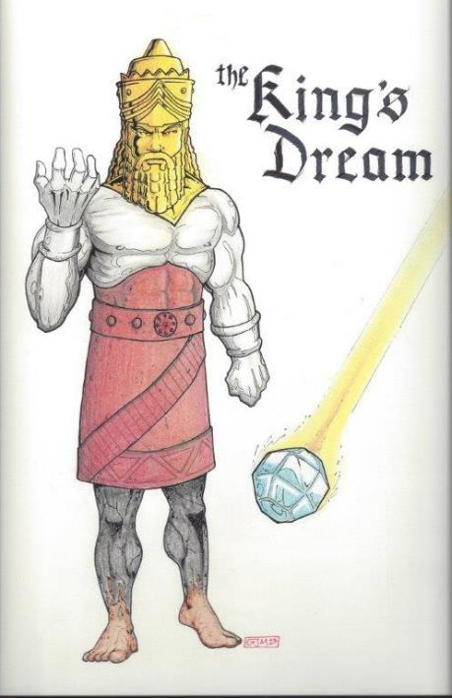
Statue
&
Stone

Slide 10
Synthetic Outline
Chiasm “Aramaic” ( 2-7)
1. Gentile History (2)
2. Protection (3)
3. Revelation to a gentile king (4)
3. Revelation to a gentile king (5)
2. Protection (6)
1. Gentile history (7)

Slide 11
Synthetic Outline
Chiasm “Aramaic” ( 2-7)
1. Gentile History (2)
2. Protection (3)
3. Revelation to a gentile king (4)
3. Revelation to a gentile king (5)
2. Protection (6)
1. Gentile history (7)

Slide 12
Synthetic Outline
Chiasm “Aramaic” ( 2-7)
1. Gentile History (2)
2. Protection (3)
3. Revelation to a gentile king (4)
3. Revelation to a gentile king (5)
2. Protection (6)
1. Gentile history (7)

Slide 13
Succession of Gentile Rulers
1-4: Nebuchadnezzar of Babylon
5: Belshazzar of Babylon
6: Darius of Media – Persia
7-8: Belshazzar of Babylon
9: Darius of Media – Persia
10-12: Cyrus of Media – Persia

Slide 14
Succession of Gentile Rulers
1-4: Nebuchadnezzar of Babylon
5: Belshazzar of Babylon
6: Darius of Media – Persia
7-8: Belshazzar of Babylon
9: Darius of Media – Persia
10-12: Cyrus of Media – Persia

Slide 15
CHAPTER & VERSE IN DANIEL | CHRONOLOGICAL DATE | BIBLICAL DATE
1:1 | 605 | 3rd year of Jehoiakim
2:1 | 603 | 2nd year of Nebuchadnezzar
5 | Sat. night 10/12/539 (Hoehner)
7:1 | 553 | 1st year of Belshazzar
8:1 | 551 | 3rd year of Belshazzar
9:1 | 538 | 1st year of Darius
10:1 | 536 | 3rd year of Cyrus

Slide 16
Daniel’s Age
CHAPTER | EVENTS | AGE
1 | Taken to Babylonian captivity | 15
2 | Interpreting Nebuchadnezzar’s 1st dream (huge image) | 17
3 | Daniel’s 3 friends cast into the fiery furnace | 19 or 20
4 | Interpreting Nebuchadnezzar’s 2nd dream (huge tree) | 45-50
5 | Interpreting handwriting of the wall at Belshazzar’s feast | Early 80’s
6 | Delivered from the den of lions | c.83
7-8 | Daniel’s visions and dreams | Mid-60’s
9 | Daniel’s seventy “sevens” prophecy | Early-80’s
10-12 | Final dreams and visions | Mid-80’s

Slide 17
Chapter 5 Outline
Belshazzar's contribution to the feast: unrestrained sensuality (1-4)
God’s contribution to the feast: the handwriting on the wall (5-6)
Daniel’s contribution to the feast: an announcement of doom (7-29)
Darius's contribution to the feast: the conquest of Babylon (30-31)
Ryrie Study Bible, pp. 1047-49

Slide 18
Chapter 5 Outline
Belshazzar's contribution to the feast: unrestrained sensuality (1-4)
God’s contribution to the feast: the handwriting on the wall (5-6)
Daniel’s contribution to the feast: an announcement of doom (7-29)
Darius's contribution to the feast: the conquest of Babylon (30-31)
Ryrie Study Bible, pp. 1047-49

Slide 20
Chapter 5 Outline
Belshazzar's contribution to the feast: unrestrained sensuality (1-4)
God’s contribution to the feast: the handwriting on the wall (5-6)
Daniel’s contribution to the feast: an announcement of doom (7-29)
Darius's contribution to the feast: the conquest of Babylon (30-31)
Ryrie Study Bible, pp. 1047-49

Slide 21
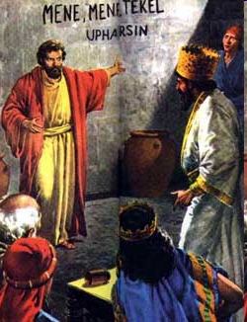
II. God’s Contribution to the Feast: The Handwriting on the Wall (5-6)
The writing v. 5
The reaction v. 6

Slide 22
Chapter 5 Outline
Belshazzar's contribution to the feast: unrestrained sensuality (1-4)
God’s contribution to the feast: the handwriting on the wall (5-6)
Daniel’s contribution to the feast: an announcement of doom (7-29)
Darius's contribution to the feast: the conquest of Babylon (30-31)
Ryrie Study Bible, pp. 1047-49

Slide 23
III. Daniel’s Contribution to the Feast: An Announcement of Doom (7-29)
Inability of the Chaldeans to interpret v. 7-9
Daniel’s summons v. 10-16
Daniel’s rebuke v. 17-23
Daniel interprets the writing v. 24-28
Belshazzar rewards Daniel v. 29

Slide 24
III. Daniel’s Contribution to the Feast: An Announcement of Doom (7-29)
Inability of the Chaldeans to interpret v. 7-9
Daniel’s summons v. 10-16
Daniel’s rebuke v. 17-23
Daniel interprets the writing v. 24-28
Belshazzar rewards Daniel v. 29

Slide 25
Nebuchadnezzar Demands the Revelation & Interpretation (2:2-13)
Nebuchadnezzar’s command (2:2-3)
Chaldean’s 1st response (2:4)
Nebuchadnezzar reaffirms his command (2:5-6)
Chaldean’s 2nd response (2:7)
Nebuchadnezzar reaffirms his command (2:8-9)
Chaldean’s 3rd response (2:10-11)
Nebuchadnezzar’s order for destruction (2:12-13)

Slide 26
III. Daniel’s Contribution to the Feast: An Announcement of Doom (7-29)
Inability of the Chaldeans to interpret v. 7-9
Daniel’s summons v. 10-16
Daniel’s rebuke v. 17-23
Daniel interprets the writing v. 24-28
Belshazzar rewards Daniel v. 29

Slide 27
III. Daniel’s Contribution to the Feast: An Announcement of Doom (7-29)
Inability of the Chaldeans to interpret v. 7-9
Daniel’s summons v. 10-16
Daniel’s rebuke v. 17-23
Daniel interprets the writing v. 24-28
Belshazzar rewards Daniel v. 29

Slide 28
C. Daniel’s Rebuke (17-23)
Rejection of the King’s gifts v. 17
Reminder of Nebuchadnezzar’s judgment v. 18-21
Rehearsal of Nebuchadnezzar's sins (22-23)

Slide 29
III. Daniel’s Contribution to the Feast: An Announcement of Doom (7-29)
Inability of the Chaldeans to interpret v. 7-9
Daniel’s summons v. 10-16
Daniel’s rebuke v. 17-23
Daniel interprets the writing v. 24-28
Belshazzar rewards Daniel v. 29

Slide 30
D. Daniel Interprets the Writing (24-28)
The message v. 24-25
The meaning v. 26-28

Slide 31
D. Daniel Interprets the Writing (24-28)
The message v. 24-25
The meaning v. 26-28

Slide 32
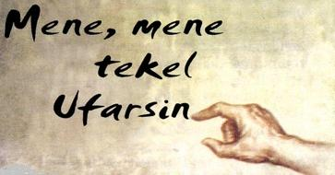
D. Daniel Interprets the Writing (24-28)

Slide 33
D. Daniel Interprets the Writing (24-28)
The message v. 24-25
The meaning v. 26-28

Slide 34
Belshazzar’s kingdom was to be taken away from him because he had been weighed in the balance of God’s justice and found wanting.

Slide 35
Statue
&
Stone

Slide 36
6 Empires
Four historical
Babylon (2:36-38) 605-539 BC
Media-Persia (2:39a) 539-331 BC
Greece (2:39b) 331-63 BC
Rome I (2:40) 63 BC – 70 AD
Two future
Rome II (2:41-43) Tribulation
Kingdom (2:44-45) After 2nd Coming

Slide 37
4 Empires
Babylon (2:36-38) 605-539 BC
Media (2:39a) 539-331 BC
Persia (2:39a) 539-331 BC
Greece (2:39b) 331-63 BC

Slide 38
III. Daniel’s Contribution to the Feast: An Announcement of Doom (7-29)
Inability of the Chaldeans to interpret v. 7-9
Daniel’s summons v. 10-16
Daniel’s rebuke v. 17-23
Daniel interprets the writing v. 24-28
Belshazzar rewards Daniel v. 29

Slide 39
Chapter 5 Outline
Belshazzar's contribution to the feast: unrestrained sensuality (1-4)
God’s contribution to the feast: the handwriting on the wall (5-6)
Daniel’s contribution to the feast: an announcement of doom (7-29)
Darius's contribution to the feast: the conquest of Babylon (30-31)
Ryrie Study Bible, pp. 1047-49

Slide 40
IV. Darius’s Contribution to the Feast: The Conquest of Babylon (30-31)
Belshazzar’s death v. 30
Babylon’s fall v. 31

Slide 41
IV. Darius’s Contribution to the Feast: The Conquest of Babylon (30-31)
Belshazzar’s death v. 30
Babylon’s fall v. 31

Slide 42
IV. Darius’s Contribution to the Feast: The Conquest of Babylon (30-31)
Belshazzar’s death v. 30
Babylon’s fall v. 31

Slide 43
Important Lessons (30-31)
The historicity of the events
The folly of false security
The reliability of predictive prophecy
The sovereignty of God
A reminder of Babylon’s future

Slide 44
Important Lessons (30-31)
The historicity of the events
The folly of false security
The reliability of predictive prophecy
The sovereignty of God
A reminder of Babylon’s future

Slide 45
Important Lessons (30-31)
The historicity of the events
The folly of false security
The reliability of predictive prophecy
The sovereignty of God
A reminder of Babylon’s future

Slide 46
Important Lessons (30-31)
The historicity of the events
The folly of false security
The reliability of predictive prophecy
The sovereignty of God
A reminder of Babylon’s future

Slide 47
Statue
&
Stone

Slide 48
Important Lessons (30-31)
The historicity of the events
The folly of false security
The reliability of predictive prophecy
The sovereignty of God
A reminder of Babylon’s future

Slide 49
Daniel 2:21 (NASB)
“It is He who changes the times and the epochs; He removes kings and establishes kings; He gives wisdom to wise men And knowledge to men of understanding.”

Slide 50
Important Lessons (30-31)
The historicity of the events
The folly of false security
The reliability of predictive prophecy
The sovereignty of God
A reminder of Babylon’s future

Slide 51
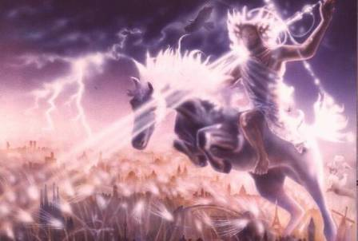
Isaiah 13-14
Day of the Lord (13:6-9)
Cosmic disturbances (13:10-13)
Global judgment (13:11-12)
Sodom and Gomorrah (13:19)
Complete and final desolation (13:20-22)
Universal peace and rest (14:5-8)
Israel’s regeneration (14:1-4)
Morris, Revelation Record, 348.

Slide 52
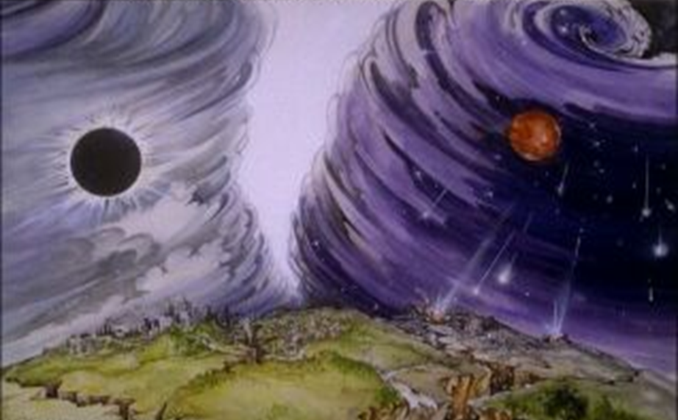
Isaiah 13/Matthew 24 Connection
Isaiah 13:10; Matthew 24:29
Isaiah 13:12; Matthew 24:21-22

Slide 53
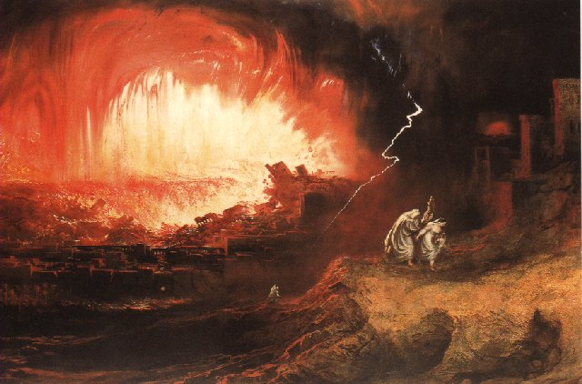
Jeremiah 50-51
Sudden destruction (51:8)
Complete destruction (50:3, 13, 26, 39-40; 51:29, 43, 62)
No reuse of building materials (51:26)
Believers flee (50:8; 51:6, 45)
Israel’s regeneration (50:2, 4-5, 20; 51:50)
Dyer, "The Identity of Babylon in Revelation 17–18 (Part 2)," 443-49.

Slide 54
Herodotus, Histories, 1:191 (450 B.C.)
“…he conducted the river by a channel into the lake…and so he made the former course of the river passable by the sinking of the stream. When this had been done, the Persians who had been posted for this very purpose entered by the bed of the river Euphrates into Babylon, the stream having sunk so far that it reached about to the middle of a man’s thigh…those Babylonians who dwelt in the middle did not know that they had been captured…”

Slide 56
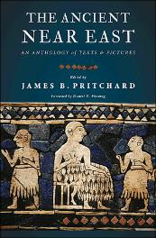
James Pritchard The Ancient Near East Texts Relating to the Old Testament, 315-16.
Without any battle. . . sparing Babylon . . . any calamity.... I am Cyrus...king of Babylon....When I entered Babylon...under jubilation and rejoicing...troops walked around Babylon...in peace, I did not allow anybody to terrorize (any place) of the [country of Sumer] and Akkad. I strove for peace in Babylon...and in all his (other) sacred cities....I returned to (these) sacred cities on the other side of the Tigris, the sanctuaries of which have been in ruins for a long time, the images which (used) to live therein and established for them permanent sanctuaries.

Slide 57
James Pritchard The Ancient Near East Texts Relating to the Old Testament, 315-16.
I (also) gathered all their (former) inhabitants and returned (to them) their habitations. Furthermore, I resettled... unharmed, in their (former) chapels, the places which make them happy. May all the gods whom I have resettled in their sacred cities ask daily Bel and Nebo for a long life for me...all of them I resettled in a peaceful place... ducks and doves,...I endeavoured to fortify/repair their dwelling places . . .

Slide 58
Isaiah 13-14
Day of the Lord (13:6-9)
Cosmic disturbances (13:10-13)
Global judgment (13:11-12)
Sodom and Gomorrah (13:19)
Complete and final desolation (13:20-22)
Universal peace and rest (14:5-8)
Israel’s regeneration (14:1-4)
Morris, Revelation Record, 348.

Slide 59
Jeremiah 50-51
Sudden destruction (51:8)
Complete destruction (50:3, 13, 26, 39-40; 51:29, 43, 62)
No reuse of building materials (51:26)
Believers flee (50:8; 51:6, 45)
Israel’s regeneration (50:2, 4-5, 20; 51:50)
Dyer, "The Identity of Babylon in Revelation 17–18 (Part 2)," 443-49.

Slide 60
Babylon’s History After 539 B.C.
Herodotus gives Babylon’s measurements (450 B.C.)
Alexander the Great visits and dies in Babylon (323 B.C.)
Seleucus seizes Babylon (312 B.C.)
Strabo pronounces Babylon’s hanging gardens as one of “seven wonders of the world” (25 B.C)
Babylonians present on Pentecost (Acts 2:9)
Talmud promulgated from Babylon (A.D. 500)
Haukal mentions Babylonian village (A.D. 917)
Babylon known as “Two Mosques” and “Hilah” (A.D. 1100)
Hitchcock and Ice, The Truth Behind Left Behind, 109

Slide 61
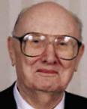
Dr. John Walvoord The Nations in Prophecy, 63-64
“As far as the historic fulfillment is concerned, it is obvious from both Scripture and history that these verses have not been literally fulfilled. The city of Babylon continued to flourish after the Medes conquered it, and though its glory dwindled, especially after the control of the Medes and the Persians ended in 323 B.C., the city continued in some form or substance until A.D. 1000 and did not experience a sudden termination such as anticipated in this prophecy.”

Slide 62
Parallels Between Jeremiah 50-51 & Revelation 17-18
 | Jeremiah | Revelation
Associated with a Golden cup | 51:7a | 17:3-4; 18:6
Dwelling on many waters | 51:13 | 17:1
Intoxicating the nations | 51:7b | 17:2
Same name | 50:1 | 17:5
Stone sinking into Euphrates | 51:63-64 | 18:21
Sudden destruction | 51:8 | 18:8
Destroyed by fire | 51:30 | 17:16
Final, uninhabitable | 50:39 | 18:21
Deserved | 50:29 | 18:6
God’s people flee | 51:6, 45 | 18:4
Heaven rejoices | 51:48 | 18:20
Dyer, "The Identity of Babylon in Revelation 17–18 (Part 2)," 441-43.

Slide 63
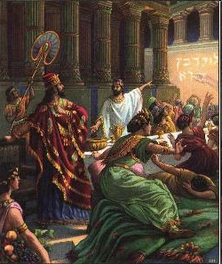
Isaiah’s Oracles Against the Nations (Isa 13–23)
Babylon (13:1-14:23)
Assyria (14:24-27)
Philistia (14:28-32)
Moab (15-16)
Damascus and Samaria (17)
Ethiopia (18)
Egypt (19-20)
Babylon (21:1-10)
Edom (21:11-12)
Arabia (21:13-17)
Jerusalem (22)
Tyre (23)

Slide 64
Isaiah’s Oracles Against the Nations (Isa 13–23)
Babylon (13:1-14:23)
Assyria (14:24-27)
Philistia (14:28-32)
Moab (15-16)
Damascus and Samaria (17)
Ethiopia (18)
Egypt (19-20)
Babylon (21:1-10)
Edom (21:11-12)
Arabia (21:13-17)
Jerusalem (22)
Tyre (23)

Slide 65
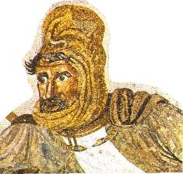
Darius the Mede?
Darius the Mede – in the Bible, a king of the Medes who succeeded to the throne of Babylonia after Belshazzar. Otherwise unknown outside biblical tradition, it is likely that this Darius has been confused with Cyrus the Persian, who succeeded Belshazzar and decreed (539 B.C.) the return of exiled Jews. He is also mentioned by Herodotus and Josephus.

Slide 66
Conclusion

Slide 67
Chapter 5 Outline
Belshazzar's contribution to the feast: unrestrained sensuality (1-4)
God’s contribution to the feast: the handwriting on the wall (5-6)
Daniel’s contribution to the feast: an announcement of doom (7-29)
Darius's contribution to the feast: the conquest of Babylon (30-31)
Ryrie Study Bible, pp. 1047-49

