Slide 1


Slide 2

The Coming Kingdom
Chapter 5
Dr. Andy Woods
Senior Pastor – Sugar Land Bible Church
Adjunct Professor of Bible & Theology – College of Biblical Studies

Slide 3

Kingdom Study Outline
What does the Bible Say About the Kingdom?
The Main Problem with Kingdom Now NT interpretations
Why do some believe that we are in the kingdom now?
Why does it matter?

Slide 4
Kingdom Study Outline
What does the Bible Say About the Kingdom?
The Main Problem with Kingdom Now NT interpretations
Why do some believe that we are in the kingdom now?
Why does it matter?

Slide 5
1. Kingdom Throughout the Bible
Eden Abrahamic Covenant Mosaic Covenant Divided Kingdom Times of the Gentiles | Old Testament Prophets Post exile Offer of the King / Kingdom Rejection of the Offer Interim Age

Slide 6
1. Kingdom Throughout the Bible
Eden Abrahamic Covenant Mosaic Covenant Divided Kingdom Times of the Gentiles | Old Testament Prophets Post exile Offer of the King / Kingdom Rejection of the Offer Interim Age

Slide 7
1. Kingdom Throughout the Bible
Eden Abrahamic Covenant Mosaic Covenant Divided Kingdom Times of the Gentiles | Old Testament Prophets Post exile Offer of the King / Kingdom Rejection of the Offer Interim Age

Slide 8
1. Kingdom Throughout the Bible
Eden Abrahamic Covenant Mosaic Covenant Divided Kingdom Times of the Gentiles | Old Testament Prophets Post exile Offer of the King / Kingdom Rejection of the Offer Interim Age

Slide 9
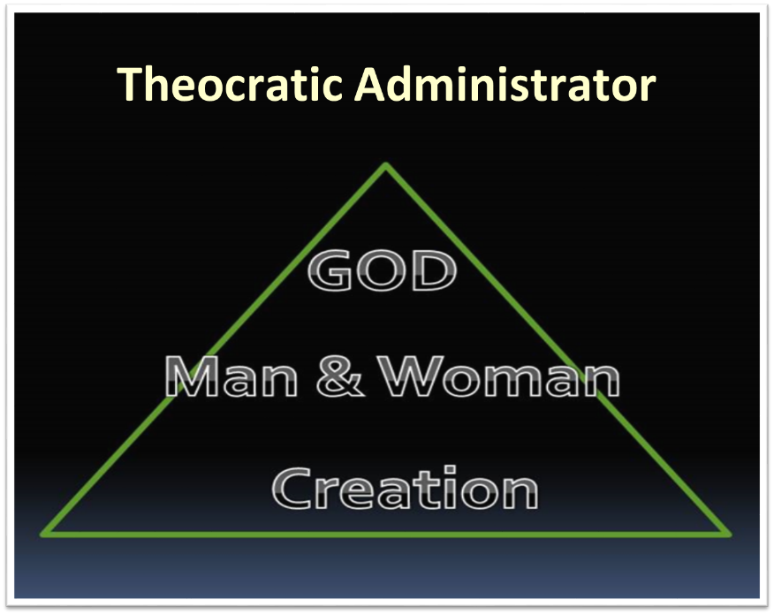

Slide 10


Romans 5:13-14
“for until the Law sin was in the world, but sin is not imputed when there is no law. ¹⁴ Nevertheless death reigned from Adam until Moses, even over those who had not sinned in the likeness of the offense of Adam, who is a type of Him who was to come.”

Slide 11
Exodus 19:5-6
“Now then, if you will indeed obey My voice and keep My covenant, then you shall be My own possession among all the peoples, for all the earth is Mine; and you shall be to Me a kingdom of priests and a holy nation.’ These are the words that you shall speak to the sons of Israel.”

Slide 12
Six Parts of a Suzerain-Vassal Treaty in Deuteronomy
Preamble (1:1-5)
Prologue (1:6–4:40)
Covenant obligations (5–26)
Storage and reading instructions (27:2-3; 31:9, 24, 26)
Witnesses (32:1)
Blessings and curses (28)

Slide 13
Israel's Judgments
Division of the kingdom in 931 B.C. (1 Kgs. 12)
Assyrian judgment in 722 B.C. (2 Kgs. 17)
Babylonian captivity in 586 B.C. (2 Kgs. 25)

Slide 14
Israel's Judgments
Division of the kingdom in 931 B.C. (1 Kgs. 12)
Assyrian judgment in 722 B.C. (2 Kgs. 17)
Babylonian captivity in 586 B.C. (2 Kgs. 25)

Slide 15
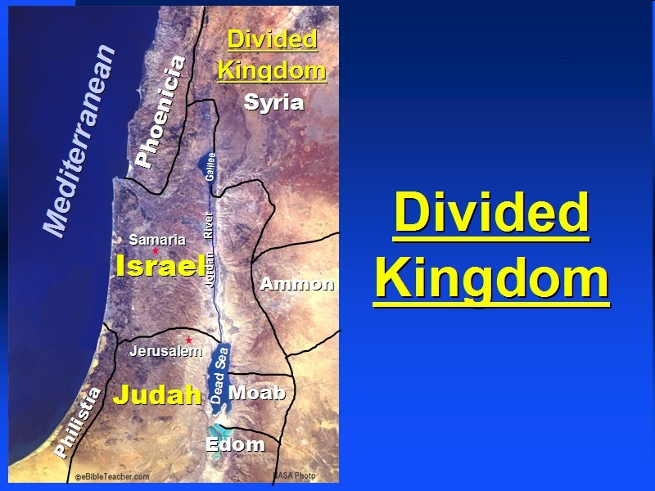

Slide 16
Six Parts of a Suzerain-Vassal Treaty in Deuteronomy
Preamble (1:1-5)
Prologue (1:6–4:40)
Covenant obligations (5–26)
Storage and reading instructions (27:2-3; 31:9, 24, 26)
Witnesses (32:1)
Blessings and curses (28)

Slide 17
Israel's Judgments
Division of the kingdom in 931 B.C. (1 Kgs. 12)
Assyrian judgment in 722 B.C. (2 Kgs. 17)
Babylonian captivity in 586 B.C. (2 Kgs. 25)

Slide 18

Good and Bad Kings
North – 19 kings (all bad)
South – 20 kings (8 good; significance of Gen 49:10)

Slide 19
Israel's Judgments
Division of the kingdom in 931 B.C.
Assyrian judgment in 722 B.C.
Babylonian captivity in 586 B.C. (significance of Gen 49:10)

Slide 20


Slide 21

2 Samuel 7:12-16
“When your days are complete and you lie down with your fathers, I will raise up your descendant after you, who will come forth from you, and I will establish his kingdom. ¹³ He shall build a house for My name, and I will establish the throne of his kingdom forever. ¹⁴ I will be a father to him and he will be a son to Me; when he commits iniquity, I will correct him with the rod of men and the strokes of the sons of men, ¹⁵ but My lovingkindness shall not depart from him, as I took it away from Saul, whom I removed from before you. ¹⁶ Your house and your kingdom shall endure before Me forever; your throne shall be established forever.” ¹⁷ In accordance with all these words and all this vision, so Nathan spoke to David.”

Slide 22
Six Parts of a Suzerain-Vassal Treaty in Deuteronomy
Preamble (1:1-5)
Prologue (1:6–4:40)
Covenant obligations (5–26)
Storage and reading instructions (27:2-3; 31:9, 24, 26)
Witnesses (32:1)
Blessings and curses (28)

Slide 23
Israel's Judgments
Division of the kingdom in 931 B.C. (1 Kgs. 12)
Assyrian judgment in 722 B.C. (2 Kgs. 17)
Babylonian captivity in 586 B.C. (2 Kgs. 25)

Slide 24
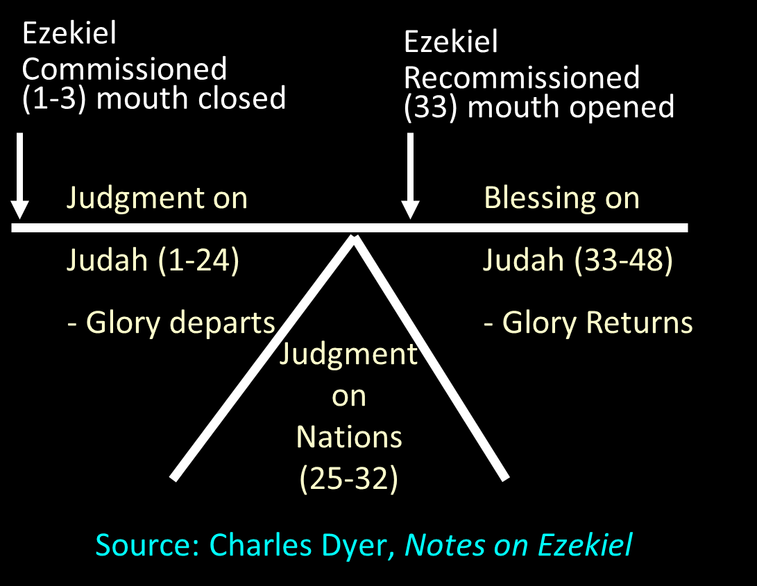

Slide 25
1. Kingdom Throughout the Bible
Eden Abrahamic Covenant Mosaic Covenant Divided Kingdom Times of the Gentiles | Old Testament Prophets Post exile Offer of the King / Kingdom Rejection of the Offer Interim Age

Slide 26

Hosea 3:3-4
“Then I said to her, “You shall stay with me for many days. You shall not play the harlot, nor shall you have a man; so I will also be toward you.” ⁴For the sons of Israel will remain for many days without king or prince, without sacrifice or sacred pillar and without ephod or household idols.”

Slide 27

Statue
&
Stone

Slide 28

Statue
&
Stone

Slide 29

6 Empires
Babylon (2:36-38) 605-539 BC
Media-Persia (2:39a) 539-331 BC
Greece (2:39b) 331-63 BC
Rome I (2:40) 63 BC – 70 AD
Rome II (2:41-43) Tribulation
Kingdom (2:44-45) After 2nd Coming

Slide 30

Isaiah 9:6-7 (NASB)
⁶ For a child will be born to us, a son will be given to us; And the government will rest on His shoulders; And His name will be called Wonderful Counselor, Mighty God, Eternal Father, Prince of Peace.⁷ There will be no end to the increase of His government or of peace, On the throne of David and over his kingdom, To establish it and to uphold it with justice and righteousness From then on and forevermore. The zeal of the Lord of hosts will accomplish this.

Slide 31
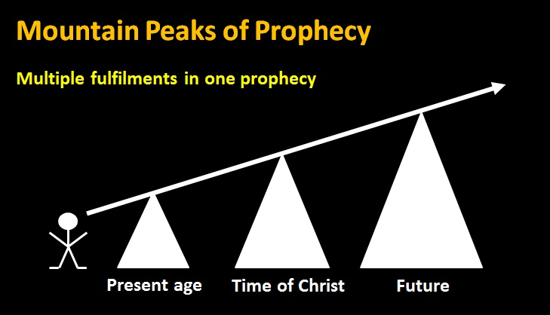
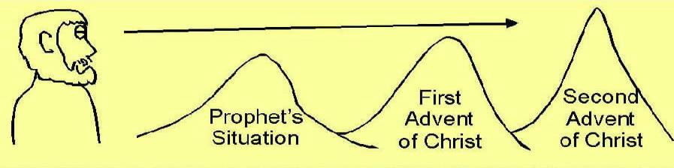

Slide 32
1 Peter 1:10-11 (NASB)
The zeal of the Lord of hosts will accomplish this. As to this salvation, the prophets who prophesied of the grace that would come to you made careful searches and inquiries, ¹¹ seeking to know what person or time the Spirit of Christ within them was indicating as He predicted the sufferings of Christ and the glories to follow.

Slide 33
Synthetic Outline
  Chiasm “Aramaic” ( 2-7)
1. Gentile History (2)
  2. Protection (3)
    3. Revelation to a gentile king (4)
    3. Revelation to a gentile king (5)
  2. Protection (6)
1. Gentile history (7)

Slide 34
Synthetic Outline
  Chiasm “Aramaic” ( 2-7)
1. Gentile History (2)
  2. Protection (3)
    3. Revelation to a gentile king (4)
    3. Revelation to a gentile king (5)
  2. Protection (6)
1. Gentile history (7)

Slide 35
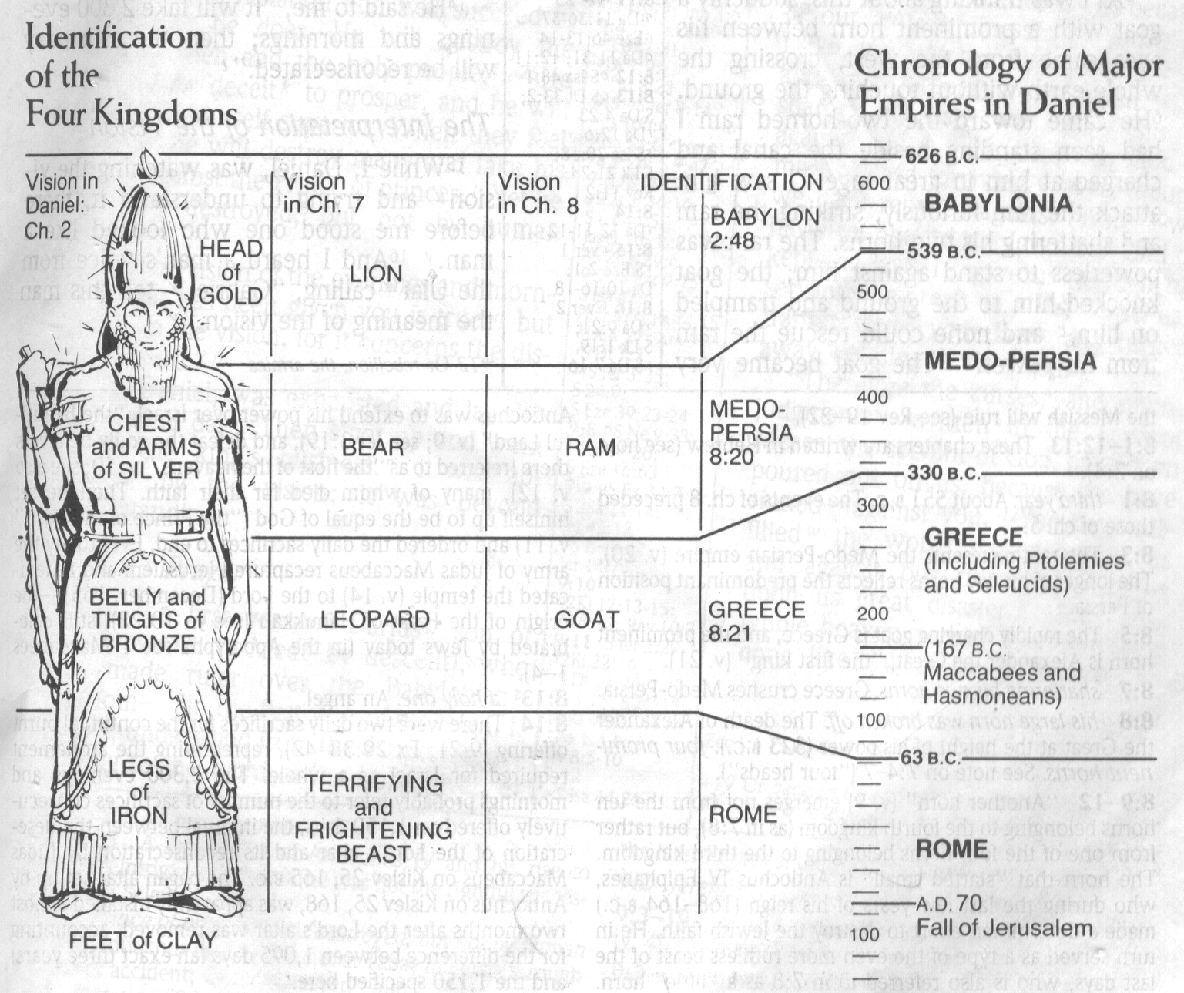
CHART OF NATIONS

Slide 36
Statue
&
Stone

Slide 37
Statue
&
Stone

Slide 38
6 Empires
Babylon (2:36-38) 605-539 BC
Media-Persia (2:39a) 539-331 BC
Greece (2:39b) 331-63 BC
Rome I (2:40) 63 BC – 70 AD
Rome II (2:41-43) Tribulation
Kingdom (2:44-45) After 2nd Coming

Slide 40
Statue
&
Stone

Slide 41
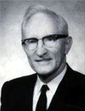
Merill F. Unger
Unger's Commentary on the Old Testament (Chicago: Moody, 1981; reprint, Chatanooga, TN: AMG, 2002), 1643.
“Hence, the iron kingdom with its feet of iron and clay (cf. 3:33-35, 40, 44) and the nondescript beast of 7:7-8 envision…the form in which it will exist after the church period, when God will resume His dealing with the nation Israel. How futile for conservative scholars to ignore that fact and to seek to find literal fulfillment of those prophecies in history or in the church, when those predictions refer to events yet future and have no application whatever to the church.”

Slide 42

Daniel 2:44-45 is Future
Christianity did not suddenly fill the whole earth
Christ did not destroy Rome
No 10 simultaneous kings in the time of Christ
Christ was not the smiting stone
Christ did not destroy all the kingdoms of the world
The church is not a political kingdom
J. Dwight Pentecost, Bible Knowledge Commentary, 1336

Slide 43
Conclusion

Slide 44
1. Kingdom Throughout the Bible
Eden Abrahamic Covenant Mosaic Covenant Divided Kingdom Times of the Gentiles | Old Testament Prophets Post exile Offer of the King / Kingdom Rejection of the Offer Interim Age

Slide 45
1. Kingdom Throughout the Bible
Eden Abrahamic Covenant Mosaic Covenant Divided Kingdom Times of the Gentiles | Old Testament Prophets Post exile Offer of the King / Kingdom Rejection of the Offer Interim Age

Slide 46

2 Peter 1:19
“So we have the prophetic word made more sure, to which you do well to pay attention as to a lamp shining in a dark place, until the day dawns and the morning star arises in your hearts.”

Slide 47

OT PROPHETS DESCRIBE THE KINGDOM
Kingdom Characteristics
Is. 2:1-4; 11:6-9; 65:17-25
  Jerusalem = center of world spiritual and political authority
  Perfect justice
  World peace
  Peace in the animal kingdom
  Universal spiritual knowledge.

