Slide 1
Soteriology Session 47
Dr. Andy Woods
Senior Pastor – Sugar Land Bible Church
Professor of Bible & Theology – College of Biblical Studies

Slide 2
Soteriology Overview
Definition
Election
Atonement
Salvation words
God’s one condition of salvation
Results of salvation
Eternal security
Faulty views of salvation

Slide 3
Soteriology Overview
This Session
VII. Eternal Security

Slide 4
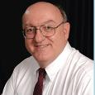
Definition of Eternal Security
“Eternal Security means that those who have been genuinely saved by God’s grace through faith alone in Christ alone shall never be in danger of God’s condemnation or loss of salvation but God’s grace and power keep them forever saved and secure.”
Dennis Rokser, Shall Never Perish Forever, p. 11

Slide 5
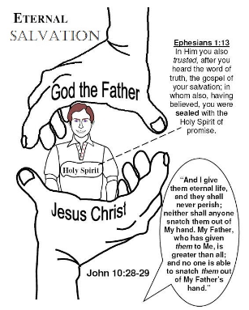
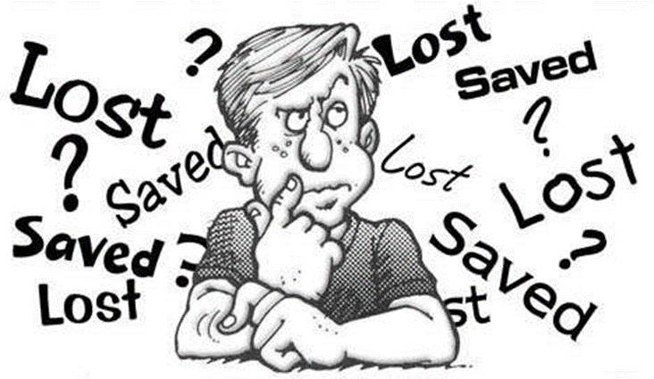
Eternal Security Outline
Eternal security arguments
Response to problem passages

Slide 6
Eternal Security Outline
Eternal security arguments
Response to problem passages

Slide 7
Eternal Security Outline
Eternal security arguments
Response to problem passages

Slide 8
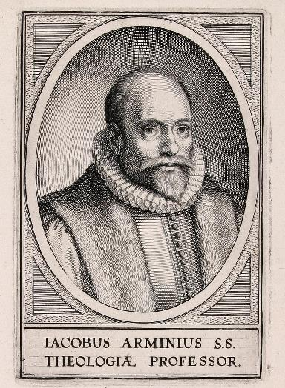
Response to Problem Passages
OT Passages
Passages from Matthew
Passages from John
Passages from Acts
Passages from Paul

Slide 9
Response to Problem Passages
Passages from James
Passages from Hebrews
Passages from 2 Peter
Passages from 1 John
Passages from Revelation
Miscellaneous argument

Slide 10
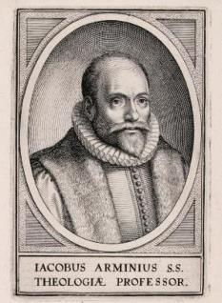
Passages from the General Letters & Revelation
Jas. 5:19-20
Heb. 3:6, 14
Heb. 5:9-10
Heb. 6:4-6
Heb. 10:26-30
Heb. 12:14
2 Pet. 1:10-11, 20-22
Jude 11
1 John 2:3
1 John 3:9
1 John 3:15
1 John 5:16
Rev. 3:5
Rev. 22:18-19

Slide 11
Passages from the General Letters & Revelation
Jas. 5:19-20
Heb. 3:6, 14
Heb. 5:9-10
Heb. 6:4-6
Heb. 10:26-30
Heb. 12:14
2 Pet. 1:10-11, 20-22
Jude 11
1 John 2:3
1 John 3:9
1 John 3:15
1 John 5:16
Rev. 3:5
Rev. 22:18-19

Slide 12
Jude 11
“Woe to them! For they have gone the way of Cain, and for pay they have rushed headlong into the error of Balaam, and perished in the rebellion of Korah.” (NASB)

Slide 13
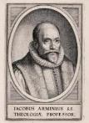
Jude 11
Saved audience (Exod. 14:30-31; Heb. 11:29)
Not loss of salvation but divine discipline (Heb. 12:5-11; Rev. 3:19)
Maximum divine discipline (Acts 5:1-11; 1 Cor. 11:30; 1 John 5:16; Rev. 2:22-23)
Maximum divine discipline common in the OT
Discipline from God is not the same thing as loss of salvation
No comment on loss of salvation
Although “perish” (apollymi) can refer to hell (John 3:16), it also can refer to just to something more temporal (Matt. 9:17) such as common death (Matt. 2:13) rather than the second death.

Slide 14
Jude 11
Saved audience (Exod. 14:30-31; Heb. 11:29)
Not loss of salvation but divine discipline (Heb. 12:5-11; Rev. 3:19)
Maximum divine discipline (Acts 5:1-11; 1 Cor. 11:30; 1 John 5:16; Rev. 2:22-23)
Maximum divine discipline common in the OT
Discipline from God is not the same thing as loss of salvation
No comment on loss of salvation
Although “perish” (apollymi) can refer to hell (John 3:16), it also can refer to just to something more temporal (Matt. 9:17) such as common death (Matt. 2:13) rather than the second death.

Slide 15
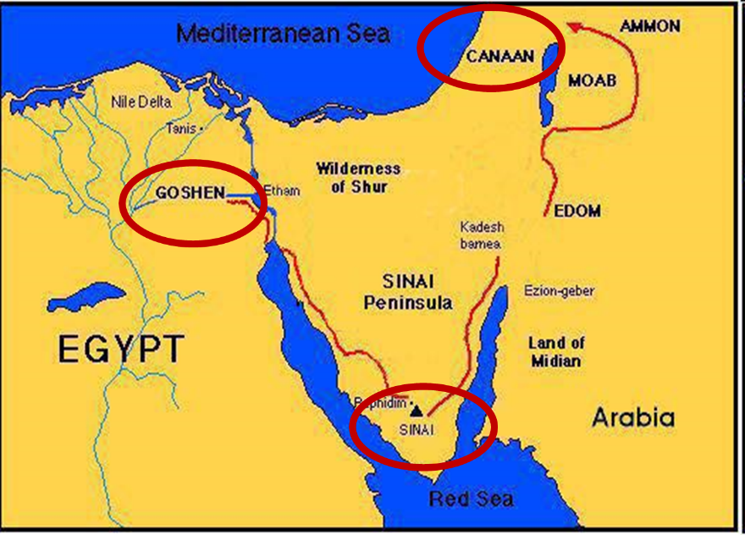

Slide 16
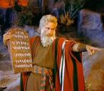
Exodus 14:30-31 (NASB)
³⁰ Thus the Lord saved Israel that day from the hand of the Egyptians, and Israel saw the Egyptians dead on the seashore. ³¹ When Israel saw the great power which the Lord had used against the Egyptians, the people feared the Lord, and they believed in the Lord and in His servant Moses.”

Slide 17
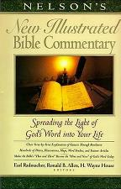
Exodus 14:31
“When we read so the people feared the Lord and the words that follow, we are meant to understand that the community had come to saving faith and so were a reborn people. They believed the Lord (the same wording used of Abraham’s saving faith in Gen. 15:6; read Paul’s comments in Rom. 4)…The people were transformed spiritually even as they were delivered physically.”
Nelson's New Illustrated Bible Commentary, 113.

Slide 18
Jude 11
Saved audience (Exod. 14:30-31; Heb. 11:29)
Not loss of salvation but divine discipline (Heb. 12:5-11; Rev. 3:19)
Maximum divine discipline (Acts 5:1-11; 1 Cor. 11:30; 1 John 5:16; Rev. 2:22-23)
Maximum divine discipline common in the OT
Discipline from God is not the same thing as loss of salvation
No comment on loss of salvation
Although “perish” (apollymi) can refer to hell (John 3:16), it also can refer to just to something more temporal (Matt. 9:17) such as common death (Matt. 2:13) rather than the second death.

Slide 19
Jude 11
Saved audience (Exod. 14:30-31; Heb. 11:29)
Not loss of salvation but divine discipline (Heb. 12:5-11; Rev. 3:19)
Maximum divine discipline (Acts 5:1-11; 1 Cor. 11:30; 1 John 5:16; Rev. 2:22-23)
Maximum divine discipline common in the OT
Discipline from God is not the same thing as loss of salvation
No comment on loss of salvation
Although “perish” (apollymi) can refer to hell (John 3:16), it also can refer to just to something more temporal (Matt. 9:17) such as common death (Matt. 2:13) rather than the second death.

Slide 20
Jude 11
Saved audience (Exod. 14:30-31; Heb. 11:29)
Not loss of salvation but divine discipline (Heb. 12:5-11; Rev. 3:19)
Maximum divine discipline (Acts 5:1-11; 1 Cor. 11:30; 1 John 5:16; Rev. 2:22-23)
Maximum divine discipline common in the OT
Discipline from God is not the same thing as loss of salvation
No comment on loss of salvation
Although “perish” (apollymi) can refer to hell (John 3:16), it also can refer to just to something more temporal (Matt. 9:17) such as common death (Matt. 2:13) rather than the second death.

Slide 21
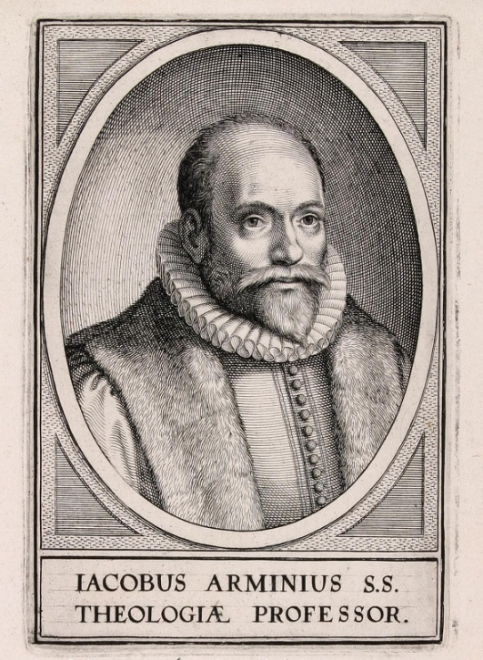
1. OT Passages
Adam & Eve (Gen. 1‒3)
Nadab & Abihu (Lev. 10:1-2)
Korah’s rebellion (Num. 16)
Joshua 24:20
Saul (1 Sam. 16:14; 28; 1 Chron. 10:13-14)
Solomon (1 Kgs. 11)
David (Ps. 51:11)
Ezekiel 18:20

Slide 22
1. OT Passages
Adam & Eve (Gen. 1‒3)
Nadab & Abihu (Lev. 10:1-2)
Korah’s rebellion (Num. 16)
Joshua 24:20
Saul (1 Sam. 16:14; 28; 1 Chron. 10:13-14)
Solomon (1 Kgs. 11)
David (Ps. 51:11)
Ezekiel 18:20

Slide 23
Jude 11
Saved audience (Exod. 14:30-31; Heb. 11:29)
Not loss of salvation but divine discipline (Heb. 12:5-11; Rev. 3:19)
Maximum divine discipline (Acts 5:1-11; 1 Cor. 11:30; 1 John 5:16; Rev. 2:22-23)
Maximum divine discipline common in the OT
Discipline from God is not the same thing as loss of salvation
No comment on loss of salvation
Although “perish” (apollymi) can refer to hell (John 3:16), it also can refer to just to something more temporal (Matt. 9:17) such as common death (Matt. 2:13) rather than the second death.

Slide 24
Jude 11
Saved audience (Exod. 14:30-31; Heb. 11:29)
Not loss of salvation but divine discipline (Heb. 12:5-11; Rev. 3:19)
Maximum divine discipline (Acts 5:1-11; 1 Cor. 11:30; 1 John 5:16; Rev. 2:22-23)
Maximum divine discipline common in the OT
Discipline from God is not the same thing as loss of salvation
No comment on loss of salvation
Although “perish” (apollymi) can refer to hell (John 3:16), it also can refer to just to something more temporal (Matt. 9:17) such as common death (Matt. 2:13) rather than the second death.

Slide 25
Jude 11
Saved audience (Exod. 14:30-31; Heb. 11:29)
Not loss of salvation but divine discipline (Heb. 12:5-11; Rev. 3:19)
Maximum divine discipline (Acts 5:1-11; 1 Cor. 11:30; 1 John 5:16; Rev. 2:22-23)
Maximum divine discipline common in the OT
Discipline from God is not the same thing as loss of salvation
No comment on loss of salvation
Although “perish” (apollymi) can refer to hell (John 3:16), it also can refer to just to something more temporal (Matt. 9:17) such as common death (Matt. 2:13) rather than the second death.

Slide 26
Jude 11
“Woe to them! For they have gone the way of Cain, and for pay they have rushed headlong into the error of Balaam, and perished in the rebellion of Korah.” (NASB)

Slide 27
John 3:16 (NASB)
“For God so loved the world, that He gave His only begotten Son, that whoever believes in Him shall not perish, but have eternal life.”

Slide 28
1 Corinthians 8:11 (KJV)
“And through thy knowledge shall the weak brother perish, for whom Christ died?”

Slide 29
Definition of Perish?
“The weak Christian ‘perished’ in that he suffered spiritual loss, a sense of sin that affected his fellowship with God. This reckless use of liberty actually violates the purposes for which Christ died.”
Robert Gromacki, Called to be Saints: an Exposition of 1 Corinthians, p. 107

Slide 30
Passages from the General Letters & Revelation
Jas. 5:19-20
Heb. 3:6, 14
Heb. 5:9-10
Heb. 6:4-6
Heb. 10:26-30
Heb. 12:14
2 Pet. 1:10-11, 20-22
Jude 11
1 John 2:3
1 John 3:9
1 John 3:15
1 John 5:16
Rev. 3:5
Rev. 22:18-19

Slide 31
1 John 2:3
“By this we know that we have come to know Him, if we keep His commandments.” (NASB)

Slide 32
Believing Audience
1 John 1:4; 2 John 12 – Loss of joy
1 John 1:8 – “We”
1 John 2:1, 18, 28; 3:2, 7, 18; 5:21 – Children of God
1 John 2:12-14 – Eight descriptions
1 John 2:20, 27 – Have the Spirit’s anointing
1 John 2:28; 2 John 8 – Loss of reward

Slide 33
Believing Audience
1 John 1:4; 2 John 12 – Loss of joy
1 John 1:8 – “We”
1 John 2:1, 18, 28; 3:2, 7, 18; 5:21 – Children of God
1 John 2:12-14 – Eight descriptions
1 John 2:20, 27 – Have the Spirit’s anointing
1 John 2:28; 2 John 8 – Loss of reward

Slide 34
1 John 2:12-14
“I am writing to you, little children, because your sins have been forgiven you for His name’s sake. ¹³ I am writing to you, fathers, because you know Him who has been from the beginning. I am writing to you, young men, because you have overcome the evil one. I have written to you, children, because you know the Father. ¹⁴ I have written to you, fathers, because you know Him who has been from the beginning. I have written to you, young men, because you are strong, and the word of God abides in you, and you have overcome the evil one.” (NASB)

Slide 35
1 John 2:12-14
“I am writing to you, little children, because your sins have been forgiven you for His name’s sake. ¹³ I am writing to you, fathers, because you know Him who has been from the beginning. I am writing to you, young men, because you have overcome the evil one. I have written to you, children, because you know the Father. ¹⁴ I have written to you, fathers, because you know Him who has been from the beginning. I have written to you, young men, because you are strong, and the word of God abides in you, and you have overcome the evil one.” (NASB)

Slide 36
Believing Audience
1 John 1:4; 2 John 12 – Loss of joy
1 John 1:8 – “We”
1 John 2:1, 18, 28; 3:2, 7, 18; 5:21 – Children of God
1 John 2:12-14 – Eight descriptions
1 John 2:20, 27 – Have the Spirit’s anointing
1 John 2:28; 2 John 8 – Loss of reward

Slide 37
Believing Audience
1 John 3:1-2 – Those who will be like Him
1 John 3:2, 21; 4:1, 7, 11 – Beloved ones in the faith
1 John 3:13 – My brothers
1 John 4:4 – Born of God
1 John 4:13 – Possessing the Holy Spirit

Slide 38
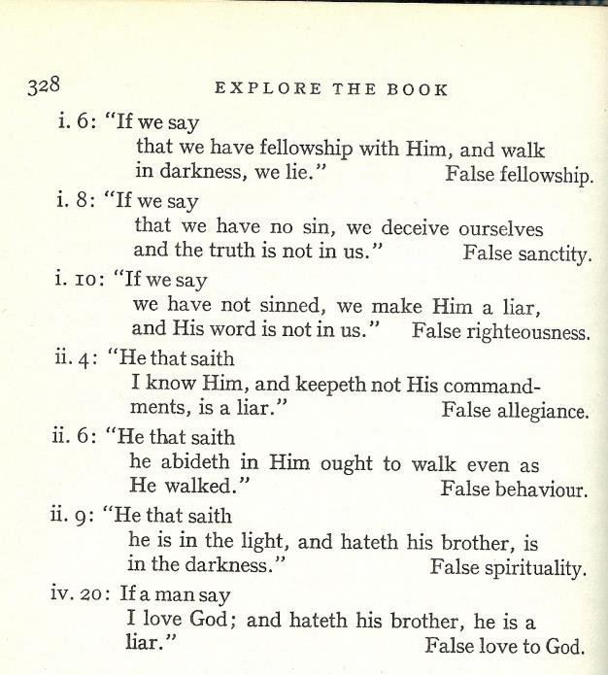
7 Tests in 1 John

Slide 39
What is Being Tested?
Test of life – saved, union, justification
Test of fellowship – fellowship with God, communion, sanctification

Slide 40
Three Tenses of Salvation
Phase | Justification | Sanctification | Glorification
Tense | Past | Present | Future
Saved from sin’s: | Penalty | Power | Presence
Scripture | Eph 2:8-9; Titus 3:5 | Philip 2:12 | Rom 5:10

Slide 41
Three Tenses of Salvation
Phase | Justification | Sanctification | Glorification
Tense | Past | Present | Future
Saved from sin’s: | Penalty | Power | Presence
Scripture | Eph 2:8-9; Titus 3:5 | Philip 2:12 | Rom 5:10

Slide 42
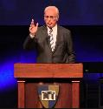
John F. MacArthur,
Saved Without a Doubt? How to be Sure of Your Salvation (Wheaton, IL: Victor, 1988), 67-91.
“John MacArthur claims that John wrote this epistle to provide "eleven tests" of genuine saving faith. These include such subjective questions as:
"Do you obey God's Word?"
"Do you reject this evil world?"
"Do you eagerly await Christ’s return?" and
"Do you see a decreasing pattern of sin in your life?.”

Slide 43
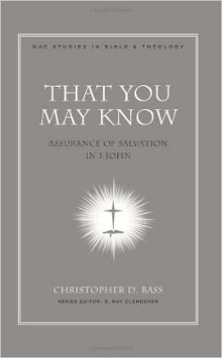
Christopher D. Bass,
That You May Know: Assurance of Salvation in 1 John (Nashville, TN: Broadman and Holman, 2008), 182-83.
“We must remember that the first letter of John is laden with various sets of criteria or ‘tests’ by which its readers are to evaluate their religious claims in light of the way they conduct their lives. The believers life style therefore serves as either a vital support to his or her assurance or is evidence that he has never really passed over from death to life.”

Slide 44
Three Tenses of Salvation
Phase | Justification | Sanctification | Glorification
Tense | Past | Present | Future
Saved from sin’s: | Penalty | Power | Presence
Scripture | Eph 2:8-9; Titus 3:5 | Philip 2:12 | Rom 5:10

Slide 45
2 VIEWS OF 1 JOHN
 | TEST OF LIFE VIEW | TEST OF FELLOWSHIP VIEW
Summary | If you have righteous conduct, love, and truth then you know you were saved | If you have righteous conduct, love, in truth then you know you’re in fellowship with God
Purpose Statement | 1 Jn 5:13, “so that you may know that you have eternal life” | 1 Jn 1:3, “so that you also may have fellowship with us (and) with the Father and with His Son”
Fellowship, Abiding | Being saved, being in union with God (in Christ) | Being in communion with God (walking in His Spirit)
Knowing God | Possessing eternal life | Enjoying fellowship with God
Eternal Life | Salvation (Jn 17:3) | Quality of life (Jn 10:10)
Light or Darkness | Being saved or being lost | Being in fellowship with God or being out of fellowship

Slide 46
Test of Life vs Fellowship
 | TEST OF LIFE | TEST OF FELLOWSHIP
Summary | saved | in fellowship
Purpose statement | 5:13 | 1:3-4
Fellowship, abiding | union | Communion (John 15:5)
Knowing God | eternal life | fellowship with God
Eternal life | John 17:3 | John 10:10; Gal. 6:8
Light/darkness | saved/unsaved | in/out of fellowship
Judgment/fear | Hell (John 5:24) | Discipline/Bema (2 Cor. 5:10)
Spirit | Possession (Rom 8:9) | Influence (Gal 5:16; 1 Thess. 5:19)
Satan | Unbeliever (John 8:44) | Influence upon believer (Matt 16:21-23; Acts 5:3; Eph 4:26-27)

Slide 47
1 John 2:3
“By this we know that we have come to know Him, if we keep His commandments.” (NASB)

Slide 48
1 John 2:3
Other purpose statements in 1 John cover only what immediately follows (2:1 & 1:5-10; 2:26 & 2:18-25)
1 John 5:13 is not the book’s purpose statement
1 John 1:3-4 is the book’s purpose statement
Heading in Scofield Reference Bible: “The Tests of Fellowship: Obedience and Love.”
“Knowing God” refers to intimacy or fellowship with God rather than being born again
Out of fellowship believers do not know God (John 14:7-9; Gal. 4:9; 1 Cor. 15:34; 2 Pet. 3:18)
Keeping God’s commandments to know God (gain or keep salvation) contradicts Ephes. 2:8-9.

Slide 49
1 John 2:3
Other purpose statements in 1 John cover only what immediately follows (2:1 & 1:5-10; 2:26 & 2:18-25)
1 John 5:13 is not the book’s purpose statement
1 John 1:3-4 is the book’s purpose statement
Heading in Scofield Reference Bible: “The Tests of Fellowship: Obedience and Love.”
“Knowing God” refers to intimacy or fellowship with God rather than being born again
Out of fellowship believers do not know God (John 14:7-9; Gal. 4:9; 1 Cor. 15:34; 2 Pet. 3:18)
Keeping God’s commandments to know God (gain or keep salvation) contradicts Ephes. 2:8-9.

Slide 50
1 John 2:3
Other purpose statements in 1 John cover only what immediately follows (2:1 & 1:5-10; 2:26 & 2:18-25)
1 John 5:13 is not the book’s purpose statement
1 John 1:3-4 is the book’s purpose statement
Heading in Scofield Reference Bible: “The Tests of Fellowship: Obedience and Love.”
“Knowing God” refers to intimacy or fellowship with God rather than being born again
Out of fellowship believers do not know God (John 14:7-9; Gal. 4:9; 1 Cor. 15:34; 2 Pet. 3:18)
Keeping God’s commandments to know God (gain or keep salvation) contradicts Ephes. 2:8-9.

Slide 51
1 John 5:13
“These things I have written to you who believe in the name of the Son of God, so that you may know that you have eternal life.” (NASB)

Slide 52
1 John 2:3
Other purpose statements in 1 John cover only what immediately follows (2:1 & 1:5-10; 2:26 & 2:18-25)
1 John 5:13 is not the book’s purpose statement
1 John 1:3-4 is the book’s purpose statement
Heading in Scofield Reference Bible: “The Tests of Fellowship: Obedience and Love.”
“Knowing God” refers to intimacy or fellowship with God rather than being born again
Out of fellowship believers do not know God (John 14:7-9; Gal. 4:9; 1 Cor. 15:34; 2 Pet. 3:18)
Keeping God’s commandments to know God (gain or keep salvation) contradicts Ephes. 2:8-9.

Slide 53
1 John 1:3-4
“what we have seen and heard we proclaim to you also, so that you too may have fellowship with us; and indeed our fellowship is with the Father, and with His Son Jesus Christ. ⁴ These things we write, so that our joy may be made complete..” (NASB)

Slide 54
1 John 2:3
Other purpose statements in 1 John cover only what immediately follows (2:1 & 1:5-10; 2:26 & 2:18-25)
1 John 5:13 is not the book’s purpose statement
1 John 1:3-4 is the book’s purpose statement
Heading in Scofield Reference Bible: “The Tests of Fellowship: Obedience and Love.”
“Knowing God” refers to intimacy or fellowship with God rather than being born again
Out of fellowship believers do not know God (John 14:7-9; Gal. 4:9; 1 Cor. 15:34; 2 Pet. 3:18)
Keeping God’s commandments to know God (gain or keep salvation) contradicts Ephes. 2:8-9.

Slide 55
1 John 2:3
“By this we know that we have come to know Him, if we keep His commandments.” (NASB)

Slide 56
1 John 2:3
Other purpose statements in 1 John cover only what immediately follows (2:1 & 1:5-10; 2:26 & 2:18-25)
1 John 5:13 is not the book’s purpose statement
1 John 1:3-4 is the book’s purpose statement
Heading in Scofield Reference Bible: “The Tests of Fellowship: Obedience and Love.”
“Knowing God” refers to intimacy or fellowship with God rather than being born again
Out of fellowship believers do not know God (John 14:7-9; Gal. 4:9; 1 Cor. 15:34; 2 Pet. 3:18)
Keeping God’s commandments to know God (gain or keep salvation) contradicts Ephes. 2:8-9.

Slide 57
1 John 2:3
Other purpose statements in 1 John cover only what immediately follows (2:1 & 1:5-10; 2:26 & 2:18-25)
1 John 5:13 is not the book’s purpose statement
1 John 1:3-4 is the book’s purpose statement
Heading in Scofield Reference Bible: “The Tests of Fellowship: Obedience and Love.”
“Knowing God” refers to intimacy or fellowship with God rather than being born again
Out of fellowship believers do not know (gnōsis, ginōskō) God (John 14:7-9; 1 Cor. 15:34; 2 Pet. 3:18)
Keeping God’s commandments to know God (gain or keep salvation) contradicts Ephes. 2:8-9.

Slide 58
2 Peter 3:17-18
“You therefore, beloved, knowing this beforehand, be on your guard so that you are not carried away by the error of unprincipled men and fall from your own steadfastness, but grow in the grace and knowledge of our Lord and Savior Jesus Christ. To Him be the glory, both now and to the day of eternity. Amen.” (NASB)

Slide 59
1 John 2:3
Other purpose statements in 1 John cover only what immediately follows (2:1 & 1:5-10; 2:26 & 2:18-25)
1 John 5:13 is not the book’s purpose statement
1 John 1:3-4 is the book’s purpose statement
Heading in Scofield Reference Bible: “The Tests of Fellowship: Obedience and Love.”
“Knowing God” refers to intimacy or fellowship with God rather than being born again
Out of fellowship believers do not know God (John 14:7-9; Gal. 4:9; 1 Cor. 15:34; 2 Pet. 3:18)
Keeping God’s commandments to know God (gain or keep salvation) contradicts Ephes. 2:8-9.

Slide 60
1 John 2:3
“By this we know that we have come to know Him, if we keep His commandments.” (NASB)

Slide 61
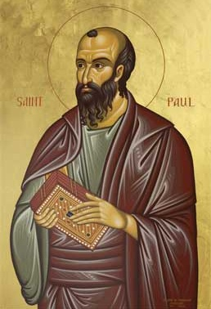
Ephesians 2:8-9
"For by grace you have been saved through faith; and that not of yourselves, it is the gift of God; not as a result of works, so that no one may boast."
Notes:
To what does “that” or “this” refer? Since it is a neuter pronoun it evidently does not refer to “grace” or “faith” both of which are feminine in gender in the Greek text. Probably it refers to the whole preceding clause that describes salvation (cf. 1:15; 3:1). Salvation is the gift of God. Constable, T. (2003). Tom Constable’s Expository Notes on the Bible (Eph 2:8). Galaxie Software.
More plausible is the…view, viz., that τοῦτο refers to the concept of a grace-by-faith salvation. As we have seen, τοῦτο regularly takes a conceptual antecedent. Whether faith is seen as a gift here or anywhere else in the NT is not addressed by this.⁵³
(⁵³ On an exegetical level, I am inclined to agree with Lincoln that “in Paul’s thinking faith can never be viewed as a meritorious work because in connection with justification he always contrasts faith with works of the law (cf. Gal 2:16; 3:2–5, 9, 10; Rom 3:27, 28)” (A. T. Lincoln, Ephesians [WBC] 111). If faith is not meritorious, but is instead the reception of the gift of salvation, then it is not a gift per se. Such a view does not preclude the notion that for faith to save, the Spirit of God must initiate the conversion process. Wallace, D. B. (1996). Greek Grammar beyond the Basics: An Exegetical Syntax of the New Testament (p. 335). Grand Rapids, MI: Zondervan.)

Slide 62
CONCLUSION

Slide 63
Passages from the General Letters & Revelation
Jas. 5:19-20
Heb. 3:6, 14
Heb. 5:9-10
Heb. 6:4-6
Heb. 10:26-30
Heb. 12:14
2 Pet. 1:10-11, 20-22
Jude 11
1 John 2:3
1 John 3:9
1 John 3:15
1 John 5:16
Rev. 3:5
Rev. 22:18-19

