Slide 1
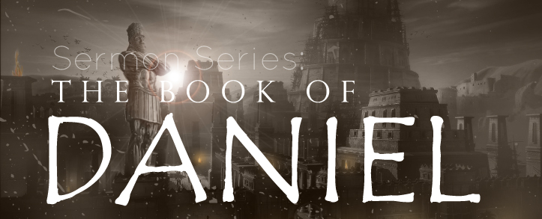
THE BOOK OF DANIEL
Dr. Andy Woods

Slide 2
Message
Times of the Gentiles are revealed prophetically (2, 7, 8-12) and ethically (1, 3-6)

Slide 3
Synthetic Outline
Historical (1-7):
Daniel interprets, 3rd person, gentile nations
Intro “Hebrew” (1)
Aramaic chiasm (2-7)

Slide 4
Synthetic Outline
Prophetic (8-12):
Angel interprets, 1st person, Jewish nation, Hebrew
Ram & Goat (8)
70 weeks (9)
Final vision (10-12)

Slide 5
Synthetic Outline
Historical (1-7):
Daniel interprets, 3rd person, gentile nations
Intro “Hebrew” (1)
Aramaic chiasm (2-7)

Slide 6
Synthetic Outline
Historical (1-7):
Daniel interprets, 3rd person, gentile nations
Intro “Hebrew” (1)
Aramaic chiasm (2-7)

Slide 7
Synthetic Outline
Chiasm “Aramaic” ( 2-7)
1. Gentile History (2)
2. Protection (3)
3. Revelation to a gentile king (4)
3. Revelation to a gentile king (5)
2. Protection (6)
1. Gentile history (7)

Slide 8
Synthetic Outline
Chiasm “Aramaic” ( 2-7)
1. Gentile History (2)
2. Protection (3)
3. Revelation to a gentile king (4)
3. Revelation to a gentile king (5)
2. Protection (6)
1. Gentile history (7)

Slide 9
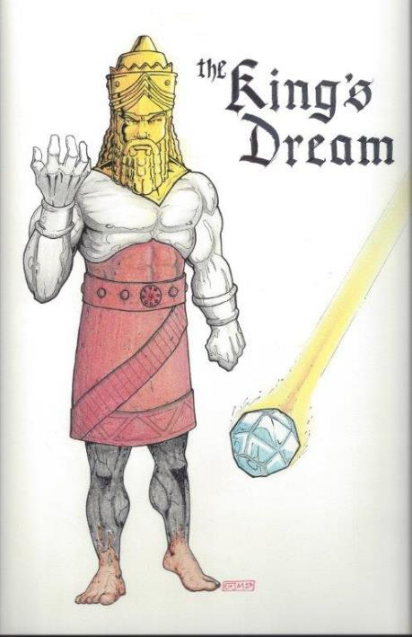
Statue
&
Stone

Slide 10
Synthetic Outline
Chiasm “Aramaic” ( 2-7)
1. Gentile History (2)
2. Protection (3)
3. Revelation to a gentile king (4)
3. Revelation to a gentile king (5)
2. Protection (6)
1. Gentile history (7)

Slide 11
Chapter 3 Outline
The Setting (3:1-7)
The Accusation (3:8-12)
The Test (3:13-18)
The Deliverance (3:19-27)
The Decree (3:28-30)

Slide 12
Chapter 3 Outline
The Setting (3:1-7)
The Accusation (3:8-12)
The Test (3:13-18)
The Deliverance (3:19-27)
The Decree (3:28-30)

Slide 13
V. The Decree (3:28-30)
Exaltation of God (3:28)
The Decree (3:29)
Prosperity (3:30)

Slide 14
V. The Decree (3:28-30)
Exaltation of God (3:28)
The Decree (3:29)
Prosperity (3:30)

Slide 15
“Believe” Defined
pisteuō…“to believe,” also “to be persuaded of,” and hence, “to place confidence in, to trust,” signifies, in this sense of the word, reliance upon, not mere credence. It is most frequent in the writings of the apostle John, especially the Gospel. He does not use the noun…Of the writers of the Gospels…uses of the verb…John ninety-nine.
W. E. Vine, Merrill F. Unger, and William White, Vine's Complete Expository Dictionary of the Old and New Testament Words (Nashville: Nelson, 1996), 61.

Slide 16
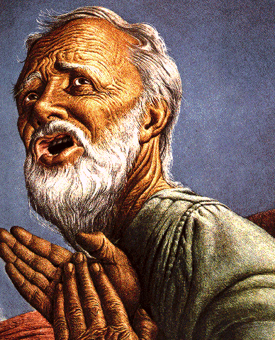
Passage Conditioning Salvation on Faith Alone (Sola Fide)
Genesis 15:6
John 3:16; 5:24; 6:28-29, 47; 16:8-9; 20:30-31
Acts 16:30-31
Romans 1:16; Ephesians 2:8-9
Hebrews 11:6

Slide 17
V. The Decree (3:28-30)
Exaltation of God (3:28)
The Decree (3:29)
Prosperity (3:30)

Slide 18
V. The Decree (3:28-30)
Exaltation of God (3:28)
The Decree (3:29)
Prosperity (3:30)

Slide 19
Conclusion

Slide 20
Chapter 3 Outline
The Setting (3:1-7)
The Accusation (3:8-12)
The Test (3:13-18)
The Deliverance (3:19-27)
The Decree (3:28-30)

Slide 21
V. The Decree (3:28-30)
Exaltation of God (3:28)
The Decree (3:29)
Prosperity (3:30)

Slide 22
Takeaways from Daniel 3
Mosaic Law taught Israel how to live inside the land
The examples of the three Hebrew youths taught them how to live outside the land
Consecrate themselves to God
Live by faith from crisis to crisis entrusting the results to God
Be willing to pay the consequences if necessary
Allow God to promote us in His due time
Our cue as well

