Slide 1
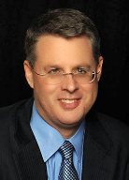
Soteriology Session 49
Dr. Andy Woods
Senior Pastor – Sugar Land Bible Church
Professor of Bible & Theology – College of Biblical Studies

Slide 2
Soteriology Overview
Definition
Election
Atonement
Salvation words
God’s one condition of salvation
Results of salvation
Eternal security
Faulty views of salvation

Slide 3
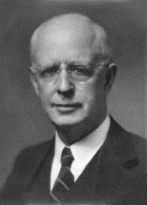
Soteriology Overview
This Session
VII. Eternal Security

Slide 4
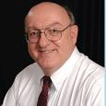
Definition of Eternal Security
“Eternal Security means that those who have been genuinely saved by God’s grace through faith alone in Christ alone shall never be in danger of God’s condemnation or loss of salvation but God’s grace and power keep them forever saved and secure.”
Dennis Rokser, Shall Never Perish Forever, p. 11

Slide 5
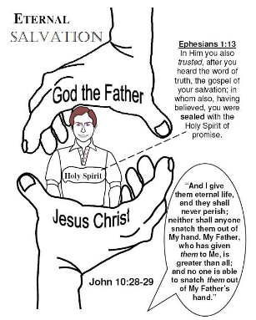
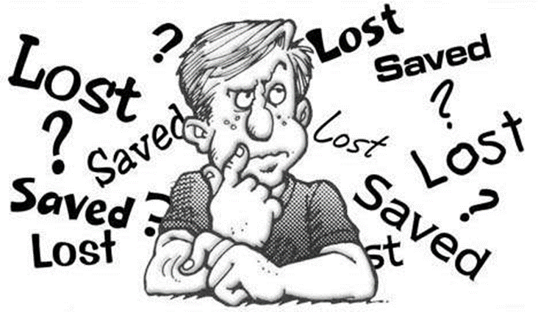
Eternal Security Outline
Eternal security arguments
Response to problem passages

Slide 6
Eternal Security Outline
Eternal security arguments
Response to problem passages

Slide 7
Eternal Security Outline
Eternal security arguments
Response to problem passages

Slide 8
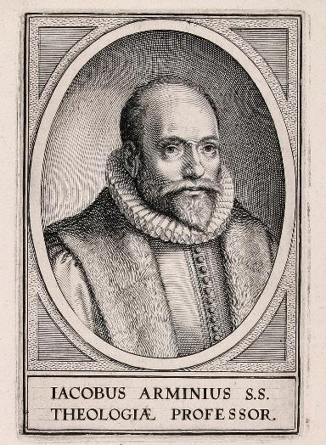
Response to Problem Passages
OT Passages
Passages from Matthew
Passages from John
Passages from Acts
Passages from Paul

Slide 9
Response to Problem Passages
Passages from James
Passages from Hebrews
Passages from 2 Peter
Passages from 1 John
Passages from Revelation
Miscellaneous argument

Slide 10
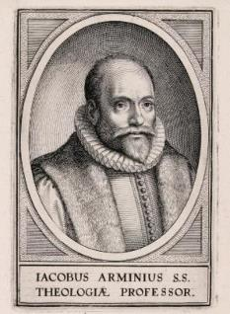
Passages from the General Letters & Revelation
Jas. 5:19-20
Heb. 3:6, 14
Heb. 5:9-10
Heb. 6:4-6
Heb. 10:26-30
Heb. 12:14
2 Pet. 1:10-11, 20-22
Jude 11
1 John 2:3
1 John 3:9
1 John 3:15
1 John 5:16
Rev. 3:5
Rev. 22:18-19

Slide 11
Passages from the General Letters & Revelation
Jas. 5:19-20
Heb. 3:6, 14
Heb. 5:9-10
Heb. 6:4-6
Heb. 10:26-30
Heb. 12:14
2 Pet. 1:10-11, 20-22
Jude 11
1 John 2:3
1 John 3:9
1 John 3:15
1 John 5:16
Rev. 3:5
Rev. 22:18-19

Slide 12
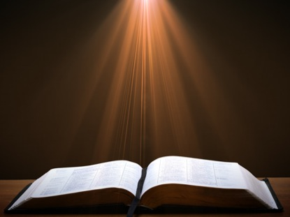
1 John 3:9
“No one who is born of God practices sin, because His seed abides in him; and he cannot sin, because he is born of God.” (NASB)

Slide 13
1 John 3:9
The believer never sins? (1 John 1:8-10; Rom. 6:12-14)
The believer cannot habitually practice sin?
Misuse of the present tense
Book ends (1 John 1:9; 5:16)
Biblical examples
Practical problem
Denial of the assurance of salvation
Better solution: fellowship focus
Context
1 John 2:28ff; 3:6, 7
1 John 3:9
Dennis Rokser, Shall Never Perish Forever, p. 277-87

Slide 14
1 John 3:9
The believer never sins? (1 John 1:8-10; Rom. 6:12-14)
The believer cannot habitually practice sin?
Misuse of the present tense
Book ends (1 John 1:9; 5:16)
Biblical examples
Practical problem
Denial of the assurance of salvation
Better solution: fellowship focus
Context
1 John 2:28ff; 3:6, 7
1 John 3:9
Dennis Rokser, Shall Never Perish Forever, p. 277-87

Slide 15
1 John 3:9
The believer never sins? (1 John 1:8-10; Rom. 6:12-14)
The believer cannot habitually practice sin?
Misuse of the present tense
Book ends (1 John 1:9; 5:16)
Biblical examples
Practical problem
Denial of the assurance of salvation
Better solution: fellowship focus
Context
1 John 2:28ff; 3:6, 7
1 John 3:9
Dennis Rokser, Shall Never Perish Forever, p. 277-87

Slide 16
1 John 3:9
The believer never sins? (1 John 1:8-10; Rom. 6:12-14)
The believer cannot habitually practice sin?
Misuse of the present tense
Book ends (1 John 1:9; 5:16)
Biblical examples
Practical problem
Denial of the assurance of salvation
Better solution: fellowship focus
Context
1 John 2:28ff; 3:6, 7
1 John 3:9
Dennis Rokser, Shall Never Perish Forever, p. 277-87

Slide 17
W. Hall Harris III,
1, 2, 3 John: Comfort and Counsel for a Church in Crisis (Biblical Studies Press, 2003), 143.
“A popular interpretation of these verses distinguishes between occasional sin (which every Christian commits) and a continuing lifestyle of sin, which a genuine Christian cannot pursue. Appeal is usually made to the present tense to support this view. The Greek present tense describes ongoing action (action in progress). The problem with this view is that the author of 1 John does not appear to distinguish anywhere else between lifestyle of sin and occasional acts of sin. Also, to make a significant interpretive point on the basis of the Greek text alone is extremely subtle. One can only wonder whether John's readers would've gotten the point.”

Slide 18
1 John 3:9
The believer never sins? (1 John 1:8-10; Rom. 6:12-14)
The believer cannot habitually practice sin?
Misuse of the present tense
Book ends (1 John 1:9; 5:16)
Biblical examples
Practical problem
Denial of the assurance of salvation
Better solution: fellowship focus
Context
1 John 2:28ff; 3:6, 7
1 John 3:9
Dennis Rokser, Shall Never Perish Forever, p. 277-87

Slide 19
1 John 1:9
“If we confess our sins, He is faithful and righteous to forgive us our sins and to cleanse us from all unrighteousness.” (NASB)

Slide 20
1 John 5:16
“If anyone sees his brother committing a sin not leading to death, he shall ask and God will for him give life to those who commit sin not leading to death. There is a sin leading to death; I do not say that he should make request for this.” (NASB)

Slide 21
1 John 3:9
The believer never sins? (1 John 1:8-10; Rom. 6:12-14)
The believer cannot habitually practice sin?
Misuse of the present tense
Book ends (1 John 1:9; 5:16)
Biblical examples
Practical problem
Denial of the assurance of salvation
Better solution: fellowship focus
Context
1 John 2:28ff; 3:6, 7
1 John 3:9
Dennis Rokser, Shall Never Perish Forever, p. 277-87

Slide 22
Sinning Believers
Abraham – lying
Moses – uncontrolled anger
David – adultery and murder (2 Sam. 11)
Peter – threefold denial and legalism (Gal. 2:11-14)
Never repented
Lot (2 Pet. 2:7-8; Gen. 19:30-38)
Solomon (1 Kings 11)
Ananias and Sapphira (Acts 5:1-11)
Corinthians (1 Cor. 11:30-32)

Slide 23
1 John 3:9
The believer never sins? (1 John 1:8-10; Rom. 6:12-14)
The believer cannot habitually practice sin?
Misuse of the present tense
Book ends (1 John 1:9; 5:16)
Biblical examples
Practical problem
Denial of the assurance of salvation
Better solution: fellowship focus
Context
1 John 2:28ff; 3:6, 7
1 John 3:9
Dennis Rokser, Shall Never Perish Forever, p. 277-87

Slide 24
1 John 3:9
The believer never sins? (1 John 1:8-10; Rom. 6:12-14)
The believer cannot habitually practice sin?
Misuse of the present tense
Book ends (1 John 1:9; 5:16)
Biblical examples
Practical problem
Denial of the assurance of salvation
Better solution: fellowship focus
Context
1 John 2:28ff; 3:6, 7
1 John 3:9
Dennis Rokser, Shall Never Perish Forever, p. 277-87

Slide 25
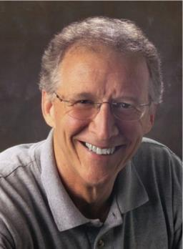
John Piper
“No Christian can be sure that he is a true believer. Hence, there is an ongoing need to be dedicated to the Lord and to deny ourselves so that we might make it.”
John Piper and Pastoral Staff, TULIP: What We Believe about the Five Points of Calvinism: Position Paper of the Pastoral Staff (Desiring God Ministries, 1997), 25, cited in Dave Hunt, What Love is This?, 379.

Slide 26
John 5:24
“Truly, truly, I say to you, he who hears My word, and believes Him who sent Me, has eternal life, and does not come into judgment, but has passed out of death into life.” (NASB)

Slide 27
John 6:47
“Truly, truly, I say to you, he who believes has eternal life.” (NASB)

Slide 28
DTS Doctrinal Statement Article XI—Assurance
“We believe it is the privilege, not only of some, but of all by the Spirit through faith who are born again in Christ as revealed in the Scriptures, to be assured of their salvation from the very day they take Him to be their Savior and that this assurance is not founded upon any fancied discovery of their own worthiness or fitness, but wholly upon the testimony of God in His written Word, exciting within His children filial love...”

Slide 29
1 John 3:9
The believer never sins? (1 John 1:8-10; Rom. 6:12-14)
The believer cannot habitually practice sin?
Misuse of the present tense
Book ends (1 John 1:9; 5:16)
Biblical examples
Practical problem
Denial of the assurance of salvation
Better solution: fellowship focus
Context
1 John 2:28ff; 3:6, 7
1 John 3:9
Dennis Rokser, Shall Never Perish Forever, p. 277-87

Slide 30
Three Tenses of Salvation
Phase | Justification | Sanctification | Glorification
Tense | Past | Present | Future
Saved from sin’s: | Penalty | Power | Presence
Scripture | Eph 2:8-9; Titus 3:5 | Philip 2:12 | Rom 5:10

Slide 31
Three Tenses of Salvation
Phase | Justification | Sanctification | Glorification
Tense | Past | Present | Future
Saved from sin’s: | Penalty | Power | Presence
Scripture | Eph 2:8-9; Titus 3:5 | Philip 2:12 | Rom 5:10

Slide 32
Three Tenses of Salvation
Phase | Justification | Sanctification | Glorification
Tense | Past | Present | Future
Saved from sin’s: | Penalty | Power | Presence
Scripture | Eph 2:8-9; Titus 3:5 | Philip 2:12 | Rom 5:10

Slide 33
Believing Audience
1 John 1:4; 2 John 12 – Loss of joy
1 John 1:8 – “We”
1 John 2:1, 18, 28; 3:2, 7, 18; 5:21 – Children of God
1 John 2:12-14 – Eight descriptions
1 John 2:20, 27 – Have the Spirit’s anointing
1 John 2:28; 2 John 8 – Loss of reward

Slide 34
Believing Audience
1 John 3:1-2 – Those who will be like Him
1 John 3:2, 21; 4:1, 7, 11 – Beloved ones in the faith
1 John 3:13 – My brothers
1 John 4:4 – Born of God
1 John 4:13 – Possessing the Holy Spirit

Slide 35
1 John 1:3-4
“what we have seen and heard we proclaim to you also, so that you too may have fellowship with us; and indeed our fellowship is with the Father, and with His Son Jesus Christ. ⁴ These things we write, so that our joy may be made complete.” (NASB)

Slide 36
John 15:4-5
“Abide in Me, and I in you. As the branch cannot bear fruit of itself unless it abides in the vine, so neither can you unless you abide in Me. ⁵ I am the vine, you are the branches; he who abides in Me and I in him, he bears much fruit, for apart from Me you can do nothing..” (NASB)

Slide 37
 | Gospel of John | First John
Believe | 99 times | 6 times
Abide | Many times in a much longer book | 21 times
Purpose | 20:30-31 | 1:3-4

Slide 38
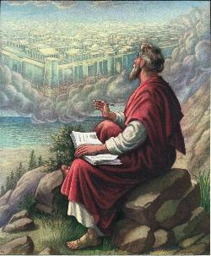
John 20:30-31
“Therefore many other signs Jesus also performed in the presence of the disciples, which are not written in this book; but these have been written so that you may believe that Jesus is the Christ, the Son of God; and that believing you may have life in His name.”

Slide 39
1 John 1:3-4
“what we have seen and heard we proclaim to you also, so that you too may have fellowship with us; and indeed our fellowship is with the Father, and with His Son Jesus Christ. ⁴ These things we write, so that our joy may be made complete..” (NASB)

Slide 40
1 John 3:9
The believer never sins? (1 John 1:8-10; Rom. 6:12-14)
The believer cannot habitually practice sin?
Misuse of the present tense
Book ends (1 John 1:9; 5:16)
Biblical examples
Practical problem
Denial of the assurance of salvation
Better solution: fellowship focus
Context
1 John 2:28ff; 3:6, 7
1 John 3:9
Dennis Rokser, Shall Never Perish Forever, p. 277-87

Slide 41
1 John 3:9
The believer never sins? (1 John 1:8-10; Rom. 6:12-14)
The believer cannot habitually practice sin?
Misuse of the present tense
Book ends (1 John 1:9; 5:16)
Biblical examples
Practical problem
Denial of the assurance of salvation
Better solution: fellowship focus
Context
1 John 2:28ff; 3:6, 7
1 John 3:9
Dennis Rokser, Shall Never Perish Forever, p. 277-87

Slide 42
1 John 2:28-29
“Now, little children, abide in Him, so that when He appears, we may have confidence and not shrink away from Him in shame at His coming.” (NASB)

Slide 43
1 John 3:6
“No one who abides in Him sins; no one who sins has seen Him or knows Him.” (NASB)

Slide 44
1 John 3:7
“Little children, make sure no one deceives you; the one who practices righteousness is righteous, just as He is righteous.” (NASB)

Slide 45
1 John 3:9
The believer never sins? (1 John 1:8-10; Rom. 6:12-14)
The believer cannot habitually practice sin?
Misuse of the present tense
Book ends (1 John 1:9; 5:16)
Biblical examples
Practical problem
Denial of the assurance of salvation
Better solution: fellowship focus
Context
1 John 2:28ff; 3:6, 7
1 John 3:9
Dennis Rokser, Shall Never Perish Forever, p. 277-87

Slide 46
1 John 3:9
“No one who is born of God practices sin, because His seed abides in him; and he cannot sin, because he is born of God.” (NASB)

Slide 47
2 Peter 1:3-4
“seeing that His divine power has granted to us everything pertaining to life and godliness, through the true knowledge of Him who called us by His own glory and excellence. ⁴ For by these He has granted to us His precious and magnificent promises, so that by them you may become partakers of the divine nature, having escaped the corruption that is in the world by lust.” (NASB)

Slide 48
John 20:30-31
“Therefore many other signs Jesus also performed in the presence of the disciples, which are not written in this book; but these have been written so that you may believe that Jesus is the Christ, the Son of God; and that believing you may have life in His name.”

Slide 49
John 21:25
“And there are also many other things which Jesus did, which if they were written in detail, I suppose that even the world itself would not contain the books that would be written.”

Slide 50
2 John 12
“Though I have many things to write to you, I do not want to do so with paper and ink; but I hope to come to you and speak face to face, so that your joy may be made full.”

Slide 51
3 John 13-14
“I had many things to write to you, but I am not willing to write them to you with pen and ink; but I hope to see you shortly, and we will speak face to face.”

Slide 52
John 15:4
“Abide in Me, and I [will abide] in you. As the branch cannot bear fruit of itself unless it abides in the vine, so neither can you unless you abide in Me.” (NASB)

Slide 53
1 John 2:3-5
“By this we know that we have come to know Him [by fellowship, 1:2–2:2], if we keep His commandments. The one who says, “I have come to know Him,” and does not keep His commandments, is a liar, and the truth is not in him; but whoever keeps His word, in him the love of God has truly been perfected. By this we know that we are in [fellowship with, 1:3-7] Him.” (NASB)

Slide 54
1 John 2:7-11
“Beloved, I am not writing a new commandment to you, but an old commandment which you have had from the beginning; the old commandment is the word which you have heard. On the other hand, I am writing a new commandment to you, which is true in Him and in you, because the darkness is passing away and the true Light is already shining. The one who says he is [walking/abiding, 1:7] in the Light and yet hates his . . .

Slide 55
1 John 2:7-11
. . .brother is [walking/abiding, 1:6] in the darkness until now. The one who loves his brother abides in the Light and there is no cause for stumbling in him. But the one who hates his brother [a fellow believer] is [abiding, 2:10] in the darkness and walks in the darkness [1:6], and does not know where he is going because the darkness has blinded his eyes.” (NASB)

Slide 56
1 John 3:24
“The one who keeps His commandments abides in Him, and He [abides, John 15:4] in him. We know by this that He abides in us, by the Spirit whom He has given us.” (NASB)

Slide 57
1 John 4:13
“By this we know that we abide in Him and He [abides] in us, because He has given us of His Spirit.” (NASB)

Slide 58
1 John 4:15
“Whoever confesses that Jesus is the Son of God, God abides in him, and he [abides] in God.” (NASB)

Slide 59
1 John 3:6
“No one who abides in Him sins; no one who sins has seen Him or knows Him.” (NASB)

Slide 60
1 John 3:9
“No one who is born of God practices sin, because His seed abides in him; and he cannot sin, because he is born of God.” (NASB)

Slide 61
1 John 3:9
“No one who is born of God practices sin [when abiding in Him], because His seed [the new nature] abides in him; and he cannot sin [when he is abiding in Him], because he is born of God [with a new nature].” (NASB)

Slide 62
CONCLUSION

Slide 63
Passages from the General Letters & Revelation
Jas. 5:19-20
Heb. 3:6, 14
Heb. 5:9-10
Heb. 6:4-6
Heb. 10:26-30
Heb. 12:14
2 Pet. 1:10-11, 20-22
Jude 11
1 John 2:3
1 John 3:9
1 John 3:15
1 John 5:16
Rev. 3:5
Rev. 22:18-19

