Slide 1
THE BOOK OF DANIEL
Dr. Andy Woods

Slide 2
Message
Times of the Gentiles are revealed prophetically (2, 7, 8-12) and ethically (1, 3-6)

Slide 3
Synthetic Outline
Historical (1-7):
Daniel interprets, 3rd person, gentile nations
Intro “Hebrew” (1)
Aramaic chiasm (2-7)

Slide 4
Synthetic Outline
Prophetic (8-12):
Angel interprets, 1st person, Jewish nation, Hebrew
Ram & Goat (8)
70 weeks (9)
Final vision (10-12)

Slide 5
Synthetic Outline
Historical (1-7):
Daniel interprets, 3rd person, gentile nations
Intro “Hebrew” (1)
Aramaic chiasm (2-7)

Slide 6
Synthetic Outline
Historical (1-7):
Daniel interprets, 3rd person, gentile nations
Intro “Hebrew” (1)
Aramaic chiasm (2-7)

Slide 7
Synthetic Outline
Chiasm “Aramaic” ( 2-7)
1. Gentile History (2)
2. Protection (3)
3. Revelation to a gentile king (4)
3. Revelation to a gentile king (5)
2. Protection (6)
1. Gentile history (7)

Slide 8
Synthetic Outline
Chiasm “Aramaic” ( 2-7)
1. Gentile History (2)
2. Protection (3)
3. Revelation to a gentile king (4)
3. Revelation to a gentile king (5)
2. Protection (6)
1. Gentile history (7)

Slide 9
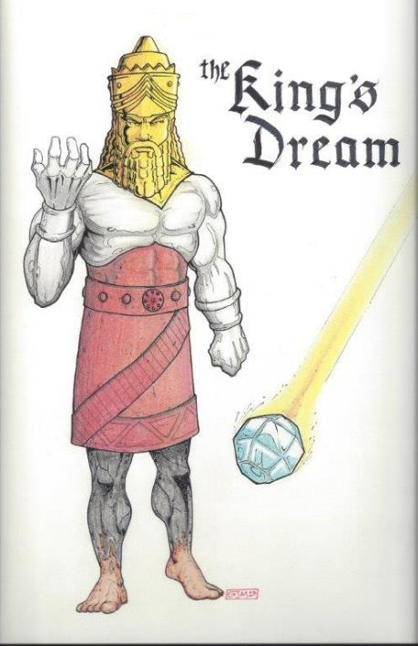
Statue
&
Stone

Slide 10
Synthetic Outline
Chiasm “Aramaic” ( 2-7)
1. Gentile History (2)
2. Protection (3)
3. Revelation to a gentile king (4)
3. Revelation to a gentile king (5)
2. Protection (6)
1. Gentile history (7)

Slide 11
Synthetic Outline
Chiasm “Aramaic” ( 2-7)
1. Gentile History (2)
2. Protection (3)
3. Revelation to a gentile king (4)
3. Revelation to a gentile king (5)
2. Protection (6)
1. Gentile history (7)

Slide 12
Succession of Gentile Rulers
1-4: Nebuchadnezzar of Babylon
5: Belshazzar of Babylon
6: Darius of Media – Persia
7-8: Belshazzar of Babylon
9: Darius of Media – Persia
10-12: Cyrus of Media – Persia

Slide 13
Succession of Gentile Rulers
1-4: Nebuchadnezzar of Babylon
5: Belshazzar of Babylon
6: Darius of Media – Persia
7-8: Belshazzar of Babylon
9: Darius of Media – Persia
10-12: Cyrus of Media – Persia

Slide 14
Daniel’s Age
CHAPTER | EVENTS | AGE
1 | Taken to Babylonian captivity | 15
2 | Interpreting Nebuchadnezzar’s 1st dream (huge image) | 17
3 | Daniel’s 3 friends cast into the fiery furnace | 19 or 20
4 | Interpreting Nebuchadnezzar’s 2nd dream (huge tree) | 45-50
5 | Interpreting handwriting of the wall at Belshazzar’s feast | Early 80’s
6 | Delivered from the den of lions | c.83
7-8 | Daniel’s visions and dreams | Mid-60’s
9 | Daniel’s seventy “sevens” prophecy | Early-80’s
10-12 | Final dreams and visions | Mid-80’s

Slide 15
Daniel’s Age
CHAPTER | EVENTS | AGE
1 | Taken to Babylonian captivity | 15
2 | Interpreting Nebuchadnezzar’s 1st dream (huge image) | 17
3 | Daniel’s 3 friends cast into the fiery furnace | 19 or 20
4 | Interpreting Nebuchadnezzar’s 2nd dream (huge tree) | 45-50
5 | Interpreting handwriting of the wall at Belshazzar’s feast | Early 80’s
6 | Delivered from the den of lions | c.83
7-8 | Daniel’s visions and dreams | Mid-60’s
9 | Daniel’s seventy “sevens” prophecy | Early-80’s
10-12 | Final dreams and visions | Mid-80’s

Slide 16
Chapter 4 Outline
Introduction (1-3)
Dream Described by Nebuchadnezzar (4-18)
Dream Interpreted by Daniel (19-27)
Dream Fulfilled by God (28-37)

Slide 17
Chapter 4 Outline
Introduction (1-3)
Dream Described by Nebuchadnezzar (4-18)
Dream Interpreted by Daniel (19-27)
Dream Fulfilled by God (28-37)

Slide 18
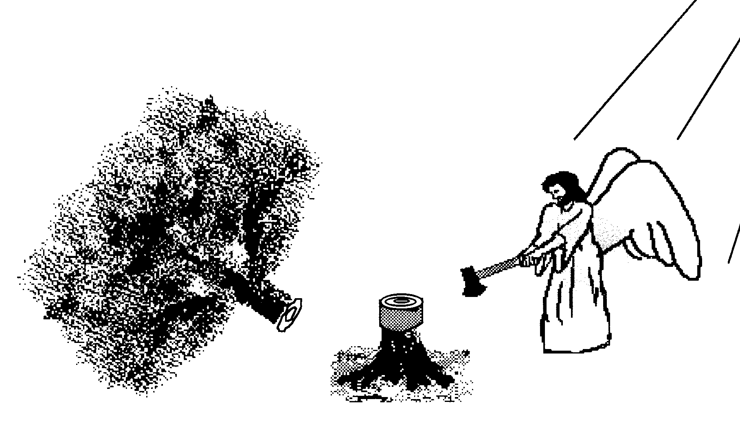
I. Introduction 4:1-3
Nebuchadnezzar’s public decree v. 1
Nebuchadnezzar’s personal testimony v. 2
Nebuchadnezzar’s change in attitude v. 3

Slide 19
Chapter 4 Outline
Introduction (1-3)
Dream Described by Nebuchadnezzar (4-18)
Dream Interpreted by Daniel (19-27)
Dream Fulfilled by God (28-37)

Slide 20
II. Dream Described By Nebuchadnezzar 4:4-18
To the wise men v. 4-7
To Daniel v. 8-18

Slide 21
B. To Daniel (8-18)
Daniel’s entrance v. 8-9
The growing tree v. 10-12
The tree chopped down (13-14)
The stump remains (15a)
Animalistic behavior (15b-16)
Chapter lesson (17)
Nebuchadnezzar’s request (18)

Slide 22
Chapter 4 Outline
Introduction (1-3)
Dream Described by Nebuchadnezzar (4-18)
Dream Interpreted by Daniel (19-27)
Dream Fulfilled by God (28-37)

Slide 23
III. Dream Interpreted By Daniel 4:19-27
Daniel’s reluctance v. 19
Interpretation of the tree v. 20-22
Chopping down of the tree v. 23-25
Interpretation of the preserved stump v. 26
Daniel’s advice to Nebuchadnezzar v. 27

Slide 24
III. Dream Interpreted By Daniel 4:19-27
Daniel’s reluctance v. 19
Interpretation of the tree v. 20-22
Chopping down of the tree v. 23-25
Interpretation of the preserved stump v. 26
Daniel’s advice to Nebuchadnezzar v. 27

Slide 25
Daniel 2:36 (NASB)
This was the dream; now we will tell its interpretation before the king.

Slide 26
III. Dream Interpreted By Daniel 4:19-27
Daniel’s reluctance v. 19
Interpretation of the tree v. 20-22
Chopping down of the tree v. 23-25
Interpretation of the preserved stump v. 26
Daniel’s advice to Nebuchadnezzar v. 27

Slide 27
III. Dream Interpreted By Daniel 4:19-27
Daniel’s reluctance v. 19
Interpretation of the tree v. 20-22
Chopping down of the tree v. 23-25
Interpretation of the preserved stump v. 26
Daniel’s advice to Nebuchadnezzar v. 27

Slide 28
Statue
&
Stone

Slide 29
Daniel 2:37-38 (NASB)
You, O king, are the king of kings, to whom the God of heaven has given the kingdom, the power, the strength and the glory; ³⁸ and wherever the sons of men dwell, or the beasts of the field, or the birds of the sky, He has given them into your hand and has caused you to rule over them all. You are the head of gold.

Slide 30
III. Dream Interpreted By Daniel 4:19-27
Daniel’s reluctance v. 19
Interpretation of the tree v. 20-22
Chopping down of the tree v. 23-25
Interpretation of the preserved stump v. 26
Daniel’s advice to Nebuchadnezzar v. 27

Slide 31
Daniel 2:36 (NASB)
This was the dream; now we will tell its interpretation before the king.

Slide 32
Daniel 2:37-38 (NASB)
You, O king, are the king of kings, to whom the God of heaven has given the kingdom, the power, the strength and the glory; ³⁸ and wherever the sons of men dwell, or the beasts of the field, or the birds of the sky, He has given them into your hand and has caused you to rule over them all. You are the head of gold.

Slide 33
III. Dream Interpreted By Daniel 4:19-27
Daniel’s reluctance v. 19
Interpretation of the tree v. 20-22
Chopping down of the tree v. 23-25
Interpretation of the preserved stump v. 26
Daniel’s advice to Nebuchadnezzar v. 27

Slide 34
III. Dream Interpreted By Daniel 4:19-27
Daniel’s reluctance v. 19
Interpretation of the tree v. 20-22
Chopping down of the tree v. 23-25
Interpretation of the preserved stump v. 26
Daniel’s advice to Nebuchadnezzar v. 27

Slide 35
Grace Before Judgment
Gen 6:3
1 Cor 11:31
Rev 2:21
Parent analogy

Slide 36
Chapter 4 Outline
Introduction (1-3)
Dream Described by Nebuchadnezzar (4-18)
Dream Interpreted by Daniel (19-27)
Dream Fulfilled by God (28-37)

Slide 37
IV. Dream Fulfilled By God Daniel 4:28-37
Nebuchadnezzar’s insanity v. 28-33
Nebuchadnezzar’s humility v. 34-37

Slide 38
IV. Dream Fulfilled By God Daniel 4:28-37
Nebuchadnezzar’s insanity v. 28-33
Nebuchadnezzar’s humility v. 34-37

Slide 39
A. Nebuchadnezzar’s Insanity (28-33)
Daniel’s prophecy fulfilled v. 28-29
Nebuchadnezzar’s pride v. 30
Nebuchadnezzar’s pride v. 31-33

Slide 40
A. Nebuchadnezzar’s Insanity (28-33)
Daniel’s prophecy fulfilled v. 28-29
Nebuchadnezzar’s pride v. 30
Nebuchadnezzar’s pride v. 31-33

Slide 41
A. Nebuchadnezzar’s Insanity (28-33)
Daniel’s prophecy fulfilled v. 28-29
Nebuchadnezzar’s pride v. 30
Nebuchadnezzar’s pride v. 31-33

Slide 42
Daniel 4:30 (NASB)
“The king reflected and said, ‘Is this not Babylon the great, which I myself have built as a royal residence by the might of my power and for the glory of my majesty?’”

Slide 43
Daniel 2:37-38 (NASB)
You, O king, are the king of kings, to whom the God of heaven has given the kingdom, the power, the strength and the glory; ³⁸ and wherever the sons of men dwell, or the beasts of the field, or the birds of the sky, He has given them into your hand and has caused you to rule over them all. You are the head of gold.

Slide 44
A. Nebuchadnezzar’s Insanity (28-33)
Daniel’s prophecy fulfilled v. 28-29
Nebuchadnezzar’s pride v. 30
Nebuchadnezzar’s pride v. 31-33

Slide 45
Scripture and Pride
Prov 16:18
Isa 14:12-15; Ezek 28:12-17
1 Tim 3:6
Acts 12:21-23
2 Cor 12:7
1 Pet 5:5

Slide 46
Hall of the Humbled (Prov. 16:18; 1 Peter 5:5)
Satan (Isa. 14:12-15; Ezek. 28:12-17; 1 Tim. 3:6)
Uzziah (2 Chron 26:16)
Herod (Acts 12:20-23)
Paul (2 Cor 12:1-10)

Slide 47
IV. Dream Fulfilled By God Daniel 4:28-37
Nebuchadnezzar’s insanity v. 28-33
Nebuchadnezzar’s humility v. 34-37

Slide 48
B. Nebuchadnezzar’s Humility (34-37)
Nebuchadnezzar’s Humiliation v. 34-35
Nebuchadnezzar’s Restoration v. 36-37

Slide 49
B. Nebuchadnezzar’s Humility (34-37)
Nebuchadnezzar’s Humiliation v. 34-35
Nebuchadnezzar’s Restoration v. 36-37

Slide 50
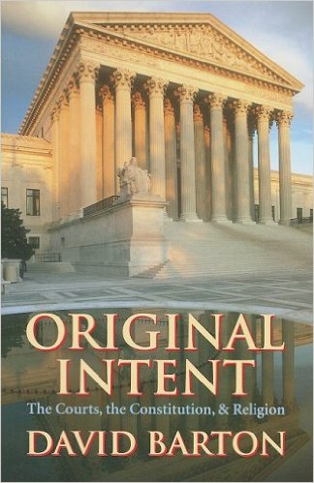
David Barton, Original Intent, p. 245

Slide 51
B. Nebuchadnezzar’s Humility (34-37)
Nebuchadnezzar’s Humiliation v. 34-35
Nebuchadnezzar’s Restoration v. 36-37

Slide 52
Conclusion

Slide 53
Chapter 4 Outline
Introduction (1-3)
Dream Described by Nebuchadnezzar (4-18)
Dream Interpreted by Daniel (19-27)
Dream Fulfilled by God (28-37)

