Slide 1


Slide 2

The Coming Kingdom
Chapter 7
Dr. Andy Woods
Senior Pastor – Sugar Land Bible Church
Adjunct Professor of Bible & Theology – College of Biblical Studies

Slide 3

Kingdom Study Outline
What does the Bible Say About the Kingdom?
The Main Problem with Kingdom Now NT interpretations
Why do some believe that we are in the kingdom now?
Why does it matter?

Slide 4
Kingdom Study Outline
What does the Bible Say About the Kingdom?
The Main Problem with Kingdom Now NT interpretations
Why do some believe that we are in the kingdom now?
Why does it matter?

Slide 5
1. Kingdom Throughout the Bible
Eden Abrahamic Covenant Mosaic Covenant Divided Kingdom Times of the Gentiles | Old Testament Prophets Post exile Offer of the King / Kingdom Rejection of the Offer Interim Age

Slide 6
1. Kingdom Throughout the Bible
Eden Abrahamic Covenant Mosaic Covenant Divided Kingdom Times of the Gentiles | Old Testament Prophets Post exile Offer of the King / Kingdom Rejection of the Offer Interim Age

Slide 7
1. Kingdom Throughout the Bible
Eden Abrahamic Covenant Mosaic Covenant Divided Kingdom Times of the Gentiles | Old Testament Prophets Post exile Offer of the King / Kingdom Rejection of the Offer Interim Age

Slide 8
1. Kingdom Throughout the Bible
Eden Abrahamic Covenant Mosaic Covenant Divided Kingdom Times of the Gentiles | Old Testament Prophets Post exile Offer of the King / Kingdom Rejection of the Offer Interim Age

Slide 9
1. Kingdom Throughout the Bible
Eden Abrahamic Covenant Mosaic Covenant Divided Kingdom Times of the Gentiles | Old Testament Prophets Post exile Offer of the King / Kingdom Rejection of the Offer Interim Age

Slide 10
1. Kingdom Throughout the Bible
Eden Abrahamic Covenant Mosaic Covenant Divided Kingdom Times of the Gentiles | Old Testament Prophets Post exile Offer of the King / Kingdom Rejection of the Offer Interim Age

Slide 11
1. Kingdom Throughout the Bible
Eden Abrahamic Covenant Mosaic Covenant Divided Kingdom Times of the Gentiles | Old Testament Prophets Post exile Offer of the King / Kingdom Rejection of the Offer Interim Age

Slide 12
Six Parts of a Suzerain-Vassal Treaty in Deuteronomy
Preamble (1:1-5)
Prologue (1:6–4:40)
Covenant obligations (5–26)
Storage and reading instructions (27:2-3; 31:9, 24, 26)
Witnesses (32:1)
Blessings and curses (28)

Slide 13
Six Parts of a Suzerain-Vassal Treaty in Deuteronomy
Preamble (1:1-5)
Prologue (1:6–4:40)
Covenant obligations (5–26)
Storage and reading instructions (27:2-3; 31:9, 24, 26)
Witnesses (32:1)
Blessings and curses (28)

Slide 14

Statue
&
Stone

Slide 15

Statue
&
Stone

Slide 16

6 Empires
Babylon (2:36-38) 605-539 BC
Media-Persia (2:39a) 539-331 BC
Greece (2:39b) 331-63 BC
Rome I (2:40) 63 BC – 70 AD
Rome II (2:41-43) Tribulation
Kingdom (2:44-45) After 2nd Coming

Slide 17
6 Empires
Babylon (2:36-38) 605-539 BC
Media-Persia (2:39a) 539-331 BC
Greece (2:39b) 331-63 BC
Rome I (2:40) 63 BC – 70 AD
Rome II (2:41-43) Tribulation
Kingdom (2:44-45) After 2nd Coming

Slide 18
NEBUCHADNEZZAR’S 3 SIEGES OF JUDAH
 | 1 | 2 | 3
Year | 605 | 597 | 586
Scripture | 2 Kings 24:1; Dan.1:1 | 2 Kings 24:10-16; Ezek. 1:1-2 | 2 Kings 25:1-2, Ezek 33:21
Judah’s king | Jehoiakim | Jehoiachin | Zedekiah
Those taken | Daniel & some princes | Ezekiel & majority 10k | Remnant captured, Jerusalem & Temple destroyed

Slide 19
6 Empires
Babylon (2:36-38) 605-539 BC
Media-Persia (2:39a) 539-331 BC
Greece (2:39b) 331-63 BC
Rome I (2:40) 63 BC – 70 AD
Rome II (2:41-43) Tribulation
Kingdom (2:44-45) After 2nd Coming

Slide 20
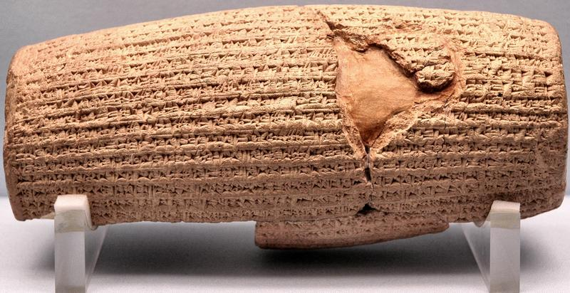
Cyrus Cylinder

Slide 21
Three Returns
 | Date | Duration | Persian king | Jewish leader | Scripture | Purpose | Number of returnees
1st return | 538–515 B.C. | 23 years | Cyrus (Isa 44:28‒45:1) | Zerubbabel | Ezra 1–6; Isaiah 44:28 | Rebuilding the temple | 50,000
2nd return | 458–457 B.C. | 2 years | Artaxerxes | Ezra | Ezra 7–10 | Adorning of the temple and reforming the people | 2,000
3rd return | 444–432 B.C. | 8 years | Artaxerxes | Nehemiah | Nehemiah | Rebuilding the wall

Slide 22
6 Empires
Babylon (2:36-38) 605-539 BC
Media-Persia (2:39a) 539-331 BC
Greece (2:39b) 331-63 BC
Rome I (2:40) 63 BC – 70 AD
Rome II (2:41-43) Tribulation
Kingdom (2:44-45) After 2nd Coming

Slide 23
6 Empires
Babylon (2:36-38) 605-539 BC
Media-Persia (2:39a) 539-331 BC
Greece (2:39b) 331-63 BC
Rome I (2:40) 63 BC – 70 AD
Rome II (2:41-43) Tribulation
Kingdom (2:44-45) After 2nd Coming

Slide 24
1. Kingdom Throughout the Bible
Eden Abrahamic Covenant Mosaic Covenant Divided Kingdom Times of the Gentiles | Old Testament Prophets Post exile Offer of the King / Kingdom Rejection of the Offer Interim Age

Slide 25


Slide 26


Exodus 19:5-6
“Now then, if you will indeed obey My voice and keep My covenant, then you shall be My own possession among all the peoples, for all the earth is Mine; and you shall be to Me a kingdom of priests and a holy nation.’ These are the words that you shall speak to the sons of Israel.”

Slide 27
Deuteronomy 17:15
“you shall surely set a king over you whom the Lord your God chooses, one from among your countrymen you shall set as king over yourselves; you may not put a foreigner over yourselves who is not your countryman.”

Slide 28

John 5:45-47
“Do not think that I will accuse you before the Father; the one who accuses you is Moses, in whom you have set your hope. ⁴⁶ For if you believed Moses, you would believe Me, for he wrote about Me. ⁴⁷ But if you do not believe his writings, how will you believe My words?”

Slide 29
Messengers of the Kingdom In Matthew
John the Baptist – 3:2
Jesus Christ – 4:17
12 Apostles – 10:5-7
Seventy – Luke 10:1, 9
Toussaint, Behold the King, 18-20

Slide 30
Matthew 3:1-2 (NASB)
“Now in those days John the Baptist came, preaching in the wilderness of Judea, saying, ‘Repent, for the kingdom of heaven is at hand.’”

Slide 31
Matthew 4:17 (NASB)
“From that time Jesus began to preach and say, ‘Repent, for the kingdom of heaven is at hand.’”

Slide 32
Matthew 10:5-7 (NASB)
“These twelve Jesus sent out after instructing them: “Do not go in the way of the Gentiles, and do not enter any city of the Samaritans; ⁶ but rather go to the lost sheep of the house of Israel. ⁷ And as you go, preach, saying, ‘The kingdom of heaven is at hand.’”

Slide 33
Luke 10:1, 9 (NASB)
“Now after this the Lord appointed seventy others, and sent them in pairs ahead of Him to every city and place where He Himself was going to come…and heal those in it who are sick, and say to them, ‘The kingdom of God has come near to you.’”

Slide 34

QUESTIONS CONCERNING THE
OFFER OF THE KINGDOM
Kingdom?
Kingdom of Heaven?
At hand?
To whom was the kingdom offered?
Misinterpretation of the kingdom offer?

Slide 35
QUESTIONS CONCERNING THE
OFFER OF THE KINGDOM
Kingdom?
Kingdom of Heaven?
At hand?
To whom was the kingdom offered?
Misinterpretation of the kingdom offer?

Slide 36
Matthew 10:5-7 (NASB)
“These twelve Jesus sent out after instructing them: “Do not go in the way of the Gentiles, and do not enter any city of the Samaritans; ⁶ but rather go to the lost sheep of the house of Israel. ⁷ And as you go, preach, saying, ‘The kingdom of heaven is at hand.’”

Slide 37
1. Kingdom Throughout the Bible
Eden Abrahamic Covenant Mosaic Covenant Divided Kingdom Times of the Gentiles | Old Testament Prophets Post exile Offer of the King / Kingdom Rejection of the Offer Interim Age

Slide 39
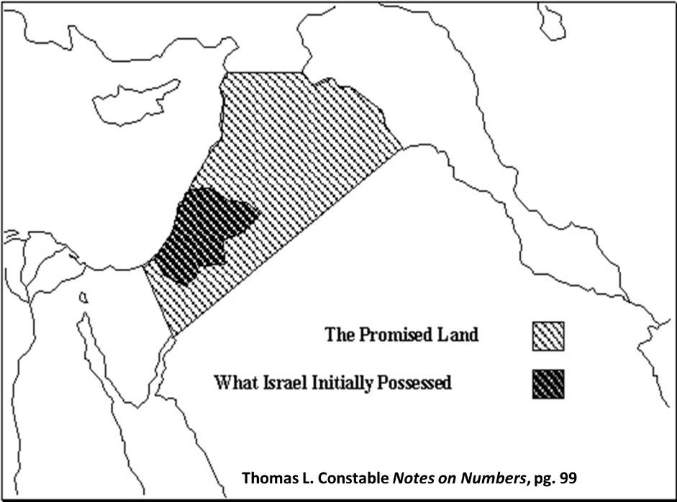

Slide 40
Statue
&
Stone

Slide 41

OT PROPHETS DESCRIBE THE KINGDOM
Kingdom Characteristics
Is. 2:1-4; 11:6-9; 65:17-25
  Jerusalem = center of world spiritual and political authority
  Perfect justice
  World peace
  Peace in the animal kingdom
  Universal spiritual knowledge.

Slide 42

G. Michael Cocoris
“The nature of communication is such that once authors define a term, they are obligated to use that term the same way, until they notify the readers otherwise.”
G. Michael Cocoris, Repentance: The Most Misunderstood Word in the Bible (Milwauke, WI: Grace Gospel, 2010), Kindle edition, loc. 366.

Slide 43
The Prophetic Parables of
Matthew Thirteen - A. W. Pink
“In [Daniel 2] verse 44 we are told, ‘And in the days of these kings (the “kingdom” before referred to) shall the God of heaven set up a kingdom, which shall never be destroyed: and the kingdom shall not be left to other people, but it shall break in pieces and consume all the kingdoms, and it shall stand forever.’…Further details concerning it are given in Daniel 7:13, 14 . . . After Daniel, the voice of prophecy was soon silenced, and for four hundred years the people of Israel remained in a state of eager expectation, waiting for God to fulfill His promises. Next appeared John the Baptist, who took…
A. W. Pink (2005). The Prophetic Parables of Matthew Thirteen. Bellingham, WA: Logos Bible Software.

Slide 44
The Prophetic Parables of
Matthew Thirteen - A. W. Pink. Cont’d)
…up the kingdom message just where the O. T. prophets had dropped it. In Matthew 3:1, 2 we read, ‘…Repent ye: for the kingdom of heaven is at hand’—it was ‘at hand,’ because the King Himself was about to appear in the midst of the Jews. When John said, ‘The kingdom of heaven is at hand,’ what do you suppose his Jewish hearers understood by that expression? They had the whole of the O.T. in their hands, but that is all which they then had. Obviously, all their thoughts would naturally turn to that kingdom which the Son of Man was to receive in heaven at the hands of the Ancient of days.”
A. W. Pink (2005). The Prophetic Parables of Matthew Thirteen. Bellingham, WA: Logos Bible Software.

Slide 45
QUESTIONS CONCERNING THE
OFFER OF THE KINGDOM
Kingdom?
Kingdom of Heaven?
At hand?
To whom was the kingdom offered?
Misinterpretation of the kingdom offer?

Slide 46
Matthew 10:5-7 (NASB)
“These twelve Jesus sent out after instructing them: “Do not go in the way of the Gentiles, and do not enter any city of the Samaritans; ⁶ but rather go to the lost sheep of the house of Israel. ⁷ And as you go, preach, saying, ‘The kingdom of heaven is at hand.’”

Slide 47
Statue
&
Stone

Slide 48
Daniel 2:44 (NASB)
“In the days of those kings the God of heaven will set up a kingdom which will never be destroyed, and that kingdom will not be left for another people; it will crush and put an end to all these kingdoms, but it will itself endure forever.”

Slide 49
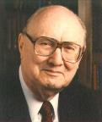
John F. Walvoord,
Matthew: Thy Kingdom Come (Chicago: Moody, 1974), 30.
“What did John mean by ‘kingdom of heaven’? While the precise phrase is not found in the Old Testament, it is based on Old Testament terminology. Nebuchadnezzar, for instance, referred to God as the ‘King of heaven’ (Dan 4:37). Daniel had predicted that the climax of world history would come with the advent of the Son of Man, who would be given an everlasting kingdom. This was likewise to be fulfilled by the prediction of Daniel 2:44 that ‘the God of heaven’ would ‘set up a kingdom, which shall never be destroyed.’ Matthew, alone of New Testament writers, uses ‘the kingdom of heaven’ and rarely uses ‘the kingdom of God,’ which is often used in parallel passages in the other gospels and throughout the New Testament. Most expositors consider the two terms identical.”

Slide 50
QUESTIONS CONCERNING THE
OFFER OF THE KINGDOM
Kingdom?
Kingdom of Heaven?
At hand?
To whom was the kingdom offered?
Misinterpretation of the kingdom offer?

Slide 51
Matthew 10:5-7 (NASB)
“These twelve Jesus sent out after instructing them: “Do not go in the way of the Gentiles, and do not enter any city of the Samaritans; ⁶ but rather go to the lost sheep of the house of Israel. ⁷ And as you go, preach, saying, ‘The kingdom of heaven is at hand.’”

Slide 52
The Prophetic Parables of
Matthew Thirteen - A. W. Pink
“In [Daniel 2] verse 44 we are told, ‘And in the days of these kings (the “kingdom” before referred to) shall the God of heaven set up a kingdom, which shall never be destroyed: and the kingdom shall not be left to other people, but it shall break in pieces and consume all the kingdoms, and it shall stand forever.’…Further details concerning it are given in Daniel 7:13, 14 . . . After Daniel, the voice of prophecy was soon silenced, and for four hundred years the people of Israel remained in a state of eager expectation, waiting for God to fulfill His promises. Next appeared John the Baptist, who took…
A. W. Pink (2005). The Prophetic Parables of Matthew Thirteen. Bellingham, WA: Logos Bible Software.

Slide 53
The Prophetic Parables of
Matthew Thirteen - A. W. Pink. Cont’d)
…up the kingdom message just where the O. T. prophets had dropped it. In Matthew 3:1, 2 we read, ‘…Repent ye: for the kingdom of heaven is at hand’—it was ‘at hand,’ because the King Himself was about to appear in the midst of the Jews. When John said, ‘The kingdom of heaven is at hand,’ what do you suppose his Jewish hearers understood by that expression? They had the whole of the O.T. in their hands, but that is all which they then had. Obviously, all their thoughts would naturally turn to that kingdom which the Son of Man was to receive in heaven at the hands of the Ancient of days.”
A. W. Pink (2005). The Prophetic Parables of Matthew Thirteen. Bellingham, WA: Logos Bible Software.

Slide 54
James 5:8-9 (NASB)
“You too be patient; strengthen your hearts, for the coming of the Lord is near. ⁹ Do not complain, brethren, against one another, so that you yourselves may not be judged; behold, the Judge is standing right at the door.”

Slide 55
QUESTIONS CONCERNING THE
OFFER OF THE KINGDOM
Kingdom?
Kingdom of Heaven?
At hand?
To whom was the kingdom offered?
Misinterpretation of the kingdom offer?

Slide 56
Matthew 10:5-7 (NASB)
“These twelve Jesus sent out after instructing them: “Do not go in the way of the Gentiles, and do not enter any city of the Samaritans; ⁶ but rather go to the lost sheep of the house of Israel. ⁷ And as you go, preach, saying, ‘The kingdom of heaven is at hand.’”

Slide 57
Matthew 15:24 (NASB)
“But He answered and said, ‘I was sent only to the lost sheep of the house of Israel.’”

Slide 58
Statue
&
Stone

Slide 59
The Prophetic Parables of
Matthew Thirteen - A. W. Pink
“Had Israel remained in subjection to their King and obeyed His laws, not only would He have continued in their midst, but through them He would have governed the whole earth—as He will yet do in the Millennium.”
A. W. Pink (2005). The Prophetic Parables of Matthew Thirteen. Bellingham, WA: Logos Bible Software.

Slide 60
Matthew 4:23 (NASB)
“Jesus was going throughout all Galilee, teaching in their synagogues and proclaiming the gospel of the kingdom, and healing every kind of disease and every kind of sickness among the people.”

Slide 61
Matthew 24:14 (NASB)
“This gospel of the kingdom shall be preached in the whole world as a testimony to all the nations, and then the end will come.”

Slide 62
QUESTIONS CONCERNING THE
OFFER OF THE KINGDOM
Kingdom?
Kingdom of Heaven?
At hand?
To whom was the kingdom offered?
Misinterpretation of the kingdom offer?

Slide 63
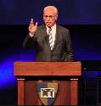
John F. MacArthur
“Listen, the Jews were looking for a political kingdom but Jesus never offered one...There’s no politics in the Sermon on the Mount. None. There is not one reference to the social, political aspect of the kingdom made here, not one. The Jews were so concerned about the politics and the social life. Jesus makes no reference to that at all...The stress is on being. It’s not on ruling or possessing, it is on being...So the political aspect of this message was devastating. It was absolutely everything was the opposite of what they expected a Messiah to say.”
https://www.gty.org/library/print/study-guide-chapter/2197

Slide 64
John F. MacArthur,
John F. MacArthur, The Gospel According to Jesus: What Does Jesus Mean When He Says, “Follow Me”? (Grand Rapids: Zondervan, 1988), 89.
“We must not forget that Jesus came to seek and to save the lost, not merely to announce the earthly kingdom. When Jesus proclaimed His kingdom, He was preaching salvation.”

Slide 65
Matthew 28:18-20 (NASB)
“And Jesus came up and spoke to them, saying, ‘All authority has been given to Me in heaven and on earth. ¹⁹ Go therefore and make disciples of all the nations, baptizing them in the name of the Father and the Son and the Holy Spirit, ²⁰ teaching them to observe all that I commanded you; and lo, I am with you always, even to the end of the age.’”

Slide 66
Matthew 10:5-7 (NASB)
“These twelve Jesus sent out after instructing them: “Do not go in the way of the Gentiles, and do not enter any city of the Samaritans; ⁶ but rather go to the lost sheep of the house of Israel. ⁷ And as you go, preach, saying, ‘The kingdom of heaven is at hand.’”

Slide 67
Acts 16:30-31 (NASB)
“and after he brought them out, he said, ‘Sirs, what must I do to be saved?’ ³¹ They said, ‘Believe in the Lord Jesus, and you will be saved, you and your household.’”

Slide 68
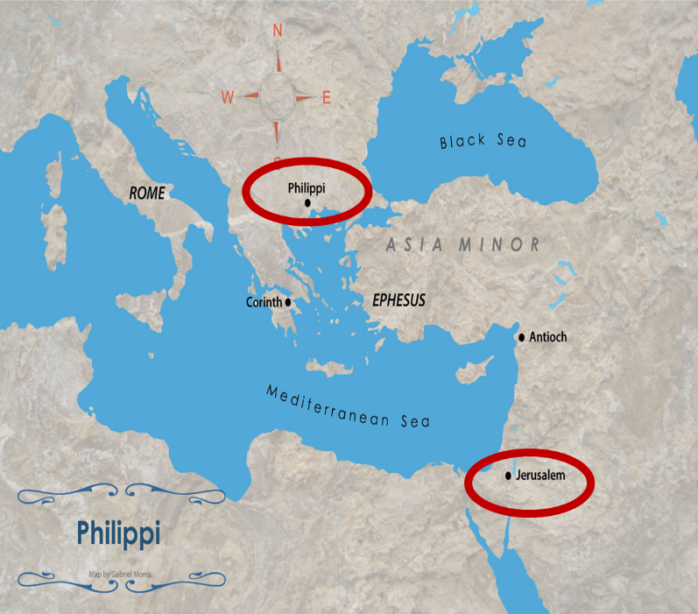

Slide 69
Matthew 10:5-7 (NASB)
“These twelve Jesus sent out after instructing them: “Do not go in the way of the Gentiles, and do not enter any city of the Samaritans; ⁶ but rather go to the lost sheep of the house of Israel. ⁷ And as you go, preach, saying, ‘The kingdom of heaven is at hand.’”

Slide 70
Kingdom Gospel vs. Personal Gospel
 | Kingdom Gospel | Personal Gospel
Biblical example | Matt. 3:2; 4:17; 10:5-7 | Acts 16:30-31
Target audience | National Israel (Matt. 10:5-7) | All nations (Matt. 28:18-20)
Type of salvation offered | National | Personal and individual
Portrayal of Christ | National savior and king | Personal savior
Kingdom expectancy | Imminent | Absent

Slide 71
Kingdom Gospel vs. Personal Gospel
 | Kingdom Gospel | Personal Gospel
Contribution to God’s program | Appearing of the kingdom | Building of the church (Matt. 16:18; Rom. 11:25b)
Scriptural foundation | Mosaic Covenant (Exod. 19:5-6; Deut. 28:15-68) | Gen. 3:15; 15:6; John 3:16; Gal 3:16
When preached? | Early Gospels and Tribulation (Matt. 3:2; 24:14) | Church Age
Preached today? | No | Yes
Perpetual availability? | No | Yes

Slide 72
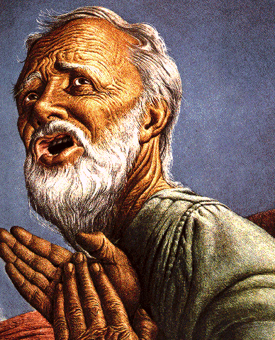
Belief – God’s One Condition for Justification
Gen 15:6
Then he believed in the LORD; and He reckoned it to him as righteousness.
John 3:16
For God so loved the world, that He gave His only begotten Son, that whoever believes in Him shall not perish, but have eternal life.
Acts 16:30-31
"Sirs, what must I do to be saved?" They said, "Believe in the Lord Jesus, and you will be saved..."

Slide 73

Lewis Sperry Chafer, Salvation: God’s Marvelous Work of Grace (Grand Rapids: Kregel, 1991), 49–50; idem, Grace: The Glorious Theme (Grand Rapids: Zondervan, 1972), 132.
Lewis Sperry Chafer
“Such insistence is too often based on Scripture which is addressed to the covenant people, Israel. They . . . being covenant people, are privileged to return to God on the grounds of their covenant by repentance. There is much Scripture both in the Old Testament and in the New that calls this one nation to its long-predicted repentance. . . . The preaching of John the Baptist, of Jesus and the early message of the disciples, was, ‘repent for the kingdom of heaven is at hand’; but it was addressed only to Israel (Matt. 10:5, 6).” The gospel of the kingdom was for the nation of Israel only “and should in no wise be confused with the gospel of saving grace.”

Slide 74

Charles Ryrie
So Great A Salvation, Pages 36-37
“Even the New Testament uses the word gospel to mean various types of good news, so one has to describe what good news is in view. . . . In the Gospel of Matthew, all but one time the word gospel is used concerning the good news of the gospel of the kingdom. This is the message of John the Baptist (Matthew 3:1–2), of our Lord (Matthew 4:17), and of the twelve disciples when they were first sent out by the Lord (Matthew 10:5–7). What was the good news about the kingdom? The correct answer lies in the concept and hope of the kingdom that the Jewish people had at the time of the first coming of Christ. In fact, their hope was for the establishment of the promised rule of the Messiah in His kingdom on this earth, and in the kingdom that would exalt the Jewish people and free them from the rule of Rome under which they lived. But the rule of heaven did not arrive during Jesus’ lifetime because the people refused to repent and meet the spiritual conditions for the kingdom. Most only wanted a political deliverance without having to meet any personal requirements for change of life. So the kingdom did not arrive because the people would not prepare properly for it.”

Slide 75

George Zeller
“MacArthur also runs counter to traditional Dispensationalism in his understanding of ‘the gospel of the kingdom’. . . . He sees this phrase as simply meaning that Jesus was ‘preaching salvation’. . . . Dispensationalists understand this as a reference to that preaching which takes place when the Messianic kingdom is ‘at hand’ which was true in the days of John the Baptist and Christ, and will also be true during the closing years of this age (Matthew 24:14). Nowhere in the New Testament does it say that the gospel of the kingdom is being preached during this church age.”
George Zeller, “John MacArthur and Dispensationalism: And Our Response,” 14, accessed April 5, 2016, http://www.middletownbiblechurch.org/dispen/jmacdis.htm.

Slide 76

John MacArthur
The Gospel According to Jesus, page 25.
“There is a tendency, however, for dispensationalists to get carried away with compartmentalizing truth to the point that they make unbiblical differentiations. An almost obsessive desire to categorize and contrast related truths has carried various dispensationalist interpreters (Chafer, Ryrie, Hodges, etc.) far beyond the legitimate distinctions between Israel and the Church. Many would also draw hard lines between salvation and discipleship (justification and sanctification), the church and the kingdom, Christ's preaching and the apostolic message, faith and repentance, and the age of law and the age of grace." (bold & emphasis mine)

Slide 77
John MacArthur
“I was raised in a dispensational environment; there’s no question… But, as I got into seminary, I began to test some of those things. I have been perhaps aptly designated as a leaky dispensationalist…. Here’s my dispensationalism – I’ll give it to you in one sentence: there’s a difference between the church and Israel – period!... At the same time in seminary, I began to be exposed to reading among more Reformed theologians… And over the years of exegeting the scripture, it has again yielded to me a Reformed theology…. I was convinced of it (Reformed theology) when I started and I’m more convinced of it now as I’ve gone through the text. I was convinced of it when I started because I read so many noble men who have held that view (Reformed Theology). It was more at that point hero worship, and now it’s become my own.”
Transcribed from tape, #GC 70-15, entitled “Bible Questions and Answers” (italics added). A copy of the tape can be obtained by writing, Word of Grace, P.O. Box 4000, Panorama City, CA 91412. Copyright 1994 by John MacArthur Jr., All Rights Reserved.

Slide 78
Conclusion

Slide 79
QUESTIONS CONCERNING THE
OFFER OF THE KINGDOM
Kingdom?
Kingdom of Heaven?
At hand?
To whom was the kingdom offered?
Misinterpretation of the kingdom offer?

