Slide 1
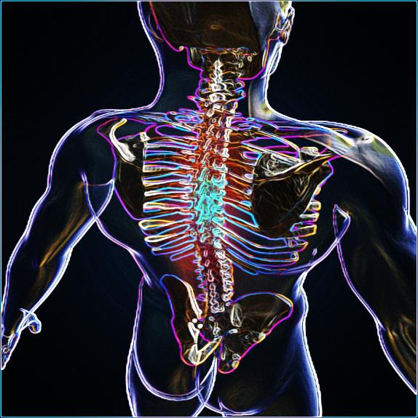
SPIRITUAL
ANATOMY
Part 3
Jim McGowan, Th.D.
Sugar Land Bible Church
Feb. 26, 2017
This presentation was compiled using excerpts from the Complete Works of Miles J. Stanford, resources obtained from Duluth Bible Church’s website, and resources obtained from Pastor Vern Peterman, Holly Hills Bible Church – Used with permission.

Slide 2
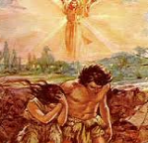

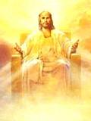
Who We Were……………..
Who We Are……………….
Who We Are Becoming…….

Slide 3
Session 5 Outline
Spiritual Anatomy Part 3
  Review Session 4 Concepts
  Physical Realm vs. Spiritual Realm
    Introduction
      Misunderstanding Terms
      Correctly Understanding Terms
    Spiritual Realm vs. Physical Realm
      The 5 Senses – A Biblical Analogy
      Proper Nourishment For Growth
  Review and Summation
Notes:
Session 5 Outline

Slide 4

SPIRITUAL
ANATOMY

Slide 5



Slide 6


Identification Synonyms
The word ‘identification’ is a convenient ‘handle’ for what Scripture teaches, but the actual words used to convey this biblical truth include:
In | - being placed entirely in, so as to share an identity
With | - intimately joined in action and consequence
Together with United with (Rom. 6) | - as above, with ‘together’ underscoring the same identity & action - ‘united’ implies a oneness, so a spiritual oneness is communicated
Baptized into (Rom. 6; Col) | - ‘baptized’ means to be immersed or entirely placed into, so as to be permanently changed by that immersion or entire placement
Notes:
Identification Synonyms
The word ‘identification’ is a convenient ‘handle’ for what the Scripture teaches, but the actual words used to convey this biblical truth include:
In - being placed entirely in, so as to share an identity
With - intimately joined in action and consequence
Together with - as above, with ‘together’ underscoring the same identity & action
United with (Rom. 6) - ‘united’ implies a oneness, so a spiritual oneness is communicated
Baptized into (Rom. 6; Col) - ‘baptized’ means to be immersed or entirely placed into, so as to be permanently changed by that immersion or placement

Slide 7

Death is Separation
God also used the ‘death is separation’ principle graciously and for our benefit, when we were identified with Christ in His death, then with His burial and resurrection:
Rom. 6:1-11 | dead to sin, alive to Christ
Rom. 7:1-6 | death releases from marriage; died to the Law, joined to Christ
2 Cor. 5:14-15 | dead to ourselves, alive to Christ
Gal. 2:19- 20 | died to the Law, to live to God
Col. 2:20 | died with Christ to the elementary principles of the world
Col. 3:5, 20 | dead to sin, died with Christ to the world
Notes:
Death is Separation - “Death is Separation” is bad news, unless it is good news!
Rom. 6:1-11 - dead to sin (sin nature), alive to Christ
Rom. 7:1-6 - died to the Law, joined to Christ
2 Cor. 5:14-15 - dead to ourselves, alive to Christ
Gal. 2:19- 20 - died to the Law, to live to God
Col. 2:20 - died with Christ to the elementary principles of the world
Col. 3:5, 20 - dead to sin, died with Christ to the world

Slide 8


The Key Biblical Principles Summarized
Identification joins us…
Death separates us…
Our Identification with death joins us to that death; that death separates us.

Slide 9
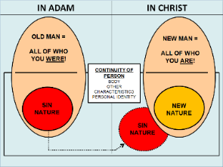
The Key Biblical Principles Summarized
In Adam |  | In Christ
Joined to | Old Man, Sin Nature, Adam’s History, Trio of enemies – World, Flesh, Devil, Satan’s Authority | Joined to | New Man, New Nature, Christ’s History, righteousness, Life. Different Future! (Short Term Good or Bad; Long Term – Bright)
Separated From | Separated From – Christ | Separated From | Old Man, Adam’s History, the World, Devil. The Sin Nature no longer has the claim over us that it had.
Notes:
The Key Biblical Principles Summarized
In Adam
Joined To – Old Man, Sin Nature, Adam’s History, Trio of enemies – World, Flesh, Devil, Satan’s Authority
Separated From – Christ,
In Christ
Joined To – New Man, New Nature, Christ’s History, Christ’s righteousness, Christ’s Life, Different Future! (Short Term Good or Bad; Long Term – Bright)
Separated From – Old Man, Sin Nature (no longer has the claim over us that it had), Adam’s History, World, Devil,
“Separation From” does not mean annihilation or extermination! The devil is still here, as is the sin nature, and the world. Discuss those who teach the annihilation of the sin nature – use Iraq and Afghanistan as examples. Send soldiers there and tell them there is no enemy. In order for God to remove us from the presence of sin, He would have to kill us because we must have a new body to complete the entire process.

Slide 10

Why is this important?
There are at least two areas of application that touch directly upon what God is doing in the life of the believer:
The primary manner of dealing with the Sin Nature comes about because we were identified with Christ (Rom. 6:1-14).
Even so reckon ye also yourselves to be dead unto sin…
…but alive unto God in Christ Jesus (Rom. 6:11 KJV).
Notes:
Why is this important?
There are at least two areas of application that touch directly upon what God is doing in the life of the believer:
The primary manner of dealing with the Sin Nature comes about because we were identified with Christ (Rom. 6:1-14).
Romans 6:11 (KJV) - Likewise reckon ye also yourselves to be dead indeed unto sin, but alive unto God through Jesus Christ our Lord.

Slide 11

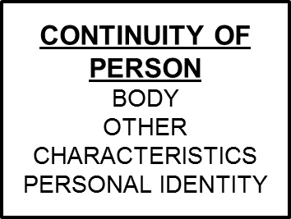
Why is this important?
The changes in our “Continuing Person” as we walk dead to the Sin Nature and alive to God are in the direction of Christ (ongoing processes - conformed, transformed, growing, maturing, being sanctified, etc.).
Notes:
Why is this important?
There is actual spiritual change taking place in the Continuity of Person! (The essential you). There are things that remain the same through the radical spiritual transition of the new birth:
The human body – all that goes with it and identifies that body.
One’s personal identity and earthly relationships.
One’s personal characteristics, including likes and dislikes.
One’s earthly skills and knowledge.
The process is all in the direction of Christ…we do not have some vague notion of how to be better people and we are not heading in some vague direction. We’re not even trying to be a good person or Christ-like. God, Himself IS carrying out these processes in each believer and it’s directed toward a Person – Christ. God is not just trying to vaguely change our character. It is all toward Christ. The end being that we will be like Christ when we see Him as He is.
That’s where all this is headed. And that’s why we need to see that, “EVERTHING THAT HAPPENS TO US, IN US, AND AROUND US IS PART OF GOD’S PROCESS TO ACCOMPLISH HIS PROCESSES.” It’s all to conform us, to transform us, into the image of His Son.

Slide 12
Session 5 Outline
Spiritual Anatomy Part 3
  Review Session 4 Concepts
  Physical Realm vs. Spiritual Realm
    Introduction
      Misunderstanding Terms
      Correctly Understanding Terms
    Spiritual Realm vs. Physical Realm
      The 5 Senses – A Biblical Analogy*
      Proper Nourishment For Growth
  Review and Summation
Notes:
Session 5 Outline

Slide 13

Physical Realm
vs.
SPIRITUAL REALM

Slide 14
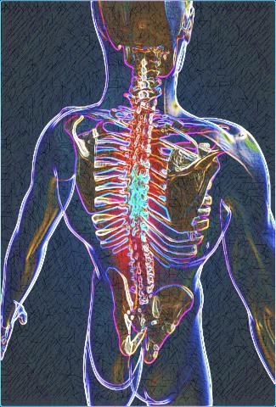
INTRODUCTION
We have been examining what the Bible says about the ‘Spiritual Anatomy’ of human beings – unbelievers and believers.
Thus far, we have made little mention of the physical body focusing mostly on the general spiritual aspects of the Church Age believer (those saved from Acts 2 until the Rapture).
Notes:
INTRODUCTION
We have been examining what the Bible says about the ‘Spiritual Anatomy’ of human beings – unbelievers and believers.
Thus far, we have made little mention of the physical body focusing mostly on the general spiritual aspects of the Church Age believer (those saved from Acts 2 until the Rapture).

Slide 15

INTRODUCTION
We will now turn our attention to a more complete discussion of the spiritual aspects and physical aspects in each individual, believer or unbeliever.
Correctly distinguishing these categories is essential if we hope to have a proper understanding of our topic: ‘Who were we - Who we are - Who are we becoming.’
Notes:
INTRODUCTION
We will now turn our attention to a more complete discussion of the spiritual aspects and physical aspects in each individual, believer or unbeliever.
Correctly distinguishing these categories is essential if we hope to have a proper understanding of our topic: ‘Who were we - Who are we - Who are we becoming.’

Slide 16
Session 5 Outline
Spiritual Anatomy Part 3
  Review Session 4 Concepts
  Physical Realm vs. Spiritual Realm
    Introduction
      Misunderstanding Terms
      Correctly Understanding Terms
    Spiritual Realm vs. Physical Realm
      The 5 Senses – A Biblical Analogy*
      Proper Nourishment For Growth
  Review and Summation
Notes:
Session 5 Outline

Slide 17
MISUNDERSTANDING TERMS
There is some theological debate regarding what constitutes the ‘physical’ and ‘spiritual’ aspects, of mankind. With some variation the two positions are:
  Man is two parts (body, and soul-spirit; dichotomy).
  Man is three parts (body, soul, and spirit; trichotomy).
This is an in-house debate and there are good, godly, men in each camp. The position from which I will be working is the later, trichotomy position.
The most common passage used to support the trichotomy position is 1 Thess. 5:23.
Notes:
MISUNDERSTANDING TERMS
There is some theological debate regarding what constitutes the ‘physical’ and ‘spiritual’ aspects, of mankind. With some variation the two positions are:
Man is two parts (body, and soul-spirit; dichotomy).
Man is three parts (body, soul, and spirit; trichotomy).
This is an in-house debate and there are good, godly, men in each camp. The position I will be working from is the later, trichotomy position.
The most common passage used to support the trichotomy position is 1 Thess. 5:23.

Slide 18


  1 Thess. 5:23
  Now may the God of peace Himself sanctify you entirely; and may your spirit and soul and body be preserved complete, without blame at the coming of our Lord Jesus Christ.

Slide 19

MISUNDERSTANDING TERMS
The primary reason for disagreement, (regarding the terms spirit, soul, and body), is a failure to acknowledge that they are not always employed with ‘scientific, technical, precision’ – i.e., in poetic contexts, where ‘soul’ and ‘spirit’ are often used as synonyms.
  Job 7:11
    I will speak in the anguish of my spirit, I will complain in the bitterness of my soul.
  Isaiah 26:9
    At night my soul longs for You, Indeed, my spirit within me seeks You diligently;
Notes:
MISUNDERSTANDING TERMS
The primary reason for disagreement, (regarding the terms spirit, soul, and body), is a failure to acknowledge that they are not always employed with ‘scientific precision’ – i.e., in poetic contexts, where ‘soul’ and ‘spirit’ are often used as synonyms.
Job 7:11
I will speak in the anguish of my spirit,
I will complain in the bitterness of my soul.
Isaiah 26:9
At night my soul longs for You,
Indeed, my spirit within me seeks You diligently;

Slide 20
MISUNDERSTANDING TERMS
To add to the confusion, some poetic contexts make body and soul appear as synonyms.
  Psalm 44:25
    For our soul has sunk down into the dust; Our body cleaves to the earth.
Syntactically, instead of synonyms, the author’s intent here may actually be:
to use ‘soul’ and ‘body’ to represent two halves of a whole, or,
that the word ‘soul’ here is to be taken to mean living being.
Notes:
MISUNDERSTANDING TERMS
To add to the confusion, some poetic contexts make body and soul appear as synonyms, as in:
Psalm 44:25
For our soul has sunk down into the dust;
Our body cleaves to the earth.
Syntactically, instead of synonyms, the author’s intent here may actually be:
to use ‘soul’ and ‘body’ to represent two halves of a whole, or
that the word ‘soul’ here is to be taken to mean living being.

Slide 21
MISUNDERSTANDING TERMS
It also seems that there are times when the word ‘soul’ conveys more of the idea of physical function such as possessing the breath of life in the physical sense, rather than focusing on the spiritual aspects of the soul, as in Genesis 2:7
Notes:
MISUNDERSTANDING TERMS
It also seems that there are times when the word ‘soul’ conveys more of the idea of physical function such as possessing the breath of life in the physical sense, rather than focusing on the spiritual aspects of the soul, as in Genesis 2:7

Slide 22
  Genesis 2:7
    And the LORD God formed man of the dust of the ground, and breathed into his nostrils the breath of life; and man became a living soul (KJV; living being – NASB)

Slide 23
Session 5 Outline
Spiritual Anatomy Part 3
  Review Session 4 Concepts
  Physical Realm vs. Spiritual Realm
    Introduction
      Misunderstanding Terms
      Correctly Understanding Terms
    Spiritual Realm vs. Physical Realm
      The 5 Senses – A Biblical Analogy*
      Proper Nourishment For Growth
  Review and Summation
Notes:
Session 5 Outline

Slide 24

CORRECTLY UNDERSTANDING TERMS
Biblically, the words ‘soul’ and ‘heart’ can vary in definition according to context and can embrace both spiritual and physical aspects. So there is a place in some contexts for understanding a difference in meaning between the words ‘soul’ and ‘spirit’ as already noted in 1 Thess. 5:23, but note also Heb. 4:12:
Notes:
CORRECTLY UNDERSTANDING TERMS
Biblically, the words ‘soul’ and ‘heart’ can vary in definition according to context and can embrace both spiritual and physical aspects. So there is a place for understanding a difference in meaning between the words ‘soul’ and ‘spirit’ as already noted in 1 Thess. 5:23, but note also Hebrews 4:12:

Slide 25

  Hebrews 4:12
  For the word of God is living and active and sharper than any two-edged sword, and piercing as far as the division of soul and spirit, of both joints and marrow, and able to judge the thoughts and intentions of the heart.
Notes:
Hebrews 4:12 - For the word of God is living and active and sharper than any two-edged sword, and piercing as far as the division of soul and spirit, of both joints and marrow, and able to judge the thoughts and intentions of the heart.

Slide 26

CORRECTLY UNDERSTANDING TERMS
Unquestionably, Hebrews 4:12 presumes a distinction between the terms ‘soul’ and ‘spirit,’ a fact which is unmistakable given the use of the figure of speech ‘joins and marrow’, and ‘heart’, which are drawn from man’s physical anatomy.
Notes:
CORRECTLY UNDERSTANDING TERMS
Unquestionably, Hebrews 4:12 presumes a distinction between the terms ‘soul’ and ‘spirit,’ a fact which is unmistakable given the use of the figure of speech ‘joins and marrow’, and ‘heart’., which are drawn from man’s physical anatomy.

Slide 27
Session 5 Outline
Spiritual Anatomy Part 3
  Review Session 4 Concepts
  Physical Realm vs. Spiritual Realm
    Introduction
      Misunderstanding Terms
      Correctly Understanding Terms
    Spiritual Realm vs. Physical Realm
      The 5 Senses – A Biblical Analogy*
      Proper Nourishment For Growth
  Review and Summation
Notes:
Session 5 Outline

Slide 28

Spiritual Realm vs. Physical Realm
God made man as a created physical and spiritual being on the 6th day of creation.
Gen. 1:26; 2:7
²⁶ And God said, Let us make man in our image, after our likeness;…^{2:7} And the LORD God formed man of the dust of the ground, and breathed into his nostrils the breath of life; and man became a living being.
Notes:
Spiritual Realm vs. Physical Realm – Recap
God made man as a created physical and spiritual being on the 6th day of creation.

Slide 29
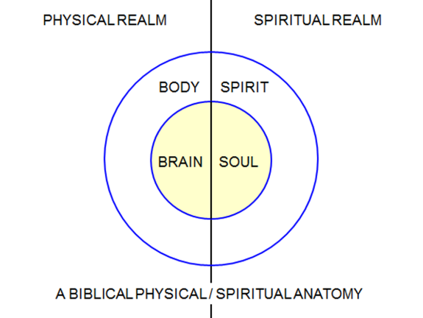
Spiritual Realm vs. Physical Realm
This diagram illustrates the physical realm, created by God (Gen. 1), and the spiritual realm, (the eternal present, the realm in which God dwells).
Notes:
Spiritual Realm vs. Physical Realm
This diagram illustrates the physical realm, created by God (Gen. 1), and the spiritual realm, the eternal present, the realm in which God dwells.

Slide 30
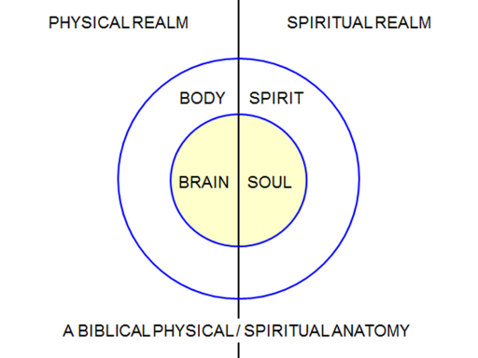
Spiritual Realm vs. Physical Realm
The Brain is a component part of the Body serving as the interface with the Physical.
The Soul is a component part of the Spirit serving as the interface with the Spiritual.
Notes:
Spiritual Realm vs. Physical Realm
The Brain is a component part of the Body and is the interface with the Physical Realm Side.
The Soul is a component part of the Spirit and is the interface with the Spiritual Realm Side.

Slide 31
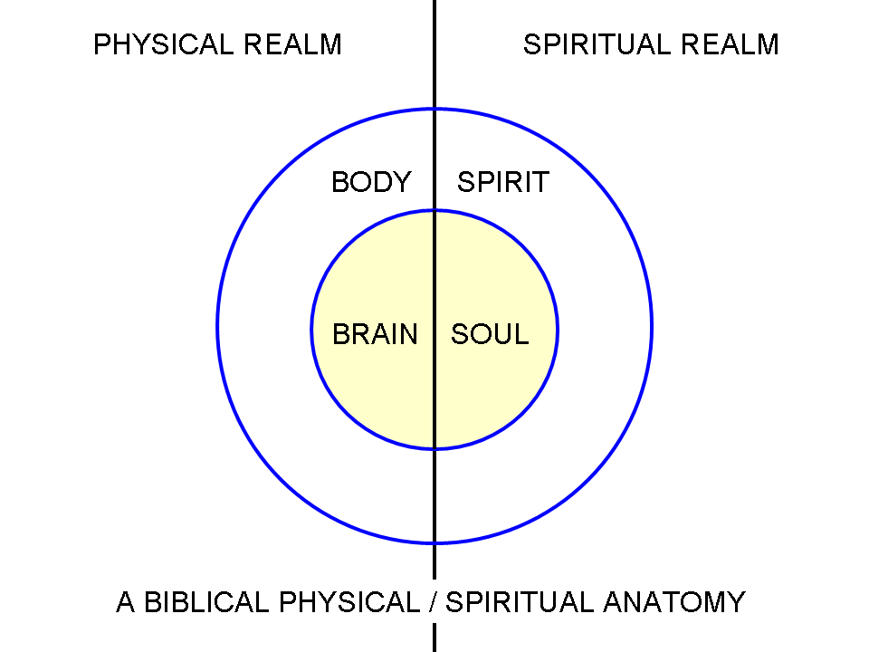
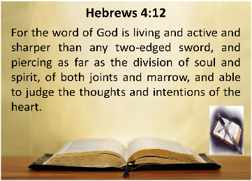
Spiritual Realm vs. Physical Realm
Hebrews 4:12 strongly implies a difference between the two spiritual aspects (soul and spirit) of the human being and both these aspects exists in the spiritual realm.
The brain and soul are the mutual interfaces of the human being, the brain in the physical realm, and the soul in the spiritual realm.
Just as the body interfaces with and interacts with the physical realm, the spirit of a person interfaces with and interacts with the spiritual realm.
Notes:
Spiritual Realm vs. Physical Realm– Recap
Hebrews 4:12 strongly implies a difference between the two spiritual aspects (soul and spirit) of the human being and both these aspects exists in the spiritual realm.
The brain and soul are the mutual interfaces of the human being, the brain in the physical realm, and the soul in the spiritual realm.
Just as the body interfaces with and interacts with the physical realm, the spirit of a person interfaces with and interacts with the spiritual realm.
But Scripture has many more insights to provide for us regarding this understanding of the various aspects of a person, both in the physical realm and the spiritual realm.

Slide 32
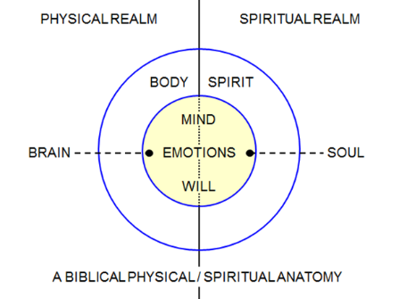
Spiritual Realm vs. Physical Realm
This diagram illustrates the Brain on the Physical Realm Side and the Soul on the Spiritual Realm Side.
Both the Brain on the Physical Realm Side and the Soul on the Spiritual Realm Side have aspects of Mind, Emotions, and Will.
Notes:
Spiritual Realm vs. Physical Realm
This diagram illustrates the Brain on the Physical Realm Side and the Soul on the Spiritual Realm Side.
Both the Brain on the Physical Realm Side and the Soul on the Spiritual Realm Side have aspects of Mind, Emotions, and Will.

Slide 33
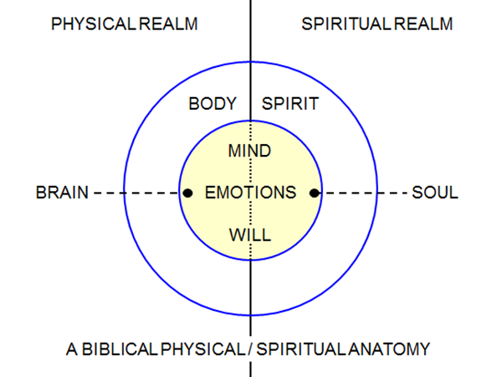
Spiritual Realm vs. Physical Realm
Physical Realm Side of Mind = Sympathetic mental thinking (subconscious – reaction to stress - trainable).
Spiritual Realm Side of Mind = Sympathetic mental thinking (subconscious - reaction to sin - trainable).
Notes:
Spiritual Realm vs. Physical Realm
Physical Realm Side of Mind = Sympathetic mental thinking (subconscious – reaction to stress - trainable).
Spiritual Realm Side of Mind = Sympathetic mental thinking (subconscious - reaction to sin - trainable).

Slide 34
Spiritual Realm vs. Physical Realm
Physical Realm Side of Emotions = Influenced and affected by physical forces hunger, pain, hormones, blood sugar levels, etc.
Spiritual Realm Side of Emotions = Influenced and affected by spiritual forces – conviction of sin, meditation and reflection upon the Word, prayer, spiritual warfare, etc.
Notes:
Spiritual Realm vs. Physical Realm
Physical Realm Side of Emotions = Influenced and affected by physical forces hunger, pain, hormones, blood sugar levels, etc.
Spiritual Realm Side of Emotions = Influenced and affected by spiritual forces – conviction of sin, meditation and reflection upon the Word, prayer, spiritual warfare, etc.

Slide 35
Spiritual Realm vs. Physical Realm
Physical Realm Side of Will = When we make decisions solely based upon what our physical senses tell us.
Spiritual Realm Side of Will = When we make decisions based upon what we understand to be the truth. What we see spiritually impacts our decisions.
Notes:
Spiritual Realm vs. Physical Realm
Physical Realm Side of Will = When we make decisions solely based upon what our physical senses tell us.
Spiritual Realm Side of Will = When we make decisions based upon what we understand to be the truth. What we see spiritually impacts our decisions.

Slide 36
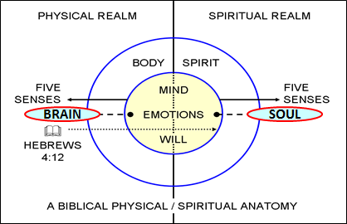
Spiritual Realm vs. Physical Realm
Both the brain and the soul have aspects of mind, emotions and will. As the mind, emotions and will of the brain are impacted by things in the Physical Realm, (including the body), so the mind, emotions and will of the soul are impacted by things in the Spiritual Realm, (including the spirit of the person).
Notes:
Spiritual Realm vs. Physical Realm
Both the brain and the soul have aspects of mind, emotions and will. As the mind, emotions and will of the brain are impacted by things in the Physical Realm, (including the body), so the mind, emotions and will of the soul are impacted by things in the Spiritual Realm, (including the spirit of the person).

Slide 37
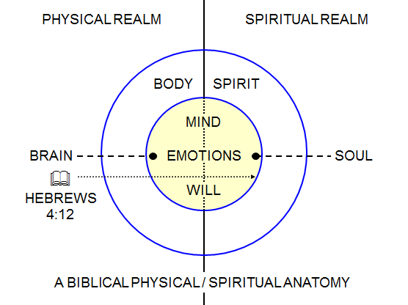
Spiritual Realm vs. Physical Realm
According to Heb. 4:12, where does God’s Word actually touch us?
Hebrews 4:12
For the word of God is living and active and sharper than any two-edged sword, …and piercing as far as the division of soul and spirit…
Notes:
Spiritual Realm vs. Physical Realm
According to Heb. 4:12, where does God’s Word actually touch us?
It goes that deep.

Slide 38
Spiritual Realm vs. Physical Realm
2 Tim. 3:16-17 | Heb. 4:12
¹⁶ All Scripture is inspired by God and profitable for teaching, for reproof, for correction, for training in righteousness; ¹⁷ so that the man of God may be adequate, equipped for every good work. | For the word of God is living and active and sharper than any two-edged sword, and piercing as far as the division of soul and spirit, of both joints and marrow…
God’s Word originates in the Spiritual Realm but He created a document (the Bible) in the Physical Realm.
The Bible impacts us first in the Physical Realm by reaching the Brain then…
The Holy Spirit directs God’s Word into the depths of the Spiritual Realm of our being where it profoundly impacts our soul and spirit.
Notes:
Spiritual Realm vs. Physical Realm
When taken together, 2 Tim. 3:16-17 and Heb. 4:12, reveal that the Bible, a book in the Physical Realm, inspired by God from the Spiritual Realm, is to be read and heard in the Physical Realm to impact people in the Spiritual Realm so deeply as to divide even between soul and spirit.
Have You Considered…
God’s Word originates in the Spiritual Realm but He created a document (the Bible) in the Physical Realm.
The Bible impacts us first in the Physical Realm by reaching the Brain then…
The Holy Spirit directs God’s Word into the depths of the Spiritual Realm of our being where it profoundly impacts our soul and spirit.
Isn’t God is Amazing?!

Slide 39

Spiritual Realm vs. Physical Realm
Romans 11:33
Oh, the depth of the riches both of the wisdom and knowledge of God! How unsearchable are His judgments and unfathomable His ways!
Notes:
Spiritual Realm vs. Physical Realm

Slide 40
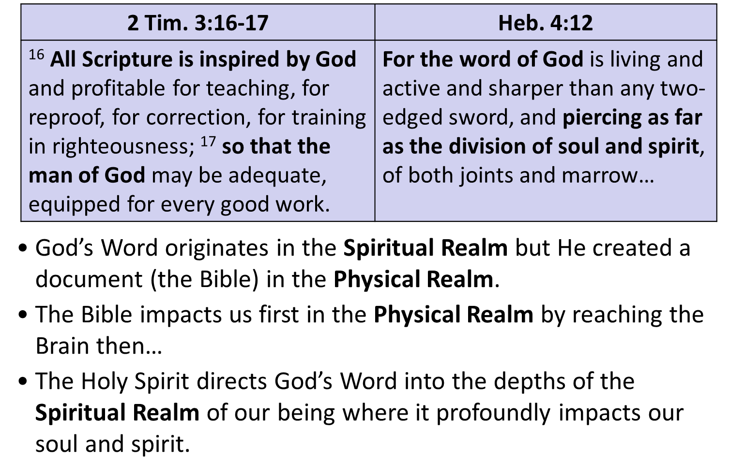

Spiritual Realm vs. Physical Realm
For unbelievers, that impact is for salvation…
Notes:
Spiritual Realm vs. Physical Realm
For unbelievers, that impact is for salvation…

Slide 41
Spiritual Realm vs. Physical Realm
For believers, that impact is for a number of God ordained processes that continue until we see Christ face to face.
Conforming
Transforming
Growth and maturity
Sanctification
Notes:
Spiritual Realm vs. Physical Realm
For believers, that impact is for a number of God ordained processes that continue until we see Christ face to face, including God’s processes of:
Conforming
Transforming
Growth & Maturity
Sanctification

Slide 42
Spiritual Realm vs. Physical Realm
So how’s your physical side handling all this new information?
Notes:
Spiritual Realm vs. Physical Realm
So how’s your physical side handling all this new information?
Take a deep breath, we’re almost done!

Slide 43

Have You Ever Considered…?
Physicians prescribe medications that impact people on the physical side. But, can anything prescribed by the Physician directly impact the spiritual realm?
Only God’s Word affects the spiritual realm because it reaches a depth that nothing else can reach.
Notes:
Have You Ever Considered…?
Physicians prescribe medications that impact people on the physical side. But, can anything prescribed by the Physician directly impact the spiritual realm?
Only God’s Word affects the spiritual realm because it reaches a depth that nothing else can reach.

Slide 44
Session 5 Outline
Spiritual Anatomy Part 3
  Review Session 4 Concepts
  Physical Realm vs. Spiritual Realm
    Introduction
      Misunderstanding Terms
      Correctly Understanding Terms
    Spiritual Realm vs. Physical Realm
      The 5 Senses – A Biblical Analogy*
      Proper Nourishment For Growth
  Review and Summation
Notes:
Session 5 Outline
*An analogy explains an idea or thing by comparing it to something that is familiar; a comparison between two things, typically for the purpose of explanation or clarification.

Slide 45
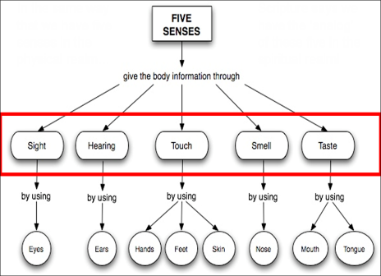
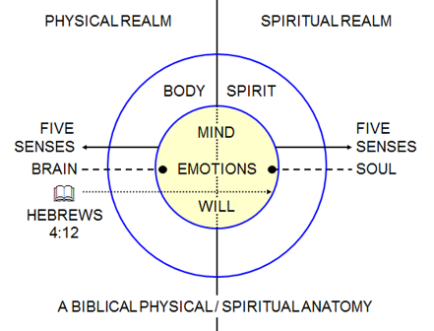
The 5 Senses – A Biblical Analogy*
We have 5 interactive senses in the physical realm…
… but Scripture signifies that we also have the ‘analog’ of these 5 senses in the spiritual realm.
Notes:
The 5 Senses – A Biblical Analogy
In the same way that we have five senses in the physical realm, Scripture says we have the ‘analog’ of these five in the spiritual realm.

Slide 46
The 5 Senses – A Biblical Analogy*
Touch | Gen. 32:24–25: …[God] touched the socket of [Jacob’s] thigh…
Taste | Psalm 34:8a: O taste and see that the Lord is good…
Smell | Amos 5:21: I hate, I despise your feast days, And I will not smell in your solemn assemblies. (cf. 2 Cor. 2:15–16)
Sight | 2 Cor. 4:3–4: ³ And even if our gospel is veiled, it is veiled to those who are perishing, ⁴ in whose case the god of this world has blinded the minds of the unbelieving so that they might not see the light of the gospel of the glory of Christ, who is the image of God. (cf. Ezekiel 12:2; Matt. 23:16–20; John 9:39–41; John 12:38–41; Rom. 2:17–20; Rom. 11:7–9; 2 Cor. 3:14; Eph. 1:18)
Hearing | Rom. 11:8: just as it is written, “God gave them a spirit of stupor, Eyes to see not and Ears to hear not, Down to this very day.”
Notes:
The 5 Senses – A Biblical Analogy

Slide 47
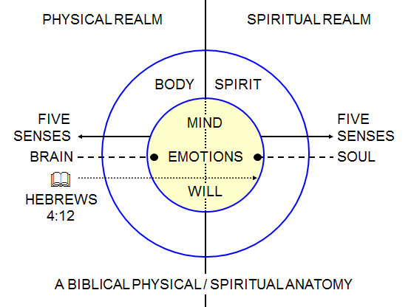
The 5 Senses – A Biblical Analogy*
The preceding passages clearly indicate that there is an “equivalent correlation” between the 5 senses in the Spiritual Realm and the 5 senses in the Physical Realm.
Contextually, Scripture often uses physical body parts to refer to the deepest part of man’s being – bowels, kidneys, joint and marrow, and heart (sometimes used for the spiritual side [soul and spirit] and the physical side – brain’s activity in thinking and emotion, and will), etc.
Notes:
The 5 Senses – A Biblical Analogy
The preceding passages indicate that there is an equivalent correlation between the 5 senses in the Spiritual Realm and the 5 senses in the Physical Realm.
Contextually, Scripture often uses physical body parts to refer to the deepest part of man’s being – bowels, kidneys, joint and marrow, and heart (sometimes used for the spiritual side [soul and spirit] and the physical side – brain’s activity in thinking and emotion, and will), etc.
Heart and Mind are not equivalent because it is too restrictive in that it deals primarily with memory and thought processes.

Slide 48


The 5 Senses – A Biblical Analogy*
While people can be diminished, distorted or nonfunctional in one or more of their physical senses, (my brother was born blind),…
…Scripture reveals that the believer’s spiritual senses can likewise be diminished, distorted or nonfunctional in the spiritual realm.
Notes:
The 5 Senses – A Biblical Analogy
While people can be diminished, distorted or nonfunctional in one or more of their physical senses, (my brother was born blind), Scripture reveals that the believer’s spiritual senses can likewise be diminished, distorted or nonfunctional in the spiritual realm.

Slide 49

The 5 Senses – A Biblical Analogy*
But, God’s perfect plan is for believers to operate in the full capacity of their spiritual senses.
Notes:
The 5 Senses – A Biblical Analogy
But, God’s perfect plan is for believers to operate in the full capacity of their spiritual senses.

Slide 50

The 5 Senses – A Biblical Analogy*
Deu. 18:10–12
¹⁰ “There shall not be found among you …one who uses divination, one who practices witchcraft, or one who interprets omens, or a sorcerer, ¹¹ or one who casts a spell, or a medium, or a spiritist, or one who calls up the dead. ¹² “For whoever does these things is detestable to the Lord…
Sorry Haley, there is no sixth sense…
Notes:
The 5 Senses – A Biblical Analogy

Slide 51
Session 5 Outline
Spiritual Anatomy Part 3
  Review Session 4 Concepts
  Physical Realm vs. Spiritual Realm
    Introduction
      Misunderstanding Terms
      Correctly Understanding Terms
    Spiritual Realm vs. Physical Realm
      The 5 Senses – A Biblical Analogy
      Proper Nourishment For Growth
  Review and Summation
Notes:
Session 5 Outline

Slide 52
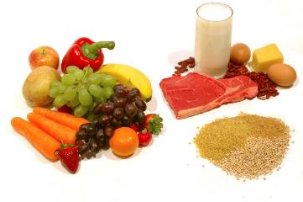
Proper Nourishment For Growth
Another aspect of the correlation between the Spiritual and Physical Realms relates to proper nourishment for growth.
Just as there is appropriate physical food based upon our varying levels of physical maturity; there is similarly appropriate ‘spiritual food’ (Scripture), based upon the believer’s varying levels of spiritual maturity.
Notes:
Proper Nourishment For Growth
Another aspect of the correlation between the Spiritual and Physical Realms relates to proper nourishment for growth.
Just as there is appropriate physical food based upon our varying levels of physical maturity; there is similarly appropriate ‘spiritual food’ (Scripture), based upon the believer’s varying levels of spiritual maturity.

Slide 53
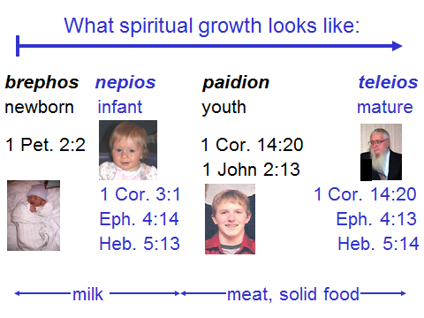
Proper Nourishment For Growth
Notes:
Proper Nourishment For Growth

Slide 54
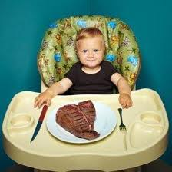


Proper Nourishment For Growth
Notes:
Proper Nourishment For Growth
Just as there is an appropriate physical food for varying levels of physical maturity, Scripture is presented to believers as ‘spiritual food’, with appropriate food for varying levels of spiritual maturity.

Slide 55
Session 5 Outline
Spiritual Anatomy Part 3
  Review Session 4 Concepts
  Physical Realm vs. Spiritual Realm
    Introduction
      Misunderstanding Terms
      Correctly Understanding Terms
    Spiritual Realm vs. Physical Realm
    The 5 Senses – A Biblical Analogy
    Proper Nourishment For Growth
  Review and Summation
Notes:
Session 5 Outline

Slide 56
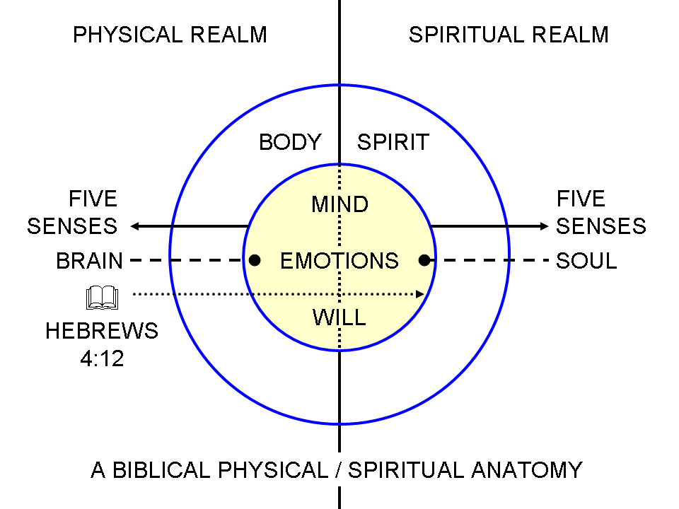
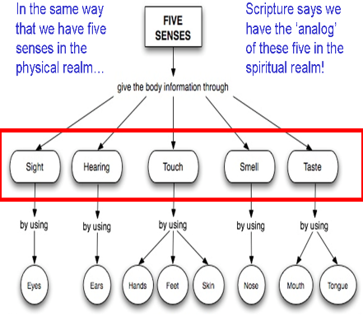
  Review and Summation
There are several key insights regarding what God is doing in the life of the believer to be gleaned from the charts and text below.
Notes:
Review and Summation
There are several key insights regarding what God is doing in the life of the believer to be gleaned from the charts and text below.

Slide 57
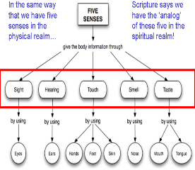
  Review and Summation
The Bible says that God, who dwells in the eternal present in the Spiritual Realm (John 8:58), is the basis of and the origin of the Physical Realm.
All spiritual error of whatever degree is based in misunderstanding of, or denial of the existence of the Spiritual Realm and/or the relationship of the Physical Realm to the Spiritual Realm.
Notes:
Review and Summation
Key Insights
The Bible says that God, who dwells in the eternal present in the spiritual realm (John 8:58), is the basis of and the origin of the physical realm.
All spiritual error of whatever degree is based in misunderstanding of or denial of the existence of the spiritual realm or the relationship of the physical to the spiritual realm.

Slide 58

  Review and Summation
When the Bible says that the unbeliever is spiritually dead, it is not saying that the unbeliever has no spirit or soul, but rather that the unbeliever’s spirit and soul are separated from God – biblically, to be separated from God is spiritually death.
Notes:
Review and Summation
Key Insights
When the Bible says that the unbeliever is spiritually dead, it is not saying that the unbeliever has no spirit or soul, but rather that the unbeliever’s spirit and soul are separated from God – biblically, to be separated from God is spiritually death.

Slide 59
  Review and Summation
Physical death takes place when the physical body stops functioning and the soul and spirit are separated from the physical body in death.
Ultimately, as believers, our soul and spirit are joined to a new body like Christ’s resurrection body at the Rapture. That body will not have a Sin Nature associated with it.
Notes:
Review and Summation
Physical death takes place when the physical body stops functioning and the soul and spirit are separated from the physical body in death.
Ultimately, as believers, our soul and spirit are joined to a new body like Christ’s resurrection body at the Rapture. That body will not have a Sin Nature associated with it.

Slide 60
  Review and Summation
The New Body freed from the influence of the Sin Nature is Paul’s desire for the Thessalonian believers.
1 Thess. 5:23
Now may the God of peace Himself sanctify you entirely; and may your spirit and soul and body be preserved complete, without blame at the coming of our Lord Jesus Christ.
Notes:
Review and Summation
This is the complete fulfillment of Paul’s desire for the believers, as expressed in 1 Thess. 5:23.

Slide 61
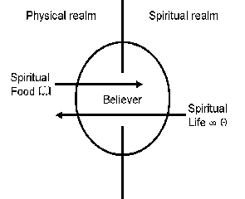

  Review and Summation
The appeal to believers is to have a continuous ingesting of appropriate spiritual nourishment (God’s Word), so as to be impacted spiritually and then to then impact others.
The various dietary characteristics of physical nourishment provide a type or pattern with spiritual nourishment; appropriateness for a specific stage of maturity, quantity, quality, timing and frequency, etc. (1 Cor. 3:1; 14:20; Eph. 4:12, 13, 14; Heb. 5:13, 14; 1 Pet. 2:2; 1 John 2:13).
Notes:
Review and Summation
The appeal to believers is to have a continuous ingesting of appropriate spiritual nourishment (God’s Word), so as to be impacted spiritually.
The various dietary characteristics of physical nourishment provide a type or pattern with spiritual nourishment; appropriateness for a specific stage of maturity, quantity, quality, timing and frequency, etc. (1 Cor. 3:1; 14:20; Eph. 4:12, 13, 14; Heb. 5:13, 14; 1 Pet. 2:2; 1 John 2:13).

Slide 62
  Review and Summation
God will use the things that take place in the physical realm to have an impact on us in the spiritual realm (James 1:2; Rom. 8:28-29).
James 1:2
Consider it all joy, my brethren, when you encounter various trials,
Romans 8:28–29
²⁸ And we know that God causes all things to work together for good to those who love God, to those who are called according to His purpose. ²⁹ For those whom He foreknew, He also predestined to become conformed to the image of His Son, so that He would be the firstborn among many brethren;
Notes:
Review and Summation
God will use the things that take place in the physical realm to have an impact on us in the spiritual realm (James 1:2; Rom. 8:28-29).
Our perspective on and spiritually insightful response to those physical circumstances can have a big impact on whether God’s intent for those physical events and circumstances have the desired spiritual outcome, or not.

Slide 63



  Review and Summation
Our senses in the spiritual realm are intended by God to be fully functional. This is dependent upon our consistent, unbroken, fellowship with the Lord, and our intake of, and correct understanding of, God’s Word.
It is possible for one or more of our physical senses to be in decline or be diminished in capacity, but to have our spiritual senses improving in utility and function at the same time.
Notes:
Review and Summation
Our senses in the spiritual realm are intended by God to be fully functional, and the functionality of those senses depend upon our fellowship with the Lord, our intake of and correct understanding of God’s word.
It is possible for one or more of our physical senses to be in decline or be diminished in capacity, but to have our spiritual senses improving in utility and function at the same time.

Slide 64
  Review and Summation
What God is doing in the life of the believer will indeed involve physically based processes and events, but the ultimate intent is for spiritual impact.
Through careful, consistent, and diligent study of Scripture, the Holy Spirit reveals what those physically based processes are, and how they are to impact us.
Notes:
Review and Summation
What God is doing in the life of the believer will indeed involve physically based processes and events, but the ultimate intent is for spiritual impact.
Through careful, consistent, and diligent study of Scripture, the Holy Spirit reveals what those physically based processes are, and how they are to impact us.

Slide 65
  Review and Summation
Ultimately all the processes that God carries out in our lives, whether originating from the physical or the spiritual realms, are intended to change the Continuing Person of the believer to prepare him for life in the Spiritual Realm.
Notes:
Review and Summation
Ultimately all the processes that God carries out in our lives, whether originating from the physical or the spiritual realms, are intended to change the Continuing Person of the believer to prepare him for life in the Spiritual Realm.

Slide 66

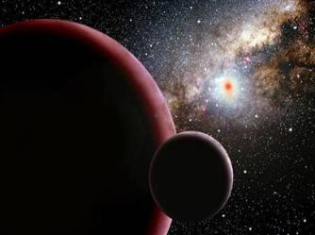
  Review and Summation
Remember, although it will experience a thousand years of considerable release from the curse of the Fall, when all things are summed up in Christ; (Eph. 1:9-10), this present Physical Realm is ultimately terminal.
Scripture promises that God will exchange this present heaven and earth for a new one (cf. 2 Cor. 2:14-16; 4:4; Eph. 1:18-19a; 4:19; Heb. 5:11-14; 1 Pet. 2:1-3). This is the reason for our spiritual preparation now!
Notes:
Review and Summation
Remember, although it will experience a thousand years of considerable release from the curse of the Fall when all things are summed up in Christ; (Eph. 1:9-10), this present Physical Realm is ultimately terminal.
Scripture promises that God will exchange this present heaven and earth for a new one (cf. 2 Cor. 2:14-16; 4:4; Eph. 1:18-19a; 4:19; Heb. 5:11-14; 1 Pet. 2:1-3).

Slide 67
Session 5 Outline
Spiritual Anatomy Part 3
  Review Session 4 Concepts
  Physical Realm vs. Spiritual Realm
    Introduction
      Misunderstanding Terms
      Correctly Understanding Terms
    Spiritual Realm vs. Physical Realm
      The 5 Senses – A Biblical Analogy
      Proper Nourishment For Growth
  Review and Summation
Notes:
Session 5 Outline

