Slide 1

THE BOOK OF DANIEL
Dr. Andy Woods

Slide 2

Message
Times of the Gentiles are revealed prophetically (2, 7, 8-12) and ethically (1, 3-6)

Slide 3

Synthetic Outline
Historical (1-7):
  Daniel interprets, 3rd person, gentile nations
  Intro “Hebrew” (1)
  Aramaic chiasm (2-7)

Slide 4
Synthetic Outline
Prophetic (8-12):
  Angel interprets, 1st person, Jewish nation, Hebrew
  Ram & Goat (8)
  70 weeks (9)
  Final vision (10-12)

Slide 5
Synthetic Outline
Historical (1-7):
  Daniel interprets, 3rd person, gentile nations
  Intro “Hebrew” (1)
  Aramaic chiasm (2-7)

Slide 6
Synthetic Outline
Historical (1-7):
  Daniel interprets, 3rd person, gentile nations
  Intro “Hebrew” (1)
  Aramaic chiasm (2-7)

Slide 7

Synthetic Outline
  Chiasm “Aramaic” ( 2-7)
1. Gentile History (2)
  2. Protection (3)
    3. Revelation to a gentile king (4)
    3. Revelation to a gentile king (5)
  2. Protection (6)
1. Gentile history (7)

Slide 8
Synthetic Outline
  Chiasm “Aramaic” ( 2-7)
1. Gentile History (2)
  2. Protection (3)
    3. Revelation to a gentile king (4)
    3. Revelation to a gentile king (5)
  2. Protection (6)
1. Gentile history (7)

Slide 9
Synthetic Outline
  Chiasm “Aramaic” ( 2-7)
1. Gentile History (2)
  2. Protection (3)
    3. Revelation to a gentile king (4)
    3. Revelation to a gentile king (5)
  2. Protection (6)
1. Gentile history (7)

Slide 10
Chapter 3 Outline
The Setting (3:1-7)
The Accusation (3:8-12)
The Test (3:13-18)
The Deliverance (3:19-27)
The Decree (3:28-30)

Slide 11
Chapter 3 Outline
The Setting (3:1-7)
The Accusation (3:8-12)
The Test (3:13-18)
The Deliverance (3:19-27)
The Decree (3:28-30)

Slide 12
I. The Setting (3:1-7)
  The Image (3:1)
  The Summons (3:2-3)
  The Command (3:4-6)
  The Peoples’ Response (3:7)

Slide 13
I. The Setting (3:1-7)
  The Image (3:1)
  The Summons (3:2-3)
  The Command (3:4-6)
  The Peoples’ Response (3:7)

Slide 14
CHAPTER AND VERSE IN DANIEL | CHRONOLOGICAL DATE | BIBLICAL DATE
1:1 | 605 | 3rd year of Jehoiakim
2:1 | 603 | 2nd year of Nebuchadnezzar
5 | Sat. night 10/12/539 (Hoehner)
7:1 | 553 | 1st year of Belshazzar
8:1 | 551 | 3rd year of Belshazzar
9:1 | 538 | 1st year of Darius
10:1 | 536 | 3rd year of Cyrus

Slide 15
Daniel’s Age
CHAPTER | EVENTS | AGE
1 | Taken into Babylonian Captivity | 15
2 | Interpreting Nebuchadnezzar’s 1st dream (huge image) | 17
3 | Daniel’s 3 friends cast into the fiery furnace | 19 or 20
4 | Interpreting Nebuchadnezzar’s 2nd dream (huge tree) | 45-50
5 | Interpreting handwriting of the wall at Belshazzar’s feast | Early 80’s
6 | Delivered from the den of lions | c.83
7-8 | Daniel’s visions and dreams | Mid-60’s
9 | Daniel’s seventy “sevens” prophecy | Early-80’s
10-12 | Final dreams and visions | Mid-80’s

Slide 16

Succession of Gentile Rulers
1-4: Nebuchadnezzar of Babylon
5: Belshazzar of Babylon
6: Darius of Media-Persia
7-8: Belshazzar of Babylon
9: Darius of Media-Persia
10-12: Cyrus of Media-Persia

Slide 17
Succession of Gentile Rulers
1-4: Nebuchadnezzar of Babylon
5: Belshazzar of Babylon
6: Darius of Media-Persia
7-8: Belshazzar of Babylon
9: Darius of Media-Persia
10-12: Cyrus of Media-Persia

Slide 18
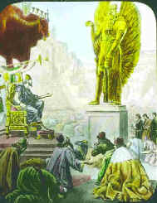
Nebuchadnezzar’s Image (3:1)
90 feet high & 9 feet wide
8 stories
No internal chronological markers

Slide 19

Statue
&
Stone

Slide 20
I. The Setting (3:1-7)
  The Image (3:1)
  The Summons (3:2-3)
  The Command (3:4-6)
  The Peoples’ Response (3:7)

Slide 21
Nebuchadnezzar’s Summons (3:2-3)
The administrators are gathered to dedicate the image
8 classes of administrators

Slide 22
I. The Setting (3:1-7)
  The Image (3:1)
  The Summons (3:2-3)
  The Command (3:4-6)
  The Peoples’ Response (3:7)

Slide 23
Nebuchadnezzar’s Command (3:4-6)
Exodus 20:1-6
Purpose of government (Gen 6:11; 9:6; Rom 13:1-7; 1 Tim 2:1-4; 1 Pet 2:23-15)
Civil disobedience (Dan 3; 6; Acts 5:29)

Slide 24
Noahic vs. Abrahamic & Mosaic Covenants
Name | Noahic Covenant | Abrahamic Covenant | Mosaic Covenant
Human agent | Noah | Abraham | Moses
Scripture | Gen. 8‒9 | Gen. 12‒17 | Exod. 19‒40
Covenant (Berith) | Gen. 9:9 | Gen. 15:18 | Exod. 19:5
Party | World, humanity | Israel, Hebrews | Israel, Hebrews
Israel | Pre-Israel | Post-Israel | Post-Israel

Slide 25
Noahic vs. Abrahamic & Mosaic Covenants
 | Noahic Covenant | Abrahamic Covenant | Mosaic Covenant
Conditional or unconditional | Unconditional | Unconditional | Conditional
Promises | No more flood judgment, enduring earth, capital punishment | Ownership of land, seed, and blessing | Enjoyment or possession of land, seed, and blessing
Sign | Rainbow | Circumcision | Sabbath
Purpose | Restrain & preserve | Redemptive | Redemptive
Directly binding today? | Yes | No | No

Slide 26
Synthetic Outline
  Chiasm “Aramaic” ( 2-7)
1. Gentile History (2)
  2. Protection (3)
    3. Revelation to a gentile king (4)
    3. Revelation to a gentile king (5)
  2. Protection (6)
1. Gentile history (7)

Slide 27
Synthetic Outline
  Chiasm “Aramaic” ( 2-7)
1. Gentile History (2)
  2. Protection (3)
    3. Revelation to a gentile king (4)
    3. Revelation to a gentile king (5)
  2. Protection (6)
1. Gentile history (7)

Slide 28
Principles of Civil Disobedience
Clear conflict between the laws of man and God
Exhaustion of all creative legal remedies
A willingness to pay the consequences
Maintaining of respect for civil authorities

Slide 29
Baker Faces Prison for Refusing to Bake Same-Sex Wedding Cake
“Jack Phillips is a baker who declined to bake a wedding cake for a same-sex couple because his Christian belief is that marriage exists only between a man and woman. Now a Colorado judge has ordered him to bake cakes for same-sex marriages, and if Phillips refuses, he could go to jail.”
Ken Klukowski, “Baker Faces Prison for Refusing to Bake Same-Sex Wedding Cake,” online: http://www.breitbart.com/Big-Government/2013/12/12/Christian-Baker-Willing-to-Go-to-Jail-for-Declining-Gay-Wedding-Cake, 12 December 2013, accessed 16 May 2014.

Slide 30
Oregon Declares War on Aaron & Melissa Klein
“In yet another example of gay activist overreach, an Oregon official has not only burdened a Christian couple with a ridiculous fine, he has imposed a gag order on them…In one of the most egregious anti-Christian acts committed by a state official in recent memory, Oregon Labor Commissioner Brad Avakian not only upheld the ridiculous $135,000 fine levied against Aaron and Melissa Klein for declining to bake a cake for a lesbian commitment ceremony, but he ordered the Kleins to ‘cease and desist’ from making any public comments about their religious convictions relative to this case.”
http://www.onenewsnow.com/perspectives/michael-brown/2015/07/06/oregon-declares-war-on-christian-faith

Slide 31
Nebuchadnezzar’s Command (3:4-6)
Musical instruments
Dating Argument

Slide 32
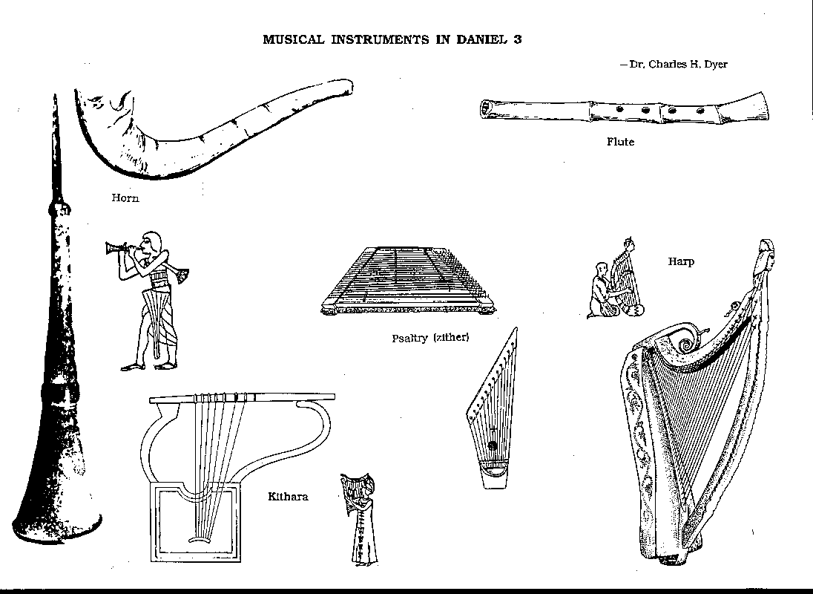
INSTRUMENTS

Slide 33
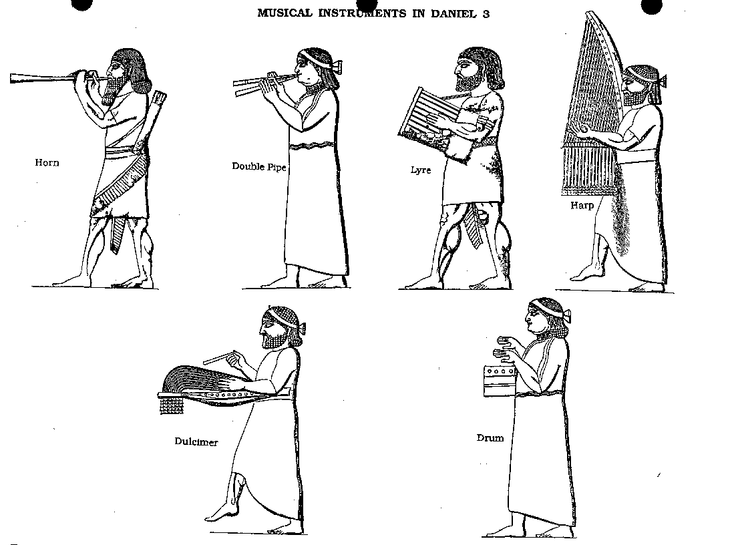
INSTRUMENTS 2

Slide 34
I. The Setting (3:1-7)
  The Image (3:1)
  The Summons (3:2-3)
  The Command (3:4-6)
  The Peoples’ Response (3:7)

Slide 35
Chapter 3 Outline
The Setting (3:1-7)
The Accusation (3:8-12)
The Test (3:13-18)
The Deliverance (3:19-27)
The Decree (3:28-30)

Slide 36
II. The Accusation (3:8-12)
Jealousy (2:49; 6:3-4; Acts 5:17)
Monotheism (Esther 3:1-6)
John 14:6; Acts 4:12; 1 Tim. 2:5
Where is Daniel? 2:49

Slide 37
Synthetic Outline
  Chiasm “Aramaic” ( 2-7)
1. Gentile History (2)
  2. Protection (3)
    3. Revelation to a gentile king (4)
    3. Revelation to a gentile king (5)
  2. Protection (6)
1. Gentile history (7)

Slide 38

“…one of the mistakes that human beings make is believing that there is only one way…We don’t accept that there are diverse ways of being in the world; that there are millions of ways to be a human being. And many ways…many paths to what you call God. That her path might be something else and when she gets there she might call it the light. But her loving, and her kindness, and her generosity brings her to the…same point that it brings you…
www.youtube.com/watch?v=Lb2RUpMDk34

Slide 39
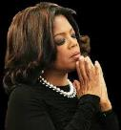
…It doesn’t matter whether she called it ‘God’ along the way or not…There couldn’t possibly be just one way!…There couldn’t possibly be only one way with millions of people in the world!...You think…if you are somewhere on the planet and you never hear the name of Jesus but yet you live with a loving heart. You lived as Jesus would have had you to live. You lived for the same purpose as Jesus came to the planet to teach us all, but you are in some remote part of the earth and you never heard the name of Jesus. You cannot get to Heaven…?”
www.youtube.com/watch?v=Lb2RUpMDk34

Slide 40
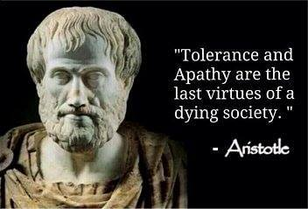

Slide 41

Daniel 2:48-49 (NASB)
“Then the king promoted Daniel and gave him many great gifts, and he made him ruler over the whole province of Babylon and chief prefect over all the wise men of Babylon. ⁴⁹ And Daniel made request of the king, and he appointed Shadrach, Meshach and Abed-nego over the administration of the province of Babylon, while Daniel was at the king’s court.”

Slide 42
Chapter 3 Outline
The Setting (3:1-7)
The Accusation (3:8-12)
The Test (3:13-18)
The Deliverance (3:19-27)
The Decree (3:28-30)

Slide 43

The Test (3:13-18)
Nebuchadnezzar’s ultimatum (3:13-15)
Battle over sovereignty (3:15b)
The response (3:16-18)
  Heb. 11:35b
  Principles of civil disobedience
    Willingness to pay consequences
    Maintain respect for the king

Slide 44
Changing of the names
Jewish names (Deut. 6:6-7; Prov. 22:6)
  Daniel – God is my judge
  Hananiah – Yahweh is gracious
  Mishael – Who is what God is?
  Azariah – Yahweh has helped

Slide 45
Changing of the names
Babylonian names (Gen 2:19; Rom 12:2)
  Beltshazzar – Lady protect the king
  Shadrach – I am fearful of God
  Meshach – I am of little account
  Abed-nego – Servant of Nebo

Slide 46
Principles of Civil Disobedience
Clear conflict between the laws of man and God
Exhaustion of all creative legal remedies
A willingness to pay the consequences
Maintaining of respect for civil authorities

Slide 47
Chapter 3 Outline
The Setting (3:1-7)
The Accusation (3:8-12)
The Test (3:13-18)
The Deliverance (3:19-27)
The Decree (3:28-30)

Slide 48
IV. The Deliverance (3:19-27)
  Cast Into the Furnace (3:19-23)
  Protected in the Furnace (3:24-25)
  Summoned Out of the Furnace (3:26-27)

Slide 49
IV. The Deliverance (3:19-27)
  Cast Into the Furnace (3:19-23)
  Protected in the Furnace (3:24-25)
  Summoned Out of the Furnace (3:26-27)

Slide 50
IV. The Deliverance (3:19-27)
  Cast Into the Furnace (3:19-23)
  Protected in the Furnace (3:24-25)
  Summoned Out of the Furnace (3:26-27)

Slide 51
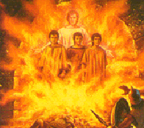
IV. The Deliverance (3:19-27)
Hebrews are cast into the fire (3:19-23)
Hebrews are protected (3:24-25)
  Theophany?
  God’s faithfulness
  Intellectual v. experiential
Hebrews summoned out of the fire (3:26-27)

Slide 52
Synthetic Outline
  Chiasm “Aramaic” ( 2-7)
1. Gentile History (2)
  2. Protection (3)
    3. Revelation to a gentile king (4)
    3. Revelation to a gentile king (5)
  2. Protection (6)
1. Gentile history (7)

Slide 53
IV. The Deliverance (3:19-27)
  Cast Into the Furnace (3:19-23)
  Protected in the Furnace (3:24-25)
  Summoned Out of the Furnace (3:26-27)

Slide 54
Chapter 3 Outline
The Setting (3:1-7)
The Accusation (3:8-12)
The Test (3:13-18)
The Deliverance (3:19-27)
The Decree (3:28-30)

Slide 55
V. The Decree (3:28-30)
  Exaltation of God (3:28)
  The Decree (3:29)
  Prosperity (3:30)

Slide 56
V. The Decree (3:28-30)
  Exaltation of God (3:28)
  The Decree (3:29)
  Prosperity (3:30)

Slide 57
The Decree (3:28-30)
Exaltation of God (3:28)
  God at work on Nebuchadnezzar (2:47; 3:28-29; 4:35-37)
  Why God allows trials
The decree
  Preservation
  Sovereignty
Promotion
  How to live
  God blesses a lack of compromise (1:15-15; 2:48)

Slide 58
V. The Decree (3:28-30)
  Exaltation of God (3:28)
  The Decree (3:29)
  Prosperity (3:30)

Slide 59
V. The Decree (3:28-30)
  Exaltation of God (3:28)
  The Decree (3:29)
  Prosperity (3:30)

Slide 60
Conclusion

Slide 61
Chapter 3 Outline
The Setting (3:1-7)
The Accusation (3:8-12)
The Test (3:13-18)
The Deliverance (3:19-27)
The Decree (3:28-30)

Slide 62

Takeaways from Daniel 3
Mosaic Law taught Israel how to live inside the land
The examples of the four Hebrew youths taught them how to live outside the land
Consecrate themselves to God
Live by faith from crisis to crisis entrusting the results to God
Allow God to promote us in His due time
Our cue as well

