Slide 1


Slide 2

The Coming Kingdom
Chapter 4
Dr. Andy Woods
Senior Pastor – Sugar Land Bible Church
Adjunct Professor of Bible & Theology – College of Biblical Studies

Slide 3

Kingdom Study Outline
What does the Bible Say About the Kingdom?
The Main Problem with Kingdom Now NT interpretations
Why do some believe that we are in the kingdom now?
Why does it matter?

Slide 4
Kingdom Study Outline
What does the Bible Say About the Kingdom?
The Main Problem with Kingdom Now NT interpretations
Why do some believe that we are in the kingdom now?
Why does it matter?

Slide 5
1. Kingdom Throughout the Bible
Eden Abrahamic Covenant Mosaic Covenant Divided Kingdom Times of the Gentiles | Old Testament Prophets Post exile Offer of the King / Kingdom Rejection of the Offer Interim Age

Slide 6
1. Kingdom Throughout the Bible
Eden Abrahamic Covenant Mosaic Covenant Divided Kingdom Times of the Gentiles | Old Testament Prophets Post exile Offer of the King / Kingdom Rejection of the Offer Interim Age

Slide 7
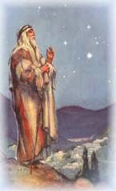
Abrahamic Covenant of Genesis 15
Necessity (Gen. 11:1-9)
Promises (Gen. 12:1-3, 7)
Literal (Gen. 11:31; 13:14-17)
To Abram’s physical descendants (Gen. 15:4-5)
Covenantal (Gen. 15:18)
Land, Seed, Blessing (Gen. 15: 1, 4-5, 18-21)
Reliable (Num. 23:19; Titus 1:2; Heb. 6:18)
Basis of the sub-covenants
Unconditional
Unfulfilled
Conclusion

Slide 8
1. Kingdom Throughout the Bible
Eden Abrahamic Covenant Mosaic Covenant Divided Kingdom Times of the Gentiles | Old Testament Prophets Post exile Offer of the King / Kingdom Rejection of the Offer Interim Age

Slide 9
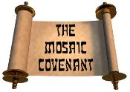
Mosaic Covenant of Exodus 19–24
Sinai Revelation (Gen. 15:13-16; Ps. 147:19-20)
Limited restoration of Theocratic Administrator (Exod. 19:6; Rom. 5:13-14)
Conditional covenant (Exod. 19:6)
Ownership vs. possession-enjoyment (Hos. 4:1ff; Ezek. 43:9)
Mosaic Covenant points to Christ (Deut. 17:15; John 5:47-49)
Kingdom’s coming based on Israel’s response to Christ (Luke 19:41-44; Matt. 23:37-39)
Purpose of the Tribulation (Dan. 9:24-27; Matt. 24:15, 20-22, 31; 25:31; Deut. 4:30; Jer. 30:7; Zech. 12:10)

Slide 10
Mosaic Covenant of Exodus 19–24
Sinai Revelation (Gen. 15:13-16; Ps. 147:19-20)
Limited restoration of Theocratic Administrator (Exod. 19:6; Rom. 5:13-14)
Conditional covenant (Exod. 19:6)
Ownership vs. possession-enjoyment (Hos. 4:1ff; Ezek. 43:9)
Mosaic Covenant points to Christ (Deut. 17:15; John 5:47-49)
Kingdom’s coming based on Israel’s response to Christ (Luke 19:41-44; Matt. 23:37-39)
Purpose of the Tribulation (Dan. 9:24-27; Matt. 24:15, 20-22, 31; 25:31; Deut. 4:30; Jer. 30:7; Zech. 12:10)

Slide 11
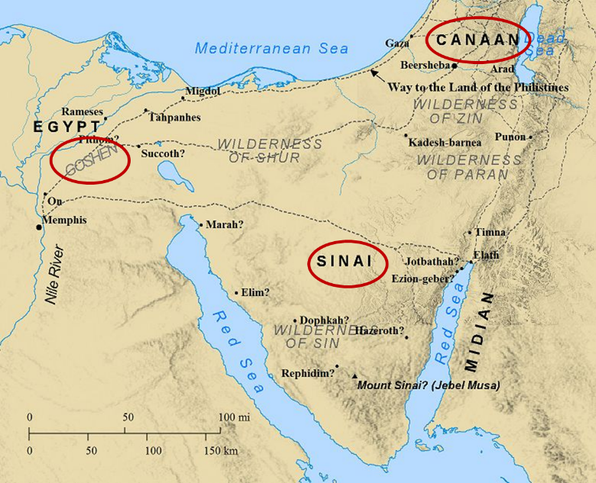

Slide 12
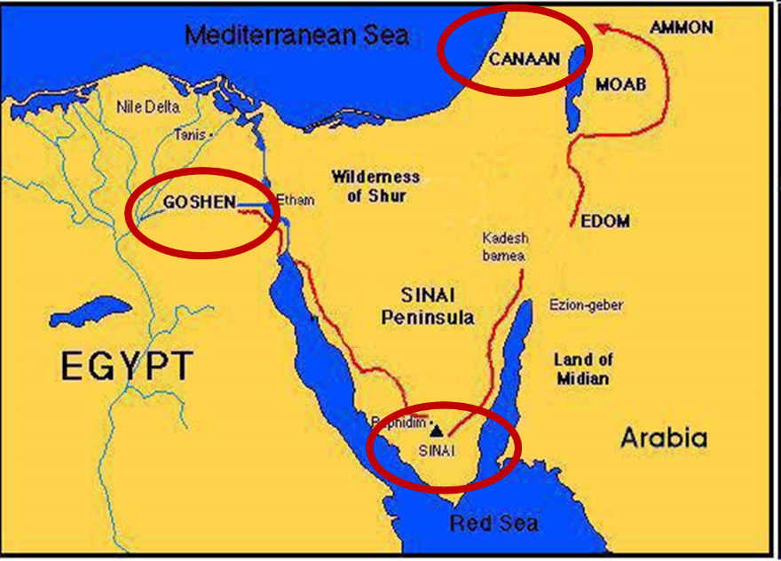

Slide 13


Psalm 147:19-20
“He declares His words to Jacob, His statutes and His ordinances to Israel. He has not dealt thus with any nation; And as for His ordinances, they have not known them. Praise the Lord!”

Slide 14
Mosaic Covenant of Exodus 19–24
Sinai Revelation (Gen. 15:13-16; Ps. 147:19-20)
Limited restoration of Theocratic Administrator (Exod. 19:6; Rom. 5:13-14)
Conditional covenant (Exod. 19:6)
Ownership vs. possession-enjoyment (Hos. 4:1ff; Ezek. 43:9)
Mosaic Covenant points to Christ (Deut. 17:15; John 5:47-49)
Kingdom’s coming based on Israel’s response to Christ (Luke 19:41-44; Matt. 23:37-39)
Purpose of the Tribulation (Dan. 9:24-27; Matt. 24:15, 20-22, 31; 25:31; Deut. 4:30; Jer. 30:7; Zech. 12:10)

Slide 15
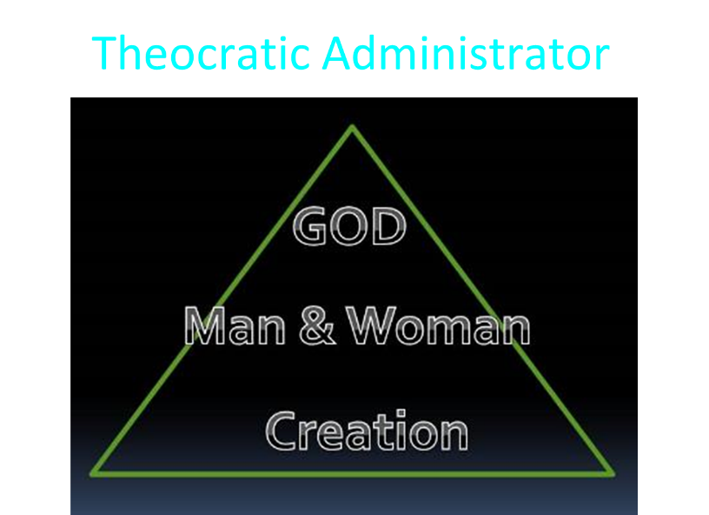

Slide 16

Exodus 19:5-6
“Now then, if you will indeed obey My voice and keep My covenant, then you shall be My own possession among all the peoples, for all the earth is Mine; and you shall be to Me a kingdom of priests and a holy nation.’ These are the words that you shall speak to the sons of Israel.”

Slide 17
Exodus 19:5-6
“Now then, if you will indeed obey My voice and keep My covenant, then you shall be My own possession among all the peoples, for all the earth is Mine; and you shall be to Me a kingdom of priests and a holy nation.’ These are the words that you shall speak to the sons of Israel.”

Slide 18
Romans 5:13-14
“for until the Law sin was in the world, but sin is not imputed when there is no law. ¹⁴ Nevertheless death reigned from Adam until Moses, even over those who had not sinned in the likeness of the offense of Adam, who is a type of Him who was to come.”

Slide 19
Mosaic Covenant of Exodus 19–24
Sinai Revelation (Gen. 15:13-16; Ps. 147:19-20)
Limited restoration of Theocratic Administrator (Exod. 19:6; Rom. 5:13-14)
Conditional covenant (Exod. 19:6)
Ownership vs. possession-enjoyment (Hos. 4:1ff; Ezek. 43:9)
Mosaic Covenant points to Christ (Deut. 17:15; John 5:47-49)
Kingdom’s coming based on Israel’s response to Christ (Luke 19:41-44; Matt. 23:37-39)
Purpose of the Tribulation (Dan. 9:24-27; Matt. 24:15, 20-22, 31; 25:31; Deut. 4:30; Jer. 30:7; Zech. 12:10)

Slide 20

Evidence of Abrahamic Covenant’s Unconditional Nature
ANE covenant ratification ceremony (Gen 15)
Lack of stated conditions for Israel’s obedience (Gen 15)
Covenant's eternality (Gen 17:7, 13, 19; Ps. 90:2)
Covenant's immutability (Heb 6:13-18; Mal. 3:6)
Trans-generational reaffirmation despite perpetual national disobedience (Jer 31:35-37)
Walvoord, The Millennial Kingdom, 149-52

Slide 21
Proverbs 3:5-6
“Trust in the Lord with all your heart And do not lean on your own understanding. In all your ways acknowledge Him, And He will make your paths straight.”

Slide 22
Exodus 19:5-6
“Now then, if you will indeed obey My voice and keep My covenant, then you shall be My own possession among all the peoples, for all the earth is Mine; and you shall be to Me a kingdom of priests and a holy nation.’ These are the words that you shall speak to the sons of Israel.”

Slide 23
Six Parts of a Suzerain-Vassal Treaty in Deuteronomy
Preamble (1:1-5)
Prologue (1:6–4:40)
Covenant obligations (5–26)
Storage and reading instructions (27:2-3; 31:9, 24, 26)
Witnesses (32:1)
Blessings and curses (28)

Slide 24
Six Parts of a Suzerain-Vassal Treaty in Deuteronomy
Preamble (1:1-5)
Prologue (1:6–4:40)
Covenant obligations (5–26)
Storage and reading instructions (27:2-3; 31:9, 24, 26)
Witnesses (32:1)
Blessings and curses (28)

Slide 25
Mosaic Covenant of Exodus 19–24
Sinai Revelation (Gen. 15:13-16; Ps. 147:19-20)
Limited restoration of Theocratic Administrator (Exod. 19:6; Rom. 5:13-14)
Conditional covenant (Exod. 19:6)
Ownership vs. possession-enjoyment (Hos. 4:1ff; Ezek. 43:9)
Mosaic Covenant points to Christ (Deut. 17:15; John 5:47-49)
Kingdom’s coming based on Israel’s response to Christ (Luke 19:41-44; Matt. 23:37-39)
Purpose of the Tribulation (Dan. 9:24-27; Matt. 24:15, 20-22, 31; 25:31; Deut. 4:30; Jer. 30:7; Zech. 12:10)

Slide 26
Hosea 4:1-2 (NASB)
“Listen to the word of the Lord, O sons of Israel, For the Lord has a case against the inhabitants of the land, Because there is no faithfulness or kindness Or knowledge of God in the land.² There is swearing, deception, murder, stealing and adultery. They employ violence, so that bloodshed follows bloodshed.”

Slide 27
Six Parts of a Suzerain-Vassal Treaty in Deuteronomy
Preamble (1:1-5)
Prologue (1:6–4:40)
Covenant obligations (5–26)
Storage and reading instructions (27:2-3; 31:9, 24, 26)
Witnesses (32:1)
Blessings and curses (28)

Slide 28


Slide 29
Mosaic Covenant of Exodus 19–24
Sinai Revelation (Gen. 15:13-16; Ps. 147:19-20)
Limited restoration of Theocratic Administrator (Exod. 19:6; Rom. 5:13-14)
Conditional covenant (Exod. 19:6)
Ownership vs. possession-enjoyment (Hos. 4:1ff; Ezek. 43:9)
Mosaic Covenant points to Christ (Deut. 17:15; John 5:47-49)
Kingdom’s coming based on Israel’s response to Christ (Luke 19:41-44; Matt. 23:37-39)
Purpose of the Tribulation (Dan. 9:24-27; Matt. 24:15, 20-22, 31; 25:31; Deut. 4:30; Jer. 30:7; Zech. 12:10)

Slide 30
Deuteronomy 17:15
“you shall surely set a king over you whom the Lord your God chooses, one from among your countrymen you shall set as king over yourselves; you may not put a foreigner over yourselves who is not your countryman.”

Slide 31
John 5:45-47
“Do not think that I will accuse you before the Father; the one who accuses you is Moses, in whom you have set your hope. ⁴⁶ For if you believed Moses, you would believe Me, for he wrote about Me. ⁴⁷ But if you do not believe his writings, how will you believe My words?”

Slide 32
Mosaic Covenant of Exodus 19–24
Sinai Revelation (Gen. 15:13-16; Ps. 147:19-20)
Limited restoration of Theocratic Administrator (Exod. 19:6; Rom. 5:13-14)
Conditional covenant (Exod. 19:6)
Ownership vs. possession-enjoyment (Hos. 4:1ff; Ezek. 43:9)
Mosaic Covenant points to Christ (Deut. 17:15; John 5:47-49)
Kingdom’s coming based on Israel’s response to Christ (Luke 19:41-44; Matt. 23:37-39)
Purpose of the Tribulation (Dan. 9:24-27; Matt. 24:15, 20-22, 31; 25:31; Deut. 4:30; Jer. 30:7; Zech. 12:10)

Slide 33
Luke 19:41-44
“When He approached Jerusalem, He saw the city and wept over it, ⁴² saying, “If you had known in this day, even you, the things which make for peace! But now they have been hidden from your eyes. ⁴³ For the days will come upon you when your enemies will throw up a barricade against you, and surround you and hem you in on every side, ⁴⁴ and they will level you to the ground and your children within you, and they will not leave in you one stone upon another, because you did not recognize the time of your visitation.”

Slide 34
Matthew 23:37-39
“Jerusalem, Jerusalem, who kills the prophets and stones those who are sent to her! How often I wanted to gather your children together, the way a hen gathers her chicks under her wings, and you were unwilling. ³⁸ Behold, your house is being left to you desolate! ³⁹ For I say to you, from now on you will not see Me until you say, ‘Blessed is He who comes in the name of the Lord!’”

Slide 35
Mosaic Covenant of Exodus 19–24
Sinai Revelation (Gen. 15:13-16; Ps. 147:19-20)
Limited restoration of Theocratic Administrator (Exod. 19:6; Rom. 5:13-14)
Conditional covenant (Exod. 19:6)
Ownership vs. possession-enjoyment (Hos. 4:1ff; Ezek. 43:9)
Mosaic Covenant points to Christ (Deut. 17:15; John 5:47-49)
Kingdom’s coming based on Israel’s response to Christ (Luke 19:41-44; Matt. 23:37-39)
Purpose of the Tribulation (Dan. 9:24-27; Matt. 24:15, 20-22, 31; 25:31; Deut. 4:30; Jer. 30:7; Zech. 12:10)

Slide 36


Slide 37
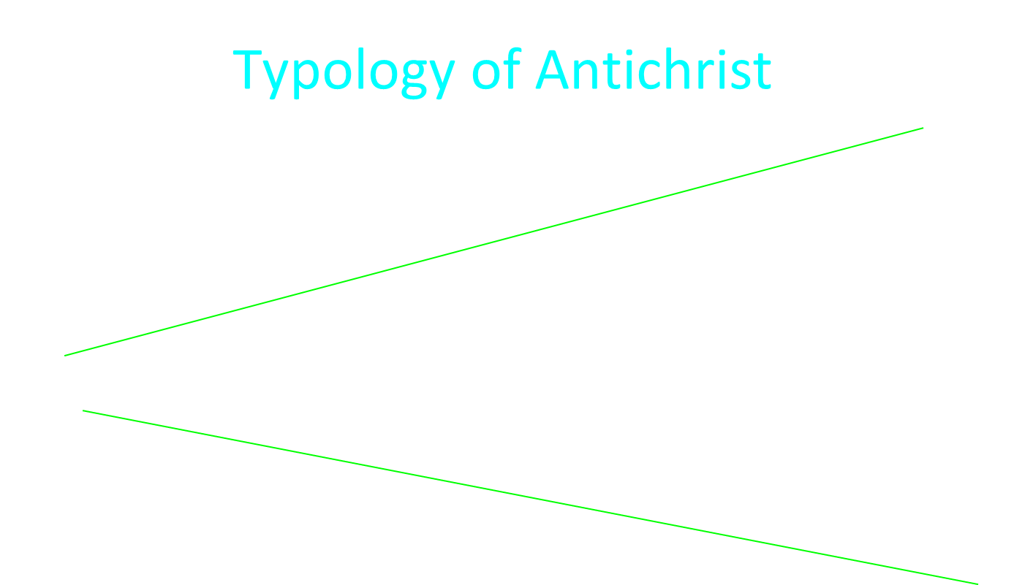

Slide 38
Matthew 23:37-39
“Jerusalem, Jerusalem, who kills the prophets and stones those who are sent to her! How often I wanted to gather your children together, the way a hen gathers her chicks under her wings, and you were unwilling. ³⁸ Behold, your house is being left to you desolate! ³⁹ For I say to you, from now on you will not see Me until you say, ‘Blessed is He who comes in the name of the Lord!’”

Slide 39
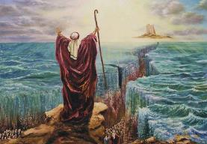
Deuteronomy 4:30
“ When you are in distress and all these things have come upon you, in the latter days you will return to the Lord your God and listen to His voice.”

Slide 40

Jeremiah 30:7
“Alas! for that day is great, There is none like it; And it is the time of Jacob’s distress, But he will be saved from it.”

Slide 41
Zechariah 12:10
“I will pour out on the house of David and on the inhabitants of Jerusalem, the Spirit of grace and of supplication, so that they will look on Me whom they have pierced; and they will mourn for Him, as one mourns for an only son, and they will weep bitterly over Him like the bitter weeping over a firstborn.”

Slide 42


Slide 43
6 Prophecies WILL BE fulfilled in Daniel 9:24c
“to finish transgression”
“to make an end of sin”
“to make atonement for iniquity”
“to bring in everlasting righteousness”
“to seal up vision and prophecy”
“to anoint the most holy place”
Arnold Fructenbaum, Footsteps of the Messiah, p.191-4

Slide 44
Conclusion

Slide 45
Mosaic Covenant of Exodus 19–24
Sinai Revelation (Gen. 15:13-16; Ps. 147:19-20)
Limited restoration of Theocratic Administrator (Exod. 19:6; Rom. 5:13-14)
Conditional covenant (Exod. 19:6)
Ownership vs. possession-enjoyment (Hos. 4:1ff; Ezek. 43:9)
Mosaic Covenant points to Christ (Deut. 17:15; John 5:47-49)
Kingdom’s coming based on Israel’s response to Christ (Luke 19:41-44; Matt. 23:37-39)
Purpose of the Tribulation (Dan. 9:24-27; Matt. 24:15, 20-22, 31; 25:31; Deut. 4:30; Jer. 30:7; Zech. 12:10)

Slide 46
1. Kingdom Throughout the Bible
Eden Abrahamic Covenant Mosaic Covenant Divided Kingdom Times of the Gentiles | Old Testament Prophets Post exile Offer of the King / Kingdom Rejection of the Offer Interim Age

