Slide 1
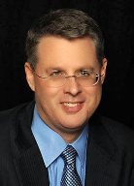
Soteriology Session 46
Dr. Andy Woods
Senior Pastor – Sugar Land Bible Church
Professor of Bible & Theology – College of Biblical Studies

Slide 2
Soteriology Overview
Definition
Election
Atonement
Salvation words
God’s one condition of salvation
Results of salvation
Eternal security
Faulty views of salvation

Slide 3
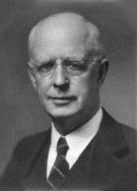
Soteriology Overview
This Session
VII. Eternal Security

Slide 4
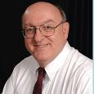
Definition of Eternal Security
“Eternal Security means that those who have been genuinely saved by God’s grace through faith alone in Christ alone shall never be in danger of God’s condemnation or loss of salvation but God’s grace and power keep them forever saved and secure.”
Dennis Rokser, Shall Never Perish Forever, p. 11

Slide 5
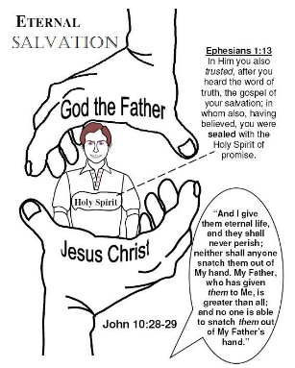
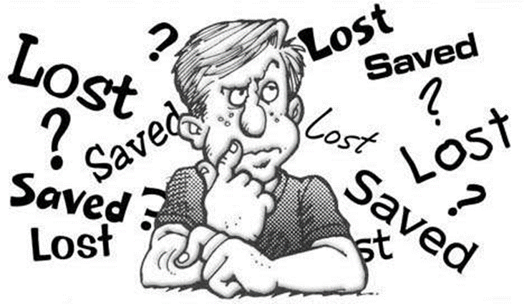
Eternal Security Outline
Eternal security arguments
Response to problem passages

Slide 6
Eternal Security Outline
Eternal security arguments
Response to problem passages

Slide 7
Eternal Security Outline
Eternal security arguments
Response to problem passages

Slide 8
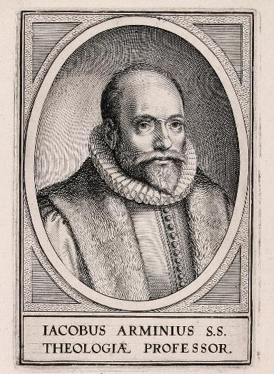
Response to Problem Passages
OT Passages
Passages from Matthew
Passages from John
Passages from Acts
Passages from Paul

Slide 9
Response to Problem Passages
Passages from James
Passages from Hebrews
Passages from 2 Peter
Passages from 1 John
Passages from Revelation
Miscellaneous argument

Slide 10
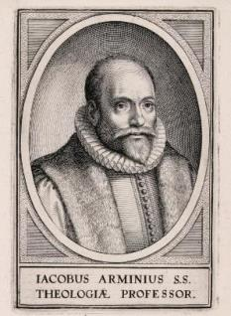
Passages from the General Letters & Revelation
Jas. 5:19-20
Heb. 3:6, 14
Heb. 5:9-10
Heb. 6:4-6
Heb. 10:26-30
Heb. 12:14
2 Pet. 1:10-11
2 Pet. 2:20-22
1 John 2:3
1 John 3:9
1 John 3:15
1 John 5:16
Rev. 3:5
Rev. 22:18-19

Slide 11
Passages from the General Letters & Revelation
Jas. 5:19-20
Heb. 3:6, 14
Heb. 5:9-10
Heb. 6:4-6
Heb. 10:26-30
Heb. 12:14
2 Pet. 1:10-11
2 Pet. 2:20-22
1 John 2:3
1 John 3:9
1 John 3:15
1 John 5:16
Rev. 3:5
Rev. 22:18-19

Slide 12
2 Peter 1:10-11
“Therefore, brethren, be all the more diligent to make certain about His calling and choosing you; for as long as you practice these things, you will never stumble; ¹¹ for in this way the entrance into the eternal kingdom of our Lord and Savior Jesus Christ will be abundantly supplied to you.” (NASB)

Slide 13
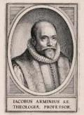
2 Peter 1:10-11
Diligence in the Christian life does not make the believer more secure
However, it can deepen inward assurance
“Abundant entrance into the kingdom”-some believers will be saved but have little reward (1 Cor. 3:15; 2 John 8; Rev. 3:11)
Our ultimate assurance comes from Christ’s promises (John 5:24; 6:47)

Slide 14
2 Peter 1:10-11
Diligence in the Christian life does not make the believer more secure
However, it can deepen inward assurance
“Abundant entrance into the kingdom”-some believers will be saved but have little reward (1 Cor. 3:15; 2 John 8; Rev. 3:11)
Our ultimate assurance comes from Christ’s promises (John 5:24; 6:47)

Slide 15
2 Peter 1:10-11
“Therefore, brethren, be all the more diligent to make certain about His calling and choosing you; for as long as you practice these things, you will never stumble; ¹¹ for in this way the entrance into the eternal kingdom of our Lord and Savior Jesus Christ will be abundantly supplied to you.” (NASB)

Slide 16
2 Peter 1:10-11
Diligence in the Christian life does not make the believer more secure
However, it can deepen inward assurance
“Abundant entrance into the kingdom”-some believers will be saved but have little reward (1 Cor. 3:15; 2 John 8; Rev. 3:11)
Our ultimate assurance comes from Christ’s promises (John 5:24; 6:47)

Slide 17
John 5:24
“Truly, truly, I say to you, he who hears My word, and believes Him who sent Me, has eternal life, and does not come into judgment, but has passed out of death into life.” (NASB)

Slide 18
John 6:47
“Truly, truly, I say to you, he who believes has eternal life.” (NASB)

Slide 19
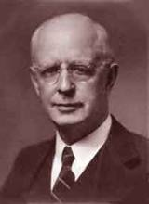
Lewis Sperry Chafer, Salvation: A Clear Doctrinal Analysis (Grand Rapids: Zondervan, 1977), 60. Italics added
Lewis Sperry Chafer
“There is a normal Christian experience. There are new and blessed emotions and desires. Old things do pass away; and behold all things do become new; but all such experiences are but secondary evidences, as to the fact of salvation, in that they grow out of that positive repose of faith which is the primary evidence.”

Slide 20
Passages from the General Letters & Revelation
Jas. 5:19-20
Heb. 3:6, 14
Heb. 5:9-10
Heb. 6:4-6
Heb. 10:26-30
Heb. 12:14
2 Pet. 1:10-11
2 Pet. 2:20-22
1 John 2:3
1 John 3:9
1 John 3:15
1 John 5:16
Rev. 3:5
Rev. 22:18-19

Slide 21
2 Peter 2:20-22
“For if, after they have escaped the defilements of the world by the knowledge of the Lord and Savior Jesus Christ, they are again entangled in them and are overcome, the last state has become worse for them than the first. ²¹ For it would be better for them not to have known the way of righteousness, than having known it, to turn away from the holy commandment handed on to them. ²² It has happened to them according to the true proverb, “A dog returns to its own vomit,” and, “A sow, after washing, returns to wallowing in the mire.” (NASB)

Slide 22
2 Peter 2:20-22
“For if, after they have escaped the defilements of the world by the knowledge of the Lord and Savior Jesus Christ, they are again entangled in them and are overcome, the last state has become worse for them than the first. ²¹ For it would be better for them not to have known the way of righteousness, than having known it, to turn away from the holy commandment handed on to them. ²² It has happened to them according to the true proverb, “A dog returns to its own vomit,” and, “A sow, after washing, returns to wallowing in the mire.” (NASB)

Slide 23
2 Peter 2:20-22
Not loss of salvation
New believers becoming entangled again by the corruption of unbelieving false teachers
This was to the detriment of the new believers’ progressive sanctification (2 Pet. 3:17-18)
Two groups
Unbelieving false teachers (2 Pet. 2:1, 9, 12, 14, 17, 19)
Believing victims (“escaped, again entangled”) of false teachers

Slide 24
2 Peter 2:20-22
“For if, after they have escaped the defilements of the world by the knowledge of the Lord and Savior Jesus Christ, they are again entangled in them and are overcome, the last state has become worse for them than the first. ²¹ For it would be better for them not to have known the way of righteousness, than having known it, to turn away from the holy commandment handed on to them. ²² It has happened to them according to the true proverb, “A dog returns to its own vomit,” and, “A sow, after washing, returns to wallowing in the mire.” (NASB)

Slide 25
2 Peter 1:1-4
“Simon Peter, a bond-servant and apostle of Jesus Christ, To those who have received a faith of the same kind as ours, by the righteousness of our God and Savior, Jesus Christ: ² Grace and peace be multiplied to you in the knowledge of God and of Jesus our Lord; ³ seeing that His divine power has granted to us everything pertaining to life and godliness, through the true knowledge of Him who called us by His own glory and excellence. ⁴ For by these He has granted to us His precious and magnificent promises, so that by them you may become partakers of the divine nature, having escaped the corruption that is in the world by lust.” (NASB)

Slide 26
2 Peter 2:20-22
“For if, after they have escaped the defilements of the world by the knowledge of the Lord and Savior Jesus Christ, they are again entangled in them and are overcome, the last state has become worse for them than the first. ²¹ For it would be better for them not to have known the way of righteousness, than having known it, to turn away from the holy commandment handed on to them. ²² It has happened to them according to the true proverb, “A dog returns to its own vomit,” and, “A sow, after washing, returns to wallowing in the mire.” (NASB)

Slide 27
2 Peter 1:1-4
“Simon Peter, a bond-servant and apostle of Jesus Christ, To those who have received a faith of the same kind as ours, by the righteousness of our God and Savior, Jesus Christ: ² Grace and peace be multiplied to you in the knowledge of God and of Jesus our Lord; ³ seeing that His divine power has granted to us everything pertaining to life and godliness, through the true knowledge of Him who called us by His own glory and excellence. ⁴ For by these He has granted to us His precious and magnificent promises, so that by them you may become partakers of the divine nature, having escaped the corruption that is in the world by lust.” (NASB)

Slide 28
2 Peter 2:20-22
“For if, after they have escaped the defilements of the world by the knowledge of the Lord and Savior Jesus Christ, they are again entangled in them and are overcome, the last state has become worse for them than the first. ²¹ For it would be better for them not to have known the way of righteousness, than having known it, to turn away from the holy commandment handed on to them. ²² It has happened to them according to the true proverb, “A dog returns to its own vomit,” and, “A sow, after washing, returns to wallowing in the mire.” (NASB)

Slide 29
2 Peter 1:1-4
“Simon Peter, a bond-servant and apostle of Jesus Christ, To those who have received a faith of the same kind as ours, by the righteousness of our God and Savior, Jesus Christ: ² Grace and peace be multiplied to you in the knowledge of God and of Jesus our Lord; ³ seeing that His divine power has granted to us everything pertaining to life and godliness, through the true knowledge of Him who called us by His own glory and excellence. ⁴ For by these He has granted to us His precious and magnificent promises, so that by them you may become partakers of the divine nature, having escaped the corruption that is in the world by lust.” (NASB)

Slide 30
2 Peter 2:20-22
“For if, after they have escaped the defilements of the world by the knowledge of the Lord and Savior Jesus Christ, they are again entangled in them and are overcome, the last state has become worse for them than the first. ²¹ For it would be better for them not to have known the way of righteousness, than having known it, to turn away from the holy commandment handed on to them. ²² It has happened to them according to the true proverb, “A dog returns to its own vomit,” and, “A sow, after washing, returns to wallowing in the mire.” (NASB)

Slide 31
2 Peter 2:20-22
“For if, after they have escaped the defilements of the world by the knowledge of the Lord and Savior Jesus Christ, they are again entangled in them and are overcome, the last state has become worse for them than the first. ²¹ For it would be better for them not to have known the way of righteousness, than having known it, to turn away from the holy commandment handed on to them. ²² It has happened to them according to the true proverb, “A dog returns to its own vomit,” and, “A sow, after washing, returns to wallowing in the mire.” (NASB)

Slide 32
Three Tenses of Salvation
Phase | Justification | Sanctification | Glorification
Tense | Past | Present | Future
Saved from sin’s: | Penalty | Power | Presence
Scripture | Eph 2:8-9; Titus 3:5 | Philip 2:12 | Rom 5:10

Slide 33
Three Tenses of Salvation
Phase | Justification | Sanctification | Glorification
Tense | Past | Present | Future
Saved from sin’s: | Penalty | Power | Presence
Scripture | Eph 2:8-9; Titus 3:5 | Philip 2:12 | Rom 5:10

Slide 34
Three Tenses of Salvation
Phase | Justification | Sanctification | Glorification
Tense | Past | Present | Future
Saved from sin’s: | Penalty | Power | Presence
Scripture | Eph 2:8-9; Titus 3:5 | Philip 2:12 | Rom 5:10

Slide 35
2 Peter 2:20-22
“For if, after they have escaped the defilements of the world by the knowledge of the Lord and Savior Jesus Christ, they are again entangled in them and are overcome, the last state has become worse for them than the first. ²¹ For it would be better for them not to have known the way of righteousness, than having known it, to turn away from the holy commandment handed on to them. ²² It has happened to them according to the true proverb, “A dog returns to its own vomit,” and, “A sow, after washing, returns to wallowing in the mire.” (NASB)

Slide 36
1 Peter 1:13-16
¹³“Therefore, prepare your minds for action, keep sober in spirit, fix your hope completely on the grace [to be brought to you at the revelation of Jesus Christ. ¹⁴ As obedient children, do not be conformed to the former lusts which were yours in your ignorance, ¹⁵ but like the Holy One who called you, be holy yourselves also in all your behavior; ¹⁶ because it is written, “You shall be holy, for I am holy.” (NASB)

Slide 37
2 Peter 2:20-22
“For if, after they have escaped the defilements of the world by the knowledge of the Lord and Savior Jesus Christ, they are again entangled in them and are overcome, the last state has become worse for them than the first. ²¹ For it would be better for them not to have known the way of righteousness, than having known it, to turn away from the holy commandment handed on to them. ²² It has happened to them according to the true proverb, “A dog returns to its own vomit,” and, “A sow, after washing, returns to wallowing in the mire.” (NASB)

Slide 38
2 Peter 2:20-22
“For if, after they have escaped the defilements of the world by the knowledge of the Lord and Savior Jesus Christ, they are again entangled in them and are overcome, the last state has become worse for them than the first. ²¹ For it would be better for them not to have known the way of righteousness, than having known it, to turn away from the holy commandment handed on to them. ²² It has happened to them according to the true proverb, “A dog returns to its own vomit,” and, “A sow, after washing, returns to wallowing in the mire.” (NASB)

Slide 39
2 Peter 2:20-22
“For if, after they have escaped the defilements of the world by the knowledge of the Lord and Savior Jesus Christ, they are again entangled in them and are overcome, the last state has become worse for them than the first. ²¹ For it would be better for them not to have known the way of righteousness, than having known it, to turn away from the holy commandment handed on to them. ²² It has happened to them according to the true proverb, “A dog returns to its own vomit,” and, “A sow, after washing, returns to wallowing in the mire.” (NASB)

Slide 40
2 Peter 3:17-18
“You therefore, beloved, knowing this beforehand, be on your guard so that you are not carried away by the error of unprincipled men and fall from your own steadfastness, but grow in the grace and knowledge of our Lord and Savior Jesus Christ. To Him be the glory, both now and to the day of eternity. Amen.” (NASB)

Slide 41
2 Peter 3:17-18
“You therefore, beloved, knowing this beforehand, be on your guard so that you are not carried away by the error of unprincipled men and fall from your own steadfastness, ¹⁸ but grow in the grace and knowledge of our Lord and Savior Jesus Christ. To Him be the glory, both now and to the day of eternity. Amen.” (NASB)

Slide 42
Passages from the General Letters & Revelation
Jas. 5:19-20
Heb. 3:6, 14
Heb. 5:9-10
Heb. 6:4-6
Heb. 10:26-30
Heb. 12:14
2 Pet. 1:10-11
2 Pet. 2:20-22
1 John 2:3
1 John 3:9
1 John 3:15
1 John 5:16
Rev. 3:5
Rev. 22:18-19

Slide 43
1 John 2:3
“By this we know that we have come to know Him, if we keep His commandments.” (NASB)

Slide 44
Believing Audience
1 John 1:4; 2 John 12 – Loss of joy
1 John 1:8 – “We”
1 John 2:1, 18, 28; 3:2, 7, 18; 5:21 – Children of God
1 John 2:12-14 – Eight descriptions
1 John 2:20, 27 – Have the Spirit’s anointing
1 John 2:21 – Know the truth
1 John 2:28; 2 John 8 – Loss of reward

Slide 45
Believing Audience
1 John 1:4; 2 John 12 – Loss of joy
1 John 1:8 – “We”
1 John 2:1, 18, 28; 3:2, 7, 18; 5:21 – Children of God
1 John 2:12-14 – Eight descriptions
1 John 2:20, 27 – Have the Spirit’s anointing
1 John 2:21 – Know the truth
1 John 2:28; 2 John 8 – Loss of reward

Slide 46
1 John 2:12-14
“I am writing to you, little children, because your sins have been forgiven you for His name’s sake. ¹³ I am writing to you, fathers, because you know Him who has been from the beginning. I am writing to you, young men, because you have overcome the evil one. I have written to you, children, because you know the Father. ¹⁴ I have written to you, fathers, because you know Him who has been from the beginning. I have written to you, young men, because you are strong, and the word of God abides in you, and you have overcome the evil one.” (NASB)

Slide 47
1 John 2:12-14
“I am writing to you, little children, because your sins have been forgiven you for His name’s sake. ¹³ I am writing to you, fathers, because you know Him who has been from the beginning. I am writing to you, young men, because you have overcome the evil one. I have written to you, children, because you know the Father. ¹⁴ I have written to you, fathers, because you know Him who has been from the beginning. I have written to you, young men, because you are strong, and the word of God abides in you, and you have overcome the evil one.” (NASB)

Slide 48
Believing Audience
1 John 1:4; 2 John 12 – Loss of joy
1 John 1:8 – “We”
1 John 2:1, 18, 28; 3:2, 7, 18; 5:21 – Children of God
1 John 2:12-14 – Eight descriptions
1 John 2:20, 27 – Have the Spirit’s anointing
1 John 2:21 – Know the truth
1 John 2:28; 2 John 8 – Loss of reward

Slide 49
Believing Audience
1 John 3:1-2 – Those who will be like Him
1 John 3:2, 21; 4:1, 7, 11 – Beloved ones in the faith
1 John 3:13 – My brothers
1 John 4:4 – Born of God
1 John 4:13 – Possessing the Holy Spirit

Slide 50
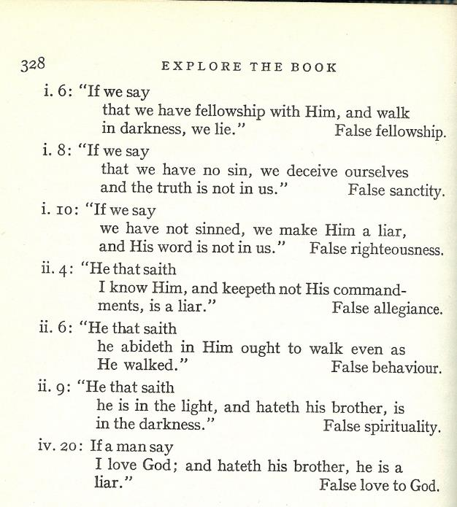
7 Tests in 1 John

Slide 51
What is Being Tested?
Test of life – saved, union, justification
Test of fellowship – fellowship with God, communion, sanctification

Slide 52
Three Tenses of Salvation
Phase | Justification | Sanctification | Glorification
Tense | Past | Present | Future
Saved from sin’s: | Penalty | Power | Presence
Scripture | Eph 2:8-9; Titus 3:5 | Philip 2:12 | Rom 5:10

Slide 53
Three Tenses of Salvation
Phase | Justification | Sanctification | Glorification
Tense | Past | Present | Future
Saved from sin’s: | Penalty | Power | Presence
Scripture | Eph 2:8-9; Titus 3:5 | Philip 2:12 | Rom 5:10

Slide 54
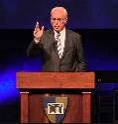
John F. MacArthur,
Saved Without a Doubt? How to be Sure of Your Salvation (Wheaton, IL: Victor, 1988), 67-91.
John MacArthur claims that John wrote this epistle to provide "eleven tests" of genuine saving faith. These include such subjective questions as:
"Do you obey God's Word?"
"Do you reject this evil world?"
"Do you eagerly await Christ’s return?" and
"Do you see a decreasing pattern of sin in your life?.”

Slide 55
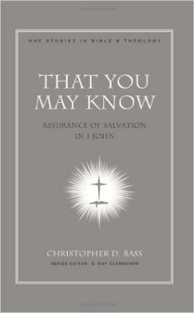
Christopher D. Bass,
That You May Know: Assurance of Salvation in 1 John (Nashville, TN: Broadman and Holman, 2008), 182-83.
“We must remember that the first letter of John is laden with various sets of criteria or ‘tests’ by which its readers are to evaluate their religious claims in light of the way they conduct their lives. The believers life style therefore serves as either a vital support to his or her assurance or is evidence that he has never really passed over from death to life.”

Slide 56
Three Tenses of Salvation
Phase | Justification | Sanctification | Glorification
Tense | Past | Present | Future
Saved from sin’s: | Penalty | Power | Presence
Scripture | Eph 2:8-9; Titus 3:5 | Philip 2:12 | Rom 5:10

Slide 57
2 VIEWS OF 1 JOHN
 | TEST OF LIFE VIEW | TEST OF FELLOWSHIP VIEW
Summary | If you have righteous conduct, love, and truth then you know you were saved | If you have righteous conduct, love, in truth then you know you’re in fellowship with God
Purpose Statement | 1 Jn 5:13, “so that you may know that you have eternal life” | 1 Jn 1:3, “so that you also may have fellowship with us (and) with the Father and with His Son”
Fellowship, Abiding | Being saved, being in union with God (in Christ) | Being in communion with God (walking in His Spirit)
Knowing God | Possessing eternal life | Enjoying fellowship with God
Eternal Life | Salvation (Jn 17:3) | Quality of life (Jn 10:10)
Light or Darkness | Being saved or being lost | Being in fellowship with God or being out of fellowship

Slide 58
Test of Life v. Fellowship
 | Test of Life | Test of Fellowship
Summary | saved | in fellowship
Purpose statement | 5:13 | 1:3-4
Fellowship, abiding | union | Communion (John 15:5)
Knowing God | eternal life | fellowship with God
Eternal life | John 17:3 | John 10:10; Gal. 6:8
Light/darkness | saved/unsaved | in/out of fellowship
Judgment/fear | Hell (John 5:24) | Discipline/Bema (2 Cor. 5:10)
Spirit | Possession (Rom 8:9) | Influence (Gal 5:16; 1 Thess. 5:19)
Satan | Unbeliever (John 8:44) | Influence upon believer (Matt 16:21-23; Eph 4:26-27)

Slide 59
1 John 2:3
“By this we know that we have come to know Him, if we keep His commandments.” (NASB)

Slide 60
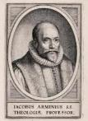
1 John 2:3
Other purpose statements in 1 John cover only what immediately follows (2:1 & 1:5-10; 2:26 & 2:18-25)
1 John 5:13 is not the book’s purpose statement
1 John 1:3-4 is the book’s purpose statement
Heading in Scofield Reference Bible: “The Tests of Fellowship: Obedience and Love.”
“Knowing God” refers to intimacy or fellowship with God rather than being born again
Out of fellowship believers do not know God (John 14:7-9; Gal. 4:9; 1 Cor. 15:34; 2 Pet. 3:18)
Keeping God’s commandments to know God (gain or keep salvation) contradicts Ephes. 2:8-9.

Slide 61
1 John 2:3
Other purpose statements in 1 John cover only what immediately follows (2:1 & 1:5-10; 2:26 & 2:18-25)
1 John 5:13 is not the book’s purpose statement
1 John 1:3-4 is the book’s purpose statement
Heading in Scofield Reference Bible: “The Tests of Fellowship: Obedience and Love.”
“Knowing God” refers to intimacy or fellowship with God rather than being born again
Out of fellowship believers do not know God (John 14:7-9; Gal. 4:9; 1 Cor. 15:34; 2 Pet. 3:18)
Keeping God’s commandments to know God (gain or keep salvation) contradicts Ephes. 2:8-9.

Slide 62
1 John 2:3
Other purpose statements in 1 John cover only what immediately follows (2:1 & 1:5-10; 2:26 & 2:18-25)
1 John 5:13 is not the book’s purpose statement
1 John 1:3-4 is the book’s purpose statement
Heading in Scofield Reference Bible: “The Tests of Fellowship: Obedience and Love.”
“Knowing God” refers to intimacy or fellowship with God rather than being born again
Out of fellowship believers do not know God (John 14:7-9; Gal. 4:9; 1 Cor. 15:34; 2 Pet. 3:18)
Keeping God’s commandments to know God (gain or keep salvation) contradicts Ephes. 2:8-9.

Slide 63
1 John 5:13
“These things I have written to you who believe in the name of the Son of God, so that you may know that you have eternal life.” (NASB)

Slide 64
1 John 2:3
Other purpose statements in 1 John cover only what immediately follows (2:1 & 1:5-10; 2:26 & 2:18-25)
1 John 5:13 is not the book’s purpose statement
1 John 1:3-4 is the book’s purpose statement
Heading in Scofield Reference Bible: “The Tests of Fellowship: Obedience and Love.”
“Knowing God” refers to intimacy or fellowship with God rather than being born again
Out of fellowship believers do not know God (John 14:7-9; Gal. 4:9; 1 Cor. 15:34; 2 Pet. 3:18)
Keeping God’s commandments to know God (gain or keep salvation) contradicts Ephes. 2:8-9.

Slide 65
1 John 1:3-4
“what we have seen and heard we proclaim to you also, so that you too may have fellowship with us; and indeed our fellowship is with the Father, and with His Son Jesus Christ. ⁴ These things we write, so that our joy may be made complete..” (NASB)

Slide 66
1 John 2:3
Other purpose statements in 1 John cover only what immediately follows (2:1 & 1:5-10; 2:26 & 2:18-25)
1 John 5:13 is not the book’s purpose statement
1 John 1:3-4 is the book’s purpose statement
Heading in Scofield Reference Bible: “The Tests of Fellowship: Obedience and Love.”
“Knowing God” refers to intimacy or fellowship with God rather than being born again
Out of fellowship believers do not know God (John 14:7-9; Gal. 4:9; 1 Cor. 15:34; 2 Pet. 3:18)
Keeping God’s commandments to know God (gain or keep salvation) contradicts Ephes. 2:8-9.

Slide 67
1 John 2:3
Other purpose statements in 1 John cover only what immediately follows (2:1 & 1:5-10; 2:26 & 2:18-25)
1 John 5:13 is not the book’s purpose statement
1 John 1:3-4 is the book’s purpose statement
Heading in Scofield Reference Bible: “The Tests of Fellowship: Obedience and Love.”
“Knowing God” refers to intimacy or fellowship with God rather than being born again
Out of fellowship believers do not know God (John 14:7-9; Gal. 4:9; 1 Cor. 15:34; 2 Pet. 3:18)
Keeping God’s commandments to know God (gain or keep salvation) contradicts Ephes. 2:8-9.

Slide 68
1 John 2:3
Other purpose statements in 1 John cover only what immediately follows (2:1 & 1:5-10; 2:26 & 2:18-25)
1 John 5:13 is not the book’s purpose statement
1 John 1:3-4 is the book’s purpose statement
Heading in Scofield Reference Bible: “The Tests of Fellowship: Obedience and Love.”
“Knowing God” refers to intimacy or fellowship with God rather than being born again
Out of fellowship believers do not know God (John 14:7-9; Gal. 4:9; 1 Cor. 15:34; 2 Pet. 3:18)
Keeping God’s commandments to know God (gain or keep salvation) contradicts Ephes. 2:8-9.

Slide 69
1 John 2:3
Other purpose statements in 1 John cover only what immediately follows (2:1 & 1:5-10; 2:26 & 2:18-25)
1 John 5:13 is not the book’s purpose statement
1 John 1:3-4 is the book’s purpose statement
Heading in Scofield Reference Bible: “The Tests of Fellowship: Obedience and Love.”
“Knowing God” refers to intimacy or fellowship with God rather than being born again
Out of fellowship believers do not know God (John 14:7-9; Gal. 4:9; 1 Cor. 15:34; 2 Pet. 3:18)
Keeping God’s commandments to know God (gain or keep salvation) contradicts Ephes. 2:8-9.

Slide 70
1 John 2:3
“By this we know that we have come to know Him, if we keep His commandments.” (NASB)

Slide 71
Passages from the General Letters & Revelation
Jas. 5:19-20
Heb. 3:6, 14
Heb. 5:9-10
Heb. 6:4-6
Heb. 10:26-30
Heb. 12:14
2 Pet. 1:10-11
2 Pet. 2:20-22
1 John 2:3
1 John 3:9
1 John 3:15
1 John 5:16
Rev. 3:5
Rev. 22:18-19

Slide 72
Passages from the General Letters & Revelation
Jas. 5:19-20
Heb. 3:6, 14
Heb. 5:9-10
Heb. 6:4-6
Heb. 10:26-30
Heb. 12:14
2 Pet. 1:10-11
2 Pet. 2:20-22
1 John 2:3
1 John 3:9
1 John 3:15
1 John 5:16
Rev. 3:5
Rev. 22:18-19

Slide 73
Passages from the General Letters & Revelation
Jas. 5:19-20
Heb. 3:6, 14
Heb. 5:9-10
Heb. 6:4-6
Heb. 10:26-30
Heb. 12:14
2 Pet. 1:10-11
2 Pet. 2:20-22
1 John 2:3
1 John 3:9
1 John 3:15
1 John 5:16
Rev. 3:5
Rev. 22:18-19

Slide 74
CONCLUSION

Slide 75
Passages From the General Letters & Revelation
Jas. 5:19-20
Heb. 3:6, 14
Heb. 5:9-10
Heb. 6:4-6
Heb. 10:26-30
Heb. 12:14
2 Pet. 1:10-11
2 Pet. 2:20-22
1 John 2:3
1 John 3:9
1 John 3:15
1 John 5:16
Rev. 3:5
Rev. 22:18-19

