Slide 1
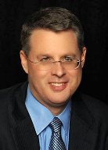
Soteriology Session 40
Dr. Andy Woods
Senior Pastor – Sugar Land Bible Church
Professor of Bible & Theology – College of Biblical Studies

Slide 2
Soteriology Overview
Definition
Election
Atonement
Salvation words
God’s one condition of salvation
Results of salvation
Eternal security
Faulty views of salvation

Slide 3
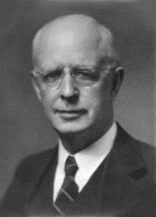
Soteriology Overview
This Session
VII. Eternal Security

Slide 4
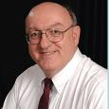
Definition of Eternal Security
“Eternal Security means that those who have been genuinely saved by God’s grace through faith alone in Christ alone shall never be in danger of God’s condemnation or loss of salvation but God’s grace and power keep them forever saved and secure.”
Dennis Rokser, Shall Never Perish Forever, p. 11

Slide 5
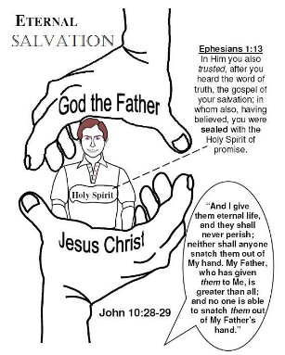
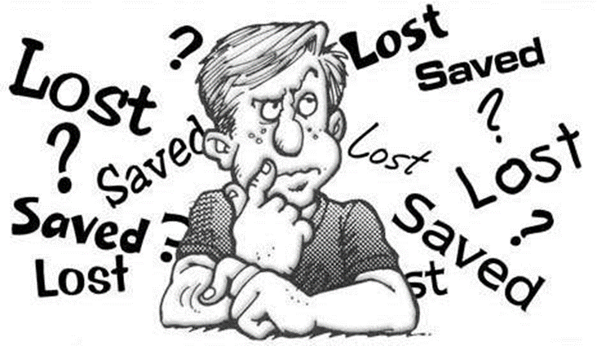
Eternal Security Outline
Eternal security arguments
Response to problem passages

Slide 6
Eternal Security Outline
Eternal security arguments
Response to problem passages

Slide 7
Eternal Security Outline
Eternal security arguments
Response to problem passages

Slide 8
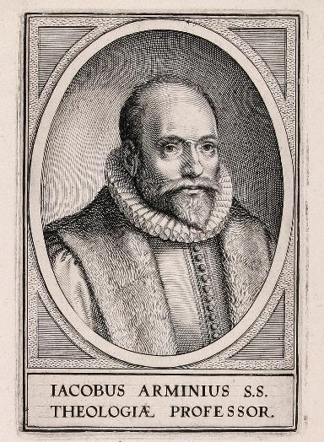
Response to Problem Passages
OT Passages
Passages from Matthew
Passages from John
Passages from Acts
Passages from Paul

Slide 9
Response to Problem Passages
Passages from James
Passages from Hebrews
Passages from 2 Peter
Passages from 1 John
Passages from Revelation
Miscellaneous argument

Slide 10
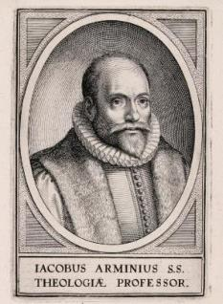
Passages from the General Letters & Revelation
Jas. 5:19-20
Heb. 3:6, 14
Heb. 5:9-10
Heb. 6:4-6
Heb. 10:26-30
Heb. 12:14
2 Pet. 1:10-11
2 Pet. 2:20-22
1 John 2:3
1 John 3:9
1 John 3:15
1 John 5:16
Rev. 3:5
Rev. 22:18-19

Slide 11
Passages from the General Letters & Revelation
Jas. 5:19-20
Heb. 3:6, 14
Heb. 5:9-10
Heb. 6:4-6
Heb. 10:26-30
Heb. 12:14
2 Pet. 1:10-11
2 Pet. 2:20-22
1 John 2:3
1 John 3:9
1 John 3:15
1 John 5:16
Rev. 3:5
Rev. 22:18-19

Slide 12
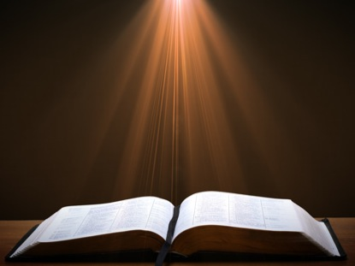
James 5:19-20 (NASB)
“¹⁹ My brethren, if any among you strays from the truth and one turns him back, ²⁰ let him know that he who turns a sinner from the error of his way will save his soul from death and will cover a multitude of sins.”

Slide 13
James 5:19-20
Sin brings death – Rom. 6:23; Jas. 1:14-15
Maximum divine discipline – Acts 5:1-11; 1 Cor. 11:30; 1 John 5:16; Rev. 2:22-23
Temporal death
Jewish audience-Jas. 1:1
Covenant curses Deut. 28:15-68
Proverbs 2:18; 5:5; 14:12; 21:16
Life of David

Slide 14
Passages from the General Letters & Revelation
Jas. 5:19-20
Heb. 3:6, 14
Heb. 5:9-10
Heb. 6:4-6
Heb. 10:26-30
Heb. 12:14
2 Pet. 1:10-11
2 Pet. 2:20-22
1 John 2:3
1 John 3:9
1 John 3:15
1 John 5:16
Rev. 3:5
Rev. 22:18-19

Slide 15
Hebrews 3:6, 14 (NASB)
“⁶ but Christ was faithful as a Son over His house—whose house we are, if we hold fast our confidence and the boast of our hope firm until the end...¹⁴For we have become partakers of Christ, if we hold fast the beginning of our assurance firm until the end.”

Slide 16
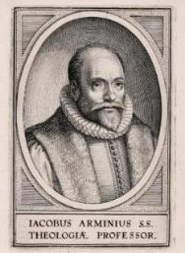
Hebrews 3:6, 14
Not an admonition to stay saved or prove one was saved to begin with
Believing audience – Heb. 3:1
Exhortation not to drift back into Judaism so as to avoid:
Immaturity – Heb. 5:11-14
Loss of rewards
Divine discipline – Heb. 12:5-11
Hell not mentioned

Slide 17
Passages from the General Letters & Revelation
Jas. 5:19-20
Heb. 3:6, 14
Heb. 5:9-10
Heb. 6:4-6
Heb. 10:26-30
Heb. 12:14
2 Pet. 1:10-11
2 Pet. 2:20-22
1 John 2:3
1 John 3:9
1 John 3:15
1 John 5:16
Rev. 3:5
Rev. 22:18-19

Slide 18
Hebrews 5:9-10 (NASB)
“⁹And having been made perfect, He became to all those who obey Him the source of eternal salvation, ¹⁰ being designated by God as a high priest according to the order of Melchizedek.”

Slide 19
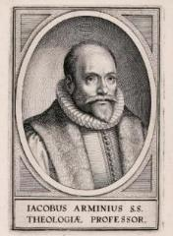
Hebrews 5:9-10
Believing audience – Heb. 3:1
Progressive sanctification
Obedience of the faith?
To obey is a synonym to believe
Rom. 1:5, 16; 2 Thess. 1:8-10; 1 Pet. 1:22-25
Or else a contradiction of Eph. 2:8-9

Slide 20
Hebrews 5:9-10
Believing audience – Heb. 3:1
Progressive sanctification
Obedience of the faith?
To obey is a synonym to believe
Rom. 1:5, 16; 2 Thess. 1:8-10; 1 Pet. 1:22-25
Or else a contradiction of Eph. 2:8-9

Slide 21
Hebrews 5:9-10
Believing audience – Heb. 3:1
Progressive sanctification
Obedience of the faith?
To obey is a synonym to believe
Rom. 1:5, 16; 2 Thess. 1:8-10; 1 Pet. 1:22-25
Or else a contradiction of Eph. 2:8-9

Slide 22
Three Tenses of Salvation
Phase | Justification | Sanctification | Glorification
Tense | Past | Present | Future
Saved from sin’s: | Penalty | Power | Presence
Scripture | Eph 2:8-9; Titus 3:5 | Philip 2:12 | Rom 5:10

Slide 23
Three Tenses of Salvation
Phase | Justification | Sanctification | Glorification
Tense | Past | Present | Future
Saved from sin’s: | Penalty | Power | Presence
Scripture | Eph 2:8-9; Titus 3:5 | Philip 2:12 | Rom 5:10

Slide 24
Three Tenses of Salvation
Phase | Justification | Sanctification | Glorification
Tense | Past | Present | Future
Saved from sin’s: | Penalty | Power | Presence
Scripture | Eph 2:8-9; Titus 3:5 | Philip 2:12 | Rom 5:10

Slide 25
Hebrews 5:9-10
Believing audience – Heb. 3:1
Progressive sanctification
Obedience of the faith?
To obey is a synonym to believe
Rom. 1:5, 16; 2 Thess. 1:8-10; 1 Pet. 1:22-25
Or else a contradiction of Eph. 2:8-9

Slide 26
Hebrews 5:9-10
Believing audience – Heb. 3:1
Progressive sanctification
Obedience of the faith?
To obey is a synonym to believe
Rom. 1:5, 16; 2 Thess. 1:8-10; 1 Pet. 1:22-25
Or else a contradiction of Eph. 2:8-9

Slide 27
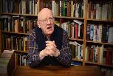
Obedience of the Faith?
“Does the phrase “them that obey Him” (Heb. 5:9) suggest that, if we do not obey Him, we may lose that eternal salvation? To “obey God” is the same as “to trust God,” as “them that obey Him” is a description of those who have put their faith in Jesus Christ. “A great company of the priests were obedient to the faith” (Acts 6:7). “But they have not all obeyed the Gospel” (Rom. 10:16). “Ye have purified your souls in obeying the truth” (1 Peter 1:22). Once we have put our faith in Jesus Christ, and thus obeyed His call, we experience His eternal salvation.”
Wiersbe, W. W. (1996). The Bible Exposition Commentary (Vol. 2, p. 294). Wheaton, IL: Victor Books.

Slide 28
Obedience of the Faith?
“The provision of salvation was achieved through the obedience of the Son to the Father at the cross, and the appropriation of salvation is accomplished through the obedience of the repentant sinner toward Christ. In this passage, obedience is synonymous with faith (acts 6:7; Romans 6:17; 10:16).”
Gromacki, Robert. (2001). Bold in Grace: An Exposition of Hebrews (p. 96). Reprint, The Woodlands, TX: Kress Christian Publications.

Slide 29
Hebrews 5:9-10
Believing audience – Heb. 3:1
Progressive sanctification
Obedience of the faith?
To obey is a synonym to believe
Rom. 1:5, 16; 2 Thess. 1:8-10; 1 Pet. 1:22-25
Or else a contradiction of Eph. 2:8-9

Slide 30
Hebrews 5:9-10
Believing audience – Heb. 3:1
Progressive sanctification
Obedience of the faith?
To obey is a synonym to believe
Rom. 1:5, 16; 2 Thess. 1:8-10; 1 Pet. 1:22-25
Or else a contradiction of Eph. 2:8-9

Slide 31
Passages From the General Letters & Revelation
Jas. 5:19-20
Heb. 3:6, 14
Heb. 5:9-10
Heb. 6:4-6
Heb. 10:26-30
Heb. 12:14
2 Pet. 1:10-11
2 Pet. 2:20-22
1 John 2:3
1 John 3:9
1 John 3:15
1 John 5:16
Rev. 3:5
Rev. 22:18-19

Slide 32
Hebrews 12:14 (NKJV)
“Pursue peace with all people, and holiness, without which no one will see the Lord.”

Slide 33
Hebrews 12:14
Holy life + faith to get to heaven
Others seeing the Lord though the believer's life and witness
Not seeing the Lord in heaven
Context = personal relationships with others (Heb. 12:14a, 15b)
Not requiring faith + holy life to get to heaven

Slide 34
Hebrews 12:14
Holy life + faith to get to heaven
Others seeing the Lord though the believer's life and witness
Not seeing the Lord in heaven
Context = personal relationships with others (Heb. 12:14a, 15b)
Not requiring faith + holy life to get to heaven

Slide 35
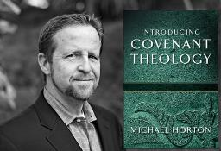
Without Personal Holiness No One Will See the Lord
“The New Testament lays before us a vast array of conditions for final salvation. Not only initial repentance and faith, but perseverance in both, demonstrated in love toward God and neighbor, are part of that holiness without which no one will see the lord (Hebrews 12:14)."
Horton, Michael. (2006). Introducing Covenant Theology (p. 182). Grand Rapids: Baker.

Slide 36
Hebrews 12:14
Holy life + faith to get to heaven
Others seeing the Lord though the believer's life and witness
Not seeing the Lord in heaven
Context = personal relationships with others (Heb. 12:14a, 15b)
Not requiring faith + holy life to get to heaven

Slide 37
Hebrews 12:14
Holy life + faith to get to heaven
Others seeing the Lord though the believer's life and witness
Not seeing the Lord in heaven
Context = personal relationships with others (Heb. 12:14a, 15b)
Not requiring faith + holy life to get to heaven

Slide 38
Hebrews 12:14
Holy life + faith to get to heaven
Others seeing the Lord though the believer's life and witness
Not seeing the Lord in heaven
Context = personal relationships with others (Heb. 12:14a, 15b)
Not requiring faith + holy life to get to heaven

Slide 39
Hebrews 12:14 (NKJV)
“¹⁴ Pursue peace with all people, and holiness, without which no one will see the Lord: looking carefully lest anyone fall short of the grace of God; lest any root of bitterness springing up cause trouble, and by this many become defiled.”

Slide 40
Hebrews 12:14
Holy life + faith to get to heaven
Others seeing the Lord though the believer's life and witness
Not seeing the Lord in heaven
Context = personal relationships with others (Heb. 12:14a, 15b)
Not requiring faith + holy life to get to heaven

Slide 41
CONCLUSION

Slide 42
Passages From the General Letters & Revelation
Jas. 5:19-20
Heb. 3:6, 14
Heb. 5:9-10
Heb. 6:4-6
Heb. 10:26-30
Heb. 12:14
2 Pet. 1:10-11
2 Pet. 2:20-22
1 John 2:3
1 John 3:9
1 John 3:15
1 John 5:16
Rev. 3:5
Rev. 22:18-19

