Slide 1
THE BOOK OF DANIEL
Dr. Andy Woods

Slide 2
Message
Times of the Gentiles are revealed prophetically (2, 7, 8-12) and ethically (1, 3-6)

Slide 3
Purpose
To encourage Judah by emphasizing the sovereignty of God during the Babylonian captivity and to teach Judah how to live while outside the land
Bifurcating Daniel

Slide 4
Synthetic Outline
Historical (1-7):
Daniel interprets, 3rd person, gentile nations
Intro “Hebrew” (1)
Aramaic chiasm (2-7)

Slide 5
Synthetic Outline
Prophetic (8-12):
Angel interprets, 1st person, Jewish nation, Hebrew
Ram & Goat (8)
70 weeks (9)
Final vision (10-12)

Slide 6
Synthetic Outline
Historical (1-7):
Daniel interprets, 3rd person, gentile nations
Intro “Hebrew” (1)
Aramaic chiasm (2-7)

Slide 7
Chapter 1 Outline
Daniel’s circumstances (1:1-2)
Daniel’s selection (1:3-7)
Daniel’s dedication (1:8-16)
Daniel’s blessing (1:17-21)

Slide 8
Chapter 1 Outline
Daniel’s circumstances (1:1-2)
Daniel’s selection (1:3-7)
Daniel’s dedication (1:8-16)
Daniel’s blessing (1:17-21)

Slide 9
NEBUCHADNEZZAR’S 3 SIEGES OF JUDAH
 | 1 | 2 | 3
Year | 605 | 597 | 586
Scripture | 2 Kings 24:1; Dan.1:1 | 2 Kings 24:10-16; Ezek. 1:1-2 | 2 Kings 25:1-2, Ezek 33:21
Judah’s king | Jehoiakim | Jehoiachin | Zedekiah
Those taken | The best & the brightest - Daniel & some princes | Ezekiel & majority 10k | Remnant captured, Jerusalem & Temple destroyed

Slide 10
CHAPTER AND VERSE IN DANIEL | CHRONOLOGICAL DATE | BIBLICAL DATE
1:1 | 605 | 3rd year of Jehoiakim
2:1 | 603 | 2nd year of Nebuchadnezzar
5 | Sat. night 10/12/539 (Hoehner)
7:1 | 553 | 1st year of Belshazzar
8:1 | 551 | 3rd year of Belshazzar
9:1 | 538 | 1st year of Darius
10:1 | 536 | 3rd year of Cyrus

Slide 11
Daniel’s Age
CHAPTER | EVENTS | AGE
1 | TAKEN TO BABYLONIAN CAPTIVITY | 15
2 | Interpreting Nebuchadnezzar’s 1st dream (huge image) | 17
3 | Daniel’s 3 friends cast into the fiery furnace | 19 or 20
4 | Interpreting Nebuchadnezzar’s 2nd dream (huge tree) | 45-50
5 | Interpreting handwriting of the wall at Belshazzar’s feast | Early 80’s
6 | Delivered from the den of lions | c.83
7-8 | Daniel’s visions and dreams | Mid-60’s
9 | Daniel’s seventy “sevens” prophecy | Early-80’s
10-12 | Final dreams and visions | Mid-80’s

Slide 12
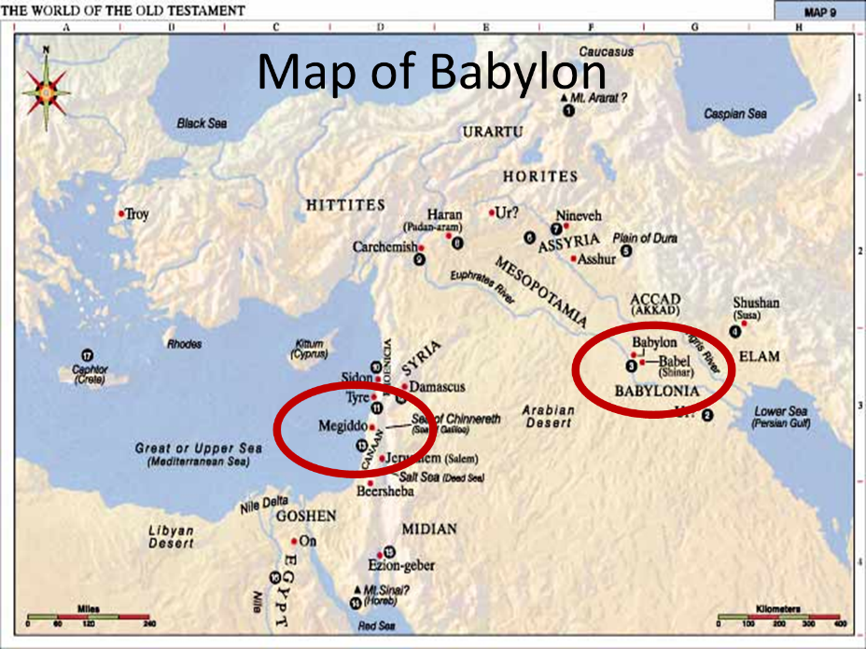

Slide 13
Chapter 1 Outline
Daniel’s circumstances (1:1-2)
Daniel’s selection (1:3-7)
Daniel’s dedication (1:8-16)
Daniel’s blessing (1:17-21)

Slide 14
Daniel’s Selection (1:3-7)
The selection (1:3)
The program (1:4-5)
Entrance requirements (1:4a)
Course of study (4b)
Physical provision (5a)
Length of study (5b)
The candidates (6-7)
Hebrew names (6)
Babylonian names (7)

Slide 15
Daniel’s Selection (1:3-7)
The selection (1:3)
The program (1:4-5)
Entrance requirements (1:4a)
Course of study (4b)
Physical provision (5a)
Length of study (5b)
The candidates (6-7)
Hebrew names (6)
Babylonian names (7)

Slide 16
Daniel’s Selection (1:3-7)
The selection (1:3)
The program (1:4-5)
Entrance requirements (1:4a)
Course of study (4b)
Physical provision (5a)
Length of study (5b)
The candidates (6-7)
Hebrew names (6)
Babylonian names (7)

Slide 17
Daniel’s Selection (1:3-7)
The selection (1:3)
The program (1:4-5)
Entrance requirements (1:4a)
Course of study (4b)
Physical provision (5a)
Length of study (5b)
The candidates (6-7)
Hebrew names (6)
Babylonian names (7)

Slide 18
Chapter 1 Outline
Daniel’s circumstances (1:1-2)
Daniel’s selection (1:3-7)
Daniel’s dedication (1:8-16)
Daniel’s blessing (1:17-21)

Slide 19
Daniel’s Dedication (1:8-16)
First round (1:8-10)
Daniel’s resolve (1:8a)
Daniel’s request (1:8b)
Commander’s response (1:9-10)
Second round (1:11-16)
Daniel’s request (1:11-13)
Commander’s response (1:14)
Results (1:15-16)

Slide 20
Chapter 1 Outline
Daniel’s circumstances (1:1-2)
Daniel’s selection (1:3-7)
Daniel’s dedication (1:8-16)
Daniel’s blessing (1:17-21)

Slide 21
The 4 Jewish Youths Rise to Favor (1:17-21)
Their God – given knowledge (1:17) – 1Cor 2:14, James 1:5
Their exam before the king (1:18-20)
The length of their service (1:21)

Slide 22
The 4 Jewish Youths Rise to Favor (1:17-21)
Their God – given knowledge (1:17) – 1Cor 2:14, James 1:5
Their exam before the king (1:18-20)
The length of their service (1:21)

Slide 24
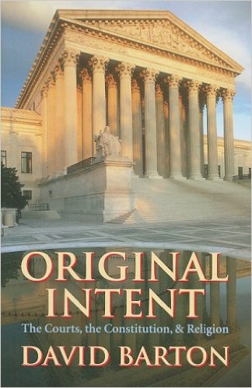
David Barton, Original Intent, p. 245

Slide 25
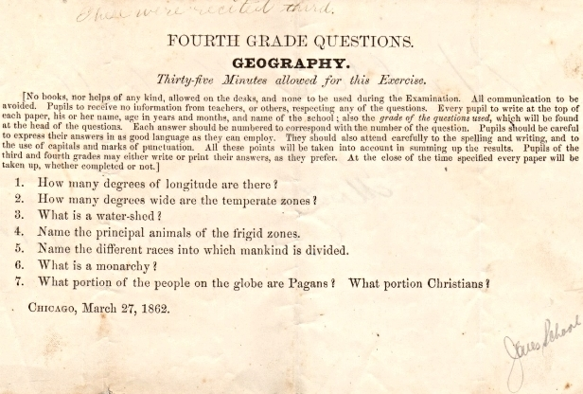
Geography Quiz that was given to Fourth Graders in 1862 (from the WallBuilders' library)

Slide 26
The 4 Jewish Youths Rise to Favor (1:17-21)
Their God – given knowledge (1:17) – 1Cor 2:14, James 1:5
Their exam before the king (1:18-20)
The length of their service (1:21)

Slide 27
The 4 Jewish Youths Rise to Favor (1:17-21)
Their God – given knowledge (1:17) – 1Cor 2:14, James 1:5
Their exam before the king (1:18-20)
The length of their service (1:21)

Slide 28
CHAPTER AND VERSE IN DANIEL | CHRONOLOGICAL DATE | BIBLICAL DATE
1:1 | 605 | 3rd year of Jehoiakim
2:1 | 603 | 2nd year of Nebuchadnezzar
5 | Sat. night 10/12/539 (Hoehner)
7:1 | 553 | 1st year of Belshazzar
8:1 | 551 | 3rd year of Belshazzar
9:1 | 538 | 1st year of Darius
10:1 | 536 | 3rd year of Cyrus

Slide 29
The 4 Jewish Youths Rise to Favor (1:17-21)
The length of their service (1:21)
Nebuchadnezzar’s initial siege (605)
Decree of Cyrus (536)
Daniel served for 69 years
Daniel served through 2 gentile empires and 4 successive gentile administrations

Slide 30
Basic Chronology
Babylon (605‒539)
Nebuchadnezzar
Belshazzar
Media-Persia (538‒536)
Darius
Cyrus

Slide 31
Daniel’s Age
CHAPTER | EVENTS | AGE
1 | TAKEN TO BABYLONIAN CAPTIVITY | 15
2 | Interpreting Nebuchadnezzar’s 1st dream (huge image) | 17
3 | Daniel’s 3 friends cast into the fiery furnace | 19 or 20
4 | Interpreting Nebuchadnezzar’s 2nd dream (huge tree) | 45-50
5 | Interpreting handwriting of the wall at Belshazzar’s feast | Early 80’s
6 | Delivered from the den of lions | c.83
7-8 | Daniel’s visions and dreams | Mid-60’s
9 | Daniel’s seventy “sevens” prophecy | Early-80’s
10-12 | Final dreams and visions | Mid-80’s

Slide 32
The 4 Jewish Youths Rise to Favor (1:17-21)
Their God – given knowledge (1:17) – 1Cor 2:14, James 1:5
Their exam before the king (1:18-20)
The length of their service (1:21)

Slide 33
Takeaways from Daniel 1
Mosaic Law taught Israel how to live inside the land
The examples of the four Hebrew youths taught them how to live outside the land
Consecrate themselves to God
Live by faith from crisis to crisis entrusting the results to God
Our cue as well

Slide 34
Conclusion

Slide 35
Chapter 1 Outline
Daniel’s circumstances (1:1-2)
Daniel’s selection (1:3-7)
Daniel’s dedication (1:8-16)
Daniel’s blessing (1:17-21)

