Slide 1
THE BOOK OF DANIEL
Dr. Andy Woods

Slide 2
Message
Times of the Gentiles are revealed prophetically (2, 7, 8-12) and ethically (1, 3-6)

Slide 3
Purpose
To encourage Judah by emphasizing the sovereignty of God during the Babylonian captivity and to teach Judah how to live while outside the land
Bifurcating Daniel

Slide 4
Synthetic Outline
Historical (1-7):
Daniel interprets, 3rd person, gentile nations
Intro “Hebrew” (1)
Aramaic chiasm (2-7)

Slide 5
Synthetic Outline
Prophetic (8-12):
Angel interprets, 1st person, Jewish nation, Hebrew
Ram & Goat (8)
70 weeks (9)
Final vision (10-12)

Slide 6
Synthetic Outline
Historical (1-7):
Daniel interprets, 3rd person, gentile nations
Intro “Hebrew” (1)
Aramaic chiasm (2-7)

Slide 7
Synthetic Outline
Historical (1-7):
Daniel interprets, 3rd person, gentile nations
Intro “Hebrew” (1)
Aramaic chiasm (2-7)

Slide 8
Synthetic Outline
Chiasm “Aramaic” ( 2-7)
1. Gentile History (2)
2. Protection (3)
3. Revelation to a gentile king (4)
3. Revelation to a gentile king (5)
2. Protection (6)
1. Gentile history (7)

Slide 9
Synthetic Outline
Chiasm “Aramaic” ( 2-7)
1. Gentile History (2)
2. Protection (3)
3. Revelation to a gentile king (4)
3. Revelation to a gentile king (5)
2. Protection (6)
1. Gentile history (7)

Slide 10
Chapter 2 Outline
Nebuchadnezzar’s dream (2:1)
Nebuchadnezzar demands the revelation & interpretation (2:2-13)
Dream revealed to Daniel (2:14-23)
Daniel’s recitation & interpretation of the dream (2:24-30)
The dream’s contents & interpretation (2:31-45)
Daniel’s promotion (2:46-49)

Slide 11
Chapter 2 Outline
Nebuchadnezzar’s dream (2:1)
Nebuchadnezzar demands the revelation & interpretation (2:2-13)
Dream revealed to Daniel (2:14-23)
Daniel’s recitation & interpretation of the dream (2:24-30)
The dream’s contents & interpretation (2:31-45)
Daniel’s promotion (2:46-49)

Slide 12
CHAPTER AND VERSE IN DANIEL | CHRONOLOGICAL DATE | BIBLICAL DATE
1:1 | 605 | 3rd year of Jehoiakim
2:1 | 603 | 2nd year of Nebuchadnezzar
5 | Sat. night 10/12/539 (Hoehner)
7:1 | 553 | 1st year of Belshazzar
8:1 | 551 | 3rd year of Belshazzar
9:1 | 538 | 1st year of Darius
10:1 | 536 | 3rd year of Cyrus

Slide 13
Chapter 2 Outline
Nebuchadnezzar’s dream (2:1)
Nebuchadnezzar demands the revelation & interpretation (2:2-13)
Dream revealed to Daniel (2:14-23)
Daniel’s recitation & interpretation of the dream (2:24-30)
The dream’s contents & interpretation (2:31-45)
Daniel’s promotion (2:46-49)

Slide 14
Chapter 2 Outline
Nebuchadnezzar’s dream (2:1)
Nebuchadnezzar demands the revelation & interpretation (2:2-13)
Dream revealed to Daniel (2:14-23)
Daniel’s recitation & interpretation of the dream (2:24-30)
The dream’s contents & interpretation (2:31-45)
Daniel’s promotion (2:46-49)

Slide 15
Chapter 2 Outline
Nebuchadnezzar’s dream (2:1)
Nebuchadnezzar demands the revelation & interpretation (2:2-13)
Dream revealed to Daniel (2:14-23)
Daniel’s recitation & interpretation of the dream (2:24-30)
The dream’s contents & interpretation (2:31-45)
Daniel’s promotion (2:46-49)

Slide 16
Daniel’s Recitation & Interpretation of the Dream (2:24-30)
Report of the dream to Nebuchadnezzar (2:24-28)
Purpose of the dream (2:29-30)

Slide 17
Daniel’s Recitation & Interpretation of the Dream (2:24-30)
Report of the dream to Nebuchadnezzar (2:24-28)
Purpose of the dream (2:29-30)

Slide 18
Daniel’s Recitation & Interpretation of the Dream (2:24-30)
Report of the dream to Nebuchadnezzar (2:24-28)
Purpose of the dream (2:29-30)

Slide 19
Chapter 2 Outline
Nebuchadnezzar’s dream (2:1)
Nebuchadnezzar demands the revelation & interpretation (2:2-13)
Dream revealed to Daniel (2:14-23)
Daniel’s recitation & interpretation of the dream (2:24-30)
The dream’s contents & interpretation (2:31-45)
Daniel’s promotion (2:46-49)

Slide 20
Contents & Interpretation of the Dream (2:24-30)
Contents (2:31-35)
Interpretation (2:36-45)

Slide 21
Contents & Interpretation of the Dream (2:24-30)
Contents (2:31-35)
Interpretation (2:36-45)

Slide 22
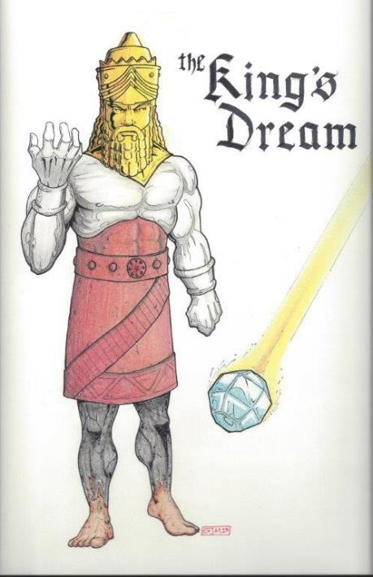
Statue & Stone

Slide 23
Contents & Interpretation of the Dream (2:24-30)
Contents (2:31-35)
Interpretation (2:36-45)

Slide 24
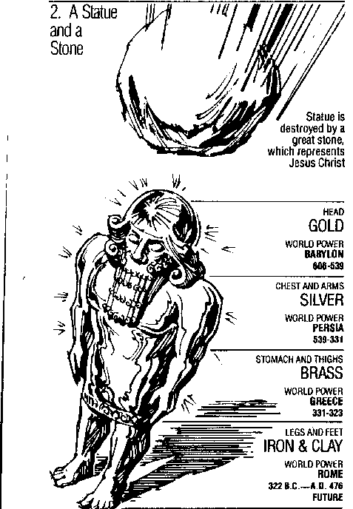
Statue & Stone

Slide 25
6 Empires
Babylon (2:36-38) 605-539 BC
Media-Persia (2:39a) 539-331 BC
Greece (2:39b) 331-63 BC
Rome I (2:40) 63 BC – 70 AD
Rome II (2:41-43) Tribulation
Kingdom (2:44-45) After 2nd Coming

Slide 26
6 Empires
Babylon (2:36-38) 605-539 BC
Media-Persia (2:39a) 539-331 BC
Greece (2:39b) 331-63 BC
Rome I (2:40) 63 BC – 70 AD
Rome II (2:41-43) Tribulation
Kingdom (2:44-45) After 2nd Coming

Slide 27
6 Empires
Babylon (2:36-38) 605-539 BC
Media-Persia (2:39a) 539-331 BC
Greece (2:39b) 331-63 BC
Rome I (2:40) 63 BC – 70 AD
Rome II (2:41-43) Tribulation
Kingdom (2:44-45) After 2nd Coming

Slide 28
Statue & Stone

Slide 29
Statue & Stone

Slide 30
Three Returns
 | Date | Duration | Persian king | Jewish leader | Scripture | Purpose | Number of returnees
1st return | 538–515 B.C. | 23 years | Cyrus (Isa 44:28‒45:1) | Zerubbabel | Ezra 1–6; Isaiah 44:28 | Rebuilding the temple | 50,000
2nd return | 458–457 B.C. | 2 years | Artaxerxes | Ezra | Ezra 7–10 | Adorning of the temple and reforming the people | 2,000
3rd return | 444–432 B.C. | 8 years | Artaxerxes | Nehemiah | Nehemiah | Rebuilding the wall

Slide 31
Cyrus Cylinder

Slide 32
6 Empires
Babylon (2:36-38) 605-539 BC
Media-Persia (2:39a) 539-331 BC
Greece (2:39b) 331-63 BC
Rome I (2:40) 63 BC – 70 AD
Rome II (2:41-43) Tribulation
Kingdom (2:44-45) After 2nd Coming

Slide 33
6 Empires
Babylon (2:36-38) 605-539 BC
Media-Persia (2:39a) 539-331 BC
Greece (2:39b) 331-63 BC
Rome I (2:40) 63 BC – 70 AD
Rome II (2:41-43) Tribulation
Kingdom (2:44-45) After 2nd Coming

Slide 34
6 Empires
Babylon (2:36-38) 605-539 BC
Media-Persia (2:39a) 539-331 BC
Greece (2:39b) 331-63 BC
Rome I (2:40) 63 BC – 70 AD
Rome II (2:41-43) Tribulation
Kingdom (2:44-45) After 2nd Coming

Slide 35
6 Empires
Babylon (2:36-38) 605-539 BC
Media-Persia (2:39a) 539-331 BC
Greece (2:39b) 331-63 BC
Rome I (2:40) 63 BC – 70 AD
Rome II (2:41-43) Tribulation
Kingdom (2:44-45) After 2nd Coming

Slide 36
Daniel 2:44-45 is Future
Christianity did not suddenly fill the whole earth
Christ did not destroy Rome
No 10 simultaneous kings in the time of Christ
Christ was not the smiting stone
Christ did not destroy all the kingdoms of the world
The church is not a political kingdom
J. Dwight Pentecost, Bible Knowledge Commentary, 1336

Slide 37
Emergent: Kingdom
“He selected 12 and trained them in a new way of life. He sent them to teach everyone this new way of life...Even if only a few would practice this new way, many would benefit. Oppressed people would be free. Poor people would be liberated from poverty. Minorities would be treated with respect. Sinners would be loved, not resented.”
Brian McLaren, A Generous Orthodoxy, 111.

Slide 38
Emergent: Kingdom
“Industrialists would realize that God cares for sparrows and wildflowers-so their industries should respect, not rape, the environment. The homeless would be invited in for a hot meal. The kingdom of God would come – not everywhere at once, not suddenly, but gradually like a seed growing in a field, like yeast spreading in a lump of bread dough, like light spreading across the sky at dawn.”
Brian McLaren, A Generous Orthodoxy, 111.

Slide 39
Emergent: Kingdom
“The Kingdom of God is a central conversation in emerging communities… And let me tell you ‘Kingdom of God’ language is really big in the emerging church” (Italics added).
Doug Pagitt, cited in Oakland, 163.

Slide 40
Emergent: Kingdom
“If Revelation were a blueprint of the distant future, it would have been unintelligible to its original readers…In light of this, Revelation becomes a powerful book about the kingdom of God here and now, available to all.”
Brian McLaren, cited in Oakland, 158.

Slide 41
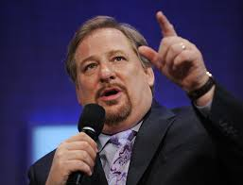
Kingdom
“I stand before you confidently right now and say to you that God is going to use you to change the world...I'm looking at a stadium full of people right now who are telling God they will do whatever it takes to establish God's Kingdom "on earth as it is in heaven. What will happen if the followers of Jesus say to Him, ‘We are yours?’ What kind of spiritual awakening will occur?”
Rick Warren, cited in Oakland, Kindle edition.

Slide 42
Kingdom
“If we are to be a part of this coming kingdom, God expects our lives – our churches and faith communities too – to be characterized by these authentic signs of our own transformation: compassion, mercy, justice, and love – demonstrated tangibly. Only then will our light break forth like the dawn, our healing quickly appear, and our cries for help be answered with a divine Here am I.”
Stearns, Hole in the Gospel, 57.

Slide 43
Kingdom
“The gospel that we have been given – the whole gospel – is God’s vision for a new way of living…Christ’s vision was of a redeemed world order populated by redeemed people – now. To accomplish this, we are to be salt and light in a dark and fallen world, the “yeast” that leavens the whole loaf of bread (the whole of society). We are the ones God has called to be His Church. It’s up to us. We are to be the change. But a changed world requires change agents, and change agents are people who have first been changed themselves.”
Stearns, Hole in the Gospel, 276, 243-44.

Slide 44
Russell Moore
President: Ethics and Religious Liberties Commission of the Southern Baptist Convention
“The locus of the kingdom of God in this age is within the church, where Jesus rules as king. As we live our lives together, we see the transforming power of the gospel and the in breaking of the future kingdom.”
Justin Taylor, “An Interview with Russell Moore,” www.thegospelcoalition.org.

Slide 45
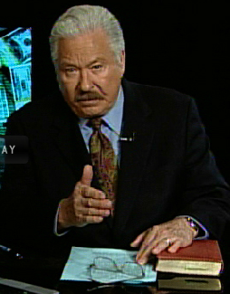
Hal Lindsey
The Road to Holocaust, 269
Bestselling author Hal Lindsey warned what could happen to the church in the last days if she began to see herself as the establisher of God's kingdom: “The last days of the church on the earth may be largely wasted seeking to accomplish a task that only the LORD Himself can and will do directly.”

Slide 46
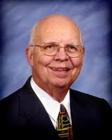
Purposes of the Local Church
Glorify God (Eph 3:21)
Edify the saints (Eph 4:11-16)
Fulfill the Great Commission (Matt 28:18-20)

Slide 47
Chapter 2 Outline
Nebuchadnezzar’s dream (2:1)
Nebuchadnezzar demands the revelation & interpretation (2:2-13)
Dream revealed to Daniel (2:14-23)
Daniel’s recitation & interpretation of the dream (2:24-30)
The dream’s contents & interpretation (2:31-45)
Daniel’s promotion (2:46-49)

Slide 48
The Promotion of Daniel (2:46-49)
Personal honor (2:46)
Praise to God (2:47)
Promotion of Daniel (2:48)
Promotion of Shadrach, Meshach, & Abed-nego (2:49)

Slide 49
The Promotion of Daniel (2:46-49)
Personal honor (2:46)
Praise to God (2:47)
Promotion of Daniel (2:48)
Promotion of Shadrach, Meshach, & Abed-nego (2:49)

Slide 50
The Promotion of Daniel (2:46-49)
Personal honor (2:46)
Praise to God (2:47)
Promotion of Daniel (2:48)
Promotion of Shadrach, Meshach, & Abed-nego (2:49)

Slide 51
The Promotion of Daniel (2:46-49)
Personal honor (2:46)
Praise to God (2:47)
Promotion of Daniel (2:48)
Promotion of Shadrach, Meshach, & Abed-nego (2:49)

Slide 52
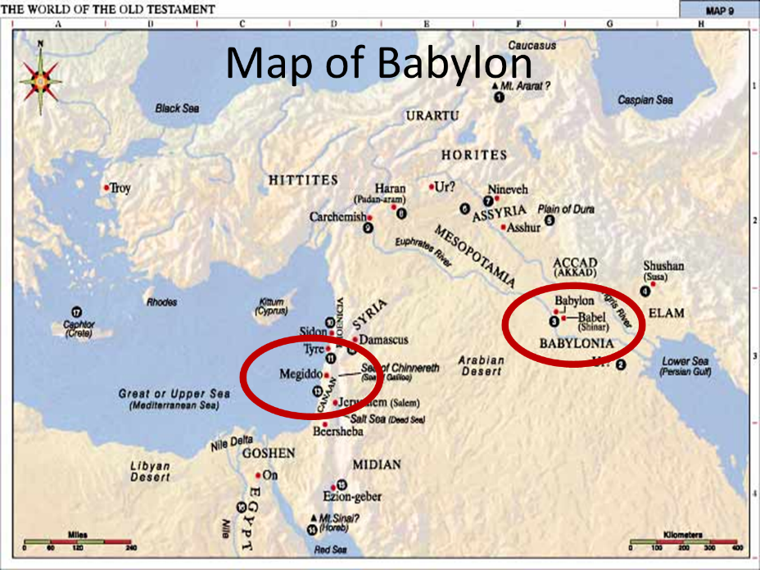

Slide 53
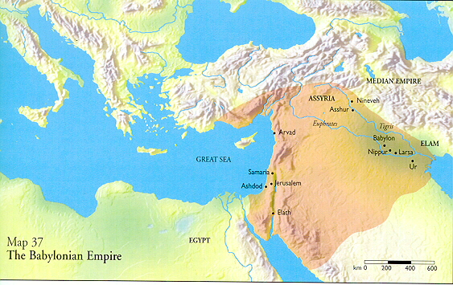

Slide 54
The Promotion of Daniel (2:46-49)
Personal honor (2:46)
Praise to God (2:47)
Promotion of Daniel (2:48)
Promotion of Shadrach, Meshach, & Abed-nego (2:49)

Slide 55
Takeaways from Daniel 2
Mosaic Law taught Israel how to live inside the land
The examples of the four Hebrew youths taught them how to live outside the land
Consecrate themselves to God
Live by faith from crisis to crisis entrusting the results to God
Allow God to promote us in His due time
Our cue as well

Slide 56
Conclusion

Slide 57
Chapter 2 Outline
Nebuchadnezzar’s dream (2:1)
Nebuchadnezzar demands the revelation & interpretation (2:2-13)
Dream revealed to Daniel (2:14-23)
Daniel’s recitation & interpretation of the dream (2:24-30)
The dream’s contents & interpretation (2:31-45)
Daniel’s promotion (2:46-49)

