Slide 1

FOUR CHRISTMAS PROPHECIES
Dr. Andrew M. Woods

Slide 2
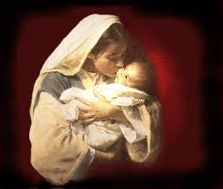
Messiah Must Be:
  A man (Gen 3:15)
  From Jacob’s line (Num 24:17)
  Be born of a virgin (Isa 7:13-14)
  Be born in Bethlehem (Micah 5:2)

Slide 3

Galatians 4:4 (NASB)
“But when the fullness of the time came, God sent forth His Son, born of a woman, born under the Law.”

Slide 4
Messiah Must Be:
  A man (Gen 3:15)
  From Jacob’s line (Num 24:17)
  Be born of a virgin (Isa 7:13-14)
  Be born in Bethlehem (Micah 5:2)

Slide 5
Messiah must be a man
Genesis 3:15

Slide 6
Genesis 3:15 (NASB)
“And I will put enmity Between you and the woman, And between your seed and her seed; He shall bruise you on the head, And you shall bruise him on the heel.”

Slide 7
Genesis 4:1 (NASB)
“Now the man had relations with his wife Eve, and she conceived and gave birth to Cain, and she said, ‘I have gotten a manchild with the help of the Lord.’”

Slide 8
Genesis 4:1 (NASB)
“Now the man had relations with his wife Eve, and she conceived and gave birth to Cain, and she said, ‘I have gotten a manchild with the help of the Lord.’”

Slide 9
Genesis 5:29 (NASB)
“Now he called his name Noah, saying, ‘This one will give us rest from our work and from the toil of our hands arising from the ground which the Lord has cursed.’”

Slide 10
Daniel 11:37 (NASB)
“He will show no regard for the gods of his fathers or for the desire of women, nor will he show regard for any other god; for he will magnify himself above them all.”

Slide 11
Genesis 3:15 (NASB)
“And I will put enmity Between you and the woman, And between your seed and her seed; He shall bruise you on the head, And you shall bruise him on the heel.”

Slide 12
Why the Virgin Birth?
To fulfill OT prophecy
To emphasize Christ’s humanity and deity
To emphasize Christ’s eternality
To maintain Christ’s sinlessness
To protect the bodily atonement
To circumvent the curse of Jeconiah

Slide 13
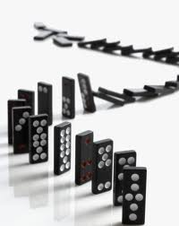

Slide 14
Messiah Must Be:
  A man (Gen 3:15)
  From Jacob’s line (Num 24:17)
  Be born of a virgin (Isa 7:13-14)
  Be born in Bethlehem (Micah 5:2)

Slide 15
Messiah must be Jewish or from the line of Jacob
Numbers 24:17

Slide 16
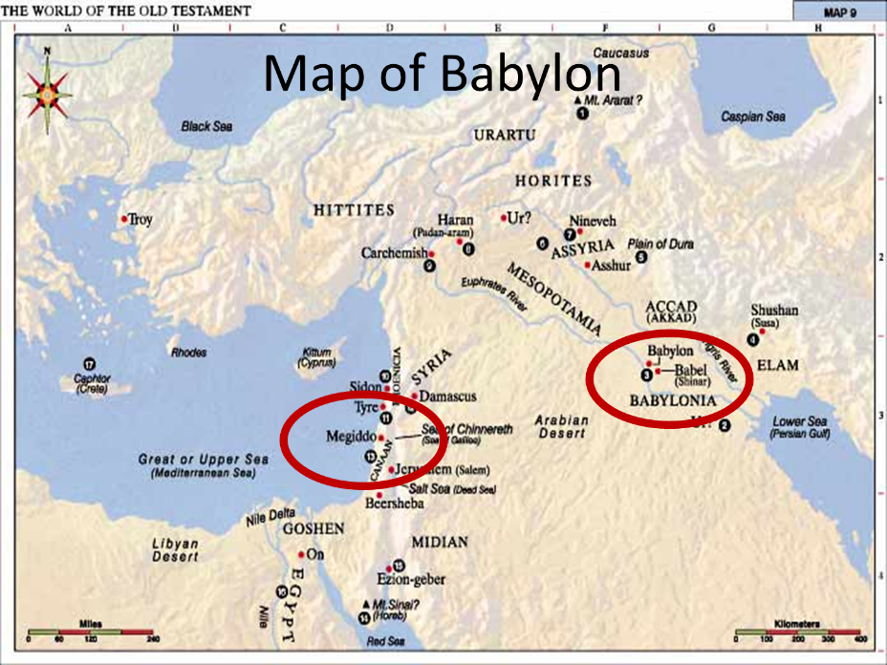

Slide 17
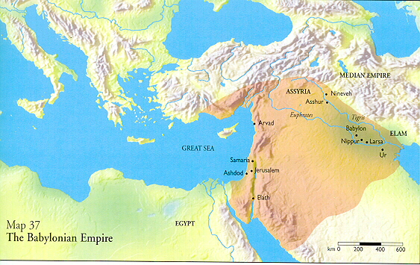

Slide 18
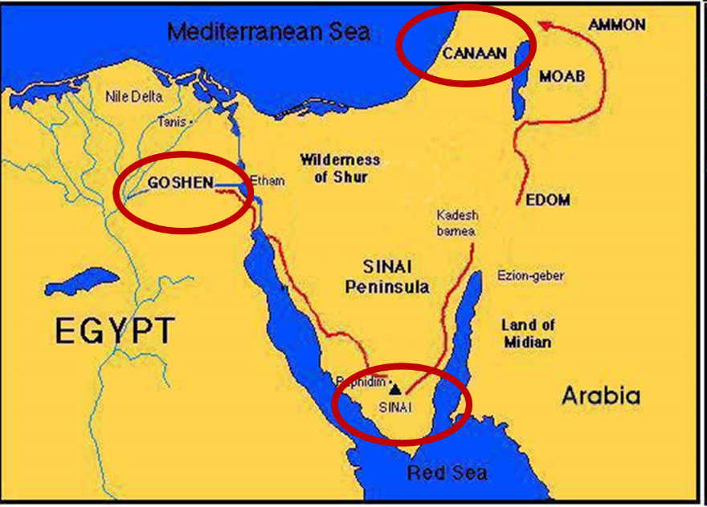

Slide 19
Balaam's 7 Oracles Blessing Israel (23-24)
First oracle (23:1-12), Balaam explained that God’s blessings upon Israel were irrevocable.
Second oracle (23:13-26), Balaam explained that the source of Israel’s blessing was her unique relationship to Yahweh
Third oracle (23:27–24:14), Balaam extolled Israel’s beauty.
Fourth oracle (24:15-19), Balaam explained that a future messianic deliverer (Gen 49:10) would spring forth and exercise dominion from Israel.

Slide 20
Balaam's 7 Oracles Blessing Israel (23-24)
Fifth oracle (Num 24:20) predicts Amalek’s destruction. Amalek was the first foe that Israel had to fight against after leaving Egypt (Exod 17).
Sixth oracle (24:21-22) predicts the destruction of the Midianite group known as the Kenites as well as Assyria.
The nations of the seventh oracle are difficult to identify (24:23-24).

Slide 21
Balaam's 7 Oracles Blessing Israel (23-24)
First oracle (23:1-12), Balaam explained that God’s blessings upon Israel were irrevocable.
Second oracle (23:13-26), Balaam explained that the source of Israel’s blessing was her unique relationship to Yahweh
Third oracle (23:27–24:14), Balaam extolled Israel’s beauty.
Fourth oracle (24:15-19), Balaam explained that a future messianic deliverer (Gen 49:10) would spring forth and exercise dominion from Israel.

Slide 22
Numbers 24:17 (NASB)
“I see him, but not now; I behold him, but not near; A star shall come forth from Jacob, A scepter shall rise from Israel, And shall crush through the forehead of Moab, And tear down all the sons of Sheth.”

Slide 24

Messiah must present Himself to Israel on March 30, A.D. 33
Daniel 9:25

Slide 25
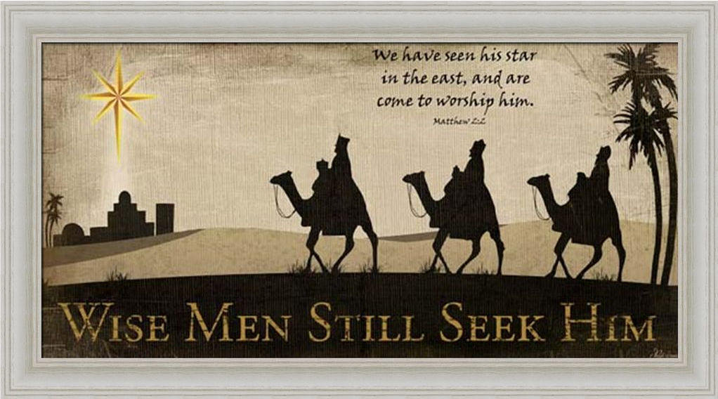

Slide 26
Messiah Must Be:
  A man (Gen 3:15)
  From Jacob’s line (Num 24:17)
  Be born of a virgin (Isa 7:13-14)
  Be born in Bethlehem (Micah 5:2)

Slide 27
Messiah must be born of a virgin
Isaiah 7:13-14

Slide 28
Isaiah 7:13-14 (NASB)
“Then he said, “Listen now, O house of David! Is it too slight a thing for you to try the patience of men, that you will try the patience of my God as well? ¹⁴ Therefore the Lord Himself will give you a sign: Behold, a virgin will be with child and bear a son, and she will call His name Immanuel.”

Slide 29
Isaiah 7:13-14 (NASB)
“Then he said, “Listen now, O house of David! Is it too slight a thing for you to try the patience of men, that you will try the patience of my God as well? ¹⁴ Therefore the Lord Himself will give you a sign: Behold, a virgin will be with child and bear a son, and she will call His name Immanuel.”

Slide 30
Three Arguments Against the Virgin Birth (Isa. 7:13-14)
The Hebrew word is Betulah and not Almah (Joel 1:8)!
The Hebrew word Almah does not mean virgin!
No relevance to Isaiah’s day!

Slide 31
Three Arguments Against the Virgin Birth (Isa. 7:13-14)
The Hebrew word is Betulah and not Almah (Joel 1:8)!
The Hebrew word Almah does not mean virgin!
No relevance to Isaiah’s day!

Slide 32
Three Arguments Against the Virgin Birth (Isa. 7:13-14)
The Hebrew word is Betulah and not Almah (Joel 1:8)
The Hebrew word Almah does not mean virgin
No relevance to Isaiah’s day

Slide 33
To Fulfill Old Testament Prophecy
Almah
  OT uses (Gen 24:43; Exod 2:8; Ps 68:25; Song of Solomon 1:3; 6:8; Prov 30:18-19)
  LXX
  Matt 1:23

Slide 34
Three Arguments Against the Virgin Birth (Isa. 7:13-14)
The Hebrew word is Betulah and not Almah (Joel 1:8)!
The Hebrew word Almah does not mean virgin!
No relevance to Isaiah’s day!

Slide 35
Isaiah 7:13-14
Ahaz’ Day?
  Isaiah 53 in Acts 8:31-35
  Sign (Isa 7:14)
  Two threats (Isa. 7:1-2)
    Shear Jashub (Isa. 7:3)
    David (Isa 7:13)
    From the singular to the plural “you”
  Extended context (Isa 9:6; 11:1-5)

Slide 36
Isaiah 7:13-14
Ahaz’ Day?
  Isaiah 53 in Acts 8:31-35
  Sign (Isa 7:14)
  Two threats (Isa. 7:1-2)
    Shear Jashub (Isa. 7:3)
    David (Isa 7:13)
    From the singular to the plural “you”
  Extended context (Isa 9:6; 11:1-5)

Slide 37
Isaiah 7:13-14
Ahaz’ Day?
  Isaiah 53 in Acts 8:31-35
  Sign (Isa 7:14)
  Two threats (Isa. 7:1-2)
    Shear Jashub (Isa. 7:3)
    David (Isa 7:13)
    From the singular to the plural “you”
  Extended context (Isa 9:6; 11:1-5)

Slide 38
Isaiah 7:13-14 (NASB)
“Then he said, “Listen now, O house of David! Is it too slight a thing for you to try the patience of men, that you will try the patience of my God as well? ¹⁴ Therefore the Lord Himself will give you a sign: Behold, a virgin will be with child and bear a son, and she will call His name Immanuel.”

Slide 39
ISAIAH 7 AND 8 DIFFERENCES
Isaiah 7 | Isaiah 8
Immanuel | Maher-shalal-hash-baz
Blessing | Judgment
Born to a virgin | Born to Isaiah's wife
Age 12 | Age 1-2
Assyrian judgment upon Judah | Assyrian judgment upon Syria and Israel

Slide 40
Isaiah 7:13-14
Ahaz’ Day?
  Isaiah 53 in Acts 8:31-35
  Sign (Isa 7:14)
  Two threats (Isa. 7:1-2)
    Shear Jashub (Isa. 7:3)
    David (Isa 7:13)
    From the singular to the plural “you”
  Extended context (Isa 9:6; 11:1-5)

Slide 41
Isaiah 7:13-14
Ahaz’ Day?
  Isaiah 53 in Acts 8:31-35
  Sign (Isa 7:14)
  Two threats (Isa. 7:1-2)
    Shear Jashub (Isa. 7:3)
    David (Isa 7:13)
    From the singular to the plural “you”
  Extended context (Isa 9:6; 11:1-5)

Slide 42
Isaiah 7:13-14
Ahaz’ Day?
  Isaiah 53 in Acts 8:31-35
  Sign (Isa 7:14)
  Two threats (Isa. 7:1-2)
    Shear Jashub (Isa. 7:3)
    David (Isa 7:13)
    From the singular to the plural “you”
  Extended context (Isa 9:6; 11:1-5)

Slide 43
Isaiah 7:13-14 (NASB)
“Then he said, “Listen now, O house of David! Is it too slight a thing for you to try the patience of men, that you will try the patience of my God as well? ¹⁴ Therefore the Lord Himself will give you a sign: Behold, a virgin will be with child and bear a son, and she will call His name Immanuel.”

Slide 44
Isaiah 7:13-14
Ahaz’ Day?
  Isaiah 53 in Acts 8:31-35
  Sign (Isa 7:14)
  Two threats (Isa. 7:1-2)
    Shear Jashub (Isa. 7:3)
    David (Isa 7:13)
    From the singular to the plural “you”
  Extended context (Isa 9:6; 11:1-5)

Slide 45

Isaiah 7:9–17 (NASB95)
⁹ “… and the head of Ephraim is Samaria and the head of Samaria is the son of Remaliah. If you [s] will not believe, you [s] surely shall not last.”’” ¹⁰ Then the Lord spoke again to Ahaz, saying, ¹¹ “Ask a sign for yourself [s] from the Lord your God; make it deep as Sheol or high as heaven.” ¹² But Ahaz said, “I will not ask, nor will I test the Lord!” ¹³ Then he said, “Listen now, O house of David! Is it too slight a thing for you [pl] to try the patience of men, that you [pl] will try the patience of my God as well? ¹⁴ “Therefore the Lord Himself will give you [pl] a sign: Behold, a virgin will be with child and bear a son, and she will call His name Immanuel. ¹⁵ “He will eat curds and honey at the time He knows enough to refuse evil and choose good. ¹⁶ “For before the boy will know enough to refuse evil and choose good, the land whose two kings you [s] dread will be forsaken. ¹⁷ “The Lord will bring on you [s], on your people, and on your father’s house such days as have never come since the day that Ephraim separated from Judah, the king of Assyria.”

Slide 46
Isaiah 7:13-14
Ahaz’ Day?
  Isaiah 53 in Acts 8:31-35
  Sign (Isa 7:14)
  Two threats (Isa. 7:1-2)
    Shear Jashub (Isa. 7:3)
    David (Isa 7:13)
    From the singular to the plural “you”
  Extended context (Isa 9:6; 11:1-5)

Slide 47
Messiah Must Be:
  A man (Gen 3:15)
  From Jacob’s line (Num 24:17)
  Be born of a virgin (Isa 7:13-14)
  Be born in Bethlehem (Micah 5:2)

Slide 48
Messiah must be born in Bethlehem
Micah 5:2

Slide 49
Micah 5:2 (NASB)
“But as for you, Bethlehem Ephrathah, Too little to be among the clans of Judah, From you One will go forth for Me to be ruler in Israel. His goings forth are from long ago, From the days of eternity.”

Slide 50
Micah 5:2 (NASB)
“But as for you, Bethlehem Ephrathah, Too little to be among the clans of Judah, From you One will go forth for Me to be ruler in Israel. His goings forth are from long ago, From the days of eternity.”

Slide 51
Micah 5:2 (NASB)
“But as for you, Bethlehem Ephrathah, Too little to be among the clans of Judah, From you One will go forth for Me to be ruler in Israel. His goings forth are from long ago, From the days of eternity.”

Slide 52
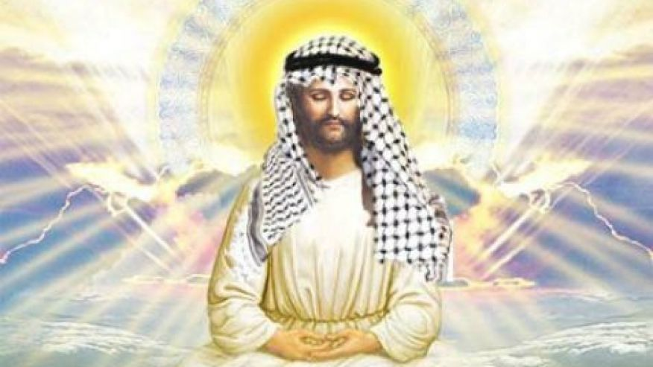

Slide 53
Micah 5:2 (NASB)
“But as for you, Bethlehem Ephrathah, Too little to be among the clans of Judah, From you One will go forth for Me to be ruler in Israel. His goings forth are from long ago, From the days of eternity.”

Slide 54
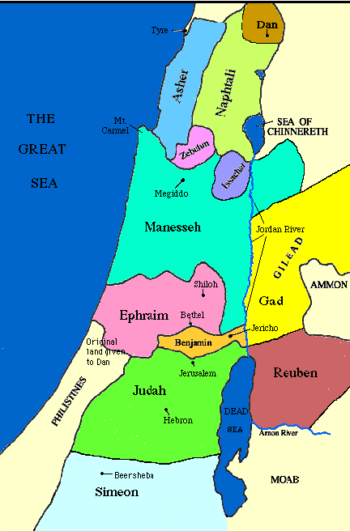

Slide 55
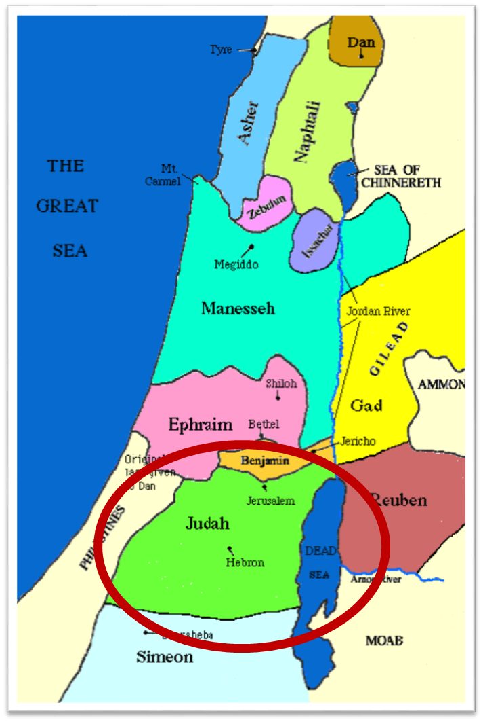

Slide 56
Messiah must be from the tribe of Judah
Genesis 49:10
Revelation 5:5

Slide 57
Micah 5:2 (NASB)
“But as for you, Bethlehem Ephrathah, Too little to be among the clans of Judah, From you One will go forth for Me to be ruler in Israel. His goings forth are from long ago, From the days of eternity.”

Slide 58
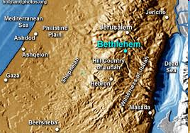

Slide 59
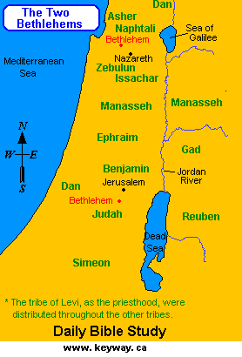

Slide 60
Micah 5:2 (NASB)
“But as for you, Bethlehem Ephrathah, Too little to be among the clans of Judah, From you One will go forth for Me to be ruler in Israel. His goings forth are from long ago, From the days of eternity.”

Slide 61
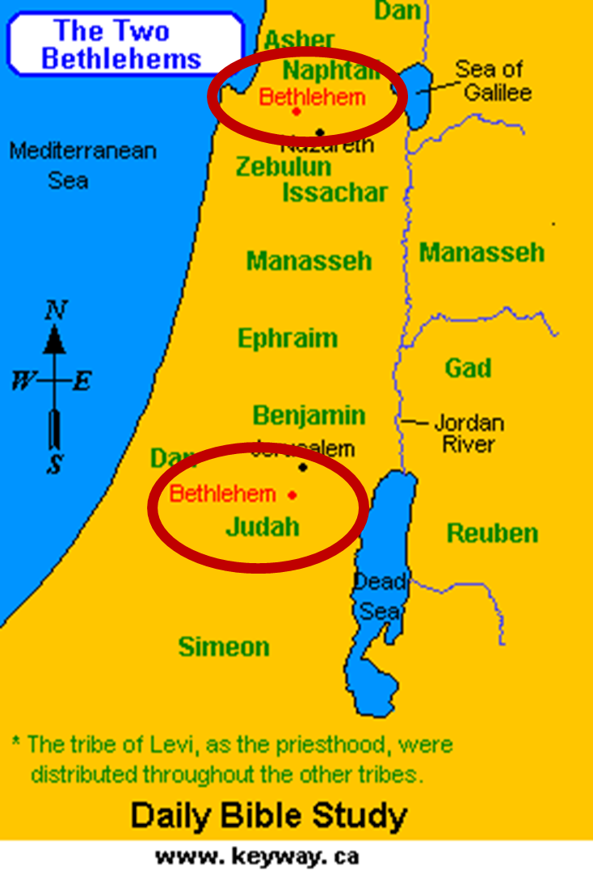

Slide 62
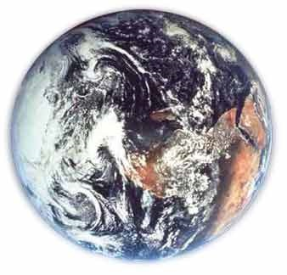
Modern Example
Hemisphere
Country
State
County
City
Zip code
Street name
Street address
Person

Slide 63
Conclusion

Slide 64
Messiah Must Be:
  A man (Gen 3:15)
  From Jacob’s line (Num 24:17)
  Be born of a virgin (Isa 7:13-14)
  Be born in Bethlehem (Micah 5:2)

