Slide 1
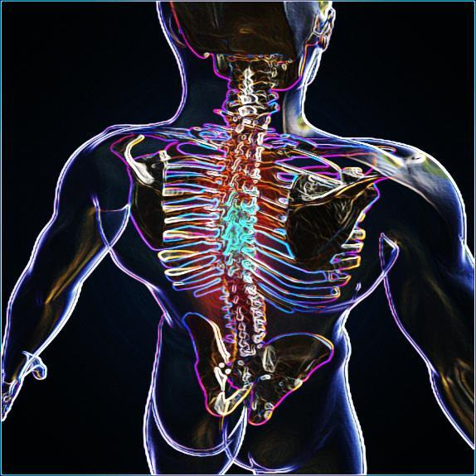
S
P
I
R
I
T
U
A
L
A
N
A
T
O
M
Y
Part 1
Jim McGowan, Th.D.
Sugar Land Bible Church
Nov. 06, 2016
This presentation was compiled using excerpts from the Complete Works of Miles J. Stanford, resources obtained from Duluth Bible Church’s website, and resources obtained from Pastor Vern Peterman, Holly Hills Bible Church – Used with permission.

Slide 2
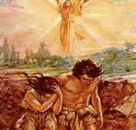
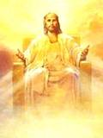
Who We Were……………..
Who We Are……………….
Who We Are Becoming…….
Notes:
Introduction to Who we were – Who we are – Who we are becoming
In this session and those that follow, we will be taking a look at what God’s word says about 1) who we were as unbelievers, 2) who we are as believers and, 3) who we are becoming, as believers.
We will examine what Scripture says about these things and discover some intriguing aspects of the unbeliever’s and the believer’s ‘spiritual anatomy’. Briefly, we will:
Consider the Spiritual Anatomy of the Unbeliever (the Old Man, the Sin Nature) and the Spiritual Anatomy of the Believer (the New Man and the New Nature)
Review and Enhance our understanding of Identification Truths
Discuss the aspects of Body, Soul and Spirit as it relates to the Unbeliever and the Believer
Consider Adam and Eve as originally created in the image of God and how that contrast and compares with Believers, who are being conformed and transformed into the image of Christ

Slide 3
Outline
Spiritual Anatomy
“In Adam” vs. “In Christ”
Unbeliever “In Adam”
Church Age Believer “In Christ”
Old Man, Sin Nature vs. New Man, New Nature
Key Points
Old Man vs. Sin Nature Critical Distinctions
Continuity of Person
Summation & Conclusion
Notes:
Spiritual Anatomy
“In Adam” vs. “In Christ”
Unbeliever “In Adam”
Church Age Believer “In Christ”
Old Man, Sin Nature vs. New Man, New Nature
Key Points
Old Man vs. Sin Nature Critical Distinctions
Continuity of Person
Summation & Conclusion

Slide 4
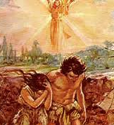
“In Adam” vs. “In Christ”

Slide 5
1 Corinthians 15:20-22
²⁰ But now Christ has been raised from the dead, the first fruits of those who are asleep. ²¹ For since by a man [Adam] came death, by a man [Christ] also came the resurrection of the dead. ²² For as IN ADAM ALL DIE, so also in Christ all will be made alive.
Notes:
1 Corinthians 15:20-22
But now Christ has been raised from the dead, the first fruits of those who are asleep. 21 For since by a man came death, by a man also came the resurrection of the dead. 22 For as in Adam all die, so also in Christ all will be made alive.
1 Corinthians chapter 15 is primarily about the resurrection, but verses 21 and 22 provide some important insights including:

Slide 6
Unbelievers “In Adam”
All human beings are conceived and born ‘in Adam’, that is, they are positionally ‘in Adam’ and identified with him, so that all unbelievers have Adam as the spiritual head (Seminal Head) of the race of fallen mankind. This is the fixed position of each unbeliever. All those ‘in Adam’ share his spiritual history, and the consequences of that history, and are identified with him.
Notes:
All human beings are conceived and born ‘in Adam’, that is, they are positionally ‘in Adam’ and identified with him, so that all unbelievers have Adam as the spiritual head of the race of fallen mankind. This is the fixed position of each unbeliever. All those ‘in Adam’ share his spiritual history, and the consequences of that history, and are identified with him.
What is Adam’s spiritual history? Where was he initially? He was not righteousness, he was fundamentally innocent! Adam disobeyed the one rule.
What does it mean to have his spiritual history? The spiritual anatomy is the same because we have the same history in Adam.

Slide 7
1 Corinthians 15:20-22
²⁰ But now Christ has been raised from the dead, the first fruits of those who are asleep. ²¹ For since by a man [Adam] came death, by a man [Christ] also came the resurrection of the dead. ²² For as in Adam all die, so also IN CHRIST ALL WILL BE MADE ALIVE.
Notes:
1 Corinthians 15:20-22
But now Christ has been raised from the dead, the first fruits of those who are asleep. 21 For since by a man came death, by a man also came the resurrection of the dead. 22 For as in Adam all die, so also in Christ all will be made alive.
1 Corinthians chapter 15 is primarily about the resurrection, but verses 21 and 22 provide some important insights including:

Slide 8
Church Age Believers “In Christ”
All of those who were conceived and born in Adam, once having believed the gospel of salvation, are placed into Christ – they are from that time forward ‘in Christ’, by God’s doing (1 Cor. 1:30). All those ‘in Christ’ share His spiritual history, and the consequences of that history, and are identified with Him.
Notes:
In Christ: All of those who were conceived and born in Adam, once having believed the gospel of salvation, are placed into Christ – they are from that time forward ‘in Christ’, by God’s doing (1 Corinthians 1:30). All those ‘in Christ’ share His spiritual history, and the consequences of that history, and are identified with Him.

Slide 9
1 Cor. 1:30
But by His doing you are in Christ Jesus, who became to us wisdom from God, and righteousness and sanctification, and redemption.
Notes:
1 Corinthians 1:30 - But by His doing you are in Christ Jesus, who became to us wisdom from God, and righteousness and sanctification, and redemption.

Slide 10
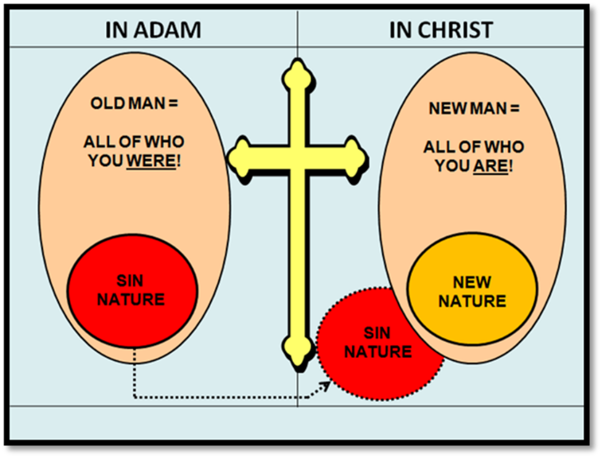
Notes:
One point that I want to stress here is that if you are a believer, you DO NOT have both spiritual histories – as we have already seen, Adam’s history was replaced by Christ’s. Furthermore, the Believer CANNOT go back and forth from being “in Adam” to being “in Christ”.
Finally, while all are saved by faith alone, all those saved ARE NOT “in Christ”.
Jews were baptized into (Identified with) Moses (1 Cor. 10:2; “Those Israelites …were indeed judicially associated by God with the Mosaic economy,—“into a spiritual union with Moses, and constituted his disciples.” Newell, W. R. (n.d.). Romans Verse-by-Verse (p. 143). Grand Rapids, MI: Christian Classics Ethereal Library.
We on the other hand, were baptized in (Identified with) Christ as Church Age believers.

Slide 11
Old Man, Sin Nature…
Vs.
…New Man, New Nature
Notes:
The Old Man, the Sin Nature - the New Man and the New Nature

Slide 12
Old Man, Sin Nature vs. New Man, New Nature
There is often at least some uncertainty as to what these terms mean, and perhaps even a lot of uncertainty.
Notes:
The Old Man, the Sin Nature - the New Man and the New Nature
When believers hear these terms, there is often at least some uncertainty as to what they mean, and perhaps even a lot of uncertainty.
Throughout the remaining sessions, we will utilize this graphic to help us gain clarity regarding these terns (Old Man, Sin Nature, New Man New Nature).

Slide 13
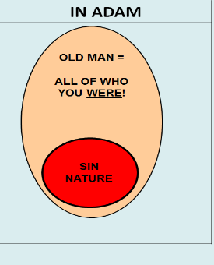
Key Points
The Old Man (Rom. 6; Eph. 4; Col. 3) is the positional person representing all who the unbeliever is in Adam; including Adam’s Spiritual History.
Adam’s Spiritual History included the Sin Nature. In Rom. 6-7, the English words, “the Sin” actually refer to the Sin Nature.
While the positional person of the Old Man in Adam possesses a Sin Nature, the two terms (Old Man / Sin Nature) are not identical or even equivalent.
Notes:
The Old Man (Rom. 6; Eph. 4; Col. 3) is the positional person representing all who the unbeliever is in Adam; including Adam’s Spiritual History. SEE HANDOUT!
Adam’s Spiritual History included the Sin Nature (all of the attributes and characteristics of how the Old Man is inclined to behave).
In Rom. 6-7, the English words, “the Sin” refer to the Sin Nature. (see Handout)
The positional person of the Old Man in Adam possesses a Sin Nature, but the two terms are not identical or even equivalent.

Slide 14
Key Points
What is a Nature?
It is not all of what a creature is…

Slide 15
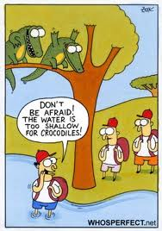
Key Points
What is a Nature?
…it is the collection of attributes and characteristics that cause that creature to behave a certain way.

Slide 16
Key Points
What the Flesh?
When contextually appropriate, the term “flesh or body” is often best understood as referring to the Sin Nature as it acts through the physical human body.
Rom. 6:6 is a clear example of this where the phrase, “body of sin” describes our physical human bodies as the vehicles through which the Sin Nature expresses itself.
Notes:
Contextually, the term “Flesh” is often best understood as referring to the Sin Nature as it acts through the physical human body.
Rom. 6:6 is a clear example of this where the phrase, “body of sin” describes our physical bodies as the vehicles through which the Sin Nature expresses itself.

Slide 17
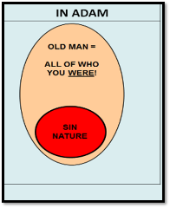
Romans 6:6
knowing this, that our old man was crucified with Him, that the body of sin might be done away with, that we should no longer be slaves of sin.
Notes:
1 Corinthians 1:30 - But by His doing you are in Christ Jesus, who became to us wisdom from God, and righteousness and sanctification, and redemption.

Slide 18
W. R. Newell
Romans Verse-by-Verse (pp. 149–150). Grand Rapids, MI: Christian Classics Ethereal Library.
That the body of sin might be annulled [done away] — The word for “annulled” is katargeo…The meaning is, to “put out of business.” The “body of sin” refers to our bodies as yet unredeemed, and not delivered from sin’s rule;…(See Chapter 7:8–24). …since our old man has been crucified with Christ, all the rights of sin are gone; and the indwelling Holy Spirit can annul “the body of sin”; thus delivering us from sin’s bondage….It is blessed to know that we do not have to crucify the old man: that was done in Christ’s federal death at the cross. Nor do we have to “annul” the “body of sin”: that is done by the blessed Spirit AS WE YIELD TO HIM. (emphasis mine)
Notes:
W. R. Newell - Romans Verse-by-Verse (pp. 149–150). Grand Rapids, MI: Christian Classics Ethereal Library.
That the body of sin might be annulled [done away] — The word for “annulled” is katargeo…The meaning is, to “put out of business.” The “body of sin” refers to our bodies as yet unredeemed, and not delivered from sin’s rule;…(See Chapter 7:8–24). …since our old man has been crucified with Christ, all the rights of sin are gone; and the indwelling Holy Spirit can annul “the body of sin”; thus delivering us from sin’s bondage….It is blessed to know that we do not have to crucify the old man: that was done in Christ’s federal death at the cross. Nor do we have to “annul” the “body of sin”: that is done by the blessed Spirit AS WE YIELD TO HIM.

Slide 19
Key Points
It is only by means of the convicting work of the Holy Spirit that the unbeliever comes to believe in Christ’s death, burial and resurrection (John 16:8-11).
Notes:
It is only by means of the convicting work of the Holy Spirit that the unbeliever comes to believe in Christ’s death, burial and resurrection (John 16:8-11).

Slide 20
John 16:8–11
⁸ “And He, when He comes, will convict the world concerning sin and righteousness and judgment; ⁹ concerning sin, because they do not believe in Me; ¹⁰ and concerning righteousness, because I go to the Father and you no longer see Me; ¹¹ and concerning judgment, because the ruler of this world has been judged.
Notes:
John 16:8–11 - ⁸ “And He, when He comes, will convict the world concerning sin and righteousness and judgment; ⁹ concerning sin, because they do not believe in Me; ¹⁰ and concerning righteousness, because I go to the Father and you no longer see Me; ¹¹ and concerning judgment, because the ruler of this world has been judged.

Slide 21
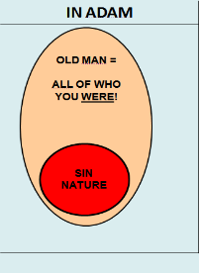
Key Points
Left to itself, the inclination of the Sin Nature would NEVER be to believe that Christ is the Son of God, who died, was buried, and rose again.
Since the unbeliever, ruled by the Sin Nature, refuses to believe until convicted by the Holy Spirit, once accomplished, we can joyfully proclaim the following:
BELIEF IN CHRIST IS THE LAST ACT
ASSOCIATED WITH THE OLD MAN!
Notes:
Left to itself, the inclination of the Sin Nature would never be to believe in Christ (that He is the Christ the Son of God, who died, was buried and rose again).
Since the unbeliever, ruled by the Sin Nature, refuses to believe until convicted by the Holy Spirit, once accomplished, we can joyfully proclaim the following:
BELIEF IN CHRIST IS THE LAST ACT ASSOCIATED WITH THE OLD MAN

Slide 22
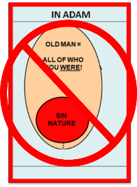
Key Points
Upon believing, that person who was positionally ‘in Adam’ is taken out of being ‘in Adam’, never again to be ‘in Adam’, and never again to have any association with the positional person of the Old Man.
Notes:
Upon believing, that person who was positionally ‘in Adam’ is taken out of being ‘in Adam’, never again to be ‘in Adam’, and never again to have any association with the positional person of the Old Man.

Slide 23
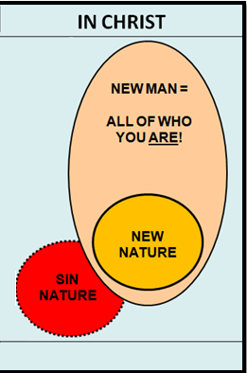
Key Points
Upon believing, that person who was positionally ‘in Adam’ is now, by faith in God’s work through Christ, made to be positionally and irreversibly ‘in Christ’.
The new positional person of the believer in Christ, called the New Man, is all of who we are in Christ, and that New Man possesses a New Nature – but the New Man is more than just the New Nature.
Notes:
Upon believing, that person who was positionally ‘in Adam’ is now, by faith in God’s work through Christ, made to be positionally and irreversibly ‘in Christ’.
The new positional person of the believer in Christ, called the New Man, is all of who we are in Christ, and that New Man possesses a New Nature – but the New Man is more than just the New Nature.

Slide 24
“Old Man” (self) vs. (Old) “Sin Nature”
The two terms, “old man” and “sin nature” are often mistakenly understood as synonyms. This is likely due to incorrect and inconsistent translation when addressing three key passages that deal with the “old man” (Rom. 6:6, Eph. 4:22 and Col. 3:9).
It is crucial that we understand that each of these passages addresses WHAT IS ALREADY ETERNALLY TRUE REGARDING OUR RELATIONSHIP TO THE “OLD MAN” because of our new eternal position “in Christ”.
Notes:
The two terms, “old man” and “sin nature” are often mistakenly understood as synonyms. This is likely due to the pattern of inconsistent translation when addressing three key passages that deal with the “old man” (Rom. 6:6, Eph. 4:22 and Col. 3:9).
It is crucial that we understand that each of these passages addresses WHAT IS ALREADY ETERNALLY TRUE REGARDING OUR RELATIONSHIP TO THE “OLD MAN” because of our new eternal position “in Christ”.

Slide 25
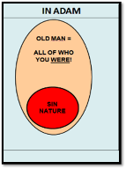
Romans 6:6
…knowing this, that our old man WAS CRUCIFIED (aorist) with Him, that the body of sin (our physical bodies as vehicles through which sin expresses itself) might be done away with, that we should no longer be slaves of sin.
Notes:
Romans 6:6 - …knowing this, that our old man WAS CRUCIFIED (aorist) with Him, that the body of sin (our physical bodies as vehicles through which sin expresses itself) might be done away with, that we should no longer be slaves of sin.

Slide 26
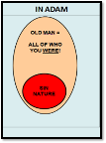
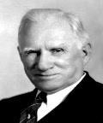
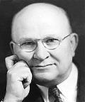
“Old Man” (self) vs. (Old) “Sin Nature”
The Theologians Speak on Romans!
"Our old man—This is our old selves, as we were in and from Adam. …we must not confuse the “old man” with “the flesh (sin nature)... When we are told, for instance, in Colossians, that we have put off the old man, we
know that we are being addressed as new creatures in Christ, and that the old man represents all we naturally were,—desires, lusts, ambitions, hopes, judgments: looked at as a whole federally: we used to be that—now we have put that off.” Wm. Newell, Romans Commentary (pg. 147).
"My old man is not merely my old (sin) nature...". H.A. Ironside, Romans Commentary (pg. 77).
Notes:
Clarifying Romans 6:6:
"Our old man—This is our old selves, as we were in and from Adam. …we must not confuse the “old man” with “the flesh (sin nature)...When we are told, for instance, in Colossians, that we have put off the old man, we know that we are being addressed as new creatures in Christ, and that the old man represents all we naturally were,—desires, lusts, ambitions, hopes, judgments: looked at as a whole federally: we used to be that—now we have put that off.” Wm. Newell, Romans Commentary (pg. 147).
"My old man is not merely my old (sin) nature...". H.A. Ironside, Romans Commentary (pg. 77).

Slide 27
Colossians 3:9
Do not lie to one another, since YOU HAVE PUT OFF (aorist) the old man with his deeds,
Ephesians 4:22
…that you put off (aorist), concerning your former conduct, the old man which grows corrupt according to the deceitful lusts,
Notes:
Colossians 3:9 - Do not lie to one another, since YOU HAVE PUT OFF (aorist) the old man with his deeds,
Ephesians 4:22 - …that you put off (aorist), concerning your former conduct, the old man which grows corrupt according to the deceitful lusts,

Slide 28
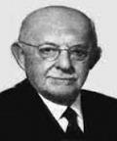
“Old Man” (self) vs. (Old) “Sin Nature”
The Theologians Speak on Romans!
“The old man is put off and the new man is put on. We are not told to put off the old man by all kinds of endeavors and resolutions; IT IS ALREADY DONE. The old man was put away by the cross of Christ (Rom. 6:6). This is the blessed truth which delivers from doubt and bondage. And then we receive something in Christ, the new man, the new nature.” A. C. Gaebelein, The Annotated Bible, Vol. 7: Romans to Ephesians (263-264)
Notes:
Clarifying Ephesians 4:22:
“The old man is put off and the new man is put on. We are not told to put off the old man by all kinds of endeavors and resolutions; it is already done. The old man was put away by the cross of Christ (Rom. 6:6). This is the blessed truth which delivers from doubt and bondage. And then we receive something in Christ, the new man, the new nature.” Gaebelein, A. C. (2009). The Annotated Bible, Volume 7: Romans to Ephesians (263-264).

Slide 29
“Old Man” (self) vs. (Old) “Sin Nature”
Incorrect and Inconsistent Translation (Eph. 4:22-25)
Two contrasting grammatical positions:
The incorrect position: that these verses present an imperative sense – continual commands for believers to follow, (most English Bibles).
Some individuals who champion this view include: Darrell L. Bock, Theodore Epp, Charles Hodge, Ruth Paxson, and Lehman Strauss.
Notes:
In treating Eph. 4 :22-25, there are two contrasting grammatical positions:
The incorrect position that these verses present an imperative sense - continual commands for believers to follow, (most English Bibles).
Some individuals who champion this view include: Darrell L. Bock, Theodore Epp, Charles Hodge, Ruth Paxson, and Lehman Strauss.

Slide 30
“Old Man” (self) vs. (Old) “Sin Nature”
Incorrect and Inconsistent Translation (Eph. 4:22-25)
The correct position: that these verses present a past indicative sense – stating facts which are already true of every believer positionally.
Some individuals who champion this view include: Lewis Sperry Chafer, William R. Newell, Harold W. Hoehner, H. A. Ironside, H. C. G. Moule, John R. W. Stott, Daniel B. Wallace, B. F. Westcott, and Warren W. Wiersbe.
Notes:
The correct position that these verses present a past indicative sense - stating facts which are already true of every believer positionally.
Some individuals who champion this view include: Lewis Sperry Chafer, Harold W. Hoehner, H.A. Ironside, H.C.G. Moule, John R.W. Stott, Daniel B. Wallace, B.F. Westcott, and Warren W. Wiersbe

Slide 31
“Old Man” (self) vs. (Old) “Sin Nature”
The Theologians Speak on Ephesians
"Some people confound the old man with the old (sin) nature. You see, the old man is more than the old nature. The old man is the man of old, what you once were before you were converted. Now you are through with the old man." H.A. Ironside, Ephesians Commentary (pg. 124)…
Notes:
"Some people confound the old man with the old (sin) nature. You see, the old man is more than the old nature. The old man is the man of old, what you once were before you were converted. Now you are through with the old man." H.A. Ironside, Ephesians Commentary (pg. 124)…

Slide 32
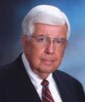
“Old Man” (self) vs. (Old) “Sin Nature”
The Theologians Speak on Ephesians
“That you have put off once for all with reference to your former manner of life the old man which is being corrupted according to the passionate desires of deceit; moreover, that you are being constantly renewed with reference to the spirit of your mind that you have put on once for all the new man which after God was created in righteousness and holiness of truth.” Dr. Kenneth Wuest, Ephesians 4:22 (page 111)
Notes:
Clarifying Ephesians 4:22:
Kenneth Wuest, on Ephesians 4:22 (page 111), “That you have put off once for all with reference to your former manner of life the old man which is being corrupted according to the passionate desires of deceit; moreover, that you are being constantly renewed with reference to the spirit of your mind that you have put on once for all the new man which after God was created in righteousness and holiness of truth.”

Slide 33
“Old Man” (self) vs. (Old) “Sin Nature”
The Theologians Speak on Ephesians
The expression, “put off,” is a figure taken from the putting off of garments…. It was in our identification with Christ in His crucifixion that potentially we put off the old man, and WE DID SO ACTUALLY at the moment we were saved….Since the old man refers to the unsaved person dominated by the totally depraved nature, the new man refers to the saved person dominated by the divine nature. This new man “after God is created in righteousness and true holiness.” This is what Paul has reference to when he says, “Therefore if any man be in Christ, he is a new creation” (II Cor. 5:17). Dr. Kenneth Wuest, Word Studies from the Greek New Testament
Notes:
Clarifying Ephesians 4:22:
The expression, “put off,” is a figure taken from the putting off of garments…. It was in our identification with Christ in His crucifixion that potentially we put off the old man, and we did so actually at the moment we were saved…. Since the old man refers to the unsaved person dominated by the totally depraved nature, the new man refers to the saved person dominated by the divine nature. This new man “after God is created in righteousness and true holiness.” This is what Paul has reference to when he says, “Therefore if any man be in Christ, he is a new creation” (II Cor. 5:17). Wuest's Word Studies from the Greek New Testament (Eph 4:22).

Slide 34
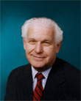
“Old Man” (self) vs. (Old) “Sin Nature”
The Theologians Speak on Ephesians
“….accomplished events rather than a process… they have put off or laid aside that old person at conversion…”… “Paul then is teaching, that having been taught in Him, believers have been taught [aorist] that the old person, according to the former lifestyle was laid aside [aorist] at the time of their faith in the one who taught them, namely Christ.”…” Harold Hoehner, Ephesians: An Exegetical Commentary, v. 4:22, (pages 603, 605-606)
Notes:
Clarifying Ephesians 4:22:
Harold Hoehner, on Ephesians 4:22, (pages 603, 605, 606), “….accomplished events rather than a process… they have put off or laid aside that old person at conversion…”… “Paul then is teaching, that having been taught in Him, believers have been taught that the old person, according to the former lifestyle was laid aside at the time of their faith in the one who taught them, namely Christ.”…”The present tense denotes continuing action, which indicates that the corruption continues in the unregenerate person.”

Slide 35
“Old Man” (self) vs. (Old) “Sin Nature”
The Theologians Speak on Ephesians
Chafer, L. S. (1935). The Ephesian letter (139-140), “The change that has been wrought in them—not by mere reformation, but by divine transformation—is no less than that the former manner of life, which has been so vividly described, and the old man, which is corrupt according to the deceitful lusts, “is put off.”
That this is not a command for these saints to do something which was not yet accomplished is seen when two other passages are examined along with this. In Romans 6:6 the old man is declared to be crucified in the crucifixion of Christ; and in Colossians 3:9, it is stated of the believers that “ye have put off the old man and his deeds.” The disposing of the old man is wrought in that particular aspect of the death of Christ which is unto sin (Rom. 6:10), and is also made an actuality by the Holy…
Notes:
Chafer, L. S. (1935). The Ephesian letter (139-140), “The change that has been wrought in them—not by mere reformation, but by divine transformation—is no less than that the former manner of life, which has been so vividly described, and the old man, which is corrupt according to the deceitful lusts, “is put off.” That this is not a command for these saints to do something which was not yet accomplished is seen when two other passages are examined along with this. In Romans 6:6 the old man is declared to be crucified in the crucifixion of Christ; and in Colossians 3:9, it is stated of the believers that “ye have put off the old man and his deeds.” The disposing of the old man is wrought in that particular aspect of the death of Christ which is unto sin (Rom. 6:10), and is also made an actuality by the Holy…

Slide 36
“Old Man” (self) vs. (Old) “Sin Nature”
The Theologians Speak on Ephesians
…Spirit in all who believe. It should be observed, however, that the old man now “put off” is not identical with the flesh which, without question, is to abide with each believer to the end of his earthly pilgrimage (Gal. 5:16, 17); but it is rather the first Adamic-relationship which, for the believer, passed
out of existence with the death of Christ, being replaced by the New-Creation relationship in Christ, the Last Adam. The connection with the first Adam, which was as …vital as the life stream itself, has been broken by divine power to the end that a new connection might be established with Christ. The appeal here is in accordance with the injunctions of grace. It is because the old man had been put off that they were to abstain from their former evil ways, rather than that by abstaining from…
Notes:
…Spirit in all who believe. It should be observed, however, that the old man now “put off” is not identical with the flesh which, without question, is to abide with each believer to the end of his earthly pilgrimage (Gal. 5:16, 17); but it is rather the first Adamic-relationship which, for the believer, passed out of existence with the death of Christ, being replaced by the New-Creation relationship in Christ, the Last Adam. The connection with the first Adam, which was as …vital as the life stream itself, has been broken by divine power to the end that a new connection might be established with Christ. The appeal here is in accordance with the injunctions of grace. It is because the old man had been put off that they were to abstain from their former evil ways, rather than that by abstaining from…

Slide 37
“Old Man” (self) vs. (Old) “Sin Nature”
The Theologians Speak on Ephesians
…evil ways the old man might be put off. Indeed a renewing of mind by the Holy Spirit is needed (verse 23) to the end that the vital importance of this purity of life shall be comprehended at all times and under all circumstances. Similarly, they had been taught as the truth is in Christ that they had also “put on the
Man, which after God is created in righteousness and true holiness” (verse 24). The new man is that which is wrought by the regenerating power of the Spirit—“a new creature” (2 Cor. 5:17; Gal. 6:15)—and, being born of God, cannot participate in the former evil which is the tendency of the flesh and which was the practice of the old man. The new man, being thus begotten of God, is said to be “created in righteousness and true holiness.” The righteousness referred to is that imputed…
Notes:
…evil ways the old man might be put off. Indeed a renewing of mind by the Holy Spirit is needed (verse 23) to the end that the vital importance of this purity of life shall be comprehended at all times and under all circumstances. Similarly, they had been taught as the truth is in Christ that they had also “put on the Man, which after God is created in righteousness and true holiness” (verse 24). The new man is that which is wrought by the regenerating power of the Spirit—“a new creature” (2 Cor. 5:17; Gal. 6:15)—and, being born of God, cannot participate in the former evil which is the tendency of the flesh and which was the practice of the old man. The new man, being thus begotten of God, is said to be “created in righteousness and true holiness.” The righteousness referred to is that imputed…

Slide 38
“Old Man” (self) vs. (Old) “Sin Nature”
The Theologians Speak on Ephesians
…righteousness which Christ is and which He is made to those who believe (2 Cor. 5:21), and, likewise, true holiness is theirs on the ground of their new position in Christ (Heb. 10:14).”
Notes:
…imputed righteousness which Christ is and which He is made to those who believe (2 Cor. 5:21), and, likewise, true holiness is theirs on the ground of their new position in Christ (Heb. 10:14).”

Slide 39
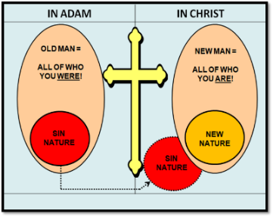
“Old Man” (self) vs. (Old) “Sin Nature”
SCRIPTURAL FACT + FAITH = SPIRITUAL VICTORY
HERE IS A PROFOUND SCRIPTURAL FACT …that must be accepted by faith, namely, that THE CORRUPTION OF THE POSITIONAL OLD MAN CONTINUES ONLY IN THE UNBELIEVER; it is no longer active in the believer, who is eternally positioned, “in Christ”.
Notes:
SCRIPTURAL FACT + FAITH = SPIRITUAL VICTORY
Here is a profound scriptural fact that must accepted by faith, namely, that the corruption of the positional Old Man CONTINUES ONLY IN THE UNBELIEVER; it is no longer active in the believer, who is eternally positioned, “in Christ”.

Slide 40
“Old Man” (self) vs. (Old) “Sin Nature”
CRITICAL DISTINCTIONS
Correctly understanding our former positional relationship to Adam and our present positional relationship “in Christ” awakens us to the fact that Romans 6 addresses the believer’s modified relationship to the Sin Nature, and not the Old Man – who was crucified.
Notes:
CRITICAL DISTINCTIONS
Correctly understanding our former positional relationship to Adam and our present positional relationship “in Christ” awakens us to the fact that Romans 6 addresses the believer’s modified relationship to the Sin Nature, and not the Old Man – who was crucified.

Slide 41
Romans 6:6
…knowing this, that our old man WAS CRUCIFIED (aorist) with Him, that the body of sin (our physical bodies as vehicles through which sin expresses itself) might be done away with, that we should no longer be slaves of sin.
Notes:
Romans 6:6 - …knowing this, that our old man WAS CRUCIFIED (aorist) with Him, that the body of sin (our physical bodies as vehicles through which sin expresses itself) might be done away with, that we should no longer be slaves of sin.

Slide 42
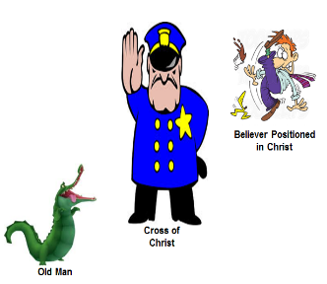
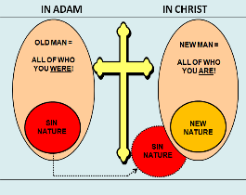
“Old Man” (self) vs. (Old) “Sin Nature”
CRITICAL DISTINCTIONS
Scripturally, we know that the Cross is an eternal, impenetrable barrier, however, when the term “old man” is incorrectly employed as a synonym for the “sin (old) nature” the implication is that believers can choose to go back or may somehow slip back into being “in Adam”, but we are no longer “in Adam” and never will be again.
Notes:
Scripturally, we know that the Cross is an eternal, impenetrable barrier, however, when the term “old man” is employed as a synonym for the “sin (old) nature” the implication is that believers can choose to go back or may somehow slip back into being “in Adam” but we are no longer “in Adam” and never will be again.

Slide 43
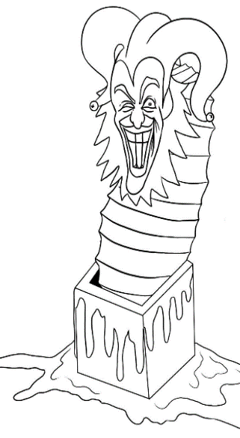
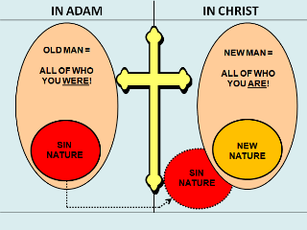
“Old Man” (self) vs. (Old) “Sin Nature”
CRITICAL DISTINCTIONS
That positional person, the Old Man in Adam, cannot revive and pop back into our lives…he was crucified! (Rom. 6:6). Nor can the believer in any way reverse his/her eternal position and get back into being the “old man” (“in Adam”).
Notes:
That positional person, the Old Man in Adam, cannot revive and pop back into our lives…he was crucified! Nor can the believer in any way reverse his/her eternal position and get back into being the “old man” (“in Adam”).

Slide 44
“Old Man” (self) vs. (Old) “Sin Nature”
CRITICAL DISTINCTIONS
“By virtue of the Spirit of God identifying us through His baptizing work with the death, burial, and resurrection of Jesus Christ (Rom. 6:3-4; 1 Cor. 12:12-13), we now stand in a new relationship… alive toward God and dead to the world (Gal. 6:14), the devil (Heb. 2:14-15), and our greatest adversary in the Christian life, our own flesh (Rom. 6:6).”
Tom Stegall, Distinguishing the "Man" and the "Nature" Pt.1, http://www.duluthbible.org/filerequest/9896.pdf
Notes:
“By virtue of the Spirit of God identifying us through His baptizing work with the death, burial, and resurrection of Jesus Christ (Rom. 6:3-4; 1 Cor. 12:12-13), we now stand in a new relationship… alive toward God and dead to the world (Gal. 6:14), the devil (Heb. 2:14-15), and our greatest adversary in the Christian life, our own flesh (Rom. 6:6).” Tom Stegall, Distinguishing the "Man" and the "Nature" Pt.1, http://www.duluthbible.org/filerequest/9896.pdf

Slide 45
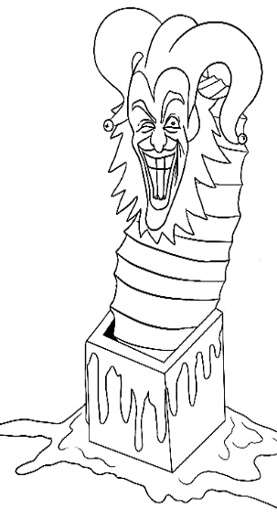
“Old Man” (self) vs. (Old) “Sin Nature”
CRITICAL DISTINCTIONS
However, the Sin Nature that pertained to the Old Man, remains associated with the “yet to be glorified” physical human body of the believer until the Lord takes the believer home.
Notes:
However, the Sin Nature that pertained to the Old Man is still associated with the physical human body of the believer until the Lord takes the believer home.

Slide 46
“Old Man” (self) vs. (Old) “Sin Nature”
CRITICAL DISTINCTIONS
“…we need to keep in mind the difference between our positional identification in the sight of God versus our constitutional make- up as a total person. Before I was saved, God did not see me as “a sin nature” but as an “old man” in Adam possessing a sin nature. Similarly, now that I've been born again, God does not see me as “a new divine nature” but as a “new man” in Christ possessing a new nature. The “old man” versus the “new man” references deal with the identity of the person as being either an unregenerate person in Adam or a regenerate person in Christ. The “sin nature” versus the “new nature” references deal with what we possessed/possess internally as part of our constitutional make-up.”
Tom Stegall, Distinguishing the "Man" and the "Nature" Pt.1, http://www.duluthbible.org/filerequest/9896.pdf
Notes:
“…we need to keep in mind the difference between our positional identification in the sight of God versus our constitutional make- up as a total person. Before I was saved, God did not see me as “a sin nature” but as an “old man” in Adam possessing a sin nature. Similarly, now that I've been born again, God does not see me as “a new divine nature” but as a “new man” in Christ possessing a new nature. The “old man” versus the “new man” references deal with the identity of the person as being either an unregenerate person in Adam or a regenerate person in Christ. The “sin nature” versus the “new nature” references deal with what we possessed/possess internally as part of our constitutional make-up.” Tom Stegall, Distinguishing the "Man" and the "Nature" Pt.1, http://www.duluthbible.org/filerequest/9896.pdf

Slide 47
“Old Man” (self) vs. (Old) “Sin Nature”
CRITICAL DISTINCTIONS
“…if we assume for a moment that Scripture doesn't distinguish between the “old man” and “sin nature” or between the “new man” and “new nature,” then 2 Cor. 5:17 would be teaching that believers no longer possess a “sin nature,” since “old things [such as the sin nature] have passed away” and “all things [including our natures] have become new.” There must therefore be a distinction between the “man” and the “nature.”
Tom Stegall, Distinguishing the "Man" and the "Nature" Pt.1, http://www.duluthbible.org/filerequest/9896.pdf
Notes:
“…if we assume for a moment that Scripture doesn't distinguish between the “old man” and “sin nature” or between the “new man” and “new nature,” then 2 Cor. 5:17 would be teaching that believers no longer possess a “sin nature,” since “old things [such as the sin nature] have passed away” and “all things [including our natures] have become new.” There must therefore be a distinction between the “man” and the “nature.” Tom Stegall, Distinguishing the "Man" and the "Nature" Pt.1, http://www.duluthbible.org/filerequest/9896.pdf

Slide 48
“Old Man” (self) vs. (Old) “Sin Nature”
CRITICAL DISTINCTIONS
“…if “old things [such as our natures] have passed away” and “all things [including our sinful natures] have become new,” then logically we shouldn't possess sin natures now that we're saved. Yet Scripture and experience both testify with unmistakable clarity that the sin nature is alive and kicking inside of every child of God (Rom. 7:15-25). If there is no distinction between the old man and the sin nature, then this would contradict 2 Corinthians 5:17. There must therefore be a distinction between the man and the nature.
Tom Stegall, Distinguishing the "Man" and the "Nature" Pt.2, http://www.duluthbible.org/filerequest/9902.pdf
Notes:
“…if “old things [such as our natures] have passed away” and “all things [including our sinful natures] have become new,” then logically we shouldn't possess sin natures now that we're saved. Yet Scripture and experience both testify with unmistakable clarity that the sin nature is alive and kicking inside of every child of God (Rom. 7:15-25). If there is no distinction between the old man and the sin nature, then this would contradict 2 Corinthians 5:17. There must therefore be a distinction between the man and the nature. Tom Stegall, Distinguishing the "Man" and the "Nature" Pt.2, http://www.duluthbible.org/filerequest/9902.pdf

Slide 49
“Old Man” (self) vs. (Old) “Sin Nature”
CRITICAL DISTINCTIONS
“…Col. 3:9-10…says that the “new man” is “renewed” (present tense) in knowledge according to the image of God. If the “new man” is equivalent to the “new divine nature,” then how can the “new nature” presently be changing or be in the process of being renewed? Is our indwelling new divine nature capable of change or growth, or are you yourself as a regenerate “person” capable of continual renewal? We as “persons” grow or mature as we more consistently walk by means of the Spirit, but our new divine nature itself does not change or need renewing. This is another reason why the “new man” cannot be the same as the “new nature,” nor the “old man” be the same as the “sin nature.”… Col. 3:9 states that we have already permanently "put off" the old man while Col. 3:10 says that…
Notes:
“…Col. 3:9-10…says that the “new man” is “renewed” (present tense) in knowledge according to the image of God. If the “new man” is equivalent to the “new divine nature,” then how can the “new nature” presently be changing or be in the process of being renewed? Is our indwelling new divine nature capable of change or growth, or are you yourself as a regenerate “person” capable of continual renewal? We as “persons” grow or mature as we more consistently walk by means of the Spirit, but our new divine nature itself does not change or need renewing. This is another reason why the “new man” cannot be the same as the “new nature,” nor the “old man” be the same as the “sin nature.” Tom Stegall, Distinguishing the "Man" and the "Nature" Pt.1, http://www.duluthbible.org/filerequest/9896.pdf

Slide 50
“Old Man” (self) vs. (Old) “Sin Nature”
CRITICAL DISTINCTIONS
…we have already permanently "put on" the new man. If the Old Man is equivalent to the Sin Nature, then this passage would be teaching that we have also permanently put off the Sin Nature. But, as we have seen, the Old Man refers to the old unregenerate man [positioned] “in Adam.” Since Scripture teaches that the Sin Nature still exists after the spiritual transition from “in Adam” to “in Christ” [and] seek[s] to express itself in the unredeemed, unglorified physical body, there must be a difference between the terms Old Man and Sin Nature.”
Tom Stegall, Distinguishing the "Man" and the "Nature" Pt.1, http://www.duluthbible.org/filerequest/9896.pdf
Notes:
Col. 3:9 states that we have already permanently "put off" the old man while Col. 3:10 says that we have already permanently "put on" the new man. If the old man is equivalent to the sin nature, then this must be saying that we have also permanently put off the sin nature? But, as we have seen, the old man refers to the old unregenerate man “in Adam.” Since we scripturallly still possess a sin nature, there must be a difference between the terms man and the nature. Tom Stegall, Distinguishing the "Man" and the "Nature" Pt.1, http://www.duluthbible.org/filerequest/9896.pdf

Slide 51
“Old Man” (self) vs. (Old) “Sin Nature”
CRITICAL DISTINCTIONS
“Scripture is clear that the sin nature and the new divine nature co-exist within the believer (Rom. 7:15-25; Gal. 5:16-17). The old man and new man, however, cannot simultaneously co-exist. The old man was terminated at the Cross of Christ (Rom. 6:6; Gal. 2:19-20) and ceased to exist at the moment of regeneration and identification with Christ (2 Cor. 5:17). To teach that the old man is equivalent to the sin nature is to teach that believers no longer possess a sin nature. The old man is NOT equivalent to the sin nature.”
Tom Stegall, Distinguishing the "Man" and the "Nature" Pt.2, http://www.duluthbible.org/filerequest/9902.pdf
Notes:
The three infinitives in Eph. 4:22-24 should be translated as indicatives and taken with the aorist participle in 4:25a, as a past tense fact ("having put away") rather than a present practice ("putting away"). When done so, Ephesians 4:22-32 beautifully parallels Colossians 3:1-25 where it is clear that our position in Christ precedes, and is the basis for, our condition and daily practice in the Christian life. Tom Stegall, Distinguishing the "Man" and the "Nature" Pt.2, http://www.duluthbible.org/filerequest/9902.pdf

Slide 52
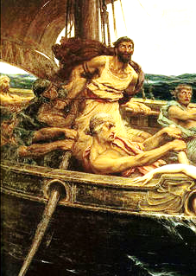
“Old Man” (self) vs. (Old) “Sin Nature”
The believer’s deposed, judged, and condemned Sin Nature is like a vicious, murderous, sea captain who, while bound to the ship’s mast awaiting execution at the next port, continually calls out to the sailors, like an alluring siren, berating them and making false promises all designed to secure his release.
Although stripped of all authority, he continues his assault on the hearts and minds of the sailors, hoping they will be seduced by him, and thus allow him to regain control of the ship and continue his murderous ways.

Slide 53
“Old Man” (self) vs. (Old) “Sin Nature”
THINGS TO PONDER
So the Sin Nature remains associated with our physical human body…
… but Paul wrote that we believers are all new (καινός) in kind creatures – a new (καινός) in kind creation (2 Cor. 5:17; Gal. 6:15).
Notes:
So the Sin Nature remains associated with our physical human body… but Paul wrote that we believers are all new in kind creatures – a new in kind creation (2 Cor. 5:17; Gal. 6:15).

Slide 54
2 Cor. 5:17
Therefore if any man is in Christ, he is a new creature; the old things passed away; behold, new things have come.
Gal. 6:15
For neither is circumcision anything, nor uncircumcision, but a new creation.
Notes:
2 Cor. 5:17 - Therefore if any man is in Christ, he is a new creature; the old things passed away; behold, new things have come.
Gal. 6:15 - For neither is circumcision anything, nor uncircumcision, but a new creation.

Slide 55
“Old Man” (self) vs. (Old) “Sin Nature”
THINGS TO PONDER
We also know that the Old Man refers to everything we were – in Adam, yet Paul wrote that the old things have “passed away” (2 Cor. 5:17).
If Paul was a new creation in Christ, how is it that he could write about who he was (and other believers were) before believing, and still say it was him (cf. Acts 22:28; 26:12; 1 Tim. 1:12-16; Eph. 2:1–3; Phil. 3:4-11)? Haven’t old things really “passed away”?
Notes:
We also know that the Old Man refers to everything we were – in Adam, yet Paul wrote that the old things have “passed away” (2 Cor. 5:17).
If Paul was a new creation in Christ, how is it that he could write about who he was (and other believers were) before believing, and still say it was him (Acts 22:28; 26:12; 1 Tim. 1:12-16; Eph. 2:1–3; Phil. 3:4-11)? Haven’t old things really “passed away”?

Slide 56
1 Timothy 1:13
… I was formerly a blasphemer and a persecutor and a violent aggressor. And yet I was shown mercy, because I acted ignorantly in unbelief;
Ephesians 2:1–3
¹ And you were dead in your trespasses and sins,… ³ we too all formerly lived in the lusts of our flesh, indulging the desires of the flesh and of the mind, and were by nature children of wrath, even as the rest.
Notes:
1 Timothy 1:13 - … I was formerly a blasphemer and a persecutor and a violent aggressor. And yet I was shown mercy, because I acted ignorantly in unbelief;
Ephesians 2:1–3 - ¹ And you were dead in your trespasses and sins,… ³ we too all formerly lived in the lusts of our flesh, indulging the desires of the flesh and of the mind, and were by nature children of wrath, even as the rest.

Slide 57
“Old Man” (self) vs. (Old) “Sin Nature”
THINGS TO PONDER
We know that the Old Man and the Sin Nature, both positioned “in Adam” cannot be improved, refurbished, or renovated.
We also know that neither our position “in Christ,” nor the New Man nor the New Nature can be improved, refurbished, or renovated.
Therefore, the old man and new man CANNOT simultaneously co-exist.
Notes:
We know that the Old Man and the Sin Nature, both positioned “in Adam” cannot be improved, refurbished, or renovated.
We also know that neither our position “in Christ,” nor the New Man nor the New Nature can be improved, refurbished, or renovated.
Therefore, the old man and new man CANNOT simultaneously co-exist.

Slide 58
“Old Man” (self) vs. (Old) “Sin Nature”
WHAT LACK I YET?
Since the Scriptures cannot lie, how is it that the New Testament can command believers, as New Creatures in Christ, to be Conformed, Changed, Transformed, Growing and Maturing?
Evidently, there must yet be something that needs to be changed, but if the old things have ‘passed away’ (2 Cor. 5:17) what is it about the believer that continues from before we were saved that needs changing?
Notes:
Given the immutability of these facts, how is it that the New Testament can command believers, as New Creatures in Christ, to be Conformed, Changed, Transformed, Growing and Maturing?
Evidently, given these commands of Scripture, there must yet be something that needs to be changed, but if the old things have ‘passed away’ (2 Cor. 5:17) what is it about the believer that continues from before we were saved that needs changing?

Slide 59
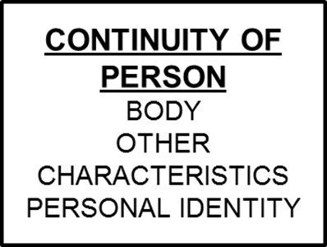
Continuity of Person - The Essential You!

Slide 60
Continuity of Person - The Essential You!
So there was this person “in Adam” who is now in “Christ”!
There are indeed some things that remain the same through the radical spiritual transition of the new birth:
The human body – all that goes with it and identifies that body.
One’s personal identity and earthly relationships (father, mother, son, daughter, etc.).
One’s personal characteristics, including likes and dislikes.
One’s skills and knowledge.
Notes:
Continuity of Person! (The essential you)
So there was this person “in Adam” who is now in “Christ”!
There are indeed some things that remain the same through the radical spiritual transition of the new birth:
The human body – all that goes with it and identifies that body.
One’s personal identity and earthly relationships.
One’s personal characteristics, including likes and dislikes.
One’s earthly skills and knowledge.

Slide 61
Continuity of Person - The Essential You!
The New Testament affirms that there is a “Continuity of Person” (the personhood, the identity of the physical body, and the soul of the person), that continues from the “Old Man” to “New Man”.
This essential part of us continues and is conveyed through the transition from being spiritually the “Old Man” (who is crucified), to being spiritually the “New Man” (Gk. kαινός: new in kind), who is “in Christ”, and will remain with us throughout eternity.
Notes:
The New Testament affirms that there is a “Continuity of Person” (the personhood, the identity of the physical body, and the soul of the person), that continues from the “Old Man” to “New Man”.
This essential part of us continues and is conveyed through the transition from being spiritually the “Old Man” (who is crucified), to being spiritually the “New Man” (Gk. kαινός: new in kind), who is “in Christ”, and will remain with us throughout eternity.

Slide 62
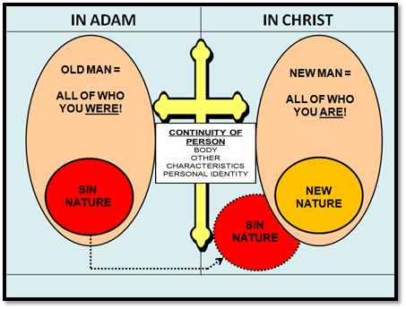
Continuity of Person - The Essential You!

Slide 63
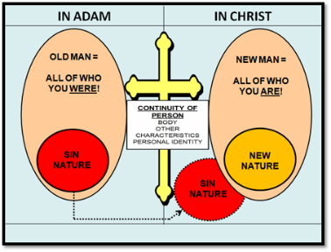
Continuity of Person - The Essential You!
It is the “continuing person” that is moment by moment being changed during our earthly pilgrimage.
Ultimately, when we see Christ face to face, being then, fully like Him, these changes will be fully realized! (1 John 3:2)
Notes:
It is the “continuing person” that is moment by moment being changed during our earthly pilgrimage.
Ultimately, when we see Christ face to face, being then, fully like Him in body, soul and spirit, these changes will be fully realized! (1 John 3:2)

Slide 64
1 John 3:2b
…We know that, when He appears, we shall be like Him, because we shall see Him just as He is.
Notes:
1 John 3:2b - …We know that, when He appears, we shall be like Him, because we shall see Him just as He is.

Slide 65
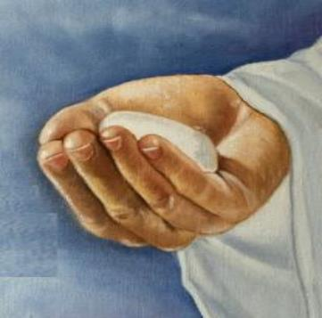
Continuity of Person - The Essential You!
Each believer has and maintains his or her own unique identity and individual relationship and fellowship with Christ now, but also on into eternity (Rev. 2:17).
Notes:
Each believer has and maintains his or her own unique identity and individual relationship and fellowship with Christ now, but also on into eternity (Rev. 2:17).

Slide 66
Rev. 2:17
‘He who has an ear, let him hear what the Spirit says to the churches. To him who overcomes, to him I will give some of the hidden manna, and I will give him a white stone, and a new name written on the stone which no one knows but he who receives it.’
Notes:
Rev. 2:17 - ‘He who has an ear, let him hear what the Spirit says to the churches. To him who overcomes, to him I will give some of the hidden manna, and I will give him a white stone, and a new name written on the stone which no one knows but he who receives it.’

Slide 67
Continuity of Person - The Essential You!
Presently, during our earthly existence, God is changing the spiritual aspects of the “Continuing Person,” (formerly “in Adam”) through the use of specific processes including:
Notes:
Presently, during our earthly existence, God is changing the spiritual aspects of the “continuing person,” (formerly “in Adam”).

Slide 68
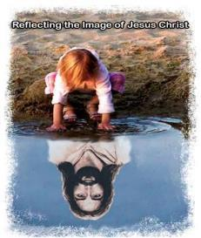
Continuity of Person - The Essential You!
Conforming us into Christ’s image (Rom. 8:28-29)
Transforming us into Christ’s image (2 Cor. 3:18)
Spiritual Growth and Maturing processes (Eph. 4:12-16; 2 Pet. 3:18)
Sanctification processes (Heb. 10:14)
These processes are changing the “continuing person” more and more into the “positional person” of the New Man.
Notes:
It is the spiritual aspects of this continuing person, formerly “in Adam” that God will change over the course of earthly existence:
Conformed to the image of Christ (Romans 8:28, 29)
Transformed into the image of Christ (2 Corinthians 3:18)
Growing and maturing spiritually (Ephesians 4:12-16; 2 Peter 3:18)
Sanctified – set apart and made Holy (Hebrews 10:14)
These processes are changing the continuing person more and more into the positional person of the New Man.

Slide 69
Summation
and
Closing

Slide 70
Outline
Spiritual Anatomy
“In Adam” vs. “In Christ”
Unbeliever “In Adam”
Church Age Believer “In Christ”
Old Man, Sin Nature vs. New Man, New Nature
Key Points
Old Man vs. Sin Nature Critical Distinctions
Continuity of Person
Summation & Conclusion
Notes:
Spiritual Anatomy
“In Adam” vs. “In Christ”
Unbeliever “In Adam”
Church Age Believer “In Christ”
Old Man, Sin Nature vs. New Man, New Nature
Key Points
Old Man vs. Sin Nature Critical Distinctions
Continuity of Person
Summation & Conclusion

