Slide 1
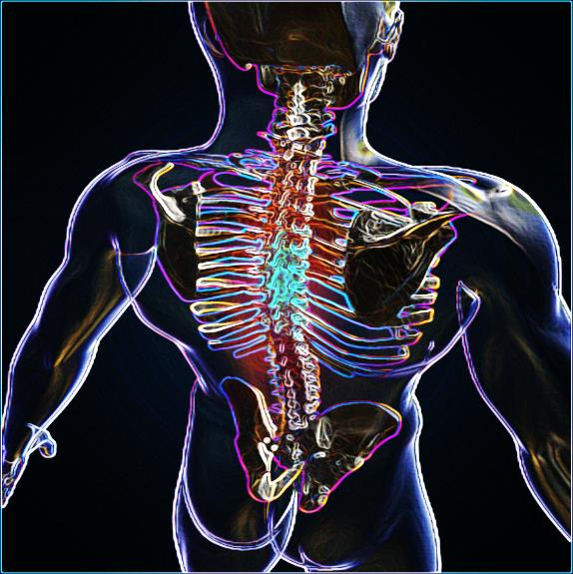
SPIRITUAL
ANATOMY
Part 2
Jim McGowan, Th.D.
Sugar Land Bible Church
Nov. 20, 2016
This presentation was compiled using excerpts from the Complete Works of Miles J. Stanford, resources obtained from Duluth Bible Church’s website, and resources obtained from Pastor Vern Peterman, Holly Hills Bible Church – Used with permission.

Slide 2
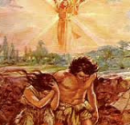

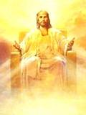
Who We Were……………..
Who We Are……………….
Who We Are Becoming…….

Slide 3
Session 4 Outline
  Spiritual Anatomy – Part 2
  Brief Review Session 3 Concepts
  Identification Truth - Deeper in and Farther Along
    Clarification
    Identification Synonyms
    Death is Separation
    Adam’s Spiritual History
    Christ’s Spiritual History
    So is this all… just hypothetical?
  Summation

Slide 4

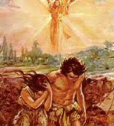

Slide 5

In Adam
All human beings are conceived and born “in Adam”, that is, they are positionally “in Adam” and identified with him.
Each unbeliever has Adam as his/her spiritual head since Adam is the seminal head of fallen mankind. This is the fixed position of each unbeliever.
All unbelievers share Adam’s spiritual history and the consequences of that history, through their identification with him.
Notes:
All human beings are conceived and born “in Adam”, that is, they are positionally “in Adam” and identified with him. Each unbeliever has Adam as his/her spiritual head since Adam is the seminal head of fallen mankind. This is the fixed position of each unbeliever.
All unbelievers share Adam’s spiritual history and the consequences of that history, through their identification with him.

Slide 6
In Christ
All of those who were conceived and born “in Adam”, upon believing the gospel of salvation, are placed into Christ – they are from that time forward “in Christ”, by God’s doing (1 Cor. 1:30).
All believers, being “in Christ” share Christ’s spiritual history, and the consequences of that history, through their identification with Him.
Notes:
All of those who were conceived and born “in Adam”, upon believing the gospel of salvation, are placed into Christ – they are from that time forward “in Christ”, by God’s doing (1 Cor. 1:30).
All believers, being “in Christ” share Christ’s spiritual history, and the consequences of that history, through their identification with Him.

Slide 7
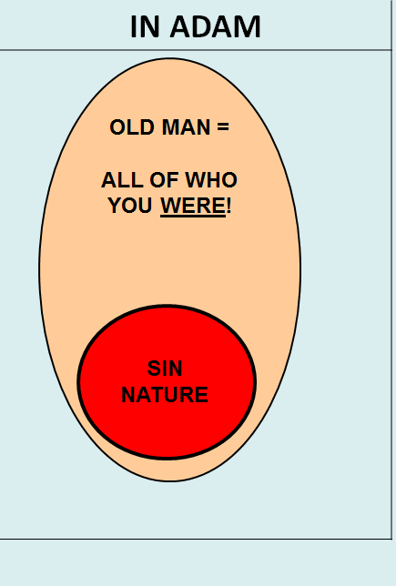
We said that:
The Old Man is a positional person.
The Old Man is all of who each of us was as an unbeliever, “in Adam”.
The Old Man possesses a Sin Nature.
Notes:
We said that:
The Old Man is a positional person.
The Old Man is all of who each of us was as an unbeliever, “in Adam”.
The Old Man possesses a Sin Nature.

Slide 8
We said that:
The Sin Nature is the collection of attributes and characteristics of how the Old Man is inclined to behave.
The Sin Nature is not the same as the Old Man.
The Sin Nature pertains to the physical human body.
Notes:
We said that:
The Sin Nature is the collection of attributes and characteristics of how the Old Man is inclined to behave.
The Sin Nature is not the same as the Old Man.
The Sin Nature pertains to the physical human body.

Slide 9
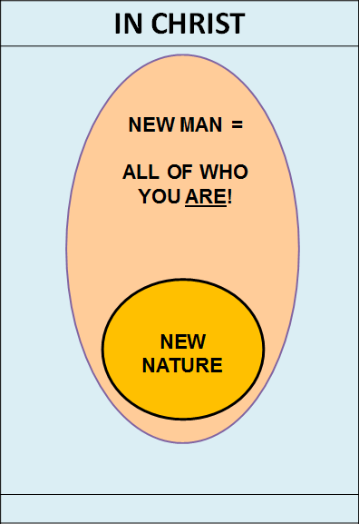
We said that:
The New Man is also a positional person.
The New Man is all of who we are now, as believers “in Christ”.
The New Man possesses a New Nature.
The terms “New Man” and “New Nature” are NOT interchangeable terms for the same thing.
Notes:
We said that:
The New Man is also a positional person.
The New Man is all of who we are now, as believers “in Christ”.
The New Man possesses a New Nature.
The terms “New Man” and “New Nature” are NOT interchangeable terms for the same thing.

Slide 10
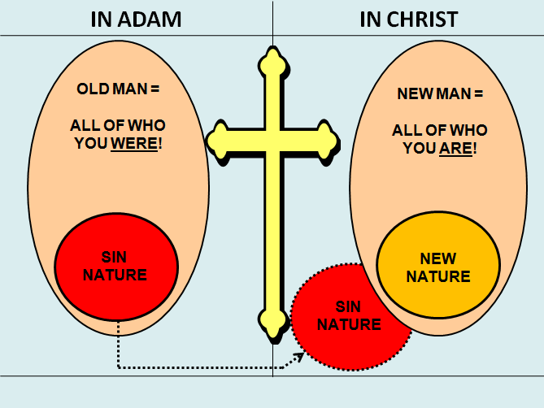
We said that:
The “believer” continues to have the Sin Nature, (that once dominated the Old Man), because it is associated with the physical human body, even though the believer is “in Christ”.
The Sin Nature will be present with the “believer” until he/she receives the new body which is fashioned after Christ’s (1 Jn. 3:2).
Notes:
We said that:
The New Man is also a positional person.
The New Man is all of who we are now, as believers “in Christ”.
The New Man possesses a New Nature.
The terms “New Man” and “New Nature” are NOT interchangeable terms for the same thing.
The Sin Nature will be present with the “believer” until he/she receives the new body which is fashioned after Christ’s (1 Jn. 3:2).

Slide 11

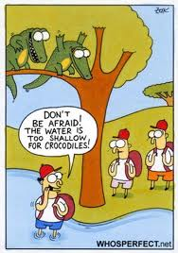

What is a Nature?
Nature is not all of what a creature is…
..it is the collection of attributes and characteristics that cause that creature to behave a certain way.
Notes:
Nature is not all of what a creature is…..it is the collection of attributes and characteristics that cause that creature to behave a certain way.

Slide 12
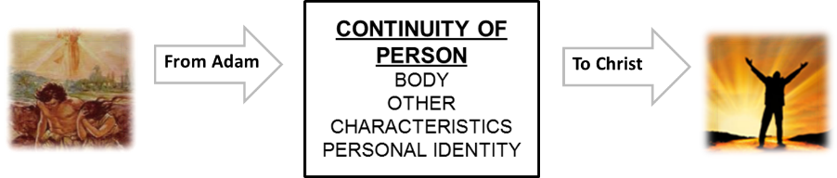
We said that:
Individual Personhood continues from Adam to Christ.
The part of the believer that changes over time, (conformed, transformed, grows and matures, is sanctified, etc.), is the Continuing Person.
It is the Continuing Person that Paul, as a believer, referred to in Acts 22:3; 20, where he discusses his former life as an unbeliever, (“I was…”).
Notes:
We said that:
Individual Personhood continues from Adam to Christ.
The part of the believer that changes over time, (conformed, transformed, grows and matures, is sanctified, etc.), is the Continuing Person.
It is the Continuing Person that Paul, as a believer, referred to in Acts 22:3; 20, where he discusses his former life as an unbeliever, (“I was…”).

Slide 13
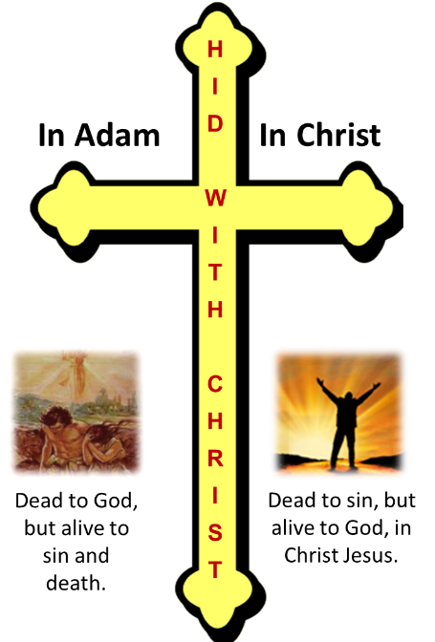
We also said that:
Just as there is no variation in being “in Adam”, there is also no changing the Old Man or the Sin Nature.
There is also no changing the New Man nor the New Nature, since there is no variation in being “in Christ”.
Notes:
We also said that:
Just as there is no variation in being “in Adam”, there is also no changing the Old Man or the Sin Nature.
There is also no changing the New Man nor the New Nature, since there is no variation in being “in Christ”.

Slide 14

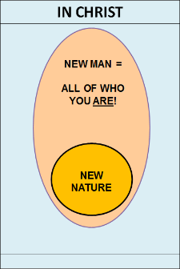
Does All This Really Matter?
Consider how you would answer the following questions:
Am I trying to make the Sin Nature better?
Is it God’s plan for me to try really, really, hard, to be a good Christian or to be more like Christ?
Do we need to improve the New Nature?
Do we need to improve The New Man?
Do we need to get more ‘in Christ’ than we were yesterday?
Notes:
Why is it important to consider these things and will it make a difference as we go forward in our discussion?
Consider how you would answer the following questions:
Am I trying to make the Sin Nature better?
Is it God’s plan for me to try really, really, hard, to be a good Christian or be more like Christ?
Do we need to improve the New Nature? The New Man?
Do we need to get more ‘in Christ’ than we were yesterday?

Slide 15

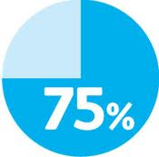

MORE “IN CHRIST”?
DOES THAT EVEN MAKE SENSE?

Slide 16

Does All This Really Matter?
Getting these concepts clear is vitally important, otherwise we may find ourselves trying to change things that can never change or never need to change.
Believers often get frustrated, confused, and flustered, wondering what God is doing because they don’t have a clear biblical understanding of these concepts.
Notes:
Getting these concepts clear is vitally important, otherwise we may find ourselves trying to change things that can never change or never need to change.
Believers often get frustrated, confused, and flustered, wondering what God is doing because they don’t have a clear biblical understanding of these concepts.

Slide 17

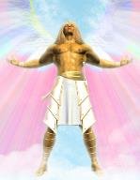

When we understand biblically…
  How God has made us…
  What God is changing in us…
  How He is producing these changes in us…
…then our perception comes in line with God’s perception and His Word, instead of with that of the World, the Flesh, and the Devil.
Notes:
When we understand biblically…
How God has made us, and
What God is changing in us, and
How He is producing this change in us,
…then our perception of reality comes in line with His.

Slide 18
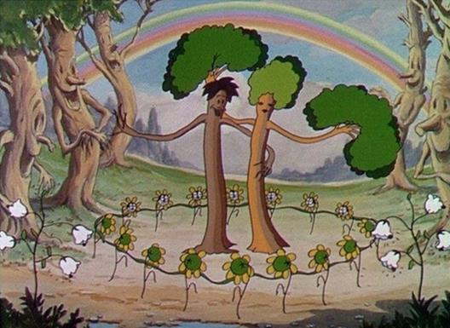
Some Points of Clarification!
WE ARE NOT SAYING that once we understand these concepts, we will never have any problems!
Notes:
Some Points of Clarification!
WE ARE NOT SAYING that once we understand these concepts, we will never have any problems!

Slide 19

Some Points of Clarification!
WE ARE SAYING that once we clearly understand these concepts we won’t have any false, ‘self-imposed’ problems springing from:
  an erroneous understanding of God’s Word.
  trying to change something that won’t change.
  struggling to be more “in Christ” or more “like Christ”!
1 Corinthians 9:26
Notes:
Some Points of Clarification!
WE ARE SAYING that once we clearly understand these concepts we won’t have any false, ‘self-imposed’ problems springing from:
an erroneous understanding of God’s Word.
trying to change something that won’t change.
struggling to be more “in Christ” or more “like Christ”!

Slide 20


1 Corinthians 9:26 (NASB95)
Therefore I run in such a way, as not without aim; I box in such a way, as not beating the air;
Notes:
1 Corinthians 9:26 (NASB95)
Therefore I run in such a way, as not without aim; I box in such a way, as not beating the air;

Slide 21
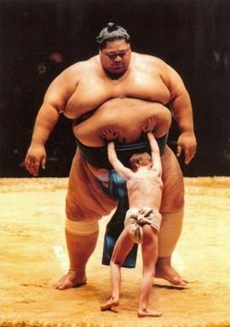
Some Points of Clarification!
WE ARE SAYING that we must correctly understand and answer the following questions:
  What God is doing?
  What has God already accomplished?
  What is God accomplishing now?
  What specific changes does God intend in the life of the believer?
  Are we trying to change what never will change and was never intended to change?
Notes:
Some Points of Clarification!
WE ARE SAYING that we must correctly understand and answer the following questions:
What God is doing?
What has God already accomplished?
What is God accomplishing now?
What specific changes does God intend in the life of the believer?
Are we trying to change what never will change and was never intended to change?

Slide 22
Session 4 Outline
  Spiritual Anatomy – Part 2
  Brief Review Session 3 Concepts
  Identification Truth - Deeper in and Farther Along
    Clarification
    Identification Synonyms
    Death is Separation
    Adam’s Spiritual History
    Christ’s Spiritual History
    So is this all… just hypothetical?
  Summation

Slide 23
Identification Truth - Deeper in and Farther Along

Slide 24
Clarification
Identification Truth is predominantly related to Church age believers, (Acts 2 to the Rapture) being explained most fully by the Apostle Paul (although it is also evidenced in the writings of John, Peter, and other authors of Scripture as well).
Identification truth is revealed and understood entirely by the will and actions of God, and the blessings of our identification with Christ are accomplished entirely by God’s infinite, eternal and amazing grace.
Notes:
Clarification
Identification Truth is predominantly related to Church age believers, (Acts 2 to the Rapture) being explained most fully by the Apostle Paul (although it is also evidenced in the writings of John, Peter, and other authors of Scripture as well).
Israel went into the sea and under the cloud – They were identified with Moses (Baptized into Moses 1 Cor. 10:1) and therefore, under the Law. We were baptized into Christ and that baptism separates us from the Law.
Jesus told the unbelieving Jews, “Unless you believe in me, you will die in your sins. They were stuck in Adam.
Identification truth is revealed and understood entirely by the will and actions of God, and the blessings of our identification with Christ are accomplished entirely by God’s infinite, eternal and amazing grace.

Slide 25
  Eph. 1:3-4a
  “³ Blessed be the God and Father of our Lord Jesus Christ, who has blessed us with every spiritual blessing in the heavenly places in Christ, ⁴ just as He chose us in Him…”.
Notes:
Eph. 1:3-4a - “³ Blessed be the God and Father of our Lord Jesus Christ, who has blessed us with every spiritual blessing in the heavenly places in Christ, ⁴ just as He chose us in Him…”.

Slide 26

Identification Synonyms
The word ‘identification’ is a convenient ‘handle’ for what the Scripture teaches, but the actual words used to convey this biblical truth include:
In | - being placed entirely in, so as to share an identity
With | - intimately joined in action and consequence
Together with | - as above, with ‘together’ underscoring the same identity & action
United with (Rom. 6) | - ‘united’ implies a oneness, so a spiritual oneness is communicated
Baptized into (Rom. 6; Col. 3) | - ‘baptized’ means to be immersed or entirely placed into, so as to be permanently changed by that immersion or placement
Notes:
Identification Synonyms
The word ‘identification’ is a convenient ‘handle’ for what the Scripture teaches, but the actual words used to convey this biblical truth include:
In - being placed entirely in, so as to share an identity
With - intimately joined in action and consequence
Together with - as above, with ‘together’ underscoring the same identity & action
United with (Rom. 6) - ‘united’ implies a oneness, so a spiritual oneness is communicated
Baptized into (Rom. 6; Col) - ‘baptized’ means to be immersed or entirely placed into, so as to be permanently changed by that immersion or placement

Slide 27

Death is Separation
A key principle in Scripture is that DEATH MEANS SEPARATION.
When Adam was told that he would surely die if he ate of the tree of the fruit of the knowledge of good and evil (Gen. 2:17), that meant separation.
When Isaiah said that the sins of the people of Israel had caused a separation from God that meant spiritual death (Isa. 59:1-10).
When Jesus told the Jewish leaders that unless they believed in Him they would ‘die in their sins’, He was pointing out that they would suffer a death that would separate them from the very God they claimed to know (John 8:24).
Paul taught that death means separation in Eph. 2:1-3, 11-13; 4:18; Col. 1:21.
Notes:
Death is Separation
When Adam was told that he would surely die if he ate of the tree of the fruit of the knowledge of good and evil (Gen. 2:17), that meant separation.
When Isaiah said that the sins of the people of Israel had caused a separation from God that meant spiritual death (Isa. 59:1-10).
When Jesus told the Jewish leaders that unless they believed in Him they would ‘die in their sins’, He was pointing out that they would suffer a death that would separate them from the very God they claimed to know (John 8:24).
Paul taught that death means separation in Eph. 2:1-3, 11-13; 4:18; Col. 1:21.

Slide 28
Death is Separation
Bad News, unless it is Good News!
God used the ‘DEATH IS SEPARATION’ principle graciously and for our benefit, when we were identified with Christ in His death, His burial and His resurrection:
Rom. 6:1-11 | dead to sin (sin nature), alive to Christ
Rom. 7:1-6 | died to the Law, joined to Christ
2 Cor. 5:14-15 | dead to ourselves, alive to Christ
Gal. 2:19- 20 | died to the Law, to live to God
Col. 2:20 | died with Christ to the elementary principles of the world
Col. 3:5, 20 | dead to sin, died with Christ to the world
Notes:
Death is Separation - “Death is Separation” is bad news, unless it is good news!
Rom. 6:1-11 - dead to sin (sin nature), alive to Christ
Rom. 7:1-6 - died to the Law, joined to Christ
2 Cor. 5:14-15 - dead to ourselves, alive to Christ
Gal. 2:19- 20 - died to the Law, to live to God
Col. 2:20 - died with Christ to the elementary principles of the world
Col. 3:5, 20 - dead to sin, died with Christ to the world

Slide 29
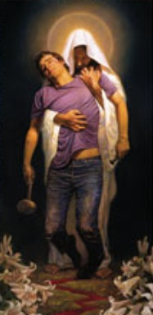

Death is Separation
The Key Biblical Principles Summarized
Identification joins us…
Death separates us…
Our Identification with death joins us to that death; that death separates us.
Notes:
Death is Separation - The Key Biblical Principles Summarized
Identification joins us…
Death separates us…
Our Identification with death joins us to that death; that death separates us.

Slide 30

Death is Separation
Primary Examples
Identification with Adam, (being “in Adam”), joins us to Adam’s death of separation from God.
Each of us was joined to the Sin Nature, to the Law, to the World, and to Adam’s spiritual history.
As an unbeliever, identified with Adam, (“in Adam”), each of us was separated from Christ, from His righteousness, and from His spiritual history.
Notes:
Death is Separation - Primary Examples
Identification with Adam, (being “in Adam”), joins us to Adam’s death of separation from God.
Each of us was joined to the Sin Nature, to the Law, to the World, and to Adam’s spiritual history.
As an unbeliever, identified with Adam, (“in Adam”), each of us was separated from Christ, from His righteousness, and from His spiritual history.

Slide 31
Adam’s Spiritual history?
“I put you in remembrance”
Adam was created in innocence NOT created righteous - Innocence is simple ‘not having sinned,’ a condition which could be lost as was apparent with Adam.
Adam died (became separated from God) because of rebellion in choosing his own way.
All humanity has inherited a sin nature through Adam.
All unbelievers are now “in Adam” and share his spiritual history and subsequent consequences, through identification with him.
Notes:
Adam’s Spiritual history? - “I put you in remembrance”
Adam was created in innocence NOT created righteous - Innocence is simple ‘not having sinned,’ a condition which could be lost as was apparent with Adam.
Adam died (became separated from God) because of rebellion in choosing his own way.
All humanity has inherited a sin nature through Adam.
All unbelievers are now “in Adam” and share his spiritual history and subsequent consequences, through identification with him.

Slide 32
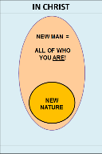
Christ’s Spiritual history?
“I put you in remembrance”
The moment we believed we were identified with (joined to) Christ in His Death, Burial, Resurrection, Ascension, and Seating in Heaven.
Christ is righteous. The moment we believed we were given Christ’s righteousness which is unchangeable and eternal. Righteousness is right standing with God.
The moment we believed we were positionally “in Christ”, a New Man with a New Nature.
Notes:
Christ’s Spiritual history? - “I put you in remembrance”
The moment we believed we were identified with (joined to) Christ in His Death, Burial, Resurrection, Ascension, and Seating in Heaven.
Christ is righteous. The moment we believed we were given Christ’s righteousness which is unchangeable and eternal. Righteousness is right standing with God.
The moment we believed we were positionally “in Christ”, a New Man with a New Nature.

Slide 33
Christ’s Spiritual history?
“I put you in remembrance”
Identification with Christ, (being “in Christ”), joins us to Christ. As believers, ‘what was true’ of our being joined to and identified with Adam has forever changed.
Identified with Christ, we were joined to Christ, to His righteousness, and to His spiritual history.
In our identification with Christ, each one of us was separated from the Sin Nature, the Law, the World, and from Adam’s spiritual history.
Notes:
Christ’s Spiritual history? - “I put you in remembrance”
Identification with Christ, (being “in Christ”), joins us to Christ. As believers, ‘what was true’ of our being joined to and identified with Adam has forever changed.
Identified with Christ, we were joined to Christ, to His righteousness, and to His spiritual history.
In our identification with Christ, each one of us was separated from the Sin Nature, the Law, the World, and from Adam’s spiritual history.
Compare these in the diagram on the next slide.

Slide 34
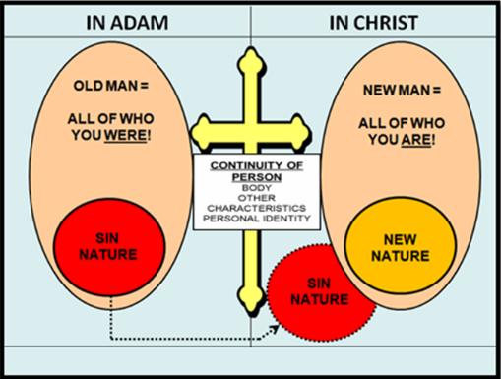
In Adam or In Christ?
 | JOINED TO | SEPARATED FROM
IN ADAM | Old Man, Sin Nature, Adam’s History, Came under Satan’s Authority | Christ, Heaven, Spiritual Blessing, Eternity with God
IN CHRIST | New Man, New Nature, Christ’s History, Christ’s righteousness, Christ’s Life | Adam, Old Man, Sin Nature, Adam’s History, World, Devil
Notes:
In Adam
Joined To – Old Man, Sin Nature, Adam’s History, Trio of enemies – World, Flesh, Devil, Satan’s Authority VS. Separated From – Christ,
In Christ
Joined To – New Man, New Nature, Christ’s History, Christ’s righteousness, Christ’s Life, Different Future! (Short Term Good or Bad; Long Term – Bright) VS. Separated From – Old Man, Sin Nature (no longer has the claim over us that it had), Adam’s History, World, Devil,
Separation From does not mean annihilation or extermination! The devil is still here, as is the sin nature, and the world. In order for God to remove us from the presence of sin, He would have to kill us because we must have a new body to complete the entire process.
Discuss those who teach the annihilation of the sin nature – use Iraq and Afganistan as examples. Send soldiers there and tell them there is no enemy.

Slide 35




Slide 36

So is this all… just hypothetical?
…our understanding of identification Truth directly affects, at least two areas that touch directly upon what God is doing in the life of the believer, 1) the Sin Nature and 2) the Continuing Person…
..and, Identification Truth provides answers to two important questions:
Why do believers sin? and,
How do believers have any hope of not sinning?
Notes:
So is this all… just hypothetical? – NO!!!
Our understanding of identification Truth directly affects, at least two areas that touch directly upon what God is doing in the life of the believer, 1) the Sin Nature and the 2) Continuing Person…
..and, Identification Truth answers two important questions:
Why do believers sin? and,
How do believers have any hope of not sinning?

Slide 37
So is this all… just hypothetical?
Identification Truth reveals the primary manner of dealing with the Sin Nature, which is – our identification with Christ (Romans 6:1-14).
Notes:
So is this all… just hypothetical? – NO!!!
Identification Truth reveals the primary manner of dealing with the Sin Nature, which is – our identification with Christ (Romans 6:1-14).

Slide 38
Romans 6:1–14 (NASB95)
¹ What shall we say then? Are we to continue in sin so that grace may increase? ² May it never be! How shall we who died to sin still live in it? ³ Or do you not know that all of us who have been baptized into Christ Jesus have been baptized into His death? ⁴ Therefore we have been buried with Him through baptism into death, so that as Christ was raised from the dead through the glory of the Father, so we too might walk in newness of life. ⁵ For if we have become united with Him in the likeness of His death, certainly we shall also be in the likeness of His resurrection, ⁶ knowing this, that our old self was crucified with Him, in order that our body of sin might be done away with, so that we would no longer be slaves to sin; ⁷ for he who has died is freed from sin. ⁸ Now if we have died with Christ, we believe that we shall also live with Him, ⁹ knowing that Christ, having been raised from the dead, is never to die again; death no longer is master over Him. ¹⁰ For the death that He died, He died to sin once for all; but the life that He lives, He lives to God. ¹¹ Even so consider yourselves to be dead to sin, but alive to God in Christ Jesus. ¹² Therefore do not let sin reign in your mortal body so that you obey its lusts, ¹³ and do not go on presenting the members of your body to sin as instruments of unrighteousness; but present yourselves to God as those alive from the dead, and your members as instruments of righteousness to God. ¹⁴ For sin shall not be master over you, for you are not under law but under grace.
Notes:
The Sin Nature is the collection of attributes and characteristics of how the Old Man is inclined to behave.
When contextually appropriate, the term “flesh or body” is often best understood as referring to the Sin Nature as it acts through the physical human body.

Slide 39


Dead to the Sin Nature (Rom 6:11) but...
Even so consider (reckon) yourselves to be dead unto sin (the sin nature)…
…but alive unto God in Christ Jesus (Rom 6:11).
Notes:
6:11 Since God has united us with Christ we should “consider,” “count,” or “reckon” ourselves as those who are not under the dominating influence of sin any longer.192 (192. In some parts of the United States, “I reckon” means “I guess.” That is not its meaning here. It means to count on something being true, to believe it). The verb is a present imperative in the Greek text indicating that we should definitely and constantly view ourselves this way. We must realize that we are free to enjoy our new relationship with God forever.193 (193. Don Matzat clarified well how Christians should view themselves in Christ-Esteem.)
Paul previously stressed the importance of knowing certain facts (vv. 3, 6, 9). Now he said that we should count on their being true. We must not just understand them but believe them. He used the same Greek word (logisthesetai) here as he did in his explanation of justification (2:26; 4:3, 4, 5, 6, 8, 9, 10, 11, 22, 23, 24). God puts righteousness down on the believer’s account. Similarly we should put it down as true that our relationship to sin and death has changed. Only as we do so will we relate to temptation, sin, and death realistically. If we fail to believe that sin no longer dominates us, we will be much more vulnerable to yield to temptation, to practice sin, and to fear death. However if we believe sin does not have that power, we will be more apt to resist temptation, to stay clear of sin, and to anticipate death less fearfully. “Consider” is in the present tense in the Greek text indicating that we need to maintain a realistic view of our relationship to sin (i.e., to “keep on considering”).
“The word reckon is a word for faith—in the face of appearances.”194 (194. Newell) …Constable, T. (2003). Tom Constable’s Expository Notes on the Bible. Galaxie Software.

Slide 40

So is this all… just hypothetical?
Identification Truth explains that the changes in our “Continuing Person” (ongoing processes - conformed, transformed, growing, maturing, being sanctified, etc.) are in the direction of Christ
Notes:
So is this all… just hypothetical? – NO!!!
Identification Truth explains that the changes in our “Continuing Person” (ongoing processes - conformed, transformed, growing, maturing, being sanctified, etc.) are in the direction of Christ
There is actual spiritual change taking place in the Continuing Person. We do not operate on some vague notion of how to be better people and we are not heading in some vague direction! God’s process of changing the Continuing Person is always in the direction of Christ.
We’re not called to struggle through life trying to be a good person, or even Christ-like, because God, Himself IS presently carrying out these processes in each believer. We are all now being directed toward a Person – Christ. God is not just trying to vaguely change our character. It is all toward Christ. The end being that we will be like Christ when we see Him as He is.
That’s where everything is headed for the believer so that’s why we need to see that, “EVERTHING THAT HAPPENS TO US, IN US, AND AROUND US IS PART OF GOD’S PROCESS TO ACCOMPLISH HIS PROCESSES.” It’s all to conform us, to transform us, into the image of His Son.

Slide 41
So is this all… just hypothetical?
Identification Truth explains that the changes in our “Continuing Person” take place as we ‘walk consistent’ with who we have been made to be in our eternal identity (positioned in Christ), and those changes are realized because it is Christ, Who does the living in and through us – by faith (2 Cor. 4:11).
Notes:
So is this all… just hypothetical?
Identification Truth explains that the changes in our “Continuing Person” take place as we ‘walk consistent’ with who we have been made to be in our eternal identity (positioned in Christ), and those changes are realized because it is Christ, Who does the living in and through us – by faith (2 Cor. 4:11).

Slide 42
  2 Cor. 4:11
For we who live are always delivered to death for Jesus’ sake, that the life of Jesus also may be manifested in our mortal flesh.
Notes:
2 Cor. 4:11 - For we who live are always delivered to death for Jesus’ sake, that the life of Jesus also may be manifested in our mortal flesh.

Slide 43
So is this all… just hypothetical?
Identification Truth explains that these changes take place as we ‘walk consistent’ with the One Who we have been ‘joined to’ and what we have been ‘separated from’, in Christ.
Notes:
So is this all… just hypothetical?
Identification Truth explains that these changes are continually taking place as we ‘walk consistent’ with the One Who we have been ‘joined to’ and what we have been ‘separated from’, in Christ.
Has God given us a bunch of assignments? Is God the great delegator? Is He saying, “Do this and this” and “Don’t do this, and this, and this” so that when we walk through Heaven’s gates, He’ll say, let’s see how you did?
No, the processes that God is using NOW, will accomplish what He desires so that when we walk through Heaven’s gates, we WILL be like Christ.

Slide 44
Summation

Slide 45
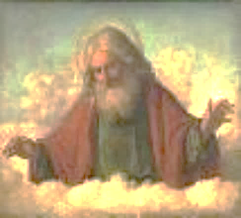
God, Himself is carrying out specific processes in each believer to produce actual spiritual change. This spiritual change is taking place within our Continuing Person.
God’s processes are not random or vague, but are directed toward a Person – Christ. His processes are not merely to change our character, but have as their end that we will be like Christ when we see Him as He is.
God wants us to see that, “EVERTHING THAT HAPPENS TO US, IN US, AND AROUND US IS PART OF HIS PLAN TO ACCOMPLISH HIS PROCESSES IN US.”
HIS PROCESSES IN US are conforming us and transforming us into the image of His Son so that when we walk through Heaven’s gates, we WILL BE like Christ.
Notes:
God, Himself is carrying out specific processes in each believer to produce actual spiritual change. This spiritual change is taking place within our Continuing Person.
God’s processes are not random or vague, but are directed toward a Person – Christ. His processes are not merely to change our character, but have as their end that we will be like Christ when we see Him as He is.
God wants us to see that, “EVERTHING THAT HAPPENS TO US, IN US, AND AROUND US IS PART OF HIS PLAN TO ACCOMPLISH HIS PROCESSES IN US.”
HIS PROCESSES IN US are conforming us and transforming us into the image of His Son so that when we walk through Heaven’s gates, we WILL be like Christ.

Slide 46
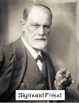
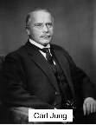
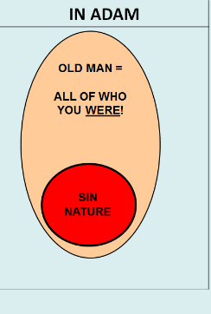
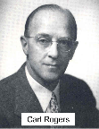
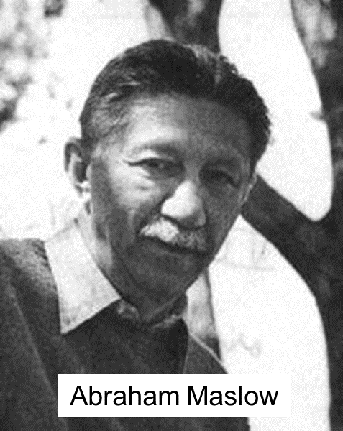
Secular Counseling
Secular Counseling focuses on our personal history “in Adam” now gone! That’s all it can do because it doesn’t understand or recognize Christ. Therefore, Secular Counselors (and sadly, uninformed Christian Counselors) struggle to improve the Old Man and Sin Nature!
Notes:
Secular Counseling
Secular Counseling focuses on our personal history “in Adam” now gone! That’s all it can do because it doesn’t understand or recognize Christ. Therefore, Secular Counselors (and sadly, uninformed Christian Counselors) struggle to improve the Old Man and Sin Nature!

Slide 47

True Biblical Counseling
Biblical Counseling focuses on our personal shared history “in Christ”! Only informed Biblical Counselors can share real hope and encouragement because they do not address the Old Man “in Adam”, but deal with the New Man who has a New History “in Christ”.
Notes:
True Biblical Counseling
Biblical Counseling focuses on our personal shared history “in Christ”! Only informed Biblical Counselors can share real hope and encouragement because they do not address the Old Man “in Adam”, but deal with the New Man who has a New History “in Christ”. This is phenomenal good news!

