Slide 1
Law & Grace Jim McGowan, Th.D. Sugar Land Bible Church 11-20-2016.
Special thanks to Dr. Vern Peterman for access to his insights and resources.
Notes:
Law vs. Grace

Slide 2
Outline
Our Purpose, Aim, and Objective
Review
Introduction to Rules of Jewish Baseball
Contextual Background
Contrast and Comparison of Law & Grace – Exo. 3:1-10
Foretaste of Future Lessons
Some things to consider regarding a proper perspective
Conclusion

Slide 3
OUR PURPOSE, AIM, AND OBJECTIVE
Law & Grace
…is to Compare and Contrast Law and Grace so as to properly understand these two important themes and how they are related to the life of the New Testament Believer.

Slide 5
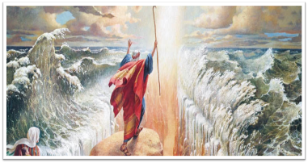
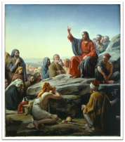
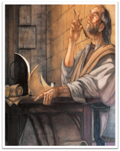
What’s Ahead?
Notes:
What’s Ahead?
As we consider the topic of Law & Grace we will consider three sections of Scripture, including: Exodus through Joshua, the book of Matthew, and Romans through James.
We’ll be comparing and contrasting Israel under the Law & the Church under Grace.

Slide 6
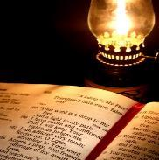
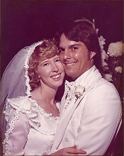
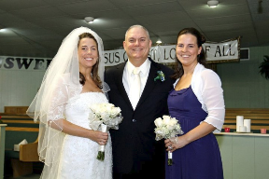
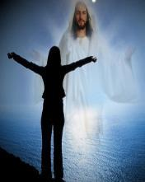
Does This Really Matter? – YES!
Notes:
Does This Really Matter? – YES!
For one thing, it is a matter of what the Bible actually says.
Secondly, making distinctions impacts relationships & identities.
We in the Church have been crucified with Christ so as to die to the Law, so that Christ would do the living through us (Gal. 2:19-20), but if we insist on living under the Law then we’ll be trying to be blessed by a ministry of death and condemnation (2 Cor. 3:7, 9).
Clarity of Identities & Relationships
Wife born in Houston, TX
Two daughters born in Houston, TX
My wife and my daughters.

Slide 7
Points of Comparison & Contrast
Steward | MOSES | CHRIST
Principle | Law | Grace
Whose Works | Self | Christ
People Group | ISRAEL | CHURCH
Baptism | Into Moses | Into Christ
Ministry Characteristic | Death Condemnation | Spirit Righteousness
Nature of Blessings | Conditional (If) / Earthly | Unconditional / Heavenly
Earthly Difficulties | Curses for disobedience | Growth or discipline
Notes:
Baptism is the outward expression of the believer’s identification with the object of his or her faith (cf. Rom. 6:3; Gal. 3:27). Consequently Paul could say the Israelites were baptized into Moses even though they did not undergo literal water baptism in the name of Moses. By following him and submitting to his authority they expressed their identification with him. Constable, T. (2003). Tom Constable’s Expository Notes on the Bible (1 Co 10:1). Galaxie Software.

Slide 8
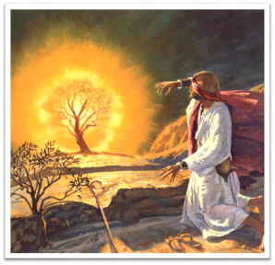
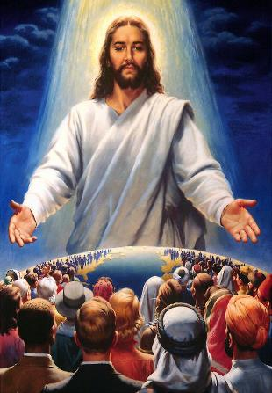
Distance & Intimacy
Notes:
A significant point of contrast between Law & Grace is in our access to and our intimacy with God:
Under the Law of Moses, distance from God was a legal requirement (cf. Exo. 19:12-13; 3:4–5).
Under Grace we have access to God, are called to draw near to Him, and to know Christ deeply and intimately (Eph. 2:18 & 3:11-12).
Law - Do not come near!!!
Grace – draw near!

Slide 9
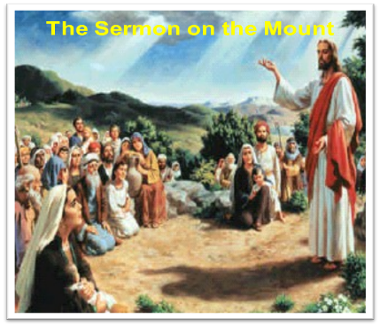
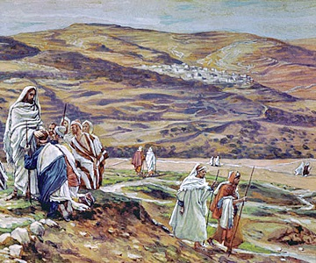
Misunderstanding Christ’s earthly ministry
Notes:
Misunderstanding Christ’s earthly ministry
As a Jew, living in Israel, Jesus , Israel’s King and Messiah, proclaimed the Gospel of the Kingdom of God only to the Jews.
Jesus introduced the topic of the Church only after the Jews rejected Him as their King, under the Law of Moses. After the Jews rejected their King and Messiah, the Church, made up of both Jews and Gentiles, not under Law but under grace, was put in place in order to make Israel jealous (Rom. 11:1).
All but the very last part of the earthly ministry of Christ was to Jews, in the land of Israel, as an appeal to live under the Law and to accept Him as their King.

Slide 10
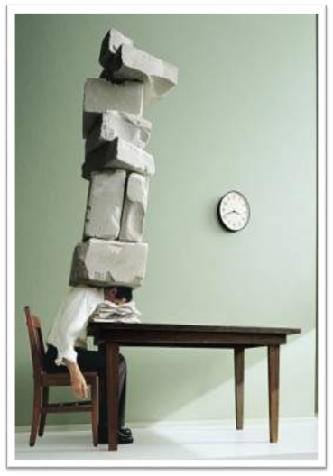
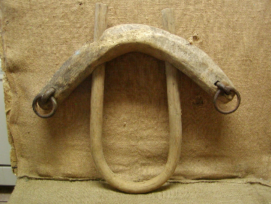
Misunderstanding leads to error!
Notes:
Misunderstanding leads to error!
A general misunderstanding of Christ’s earthly ministry and of the Law, causes many Christians to misunderstand Grace as well, leading them to think that they must do or not do things “under the Law” in order to be blessed, but “under Grace” we are already blessed because we are relying on what Christ has already accomplished for us.

Slide 11
Misunderstanding leads to error!

Slide 12
Outline
Our Purpose, Aim, and Objective
Review
Introduction to Rules of Jewish Baseball
Contextual Background
Contrast and Comparison of Law & Grace – Exo. 3:1-10
Foretaste of Future Lessons
Some things to consider regarding a proper perspective
Conclusion

Slide 13
Law & Grace
10 Strikes and YOU”RE OUT – Part 1

Slide 14
Law & Grace – 10 Strikes and YOU”RE OUT – Part 1
Scripture Reading
Exodus 3:1–10
Notes:
Our main focus this morning will be on Exo. 3:1-10, but before we go there, it is would be helpful to provide a little history background and context about Jewish Baseball.

Slide 15
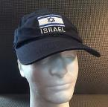
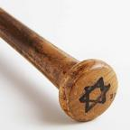
Law & Grace – 10 Strikes and YOU”RE OUT – Part 1
THE BIG RULE BOOK of
from the BIG INNING
Notes:
The BIG RULE BOOK of JEWISH BASEBALL is THE RULE BOOK from the BIG INNING! It vitally important that you understand that there are DIFFERENT RULES for JEWISH BASEBALL…different from what you may be accustomed to. Like all baseball you of course have your basic equipment – caps, bats, and baseballs, etc. But there are some differences. If you’re playing JEWISH BASEBALL your only opponent is the EGYPTIAN TEAM.

Slide 16
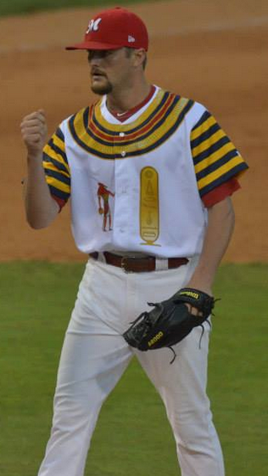
Law & Grace – 10 Strikes and YOU”RE OUT – Part 1
The
Israelites
vs
The
Egyptians
Notes:
As I stated, the rules are different…

Slide 17
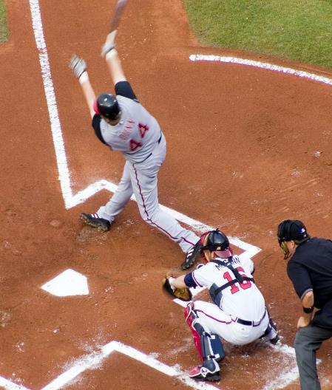
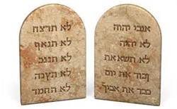
Law & Grace – 10 Strikes and YOU”RE OUT – Part 1
TEN
STRIKES
AND YOU’RE OUT!
Notes:
…and you’re all familiar with fly balls, I’m certain, but…

Slide 18
Law & Grace – 10 Strikes and YOU”RE OUT – Part 1
Fly Ball?

Slide 19
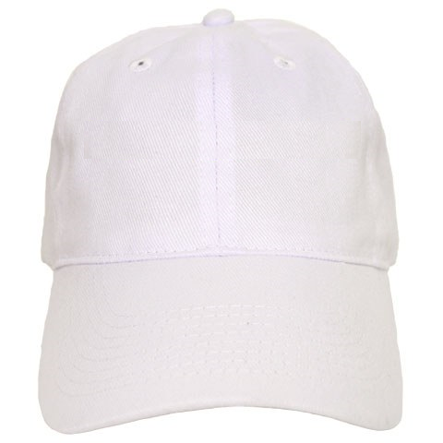
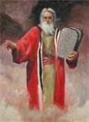
Law & Grace – 10 Strikes and YOU”RE OUT – Part 1
Mo’ Knows Best!
WWMD?
What would Moses Do?
Notes:
Also, it vitally important in JEWISH BASEBALL, that the players continually look to their Manager – Moses for all appropriate instructions while on the field. The key mindset of the JEWISH BASEBALL team is always, WHAT WOULD MOSES DO?
And just as the National and American Leagues have their sports paraphernalia, the JEWISH TEAM does too.
Now in telling you this, I am actually getting ahead of myself this morning so let me go backtrack and we will eventually catch up this a little later down the road.

Slide 20
Outline
Our Purpose, Aim, and Objective
Review
Introduction to Rules of Jewish Baseball
Contextual Background
Contrast and Comparison of Law & Grace – Exo. 3:1-10
Foretaste of Future Lessons
Some things to consider regarding a proper perspective
Conclusion

Slide 21
Law & Grace – 10 Strikes and YOU”RE OUT – Part 1
Notes:
Here is a timeline to give you an historical frame of reference for key biblical events… these are round numbers….
The specific events we will be discussing happen ~1446 B.C.
400 B.C. The Old Testament was completed.
Moses is the focal point of our study this morning so let’s move on in our discussion.

Slide 22
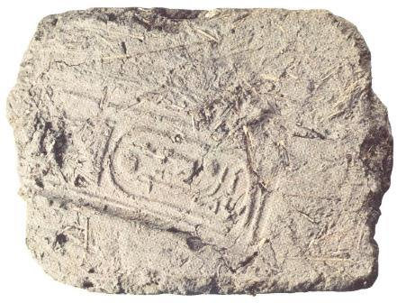
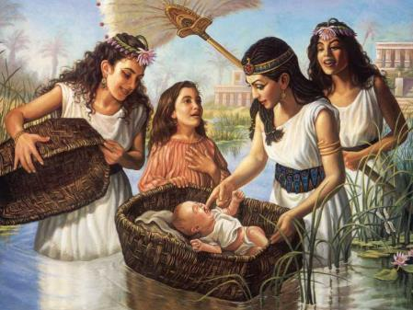
Law & Grace – 10 Strikes and YOU”RE OUT – Part 1
Brick made of straw and mud with Pharaoh's stamp.
Moses found by Pharaoh's daughter.
Notes:
You will remember that in the historical context, the Israelites after the time of Joseph, were slaves in Egypt for ~ 400 years. During that time the Israelites greatly multiplied in number even though they were making bricks for Pharaoh. The bricks were made of straw and mud and would have had the stamp of Pharaoh on them.
In order to control the population of the Israelites and to limit there ability to potentially rebel, the Pharaoh ordered the killing of all the male children 2 years old and under. Moses was found by Pharaoh's daughter and raised and educated, in Pharaoh’s household.

Slide 23
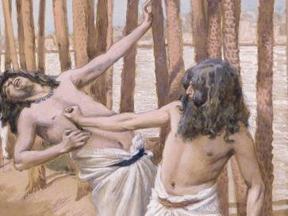
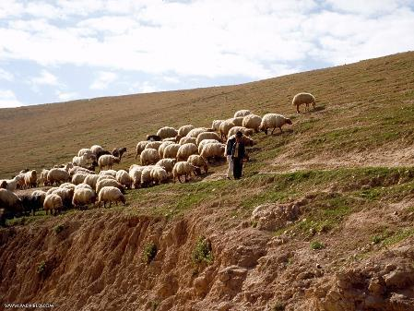
Law & Grace – 10 Strikes and YOU”RE OUT – Part 1
Moses kill an Egyptian.
Moses flees Egypt and becomes a shepherd.
Notes:
Moses, at about age 40, killed an Egyptian which caused him to have to go into exile.
Moses fled to Midian, became a shepherd, married a local girl, and started raising a family.

Slide 24
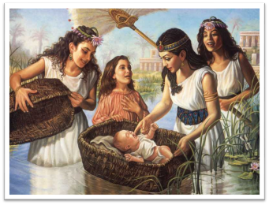
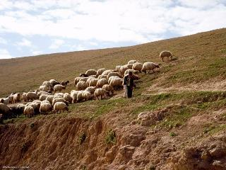
Law & Grace – 10 Strikes and YOU”RE OUT – Part 1
40 / 40 / 40
Notes:
Moses life can be broken down into 3 sets of 40 years…
Life in Pharaoh’s court as an Egyptian Prince.
Life as a shepherd in the wilderness.
Life as the Lawgiver and leader of Israel.
This brings us up to speed with our passage this morning.

Slide 25
Outline
Our Purpose, Aim, and Objective
Review
Introduction to Rules of Jewish Baseball
Contextual Background
Contrast and Comparison of Law & Grace – Exo. 3:1-10
Foretaste of Future Lessons
Some things to consider regarding a proper perspective
Conclusion

Slide 26
Exodus 3:1–10 (NASB95)
¹ Now Moses was pasturing the flock of Jethro his father-in-law, the priest of Midian; and he led the flock to the west side of the wilderness and came to Horeb, the mountain of God. ² The angel of the Lord appeared to him in a blazing fire from the midst of a bush; and he looked, and behold, the bush was burning with fire, yet the bush was not consumed. ³ So Moses said, “I must turn aside now and see this marvelous sight, why the bush is not burned up.” ⁴ When the Lord saw that he turned aside to look, God called to him from the midst of the bush and said, “Moses, Moses!” And he said, “Here I am.”

Slide 27
Exodus 3:1–10 (NASB95)
⁵ Then He said, “Do not come near here; remove your sandals from your feet, for the place on which you are standing is holy ground.” ⁶ He said also, “I am the God of your father, the God of Abraham, the God of Isaac, and the God of Jacob.” Then Moses hid his face, for he was afraid to look at God. ⁷ The Lord said, “I have surely seen the affliction of My people who are in Egypt, and have given heed to their cry because of their taskmasters, for I am aware of their sufferings. ⁸ “So I have come down to deliver them from the power of the Egyptians, and to bring them up from that land to a good and spacious land, to a land flowing with milk…

Slide 28
Exodus 3:1–10 (NASB95)
…and honey, to the place of the Canaanite and the Hittite and the Amorite and the Perizzite and the Hivite and the Jebusite. ⁹ “Now, behold, the cry of the sons of Israel has come to Me; furthermore, I have seen the oppression with which the Egyptians are oppressing them. ¹⁰ “Therefore, come now, and I will send you to Pharaoh, so that you may bring My people, the sons of Israel, out of Egypt.”

Slide 29
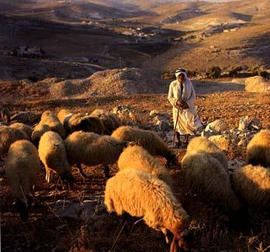
How would you like a career change?
Law & Grace – 10 Strikes and YOU”RE OUT – Part 1
Notes:
How would you like a career change?
Moses doesn’t know it, but the end of his shepherding career is about to end.
He is about to receive a new assignment from the Lord, shepherding the Israelites out of the land of Egypt.
He doesn’t know it, but this will be a much harder assignment!

Slide 30
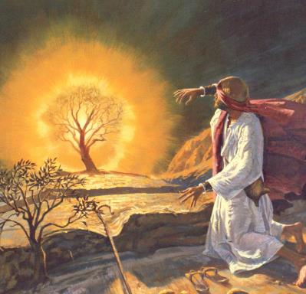
How would you like a career change?
Law & Grace – 10 Strikes and YOU”RE OUT – Part 1
So the angel of the Lord appears to Moses as a burning bush that never burns up.
That gets Moses’ attention & draws him toward the burning bush for a closer look…
Notes:
How would you like a career change?
So the angel of the Lord appears to Moses as a burning bush that never burns up.
That gets Moses’ attention & draws him toward the burning bush for a closer look…
Some interesting points to consider about this angel of the Lord:

Slide 31
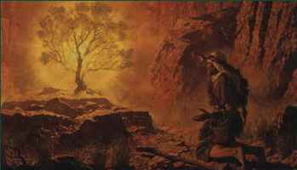
“The Angel of the Lord”
Law & Grace – 10 Strikes and YOU”RE OUT – Part 1
The angel of the Lord speaks as God, doing things that God does (Gen. 16:7-12; 21:17-18; 22:11-18; Exo. 3:2; Jud. 2:1-4; 5:23; 6:11-24; 13:3-22; 2 Sam. 24:16; Zech. 1:12; 3:1; 12:8).
Notes:
“The Angel of the Lord”
The angel of the Lord speaks as God, doing things that God does (Gen. 16:7-12; 21:17-18; 22:11-18; Exo. 3:2; Jud. 2:1-4; 5:23; 6:11-24; 13:3-22; 2 Sam. 24:16; Zech. 1:12; 3:1; 12:8).

Slide 32
“The Angel of the Lord”
Law & Grace – 10 Strikes and YOU”RE OUT – Part 1
As in this account, many who saw the angel of the Lord said that God had spoken and that they had seen God.
Appearances of the angel of the Lord ceased at Christ’s birth, so we take Him to be the Pre-Incarnate, Son of God.
Notes:
“The Angel of the Lord”
As in this account, many who saw the angel of the Lord said that God had spoken and that they had seen God.
Appearances of the angel of the Lord ceased at Christ’s birth, so we take Him to be the Pre-Incarnate, Son of God.

Slide 33
How would you like a career change?
Law & Grace – 10 Strikes and YOU”RE OUT – Part 1
So the angel of the Lord appears to Moses as a burning bush that never burns up.
Notes:
How would you like a career change?
So the angel of the Lord appears to Moses as a burning bush that never burns up.

Slide 34
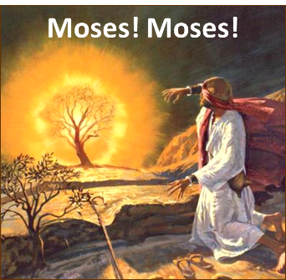
Law & Grace – 10 Strikes and YOU”RE OUT – Part 1
God calls, but keep your distance – Exo. 3:5
God calls Moses by name twice, & Moses responds by saying, “Here I am”.
God calls Moses but tells Moses, “Do not come near here”.
Moses the Lawgiver was not allowed to come nearer to God.
Notes:
God calls, but keep your distance
God calls Moses by name twice,, & Moses responds by saying, “Here I am”. (Abraham, Abraham - Genesis 22:11; Jacob, Jacob - Genesis 46:2; Samuel, Samuel - 1 Samuel 3:10; Saul, Saul – Acts 9:4; 22:7; 26:14)
God calls Moses but tells Moses, “Do not come near here”.
Moses the Lawgiver was not allowed to come nearer to God.

Slide 35
Law & Grace – 10 Strikes and YOU”RE OUT – Part 1
God calls, but keep your distance – Exo. 3:5
Moses is then told to remove his sandals as he is on holy ground.
God said, "I AM the God of your father, the God of Abraham, the God of Isaac, and the God of Jacob."
Notes:
God calls, but keep your distance
Moses is then told to remove his sandals as he is on holy ground.
God said, "I AM the God of your father, the God of Abraham, the God of Isaac, and the God of Jacob."
GOD IS AN “INDIVIDUAL” GOD…HE KNOWS YOU BY NAME!

Slide 36
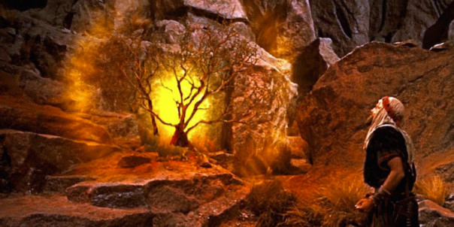
Law & Grace – 10 Strikes and YOU”RE OUT – Part 1
“Do not come near…!”
“…Then Moses hid his face, for he was afraid
to look at God.” Exodus 3:5-6
Notes:
“Do not come near…!”
“…Then Moses hid his face, for he was afraid to look at God.” Exodus 3:5-6
COMPARE THIS TO WHAT IS WRITTEN IN THE BOOK OF HEBREWS…WRITTEN TO BELIEVING JEWS!!!

Slide 37
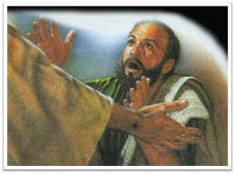
Hebrews 4:16 (NASB95)
Therefore let us draw near with confidence to the throne of grace, so that we may receive mercy and find grace to help in time of need.
Notes:
Hebrews 4:16 (NASB95) - Therefore let us draw near with confidence to the throne of grace, so that we may receive mercy and find grace to help in time of need.

Slide 38
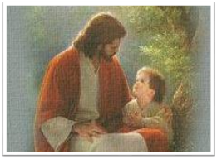
Hebrews 7:19 (NASB95)
(for the Law made nothing perfect), and on the other hand there is a bringing in of a better hope, through which we draw near to God.
Notes:
Hebrews 7:19 (NASB95) - (for the Law made nothing perfect), and on the other hand there is a bringing in of a better hope, through which we draw near to God.

Slide 39
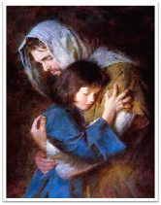
Hebrews 7:25 (NASB95)
Therefore He is able also to save forever those who draw near to God through Him, since He always lives to make intercession for them. (cf. Heb. 10:1; 22)
Notes:
Hebrews 7:25 (NASB95) - Therefore He is able also to save forever those who draw near to God through Him, since He always lives to make intercession for them. (cf. Heb. 10:1; 22)

Slide 40
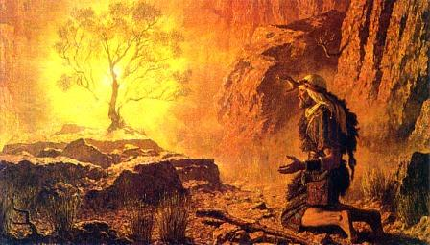
Law & Grace – 10 Strikes and YOU”RE OUT – Part 1
Exodus 3:6
He said also, "I AM* the God of your father, the God of Abraham, the God of Isaac, and the God of Jacob.
* “I AM” in the Greek Old & New Testaments (ἐγὼ εἰμί) is literally ‘I, I am’
Notes:
Exodus 3:6 - He said also, "I AM+ the God of your father, the God of Abraham, the God of Isaac, and the God of Jacob.
* “I AM” in the Greek Old & New Testaments (ἐγὼ εἰμί) is literally ‘I, I am’

Slide 41
Exodus 3:14-16 (NASB95)
¹⁴ God said to Moses, "I AM WHO I AM“*; and He said, "Thus you shall say to the sons of Israel, 'I AM* has sent me to you.'" ¹⁵ God, furthermore, said to Moses, "Thus you shall say to the sons of Israel, 'The Lord, the God of your fathers, the God of Abraham, the God of Isaac, and the God of Jacob, has sent me to you.' This is My name forever, and this is My memorial-name to all generations. ¹⁶ Go and gather the elders of Israel together and say to them, 'The Lord, the God of your fathers, the God of Abraham, Isaac and Jacob, has appeared to me, saying, "I am indeed concerned about you and what has been done to you in Egypt."
Notes:
Exodus 3:14-16
God said to Moses, "I AM WHO I AM+"; and He said, "Thus you shall say to the sons of Israel, 'I AM+ has sent me to you.'" 15 God, furthermore, said to Moses, "Thus you shall say to the sons of Israel, 'The Lord, the God of your fathers, the God of Abraham, the God of Isaac, and the God of Jacob, has sent me to you.' This is My name forever, and this is My memorial-name to all generations. 16 Go and gather the elders of Israel together and say to them, 'The Lord, the God of your fathers, the God of Abraham, Isaac and Jacob, has appeared to me, saying, "I am indeed concerned about you and what has been done to you in Egypt."

Slide 42
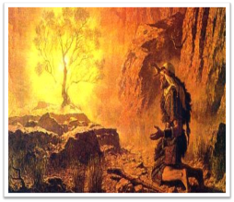
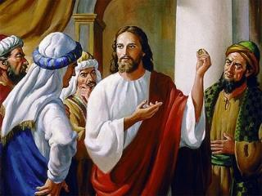
Deity Claim!
Law & Grace – 10 Strikes and YOU”RE OUT – Part 1
‘I AM’ (ἐγὼ εἰμί) in these passages & in the Greek Old Testament (LXX) in Exodus 3:6 & 14 is a claim to deity.
Jesus said to them, “Truly, truly, I say to you, before Abraham was born, I AM [ἐγὼ εἰμί])” John 8:58
Notes:
Deity Claim!
‘I AM’ (ἐγὼ εἰμί) in these passages & in the Greek Old Testament (LXX) in Exodus 3:6 & 14 is a claim to deity.
Jesus said to them, “Truly, truly, I say to you, before Abraham was born, I AM [ἐγὼ εἰμί])” John 8:58

Slide 43
Law & Grace – 10 Strikes and YOU”RE OUT – Part 1
7 “I AM” (ἐγὼ εἰμί) Statements of Christ in John’s Gospel
Notes:
I BEING IN FACT GOD, AM…

Slide 44
John 18:4–8 (NASB95)
⁴ So Jesus, knowing all the things that were coming upon Him, went forth and said to them, “Whom do you seek?” ⁵ They answered Him, “Jesus the Nazarene.” He said to them, “I am He.” And Judas also, who was betraying Him, was standing with them. ⁶ So when He said to them, “I am He,” they drew back and fell to the ground. ⁷ Therefore He again asked them, “Whom do you seek?” And they said, “Jesus the Nazarene.” ⁸ Jesus answered, “I told you that I am He; so if you seek Me, let these go their way,”
Notes:
John 18:4–8 (NASB95) - ⁴ So Jesus, knowing all the things that were coming upon Him, went forth and said to them, “Whom do you seek?” ⁵ They answered Him, “Jesus the Nazarene.” He said to them, “I am He.” And Judas also, who was betraying Him, was standing with them. ⁶ So when He said to them, “I am He,” they drew back and fell to the ground. ⁷ Therefore He again asked them, “Whom do you seek?” And they said, “Jesus the Nazarene.” ⁸ Jesus answered, “I told you that I am He; so if you seek Me, let these go their way,”

Slide 45
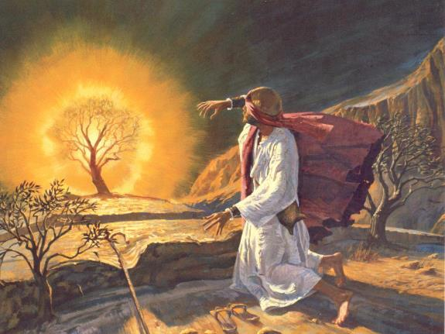
Law & Grace – 10 Strikes and YOU”RE OUT – Part 1
Exodus 3:6
Moses, soon to be the Lawgiver, then HID HIS FACE, for he was afraid to look at God.
Notes:
Exodus 3:6
Moses, soon to be the Lawgiver, then HID HIS FACE, for he was afraid to look at God.

Slide 46
Grace in 2 Corinthians 3:18; 4:6
^{3:18}But we all, WITH UNVEILED FACE, beholding as in a mirror the glory of the Lord…^{4:6}For God, who said, "Light shall shine out of darkness," is the One who has shone in our hearts to give the Light of the knowledge of the glory of God in the face of Christ.
Grace in Hebrews 12:2
…FIXING OUR EYES ON JESUS…
Notes:
Grace in 2 Corinthians 3:18; 4:6 - ^{3:18}But we all, WITH UNVEILED FACE, beholding as in a mirror the glory of the Lord…^{4:6}For God, who said, "Light shall shine out of darkness," is the One who has shone in our hearts to give the Light of the knowledge of the glory of God in the face of Christ.
Grace in Hebrews 12:2 - …FIXING OUR EYES ON JESUS…

Slide 47
Exodus 3:7-10
⁷ The LORD said, "I have surely seen the affliction of My people who are in Egypt, and have given heed to their cry because of their taskmasters, for I am aware of their sufferings. ⁸ SO I HAVE COME DOWN TO DELIVER THEM from the power of the Egyptians, and to bring them up from that land to a good and spacious land, to a land flowing with milk and honey, to the place of the Canaanite and the Hittite and the Amorite and the Perizzite and the Hivite and the Jebusite. ⁹ Now, behold, the cry of the sons of Israel has come to Me; furthermore, I have seen the oppression with which the Egyptians are oppressing them. ¹⁰ THEREFORE, COME NOW, AND I WILL SEND YOU to Pharaoh, SO THAT YOU may bring My people, the sons of Israel, out of Egypt."
Notes:
Exodus 3:7-10 - ⁷ The LORD said, "I have surely seen the affliction of My people who are in Egypt, and have given heed to their cry because of their taskmasters, for I am aware of their sufferings. ⁸ SO I HAVE COME DOWN TO DELIVER THEM from the power of the Egyptians, and to bring them up from that land to a good and spacious land, to a land flowing with milk and honey, to the place of the Canaanite and the Hittite and the Amorite and the Perizzite and the Hivite and the Jebusite. ⁹ Now, behold, the cry of the sons of Israel has come to Me; furthermore, I have seen the oppression with which the Egyptians are oppressing them. ¹⁰ THEREFORE, COME NOW, AND I WILL SEND YOU to Pharaoh, SO THAT YOU may bring My people, the sons of Israel, out of Egypt.“
Interesting alternating pattern…
vv. 7 & 9 – The Lord speaks of His awareness of the problem.
vv. 8 & 10 - The Lord speaks of what He is going to do about it.
The Law always points out the inadequacy of the Israelites.

Slide 48
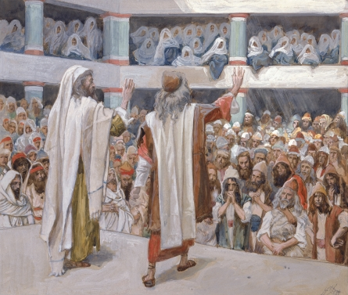
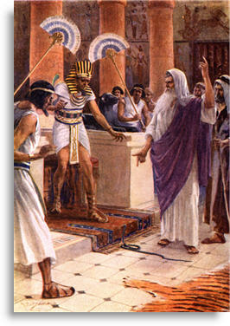
Law & Grace – 10 Strikes and YOU”RE OUT – Part 1
Notes:
Moses and his brother Aaron would appear before their own people, and before Pharaoh’s court…

Slide 49
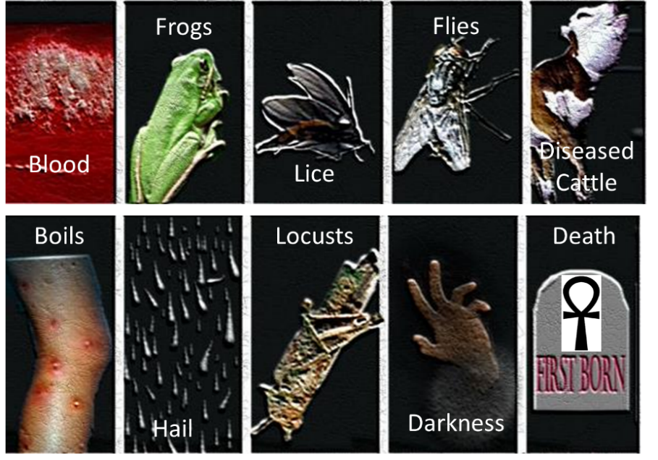
Law & Grace – 10 Strikes and YOU”RE OUT – Part 1

Slide 50
Law & Grace – 10 Strikes and YOU”RE OUT – Part 1
10 PLAGUES (STRIKES) OF EGYPT: EXO. 12:12; NUM. 33:4
PLAGUE | EGYPTIAN GOD DEFEATED | EXODUS
1. Water into blood | Osiris | 7:20
2. Frogs infestation | Hekt | 8:6
3. Lice infestation | Seb | 8:17
4. Fly infestation | Hatkok | 8:24
5. Cattle diseased | Apis | 9:6
6. Boil epidemic | Typhon | 9:10
7. Fiery Hail | Shu | 9:24
8. Locust infestation | Serapai | 10:13
9. 3 Days of darkness | Ra | 10:22
10. Death of firstborn | All the gods | 12:29
Notes:
Over 700 gods.

Slide 51
Law & Grace – 10 Strikes and YOU”RE OUT – Part 1
https://redeeminggod.com/understanding-the-ten-plagues/
Notes:
Over 700 gods.

Slide 52
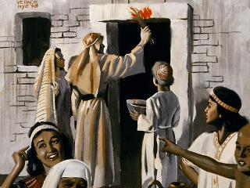
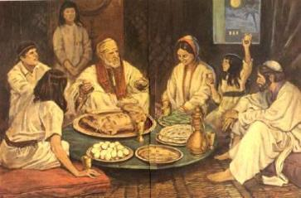
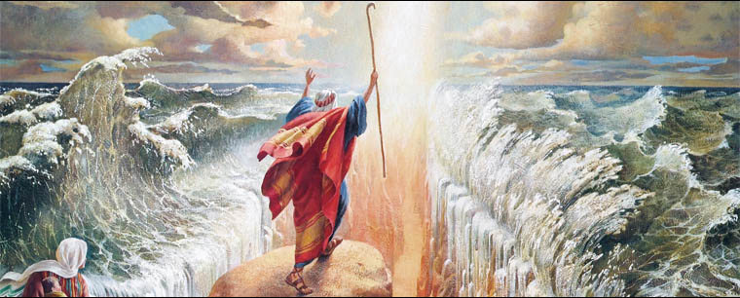
Law & Grace – 10 Strikes and YOU”RE OUT – Part 1
Notes:
Blood over the door post.
Passover meal.
Exodus.
THE FINAL PLAGUE MOVED THE EGYPTIANS AGAINST THEIR OWN PHARAOH!

Slide 53
Do not come near, or draw near?
Law & Grace – 10 Strikes and YOU”RE OUT – Part 1
Moses, later to be the Lawgiver, was told not to come near – keep your distance, Moses!
Notes:
Do not come near, or draw near?
Moses, later to be the Lawgiver, was told not to come near – keep your distance, Moses!

Slide 54
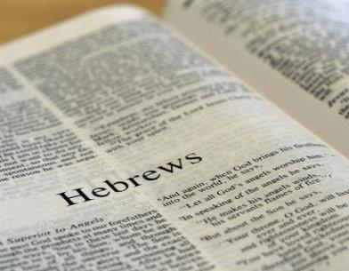
Do not come near, or draw near?
Law & Grace – 10 Strikes and YOU”RE OUT – Part 1
But the book of Hebrews repeatedly urged the Jewish believers to draw near to God.
So did Moses just have it all wrong? Or is God just not as uptight as He used to be?
Notes:
Do not come near, or draw near?
But the book of Hebrews repeatedly urged the Jewish believers to draw near to God.
So did Moses just have it all wrong? Or is God just not as uptight as He used to be?

Slide 55
Do not come near, or draw near?
Law & Grace – 10 Strikes and YOU”RE OUT – Part 1
No, the difference is Grace.
Notes:
Do not come near, or draw near?
No, the difference is Grace.
GRACE CHANGES EVERYTHING!

Slide 56
Dread of God, or Confident Access?
Law & Grace – 10 Strikes and YOU”RE OUT – Part 1
Even though Moses kept his distance, He was clearly afraid of God.
Notes:
Dread of God, or Confident Access?
Even though Moses kept his distance, He was clearly afraid of God.

Slide 57
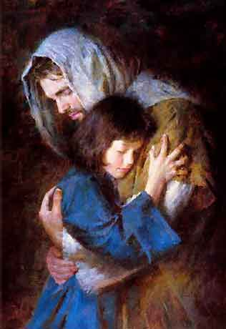
Dread of God, or Confident Access?
Law & Grace – 10 Strikes and YOU”RE OUT – Part 1
But the message of the New Testament is to approach God boldly & confidently.
Notes:
Dread of God, or Confident Access?
But the message of the New Testament is to approach God boldly & confidently.

Slide 58
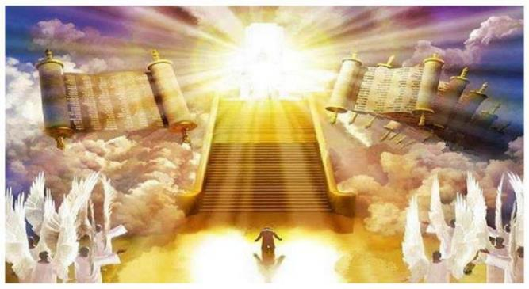
Dread of God, or Confident Access?
Law & Grace – 10 Strikes and YOU”RE OUT – Part 1
We approach God humbly but boldly and with confidence understanding that our bold & confident access is because we are by God’s Grace, in Christ!
Notes:
Dread of God, or Confident Access?
We approach God humbly but boldly and with confidence understanding that our bold & confident access is because we are by God’s Grace, in Christ!

Slide 59
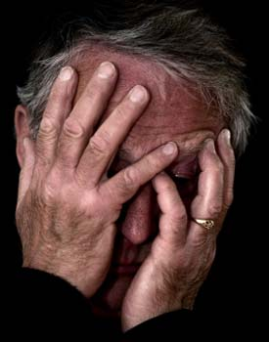
Hide Your Face or Behold Him?
Law & Grace – 10 Strikes and YOU”RE OUT – Part 1
In Exodus 3:6 we read that Moses hid his face from God, because He was simply afraid.
Before Grace, looking at the Lord was fearful, possibly even dangerous.
Notes:
Hide Your Face or Behold Him?
In Exodus 3:6 we read that Moses hid his face from God, because He was simply afraid.
Before Grace, looking at the Lord was fearful, possibly even dangerous.

Slide 60
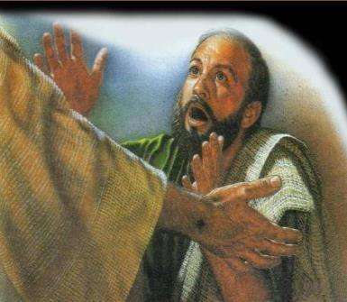
Hide Your Face or Behold Him?
Law & Grace – 10 Strikes and YOU”RE OUT – Part 1
But in the New Testament we find an appeal to be always beholding & looking to the Lord.
But under Grace, beholding Him has both present and eternal benefits, and is His will.
Notes:
Hide Your Face or Behold Him?
But in the New Testament we find an appeal to be always beholding & looking to the Lord.
But under Grace, beholding Him has both present and eternal benefits, and is His will.

Slide 61
VI. Conclusion
Law & Grace – 10 Strikes and YOU”RE OUT – Part 1

Slide 62
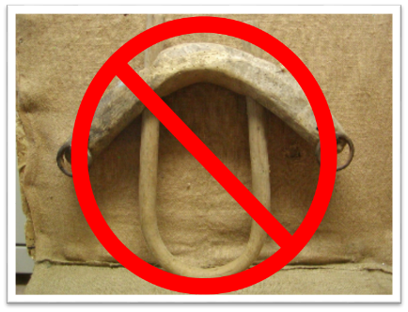
What Should I Take Away From This?
Law & Grace – 10 Strikes and YOU”RE OUT – Part 1
For the Believer:
God wants us to begin to understand the clear distinctions between the Rule of Law and the Rule of Grace so that we will fully realize and enjoy the divine riches in glory, that are ours, and available right now, in Christ Jesus.
Notes:
Conclusion - For the Believer:
God wants us to begin to understand the clear distinctions between Law and Grace so that we will fully realize and enjoy the divine riches in glory, that are ours, and available right now, in Christ Jesus.
NEXT SLIDE

Slide 63
What Should I Take Away From This?
Law & Grace – 10 Strikes and YOU”RE OUT – Part 1
For the Non-Believer:
The admonition to those present who are unbelievers is: Today is the Day of Salvation.
You can place your faith in Christ’s promises right now.
Notes:
Conclusion - For the Non-Believer:
The admonition to those present who are unbelievers is: Today is the Day of Salvation.
You can place your faith in Christ’s promises right now.
There are no magical incantations, no secret handshakes, no promise to do good deeds, no commitment to church membership, no emotional, pressure induced assurances, no hand raising, and no aisle walking required.
The one condition of salvation is simple faith, (which is trust in or confidence in or reliance upon), Christ’s promise to give New Life to all those who come to Him for salvation.
If this is something you have done or are doing right now, God’s Word authoritatively declares that you are a Child of God and you have access to all of God’s Divine Riches of Grace. God now wants you to grow and mature spiritually, and I can of no better place to do so than here at SLBC.
If you would like more information, the Elders, Deacons, Pastoral staff, and members would be happy to talk with you immediately after the service.
PRAYER - Father, thank you for the convicting power of the Holy Spirit. May we all be sensitive to heed His voice as He draws us to the Lord Jesus Christ for salvation, restoration of fellowship, or spiritual growth. Amen!

Slide 64
CLOSING
Law & Grace – 10 Strikes and YOU”RE OUT – Part 1
Numbers 6:24–26
²⁴ The Lord bless you, and keep you; ²⁵ The Lord make His face shine on you, And be gracious to you; ²⁶ The Lord lift up His countenance on you, And give you peace.’
Notes:
Numbers 6:24–26 - ²⁴ The Lord bless you, and keep you; ²⁵ The Lord make His face shine on you, And be gracious to you; ²⁶ The Lord lift up His countenance on you, And give you peace.’

