Slide 1
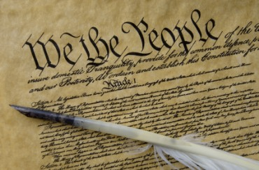
THE BIBLE AND VOTING Part 13
Dr. Andy Woods

Slide 2
Introductory Remarks
A stewardship issue (1 Cor. 4:2)
A biblical issue (2 Tim. 3:16)
Biblical principles rather than partisanship

Slide 3
The Bible and Voting
Economic issues
Social issues
Foreign affairs

Slide 4
The Bible and Voting
Economic issues
Social issues
Foreign affairs

Slide 5
Economic Issues
Ownership of private property? (Deut. 19:15)
Pursuit of economic self interest? (Gen. 8:21)
Proper definition of compassion? (2 Thess. 3:10)
Who provides charity? (1 Tim. 5:3-8)
Family is the building block of society? (Deut. 6:6-7)
Wealth retained within the family? (Prov. 13:22)
The earth experiences cyclical patterns? (Gen. 8:22)
Environmental stewardship rather than earth worship? (Rom. 1:22-23)
Opposition to runaway debt? (Prov. 22:7)
Limitations upon the government? (Acts 5:29)

Slide 6
The Bible and Voting
Economic issues
Social issues
Foreign affairs

Slide 7
Social Issues
Legal protection for the unborn? (Gen. 25:23)
Legal protection for the elderly? (Lev. 19:32)
Hetero-sexual monogamous marriage as the standard for society? (Gen. 2:18-25)
Advocacy capital punishment? (Gen. 9:6)
The right to restrict alcohol, pornography, & gambling? (Lev. 10:9; Matt. 5:27-28; Prov. 13:11)
Parental authority over children? (Eph. 6:4)
Public expressions of Christianity? (Mark 16:15)
Right to keep and bear arms? (Luke 22:36)

Slide 8
The Bible and Voting
Economic issues
Social issues
Foreign affairs

Slide 9
Foreign Affairs
Favor national sovereignty above global governance? (Gen. 11:1-9)
Favor the reality and enforceability of our national borders? (Acts 17:26)
Support for the nation of Israel? (Gen. 12:3)
Pursuit of peace though strength? (Jer. 17:9)

Slide 10
Foreign Affairs
Favor national sovereignty above global governance? (Gen. 11:1-9)
Favor the reality and enforceability of our national borders? (Acts 17:26)
Support for the nation of Israel? (Gen. 12:3)
Pursuit of peace though strength? (Jer. 17:9)

Slide 11
Foreign Affairs
Favor national sovereignty above global governance? (Gen. 11:1-9)
Favor the reality and enforceability of our national borders? (Acts 17:26)
Support for the nation of Israel? (Gen. 12:3)
Pursuit of peace though strength? (Jer. 17:9)

Slide 12
Foreign Affairs
Favor national sovereignty above global governance? (Gen. 11:1-9)
Favor the reality and enforceability of our national borders? (Acts 17:26)
Support for the nation of Israel? (Gen. 12:3)
Pursuit of peace though strength? (Jer. 17:9)

Slide 13
Foreign Affairs
Favor national sovereignty above global governance? (Gen. 11:1-9)
Favor the reality and enforceability of our national borders? (Acts 17:26)
Support for the nation of Israel? (Gen. 12:3)
Pursuit of peace though strength? (Jer. 17:9)

Slide 14
Overview
Terrorism’s false causes
Terrorism’s true causes
Ineffective deterrents of terrorism
Effective deterrents to terrorism
Going too far in deterring terrorism
Legitimate methods in deterring terrorism
Notes:
Outline

Slide 15
Overview
Terrorism’s false causes
Terrorism’s true causes
Ineffective deterrents of terrorism
Effective deterrents to terrorism
Going too far in deterring terrorism
Legitimate methods in deterring terrorism
Notes:
Outline

Slide 16
I. Terrorism’s False Causes
Poverty
Lack of education
American imperialism
Notes:
Outline

Slide 17
Overview
Terrorism’s false causes
Terrorism’s true causes
Ineffective deterrents of terrorism
Effective deterrents to terrorism
Going too far in deterring terrorism
Legitimate methods in deterring terrorism
Notes:
Outline

Slide 18
II. Terrorism’s True Causes
Depravity
Radical ideology
Notes:
Outline

Slide 19
II. Terrorism’s True Causes
Depravity
Radical ideology
Notes:
Outline

Slide 20
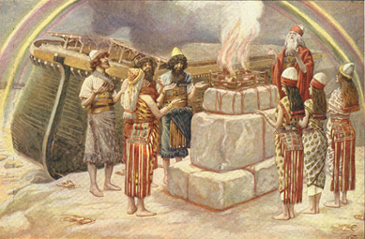
Genesis 8:21
The Lord smelled the soothing aroma; and the Lord said to Himself, “I will never again curse the ground on account of man, for the intent of man’s heart is evil from his youth; and I will never again destroy every living thing, as I have done.[emphasis mine].

Slide 21
Mark 7:20-23
“And He was saying, “That which proceeds out of the man, that is what defiles the man. ²¹ For from within, out of the heart of men, proceed the evil thoughts, fornications, thefts, murders, adulteries, ²² deeds of coveting and wickedness, as well as deceit, sensuality, envy, slander, pride and foolishness. ²³ All these evil things proceed from within and defile the man.”

Slide 22
II. Terrorism’s True Causes
Depravity
Radical ideology
Notes:
Outline

Slide 23
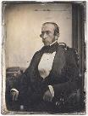
Robert Charles Winthrop
“All societies of men must be governed in some way or other. The less they may have of stringent State Government, the more they must have of individual self-government. The less they rely on public law or physical force, the more they must rely on private moral restraint. Men, in a word, must necessarily be controlled, either by a power within them, or by a power without them; either by the Word of God, or by the strong arm of man; either by the Bible, or by the bayonet. It may do for other countries and other governments to talk about the State supporting religion. Here, under our own free institutions, it is Religion which must support the State.”
Robert Winthrop, Addresses and Speeches on Various Occasions (Boston, MA: Little, Brown, 1852), 172. Speech to the Massachusetts Bible Society (1849-05-28).

Slide 24
Quran Surah* 8:12
(*chapter)
“I will cast terror into the hearts of those who disbelieve. Therefore strike off their heads and strike off every fingertip of them” (Q 8:12)

Slide 25
Quran Surah* 24:55
(*chapter)
“Allah has promised those who have believed among you and done righteous deeds that He will surely grant them succession [Caliphate] upon the earth just as He granted it to those before them and that He will surely establish for them [therein] their religion which He has preferred for them and that He will surely substitute for them, after their fear, security, [for] they worship Me, not associating anything with Me. But whoever disbelieves after that - then those are the defiantly disobedient.”

Slide 26
“Iranian school textbooks, such as The Qur'an and Life (Grade 12, p. 125) prepare Iranian children for the Ayatollahs' sublime goal: the apocalyptic, horrifying, millenarian, military battle against the USA and other "arrogant oppressors of the world," which are ostensibly led by "idolatrous devils." While the "savior" – the infallible, immortal, divinely ordained and eventual global leader, the Mahdi – has not surfaced yet, Iranian children are taught that the battle is already raging throughout the world, awaiting their sacrifice. School textbooks of Western democracies are the most authentic reflection of peoples' values and worldview. School textbooks of tyrannies are the most authentic reflection of the nature and mission of the regimes. Iranian school textbooks reflect the strategy and tactics of the Ayatollahs, much more authentically than speeches, interviews, diplomatic statements and conversations conducted by President Rouhani and Foreign Minister Zarif.”
Yoram Ettinger, “Iran's School Textbooks‒Can Congress Afford to Ignore It?,” online: http://theettingerreport.com/Iran-and-MidEast/Iran-s-School-Textbooks-%E2%80%93-can-Congress-afford-to-i.aspx, May 29, 2015, accessed 30 May 2015.

Slide 27
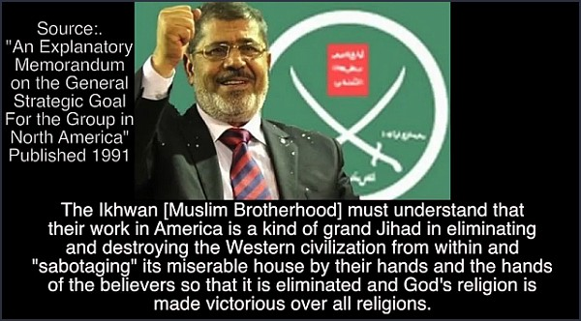

Slide 28
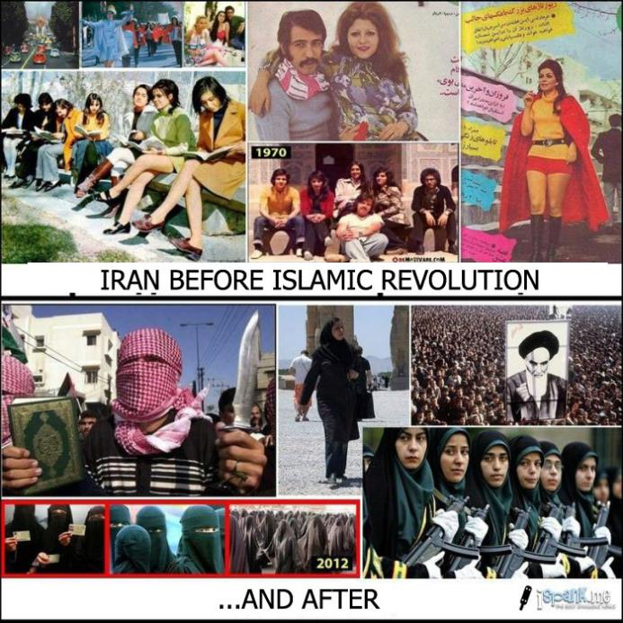

Slide 29
II. Terrorism’s True Causes
Depravity
Radical ideology
Notes:
Outline

Slide 30
Overview
Terrorism’s false causes
Terrorism’s true causes
Ineffective deterrents of terrorism
Effective deterrents to terrorism
Going too far in deterring terrorism
Legitimate methods in deterring terrorism
Notes:
Outline

Slide 31
III. Terrorism’s Ineffective Deterrents
Military reduction
Appeasement
Dialogue
Treaties
Subsidies
Apology tours
Notes:
Outline

Slide 32
III. Terrorism’s Ineffective Deterrents
Military reduction
Appeasement
Dialogue
Treaties
Subsidies
Apology tours
Notes:
Outline

Slide 33
III. Terrorism’s Ineffective Deterrents
Military reduction
Appeasement
Dialogue
Treaties
Subsidies
Apology tours
Notes:
Outline

Slide 34
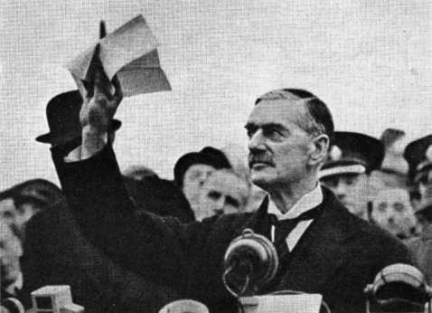

Slide 35
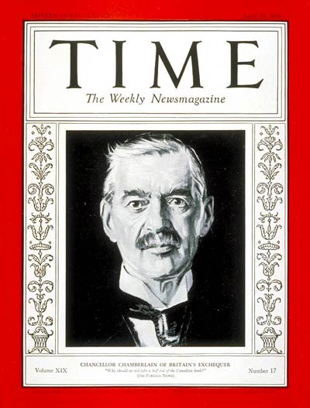

Slide 36
III. Terrorism’s Ineffective Deterrents
Military reduction
Appeasement
Dialogue
Treaties
Subsidies
Apology tours
Notes:
Outline

Slide 37
“How dreadful are the curses which Mohammedanism lays on its votaries! Besides the fanatical frenzy, which is as dangerous in a man as hydrophobia in a dog, there is this fearful fatalistic apathy. The effects are apparent in many countries. Improvident habits, slovenly systems of agriculture, sluggish methods of commerce, and insecurity of property exist wherever the followers of the Prophet rule or live. A degraded sensualism deprives this life of its grace and refinement; the next of its dignity and sanctity. The fact that in Mohammedanism law every woman must belong to some man as his absolute property–either as a child, a wife, or a concubine — must delay the final extinction of slavery until the faith of Islam has ceased to be a great power among men..”
Winston Spencer Churchill, The River War: The Historical Account of the Reconquest of the Soudan (1899), pp. 248-49.

Slide 38
III. Terrorism’s Ineffective Deterrents
Military reduction
Appeasement
Dialogue
Treaties
Subsidies
Apology tours
Notes:
Outline

Slide 39
III. Terrorism’s Ineffective Deterrents
Military reduction
Appeasement
Dialogue
Treaties
Subsidies
Apology tours
Notes:
Outline

Slide 40
III. Terrorism’s Ineffective Deterrents
Military reduction
Appeasement
Dialogue
Treaties
Subsidies
Apology tours
Notes:
Outline

Slide 41
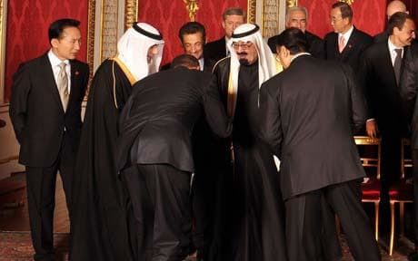

Slide 42
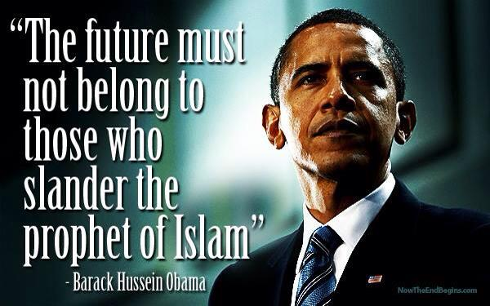

Slide 43
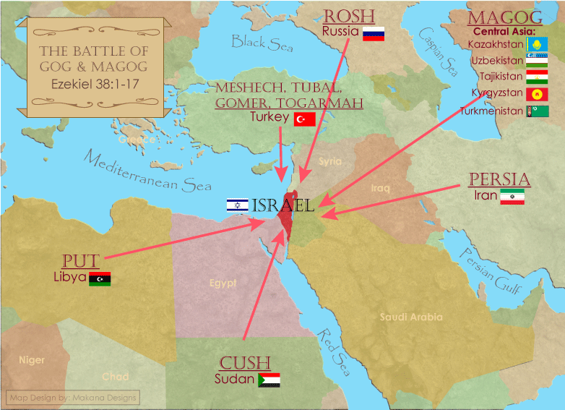

Slide 44
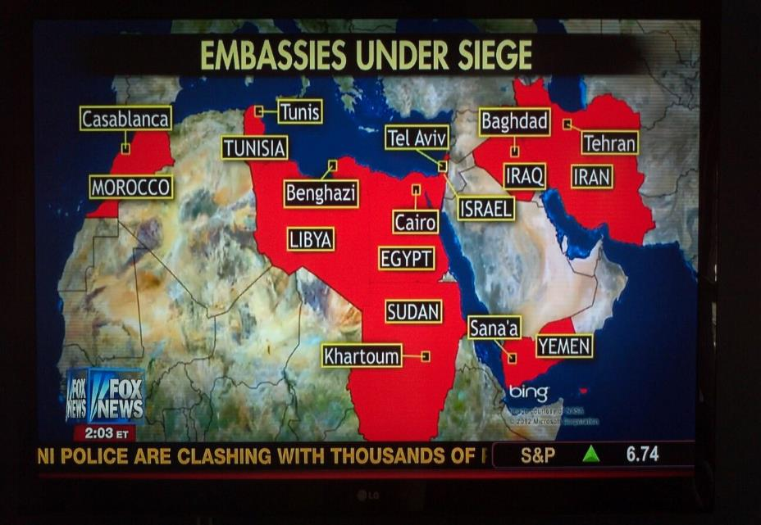

Slide 45
Ecclesiastes 8:11
“Because the sentence against an evil deed is not executed quickly, therefore the hearts of the sons of men among them are given fully to do evil.”

Slide 46
Overview
Terrorism’s false causes
Terrorism’s true causes
Ineffective deterrents of terrorism
Effective deterrents to terrorism
Going too far in deterring terrorism
Legitimate methods in deterring terrorism
Notes:
Outline

Slide 47
Robert Charles Winthrop
“All societies of men must be governed in some way or other. The less they may have of stringent State Government, the more they must have of individual self-government. The less they rely on public law or physical force, the more they must rely on private moral restraint. Men, in a word, must necessarily be controlled, either by a power within them, or by a power without them; either by the Word of God, or by the strong arm of man; either by the Bible, or by the bayonet. It may do for other countries and other governments to talk about the State supporting religion. Here, under our own free institutions, it is Religion which must support the State.”
Robert Winthrop, Addresses and Speeches on Various Occasions (Boston, MA: Little, Brown, 1852), 172. Speech to the Massachusetts Bible Society (1849-05-28).

Slide 48
Genesis 9:6
“Whoever sheds man’s blood, By man his blood shall be shed, For in the image of God He made man.”

Slide 49
Noahic vs. Abrahamic & Mosaic Covenants
Name | Noahic Covenant | Abrahamic Covenant | Mosaic Covenant
Human agent | Noah | Abraham | Moses
Scripture | Gen. 8‒9 | Gen. 12‒17 | Exod. 19‒40
Covenant (Berith) | Gen. 9:9 | Gen. 15:18 | Exod. 19:5
Party | World, humanity | Israel, Hebrews | Israel, Hebrews
Israel | Pre-Israel | Post-Israel | Post-Israel

Slide 50
Noahic vs. Abrahamic & Mosaic Covenants
 | Noahic Covenant | Abrahamic Covenant | Mosaic Covenant
Conditional or unconditional | Unconditional | Unconditional | Conditional
Promises | No more flood judgment, enduring earth, capital punishment | Ownership of land, seed, and blessing | Enjoyment or possession of land, seed, and blessing
Sign | Rainbow | Circumcision | Sabbath
Purpose | Restrain & preserve | Redemptive | Redemptive
Directly binding today? | Yes | No | No

Slide 51
Romans 13:3-5
“For rulers are not a cause of fear for good behavior, but for evil. Do you want to have no fear of authority? Do what is good and you will have praise from the same; for it is a minister of God to you for good. But if you do what is evil, be afraid; for it does not bear the sword for nothing; for it is a minister of God, an avenger who brings wrath on the one who practices evil.”

Slide 52
1 Peter 2:13-14
“Submit yourselves for the Lord’s sake to every human institution, whether to a king as the one in authority, or to governors as sent by him for the punishment of evildoers and the praise of those who do right.”

Slide 53
Deuteronomy 13:10-11
“So you shall stone him to death because he has sought to seduce you from the Lord your God who brought you out from the land of Egypt, out of the house of slavery. Then all Israel will hear and be afraid, and will never again do such a wicked thing among you.”

Slide 54
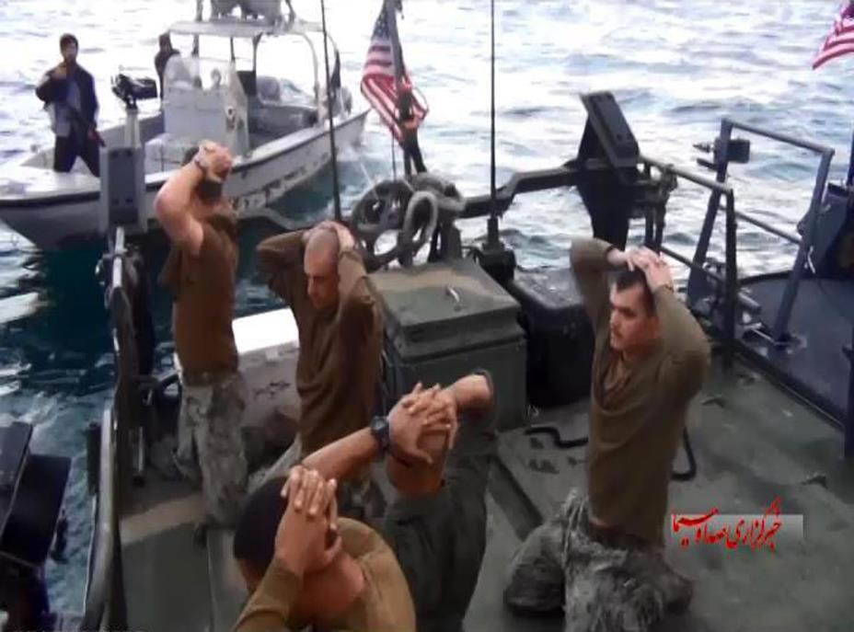

Slide 55
Answering Pacifism’s Arguments
Violence begets violence?
Trust God?
World court resolution?
Love your neighbor (Matt. 22:39)
Turn the other cheek (Matt. 5:39)
Thou shalt not kill? (Exod. 20:13)
Wayne Grudem, Politics According to the Bible, 390-94
Notes:
Outline

Slide 56
Overview
Terrorism’s false causes
Terrorism’s true causes
Ineffective deterrents of terrorism
Effective deterrents to terrorism
Going too far in deterring terrorism
Legitimate methods in deterring terrorism
Notes:
Outline

Slide 57
V. Going Too Far in Deterring Terrorism? Just War Principles
Just cause
Competent authority
Comparative justice
Right intention
Last resort
Probability of success (Luke 14:31)
Proportionality of projected results
Right spirit
“War” in ESV Study Bible, 255
Notes:
Outline

Slide 58
V. Going Too Far in Deterring Terrorism? How to Fight a Just War
Proportionality in the use of force (Deut. 20:10-12)
Discrimination between combatants & non-combatants (Deut. 20:13-14)
Avoidance of evil means
Good faith
“War” in ESV Study Bible, 255
Notes:
Outline

Slide 59
Overview
Terrorism’s false causes
Terrorism’s true causes
Ineffective deterrents of terrorism
Effective deterrents to terrorism
Going too far in deterring terrorism
Legitimate methods in deterring terrorism
Notes:
Outline

Slide 60
VI. What Legitimate Methods Can the Government Employ in Deterring Terrorism?
Proper label
Deterrence
Missile defense
Pre-emption
Invading other nations
Holding nations accountable harboring terrorists
Spying
Enhanced interrogations
Notes:
Outline

Slide 61
VI. What Legitimate Methods Can the Government Employ in Deterring Terrorism?
Proper label
Deterrence
Missile defense
Pre-emption
Invading other nations
Holding nations accountable harboring terrorists
Spying
Enhanced interrogations
Notes:
Outline

Slide 62
VI. What Legitimate Methods Can the Government Employ in Deterring Terrorism?
Proper label
Deterrence
Missile defense
Pre-emption
Invading other nations
Holding nations accountable harboring terrorists
Spying
Enhanced interrogations
Notes:
Outline

Slide 63
VI. What Legitimate Methods Can the Government Employ in Deterring Terrorism?
Proper label
Deterrence
Missile defense
Pre-emption
Invading other nations
Holding nations accountable harboring terrorists
Spying
Enhanced interrogations
Notes:
Outline

Slide 64
VI. What Legitimate Methods Can the Government Employ in Deterring Terrorism?
Proper label
Deterrence
Missile defense
Pre-emption
Invading other nations
Holding nations accountable harboring terrorists
Spying
Enhanced interrogations
Notes:
Outline

Slide 65
VI. What Legitimate Methods Can the Government Employ in Deterring Terrorism?
Proper label
Deterrence
Missile defense
Pre-emption
Invading other nations
Holding nations accountable harboring terrorists
Spying
Enhanced interrogations
Notes:
Outline

Slide 66
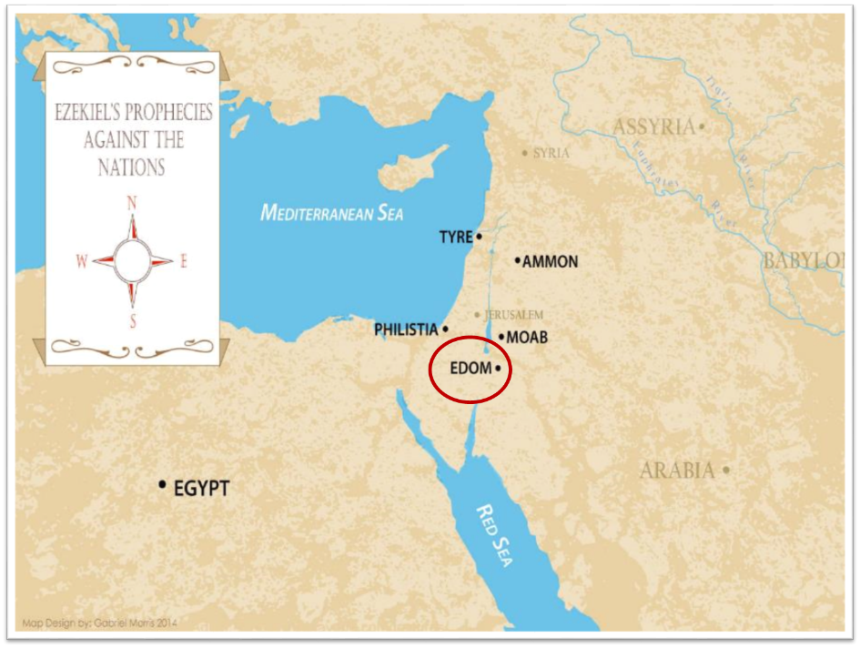

Slide 67
Obadiah 11
“On the day that you stood aloof, On the day that strangers carried off his wealth, And foreigners entered his gate And cast lots for Jerusalem—You too were as one of them.”

Slide 68
VI. What Legitimate Methods Can the Government Employ in Deterring Terrorism?
Proper label
Deterrence
Missile defense
Pre-emption
Invading other nations
Holding nations accountable harboring terrorists
Spying
Enhanced interrogations
Notes:
Outline

Slide 69
VI. What Legitimate Methods Can the Government Employ in Deterring Terrorism?
Proper label
Deterrence
Missile defense
Pre-emption
Invading other nations
Holding nations accountable harboring terrorists
Spying
Enhanced interrogations
Notes:
Outline

Slide 70
VI. What Legitimate Methods Can the Government Employ in Deterring Terrorism?
Proper label
Deterrence
Missile defense
Pre-emption
Invading other nations
Holding nations accountable harboring terrorists
Spying
Enhanced interrogations
Notes:
Outline

Slide 71
Enhanced Interrogation Limitations
Immorality
Denial of medical treatment
Sadistic humiliation
Violation of religious convictions
Causing lasting physical damage
Wayne Grudem, Politics According to the Bible, 429
Notes:
Outline

Slide 72
Conclusion

Slide 73
Review
Terrorism’s false causes
Terrorism’s true causes
Ineffective deterrents of terrorism
Effective deterrents to terrorism
Going too far in deterring terrorism
Legitimate methods in deterring terrorism
Notes:
Outline

