Slide 1
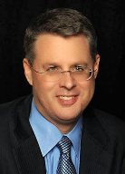
Soteriology Session 36
Dr. Andy Woods
Senior Pastor – Sugar Land Bible Church
Professor of Bible & Theology – College of Biblical Studies

Slide 2
Soteriology Overview
Definition
Election
Atonement
Salvation words
God’s one condition of salvation
Results of salvation
Eternal security
Faulty views of salvation

Slide 3
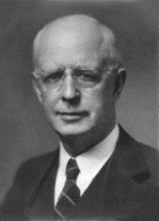
Soteriology Overview
This Session
VII. Eternal Security

Slide 4
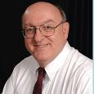
Definition of Eternal Security
“Eternal Security means that those who have been genuinely saved by God’s grace through faith alone in Christ alone shall never be in danger of God’s condemnation or loss of salvation but God’s grace and power keep them forever saved and secure.”
Dennis Rokser, Shall Never Perish Forever, p. 11

Slide 5
Eternal Security Outline
Eternal security arguments
Response to problem passages

Slide 6
Eternal Security Outline
Eternal security arguments
Response to problem passages

Slide 7
Eternal Security Outline
Eternal security arguments
Response to problem passages

Slide 8
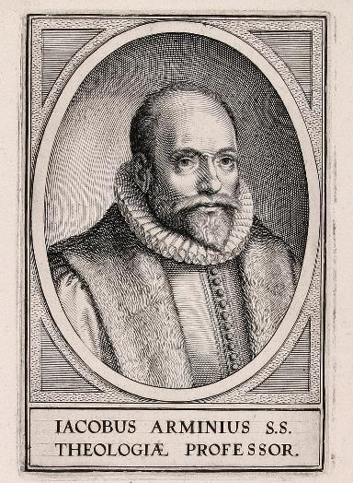
Response to Problem Passages
OT Passages
Passages from Matthew
Passages from John
Passages from Acts
Passages from Paul

Slide 9
Response to Problem Passages
Passages from James
Passages from Hebrews
Passages from 2 Peter
Passages from 1 John
Passages from Revelation
Miscellaneous argument

Slide 10
Response to Problem Passages
OT Passages
Passages from Matthew
Passages from John
Passages from Acts
Passages from Paul

Slide 11
Response to Problem Passages
OT Passages
Passages from Matthew
Passages from John
Passages from Acts
Passages from Paul

Slide 12
Response to Problem Passages
OT Passages
Passages from Matthew
Passages from John
Passages from Acts
Passages from Paul

Slide 13
Response to Problem Passages
OT Passages
Passages from Matthew
Passages from John
Passages from Acts
Passages from Paul

Slide 14
Response to Problem Passages
OT Passages
Passages from Matthew
Passages from John
Passages from Acts
Passages from Paul

Slide 15
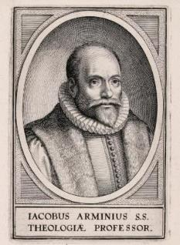
5. Passages From Paul
Gal. 5:4
Gal. 5:19-21
Rom. 8:13
1 Cor. 8:11
1 Cor. 9:24-27
1 Cor. 11:28-30, 32
1 Cor. 15:2
2 Cor. 13:5
Philip. 2:12
Col. 1:23
1 Tim. 5:15
2 Tim. 2:12
2 Tim. 4:10

Slide 16
5. Passages From Paul
Gal. 5:4
Gal. 5:19-21
Rom. 8:13
1 Cor. 8:11
1 Cor. 9:24-27
1 Cor. 11:28-30, 32
1 Cor. 15:2
2 Cor. 13:5
Philip. 2:12
Col. 1:23
1 Tim. 5:15
2 Tim. 2:12
2 Tim. 4:10

Slide 17
5. Passages From Paul
Gal. 5:4
Gal. 5:19-21
Rom. 8:13
1 Cor. 8:11
1 Cor. 9:24-27
1 Cor. 11:28-30, 32
1 Cor. 15:2
2 Cor. 13:5
Philip. 2:12
Col. 1:23
1 Tim. 5:15
2 Tim. 2:12
2 Tim. 4:10

Slide 18
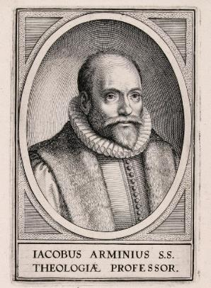
Household Codes
Galatians 5:19-21
1 Corinthians 6:9-11
Ephesians 5:5
Revelation 22:14-15

Slide 19
5. Passages From Paul
Gal. 5:4
Gal. 5:19-21
Rom. 8:13
1 Cor. 8:11
1 Cor. 9:24-27
1 Cor. 11:28-30, 32
1 Cor. 15:2
2 Cor. 13:5
Philip. 2:12
Col. 1:23
1 Tim. 5:15
2 Tim. 2:12
2 Tim. 4:10

Slide 20
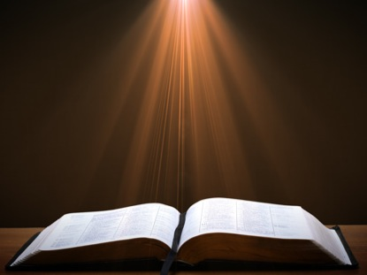
Romans 8:13 (NASB)
“for if you are living according to the flesh, you must die; but if by the Spirit you are putting to death the deeds of the body, you will live.” (NASB)

Slide 21
Romans 8:38-39 (NASB)
“For I am convinced that neither death, nor life, nor angels, nor principalities, nor things present, nor things to come, nor powers, 39 nor height, nor depth, nor any other created thing, will be able to separate us from the love of God, which is in Christ Jesus our Lord.”

Slide 22
5. Passages From Paul
Gal. 5:4
Gal. 5:19-21
Rom. 8:13
1 Cor. 8:11
1 Cor. 9:24-27
1 Cor. 11:28-30, 32
1 Cor. 15:2
2 Cor. 13:5
Philip. 2:12
Col. 1:23
1 Tim. 5:15
2 Tim. 2:12
2 Tim. 4:10

Slide 23
1 Corinthians 8:11 (KJV)
“And through thy knowledge shall the weak brother perish, for whom Christ died?”

Slide 24
John 3:16 (NASB)
“For God so loved the world, that He gave His only begotten Son, that whoever believes in Him shall not perish, but have eternal life.”

Slide 25
Definition of Perish?
“The weak Christian ‘perished’ in that he suffered spiritual loss, a sense of sin that affected his fellowship with God. This reckless use of liberty actually violates the purposes for which Christ died.”
Robert Gromacki, Called to be Saints: an Exposition of 1 Corinthians, p. 107

Slide 26
5. Passages From Paul
Gal. 5:4
Gal. 5:19-21
Rom. 8:13
1 Cor. 8:11
1 Cor. 9:24-27
1 Cor. 11:28-30, 32
1 Cor. 15:2
2 Cor. 13:5
Philip. 2:12
Col. 1:23
1 Tim. 5:15
2 Tim. 2:12
2 Tim. 4:10

Slide 27
1 Corinthians 9:24-27 (NASB)
“Do you not know that those who run in a race all run, but only one receives the prize? Run in such a way that you may win. ²⁵ Everyone who competes in the games exercises self-control in all things. They then do it to receive a perishable wreath, but we an imperishable. ²⁶ Therefore I run in such a way, as not without aim; I box in such a way, as not beating the air; ²⁷ but I discipline my body and make it my slave, so that, after I have preached to others, I myself will not be disqualified.”

Slide 28
Scripture’s Five Crowns (Rev 4:10: 3:11; 2 John 8)
Scripture | Crown | Purpose
1 Cor. 9:24-27 | Incorruptible | Gaining mastery over the flesh
1 Thess. 2:19-20 | Rejoicing | Soul winning
Jas. 1:12; Rev. 2:10 | Life | Enduring trials
1 Pet. 5:2-4 | Glory | Shepherding God’s people
2 Tim. 4:8 | Righteousness | Longing for His appearing

Slide 29
5. Passages From Paul
Gal. 5:4
Gal. 5:19-21
Rom. 8:13
1 Cor. 8:11
1 Cor. 9:24-27
1 Cor. 11:28-30, 32
1 Cor. 15:2
2 Cor. 13:5
Philip. 2:12
Col. 1:23
1 Tim. 5:15
2 Tim. 2:12
2 Tim. 4:10

Slide 30
1 Corinthians 11:28-30, 32 (KJV)
“But let a man examine himself, and so let him eat of that bread, and drink of that cup.²⁹ For he that eateth and drinketh unworthily, eateth and drinketh damnation to himself, not discerning the Lord's body.³⁰ For this cause many are weak and sickly among you, and many sleep.³¹ For if we would judge ourselves, we should not be judged.³² But when we are judged, we are chastened of the Lord, that we should not be condemned with the world.”

Slide 31
1 Corinthians 11:28-30, 32 (NASB)
“But a man must examine himself, and in so doing he is to eat of the bread and drink of the cup. ²⁹ For he who eats and drinks, eats and drinks judgment to himself if he does not judge the body rightly. ³⁰ For this reason many among you are weak and sick, and a number sleep. ³¹ But if we judged ourselves rightly, we would not be judged... ³² But when we are judged, we are disciplined by the Lord so that we will not be condemned along with the world.”

Slide 32
5. Passages From Paul
Gal. 5:4
Gal. 5:19-21
Rom. 8:13
1 Cor. 8:11
1 Cor. 9:24-27
1 Cor. 11:28-30, 32
1 Cor. 15:2
2 Cor. 13:5
Philip. 2:12
Col. 1:23
1 Tim. 5:15
2 Tim. 2:12
2 Tim. 4:10

Slide 33
1 Corinthians 15:2 (NASB)
“by which also you are saved, if you hold fast the word which I preached to you, unless you believed in vain.”

Slide 34
1 Corinthians 15:12 (NASB)
“Now if Christ is preached, that He has been raised from the dead, how do some among you say that there is no resurrection of the dead?”

Slide 35
Acts 17:32 (NASB)
“Now when they heard of the resurrection of the dead, some began to sneer, but others said, “We shall hear you again concerning this.”

Slide 36
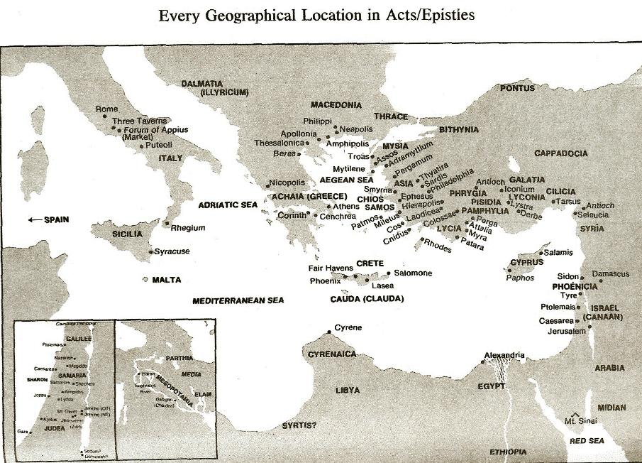

Slide 37
1 Corinthians 15:14 (NASB)
“and if Christ has not been raised, then our preaching is vain, your faith also is vain.”

Slide 38
CONCLUSION

Slide 39
5. Passages From Paul
Gal. 5:4
Gal. 5:19-21
Rom. 8:13
1 Cor. 8:11
1 Cor. 9:24-27
1 Cor. 11:28-30, 32
1 Cor. 15:2
2 Cor. 13:5
Philip. 2:12
Col. 1:23
1 Tim. 5:15
2 Tim. 2:12
2 Tim. 4:10

