Slide 1
THE BIBLE AND VOTING Part 16
Dr. Andy Woods

Slide 2
Introductory Remarks
A stewardship issue (1 Cor. 4:2)
A biblical issue (2 Tim. 3:16)
Biblical principles rather than partisanship

Slide 3
The Bible and Voting
Economic issues
Social issues
Foreign affairs

Slide 4
The Bible and Voting
Economic issues
Social issues
Foreign affairs

Slide 5
Economic Issues
Ownership of private property? (Deut. 19:15)
Pursuit of economic self interest? (Gen. 8:21)
Proper definition of compassion? (2 Thess. 3:10)
Who provides charity? (1 Tim. 5:3-8)
Family is the building block of society? (Deut. 6:6-7)
Wealth retained within the family? (Prov. 13:22)
The earth experiences cyclical patterns? (Gen. 8:22)
Environmental stewardship rather than earth worship? (Rom. 1:22-23)
Opposition to runaway debt? (Prov. 22:7)
Limitations upon the government? (Acts 5:29)

Slide 6
The Bible and Voting
Economic issues
Social issues
Foreign affairs

Slide 7
Social Issues
Legal protection for the unborn? (Gen. 25:23)
Legal protection for the elderly? (Lev. 19:32)
Hetero-sexual monogamous marriage as the standard for society? (Gen. 2:18-25)
Advocacy capital punishment? (Gen. 9:6)
The right to restrict alcohol, pornography, & gambling? (Lev. 10:9; Matt. 5:27-28; Prov. 13:11)
Parental authority over children? (Eph. 6:4)
Public expressions of Christianity? (Mark 16:15)
Right to keep and bear arms? (Luke 22:36)

Slide 8
The Bible and Voting
Economic issues
Social issues
Foreign affairs

Slide 9
Foreign Affairs
Favor national sovereignty above global governance? (Gen. 11:1-9)
Favor the reality and enforceability of our national borders? (Acts 17:26)
Support for the nation of Israel? (Gen. 12:3)
Pursuit of peace though strength? (Jer. 17:9)

Slide 10
Foreign Affairs
Favor national sovereignty above global governance? (Gen. 11:1-9)
Favor the reality and enforceability of our national borders? (Acts 17:26)
Support for the nation of Israel? (Gen. 12:3)
Pursuit of peace though strength? (Jer. 17:9)

Slide 11
Foreign Affairs
Favor national sovereignty above global governance? (Gen. 11:1-9)
Favor the reality and enforceability of our national borders? (Acts 17:26)
Support for the nation of Israel? (Gen. 12:3)
Pursuit of peace though strength? (Jer. 17:9)

Slide 12
Foreign Affairs
Favor national sovereignty above global governance? (Gen. 11:1-9)
Favor the reality and enforceability of our national borders? (Acts 17:26)
Support for the nation of Israel? (Gen. 12:3)
Pursuit of peace though strength? (Jer. 17:9)

Slide 13
Foreign Affairs
Favor national sovereignty above global governance? (Gen. 11:1-9)
Favor the reality and enforceability of our national borders? (Acts 17:26)
Support for the nation of Israel? (Gen. 12:3)
Pursuit of peace though strength? (Jer. 17:9)

Slide 14
Overview
Terrorism’s false causes
Terrorism’s true causes
Ineffective deterrents of terrorism
Effective deterrents to terrorism
Going too far in deterring terrorism
Legitimate methods in deterring terrorism
Notes:
Outline

Slide 15
Overview
Terrorism’s false causes
Terrorism’s true causes
Ineffective deterrents of terrorism
Effective deterrents to terrorism
Going too far in deterring terrorism
Legitimate methods in deterring terrorism
Notes:
Outline

Slide 16
I. Terrorism’s False Causes
Poverty
Lack of education
American imperialism
Notes:
Outline

Slide 17
Overview
Terrorism’s false causes
Terrorism’s true causes
Ineffective deterrents of terrorism
Effective deterrents to terrorism
Going too far in deterring terrorism
Legitimate methods in deterring terrorism
Notes:
Outline

Slide 18
II. Terrorism’s True Causes
Depravity (Mark 7:20-23)
Radical ideology
Notes:
Outline

Slide 19
Mark 7:20-23
“And He was saying, “That which proceeds out of the man, that is what defiles the man. ²¹ For from within, out of the heart of men, proceed the evil thoughts, fornications, thefts, murders, adulteries, ²² deeds of coveting and wickedness, as well as deceit, sensuality, envy, slander, pride and foolishness. ²³ All these evil things proceed from within and defile the man.”

Slide 20
Overview
Terrorism’s false causes
Terrorism’s true causes
Ineffective deterrents of terrorism
Effective deterrents to terrorism
Going too far in deterring terrorism
Legitimate methods in deterring terrorism
Notes:
Outline

Slide 21
III. Terrorism’s Ineffective Deterrents
Military reduction
Appeasement
Dialogue
Treaties
Subsidies
Apology tours
Notes:
Outline

Slide 22
Ecclesiastes 8:11
“Because the sentence against an evil deed is not executed quickly, therefore the hearts of the sons of men among them are given fully to do evil.”

Slide 23
Overview
Terrorism’s false causes
Terrorism’s true causes
Ineffective deterrents of terrorism
Effective deterrents to terrorism
Going too far in deterring terrorism
Legitimate methods in deterring terrorism
Notes:
Outline

Slide 24
Genesis 6:11
“Now the earth was corrupt in the sight of God, and the earth was filled with violence.”

Slide 25
Genesis 9:6
“Whoever sheds man’s blood, By man his blood shall be shed, For in the image of God He made man.”

Slide 26
Romans 13:3-5
“For rulers are not a cause of fear for good behavior, but for evil. Do you want to have no fear of authority? Do what is good and you will have praise from the same; for it is a minister of God to you for good. But if you do what is evil, be afraid; for it does not bear the sword for nothing; for it is a minister of God, an avenger who brings wrath on the one who practices evil.”

Slide 27
Deuteronomy 13:10-11
“So you shall stone him to death because he has sought to seduce you from the Lord your God who brought you out from the land of Egypt, out of the house of slavery. Then all Israel will hear and be afraid, and will never again do such a wicked thing among you.”

Slide 28
Overview
Terrorism’s false causes
Terrorism’s true causes
Ineffective deterrents of terrorism
Effective deterrents to terrorism
Going too far in deterring terrorism
Legitimate methods in deterring terrorism
Notes:
Outline

Slide 29
V. Going Too Far in Deterring Terrorism? Just War Principles
Just cause (Rev. 19:11)
Competent authority (Art. 1, sect. 8; Art II, sect. 2)
Comparative justice (Rom. 13:3)
Right intention (Prov. 21:2)
Last resort (Rom. 12:18)
Probability of success (Luke 14:31)
Proportionality of projected results (Rom. 12:21)
Right spirit (Ps. 68:30)
“War” in ESV Study Bible, 255
Notes:
Outline

Slide 30
V. Going Too Far in Deterring Terrorism? How to Fight a Just War
Proportionality in the use of force (Deut. 20:10-12)
Discrimination between combatants & non-combatants (Deut. 20:13-14)
Avoidance of evil means
Good faith (Ps. 34:14)
“War” in ESV Study Bible, 255
Notes:
Outline

Slide 31
Overview
Terrorism’s false causes
Terrorism’s true causes
Ineffective deterrents of terrorism
Effective deterrents to terrorism
Going too far in deterring terrorism
Legitimate methods in deterring terrorism
Notes:
Outline

Slide 32
VI. What Legitimate Methods Can the Government Employ in Deterring Terrorism?
Proper label
Deterrence (Deut. 13:10-11)
Missile defense
Pre-emption
Invading other nations (Obadiah 11)
Holding nations accountable harboring terrorists
Spying (Josh. 2:1)
Enhanced interrogations (Prov. 13:24)
Notes:
Outline

Slide 33
VI. What Legitimate Methods Can the Government Employ in Deterring Terrorism?
Proper label
Deterrence (Deut. 13:10-11)
Missile defense
Pre-emption
Invading other nations (Obadiah 11)
Holding nations accountable harboring terrorists
Spying (Josh. 2:1)
Enhanced interrogations (Prov. 13:24)
Notes:
Outline

Slide 34
VI. What Legitimate Methods Can the Government Employ in Deterring Terrorism?
Proper label
Deterrence (Deut. 13:10-11)
Missile defense
Pre-emption
Invading other nations (Obadiah 11)
Holding nations accountable harboring terrorists
Spying (Josh. 2:1)
Enhanced interrogations (Prov. 13:24)
Notes:
Outline

Slide 35
Deuteronomy 13:10-11
“So you shall stone him to death because he has sought to seduce you from the Lord your God who brought you out from the land of Egypt, out of the house of slavery. Then all Israel will hear and be afraid, and will never again do such a wicked thing among you.”

Slide 36
VI. What Legitimate Methods Can the Government Employ in Deterring Terrorism?
Proper label
Deterrence (Deut. 13:10-11)
Missile defense
Pre-emption
Invading other nations (Obadiah 11)
Holding nations accountable harboring terrorists
Spying (Josh. 2:1)
Enhanced interrogations (Prov. 13:24)
Notes:
Outline

Slide 37
VI. What Legitimate Methods Can the Government Employ in Deterring Terrorism?
Proper label
Deterrence (Deut. 13:10-11)
Missile defense
Pre-emption
Invading other nations (Obadiah 11)
Holding nations accountable harboring terrorists
Spying (Josh. 2:1)
Enhanced interrogations (Prov. 13:24)
Notes:
Outline

Slide 38
VI. What Legitimate Methods Can the Government Employ in Deterring Terrorism?
Proper label
Deterrence (Deut. 13:10-11)
Missile defense
Pre-emption
Invading other nations (Obadiah 11)
Holding nations accountable harboring terrorists
Spying (Josh. 2:1)
Enhanced interrogations (Prov. 13:24)
Notes:
Outline

Slide 39
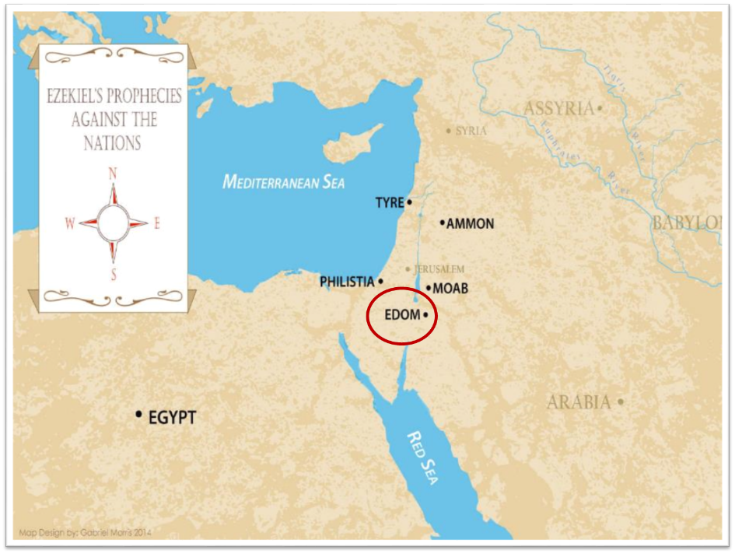

Slide 40
Obadiah 11
“On the day that you stood aloof, On the day that strangers carried off his wealth, And foreigners entered his gate And cast lots for Jerusalem—You too were as one of them.”

Slide 41
VI. What Legitimate Methods Can the Government Employ in Deterring Terrorism?
Proper label
Deterrence (Deut. 13:10-11)
Missile defense
Pre-emption
Invading other nations (Obadiah 11)
Holding nations accountable harboring terrorists
Spying (Josh. 2:1)
Enhanced interrogations (Prov. 13:24)
Notes:
Outline

Slide 42
VI. What Legitimate Methods Can the Government Employ in Deterring Terrorism?
Proper label
Deterrence (Deut. 13:10-11)
Missile defense
Pre-emption
Invading other nations (Obadiah 11)
Holding nations accountable harboring terrorists
Spying (Josh. 2:1)
Enhanced interrogations (Prov. 13:24)
Notes:
Outline

Slide 43
Spying in the Bible
Joshua spies out Canaan (Josh. 2:1)
David spies on the whereabouts of Saul (1 Sam. 26:4)
David sent Hashai to serve as an undercover agent when Absalom was about to capture Jerusalem (2 Sam. 15:32-37; 16:15-19; 17:5-22)

Slide 44
Romans 13:3-5
“For rulers are not a cause of fear for good behavior, but for evil. Do you want to have no fear of authority? Do what is good and you will have praise from the same; for it is a minister of God to you for good. But if you do what is evil, be afraid; for it does not bear the sword for nothing; for it is a minister of God, an avenger who brings wrath on the one who practices evil.”

Slide 45
1 Timothy 2:1-4
“First of all, then, I urge that entreaties and prayers, petitions and thanksgivings, be made on behalf of all men, ² for kings and all who are in authority, so that we may lead a tranquil and quiet life in all godliness and dignity. ³ This is good and acceptable in the sight of God our Savior, ⁴ who desires all men to be saved and to come to the knowledge of the truth.”

Slide 46
VI. What Legitimate Methods Can the Government Employ in Deterring Terrorism?
Proper label
Deterrence (Deut. 13:10-11)
Missile defense
Pre-emption
Invading other nations (Obadiah 11)
Holding nations accountable harboring terrorists
Spying (Josh. 2:1)
Enhanced interrogations (Prov. 13:24)
Notes:
Outline

Slide 47
Enhanced Interrogation Limitations
Immorality
Denial of medical treatment
Sadistic humiliation
Violation of religious convictions
Causing lasting physical damage
Wayne Grudem, Politics According to the Bible, 429
Notes:
Outline

Slide 48
Enhanced Interrogation Limitations
Immorality
Denial of medical treatment
Sadistic humiliation
Violation of religious convictions
Causing lasting physical damage
Wayne Grudem, Politics According to the Bible, 429
Notes:
Outline

Slide 49
Enhanced Interrogation Limitations
Immorality
Denial of medical treatment
Sadistic humiliation
Violation of religious convictions
Causing lasting physical damage
Wayne Grudem, Politics According to the Bible, 429
Notes:
Outline

Slide 50
Enhanced Interrogation Limitations
Immorality
Denial of medical treatment
Sadistic humiliation
Violation of religious convictions
Causing lasting physical damage
Wayne Grudem, Politics According to the Bible, 429
Notes:
Outline

Slide 51
Enhanced Interrogation Limitations
Immorality
Denial of medical treatment
Sadistic humiliation
Violation of religious convictions
Causing lasting physical damage
Wayne Grudem, Politics According to the Bible, 429
Notes:
Outline

Slide 52
Enhanced Interrogation Limitations
Immorality
Denial of medical treatment
Sadistic humiliation
Violation of religious convictions
Causing lasting physical damage
Wayne Grudem, Politics According to the Bible, 429
Notes:
Outline

Slide 53
Conclusion

Slide 54
Review
Terrorism’s false causes
Terrorism’s true causes
Ineffective deterrents of terrorism
Effective deterrents to terrorism
Going too far in deterring terrorism
Legitimate methods in deterring terrorism
Notes:
Outline

Slide 55
The Bible and Voting
Economic issues
Social issues
Foreign affairs

