Slide 1
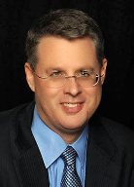
Soteriology Session 37
Dr. Andy Woods
Senior Pastor – Sugar Land Bible Church
Professor of Bible & Theology – College of Biblical Studies

Slide 2
Soteriology Overview
Definition
Election
Atonement
Salvation words
God’s one condition of salvation
Results of salvation
Eternal security
Faulty views of salvation

Slide 3
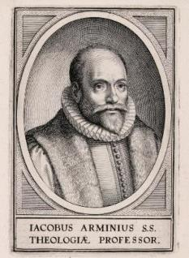
5. Passages From Paul
Gal. 5:4
Gal. 5:19-21
Rom. 8:13
1 Cor. 8:11
1 Cor. 9:24-27
1 Cor. 11:28-30, 32
1 Cor. 15:2
2 Cor. 13:5
Philip. 2:12
Col. 1:23
1 Tim. 5:15
2 Tim. 2:12
2 Tim. 4:10

Slide 4
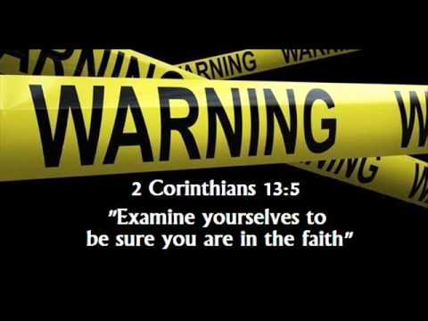
2 Corinthians 13:5 - Must We Examine Ourselves to See if We are Saved?

Slide 5
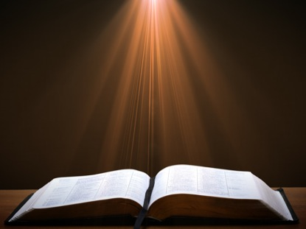
2 Cor. 13:5 (NASB)
“Test yourselves to see if you are in the faith; examine yourselves! Or do you not recognize this about yourselves, that Jesus Christ is in you—unless indeed you fail the test?”

Slide 6
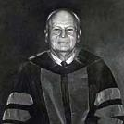
James Oliver Buswell, Jr.,
A Systematic Theology of the Christian Religion, 2 vols., vol. 2 (Grand Rapids: Zondervan, 1962), 147.
“But my point is that so long as a professing Christian is in the state of carnality, no pastor, no Christian friend, has the slightest ground for holding that this carnal person has ever been regenerated...it is a pastor’s duty to counsel such a person. “You do not give evidence of being in a regenerate state. You must remember Paul’s warning, ‘Examine yourselves whether you are in the faith; prove yourselves. Do you not know yourselves, that Jesus Christ is in you? You are not reprobate, are you?’ (2 Corinthians 13:5).”

Slide 7
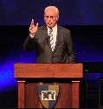
John F. MacArthur,
The Gospel According to Jesus: What Does Jesus Mean When He Says, "Follow Me"? (Grand Rapids: Zondervan, 1988), 190.
“Doubts about one’s salvation are not wrong...Scripture encourages self-examination...In 2 Corinthians 13:5, Paul wrote, ‘Test yourselves to see if you are in the faith; examine yourselves! Or do you not recognize this about yourselves, that Jesus Christ is in you—unless indeed you fail the test?’ That admonition is largely ignored—and often explained away—in the contemporary church.”

Slide 8
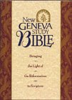
The New Geneva Study Bible:
Bringing the Light of the Reformation to Scripture
“Paul’s words help clarify the doctrine of assurance of faith. Paul asks the Corinthians to examine their own lives for evidence of salvation. Such evidence would include trust in Christ (Heb. 3:6), obedience to God (Matt. 7:21), growth in holiness (Heb. 12:14; 1 John 3:3), the fruit of the Spirit (Gal. 5:22, 23), love for other Christians (1 John 3:14), positive influence on others (Matt. 5:16), adhering to the apostolic teaching (1 John 4:2), and the testimony of the Holy Spirit within them (Rom. 8:15, 16).”
Luder Whitlock and Bruce Waltke R.C. Sproul, Moises Silva, et al, eds., The New Geneva Study Bible: Bringing the Light of the Reformation to Scripture (Nashville, TN: Thomas Nelson, 1995), 1844.

Slide 9
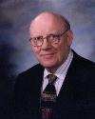
Warren W. Wiersbe
The Wiersbe Bible Commentary (Colorado Springs, CO: David Cook, 2007), 542.
“Paul told the Corinthians that they should examine their hearts to see if they were really born again and members of the family of God. Do you have the witness of the Holy Spirit in your heart? (Ro 8:9, 16) Do you love the brethren? (1Jn 3:14) Do you practice righteousness? (1John 2:29; 3:9) Have you overcome the world so that you are living a life of godly separation? (1John 5:4) These are just a few of the tests we can apply to our own lives to be certain that we are the children of God. In one of the churches I pastored, we had a teenager who was the center of every problem in the youth group…”

Slide 10
Warren W. Wiersbe
The Wiersbe Bible Commentary (Colorado Springs, CO: David Cook, 2007), 542.
“One summer when he went off to our church youth camp...At one of the meetings, he got up and announced that he had been saved that week! His Christian profession up to that time had been counterfeit. He experienced a dramatic change in his life, and today he is serving the Lord faithfully. No doubt many of the problems in the church at Corinth were caused by people who professed to be saved, but who had never repented and trusted Jesus Christ. Our churches are filled with such people today. Paul called such people reprobate, which means ‘counterfeit, discredited after a test.’”

Slide 11
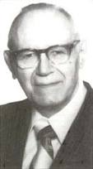
William Hendriksen
“Many trusted in his name; i.e., because of the manner in which his power was displayed they accepted him as a great prophet and perhaps even as the Messiah. This, however, is not the same as saying that they surrendered their hearts to him. Not all faith is saving faith...”
William Hendriksen, A Commentary on the Gospel of John, 3d ed. (London: Banner of Truth Trust, 1964), p. 127. (1978). Bibliotheca Sacra, 135. (1978). Bibliotheca Sacra, 135.

Slide 12
Three Tenses of Salvation
Phase | Justification | Sanctification | Glorification
Tense | Past | Present | Future
Saved from sin’s: | Penalty | Power | Presence
Scripture | Eph 2:8-9; Titus 3:5 | Philip 2:12 | Rom 5:10

Slide 13
Three Tenses of Salvation
Phase | Justification | Sanctification | Glorification
Tense | Past | Present | Future
Saved from sin’s: | Penalty | Power | Presence
Scripture | Eph 2:8-9; Titus 3:5 | Philip 2:12 | Rom 5:10

Slide 14
Three Tenses of Salvation
Phase | Justification | Sanctification | Glorification
Tense | Past | Present | Future
Saved from sin’s: | Penalty | Power | Presence
Scripture | Eph 2:8-9; Titus 3:5 | Philip 2:12 | Rom 5:10

Slide 15
9 Reasons Favoring the Progressive Sanctification View
The Corinthians' Assumed Believing Status
Proving Oneself Applies to the Believer
Disqualification Applies to the Believer
In the Faith Refers to Experience Rather than Position
Christ in You Relates to Progressive Sanctification

Slide 16
9 Reasons Favoring the Progressive Sanctification View
Reform View Destroys the Passage's Symmetry
Only Believers Experience Discipline
Scripture Nowhere Tells Believers to Test the Authenticity of Their Faith
The Reformed View Damages Assurance of Salvation

Slide 17
http://boldgrace.org/article/152/21-Tough-Questions-Pre-Order

Slide 18
9 Reasons Favoring the Progressive Sanctification View
The Corinthians' Assumed Believing Status
Proving Oneself Applies to the Believer
Disqualification Applies to the Believer
In the Faith Refers to Experience Rather than Position
Christ in You Relates to Progressive Sanctification

Slide 19
1 Corinthians 1:2.
“To the church of God that is in Corinth, to those sanctified in Christ Jesus, called to be saints together with all those who in every place call upon the name of our Lord Jesus Christ, both their Lord and ours.”

Slide 20
2 Corinthians 1:1.
"To the church of God that is at Corinth, with all the saints who are in the whole of Achaia."

Slide 21
The Corinthians' Assumed Believing Status
1 Corinthians 1:2; 3:1, 5, 6:11, 19-20
2 Corinthians 1:1, 21-22, 24; 3:2-3; 6:14-16; 8:9; 10:15

Slide 22
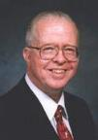
Zane C. Hodges
Absolutely Free! A Biblical Reply to Lordship Salvation (Grand Rapids: Zondervan, 1989), 200.
“Regrettably...these forceful words have been sadly misconstrued. They have been read by some interpreters as though they were a challenge to the Corinthians to find out whether they were really saved or not! This is unthinkable. After twelve chapters in which Paul takes their Christianity for granted, can he only now be asking them to make sure they are born again?...Let the readers of this book examine 2 Corinthians on their own. They will see clearly how often the apostle affirms in one way or another his conviction that his readers are genuinely Christian.”

Slide 23
9 Reasons Favoring the Progressive Sanctification View
The Corinthians' Assumed Believing Status
Proving Oneself Applies to the Believer
Disqualification Applies to the Believer
In the Faith Refers to Experience Rather than Position
Christ in You Relates to Progressive Sanctification

Slide 24
2 Corinthians 13:5 (NASB)
“Test yourselves to see if you are in the faith; examine yourselves! Or do you not recognize this about yourselves, that Jesus Christ is in you—unless indeed you fail the test?”

Slide 25
2 Timothy 2:15 (NASB)
"Be diligent to present yourself approved to God as a workman who does not need to be ashamed, accurately handling the word of truth."

Slide 26
9 Reasons Favoring the Progressive Sanctification View
The Corinthians' Assumed Believing Status
Proving Oneself Applies to the Believer
Disqualification Applies to the Believer
In the Faith Refers to Experience Rather than Position
Christ in You Relates to Progressive Sanctification

Slide 27
2 Corinthians 13:5 (NASB)
“Test yourselves to see if you are in the faith; examine yourselves! Or do you not recognize this about yourselves, that Jesus Christ is in you—unless indeed you fail the test?”

Slide 28
1 Corinthians 9:27 (NASB)
“but I discipline my body and make it my slave, so that, after I have preached to others, I myself will not be disqualified.”

Slide 29
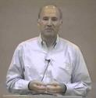
Joseph Dillow
Final Destiny: The Future Reign of the Servant Kings (Monument, CO: Panyim, 2012), 449.
if adokimos or disqualified here means that "...the apostle Paul was not certain that he would go to heaven...one wonders...how any Christian in the history of the church could ever know for certain that God was his Father!"

Slide 30
Scripture’s Five Crowns (Rev 4:10: 3:11; 2 John 8)
Scripture | Crown | Purpose
1 Cor. 9:24-27 | Incorruptible | Gaining mastery over the flesh
1 Thess. 2:19-20 | Rejoicing | Soul winning
Jas. 1:12; Rev. 2:10 | Life | Enduring trials
1 Pet. 5:2-4 | Glory | Shepherding God’s people
2 Tim. 4:8 | Righteousness | Longing for His appearing

Slide 31
Scripture’s Five Crowns (Rev 4:10: 3:11; 2 John 8)
Scripture | Crown | Purpose
1 Cor. 9:24-27 | Incorruptible | Gaining mastery over the flesh
1 Thess. 2:19-20 | Rejoicing | Soul winning
Jas. 1:12; Rev. 2:10 | Life | Enduring trials
1 Pet. 5:2-4 | Glory | Shepherding God’s people
2 Tim. 4:8 | Righteousness | Longing for His appearing

Slide 32
9 Reasons Favoring the Progressive Sanctification View
The Corinthians' Assumed Believing Status
Proving Oneself Applies to the Believer
Disqualification Applies to the Believer
In the Faith Refers to Experience Rather than Position
Christ in You Relates to Progressive Sanctification

Slide 33
2 Corinthians 13:5 (NASB)
“Test yourselves to see if you are in the faith; examine yourselves! Or do you not recognize this about yourselves, that Jesus Christ is in you—unless indeed you fail the test?”

Slide 34
1 Corinthians 16:13-15 (NASB)
“Be on the alert, stand firm in the faith, act like men, be strong. Let all that you do be done in love. Now I urge you, brethren…”

Slide 35
9 Reasons Favoring the Progressive Sanctification View
The Corinthians' Assumed Believing Status
Proving Oneself Applies to the Believer
Disqualification Applies to the Believer
In the Faith Refers to Experience Rather than Position
Christ in You Relates to Progressive Sanctification

Slide 36
2 Corinthians 13:5 (NASB)
“Test yourselves to see if you are in the faith; examine yourselves! Or do you not recognize this about yourselves, that Jesus Christ is in you—unless indeed you fail the test?”

Slide 37
Galatians 4:19 (NASB)
"My children, with whom I am again in labor until Christ is formed in you—"

Slide 38
Galatians 3:3 (NASB)
“Are you so foolish? Having begun by the Spirit, are you now being perfected by the flesh?”

Slide 39
Galatians 4:6 (NASB)
“Because you are sons, God has sent forth the Spirit of His Son into our hearts, crying, “Abba! Father!”

Slide 40
Galatians 5:16 (NASB)
“But I say, walk by the Spirit, and you will not carry out the desire of the flesh.”

Slide 41
John 15:4 (NASB)
"Abide in Me, and I in you. As the branch cannot bear fruit of itself unless it abides in the vine, so neither can you unless you abide in Me."

Slide 42
John 8:31 (NASB)
“So Jesus was saying to those Jews who had believed Him, “If you continue in My word, then you are truly disciples of Mine."

Slide 43
9 Reasons Favoring the Progressive Sanctification View
Reform View Destroys the Passage's Symmetry
Only Believers Experience Discipline
Scripture Nowhere Tells Believers to Test the Authenticity of Their Faith
The Reformed View Damages Assurance of Salvation

Slide 44
2 Cor. 13:3 (NASB)
“Since you are seeking for proof of the Christ who speaks in me, and who is not weak toward you, but mighty in you.”

Slide 45
2 Cor. 13:6-7 (NASB)
“⁶ But I trust that you will realize that we ourselves do not fail the test. ⁷ Now we pray to God that you do no wrong; not that we ourselves may appear approved, but that you may do what is right, even though we may appear unapproved.”

Slide 46
2 Corinthians 13:5 (NASB)
“Test yourselves to see if you are in the faith; examine yourselves! Or do you not recognize this about yourselves, that Jesus Christ is in you—unless indeed you fail the test?”

Slide 47
9 Reasons Favoring the Progressive Sanctification View
Reform View Destroys the Passage's Symmetry
Only Believers Experience Discipline
Scripture Nowhere Tells Believers to Test the Authenticity of Their Faith
The Reformed View Damages Assurance of Salvation

Slide 48
2 Cor. 13:1 (NASB)
“This is the third time I am coming to you. Every fact is to be confirmed by the testimony of two or three witnesses.”

Slide 49
Matt. 18:15-17 (NASB)
¹⁵ “If your brother sins, go and show him his fault in private; if he listens to you, you have won your brother. ¹⁶ But if he does not listen to you, take one or two more with you, so that by the mouth of two or three witnesses every fact may be confirmed. ¹⁷ If he refuses to listen to them, tell it to the church; and if he refuses to listen even to the church, let him be to you as a Gentile and a tax collector.”

Slide 50
9 Reasons Favoring the Progressive Sanctification View
Reform View Destroys the Passage's Symmetry
Only Believers Experience Discipline
Scripture Nowhere Tells Believers to Test the Authenticity of Their Faith
The Reformed View Damages Assurance of Salvation

Slide 51
Matt. 7:15-20 (NASB)
¹⁵ “Beware of the false prophets, who come to you in sheep’s clothing, but inwardly are ravenous wolves. ¹⁶ You will know them by their fruits. Grapes are not gathered from thorn bushes nor figs from thistles, are they? ¹⁷ So every good tree bears good fruit, but the bad tree bears bad fruit. ¹⁸ A good tree cannot produce bad fruit, nor can a bad tree produce good fruit. ¹⁹ Every tree that does not bear good fruit is cut down and thrown into the fire. ²⁰ So then, you will know them by their fruits.

Slide 52
Joseph Dillow
Final Destiny: The Future Reign of the Servant Kings (Monument, CO: Panyim, 2012), 454.
“Nowhere in the Bible is a Christian asked to examine either his faith or his life to find out if he is a Christian. He is told only to look outside of himself to Christ alone for his assurance that he is a Christian. The Christian is, however, often told to examine his walk of faith and life to see if he is walking in fellowship and in conformity to God's commands.”

Slide 53
1 John 4:1-3 (NASB)
“¹ Beloved, do not believe every spirit, but test the spirits to see whether they are from God, because many false prophets have gone out into the world. ² By this you know the Spirit of God: every spirit that confesses that Jesus Christ has come in the flesh is from God; ³ and every spirit that does not confess Jesus is not from God; this is the spirit of the antichrist, of which you have heard that it is coming, and now it is already in the world.”

Slide 54
Revelation 2:2 (NASB)
“² I know your deeds and your toil and perseverance, and that you cannot tolerate evil men, and you put to the test those who call themselves apostles, and they are not, and you found them to be false.”

Slide 55
9 Reasons Favoring the Progressive Sanctification View
Reform View Destroys the Passage's Symmetry
Only Believers Experience Discipline
Scripture Nowhere Tells Believers to Test the Authenticity of Their Faith
The Reformed View Damages Assurance of Salvation

Slide 56
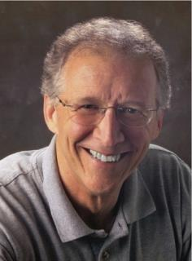
John Piper
“No Christian can be sure that he is a true believer. Hence, there is an ongoing need to be dedicated to the Lord and to deny ourselves so that we might make it.”
John Piper and Pastoral Staff, TULIP: What We Believe about the Five Points of Calvinism: Position Paper of the Pastoral Staff (Desiring God Ministries, 1997), 25, cited in Dave Hunt, What Love is This?, 379.

Slide 57
John 5:24 (NASB)
“Truly, truly, I say to you, he who hears My word, and believes Him who sent Me, has eternal life, and does not come into judgment, but has passed out of death into life.”

Slide 58
DTS Doctrinal Statement Article XI—Assurance
“We believe it is the privilege, not only of some, but of all by the Spirit through faith who are born again in Christ as revealed in the Scriptures, to be assured of their salvation from the very day they take Him to be their Savior and that this assurance is not founded upon any fancied discovery of their own worthiness or fitness, but wholly upon the testimony of God in His written Word, exciting within His children filial love...”

Slide 59
Conclusion

Slide 60
9 Reasons Favoring the Progressive Sanctification View
The Corinthians' Assumed Believing Status
Proving Oneself Applies to the Believer
Disqualification Applies to the Believer
In the Faith Refers to Experience Rather than Position
Christ in You Relates to Progressive Sanctification

Slide 61
9 Reasons Favoring the Progressive Sanctification View
Reform View Destroys the Passage's Symmetry
Only Believers Experience Discipline
Scripture Nowhere Tells Believers to Test the Authenticity of Their Faith
The Reformed View Damages Assurance of Salvation

Slide 62
Three Tenses of Salvation
Phase | Justification | Sanctification | Glorification
Tense | Past | Present | Future
Saved from sin’s: | Penalty | Power | Presence
Scripture | Eph 2:8-9; Titus 3:5 | Philip 2:12 | Rom 5:10

