Slide 1
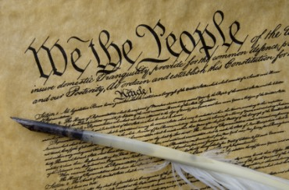
THE BIBLE AND VOTING
Part 9
Dr. Andy Woods

Slide 2

Introductory Remarks
A stewardship issue (1 Cor. 4:2)
A biblical issue (2 Tim. 3:16)
Biblical principles rather than partisanship

Slide 3
The Bible and Voting
Economic issues
Social issues
Foreign affairs

Slide 4
The Bible and Voting
Economic issues
Social issues
Foreign affairs

Slide 5
Economic Issues
Ownership of private property? (Deut. 19:15)
Pursuit of economic self interest? (Gen. 8:21)
Proper definition of compassion? (2 Thess. 3:10)
Who provides charity? (1 Tim. 5:3-8)
Family is the building block of society? (Deut. 6:6-7)
Wealth retained within the family? (Prov. 13:22)
The earth experiences cyclical patterns? (Gen. 8:22)
Environmental stewardship rather than earth worship? (Rom. 1:22-23)
Opposition to runaway debt? (Prov. 22:7)
Limitations upon the government? (Acts 5:29)

Slide 6
The Bible and Voting
Economic issues
Social issues
Foreign affairs

Slide 7
Social Issues
Legal protection for the unborn? (Gen. 25:23)
Legal protection for the elderly? (Lev. 19:32)
Hetero-sexual monogamous marriage as the standard for society? (Gen. 2:18-25)
Advocacy capital punishment? (Gen. 9:6)
The right to restrict alcohol, pornography, & gambling? (Lev. 10:9; Matt. 5:27-28; Prov. 13:11)
Parental authority over children? (Eph. 6:4)
Public expressions of Christianity? (Mark 16:15)
Right to keep and bear arms? (Luke 22:36)

Slide 8
The Bible and Voting
Economic issues
Social issues
Foreign affairs

Slide 9
Foreign Affairs
Favor national sovereignty above global governance? (Gen. 11:1-9)
Favor the reality and enforceability of our national borders? (Acts 17:26)
Support for the nation of Israel? (Gen. 12:3)
Pursuit of peace though strength? (Jer. 17:9)

Slide 10
Foreign Affairs
Favor national sovereignty above global governance? (Gen. 11:1-9)
Favor the reality and enforceability of our national borders? (Acts 17:26)
Support for the nation of Israel? (Gen. 12:3)
Pursuit of peace though strength? (Jer. 17:9)

Slide 11
Foreign Affairs
Favor national sovereignty above global governance? (Gen. 11:1-9)
Favor the reality and enforceability of our national borders? (Acts 17:26)
Support for the nation of Israel? (Gen. 12:3)
Pursuit of peace though strength? (Jer. 17:9)

Slide 12
Foreign Affairs
Favor national sovereignty above global governance? (Gen. 11:1-9)
Favor the reality and enforceability of our national borders? (Acts 17:26)
Support for the nation of Israel? (Gen. 12:3)
Pursuit of peace though strength? (Jer. 17:9)

Slide 13
Overview
The Divine Purpose for Israel
The Divine Protection of Israel
The Power of Your Voice Concerning Israel
Notes:
Outline

Slide 14
Overview
The Divine Purpose for Israel
The Divine Protection of Israel
The Power of Your Voice Concerning Israel
Notes:
Outline

Slide 15

Genesis 11:1-4
¹ Now the whole earth used the same language and the same words. ² It came about as they journeyed east, that they found a plain in the land of Shinar and settled there. ³ They said to one another, “Come, let us make bricks and burn them thoroughly.” And they used brick for stone, and they used tar for mortar. ⁴ They said, “Come, let us build for ourselves a city, and a tower whose top will reach into heaven, and let us make for ourselves a name, otherwise we will be scattered abroad over the face of the whole earth.”

Slide 16
Genesis 11:5-7
⁵ The Lord came down to see the city and the tower which the sons of men had built. ⁶ The Lord said, “Behold, they are one people, and they all have the same language. And this is what they began to do, and now nothing which they purpose to do will be impossible for them. ⁷ “Come, let Us go down and there confuse their language, so that they will not understand one another’s speech.”

Slide 17
Genesis 11:8-9
⁸ So the Lord scattered them abroad from there over the face of the whole earth; and they stopped building the city. ⁹ Therefore its name was called Babel, because there the Lord confused the language of the whole earth; and from there the Lord scattered them abroad over the face of the whole earth.

Slide 18
Genesis 11:1-4
¹ Now the whole earth used the same language and the same words. ² It came about as they journeyed east, that they found a plain in the land of Shinar and settled there. ³ They said to one another, “Come, let us make bricks and burn them thoroughly.” And they used brick for stone, and they used tar for mortar. ⁴ They said, “Come, let us build for ourselves a city, and a tower whose top will reach into heaven, and let us make for ourselves a name, otherwise we will be scattered abroad over the face of the whole earth.”

Slide 19
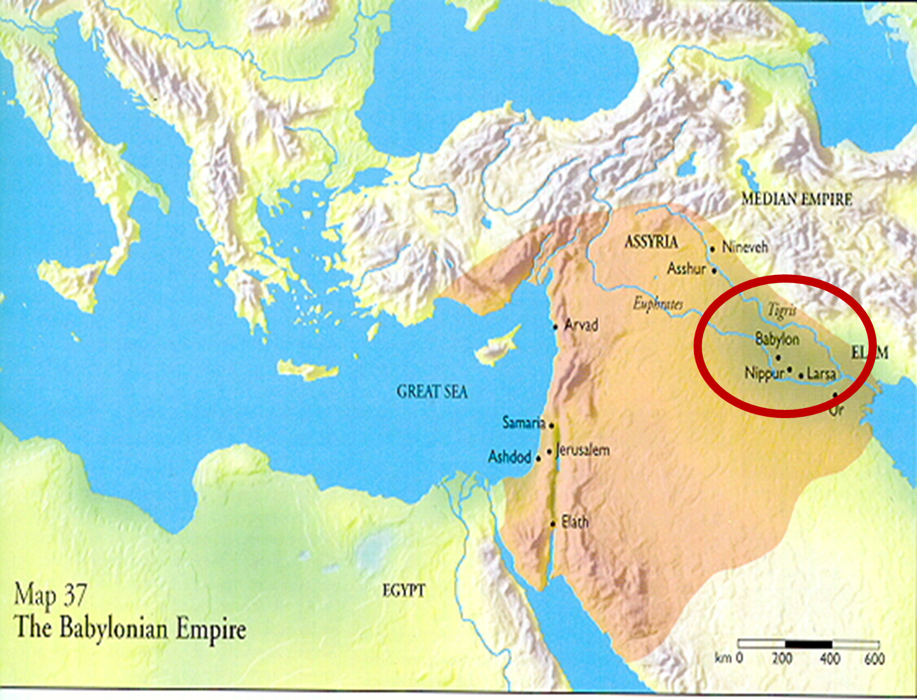

Slide 20
Genesis 11:1-4
¹ Now the whole earth used the same language and the same words. ² It came about as they journeyed east, that they found a plain in the land of Shinar and settled there. ³ They said to one another, “Come, let us make bricks and burn them thoroughly.” And they used brick for stone, and they used tar for mortar. ⁴ They said, “Come, let us build for ourselves a city, and a tower whose top will reach into heaven, and let us make for ourselves a name, otherwise we will be scattered abroad over the face of the whole earth.”

Slide 21
 | Mother | Child
Assyria | Ishtar | Tammuz
Phoenicia | Astarte | Baal
Egypt | Isis | Osirus/Horus
Greece | Aphrodite | Eros
Rome | Venus | Cupid
Asia | Cybele | Desius
India | Isi | Iswara
Alexander Hislop, The Two Babylons; or, the Papal Worship Proved to Be the Worship of Nimrod and His Wife, 2nd American ed. (Edinburgh: Wood, 1862; reprint, New York: Loizeaux, 1959).

Slide 22
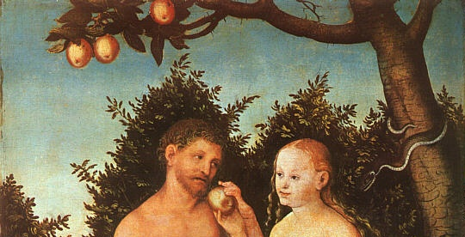
Genesis 3:15
“And I will put enmity between you and the woman, and between your seed and her seed; He shall bruise you on the head, and you shall bruise him on the heel.” (NASB)

Slide 23
From Adam to Abraham
Gen 3:15
Gen 5:1 (Adam) to Gen. 5:28-29, 32 (Noah)
Gen 6:9
Gen 7:1
Gen 9:26
Gen 11:10 (Shem) to Gen 11:32 (Terah)

Slide 24
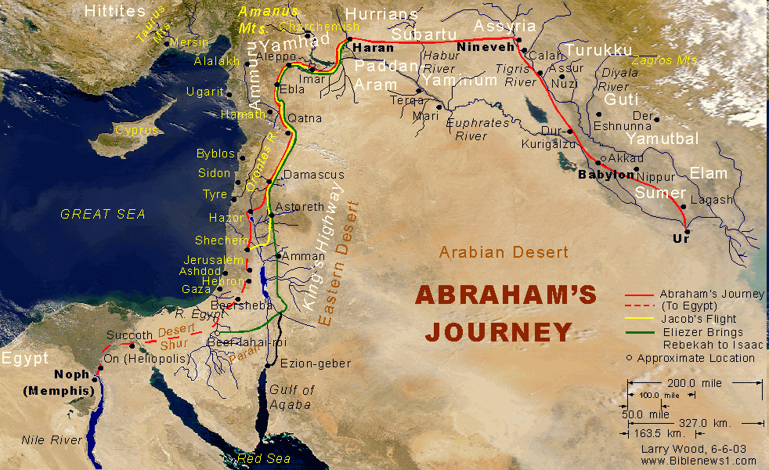

Slide 25
Genesis 12:3
“And I will bless those who bless you, And the one who curses you I will curse. And in you all the families of the earth will be blessed.” (NASB)

Slide 26
Genesis 12:3
“And I will bless those who bless you, And the one who curses you I will curse. And in you all the families of the earth will be blessed.” (NASB)

Slide 27
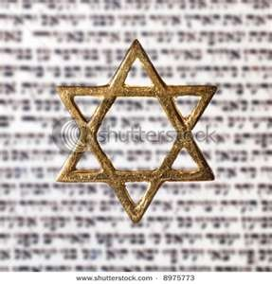
Israel’s Three Blessings to the World
(Gen 12:3b)
Scripture (Rom 3:2)
Savior (John 4:22)
Kingdom (Isa 2:2-3)

Slide 28
How Israel Has Blessed the World
(Gen 12:3; Rom 9:4-5)
Patriarchs
Law
Prophets
Messiah (John 4:22; Rom 9:5)
Apostles
Biblical writers
Early church
Early Christian martyrs
Paul
Future kingdom

Slide 29


Slide 30
Grafted in:
Gentiles
Branches:
Saved and Lost
Israel
Cut off:
Unsaved
Israel
Root: Abrahamic
Covenant
Notes:
30

Slide 31
Overview
The Divine Purpose for Israel
The Divine Protection of Israel
The Power of Your Voice Concerning Israel
Notes:
Outline

Slide 32
Genesis 12:3
“And I will bless those who bless you, And the one who curses you I will curse. And in you all the families of the earth will be blessed.” (NASB)

Slide 33


Slide 34


Slide 35

Statue & Stone

Slide 36
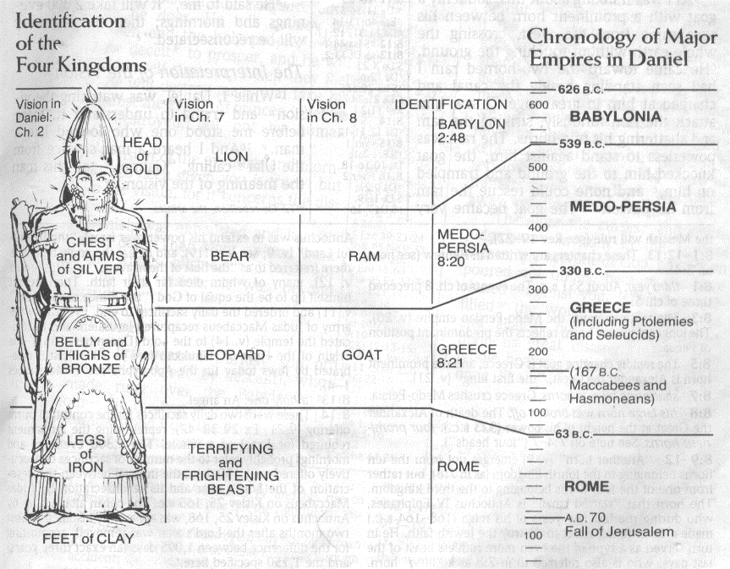

Slide 37
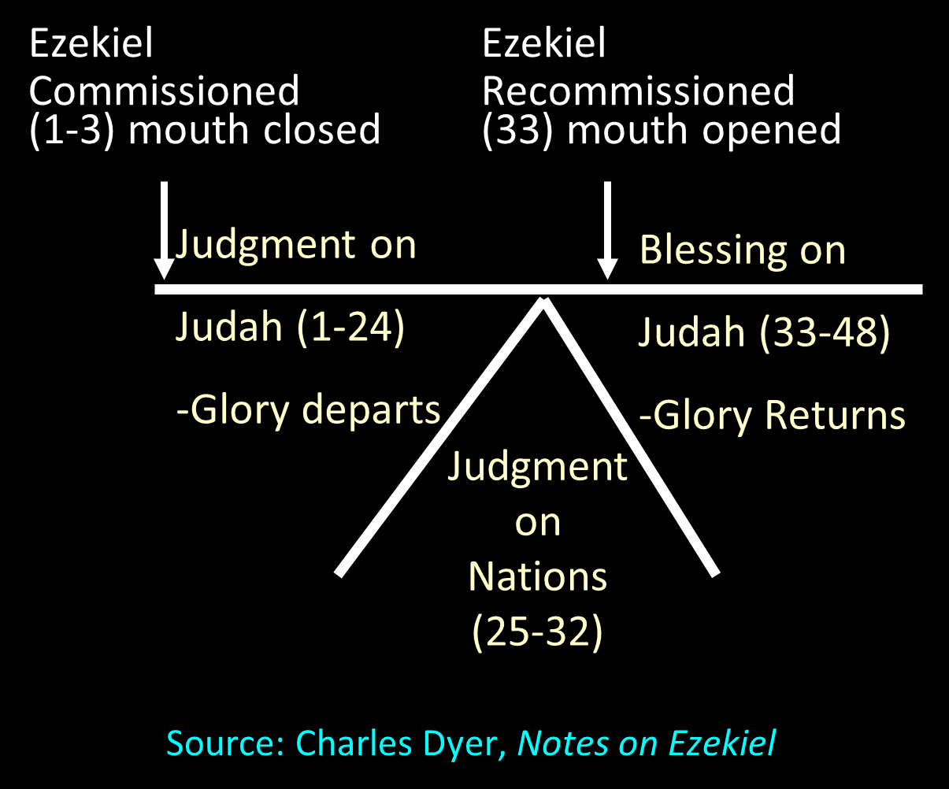

Slide 38
Judgment Against the Nations (Ezekiel 25‒32)
East
  Ammon
  Moab
  Edom

Slide 39
Judgment Against the Nations
(Ezekiel 25‒32)
West: Philistia
North: Tyre & Sidon
South: Egypt

Slide 40
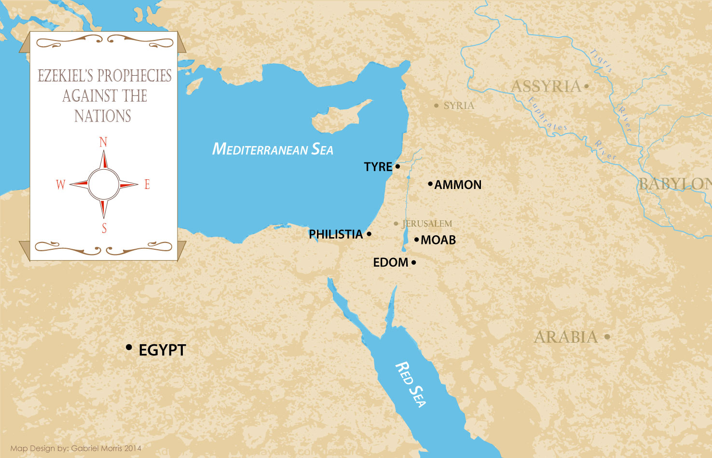

Slide 41
Genesis 12:3
“And I will bless those who bless you, And the one who curses you I will curse. And in you all the families of the earth will be blessed.” (NASB)

Slide 42
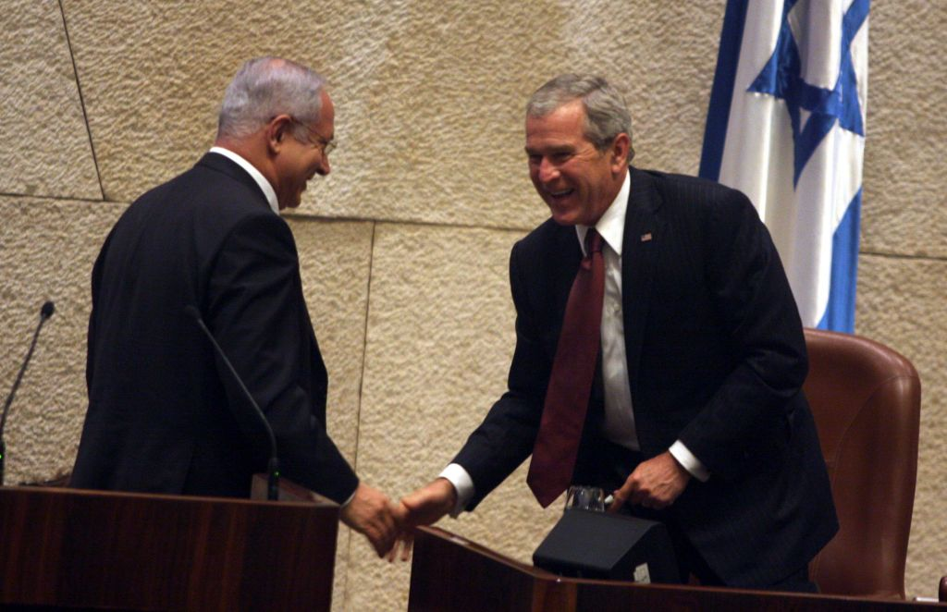

Slide 43
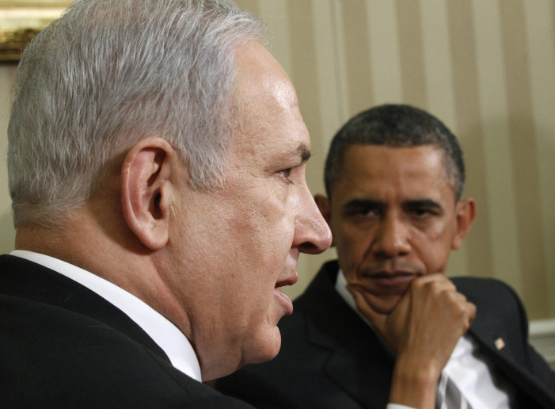

Slide 44
Overview
The Divine Purpose for Israel
The Divine Protection of Israel
The Power of Your Voice Concerning Israel
Notes:
Outline

Slide 45
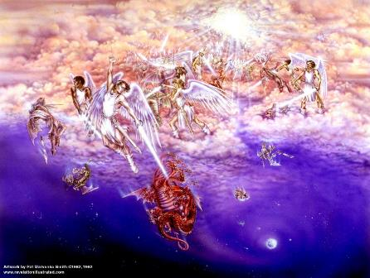
Biblical Reality of the Angelic World
Job 1:12
2 Kings 6:15-17
1 Chron 21:1
Dan 10:12-13, 20
Matt 16:21-23
Eph 6:12

Slide 46
Revelation 12:1-5
And a great sign appeared in heaven: a woman clothed in the sun, and the moon under her feet, and upon her head a crown of twelve stars; ²and she was with child; and she cried out, being in labor pain to give birth. ³And another sign was seen in heaven: and behold, a great red dragon, having seven heads and ten horns, and upon his heads seven diadems.
American Standard Version. 1995 .

Slide 47
Revelation 12:1-5
⁴And his tail swept a third part of the stars of heaven, and did cast them to the earth: and the dragon stood before the woman that is about to give birth, so that when she gave birth he may devour her child. ⁵And she gave birth to a son, a man child, who is to rule all the nations with a rod of iron: and her child was caught up unto God, and to his throne.
American Standard Version. 1995 .

Slide 48
Rev 12 Symbols
Son = Messiah (Rev 12:5; Ps. 2:9; Acts 1:9)
Dragon = Satan (Rev 12:3, 9)
Woman = Israel (Rev 12:1; Gen 37:9-10)

Slide 49
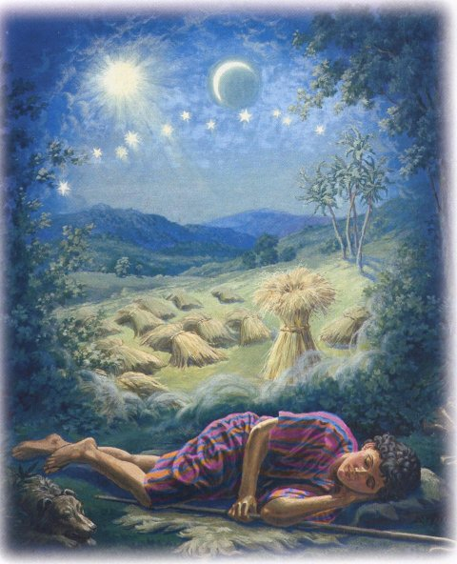
Genesis 37:9
Now he had still another dream, and related it to his brothers, and said, “Lo, I have had still another dream; and behold, the sun and the moon and eleven stars were bowing down to me.

Slide 50
Genesis 37:10
He related it to his father and to his brothers; and his father rebuked him and said to him, “What is this dream that you have had? Shall I and your mother and your brothers actually come to bow ourselves down before you to the ground?”

Slide 51
Sun = Jacob
Moon = Leah
11 Stars=Joseph’s brothers
12th Star = Joseph
12 Stars=Israel’s twelve tribes

Slide 52
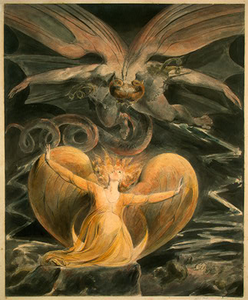
2 CYCLES OF SATANIC PERSECUTION
(Revelation 12:13-16)
“Pursues the woman” = persecution of Israel 12:13-14
“Flood from his mouth” = tries to destroy Israel 12:15-16

Slide 53
Descriptions of Satanic Hatred
(Revelation 12:12-17)
Wrath 12:12
Persecution 12:13
Sweep away 12:15
Enraged 12:17
War 12:17

Slide 54
Israel’s Two Regatherings
THE PRESENT (FIRST) REGATHERING | THE PERMANENT (SECOND) REGATHERING
Return to part of the land | Return to all the land
Return in unbelief | Return in faith
Restored to the land only | Restored to the land and the Lord
Sets the stage for Tribulation (discipline) | Sets the stage for Millennium (blessing)
Adapted from: Price, Jerusalem In Prophecy, 219

Slide 55
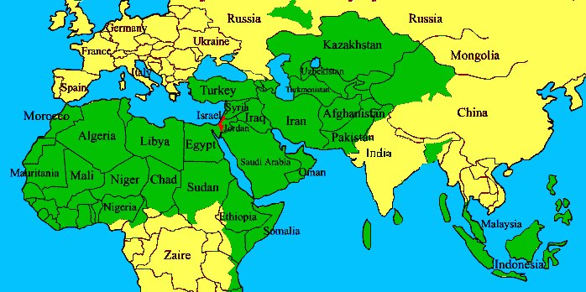

Slide 56


Slide 57
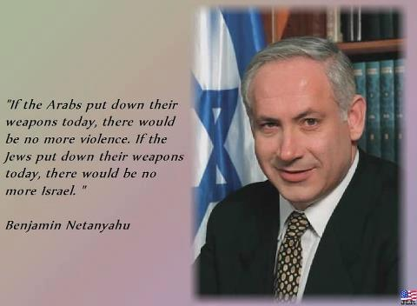

Slide 58
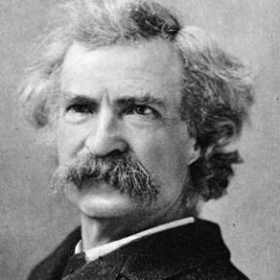
“... A desolate country whose soil is rich enough, but is given over wholly to weeds… a silent mournful expanse…. a desolation is here that not even imagination can grace with the pomp of life and action…. we never saw a human being on the whole route…. there was hardly a tree or shrub anywhere. Even the olive tree and the cactus, those fast friends of a worthless soil, had almost deserted the country.”
Mark Twain, The Innocents Abroad, Complete, 1st ed. (A Public Domain Book, 1869), 267, 285, 302. These quotes can be found in chapters 47, 49, 52.

Slide 59
Why?
COUNTRY | GROSS DOMESTIC PRODUCT
Israel | $123 billion
Egypt | $81 billion
Syria | $26 billion
Lebanon | $21 billion
Jordan | $12 billion
Source: CIA World Fact Book, 2005

Slide 60
Conclusion

Slide 61
Overview
The Divine Purpose for Israel
The Divine Protection of Israel
The Power of Your Voice Concerning Israel
Notes:
Outline

